Slide 1
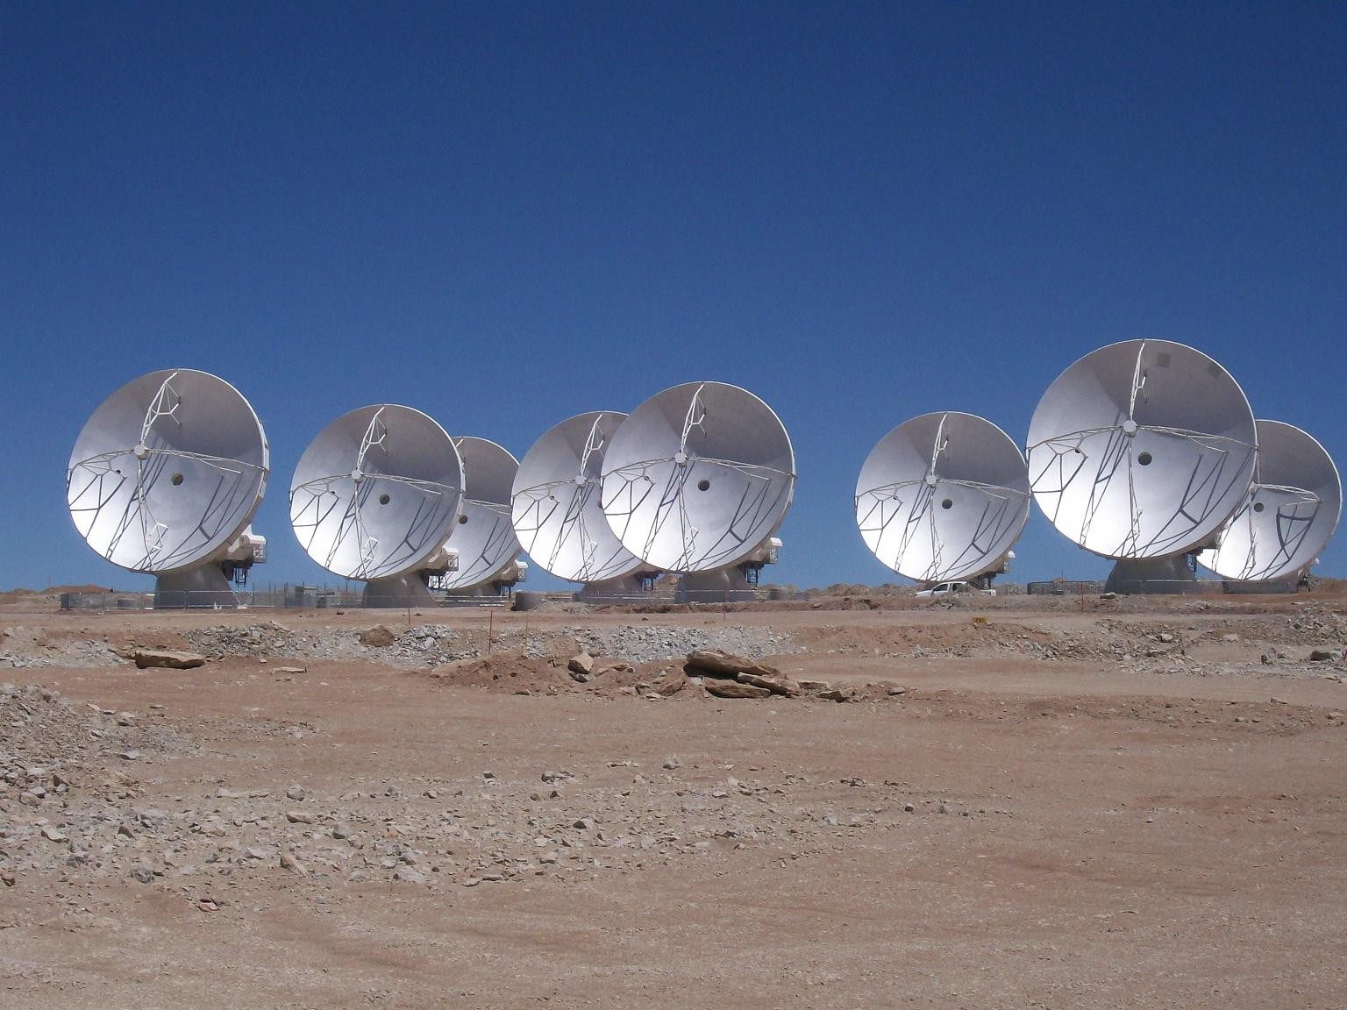
ALMA: The March to Early Science and Beyond
Al Wootten
North America ALMA Project Scientist

Slide 2
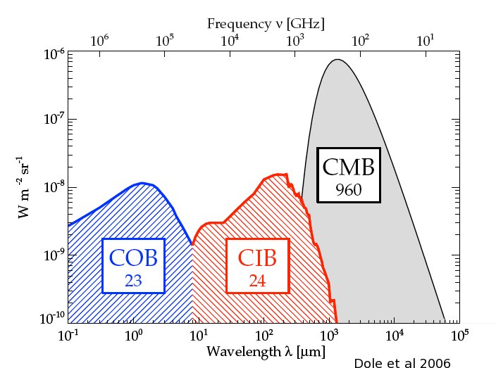
The mm/submm Spectrum:
Focus of ALMA
Millimeter/submillimeter photons are the most abundant photons in the cosmic background, and in the spectrum of the Milky Way and most spiral galaxies.
ALMA range--wavelengths from 1cm to ~0.3 mm, covers both components to the extent the atmosphere of the Earth allows.
Notes:
Most important component is the 3K Cosmic Microwave Background (CMB)
After the CMB, the strongest component is the CIB/THz component, which carries most of the remaining radiative energy in the Universe, and 40% of that in for instance the Milky Way Galaxy.

Slide 3
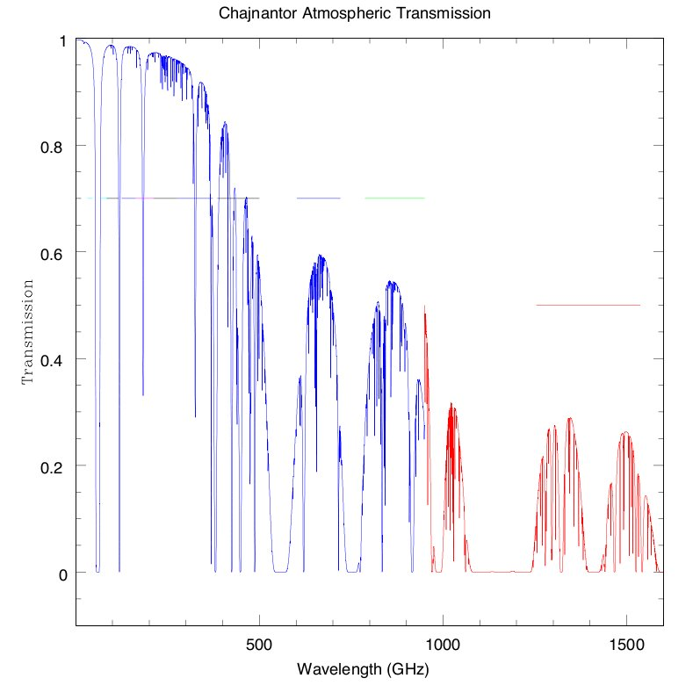
ALMA Bands and Transparency
B3
B6
B7
B9
Early Science
B4
B8
Goal
B5
B10
Construction
Future
B1
B2
???
‘B11’

Slide 4
ALMA Science Requirements
Project ensures ALMA meets three “level I” science goals:
    Spectral line CO/C+ in z=3 MWG < 24hrs
    resolve ProtoPlanetaryDisks at 150 pc – gas/dust/fields
    Precise 0.1” imaging above 0.1% peak
These require the instrument to have certain characteristics:
  High Fidelity Imaging.
  Routine sub-mJy Continuum / mK Spectral Sensitivity.
  Wideband Frequency Coverage.
  Wide Field Imaging Mosaicing.
  Submillimeter Receiver System (..& site..).
  Full Polarization Capability.
  System Flexibility (hardware/software).
Notes:
What is z~3 in years since big bang? 2.19 Gyr

Slide 5
Specifications Demand Transformational Performance
With these specifications, ALMA improves
  Existing sensitivity, by about two orders of magnitude
    Best accessible site on Earth
    Highest performance receivers available
    Enormous collecting area (1.6 acres, or >6600 m²)
  Resolution, by nearly two orders of magnitude
    Not only is the site high and dry but it is big! 18km baselines or longer may be accommodated.
  Wavelength Coverage, by a factor of two or more
    Take advantage of the site by covering all atmospheric windows with >50% transmission above 30 GHz
  Bandwidth, by a factor of a few
    Correlator processes 16 GHz or 8 GHz times two polarizations
Scientific discovery parameter space is greatly expanded!

Slide 6
Transformational Performance
ALMA improves
  Sensitivity: 100x
  Spatial Resolution: up to 100x
  Wavelength Coverage: ~2x
  Bandwidth: ~2x
    Scientific discovery parameter space is greatly expanded!
ALMA Early Science begins the transformation
  Sensitivity: ~10% full ALMA
  Resolution: up to ~0.4” (0.1” goal)
  Wavelength Coverage: 3-4 of final 8 bands (7 goal)
  Bandwidth: ~2x improvement
  Beginning the Discovery Space Expansion
Notes:
Best accessible site on Earth
Highest performance receivers available
Enormous collecting area (1.6 acres, or >6600 m²) Not only is the site high and dry but it is big! 18km baselines or longer may be accommodated.
Take advantage of the site by covering all atmospheric windows with >50% transmission above 30 GHz
Correlator processes 16 GHz or 8 GHz times two polarizations

Slide 7
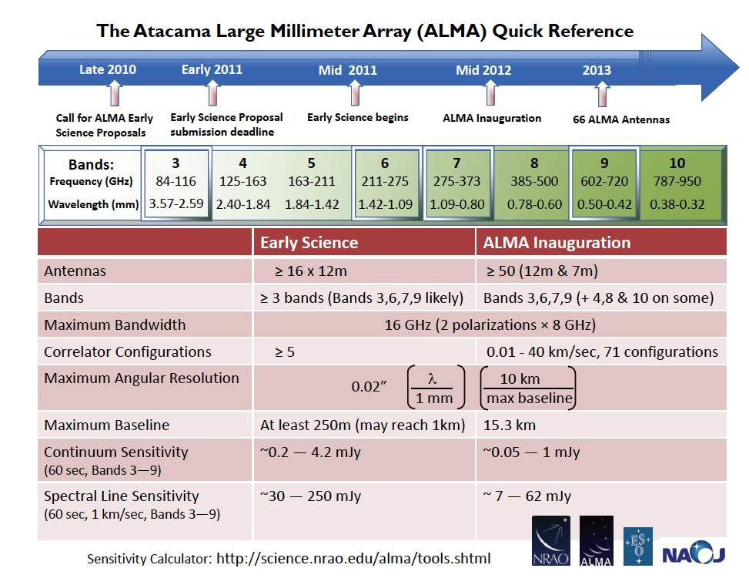
Technical Specifications
>54-68 12-m antennas, 12 7-m antennas, at 5000 m altitude site.
Surface accuracy ±25 μm, 0.6” reference pointing in 9m/s wind, 2” absolute pointing all-sky. First two antennas meet these; accurate to <±16 μm most conditions
Array configurations between 150m to ~15 -18km.
8 GHz BW, dual polarization.
Flux sensitivity 0.2 mJy in 1 min at 345 GHz (median cond.).
Interferometry, mosaicing & total-power observing.
Correlator: 4096 channels/IF (multi-IF), full Stokes.
Data rate: 6MB/s average; peak 60 MB/s.
All data archived (raw + images), pipeline processing.
Early Science
16 12m antennas at 5000m Array Operations Site, full antenna specifications
Array configurations to 250m
8 GHz bandwith, dual polarization, four Bands (3mm, 1.3mm, .85mm & .45mm)
Interferometry
Correlator: up to 4096 channels/baseband, 4 basebands x 2 polzns, selection of modes
Full data rate
All data archived (raw + images)
XXXX

Slide 8
Reviews and reviews and reviews
CSV Review 8-9 Oct:
  Good Structure and team in place
    Much work really engineering; commo needs improvement
    High fault level a concern
    Recommend progress to call for Science Verification activities
  Science verification data and public access a lead-in to the CfP/ES
SciOps Review 10-11 Oct:
  Within the realm of readiness for CfP/ES but not there yet. Feb 1 may be optimistic
    Archive critical; should be endowed with SciVer projects
    Address policies and rules, some items in risk register
    Need unambiguous capability descriptions
  More aggressive in call timing, capability offering.
Preliminary Findings
Notes:
Also ASAC, AAER

Slide 9
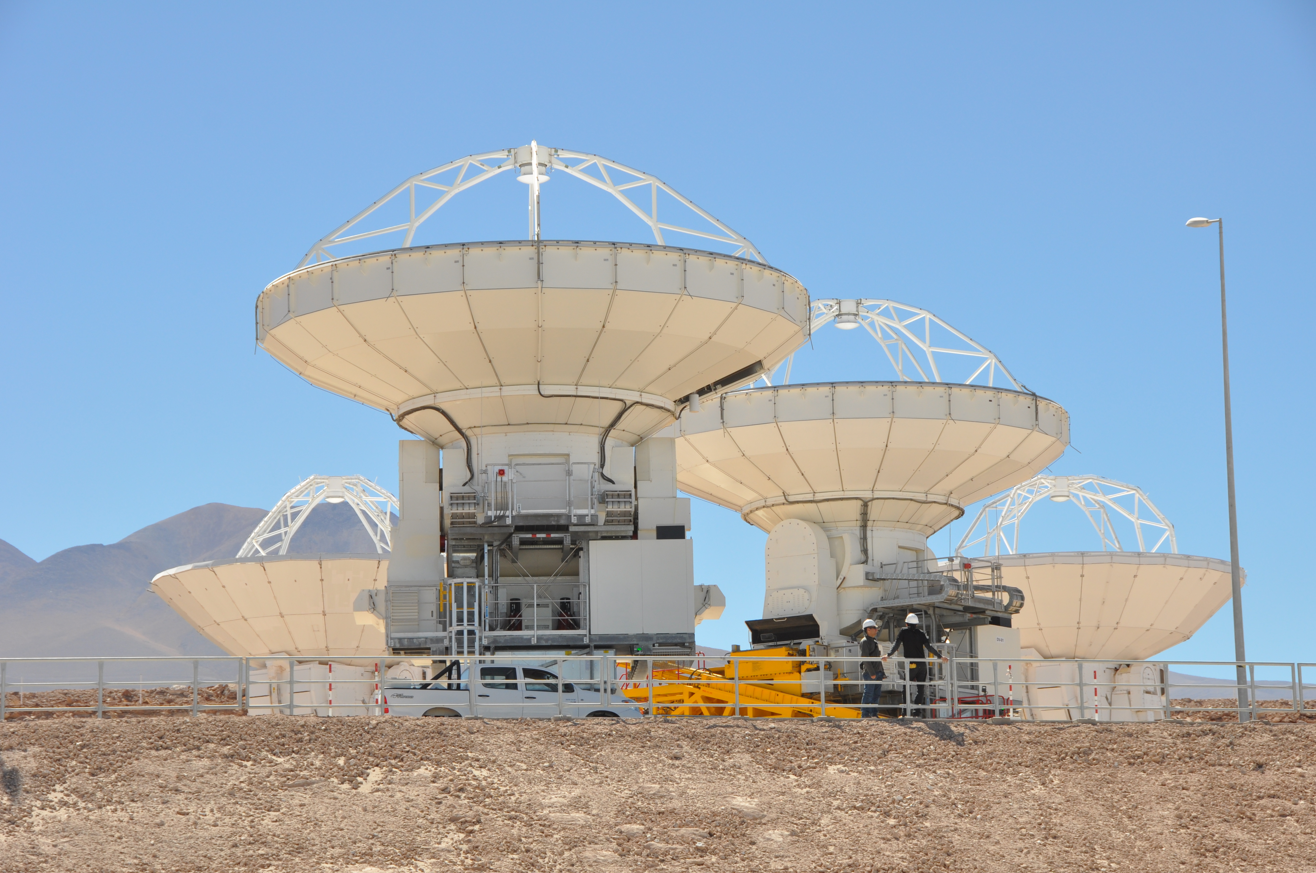
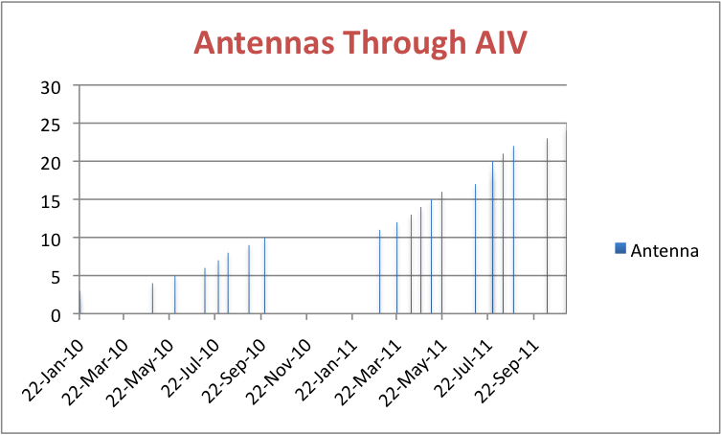
How do we get there?
Antennas: Most recent forecast (31 OCT)
  Note 16 antennas forecast by May 2011
Aggressive schedule!
Notes:
16 antennas to OSF Dec 2011—12 Vx plus 4 Melco.

Slide 10
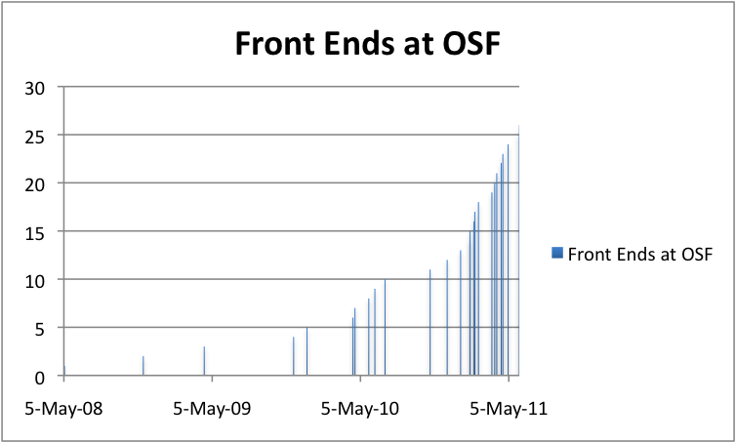
Front Ends Delivered to OSF
Forecast schedule 31 Oct 2010
N.B. If one wants a set of antennas with identical B7 rx one needs to get past 21...
Notes:
No 16 at OSF Feb 2011.

Slide 11
Correlator Modes: OT and testing
Correlator modes
  N.B. subband channels summed at edges, leaving 3840 independent channels over 1.875 GHz except in TDM mode.
Multiple spectral windows per baseband will not be available
  Each baseband's spectral window must have identical characterisics (number of channels, polarizations, bandwidth)
The ACA Correlator Team made a first astronomical detection (Saturday). The source was a Band 3 SiO maser in W Hya.

Slide 12
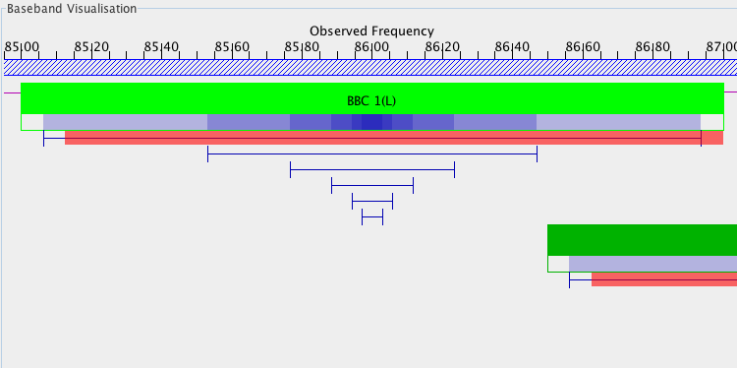
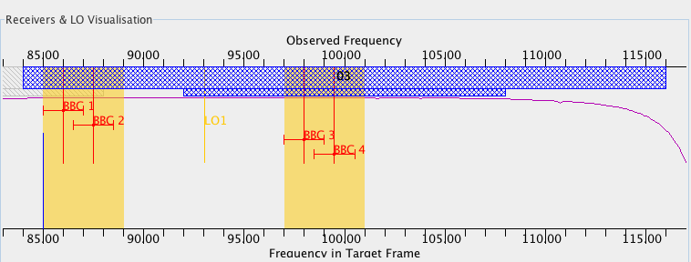
Example Correlator Window Setups
Four 2 GHz windows, B3. Then zoom in on BBC1.

Slide 13
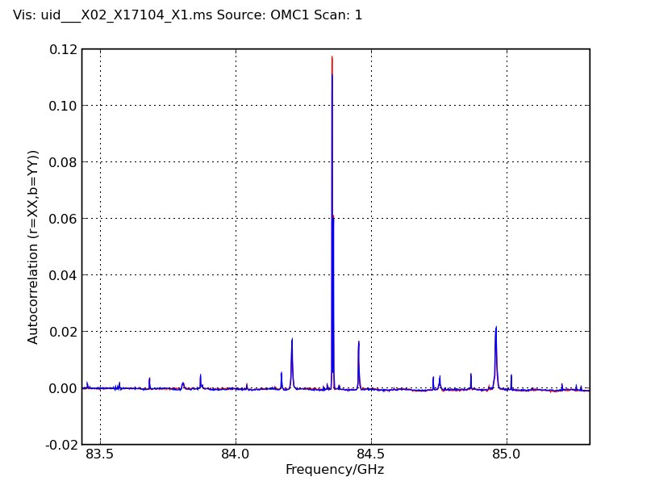
Correlator Modes
Mode 7
3840 channels
0.488 MHz resolution
1.875 GHz bandwidth
ES Mode

Slide 14
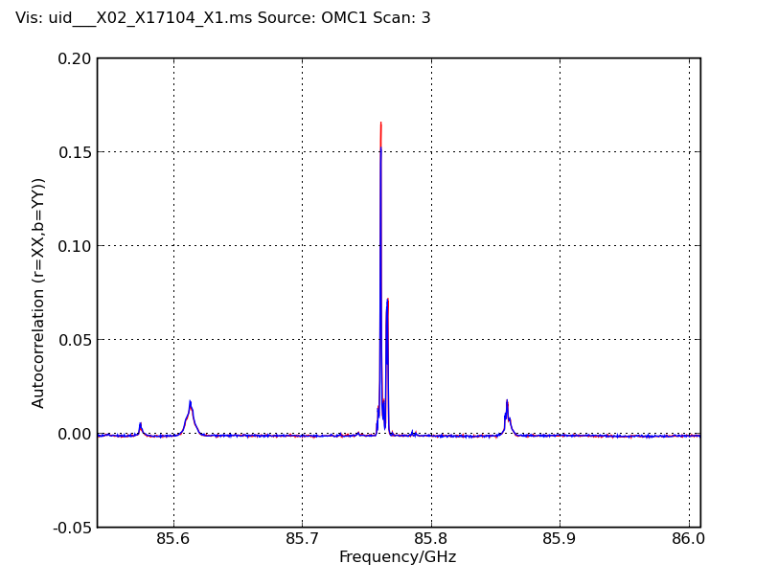
Correlator Modes
Mode 9
3840 channels
0.122 MHz resolution
0.4688GHz bandwidth
ES Mode

Slide 15
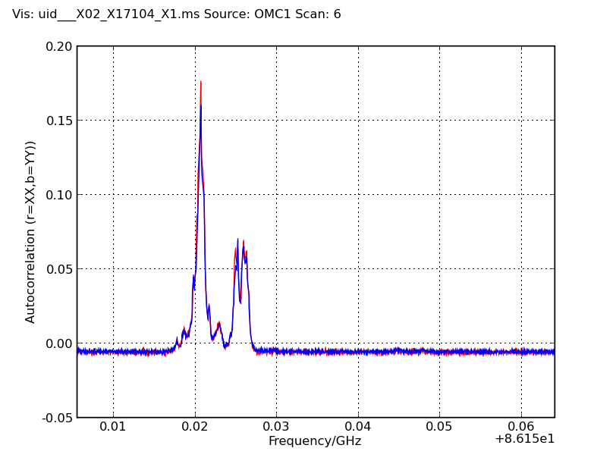
Correlator Modes
Mode 12
3840 channels
0.0153 MHz resolution
0.0586 GHz bandwidth
ES Mode

Slide 16
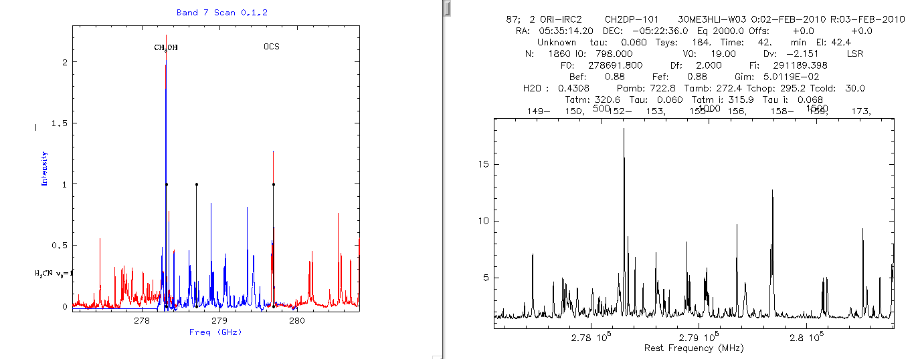
Comparison with IRAM 30m

Slide 17
Configurations
192 pads have cement poured but they are interconnected by an unfinished network of
  Power connections and transformers
  Fiber connections
  Roads
All of these are needed for pads which can hold antennas for Early Science
Although a configuration out to 250m is planned, its requirements (optimized for point sources? Extended sources?
  Recall B9 beam is 8” in extent…
  Mosaicking may not be available for ES (but should be relatively easy to implement)
  Total Power combination with interferometric data may lag.
Final spec for phase correction may not be achieved.

Slide 18
Atmospheric Restrictions: Memo 471

Slide 19
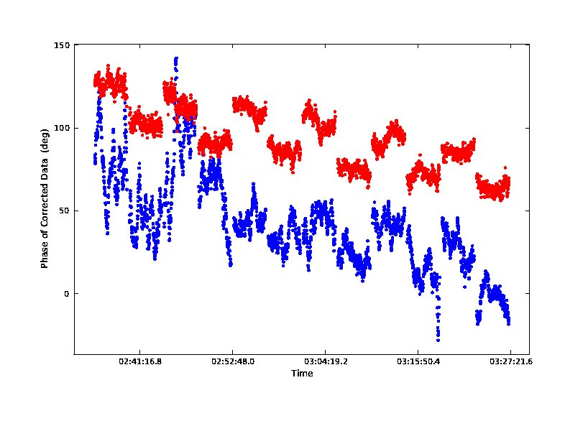
Example WVR Data
One baseline, two calibrators alternating, ~150m baseline
  Blue: no correction—can barely see the two calibrators
  Red: corrected data—clearly two calibrators are present
Taken during improving conditions—lightning thunder and rainbows initiated the session
Effected by applying program to ms, which produces gcal table to be applied in CV; available locally.

Slide 20
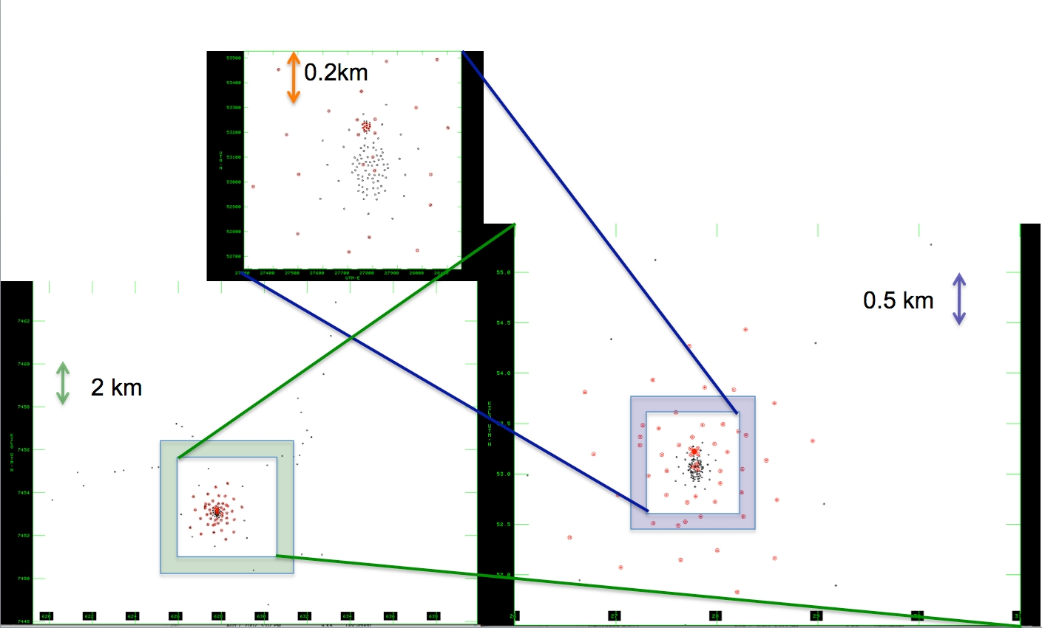
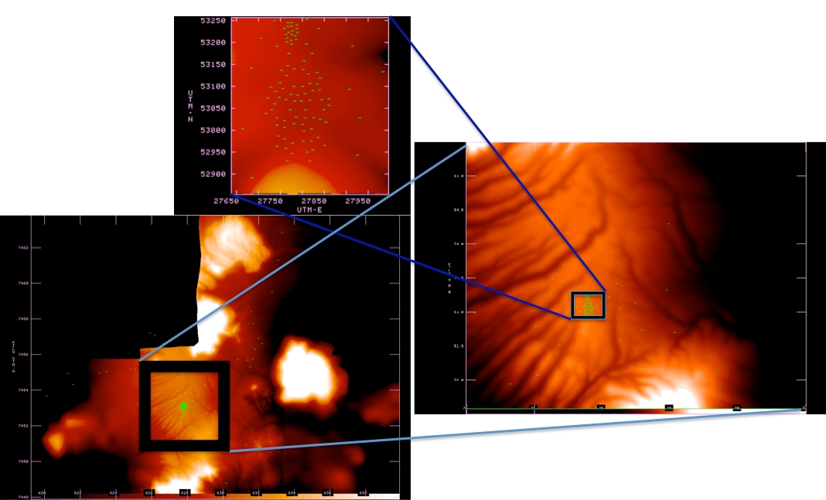
Configurations

Slide 21
Next

Slide 22
Observing Modes test examples
Run 12-18 hrs/week, astronomical validation of OT/Observing modes (Humphries, leader)
1. Multiple Spectral Spec per SB
2. LSB Frequency Axis Reversal Issue - Tony (G34)
3. Multiple sources per SB - Eelco (Shades sources)
4. Band 9 SB Verification - Liz/Andy/Al/Tony/Mark (Jovian satellites, evolved stars) - CSV-411
5. SBs run from loaded ephemeris - Mark/Liz/Al - CSV-543
6. OTF Mosaicing - Stuartt - It did half the intended area CSV-553
7. Multiple Phase Calibrators - Alison - CSV-376
8. Absorption Lines - Sergio/Tommy (PKS1830) - CSV-244
9. Spectral "Sweep" Across Receiver Band – Tony - CSV-251
10. Spectral line, no continuum - Tony (TMC-1) - CSV-520
11. Strong continuum, weak line –
12. Flux monitoring –
13. Multi bands in 1 SB - Tim (HD100546)- CSV-532
14. Discrete continuum sources – DONE
15. Verification Full Polarization Data taken with SBs writes to MS - Andy - CSV-316, CSV-432
16. Science Target and Bandpass Cal FDM; Phase and Amplitude Cal TDM - Liz/Andy - CSV-479
17. E-2-E testing of calibration using resolved calibrators (using Callisto and Ceres as calibrators); Crystal/ToddCSV-536 and CSV-539
18. Verification of frequency scale for Early Science Modes - Liz - CSV-551
Green => data at NAASC
Notes:
Run 12-18 hours per week.

Slide 23
ALMA Early Science:
Beginning the Discovery Space Expansion
ALMA Early Science initiates the transformation
  Sensitivity: ~10% full ALMA
  Resolution: up to ~0.4” (0.1” goal)
  Wavelength Coverage: 3-4 of final 8 bands (7 goal)
  Bandwidth: ~2x improvement
Begins next year

Slide 24
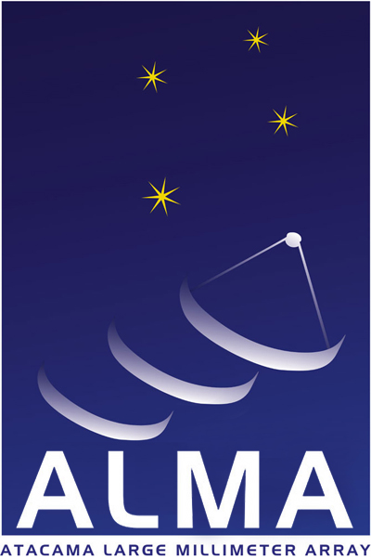
www.almaobservatory.org
The Atacama Large Millimeter/submillimeter Array (ALMA), an international astronomy facility, is a partnership among Europe, Japan and North America, in cooperation with the Republic of Chile. ALMA is funded in Europe by the European Organization for Astronomical Research in the Southern Hemisphere, in Japan by the National Institutes of Natural Sciences (NINS) in cooperation with the Academia Sinica in Taiwan and in North America by the U.S. National Science Foundation (NSF) in cooperation with the National Research Council of Canada (NRC). ALMA construction and operations are led on behalf of Europe by ESO, on behalf of Japan by the National Astronomical Observatory of Japan (NAOJ) and on behalf of North America by the National Radio Astronomy Observatory (NRAO), which is managed by Associated Universities, Inc. (AUI).

Slide 25
Observing with ALMA:
Early Science
National Radio Astronomy Observatory
North America ALMA Science Center
Charlottesville, Virginia U.S.
http://science.nrao.edu/alma

