Slide 1
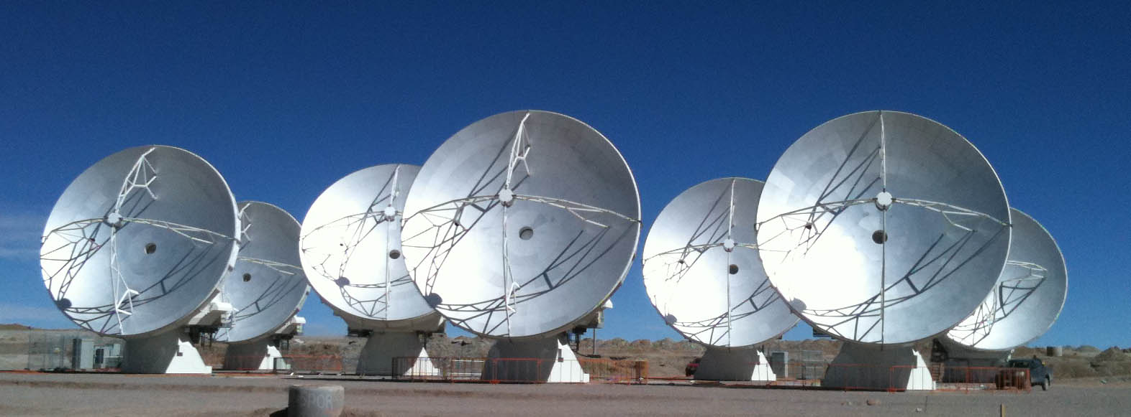




Atacama Large Millimeter/submillimeter Array: The March to Early Science
Al Wootten
North American ALMA Project Scientist, NRAO

Slide 2
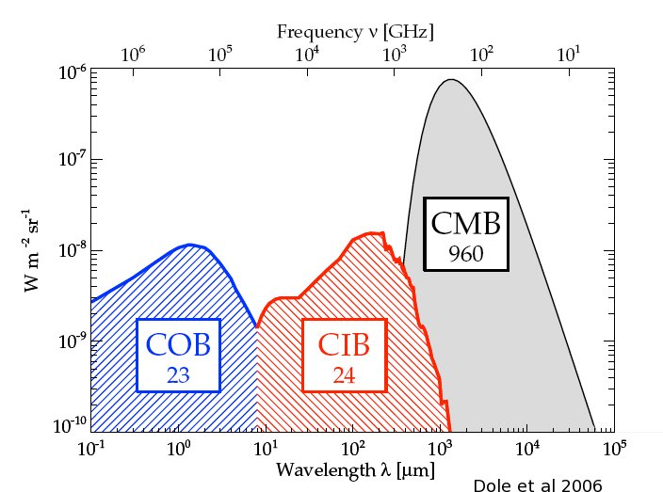
The mm/submm Spectrum:
Focus of ALMA
Millimeter/submillimeter photons are the most abundant photons in the cosmic background, and in the spectrum of the Milky Way and most spiral galaxies.
A probe of tremendous ancient galaxy-building star formation episodes, the FIR/submm/mm is a focus of missions from Spitzer/Herschel to SOFIA
ALMA range--wavelengths from 1cm to ~0.3 mm, covers both components to the extent the atmosphere of the Earth allows.
Notes:
Most important component is the 3K Cosmic Microwave Background (CMB)
After the CMB, the strongest component is the CIB/THz component, which carries most of the remaining radiative energy in the Universe, and 40% of that in for instance the Milky Way Galaxy.

Slide 3
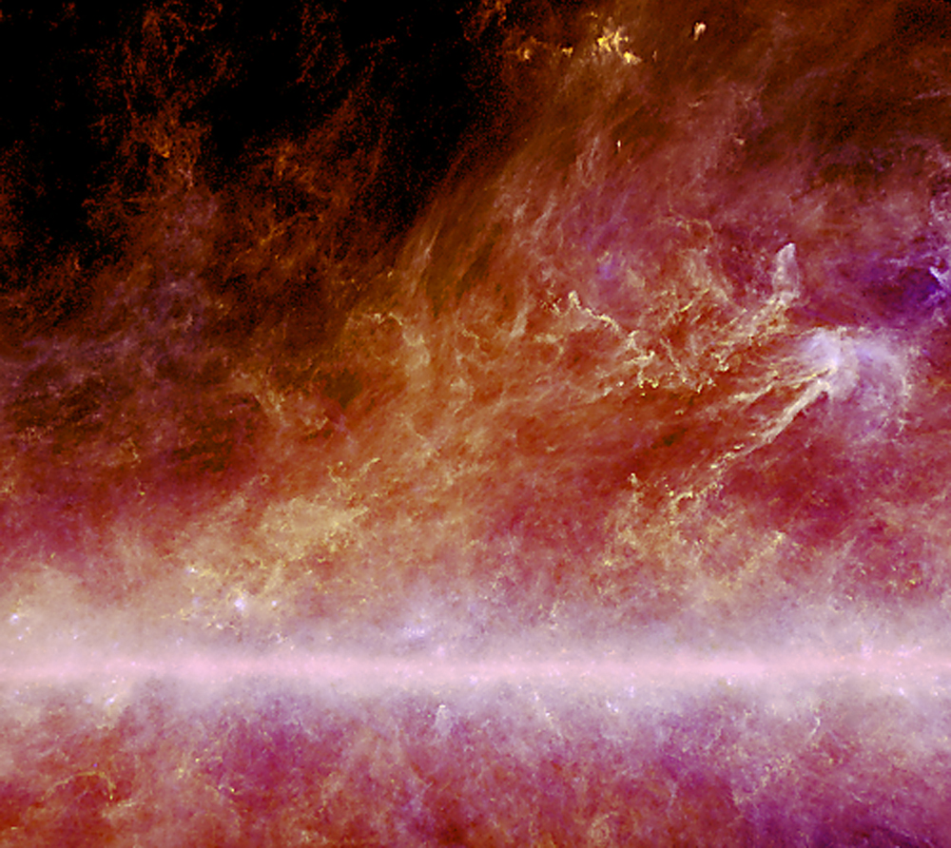
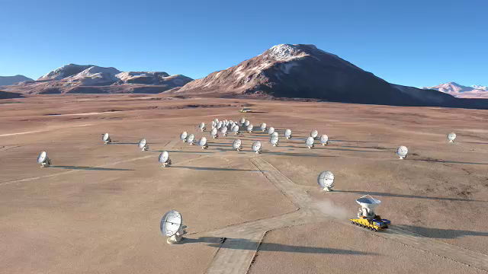
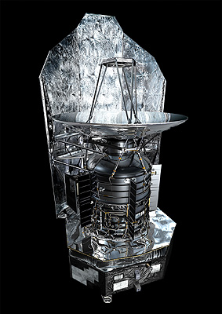
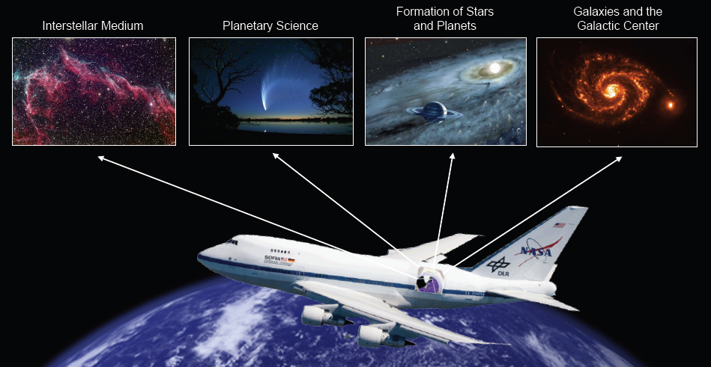
The Final Frontier
ALMA
SOFIA
Herschel
PLANCK Image Galactic dust: 100, 350 and 550 microns wavelength

Slide 4
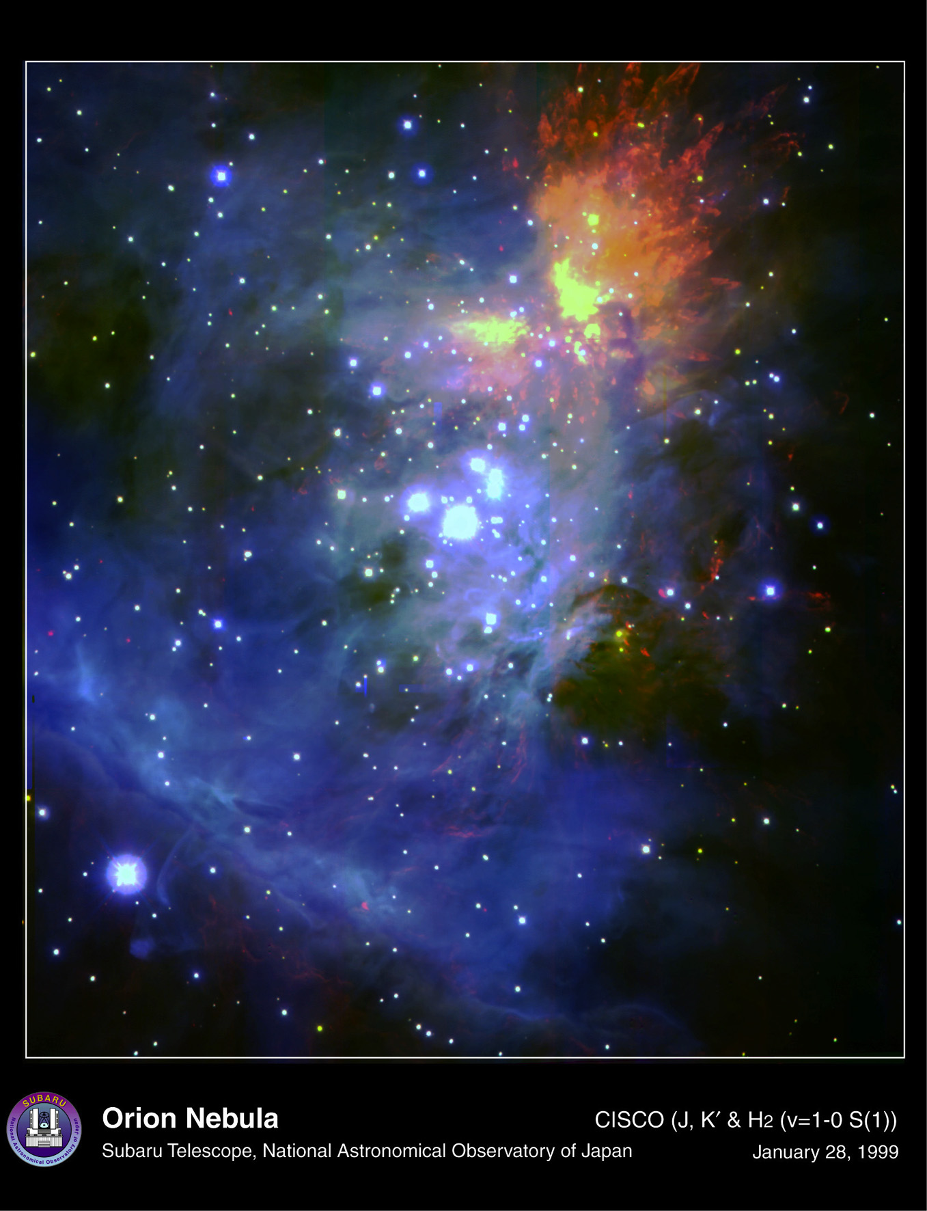
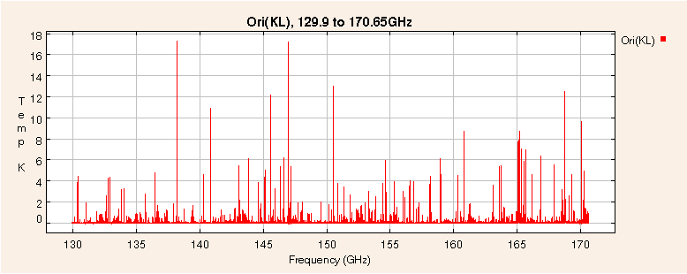
Contributors to the Millimeter Spectrum
Spectrum courtesy B. Turner (NRAO)
Spectral lines contribute significant flux to the overall spectrum.
In dense regions, line may contribute a large fraction of the total emission
  Here thousands of lines are seen in a portion of the Orion core spectrum at 2mm.
  Earth’s atmospheric lines block access to some spectral regions except at Earth’s highest dryest site.
ALMA’s 16500’ altitude site affords excellent spectral access.
ALMA’s spectral reach enables study of the Universe in all mm/submm windows for which transmission is better than 50%.
Notes:
Earth’s atmosphere transmission
Molecule list
iras, ISO, SWAS, ODIN apertures thru CSO/HHT/JCMT and resolution.

Slide 5
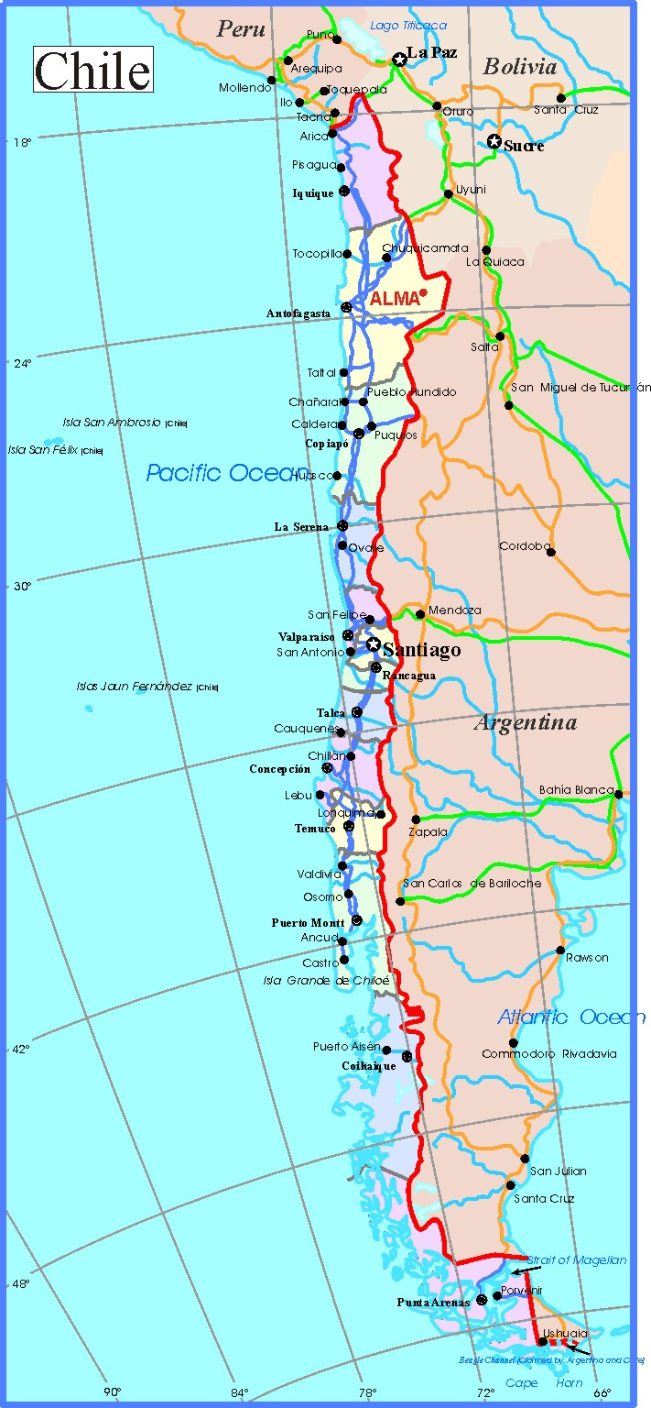
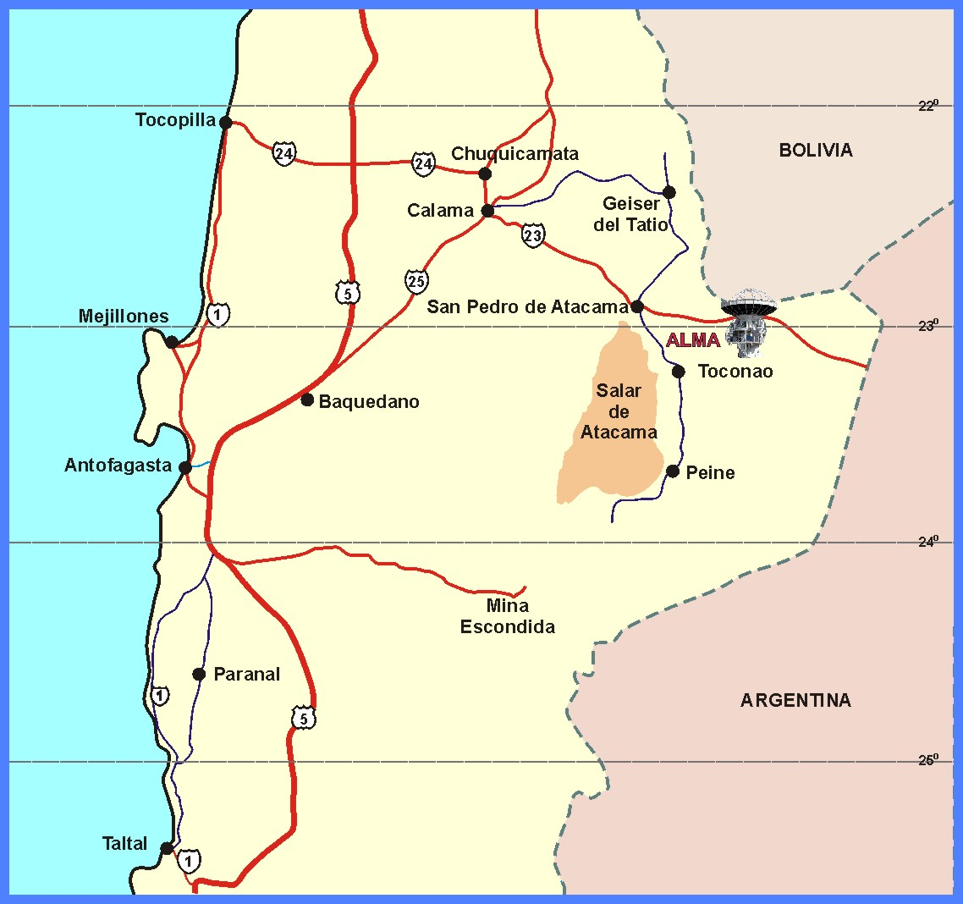
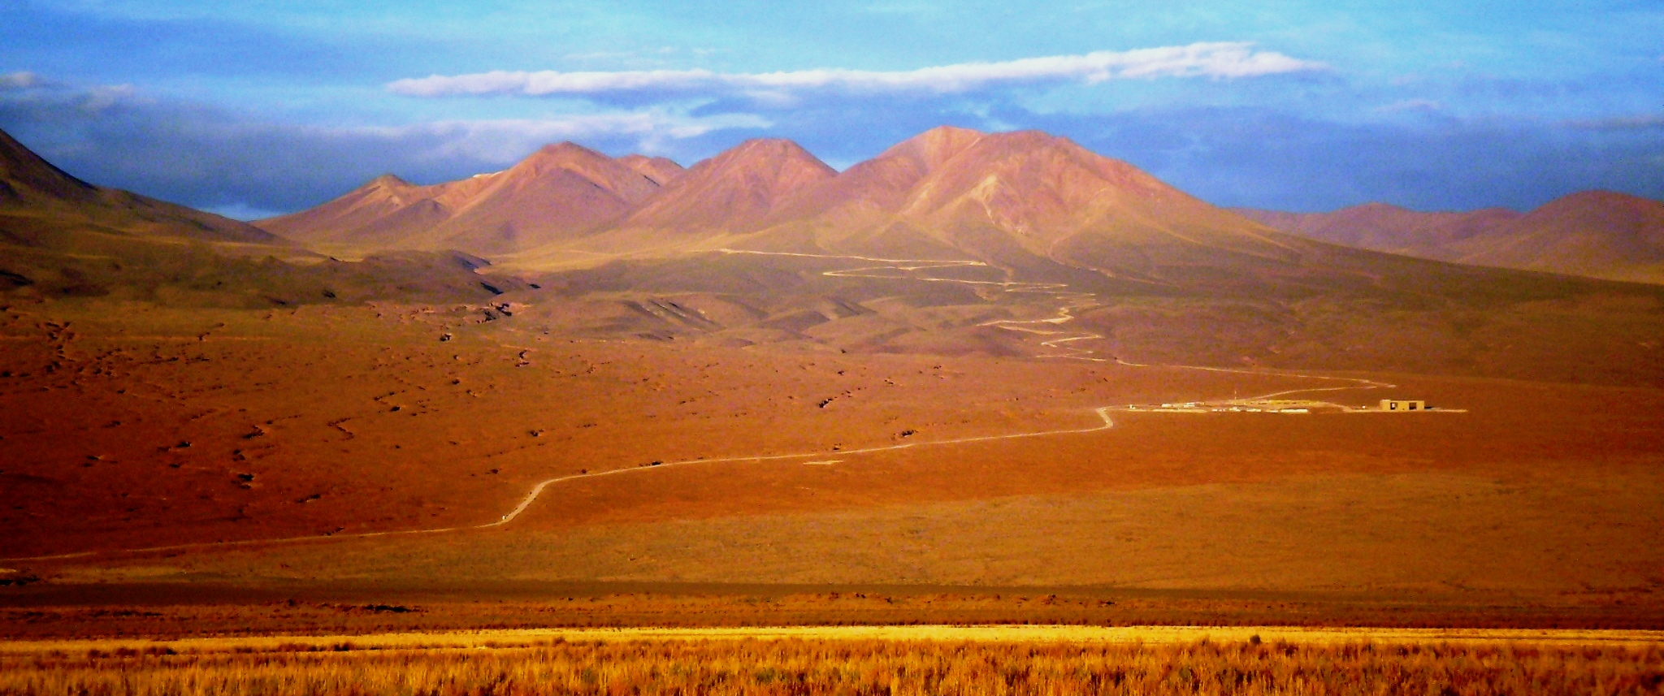
How can I find the ALMA Site?
Paranal
La Serena
Santiago

Slide 6
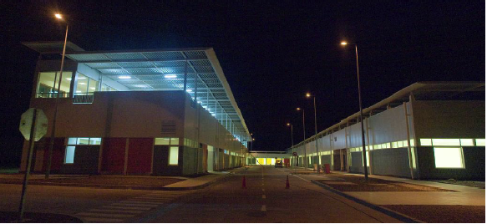
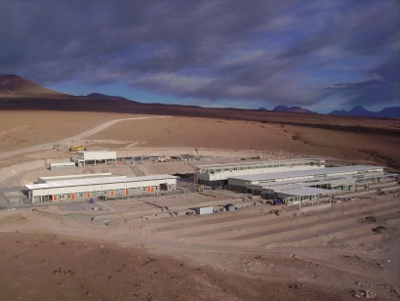
Operations Support Facility: 9500 ft altitude
15 km from gate on CH23
Technical Building
  Completed
  Warehouse
  Shops, offices, antenna area
Camps: House, feed and amuse >500 people
  ALMA
  Contractors
Antenna erection areas
  VertexRSI (NA)
  Mitsubishi (JP)
  Alcatel (EU)
Temporary Offices
OSF TB

Slide 7
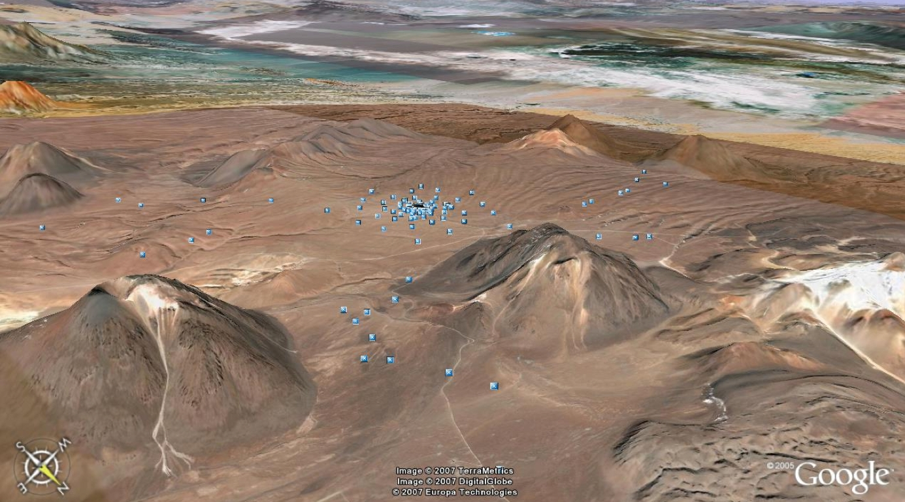
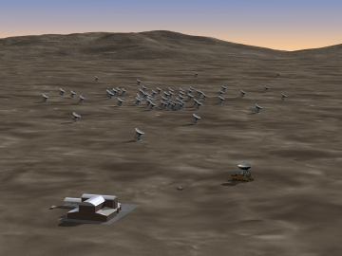
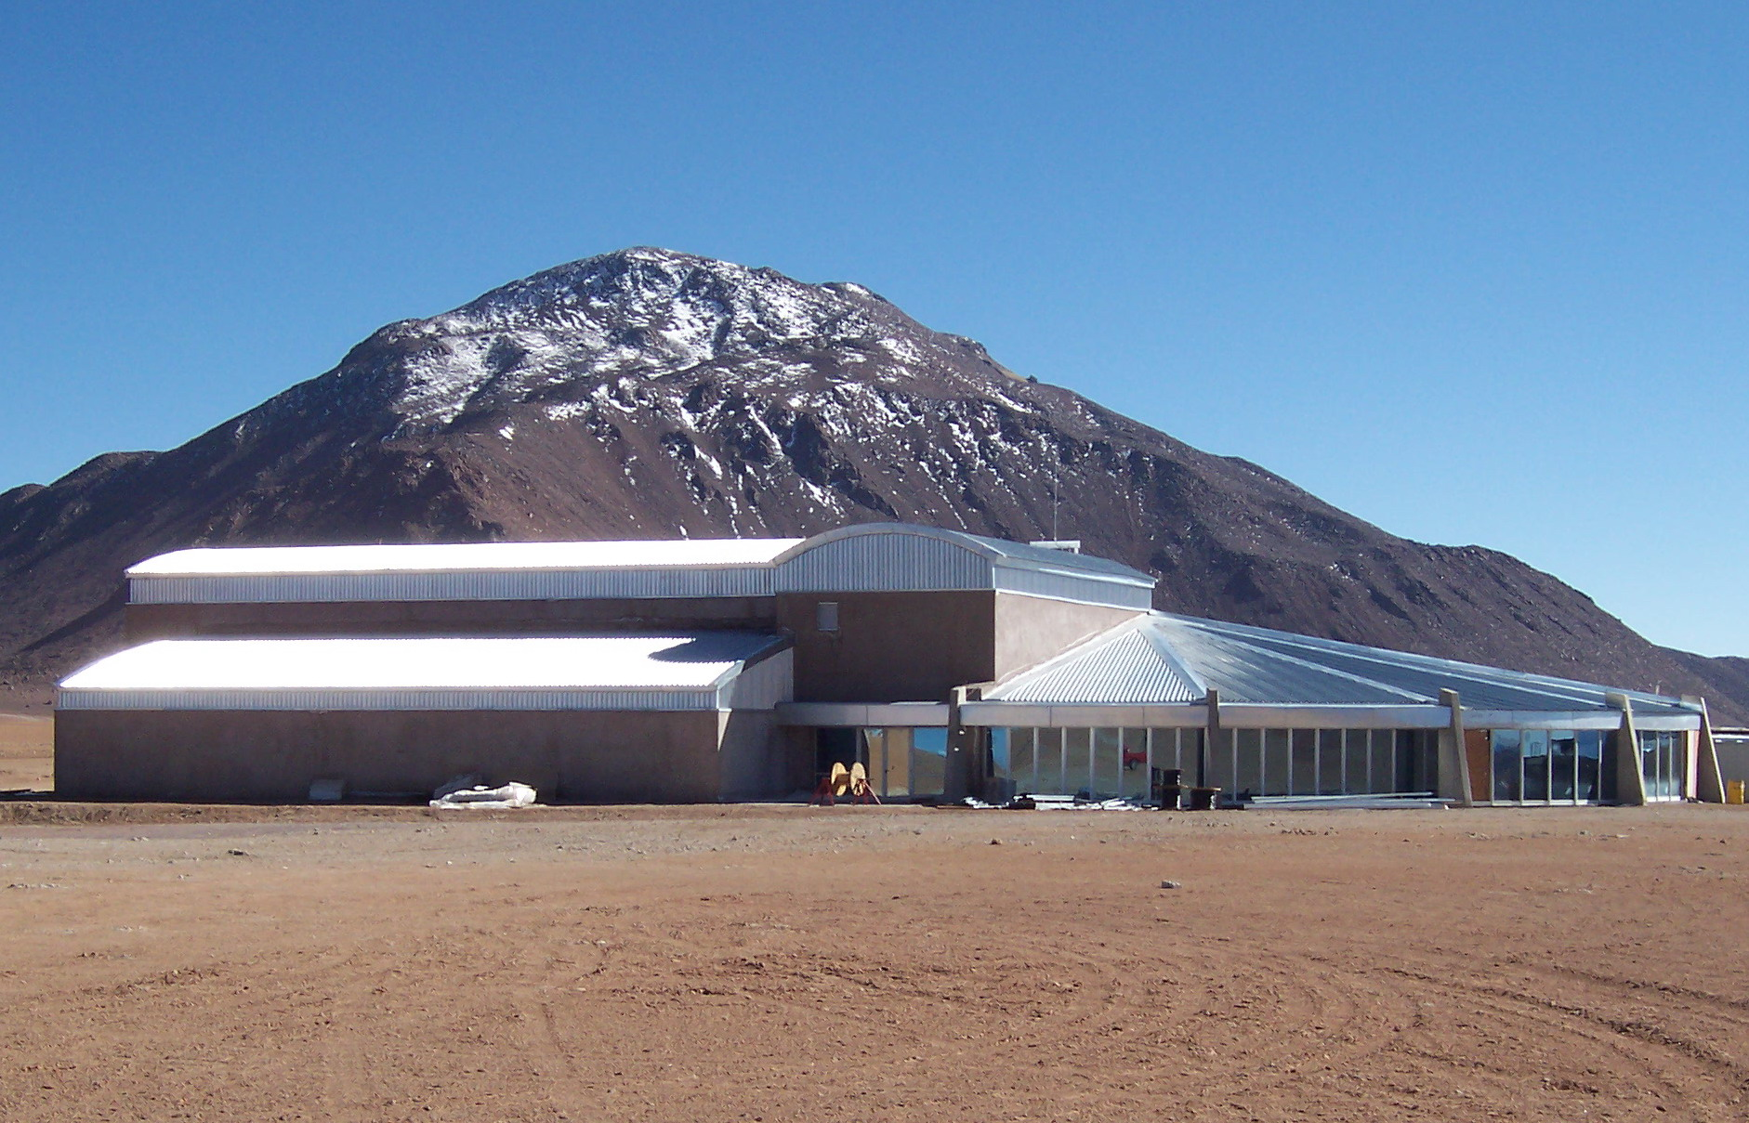
Array Operations Site: 16400 feet
43 km from gate on CH23 on 51ft wide new road
Array reconfigurable 150m-14km
Digitized signals from antenna to TB
  TB houses Correlator
  Local oscillator signals
  Antenna transporter shelter
  Refuge
  No one overnight, few during day
Array Operations Site Technical Building

Slide 8
Highest Level Science Goals
Bilateral Agreement Annex B:
“ALMA has three level-1 science requirements:
The ability to detect spectral line emission from CO or C+ in a normal galaxy like the Milky Way at a redshift of z = 3, in less than 24 hours of observation.
The ability to image the gas kinematics in a solar-mass protostellar/ protoplanetary disk at a distance of 150 pc (roughly, the distance of the star-forming clouds in Ophiuchus or Corona Australis), enabling one to study the physical, chemical, and magnetic field structure of the disk and to detect the tidal gaps created by planets undergoing formation.
The ability to provide precise images at an angular resolution of 0.1". Here the term precise image means accurately representing the sky brightness at all points where the brightness is greater than 0.1% of the peak image brightness. This requirement applies to all sources visible to ALMA that transit at an elevation greater than 20 degrees. These requirements drive the technical specifications of ALMA. “
These science goals cannot be achieved by any other instrument.
Notes:
N.B. z=3 corresponds to 11.5 Gyr ago!

Slide 9
ALMA Science Requirements
Project ensures ALMA meets three “level I” science goals:
    Spectral line CO/C+ in z=3 MWG < 24hrs
    resolve ProtoPlanetaryDisks at 150 pc – gas/dust/fields
    Precise 0.1” imaging above 0.1% peak
These require the instrument to have certain characteristics:
  High Fidelity Imaging.
  Routine sub-mJy Continuum / mK Spectral Sensitivity.
  Wideband Frequency Coverage.
  Wide Field Imaging Mosaicing.
  Submillimeter Receiver System (..& site..).
  Full Polarization Capability.
  System Flexibility (hardware/software).
Notes:
What is z~3 in years since big bang? 2.19 Gyr

Slide 10
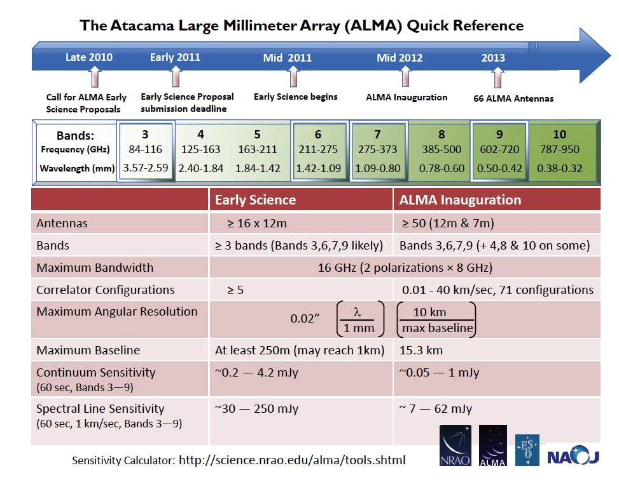
Technical Specifications
>54-68 12-m antennas, 12 7-m antennas, at 5000 m altitude site.
Surface accuracy ±25 μm, 0.6” reference pointing in 9m/s wind, 2” absolute pointing all-sky. First two antennas meet these; accurate to <±16 μm most conditions
Array configurations between 150m to ~15 -18km.
8 GHz BW, dual polarization.
Flux sensitivity 0.2 mJy in 1 min at 345 GHz (median cond.).
Interferometry, mosaicing & total-power observing.
Correlator: 4096 channels/IF (multi-IF), full Stokes.
Data rate: 6MB/s average; peak 60 MB/s.
All data archived (raw + images), pipeline processing.

Slide 11
Specifications Demand Transformational Performance
With these specifications, ALMA improves
  Existing sensitivity, by about two orders of magnitude
    Best accessible site on Earth
    Highest performance receivers available
    Enormous collecting area (1.6 acres, or >6600 m²)
  Resolution, by nearly two orders of magnitude
    Not only is the site high and dry but it is big! 18km baselines or longer may be accommodated.
  Wavelength Coverage, by a factor of two or more
    Take advantage of the site by covering all atmospheric windows with >50% transmission above 30 GHz
  Bandwidth, by a factor of a few
    Correlator processes 16 GHz or 8 GHz times two polarizations
Scientific discovery parameter space is greatly expanded!

Slide 12
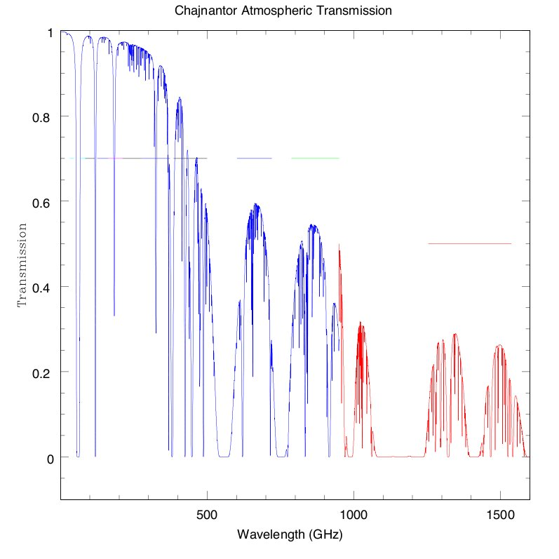
ALMA Bands and Transparency
B3
B6
B7
B9
Early Science
B4
B8
Goal
B5
B10
Construction
Future
B1
B2
???
‘B11’

Slide 13
Transformational Performance
ALMA improves
  Sensitivity: 100x
  Spatial Resolution: up to 100x
  Wavelength Coverage: ~2x
  Bandwidth: ~2x
    Scientific discovery parameter space is greatly expanded!
ALMA Early Science begins the transformation
  Sensitivity: ~10% full ALMA
  Resolution: up to ~0.4” (0.1” goal)
  Wavelength Coverage: 3-4 of final 8 bands (7 goal)
  Bandwidth: ~2x improvement
  Beginning the Discovery Space Expansion
Notes:
Best accessible site on Earth
Highest performance receivers available
Enormous collecting area (1.6 acres, or >6600 m²) Not only is the site high and dry but it is big! 18km baselines or longer may be accommodated.
Take advantage of the site by covering all atmospheric windows with >50% transmission above 30 GHz
Correlator processes 16 GHz or 8 GHz times two polarizations

Slide 14
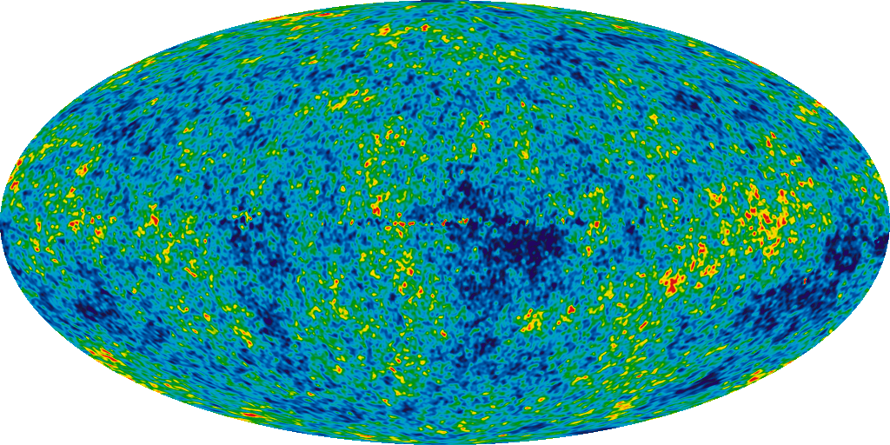
ALMA Science Targets
Design Reference Science Plan contains a suite of potential science experiments
Cosmic Dawn
  First Stars and Galaxies
  First Star Deaths: Gamma Ray Bursters
Nearby Universe
  Galaxy Clusters
  Galaxies
Star Formation
  Massive Stars
  Normal Stars and Planets
Stellar Systems
  Sun
  Planets and Small Bodies
Notes:
Seven Year Microwave Sky
The detailed, all-sky picture of the infant universe created from seven years of WMAP data. The image reveals 13.7 billion year old temperature fluctuations (shown as color differences) that correspond to the seeds that grew to become the galaxies. The signal from the our Galaxy was subtracted using the multi-frequency data. This image shows a temperature range of ± 200 microKelvin.
Credit: NASA / WMAP Science Team

Slide 15
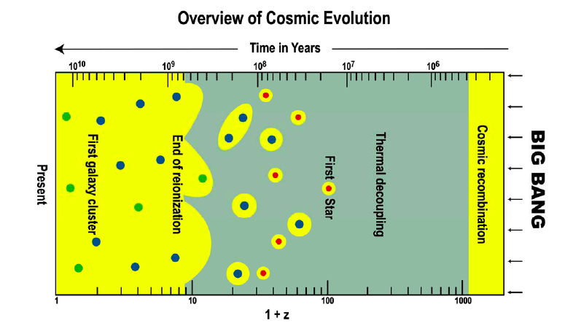
Opening Up the Dark Side of Reionization
After R. Barkana
Notes:
Evolution proceeds from right to left. Following recombination, the Dark Ages stretch
from z ~1,000 to ~100. The first Population III stars are currently believed to have formed
around redshift z ~ 20, or even earlier. Yellow is the region where most of the hydrogen is
ionized. Dark matter concentrations shown in red, blue and green, respectively, denote
concentrations with sizes 0.1, 1, and 200 kpc. FIR/SMM observations will contribute to our
understanding of most of these evolutionary phases. (After R. Barkana.(6))

Slide 16
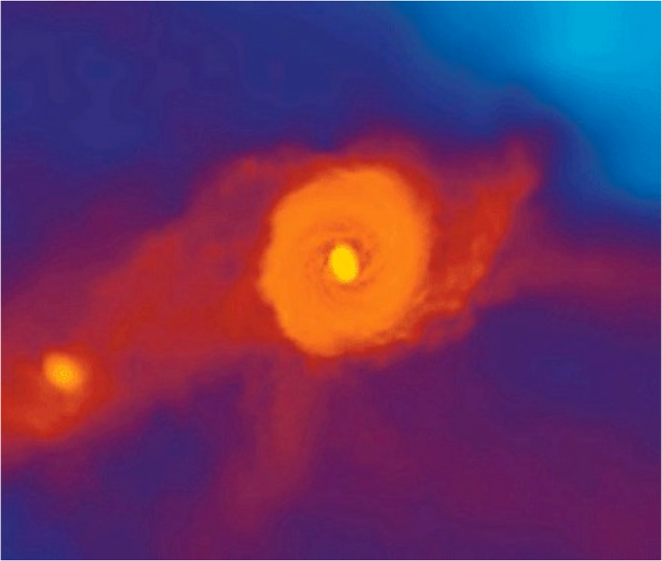
First Light
Dark Matter structures concentrate matter shortly after t=0
Molecular hydrogen (H₂, HD) forms from associative detachment
Cooling of gas allows first stars, expected to be massive, to form
This cooling via rotational lines of H₂ produces emission which shifts into ALMA bands at z~10, potentially observable from the first waves of star formation in massive proto-galaxies.
Massive stars evolve, producing heavier elements, which are distributed throughout the protogalaxies via supernovae, which may appear as Gamma Ray Bursts (GRBs)
Cooling then proceeds via the atomic fine-structure lines, which are redshifted into the ALMA bands
ALMA should be able to observe
  Rotational lines of H₂ from large mass accumulations forming the first stars
  Emission from GRBs, probing the demise of those first stars
  Emission from fine-structure lines as the first galaxies evolve
Notes:
Primordial galaxy. A supercomputer frame showing how the pristine hydrogen and helium gas has assembled in the center of one of the first galaxies, 500 million years after the Big Bang. The prominent disk is a few thousand light years across, with a massive gas cloud in the very center. This cloud is expected to fragment and give rise to a massive cluster of stars, possibly bright enough to be observable with the JWST. Future simulations will include the new Kreckel et al. results.
CREDIT: A. PAWLIK, M. MILOSAVLJEVIC, V. BROMM/TEXAS ADVANCED COMPUTING CENTER

Slide 17
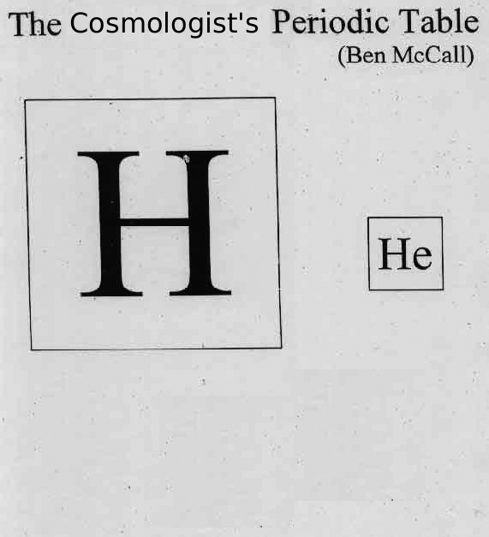

The Birth of Chemical Complexity
When chemistry got interesting
(H₃⁺, H₂D⁺, H₂, HD notwithstanding)
ALMA should be able to monitor the creation of
O ([O I], [O III], OH, H₂O)
C ([C I], [C II], CO, CH, CH⁺,¹³C)
N ([N II], NH, N₂H⁺)

Slide 18
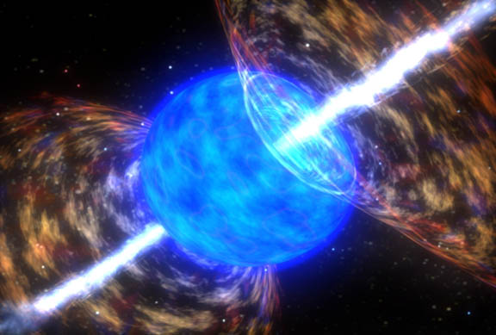
Gamma Ray Bursts and First Stars
Long duration GRBs are though to be related to the death of massive stars which give rise to bright, long-lived afterglow emission that allow them to be observed to great distances.
  They probe the epoch from the formation of the first stars (z~30) through to that of reionization (z~11)
  Form a distant background against which to view nearer stuff
  GRB 090423 (z~8.3) measured at PdBI at ~0.2mJy at 3mm, detectable with ALMA to 5σ in 2 minutes
  Excellent time resolution (emission thought caused by a reverse shock propagating inward; a short-lived phenomenon and probe of structure)
  Seeded the embryonic Universe with ‘metals’
Notes:
TITLE: GCN CIRCULAR
NUMBER: 9273
SUBJECT: GRB 090423: millimeter detection
DATE: 09/04/28 00:29:21 GMT
FROM: Alberto Castro-Tirado at Inst.de Astro. de Andalucia <ajct@iaa.es>
A. J. Castro-Tirado (IAA-CSIC Granada), M. Bremer and J.-M. Winters
(IRAM Grenoble), J. Gorosabel, S. Guziy, M. Jelínek (IAA-CSIC), P.
Kubánek (GACE, Univ. de Valencia), A. de Ugarte Postigo (ESO Santiago)
and D. Pérez-Ramírez (Univ. de Jaén), report:
"Following the detection by Swift of GRB 090423 (Krimn et al. GCNC
9198), millimeter observations were conducted on Apr 23 & 24 at the
Plateau de Bure Interferometer. Consistent with the nIR afterglow
(Tanvir et al. GCNC 9202) we clearly detect a source at 3-mm with a flux
density of ~0.2 mJy (preliminary) on the combined dataset. Pending of
confirming its variability we propose this as the likely millimeter
afterglow to GRB 090423. Considering the reported redshift values
around z ~ 8, this is the most distant radio source detected to date.
Further observations are scheduled. We acknowledge the Bure staff for
its excellent support."
(remember after z>5 the optical is gone. By z=10 the NIR
is restframe UV and also absorbed. ALMA and a sensitive X-ray
telescope will be all there is to detect the AG.)

Slide 19
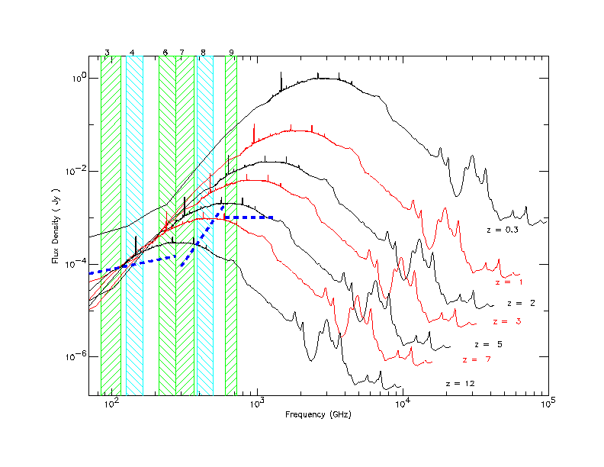
Distant Galaxies and the
Inverse K-correction--advantage: submm
As galaxies get redshifted into the ALMA bands, dimming due to distance is offset by the brighter part of the spectrum being redshifted in. Hence, galaxies remain at relatively similar brightness out to high distances.
ALMA Bands
Atomic Fine Structure Lines
Notes:
Few minute sensitivities

Slide 20
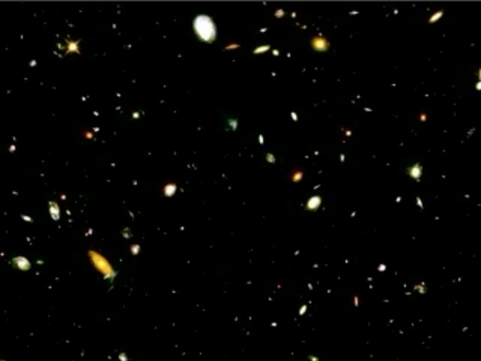
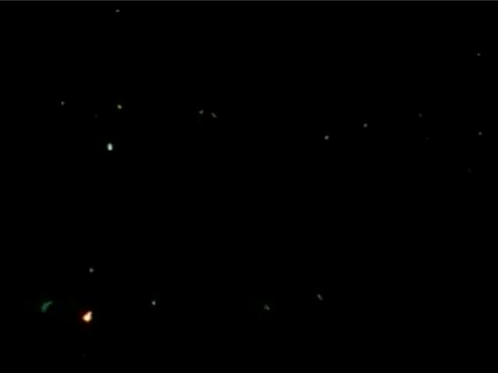
Hubble Deep Field (HDF)
Rich in Nearby Galaxies,
Poor in Distant Galaxies
Source: K. Lanzetta, SUNY-SB
Nearby galaxies in HDF
Distant galaxies in HDF
Notes:
On the left is a field from the Lanzetta et al. movie showing a zoom through time from nearer to more distant galaxies in the HDF, based on measurement of photometric redshifts of 1067 galaxies. Only 25% of these lie at z>2, with only 7% at z>3. Only photometric redshifts can be determined from these galaxies from the optical data.
The area if these two views is about a third or so of the HDF. From statistics, I’d estimate that the slide at the right, with ~20 galaxies, shows those for z>3. That is ~7% of the total number of galaxies.

Slide 21
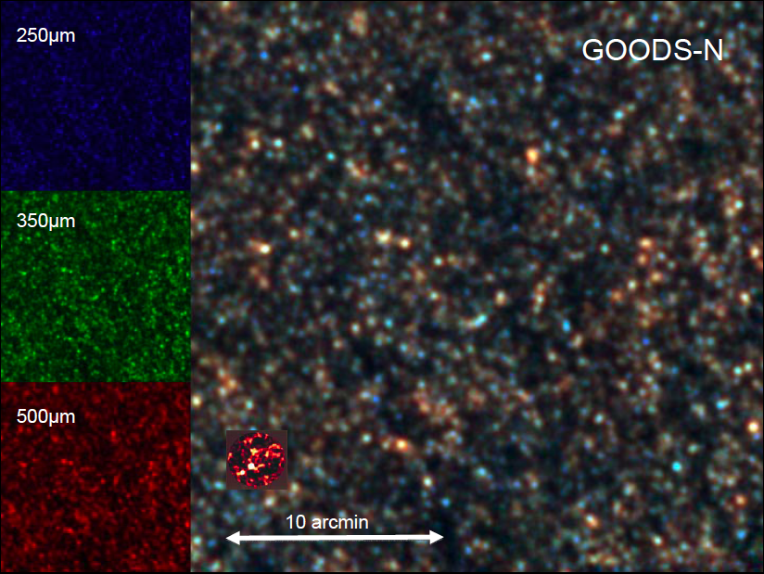
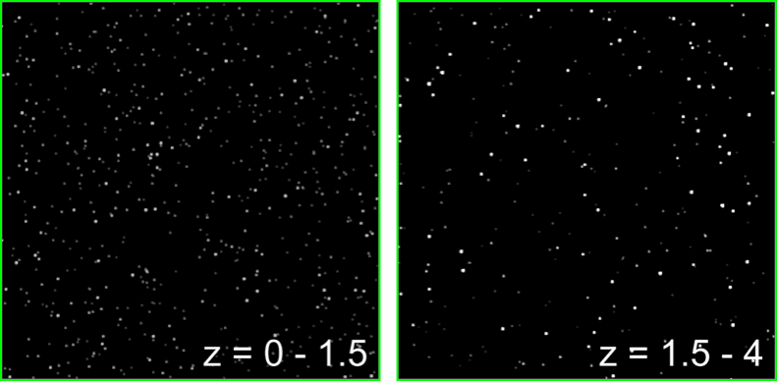
Submm Sources
High and Low z
Wang 2008
ALMA knows no confusion limit
Simulation based on:
(1) blank-field bright-end number counts (Wang, Cowie, Barger 2004)
(2) lensing cluster faint-end number counts (Cowie, Barger, Kneib 2002)
(3) redshift distribution of the submm EBL (Wang, Cowie, Barger 2004)

Slide 22
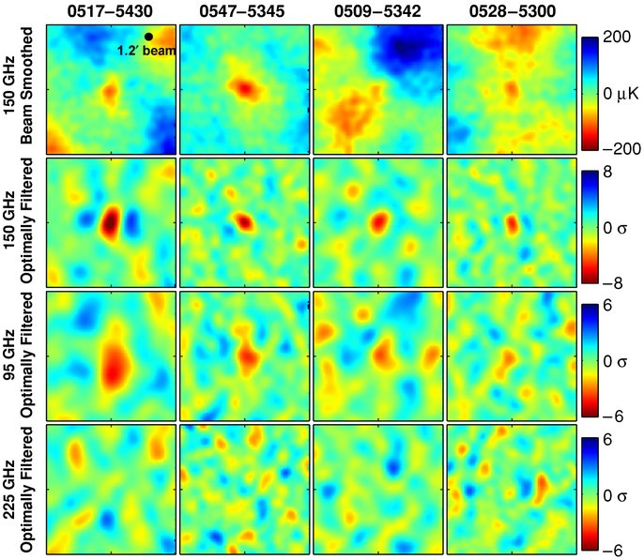
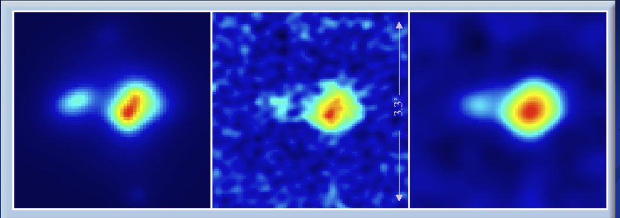
Galaxy Clusters: Sunyaev-Zel’dovich Effect
‘Hole’ in CMB where background photons scatter off hot plasma in galaxy clusters to higher energy (at ~3-7mm).
7mm capability a development item, future implementation,
Combined with a luminosity indicator, such as cluster Xray brightness, a distance may be determined.
Substructures at shock fronts, other interaction regions.
Model
ALMA Simulation
Tapered
Simulation: 34 GHz, by J. Carlstrom
Notes:
Left—simulated cluster at z~1, mass 2.5E14. Center—ALMA in compact configuration, 34 GHz. Right—4klambda taper applied.

Slide 23
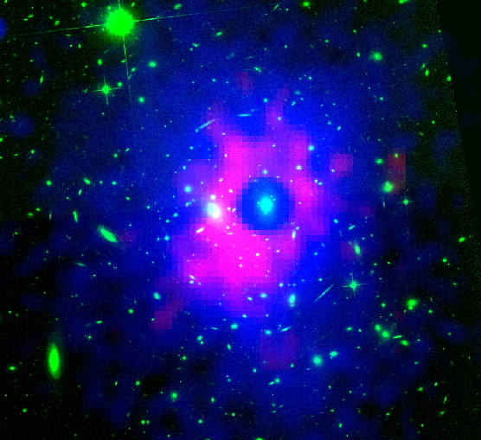
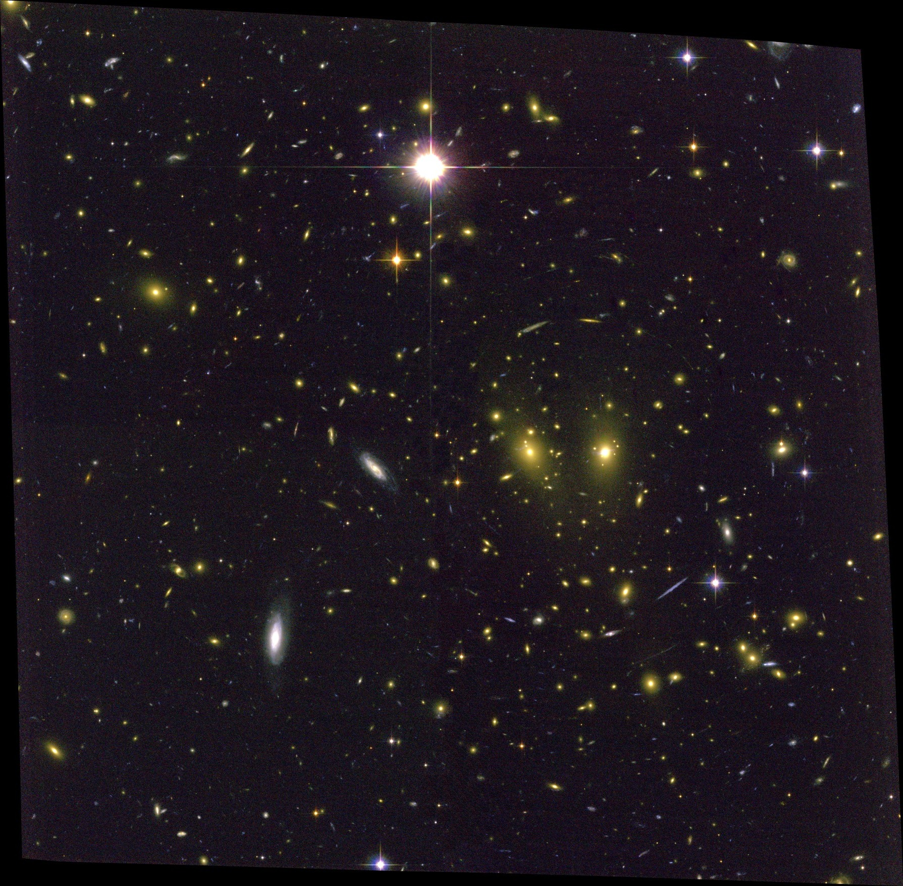
RXJ1347-1145 (z=0.45)
Shock-heated gas revealed in GBT image at 3mm
Suggests merger of two massive clusters
Possible illustration of how clusters get their hots
Fine scale structure an important guide to the interpretation of SZ observations
Highest current resolution (8”)
Notes:
Recent Mustang image of the Sunyaev Zeld'ovich effect in Galaxy Cluster RXJ1347-1145 (Red)
superimposed on Chandra X-ray (blue) and HST optical (green). At 9", this is the highest resolution image of
the SZ effect made to date.
Left: false-color composite image of RXJ1347–1145. Red/blue: Mustang SZ. Green: archival HST/ACS image taken through the F814W filter; and white contours: surface mass density κ from the weak + strong lensing analysis of Bradač et al. (2008). Contours are linearly spaced in intervals of Δκ = 0.1 beginning at κ = 1.0. Several features are labeled: "A" indicates the central BCG, which is a radio source; "B" indicates the BCG of the secondary cluster; and "3" (also labeled in the right-hand panel) indicates the location of the discrepancy between NOBA and MUSTANG, discussed in the text and Figure 5. The diamond, cross, and box mark the locations of the peaks in X-ray surface brightness, surface mass density, and SZE decrement, respectively. Right: contours of the MUSTANG decrement SNR (1σ-5σ in 1σ increments) superposed on the Chandra count-rate image smoothed to 10'' resolution.

Slide 24
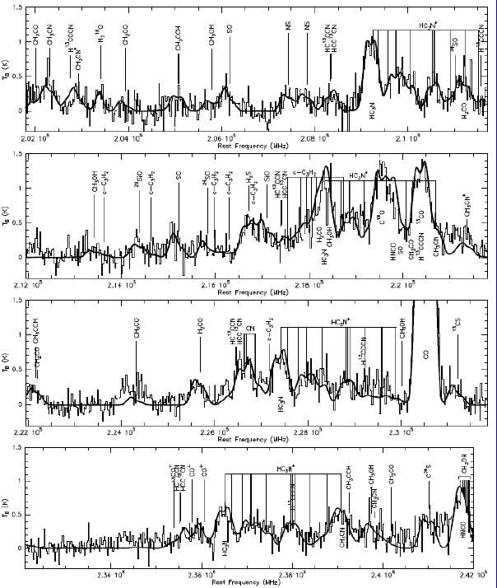
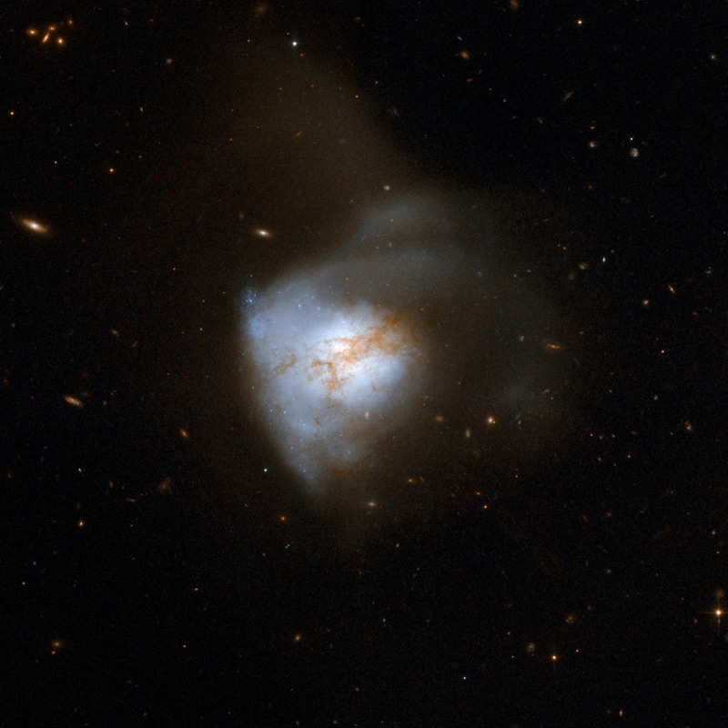
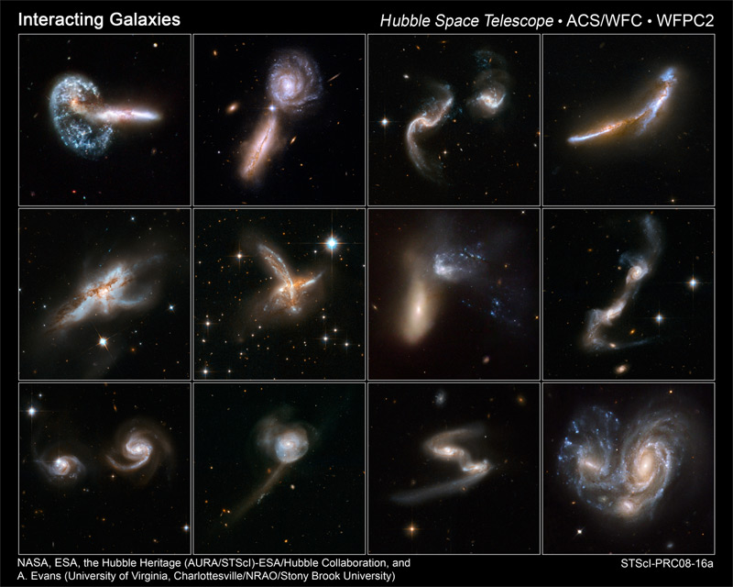
Galaxy Assembly Continues
Galaxies collide; stars passing through while gas clouds collide and shock, forming new stars from the joint molecular reservoirs.
A relatively nearby example is Arp220, 76 Mpc (250Mlyrs) distant. Current instruments reveal a chemically complex spectrum but cannot image the spatial components.
Arp 220
Martin, in prep.
Notes:
The collision, which began about 700 million years ago, has sparked a cracking burst of star formation, resulting in about 200 huge star clusters in a packed, dusty region about 5,000 light-years across (about 5 percent of the Milky Way's diameter). The amount of gas in this tiny region equals the amount of gas in the entire Milky Way Galaxy. The star clusters are the bluish-white bright knots visible in the Hubble image. Arp 220 glows brightest in infrared light and is an ultra-luminous infrared galaxy. Previous Hubble observations, taken in the infrared at a wavelength that looks through the dust, have uncovered the cores of the parent galaxies 1,200 light-years apart. 76 Mpc or 250Mlyr

Slide 25
Complexity of Molecule Distributions
Different molecules trace different environments in nearby galaxies, lending insight into their physics and providing a basis for interpretation of unresolved line emission from more distant galaxies.
Excellent tracers of gas mass: CO, C¹⁸O, N₂H⁺, HNC
Luminosity/nuclear mass tracers: HCN, HNC, continuum
Spiral arm tracers: CH₃OH, HNCO (shocked gas)
Photodissociation region tracers: C₂H, C³⁴S, CN
ALMA will enable
Higher resolution on nearby galaxies
More sensitivity, allowing imaging of additional species
Therefore providing a basis for interpretation of spectra of more distant objects, at a time when star formation in the Universe was more rampant and galaxies were obtaining their presently-observed characters.

Slide 26
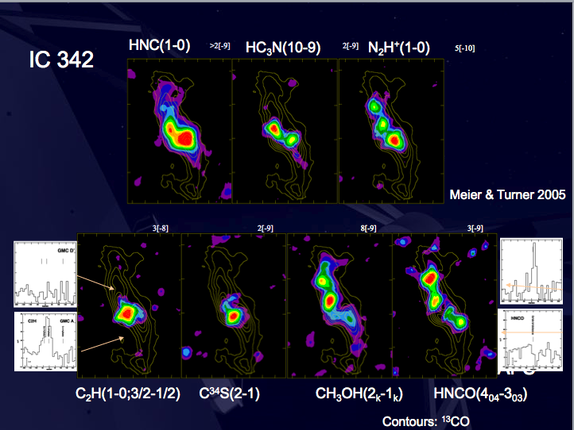
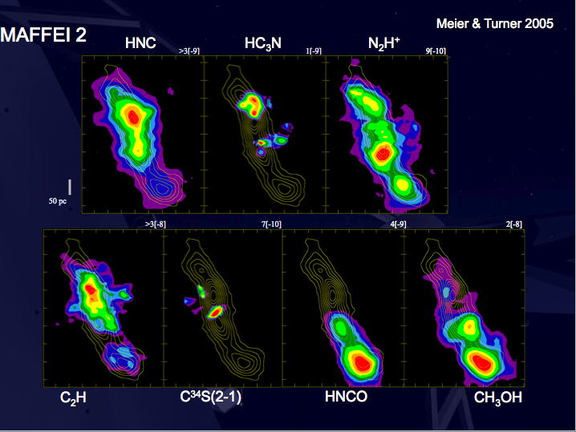
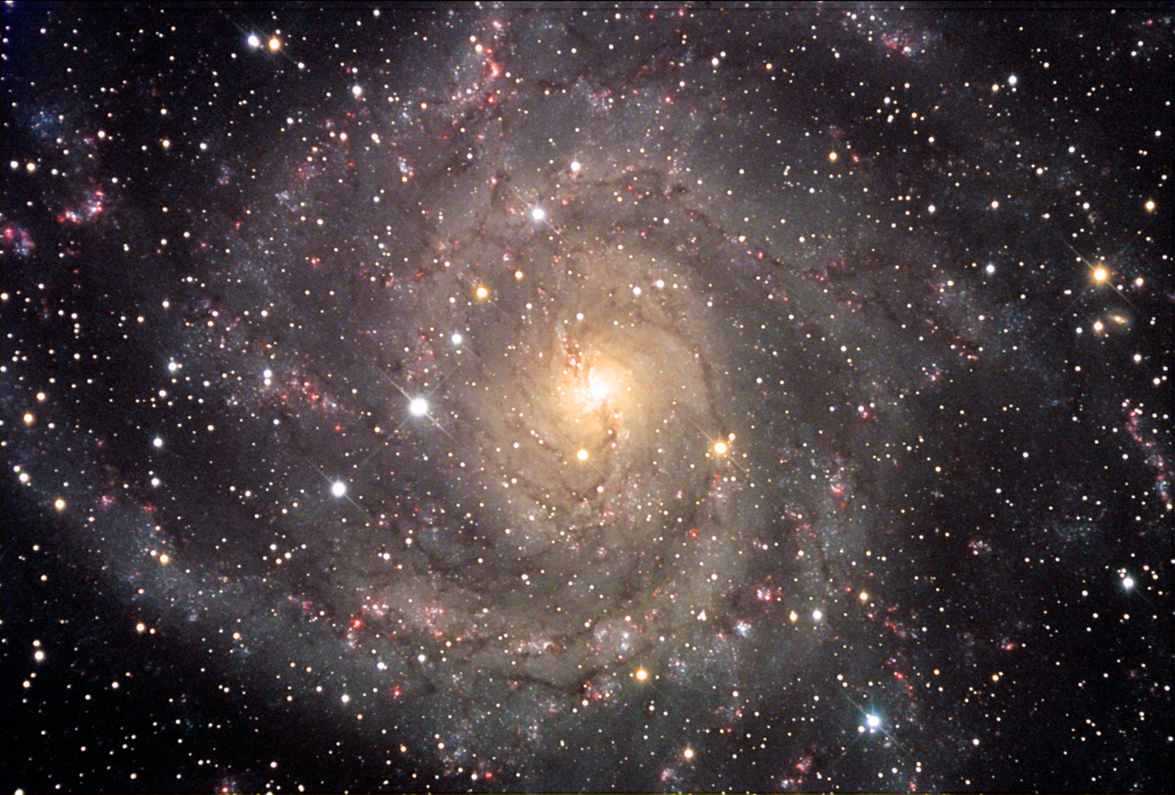
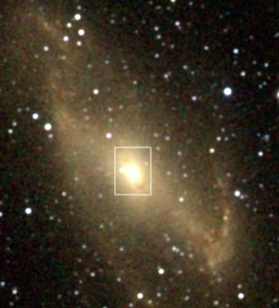
MAFFEI 2
NOAO -- Siarkiewicz
IC 342
R. Hurt - 2MASS

Slide 27
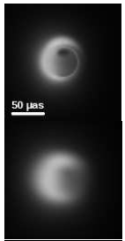
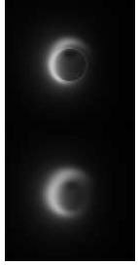
Imaging the Violent Hearts of Galaxies
230GHz
345 GHz
Very Long Baseline Interferometry
  Not in the construction plan
  ALMA Development upgrade
Enable imaging of Sgr A* Black Hole
  Model at right at 345 GHz
    ALMA as an element of a worldwide array
  M87 BH also usefully imaged

Slide 28
Birth of Stars and Planets
The fundamental objects in the Universe
The nearest Star Formation regions: ~100 pc from the Sun
  ALMA Beam at 300 GHz (100 pc): 1.5 AU
  L1457 was once reported to lie at ~80 pc but now seems to be beyond 300 pc.
  B68 lies at 95 pc (Langer et al.)
  Rho Oph has parts as close as 120 pc out to 160 pc
  Taurus has parts as close as 125 pc out to 140 pc
  Coal Sack and Chameleon and Lupus are about the same.
The nearest protoplanetary regions lie at ~20 pc from the Sun
  ALMA Beam at 300 GHz (20 pc): 0.3 AU
  TW Hya at 56 pc, TW Hya assn is 10 Myr old, not likely to be forming many planets.
  AU Microscopium, about 14 Myr old, lies only 10 pc from the Sun.
  Beta Pictoris, 20 Myr old, lies at 17 pc
The nearest debris disks are even closer—around ~10% of nearby stars.
  ALMA Beam at 300 GHz (3 pc): 0.05 AU
  Epsilon Eridani lies a little over 3 pc from the Sun
  Fomalhaut: 7.7 pc

Slide 29
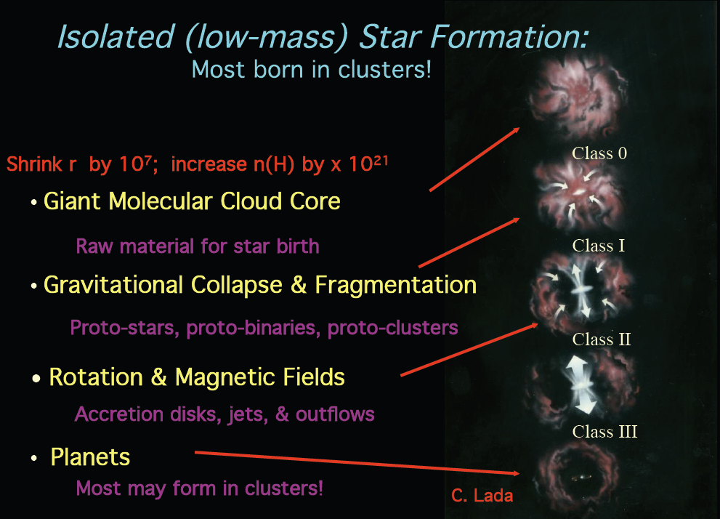
Star Formation Stages

Slide 30
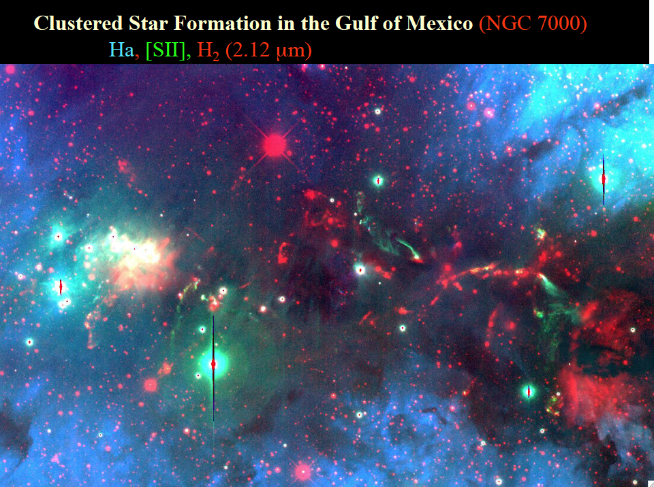
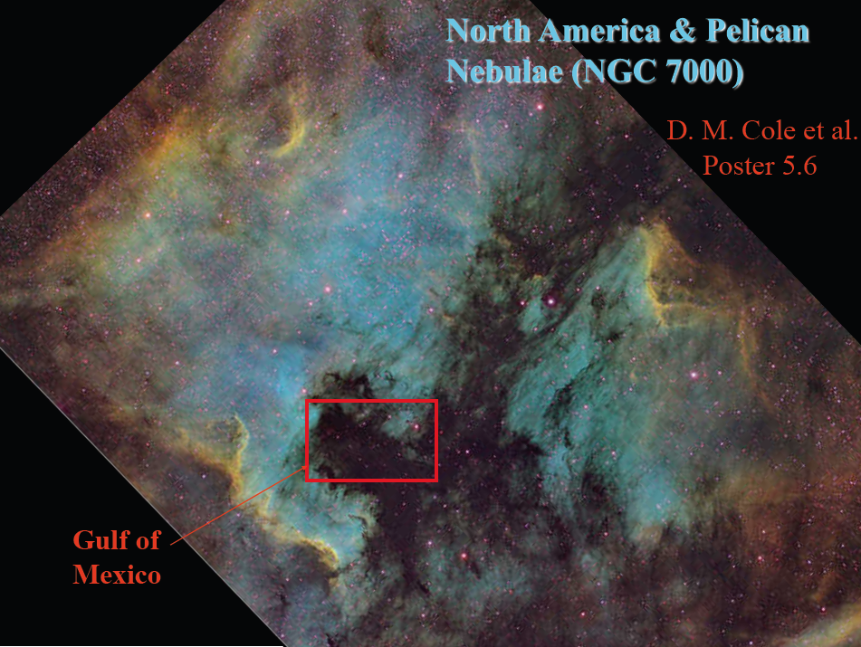
Star Spill in the Gulf
J. Bally
ALMA: Sensitive high resolution unobscured imaging of confused fields over modestly large areas.

Slide 31
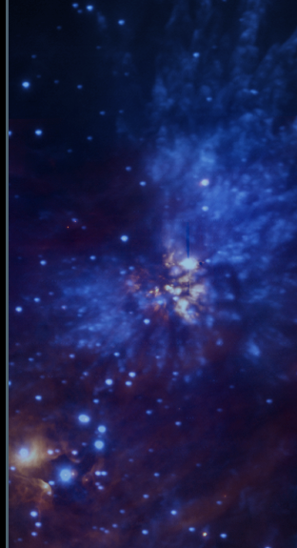
Massive Stars
J. Bally
Multiplicity high
Tend to favor massive clusters
Accretion goes quickly in massive cloud cores
Favor central regions of giant molecular clouds
Form via isolated collapse? Competitive accretion?
ALMA brings resolution and sensitivity
  Disentangle complex morphology
  Probe rarer high mass star forming regions at greater distances
  Southern hemisphere location
OMC1 in H₂: Smith et al 2005; Cunningham 2008

Slide 32
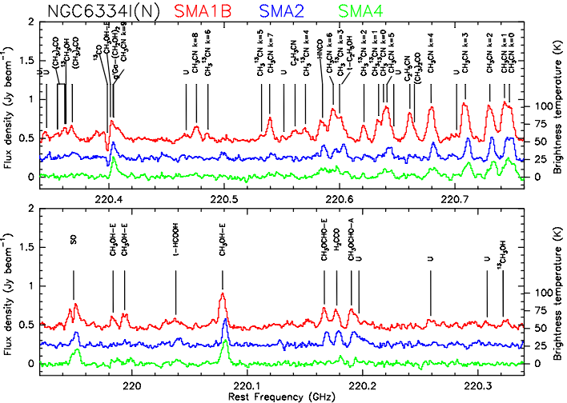
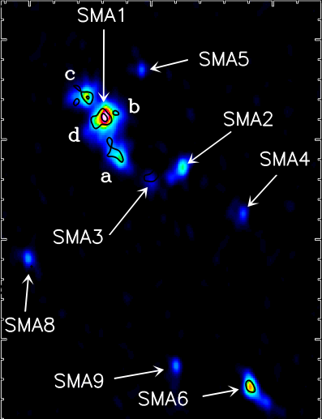
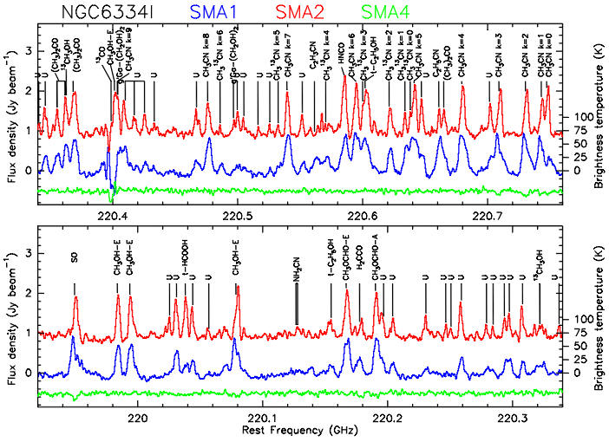
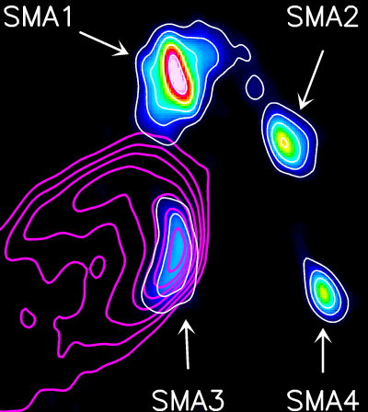
Chemical Complexity of Molecular Clouds
I(N)
A total of 6 line sources in I(N) and 3 in source I
Remarkable chemical variation between sources as little as 4000 AU apart
The 1-d radial velocity dispersion is ~2 km s⁻¹ for both protoclusters
I
Brogan
Notes:
Brogan’s slide!!

Slide 33
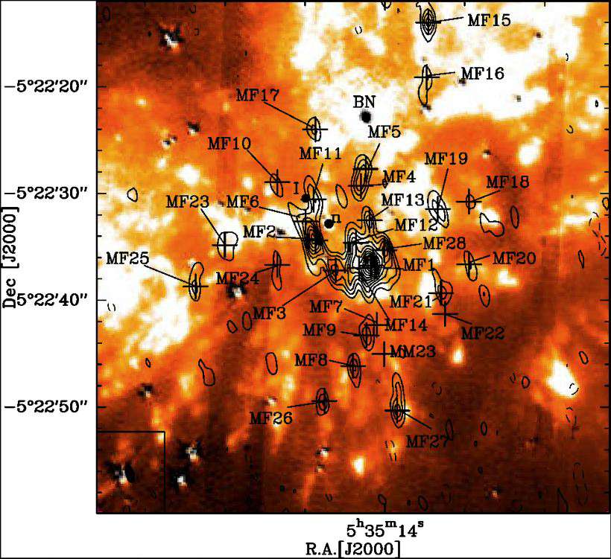
Orion Cloud Methyl Formate
Many clumps were detected in multiple transitions in this much more sensitive study of the nearer Orion Molecular Cloud. Excellent correlation of the spatial distribution with that of vibrationally excited H₂ suggests a shock origin for these clumps. This is consistent with a picture in which methyl formate is released from the icy mantles of the grains, where presumably it formed. In that sense, the clumps show some similarities to comets in our own Solar System.
ALMA will bring much improved sensitivity and resolution to the study of many more regions.

Slide 34


Formation of Planetary Systems
Wolf and D’Angelo 2005
HST view (left) sees opaque dust projected upon a bright background (if persent). In the ALMA view (above, the dust and the protoplanetary region appear bright.

Slide 35



Birth of Stars and Planets
Evolutionary Sequence Observations—
Molecular Cloud Core to Protostar (10⁴ yrs) to
Protoplanetary Disk (to ~10⁶ yrs) to
Debris Disk (to 10⁹ yrs)
Guilloteau et al 2008
Eisner et al 2008
Wilner et al 2002
Vega Dust Disk
Notes:
Guilloteau et al 2008 : A&A 478, L31-L34 (2008) HH30 disk.
\bibitem[Eisner et al.(2008)]{2008ApJ...683..304E} Eisner, J.~A., Plambeck,
R.~L., Carpenter, J.~M., Corder, S.~A., Qi, C.,
\& Wilner, D.\ 2008, \apj, 683, 304
Vega: Wilner, D.~J., Holman, M.~J., Kuchner, M.~J., \& Ho, P.~T.~P.\ 2002, \apjl, 569, L115

Slide 36





Birth of Stars and Planets
Evolutionary Sequence—
Molecular Cloud Core to Protostar (10⁴ yrs) to
Protoplanetary Disk (to ~10⁶ yrs) to
Debris Disk (to 10⁹ yrs)
Lodato and Rice 2005
Wolf and D’Angelo 2005
M. Wyatt; R. Reid
25AU
5AU
160 AU
Vega Dust Disk
Notes:
Lodato and Rice 2005: April volume of MNRAS, 358, 1489: A massive star forming disk.
Wolf and D’Angelo 2005: \apj, 619, 1114
Vega: Wilner, D.~J., Holman, M.~J., Kuchner, M.~J., \& Ho, P.~T.~P.\ 2002, \apjl, 569, L115 Image Wyatt’s model simulated observation by ALMA

Slide 37
Forming Other Planetary Systems
ALMA Advantage: Resolution
  Disks are small, <900 AU, requiring high angular resolution (1”~140 AU in nearest star-forming regions)
ALMA Advantage: Sensitivity
  Except for the innermost regions, disks are cold (10-30K at R>100 AU) requiring high sensitivity
ALMA Advantage: High spectral resolution
  Solar-mass stars will have rotation velocities around 2 km/s, turbulence around .2 km/s, requiring high spectral resolution.
The only way to provide high spatial and spectral resolution AND high sensitivity is with large collecting area. ALMA.

Slide 38
Nearby Planets
  (3) ALMA will be able to directly detect very young giant planets in the nearest star forming regions. Integration times in days for several cases:
Distance (pc) | Jupiter | Gl229B | Proto-Jupiter
1 | 1.5 | 0.01 | <1hr
5.7 | >1yr | 12.5 | <1hr
10 | >1yr | 120 | <1hr
120 | >1yr | >1yr | 12.5

Slide 39

Indirect Detection of Mature Planetary Systems
(4) Adult - ALMA will indirectly detect the presence of giant planets around nearby stars through the use of astrometry.
  A planet orbiting its central star causes the star to undergo reflexive motion about the barycenter
  ALMA would measure this motion accurately in its long configuration at submm wavelengths.
  ALMA could detect photospheres of e.g. 1000 stars well enough to detect a 5Jovian mass planet at 5AU. (10 minute integration).
  Inclination ambiguities for companions now known could be resolved.

Slide 40
ALMA Early Science:
Beginning the Discovery Space Expansion
ALMA Early Science initiates the transformation
  Sensitivity: ~10% full ALMA
  Resolution: up to ~0.4” (0.1” goal)
  Wavelength Coverage: 3-4 of final 8 bands (7 goal)
  Bandwidth: ~2x improvement
Begins next year
ALMA Development ensures the transformation continues

Slide 41

www.almaobservatory.org
The Atacama Large Millimeter/submillimeter Array (ALMA), an international astronomy facility, is a partnership among Europe, Japan and North America, in cooperation with the Republic of Chile. ALMA is funded in Europe by the European Organization for Astronomical Research in the Southern Hemisphere, in Japan by the National Institutes of Natural Sciences (NINS) in cooperation with the Academia Sinica in Taiwan and in North America by the U.S. National Science Foundation (NSF) in cooperation with the National Research Council of Canada (NRC). ALMA construction and operations are led on behalf of Europe by ESO, on behalf of Japan by the National Astronomical Observatory of Japan (NAOJ) and on behalf of North America by the National Radio Astronomy Observatory (NRAO), which is managed by Associated Universities, Inc. (AUI).

Slide 42

Dark Side of Reionization
ALMA 1 hr, 5σ, 300 km/s
Single to score of clouds of
10⁸M_{sun}
B11
B10
After Appleton et al 2009
Notes:
H2 (T=200K) and Fine-Structure Line flux predictions for single(11) and multiple cloud condensation of
10⁸M_{sun} . The lower band shows the fainter predictions for H2 after metal pollution and the upper band shows the
stronger emission expected from fine structure lines. These lines will be spread throughout the far-IR and submm
for high redshift emission. We assumed a ΛCDM cosmology (ΩL=0.7, Ωm=0.3, H0=70).

Slide 43

Science Goal I: Detect CO or C+ in MWG
Lines provide
  Distance
  Virial Mass
  Elemental Probe
  CO=>H₂
At z=2: Both lines
At z=3: CO hard
Atomic lines, redshifted, probe to great distances

Slide 44

C+ the Cosmic Candle
Detectable from ULIRGs to z~8 or more
Here, sensitivity in 4 hours to e.g. [CII], [OI] & [NII] is shown
Milky Way type galaxy detectable to z>3 in 24 hrs.

Slide 45

Star Formation History
BIMASONG (Helfer 2003)
M51 is a well-known nearby galaxy, more luminous than our own
Current CARMA image, above, can be moved to higher z in a simulation by Gallimore (2010) using CASA
Notes:
Corroborates M. Yun 1999 simulation.

Slide 46


M51 through time
z=0.1:
  Scale 1.8 kpc/”
  Look-back time 1.3 Gyr
  Spiral structure, grand design apparent
  Rotation discernible, hence mass measurable
z=0.3:
  Scale 4.4 kpc/”
  Look-back time 3.4 Gyr
  Little structure
  Rotation discernible, hence mass measurable
Notes:
For Ho = 71, OmegaM = 0.270, Omegavac = 0.730, z = 0.300

Slide 47
Numerology
Assume: 5AU orbit
Three mass ranges: 5 Jovian, Jovian, Neptunian
10 minute integrations, 345 GHz, 1.5mm H₂O
Then:
800, 180, 0 Hipparcos stars about which a companion might be detected, virtually none solar type.
200, 120, 30 Gliese stars (d<25pc) about which a companion might be detected.
  100, 30, 0 of these are solar type stars.

Slide 48
Specific Example
M dwarfs in solar neighborhood
  There are ~90 M dwarfs within 15 pc of the Sun
  Planets are hard to detect around them through radial velocity measurement of spectral lines owing to spectral crowding
  A team led by Boss seeks planets through astrometry of these stars at Las Campanas
  For ALMA at 870 microns, e.g. the M4V Barnard’s star at 1.8 pc distance would have a flux of about 2 mJy. At 15 pc, this is reduced to tens of microJy. Astrometric accuracy of 300mas would require ~20σ measurement, translating to days of integration, unlikely to win the hearts and minds of referees. For an hour’s integration, an ALMA Mdwarf survey to 5pc would seem most reasonable.

Slide 49
Summary
ALMA will image dust and gas in planetary systems at high resolution and sensitivity
Development program will upgrade receivers, implement new bands and enable techniques not within construction scope
  Very long baseline interferometry—better astrometric precision
  SupraTerahertz operation possible

Slide 50

Protoplanetary Disks with ALMA Early Science
Continuum Sensitivity excellent: targeted continuum observations will work well
Spectral Sensitivity excellent—multi line surveys an excellent science target
Good imaging performance, but high resolution high fidelity science best with full ALMA
Conclusion:
  Discovery and characterization of lower mass disks nearby improved
  Excellent progress expected on understanding the detailed composition and processes in disks
  Edges of explorable space reach to the nearby spiral arms

Slide 51
ALMA Observes Other Planetary Systems
At a disadvantage on the SED, ALMA nonetheless has a role
ALMA, reaching long FIR wavelengths with great sensitivity and spatial resolution, will image dust and gas in these systems.
We consider the ability of ALMA to observe stars and extrasolar planetary systems in various stages of evolution.
See ALMA Memo 475.

Slide 52
Best Frequency for ALMA Continuum?
Define a Figure of Merit—best frequency around 300 GHz (1mm)
Frequency | ΔS (mJy) | X_{ν}
230 | 0.07 | 76
345 | 0.12 | 99
675 | 0.85 | 54
Notes:
For observations of any thermal blackbody (with emission which goes like λ⁻²), the figure of merit that one wants to maximize is X_{ν}=ν²/ΔS, where ΔS is the noise at frequency ν. We want to maximize X_{ν} because it is proportional to the SNR obtainable. For ν>350 GHz, need better weather so use pwv=1.5mm below and 0.5mm above this ν.

Slide 53

Disk Structures
Inner dense disk probed by dust—ALMA sensitivity extends probe to outer colder regions
ALMA allows imaging of a retinue of CO lines into the warmer inner disk. Hence one can compare both dust and gas in the same regions.
ALMA sensitivity allows imaging of optically thin isotopic lines in dense inner regions.
  Disk chemistry
  Disk structure—protoplanetary clearing

Slide 54
Forming Planets
ALMA will be able to directly detect forming giant planets (‘condensations’) in protoplanetary disks, and the gaps created in these disks as the condensations grow.
  ‘Theoretical investigations show that the planet-disk interaction causes structures in circumstellar disks, which are usually much larger in size than the planet itself and thus more easily detectable.’ S. Wolf

