Slide 1
Al Wootten
ALMA Now and in the Next Decade

Slide 2
The push to the high site…
ALMA is pushing to achieve closure phase (3 antennas) at the high site before the end of this year
This target is the key driver for the entire project at the moment
To achieve this requires all of the necessary infrastructure and equipment to be in place
This activity is being masterminded by the ALMA AIV team, led by Joe McMullin
The path to the high site involves first establishing fringes at the OSF in a two antenna interferometer

Slide 3
Requirements
Buildings/Roads/Foundations
3 Antennas
Transporter
3 Front Ends
3 Back Ends
LO
Correlator
Software
End to End Connectivity

Slide 4
Requirements
Buildings/Roads/Foundations
3 Antennas
Transporter
3 Front Ends
3 Back Ends
LO
Correlator
Software
End to End Connectivity

Slide 5
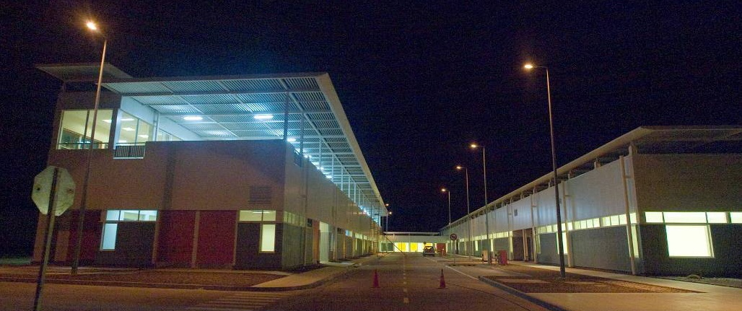
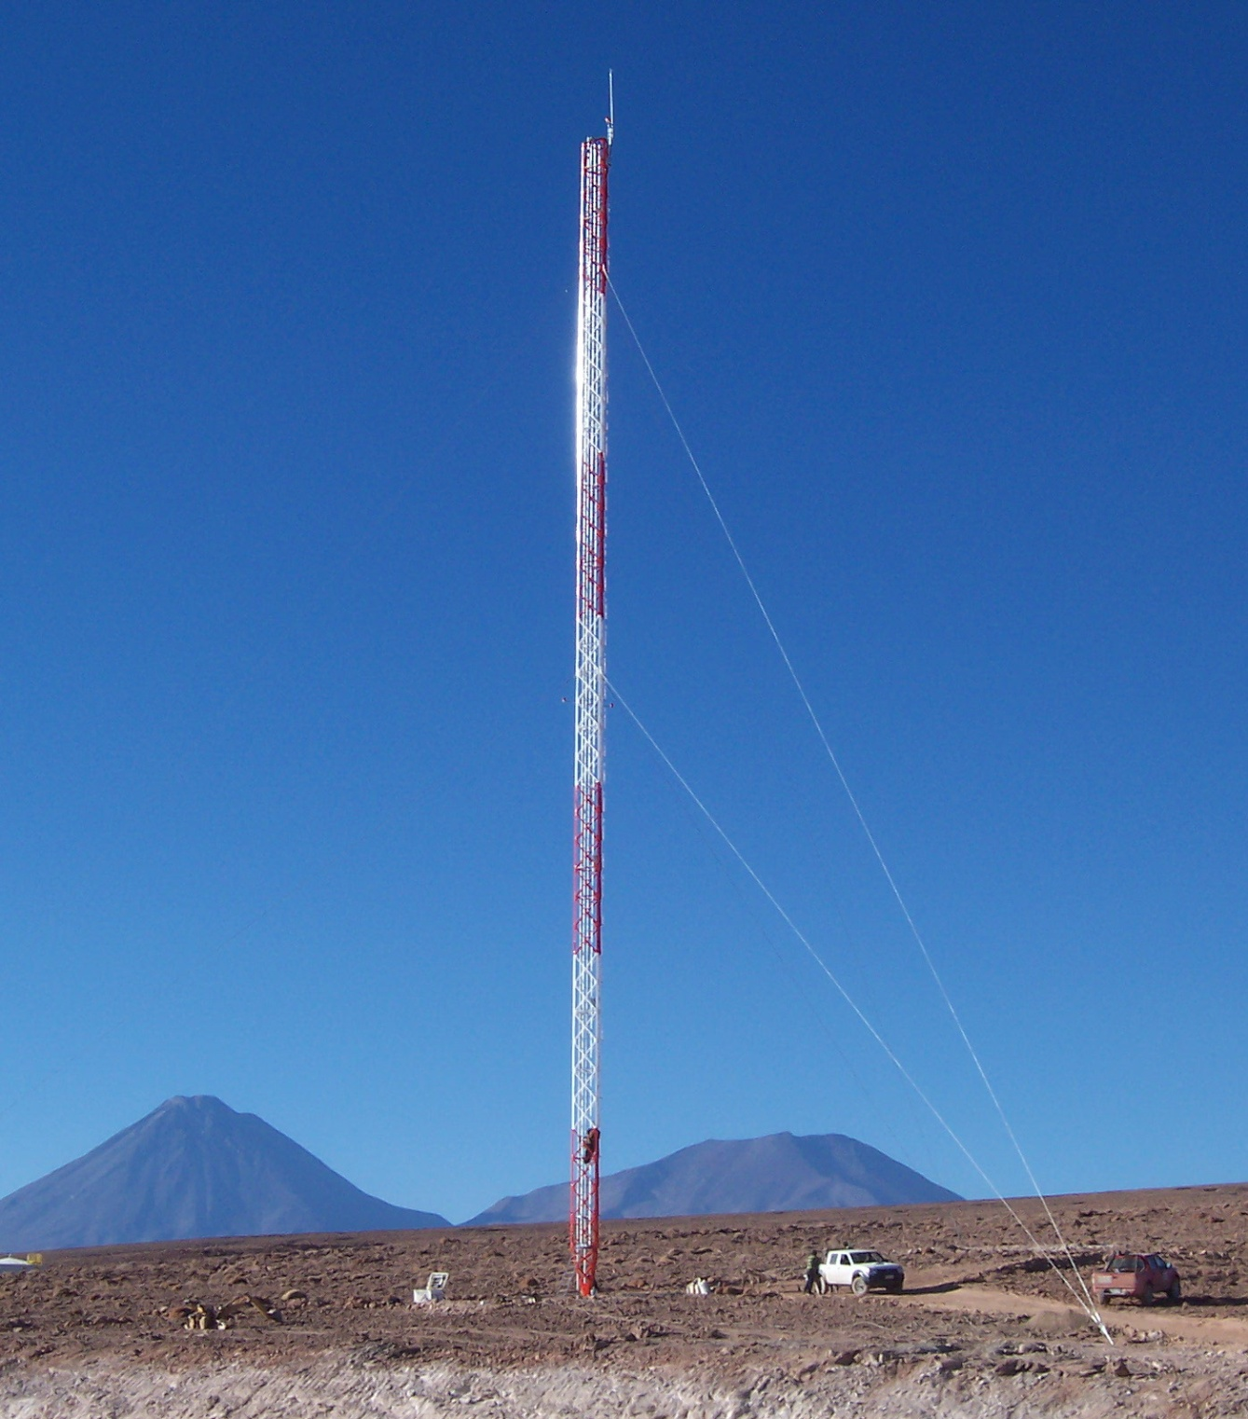
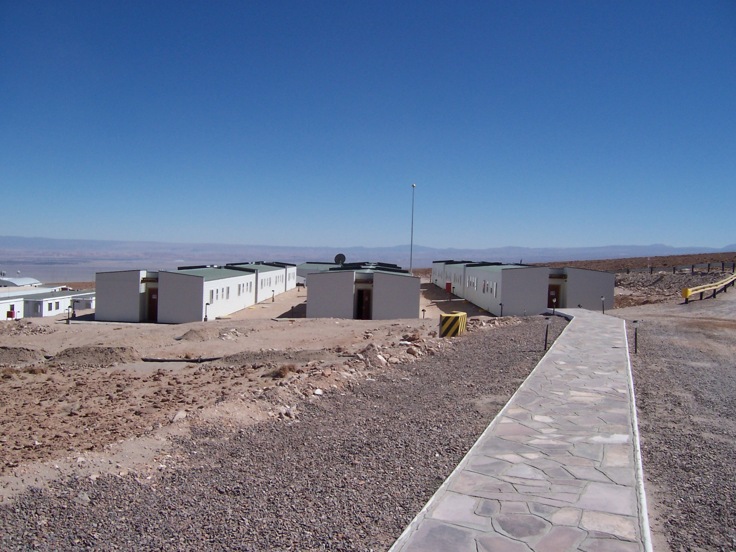
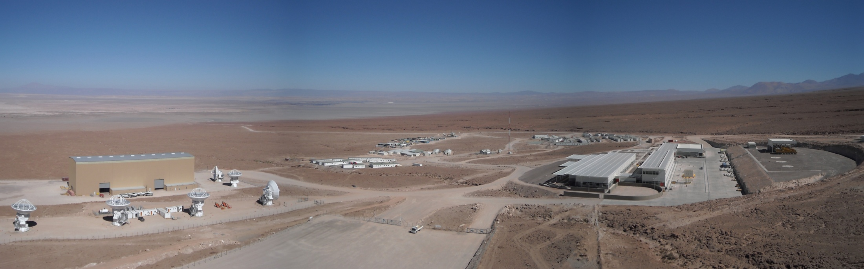
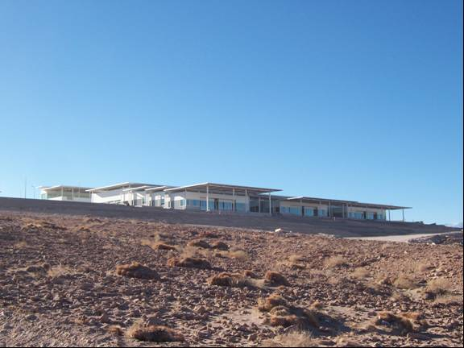
OSF

Slide 6
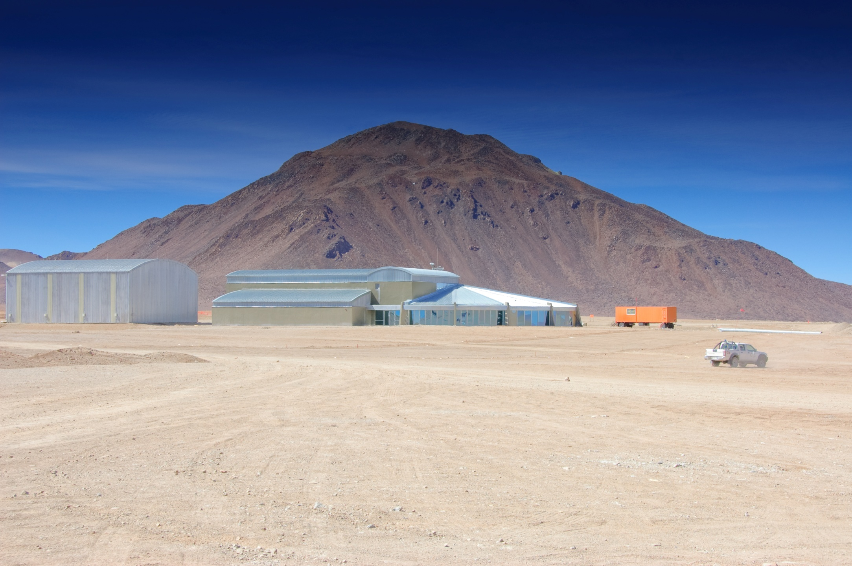
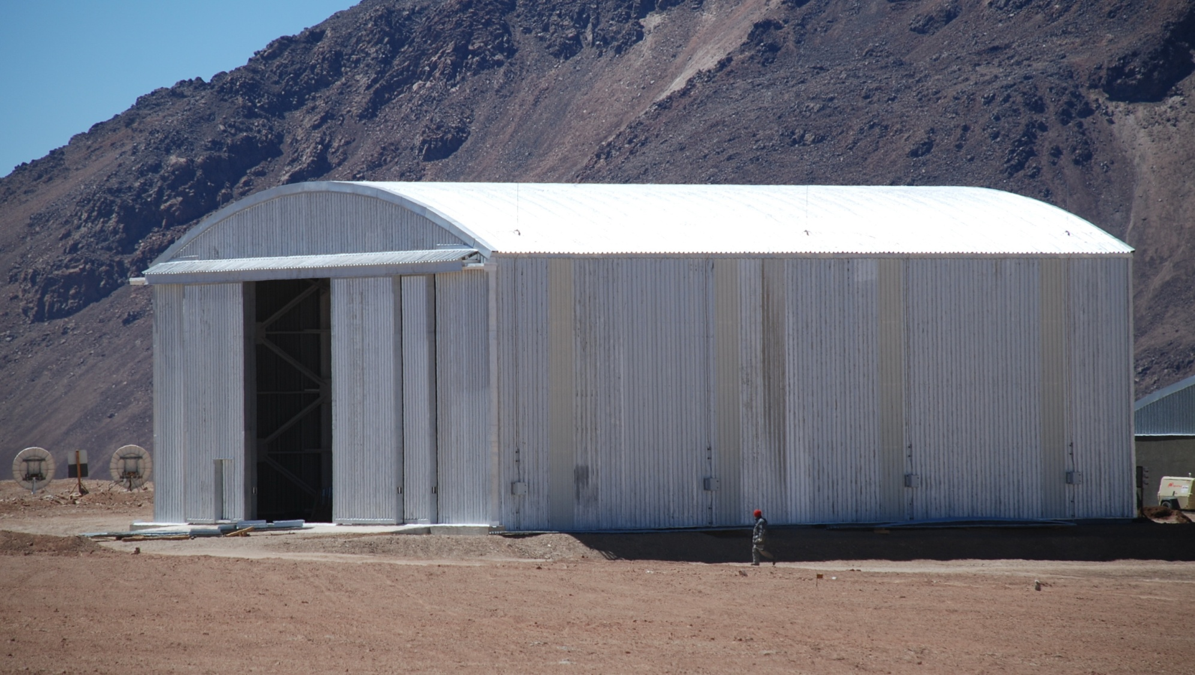
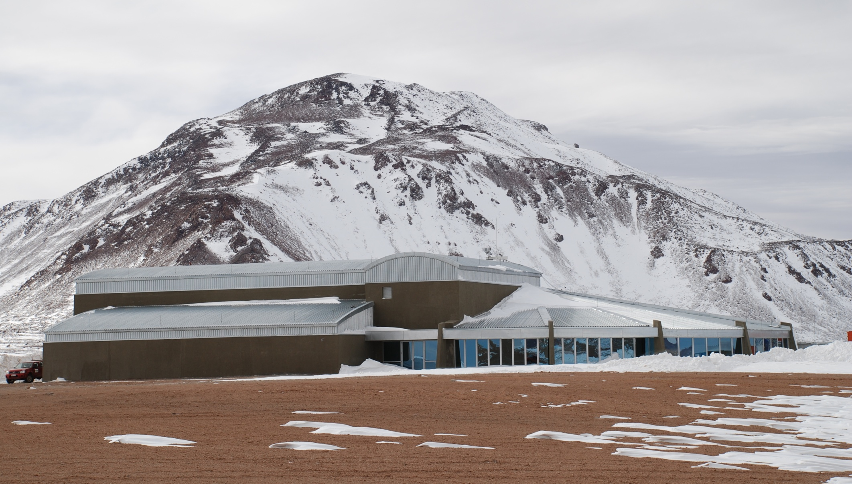
AOS

Slide 7
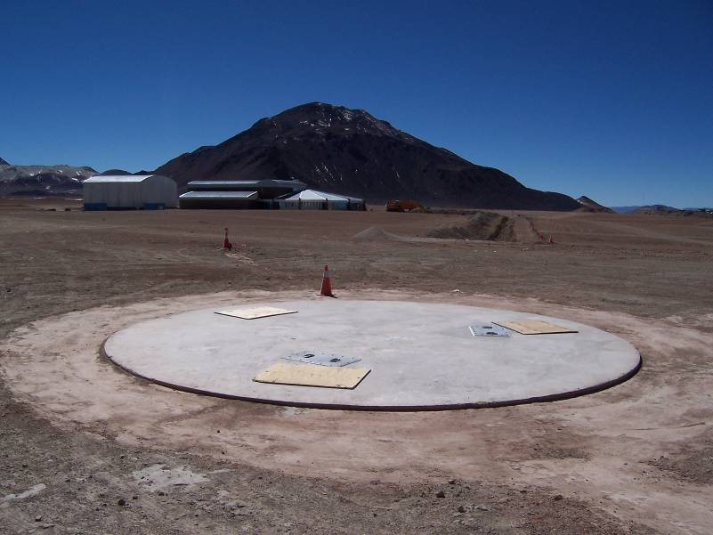
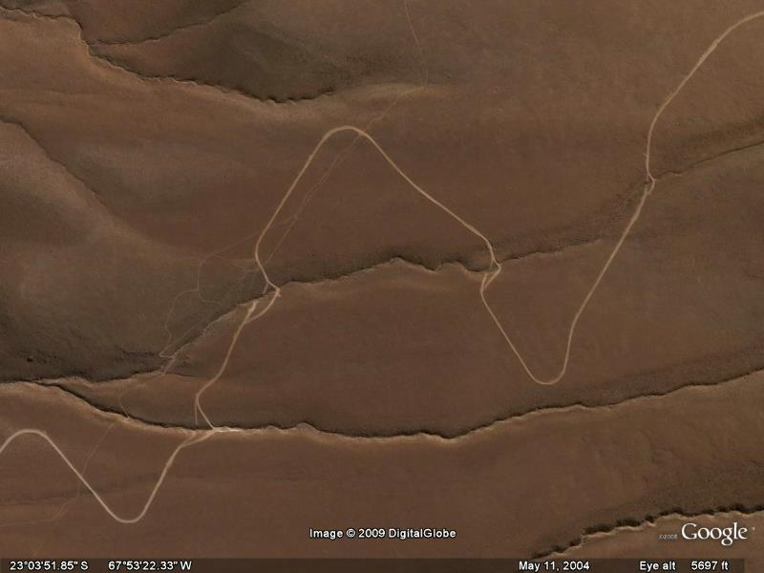
Roads & Foundations

Slide 8
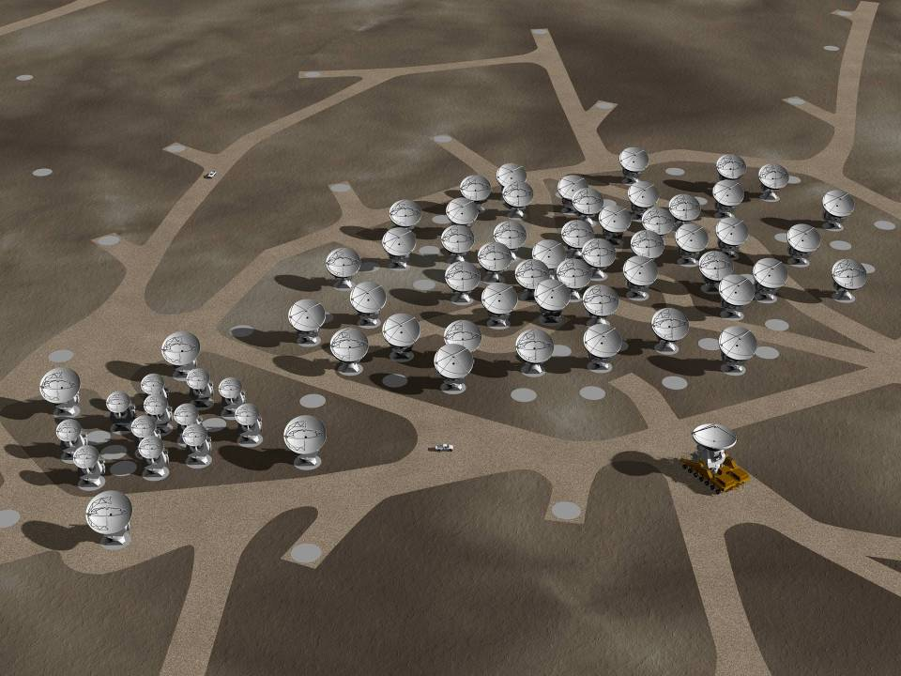
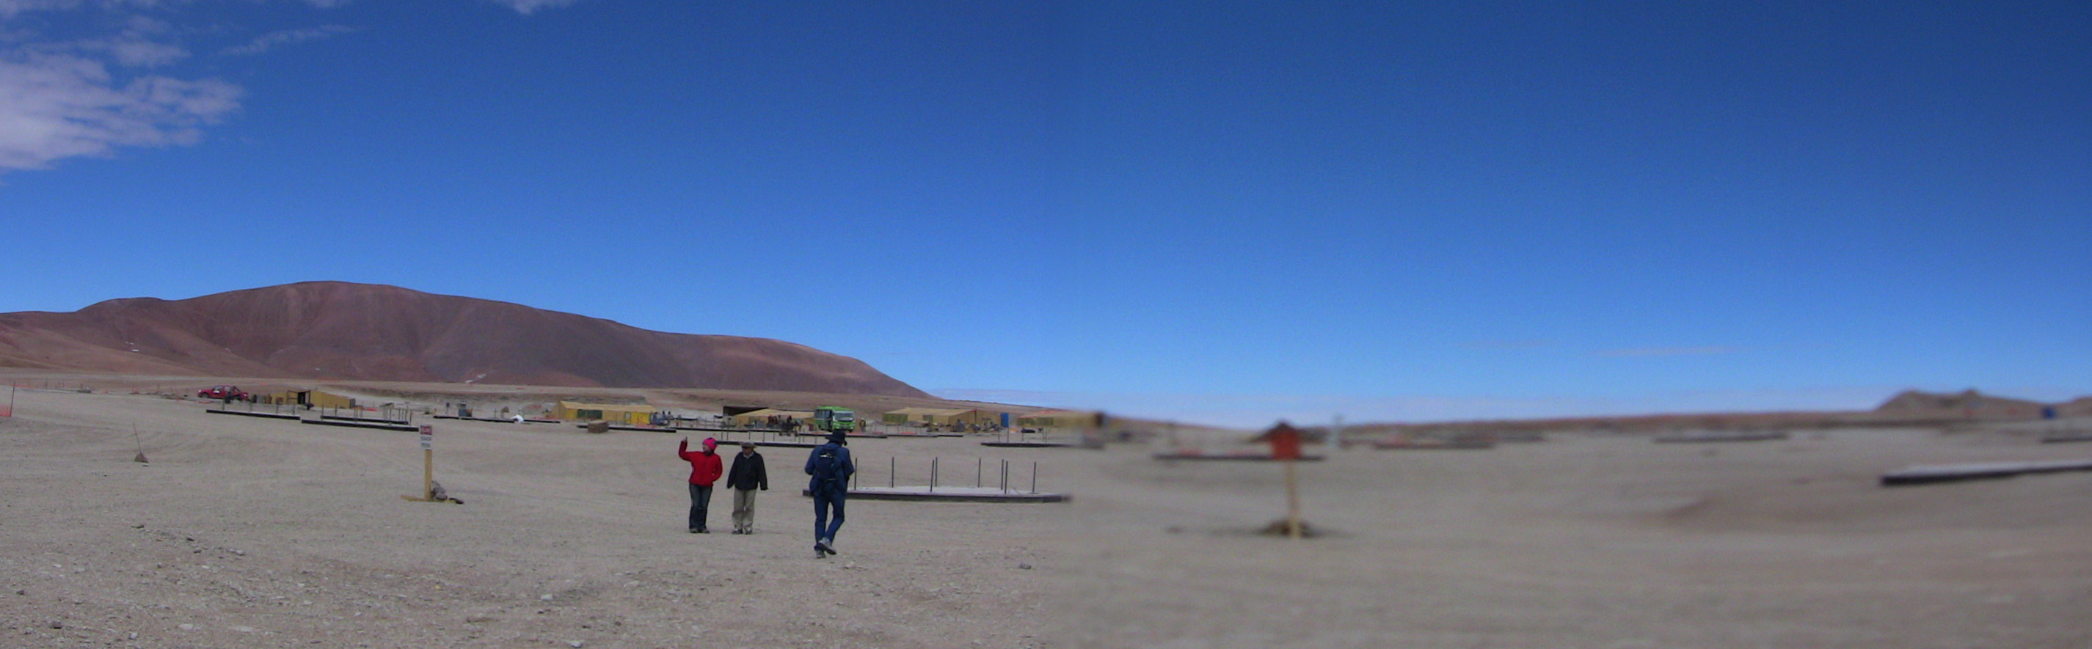
12m Array
Simulation (!)
Atacama Compact Array (ACA)

Slide 9
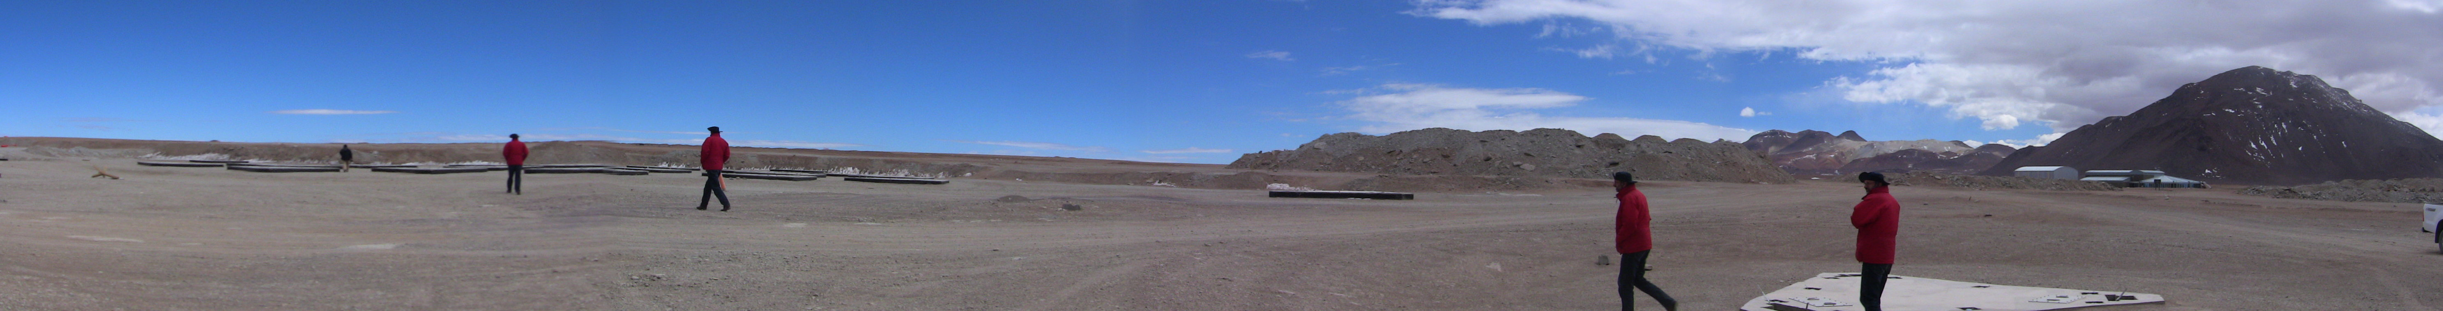
Foundations
Foundations for the Compact Array –
nearly done. Power and fibres next.
N.B. Array of P. Schilkes

Slide 10
Requirements
Buildings/Roads/Foundations
3 Antennas
Transporter
3 Front Ends
3 Back Ends
LO
Correlator
Software
End to End Connectivity

Slide 11
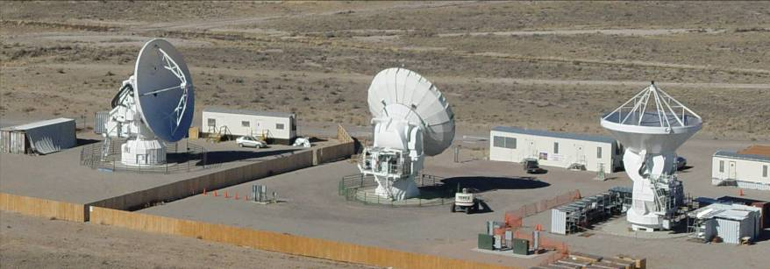
ALMA Prototype Antennas
Extensive use of Carbon Fibre
Precision panels plus holography
Very Stiff Mounts and Accurate Drives
“Metrology”

Slide 12
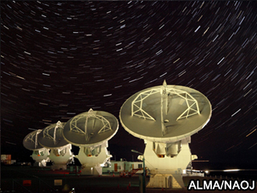
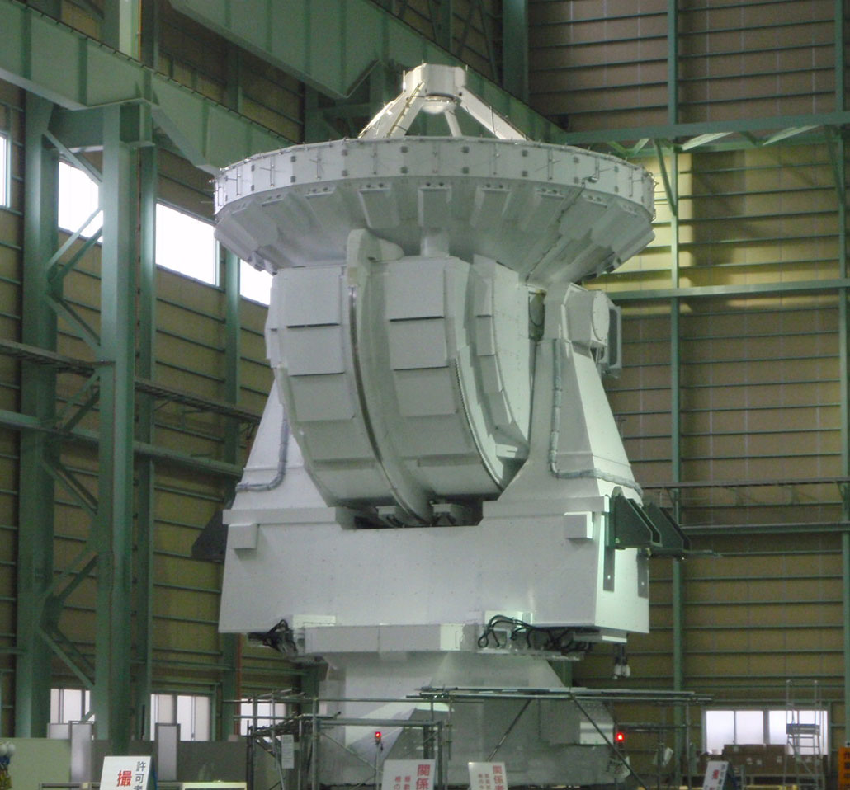
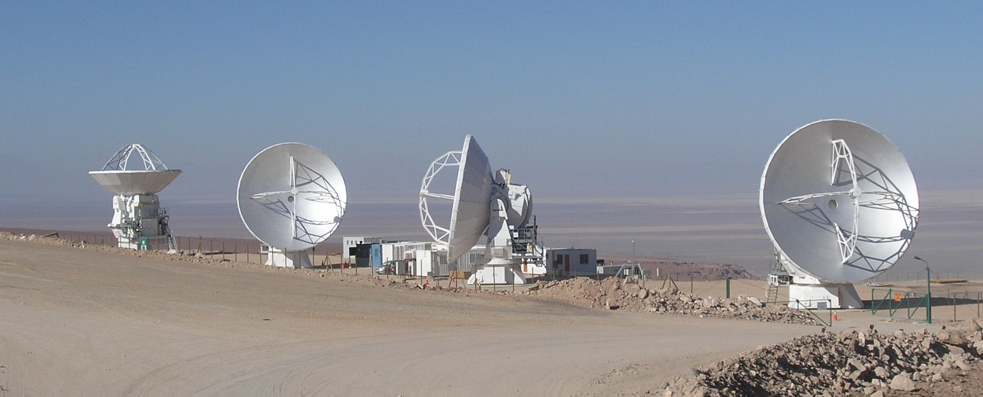
Three MELCO Antennas being tested
(non-interferometrically!)

Slide 13
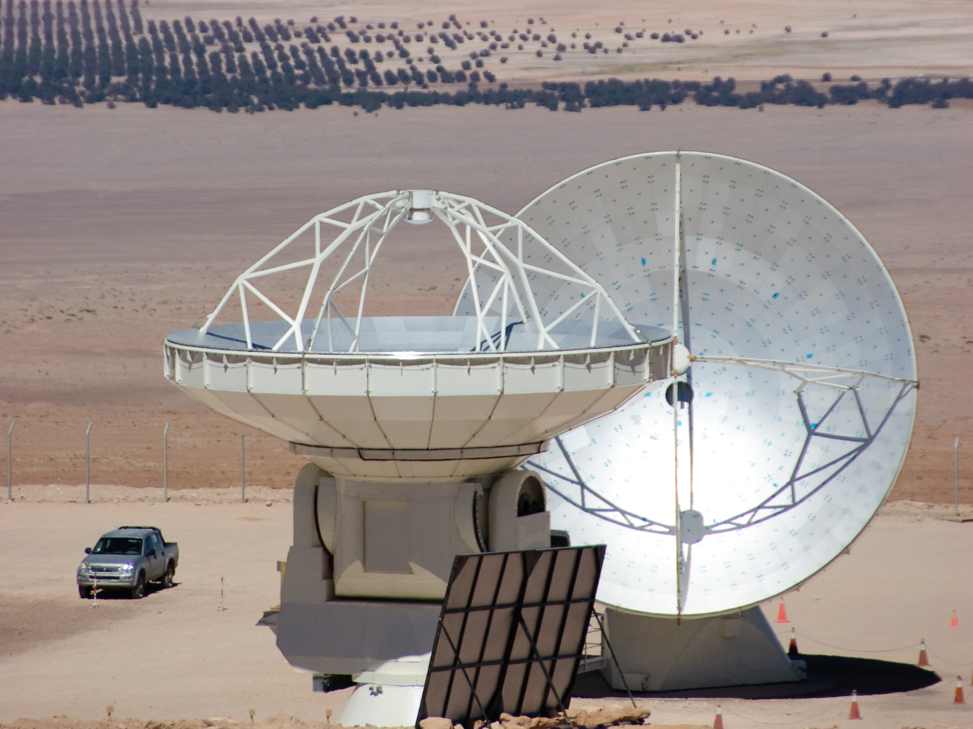
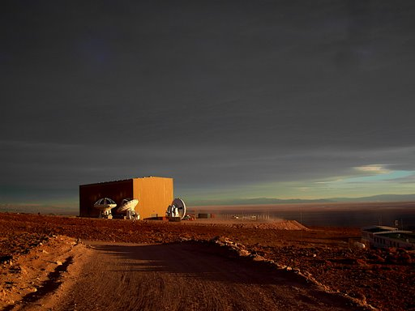
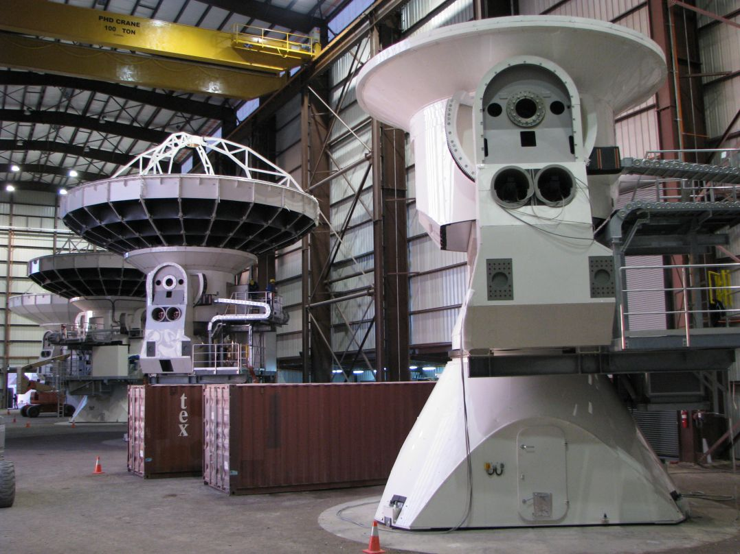
Two Vertex Antennas conditionally accepted–
Two to be accepted in September
Eight more being tested, assembled

Slide 14
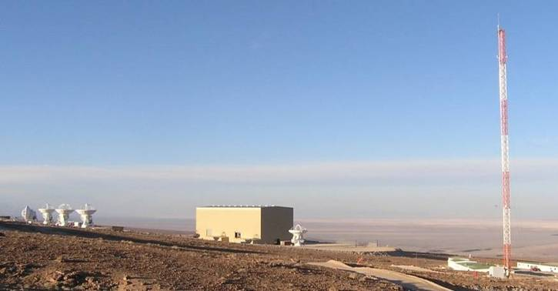
Dishes measured by holography at 104 GHz
Use source on tower at ~300m distance and correct for the curved wavefront

Slide 15
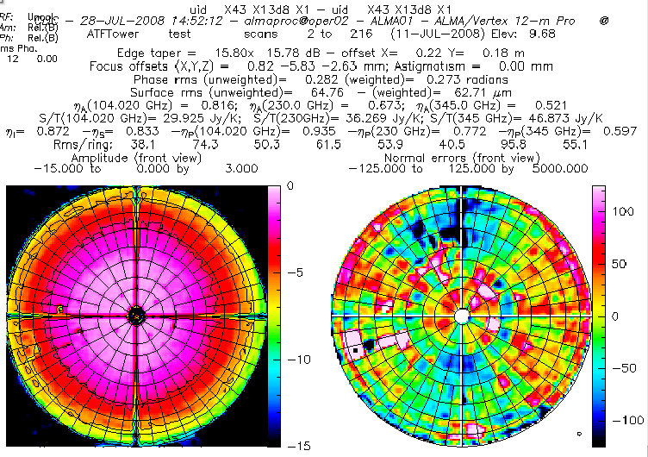
Initial Map – amplitude and phase

Slide 16
After adjustment

Slide 17
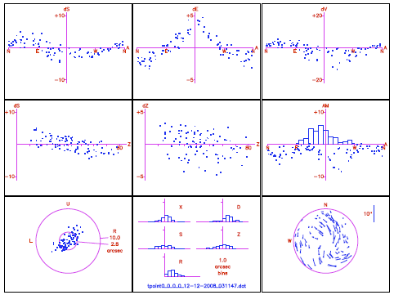
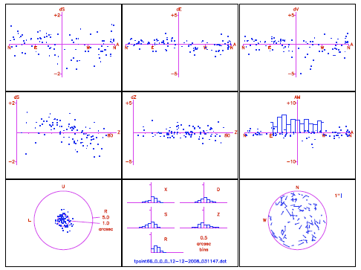
Pointing: Vertex Metrology
Metrology off (2.79” rms) Metrology on (1.01” rms)
Data taken alternating between metrology on & off every 10 stars on a 200 star run)

Slide 18
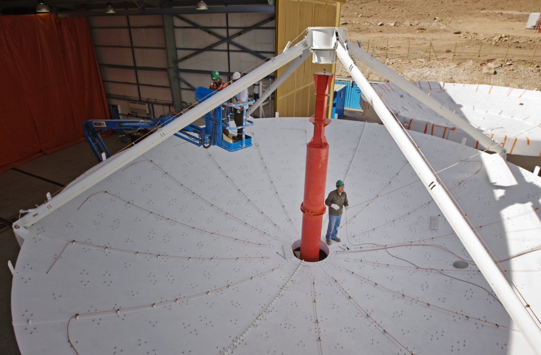
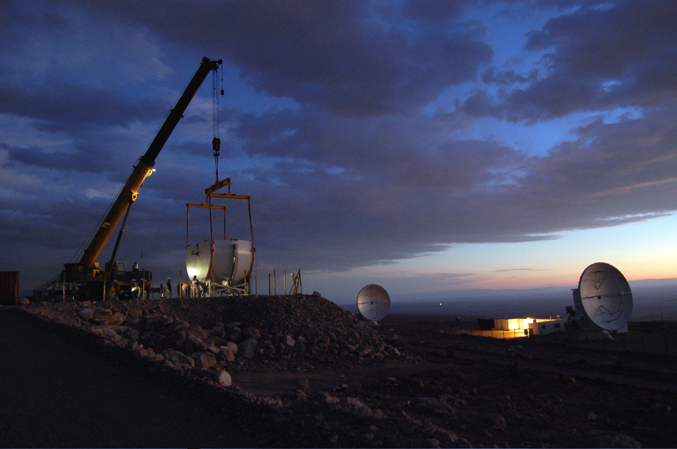
EU Antennas

Slide 19
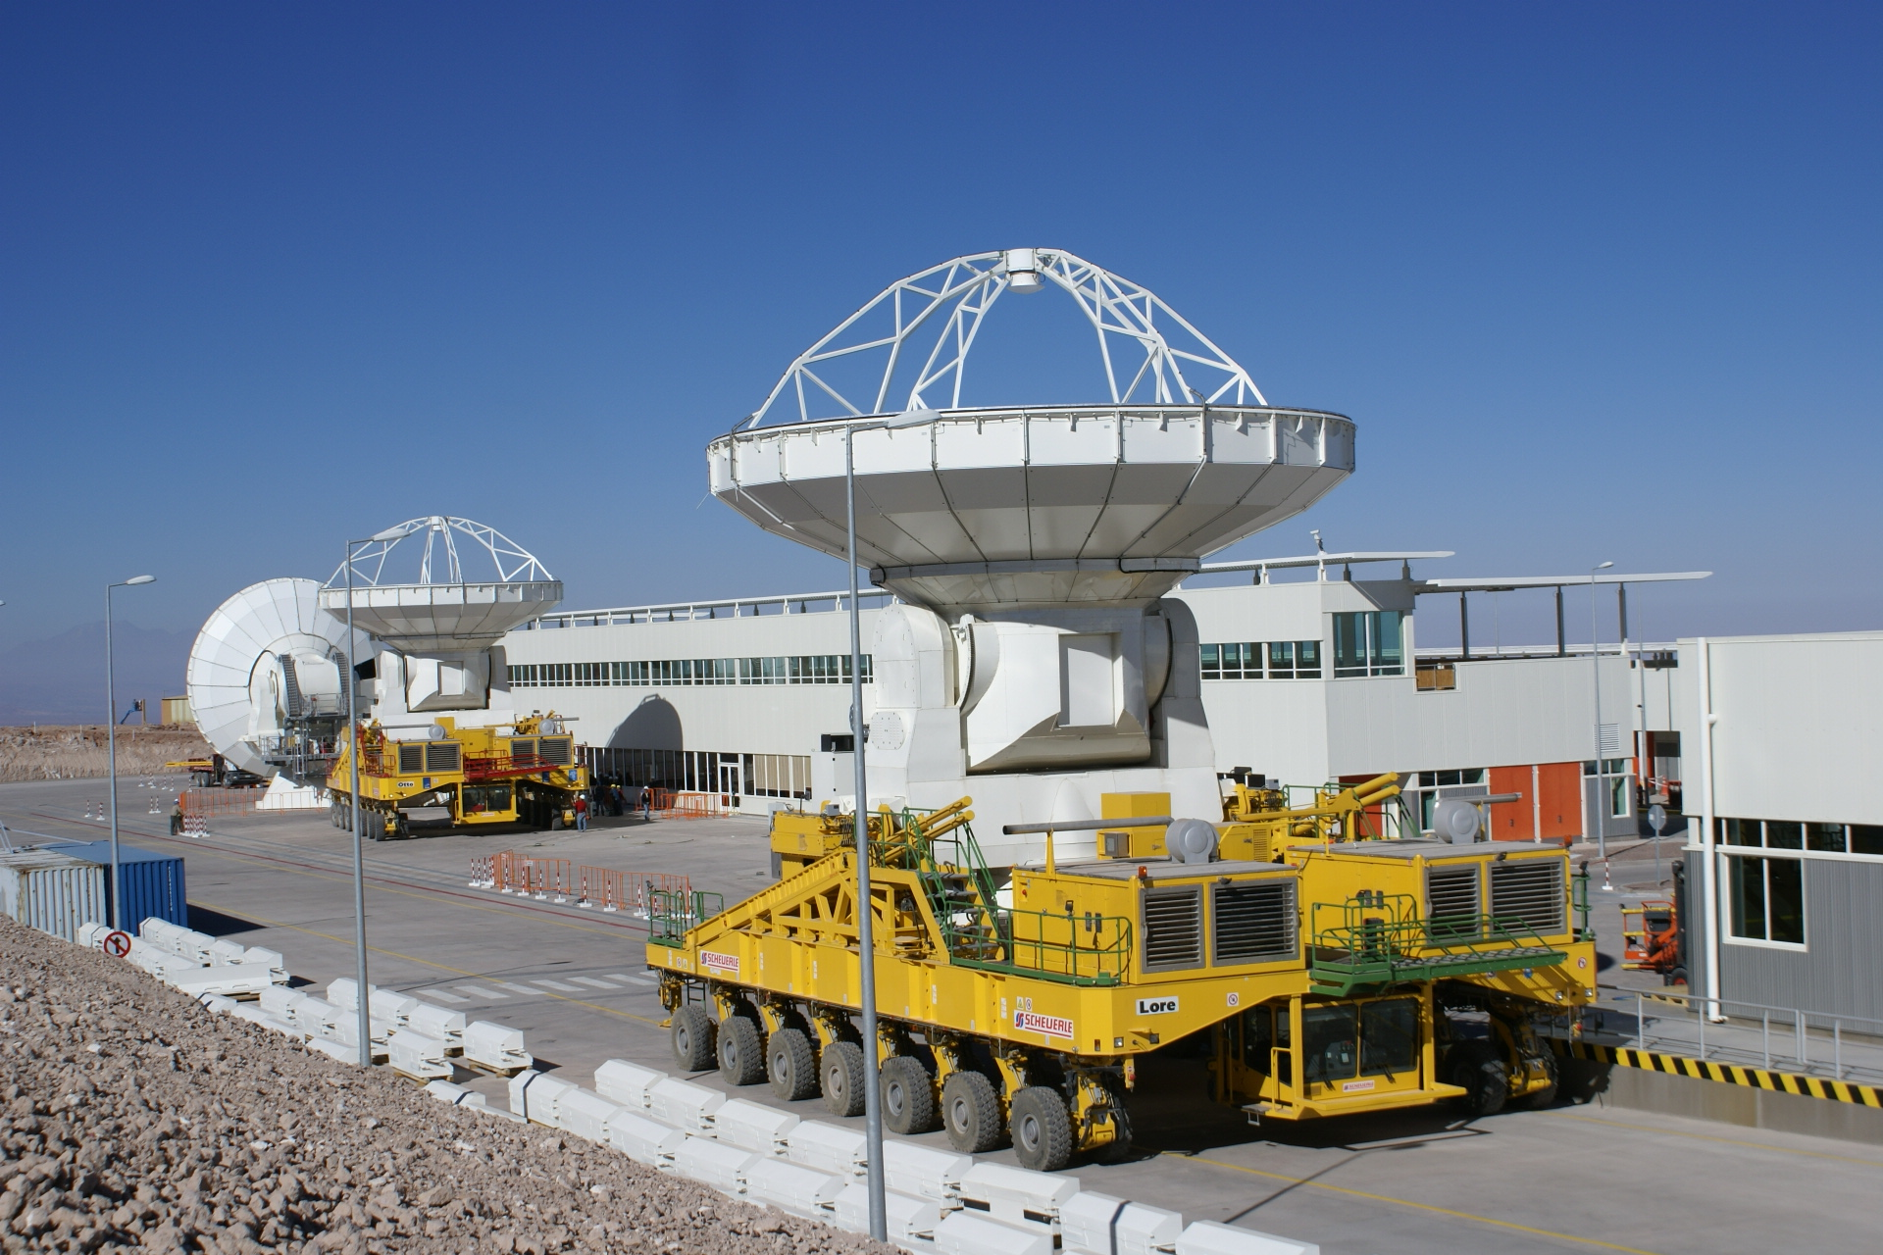
3 Antennas
One Melco and two Vertex Antennas accepted
Melco antenna to AOS 17 September
Vertex 3 & 5 acceptance September, then remaining Melco antennas

Slide 20
Requirements
Buildings/Roads/Foundations
3 Antennas
Transporter
3 Front Ends
3 Back Ends
LO
Correlator
Software
End to End Connectivity

Slide 21
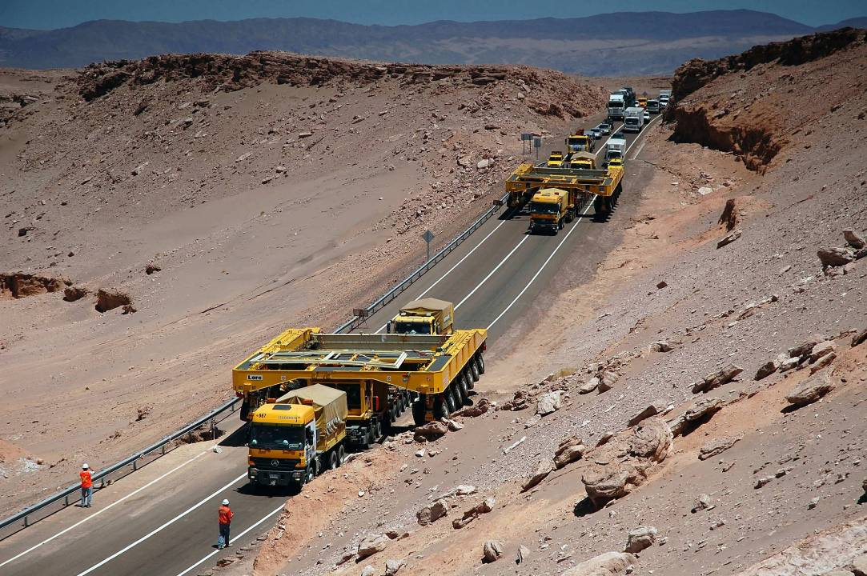
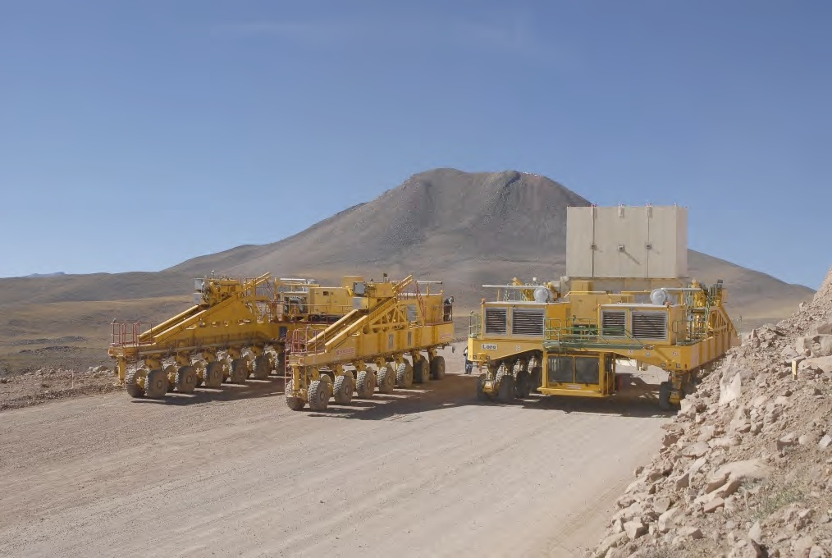
Transporters coming past the valley of moon

Slide 22
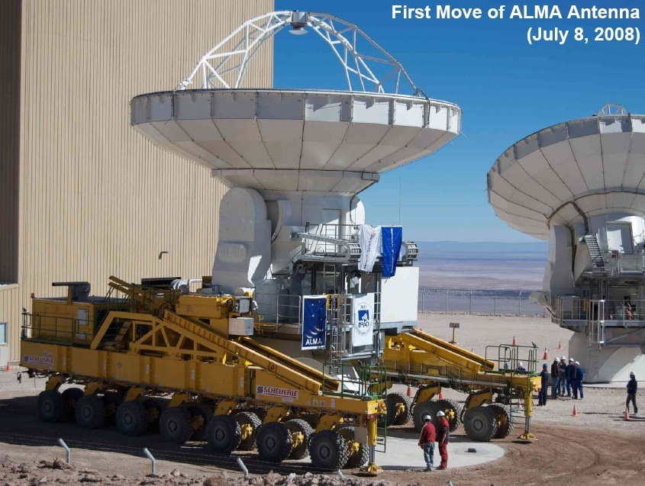

Slide 23
Requirements
Buildings/Roads/Foundations
3 Antennas
Transporter
3 Front Ends
3 Back Ends
LO
Correlator
Software
End to End Connectivity

Slide 24
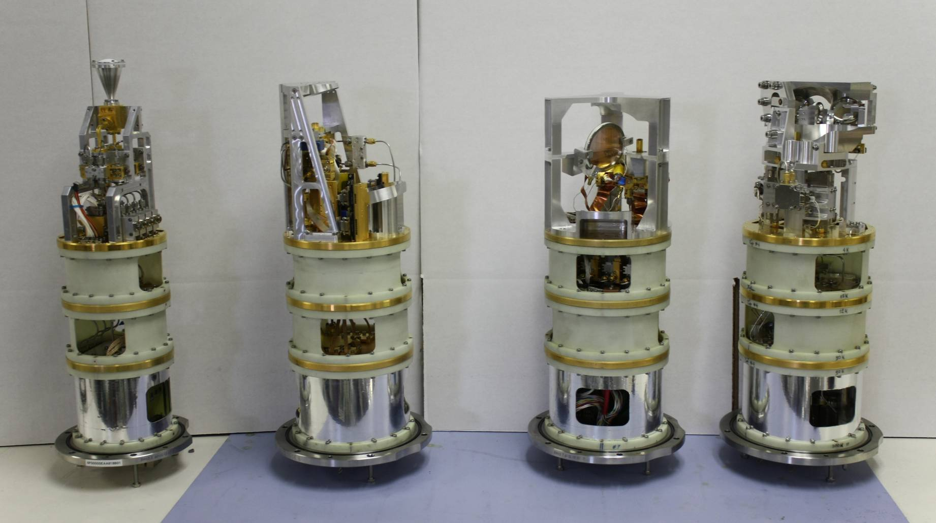
Bands 3 (84-116 GHz), 6 (211-275 GHz),
7 (275-373 GHz), and 9 (602-720 GHz)

Slide 25
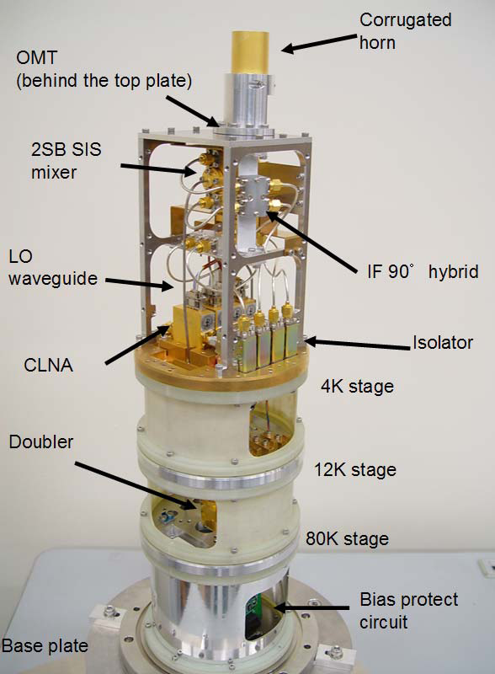
B4 & 8
Band 8, 385-500 GHz
(4K stage in test dewar)
Band 4, 125-169 GHz (qualification model)

Slide 26
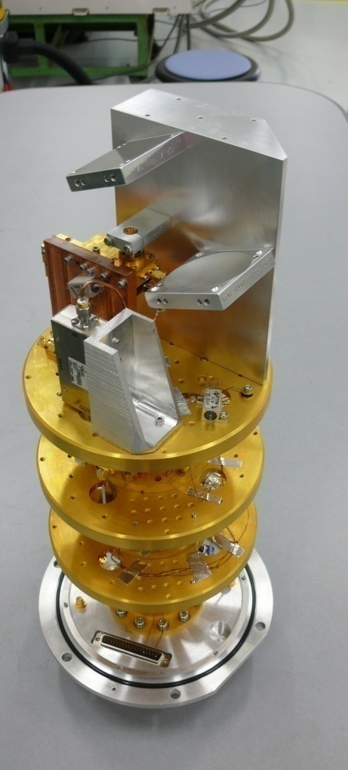
Band 10 Cartridge
Pre-prototype Cartridge (Engineering model)
  Successfully achieved the ALMA specifications!!

Slide 27
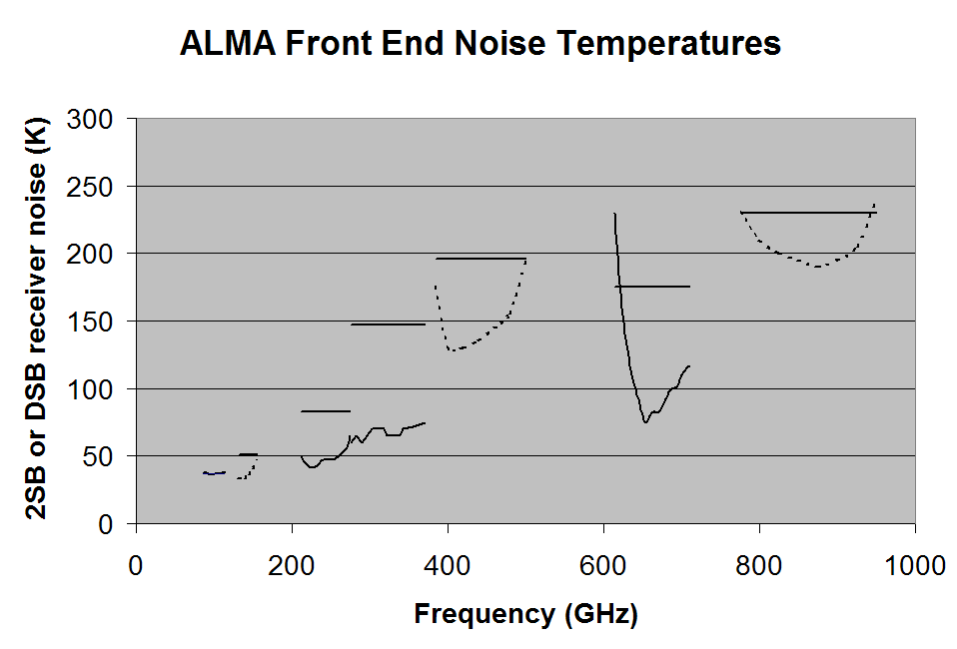
Typical results for Bands 3, 6, 7, and 9. Bands 4, 8, and 10 are in development (dashed lines). The horizontal lines are the specification which applies over 80% of the band. Above 600 GHz, mixers are DSB.

Slide 28
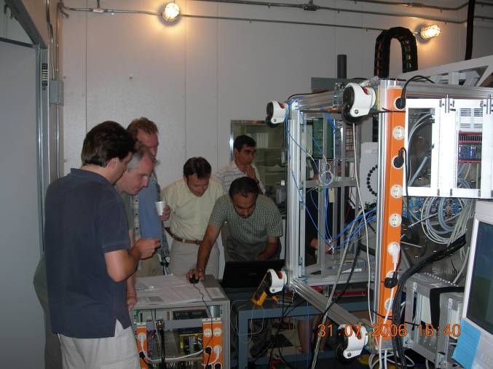
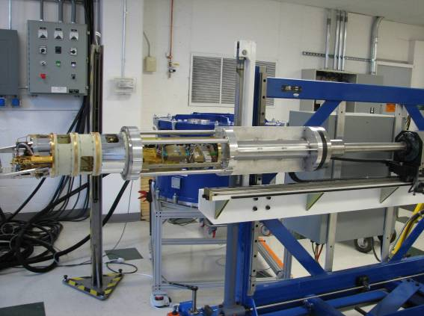
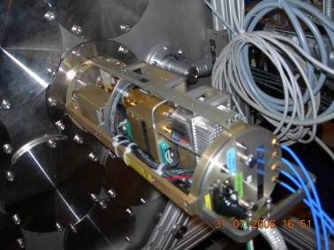
Three FE Integration Centers
Warm Optics
Warm Cartridge Assembly Band 3
(1st LO, Bias, M&C)
Band 3 Cartridge
Warm Cartridge Assembly Band 6
(1st LO, Bias, M&C)
Band 6 Cartridge
Warm Cartridge Assembly Band 7
(1st LO, Bias, M&C)
Band 7 Cartridge
Warm Cartridge Assembly Band 9
(1st LO, Bias, M&C)
Band 9 Cartridge
Cryostat
FE Assembly
FE M&C unit
Front end IF
Front end chassis

Slide 29
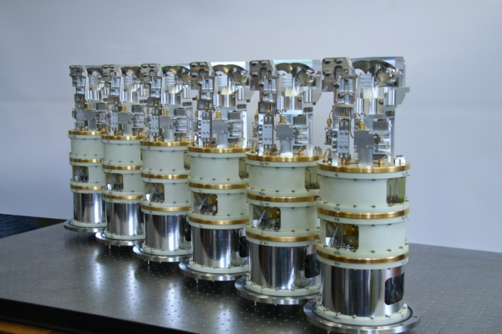
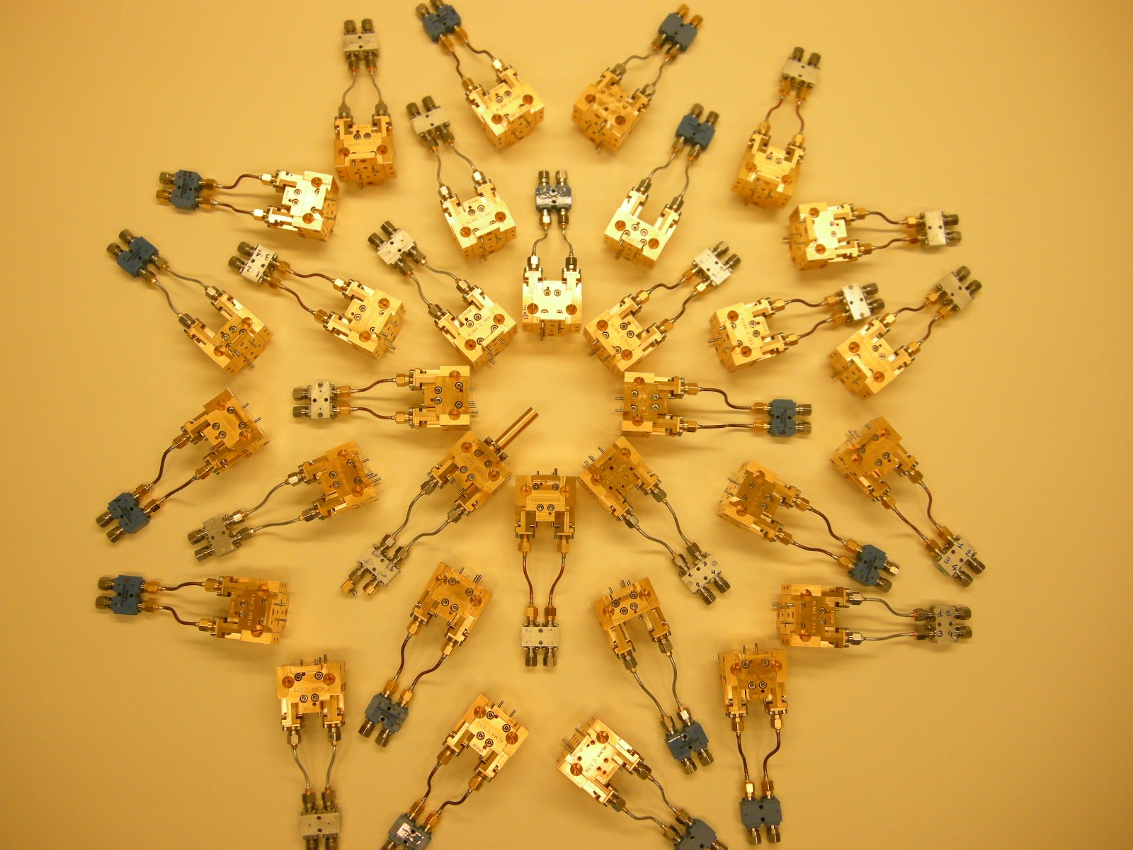
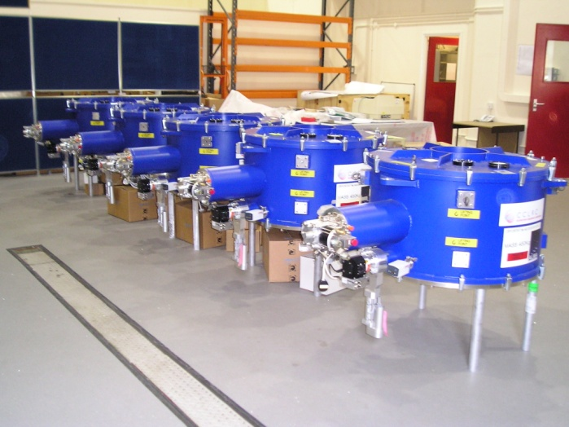

Slide 30
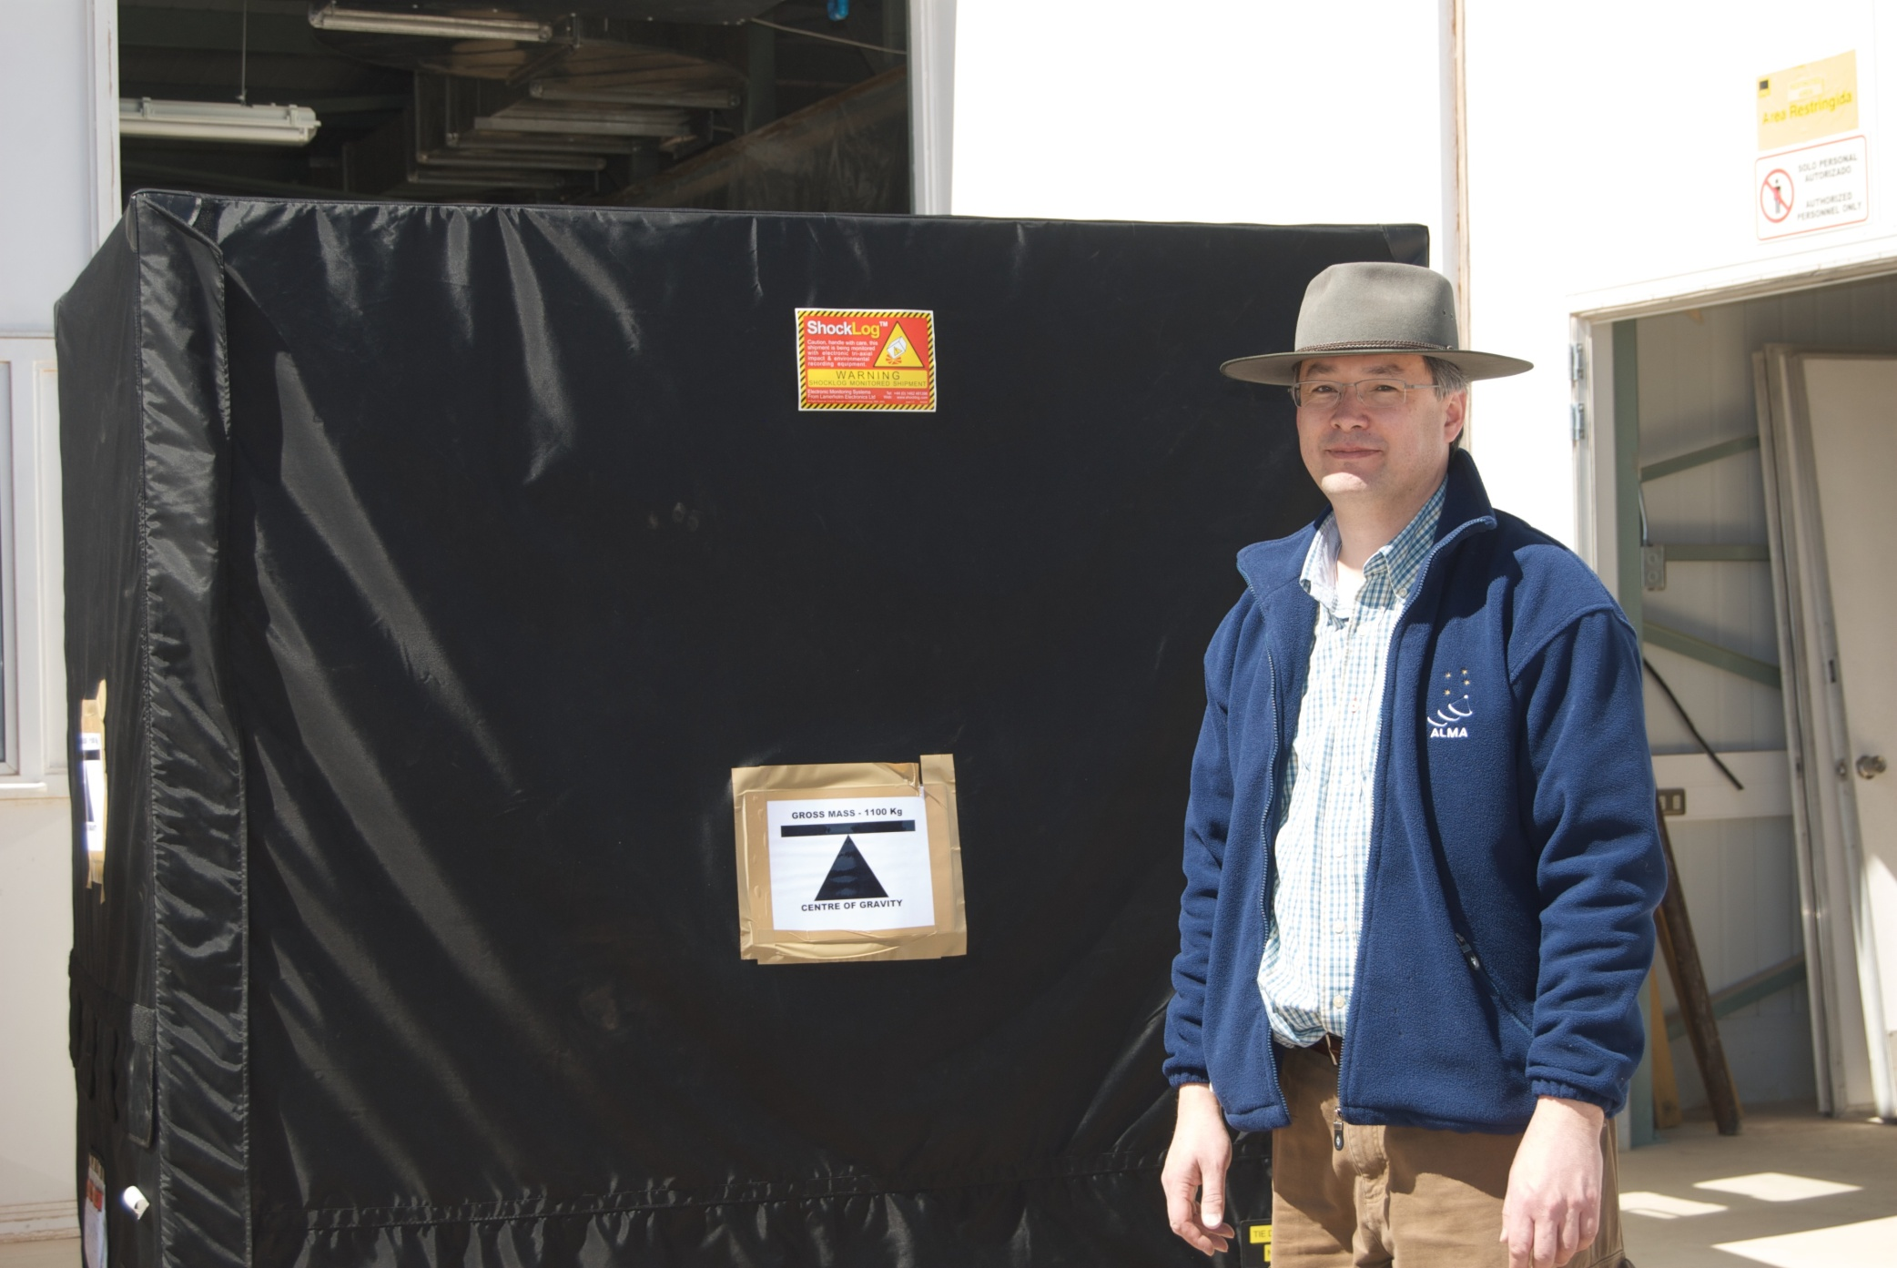
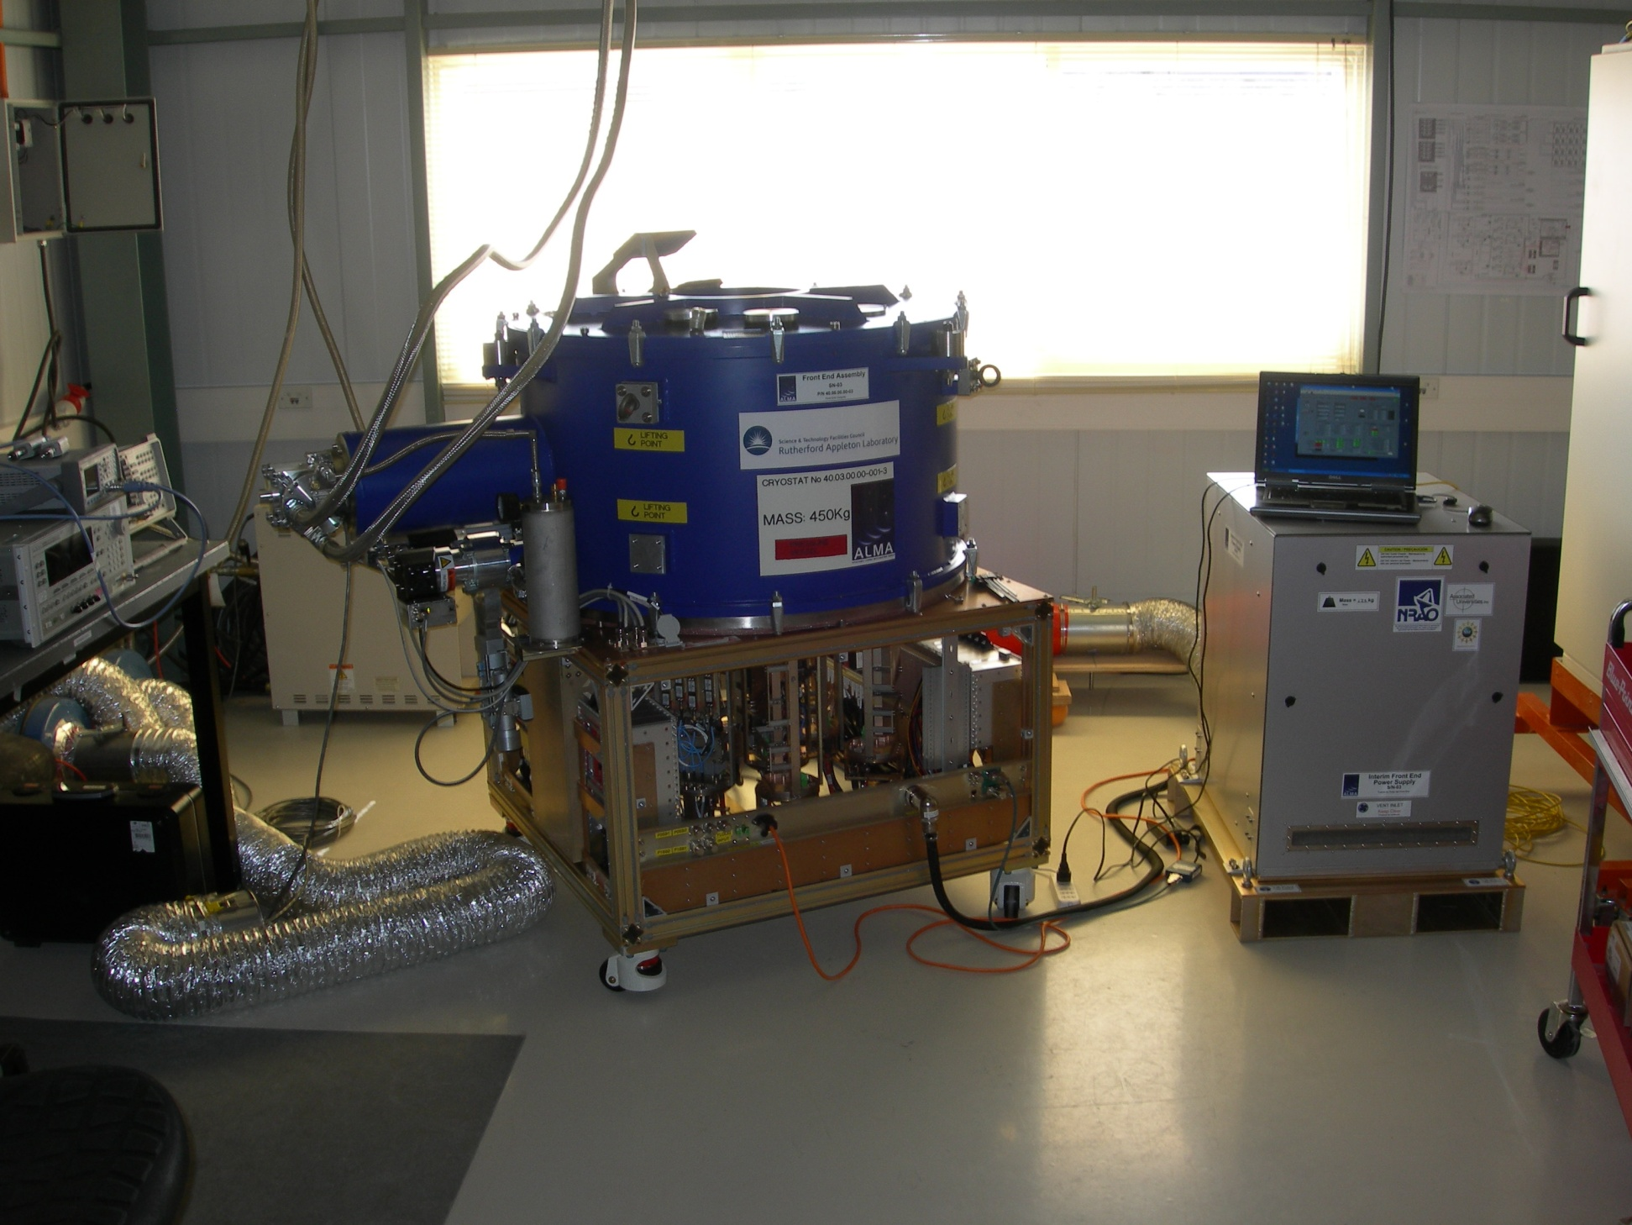
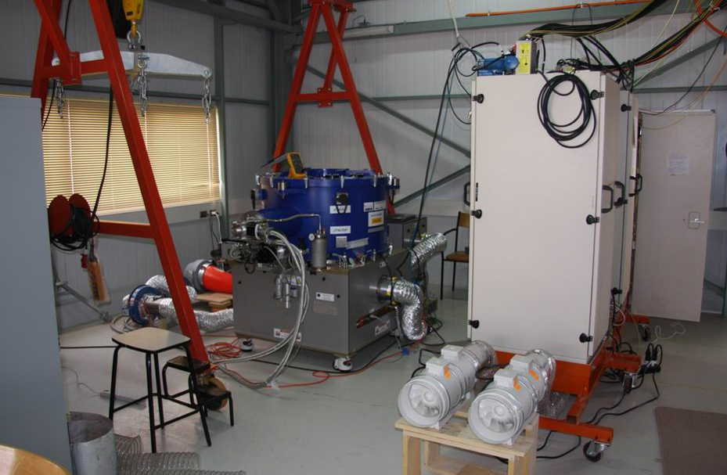
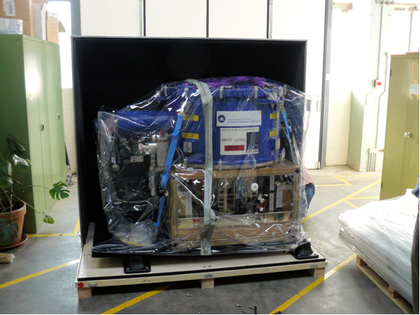
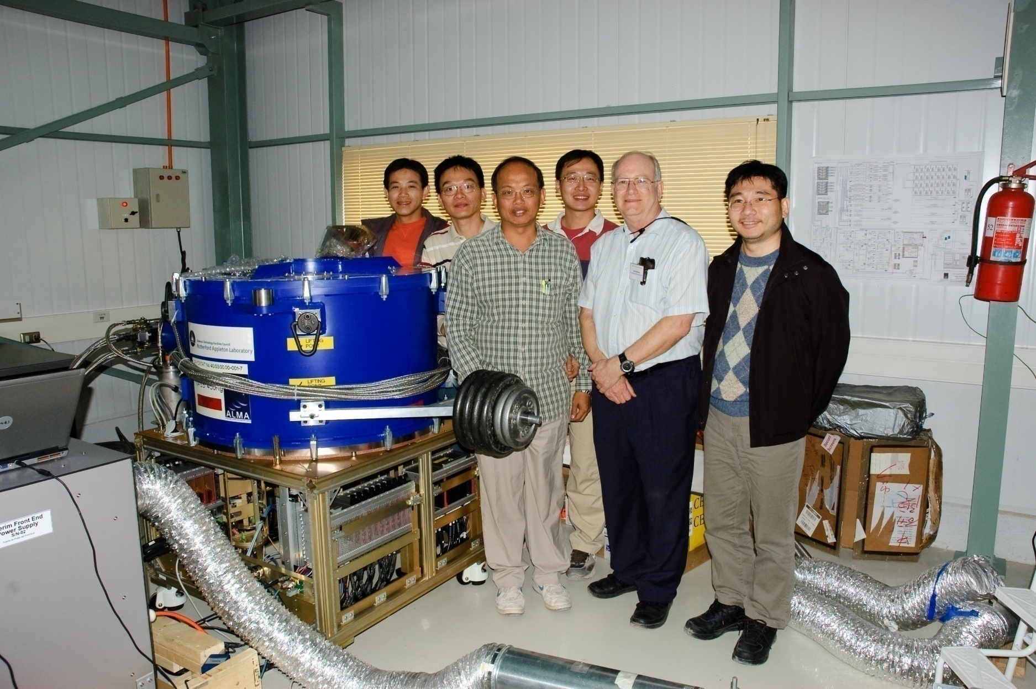
First of Three FE/BE under test at OSF

Slide 31
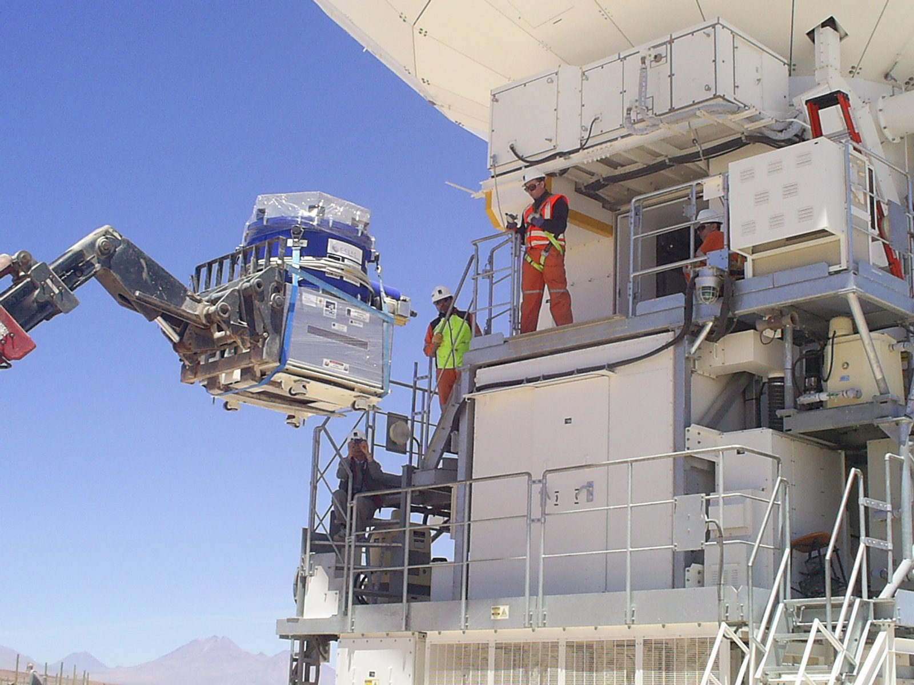

Slide 32
Requirements
Buildings/Roads/Foundations
3 Antennas
Transporter
3 Front Ends
3 Back Ends
LO
Correlator
Software
End to End Connectivity

Slide 33
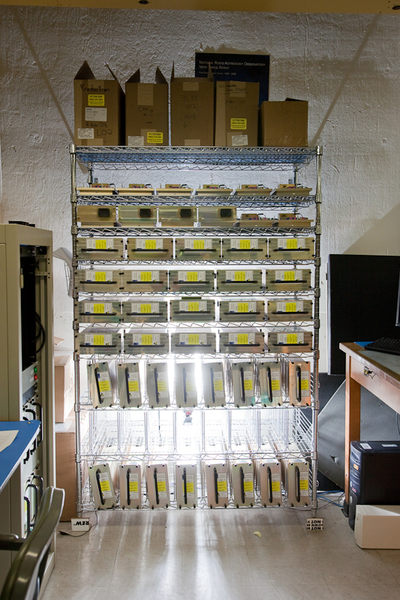
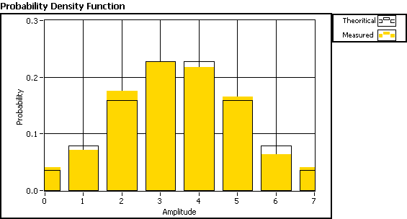
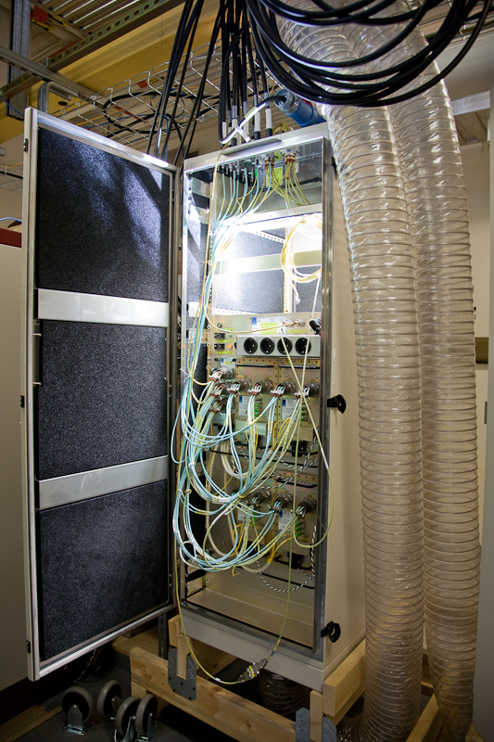
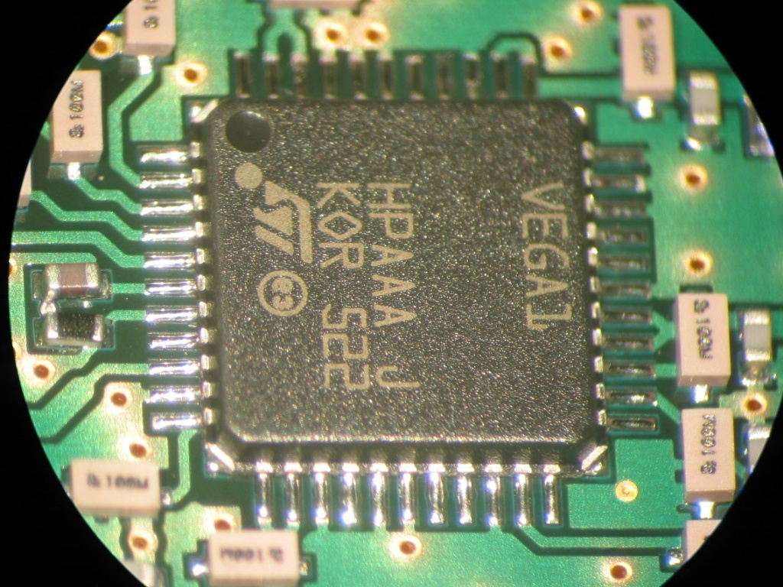



Back End Electronics
11 AAs already in Chile; 5 accepted
Production running smoothly

Slide 34
Requirements
Buildings/Roads/Foundations
3 Antennas
Transporter
3 Front Ends
3 Back Ends
LO
Correlator
Software
End to End Connectivity

Slide 35









BE Photonics
A complete 2 antenna test system is in Chile
16 element Central LO installed at AOS, finishing PAS.
LO reference distributed optically by using two lasers – master and slave – separated by ~100 GHz
EDFA Rack @ AOS-TB
Laser Synthesiszer
LLC & SAS
Patch Panel @ AOS

Slide 36
Requirements
Buildings/Roads/Foundations
3 Antennas
Transporter
3 Front Ends
3 Back Ends
LO
Correlator
Software
End to End Connectivity

Slide 37





Correlator
2 Antenna Correlator used at ATF, now installed at OSF
ACA correlator installed at AOS
Q1 and Q2 of the bilateral correlator at the AOS

Slide 38
Requirements
Buildings/Roads/Foundations
3 Antennas
Transporter
3 Front Ends
3 Back Ends
LO
Correlator
Software
End to End Connectivity

Slide 39
Software
Hugely important aspect of ALMA
Multiple levels from individual micros controlling devices, through the overall real-time control and data taking, on to data reduction and calibration and up to the broad issues of user support – proposal writing tools and the like
A very complete data reduction system, CASA, is now available for down-loading

Slide 40


Observing Tool

Slide 41


ATF
Sgr B2 Spectrum
97.9 GHz
Raster on Moon with Total Power detectors simultaneously on 2 antennas
Taken at ATF, not using production receivers, but verifying software for control, tuning, correlator and data reduction

Slide 42
Requirements
Buildings/Roads/Foundations
3 Antennas
Transporter
3 Front Ends
3 Back Ends
LO
Correlator
Software
End to End Connectivity

Slide 43



First Light!
Notes:
Update this….

Slide 44





AIV status
Antenna Surfaces set for optimum rigging angle
Melco & Vertex Antennas working in single dish mode
Beacon Interferometry established using holography tower

Slide 45


Next Steps
End April – Vertex 2 acceptance ☑
June – OSF fringes ☑
August – Central LO to the high site ✓
September – Antennas to the high site
December – Closure Phase
Start Astronomical Validation
20 months later start Early Science
Inauguration of 50-antenna array late 2012
Enhancement of ALMA through its operations phase with instrument development line

Slide 46

ALMA Phases
Construction now declining, Operations continuing rampup.
Continued Development was featured in the Ops Plan, reviewed by Intl Committee and by NSF Committee then adopted by Board.
No funding agency funds a ‘pig in a poke’, the character of development must be defined. This is up to the ALMA Board, now pondering.

Slide 47
Technical Specifications
50 12-m antennas, 12 7-m antennas, 4 TP 12m antennas at 5000 m altitude site.
  14 antennas ‘descoped’ during rebaselining. Only ~47 operational at a given time!
Surface accuracy ±25 μm, 0.6” reference pointing in 9m/s wind, 2” absolute pointing all-sky. First three antennas meet these; accurate to <±16 μm most conditions
Array configurations between 150m to ~15 -18km.
10 bands in 31-950 GHz + 183 GHz WVR. Only 7 included in construction phase.
84-116 GHz “3”
125-169 GHz “4”
163-211 GHz “5” 6 rx only, dual polzn
211-275 GHz “6”
275-373 GHz “7”
385-500 GHz “8”
602-720 GHz “9”
787-950 GHz “10” initially partially populated
8 GHz BW, dual polarization.
Flux sensitivity 0.2 mJy in 1 min at 345 GHz (median cond.).
Interferometry, mosaicing & total-power observing but no VLB capability
Correlator: 4096 channels/IF (multi-IF), full Stokes.
Data rate: 6MB/s average; peak 60 MB/s.
All data archived (raw + images), pipeline processing.

Slide 48
Specifications Breed Transformational Performance
With these specifications, ALMA improves
  Existing sensitivity, by about two orders of magnitude
    Best accessible site on Earth
    Highest performance receivers available
    Enormous collecting area (1.6 acres, or >6600 m²)
  Resolution, by nearly two orders of magnitude
    Not only is the site high and dry but it is big! 18km baselines or longer may be accommodated.
  Wavelength Coverage, by a factor of two or more
    Take advantage of the site by covering all atmospheric windows with >50% transmission above 30 GHz
  Bandwidth, by a factor of a few
    Correlator processes 16 GHz or 8 GHz times two polarizations
Scientific discovery parameter space is greatly expanded!

Slide 49
Development Possibilities
Throughput! Additional antennas
  Sensitivity
  Superior high resolution imaging
  Can be added to production line, purchased at 2005 price
VLBI capability: increased resolution
  Hardware modest cost, software should not be underestimated
  Breakthrough science: Sgr A* imaging
  Extremely sensitive element of SA array
Bandwidth increase of ~50%
  Build unimplemented Bands 1 (31.3-45 GHz) and 2 (67-90 GHz)
  Complete Band 5 (163-211 GHz)
  Consider implementation of ‘Band 11’ 1.26-1.56 THz

Slide 50

Eleven Years of Data
APEX July 2008
PWV < 200 μm for ~10% of time
Can be better in winter
Chajnantor: An Excellent Site for THz Astronomy
Data courtesy S. Radford

Slide 51
APEX
APEX is a slightly modified copy of the ALMA prototype built by Vertex.
It has operated on the ALMA site since 2005.
The surface is ~17 μm and has remained stable.
Observations have been published which were made in the 1.4 THz atmospheric window.
ALMA has an excellent and proven site for THz astronomy
ALMA has two prototype antennas; a copy of one is doing THz astronomy
    Bids now being considered for prototypes!
What are ALMA’s science goals and how do they drive development?

Slide 52

ALMA Bands and Transparency
7 Bands in Construction Project—3 ‘descoped’
B2
B4
B6
B7
B8
B9
B10
B1
B3
B5
‘B11’
0.5mm PWV ν<950 GHz 0.2mm PWV ν>950 GHz

Slide 53
Development Items for ALMA 2010-2020
Science clearly benefits from improving
  Throughput (collecting area, instantaneous bandwidth, uv coverage)
  Bandwidth (all accessible frequencies)
  Resolution
Proposal: First implement unfunded construction scope
  Unbuilt antennas (while production line remains open)
  Unbuilt receivers (and consider bands not contemplated prior)
  Unimplemented VLB capability
Many other possibilities
  ASAC Report
  Correlator upgrade
  Longer connected baselines
  Are any science goals endangered to whose realization development could contribute?

Slide 54

ASAC Recommendations

Slide 55
Science Goals
Detect CO or [C II] in 24 hrs in MW-type galaxy at z~3
Image protoplanetary disks
Image like HST

Slide 56

Science Goal I: Detect CO or C+ in MWG
Combes
At z=2 this can be done for both lines
At z=3 this becomes difficult for the CO line
But notice the ‘tall pole’ atomic lines in the THz region, including C⁺
C⁺
CO J=3-2
GBT

Slide 57

Science Goal I: Detect CO or C+ in MWG
Maiolino and Testi
Viable; depends on
exact redshift and transparency window lineup.
For MW galaxy, detection takes a few hours.
Note that other lines on the plot, from luminous galaxies in the local Universe, may be detected, some at very high z.
ALMA allows us to see the redshifted ‘tall pole’ THz lines to very high z.
ALMA could track the very creation of the Universe’s
‘metals’.

Slide 58



Birth of Stars and Planets
Evolutionary Sequence—
Molecular Cloud Core to Protostar (10⁴ yrs) to
Protoplanetary Disk (to ~10⁶ yrs) to
Debris Disk (to 10⁹ yrs)
GBT/Mustang Synergy
Lodato and Rice 2005
Wolf and D’Angelo 2005
M. Wyatt; R. Reid
25AU
5AU
160 AU
Vega Dust Disk
Notes:
Lodato and Rice 2005: April volume of MNRAS, 358, 1489: A massive star forming disk.
Wolf and D’Angelo 2005: \apj, 619, 1114
Vega: Wilner, D.~J., Holman, M.~J., Kuchner, M.~J., \& Ho, P.~T.~P.\ 2002, \apjl, 569, L115 Image Wyatt’s model simulated observation by ALMA

Slide 59
Highest Level Science Goals
Bilateral Agreement Annex B:
“ALMA’s third level-1 science requirement:
The ability to provide precise images at an angular resolution of 0.1". Here the term precise image means accurately representing the sky brightness at all points where the brightness is greater than 0.1% of the peak image brightness. This requirement applies to all sources visible to ALMA that transit at an elevation greater than 20 degrees. These requirements drive the technical specifications of ALMA. “

Slide 60
Imaging Ability
2005 NRC Panel:
  “Two of the Level-1 science goals, involving sensitivity and high-contrast imaging of protostellar disks, will not be met with either a 40- or a 50-antenna array. It is not clear if the third requirement, on dynamic range, can be met with a 40-antenna array even if extremely long integrations are allowed for.
  “Speed, image fidelity, mosaicing ability,2 and point-source sensitivity will all be affected if the ALMA array is descoped. The severest degradation is in image fidelity, which will be reduced by factors of 2 and 3 with descopes to 50 and 40 antennas, respectively.
  “Despite not achieving the level-1 requirements, a descoped array with 50 or 40 antennas would still be capable of producing transformational results, particularly in advancing understanding of the youngest galaxies in the universe, how the majority of galaxies evolved, and the structure of protoplanetary disks, and would warrant continued support by the United States.”
Holdaway memo ‘Image Quality as a Function of the Number of Antennas in ALMA’
Notes:
1Although the plan is to construct 64 antennas, only 60 will be operational
at any one time. Likewise the committee assumes that 50- and 40-antenna
arrays will require the construction of 54 and 44 antennas, respectively.
Copyright © National Academy of Sciences. All rights reserved.
The Atacama Large Millimeter Array (ALMA): Implications of a Potential Descope
http://www.nap.edu/catalog/11326.html
2 The Atacama Large Millimeter Array

Slide 61
How many Antennas?
NRC Committee: At least 54, 50 operating.
Holdaway: We perform simulations of ALMA data for array configurations with the number of antennas (Na) ranging from 40, 43, 46, 50, and 56, adding only thermal noise. For very high SNR observations (ie, 10000:1), the dynamic range shows a strong dependence upon N a, with 56 antennas yielding far superior images to 40 antennas. For high SNR (ie, 3000:1), the dynamic range shows only a modest dependence on N a, and at 1000:1 SNR and below, all arrays are basically able to achieve the theoretical dynamic range. However, even though all configurations seem to be able to achieve thermal noise limited imaging from the perspective of dynamic range, configurations with fewer antennas provide image reconstructions with on-source errors which are far from the theoretical maximum. For these simulations, the 56 element configuration produces images which have nearly thermal noise limited fidelity up to the very highest SNR, where at last deconvolution errors begin to limit the image quality instead of thermal noise.
Conclusion: 4-7 additional antennas could enable meeting goals 2 and 3.

Slide 62
Summary of Enhanced ALMA2020+

Slide 63
31-45 GHz Astronomy
Redshifted CO lines
Sunyaev-Zeldovich Effect
Excellent probe of very dense dust disks
debris disks
chemistry of heavy organic species, carbon-chains, anions
free-free emission from jets/outflows
measuring B-field using Zeeman effect (CCS)
spinning dust grains
dust chemistry in AGB envelopes
masers

Slide 64
67-94 GHz Astronomy
67-94 GHz: Resonance lines of abundant molecules
  HCO⁺, HCN, HNC, N₂H⁺, H₂CO
Resonance lines of their deuterium isotopomers
  DCO⁺, DCN, DNC, N₂D⁺, NH₂D, NHD₂, HDO, CH₂D⁺
Underutilized band but rx technology straightforward
Excellent probe of very dense dust disks
Comets--PD zone often resolved, no missing flux.
Redshifted CO, near and far
Notes:
For example: Depletion in dense cores
Only occurs where density above ~10^6 and low temperatures
e.g. IRAM04191@140pc--central 'hole' in N2H+ ~16"
difficult for current interferometer beams, ideal for GBT
HCO+ hole probably somewhat larger but too large for interferometric imaging, difficult for SD.

Slide 65
Extragalactic Targets
Redshifted CO (including Milky Way at z~3)
LIRGs 0.2<z<0.7
  L_{IR}~5 L_{IR}(MW) ⇒L(CO)₁₋₀~5 L(CO)_{1-0, MW}
  T_{sys}~250K SSB; Jy/K~0.8
  1σ 8 hrs 1mK 75 km/s (10μK km/s)
  Could probably measure CO in ~two dozen MIPS-detected LIRGS in HDF falling in this redshift range
  ‘Age’ 7.4-11.3 Gyr; Scale 24-50 kpc/beam
Sunyaev-Zeldovich Effect
Notes:
Should include HCN

Slide 66

Examples
MIPS4644, z=0.67
Note ALMA synthesized beam
Notes:
Nine similar objects in this redshift range in the MIPS/UDF survey.
I_{CO} ~ 0.16 Kkm/s (est)

Slide 67

Examples
MIPS15942, z=0.44
Notes:
I_{CO} ~ 0.4 Kkm/s (est)

Slide 68
CO to z~.55
Z=.44

Slide 69

Band 5 (163-211 GHz)
Water! High resolution Herschel followup
Redshifted CO and z~10 C⁺
Maiolino and Testi

Slide 70

Inverse K-correction, or magic of the submillimeter
As galaxies get redshifted into the ALMA bands, dimming due to distance is offset by the brighter part of the spectrum being redshifted in. Hence, galaxies remain at relatively similar brightness out to high distances. But first stars formed z~10…spectra differed.
Super M82 from ISO, Beelen and Cox
10
11

Slide 71


‘Band 11’: Creation of the Metals
When chemistry got interesting
(H₃⁺, H₂D⁺, H₂, HD notwithstanding)
ALMA should be able to monitor the creation of
O ([O I], [O III], OH, H₂O)
C ([C I], [C II], CO, CH, CH⁺,¹³C)
N ([N II], NH, N₂H⁺)
Notes:
Other carbon carriers than [C II] will also be detectable by ALMA, including [C I], CO, CH and CH+. Strong atomic oxygen lines occur at 63 and 145 ([O I]) and 52 and 88 ([O III]) microns; these lines may be detected in several hour integration times to redshift which reach the near edge of cosmic reionization. Together with OH and H2O lines detectable at moderate redshift, these lines chronicle the production of metals over the course of the history of their creation. The metals also form dust, of course. Thermal dust emission provides an essentially distance-independent means of measuring galaxies to z10 owing to the inverse K correction.

Slide 72
Opening Up the Dark Side of Reionization
After R. Barkana
Notes:
Evolution proceeds from right to left. Following recombination, the Dark Ages stretch
from z ~1,000 to ~100. The first Population III stars are currently believed to have formed
around redshift z ~ 20, or even earlier. Yellow is the region where most of the hydrogen is
ionized. Dark matter concentrations shown in red, blue and green, respectively, denote
concentrations with sizes 0.1, 1, and 200 kpc. FIR/SMM observations will contribute to our
understanding of most of these evolutionary phases. (After R. Barkana.(6))

Slide 73
J1148+52: A Paradigm Distant Monster Galaxy
An early (z=6.42; 0.8Gyr) massive and extended region of tremendous star formation observed by IRAM
~1000 M_{sun}/yr/kpc²
Region ~750 pc radius
Similar to Arp220 but 100 times larger
Mass ~2 10¹⁰ M_{sun}
Walter et al 2009

Slide 74


J1148+5251: an EoR paradigm with ALMA
CO J=6-5
Wrong declination (though ideal for Green Bank)! But…
High sensitivity
12hr 1s 0.2mJy
Wide bandwidth
3mm, 2 x 4 GHz IF
Default ‘continuum’ mode
Top: USB, 94.8 GHz
CO 6-5; HCN 8-7; HCO+ 8-7; H₂CO lines
Lower: LSB, 86.8 GHz
HNC 7-6; H₂CO lines; C¹⁸O 6-5
H₂O 658GHz maser?
Secure redshifts
Molecular astrophysics
ALMA could observe CO-luminous galaxies
(e.g. M51) at z~6.
Notes:
If one placed CO 6-5 in the LSB, one would get the 211-202 line of H2O and the 7-6 line of 13CO, in addition to several H2CO lines, in the USB.

Slide 75


ALMA into the EoR
Spectral simulation of J1148+5251
Detect dust emission in 1sec (5σ) at 250 GHz
Detect multiple lines, molecules per band => detailed astrochemistry
Image dust and gas at sub-kpc resolution – gas dynamics! CO map at 0”.15 resolution in 1.5 hours
CO
HCO+
HCN
CCH
[C II]: 60sec (10σ) at 256 GHz
[O I] 63 µm at 641 GHz
[O I] 145 µm at 277 GHz
[O III] 88 µm at 457 GHz
[N II] 122 µm at 332 GHz
[N II] 205 µm at 197 GHz
HD 112 µm at 361 GHz
Notes:
If one placed CO 6-5 in the LSB, one would get the 211-202 line of H2O and the 7-6 line of 13CO, in addition to several H2CO lines, in the USB.

Slide 76

Bandwidth Compression
Nearly a whole band scan in one spectrum
LSB
USB
Schilke et al. (2000)
Notes:
Did I draw this right? Shouldn’t there be two 4*(1+z) windowd with an 8*(1+z) hole in the center?

Slide 77

J1148: A possible (not from Chajnantor!) H₂ observation
An early (z=6.42; 0.8Gyr) massive and exteded region of tremendous star formation
~1000 M_{sun}/yr/kpc²
Region ~750 pc radius
Similar to Arp220 but 100 times larger
Mass ~2 10¹⁰ M_{sun}

Slide 78
Dark Side of Reionization
ALMA 1 hr, 5σ, 300 km/s
Single to score of clouds of
10⁸M_{sun}
B11
B10
After Appleton et al 2009
Notes:
H2 (T=200K) and Fine-Structure Line flux predictions for single(11) and multiple cloud condensation of
10⁸M_{sun} . The lower band shows the fainter predictions for H2 after metal pollution and the upper band shows the
stronger emission expected from fine structure lines. These lines will be spread throughout the far-IR and submm
for high redshift emission. We assumed a ΛCDM cosmology (ΩL=0.7, Ωm=0.3, H0=70).

Slide 79
VLB Capability
ALMA as a very sensitive node in a breakthrough array could enable:
  Imaging of the Black Hole at the center of our Galaxy
  Few 10 microarcsec resolution
  Include with sensitive elements elsewhere:
    GBT 3mm and below
    LMT to 345 GHz
    CARMA, SMA, JCMT, CSO
Element of SA Array (~1 milliarcsec resolution)
  ALMA Prototypes on high Argentine peaks (Brazil-Argentina proposal)
    Several tens milliarcsec astrometry characterizes exosolar planets
    Stellar photospheres resolved with beams much below 1 milliarcsec
    Measure motions of galactic masers
    High resolution observations of extragalactic megamasers (compare with VLBA project)
  Resited SMA (Sairecabur?)
  CCAT (short baseline)

Slide 80

ALMA is nearly here!
D. Barkats
The Atacama Large Millimeter/submillimeter Array (ALMA), an international astronomy facility, is a partnership of Europe, North America and Eas cooperation with the Republic of Chile. ALMA is funded in Europe by the European Organization for Astronomical Research in the Southern Hemisphere (ESO), in North America by the U.S. National Science Foundation (NSF) in cooperation with the National Research Council of Canada (NRC) and the National Science Council of Taiwan (NSC) and in East Asia by the National Institutes of Natural Sciences (NINS) of Japan in cooperation with the Academia Sinica (AS) in Taiwan. ALMA construction and operations are led on behalf of Europe by ESO, on behalf of North America by the National Radio Astronomy Observatory (NRAO), which is managed by Associated Universities, Inc. (AUI) and on behalf of East Asia by the National Astronomical Observatory of Japan (NAOJ). The Joint ALMA Observatory (JAO) provides the unified leadership and management of the construction, commissioning and operation of ALMA.

Slide 81
Major Scientific Milestones
1. Start of Scientific Commissioning
2. Start of Early Science
3. Inauguration
4. Completion of Construction
The schedule for these is as follows:
1. At the beginning of 2010
2. Second half of 2011
3. Late 2012
4. In 2013

Slide 82
Start of Scientific Commissioning
Three antennas operational on the high site
Front-ends containing at least bands 3,6,7 & 9
Cal units with hot and ambient loads
Complete BE and phase stable¹ LO system
Correlator able to process three inputs
Fringes and phase closure demonstrated
Software for basic operations and data reduction
Note that several important but not absolutely vital items have been left out here: e.g. water vapour radiometers and solar filters. Other items might not be the final versions, e.g. calibration loads, FE power supplies, or not completely characterized, e.g. FE’s.
¹ The requirement set here is 1 radian of phase at 300GHz in 30 minutes.

Slide 83
Start of Early Science
A) Minimum Requirements
• At least sixteen 12m antennas fully commissioned with at least 3 receiver bands available on all antennas.
• Synthesis mapping of single fields.
• Sufficient antenna stations to provide a range of configurations covering the shortest spacings and out to at least 250 m.
• A basic set of spectral modes as previously selected by ASAC.
• Calibration of all the above to a level comparable with existing millimetre-wave arrays – requires hot/ambient loads and WVRs.
• Software to support users’ applications, the preparation and execution of observations and off-line data reduction.
• After taking account of the time lost due to bad weather, power outages, equipment failures and the time needed for engineering work, at least 33% of the remaining time should be available for the Early Science observations.

Slide 84
Start of Early Science (continued)
The following criteria are to be considered as goals. The project will endeavour to achieve them, but Early Science can start without this. A readiness review will decide which of these capabilities should be announced as being available in the Call for Early Science Proposals.
B) Goals
• Receiver bands 3, 6, 7, and 9 available on all antennas plus bands 4 and 8 on as many antennas as we can manage.
• Synthesis mapping of extended fields using pointed mosaic mode.
• Configurations extending to baselines of 1km
• Linear and circular polarization of compact sources.
• Single-dish mapping of extended objects in both continuum and spectral line modes including on-the-fly observing.
• Calibration better than existing mm-wave arrays
Commissioning activities continue after the start of Early Science, which requires simultaneous operation with at least 2 sub-arrays.

Slide 85
“Inauguration”
This will mark the point at which ALMA has qualitatively reached its full capabilities, although not all of the antennas will be completely kitted out by this stage. We expect that the facility will be scheduled for scientific observations for about 75% of the time at this point.
Requirements
• Regular operation with ≥ 50 fully-equipped1 antennas. (This includes both 12m and 7m antennas.)
• All antenna stations complete, providing synthesis mapping with high fidelity using the full set of array configurations.
• Simultaneous operation of ≥ 4 subarrays possible.
Fully-equipped means a minimum of four receiver bands – typically bands 3, 6, 7, and 9 plus some of 4, 8 and 10, plus a full set of electronics, radiometers and calibration devices.

Slide 86
Inauguration Requirements (continued)
• Capability for combining data from the12m array with data from the ACA including “zero-spacing” data, and multi-configuration images
• Linear and circular polarization, including mosaicing of sources that are larger than the primary beam.
• High time resolution observations, e.g. of solar flares.
• All major software systems available and working in a way that allows astronomers who are not synthesis experts to use ALMA1.
• Accurate calibration of all the above.
The goals set for the calibration of ALMA data are very stringent and we may not achieve all of them by this point, but we must be doing a lot better than is currently achieved at these wavelengths. Some capabilities will still be under development at this stage – e.g. on-the-fly aperture-synthesis mosaics, high-precision polarization maps of extended sources, and some of the less popular correlator modes .
1At this stage ALMA staff will still be performing a lot of the data verification but the users will receive the images ready for analysis & interpretation.

Slide 87
Completion of Construction
• By definition this occurs when all the items defined in the current baseline have been delivered and accepted.
• This should clearly include a full sets of spare components and resolution of substantial non-conformities in the performance of all major components and sub-systems.
For practical reasons it may be necessary to exclude some items from this so that the construction effort can be wound up at an appropriate time. The most obvious case is the final deliveries of the band 10 cartridges, which were only recently given approval.

Slide 88
First Call for Proposals
This will go out when we have progressed far enough with the integration and commissioning to be confident that we will be ready for the Start of Early Science in 8 months time.
The deadline for these proposals will be 2 months after the call, allowing 6 months for assessment and for the preparation of the detailed observing plans.
After this we will move on to a regular cycle of calls for proposals, each of which will include a description of the capabilities that are expected to be available in the relevant observing period.

Slide 89

Second-level Scientific Milestones

