Slide 1
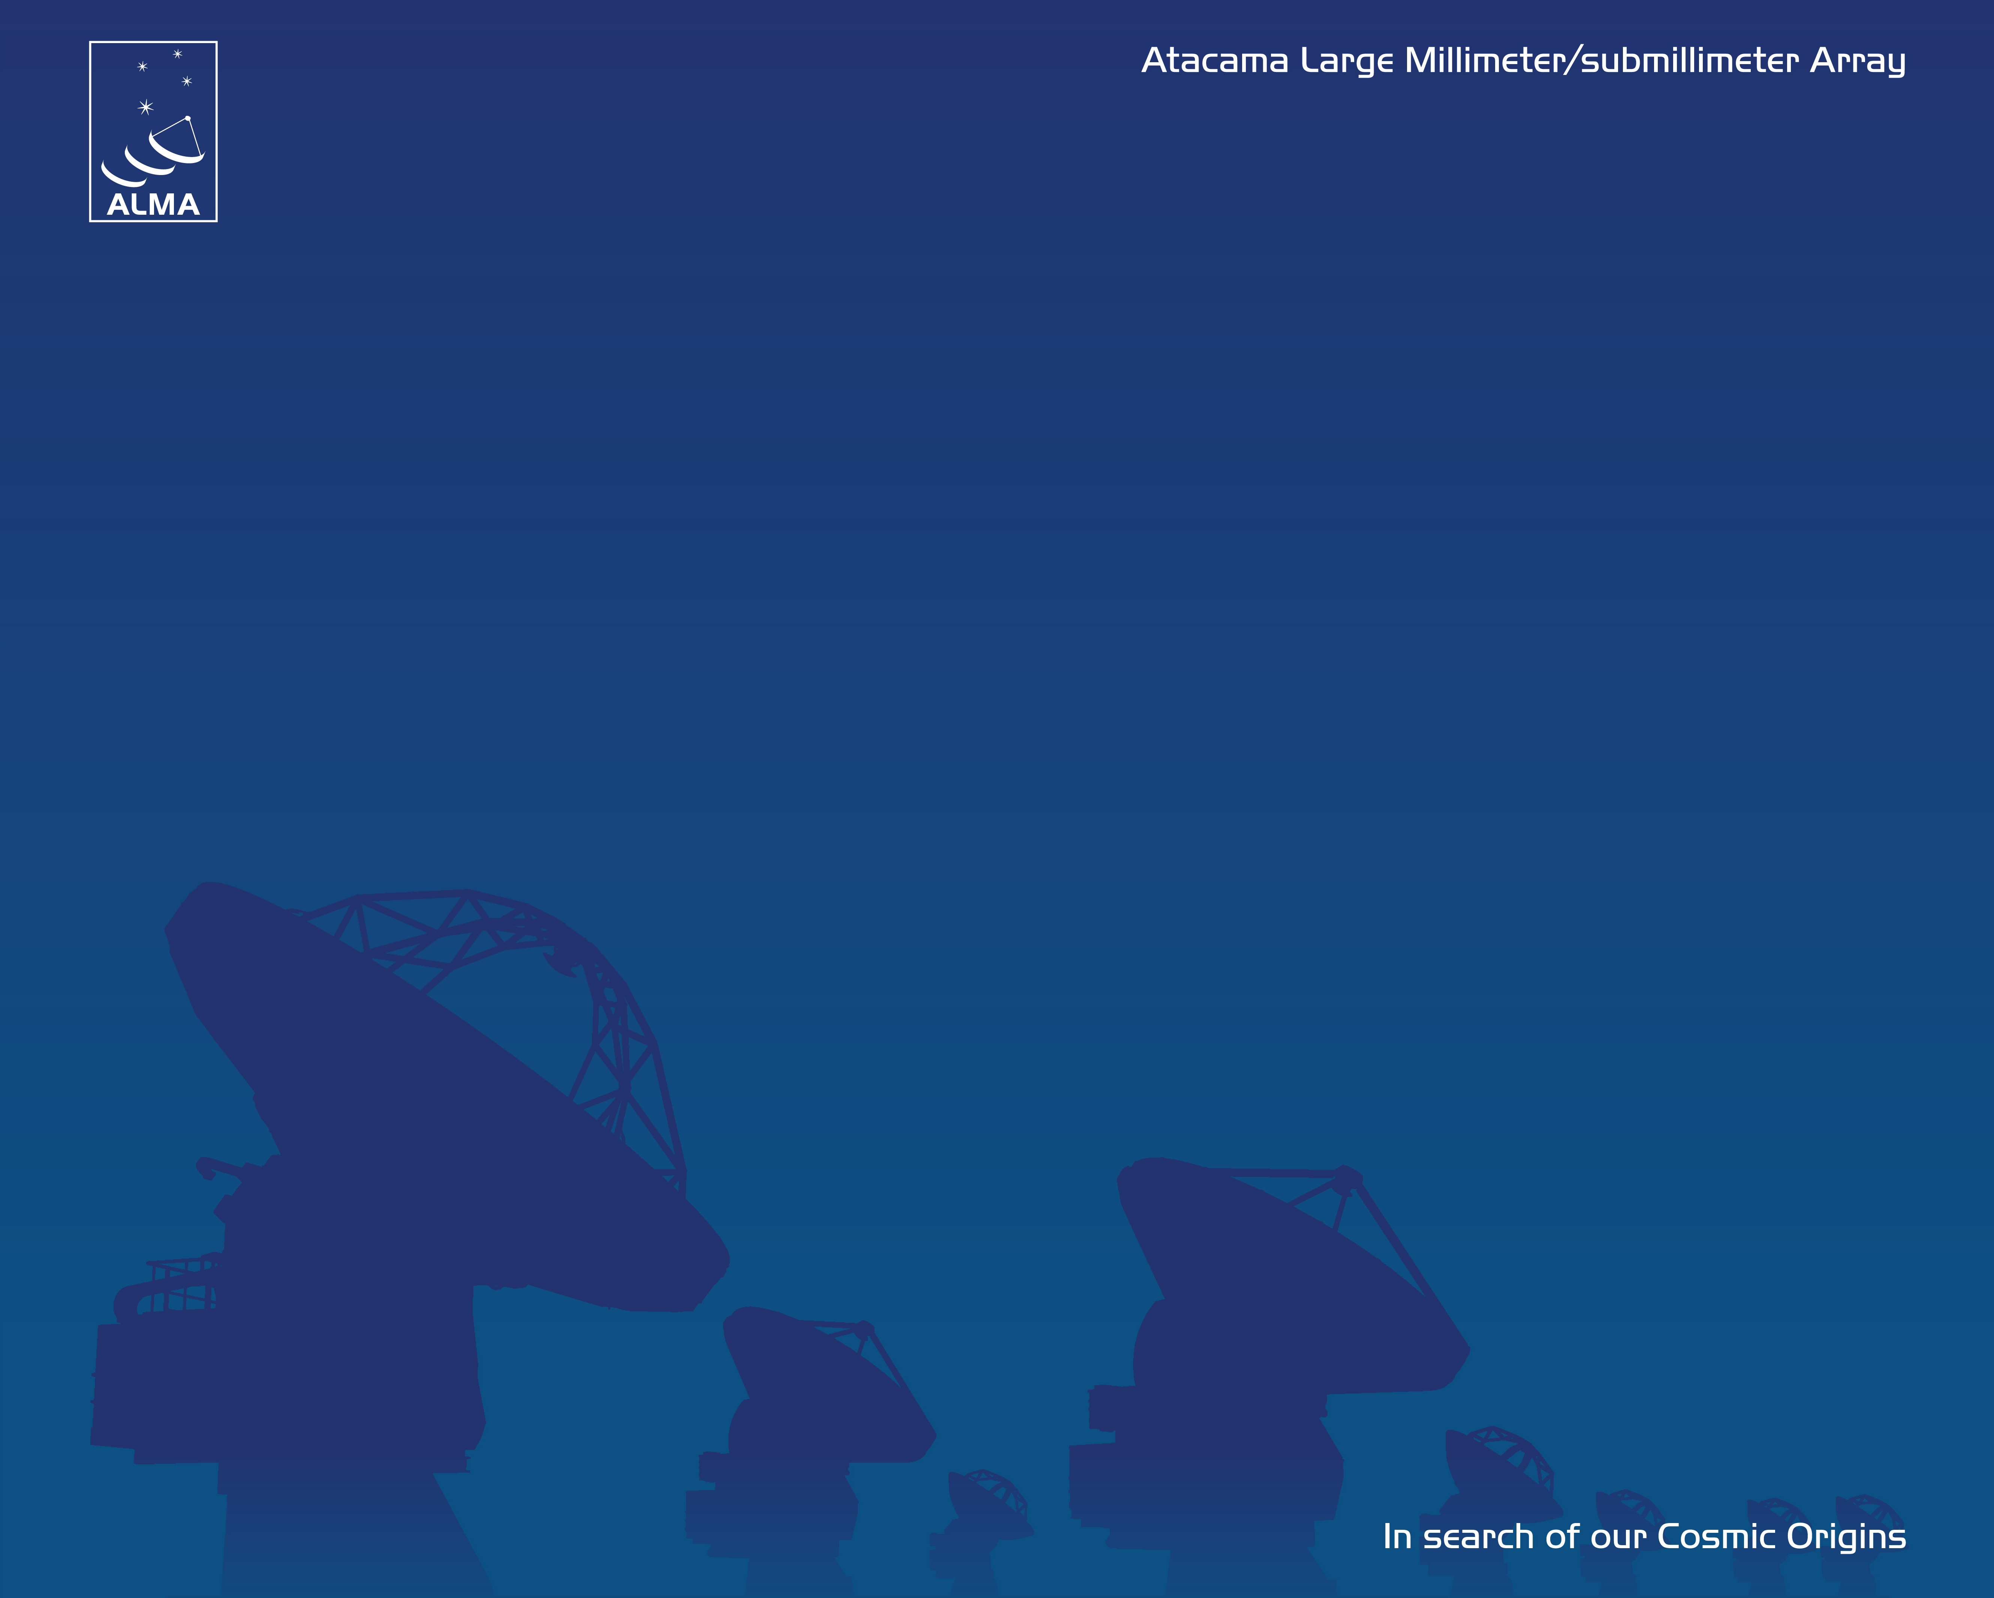



ALMA: The March to Early Science
Al Wootten, ALMA/NA Project Scientist
Notes:
In the 1970’s, the world’s best microwave diodes were fabricated of GaAs by Robert Mattauch in the
University of Virginia Engineering School, and he and Bascom collaborated to develop
superconducting tunnel junction diodes. These diodes have replaced GaAs diodes when the
ultimate sensitivity is required, and this work has been carried on by Arthur Lichtenberger in the
University of Virginia Engineering School. University of Virginia diodes can now be found in
radio telescopes around the world. Bascom, Robert Mattauch, Arthur Lichtenberger, and Tom Crowe have made enormous
progress in the development of sources and receivers operating at frequencies up to 1 THz.

Slide 2
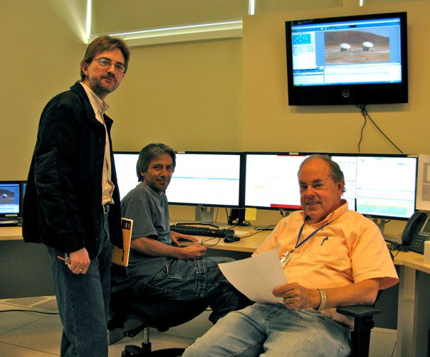
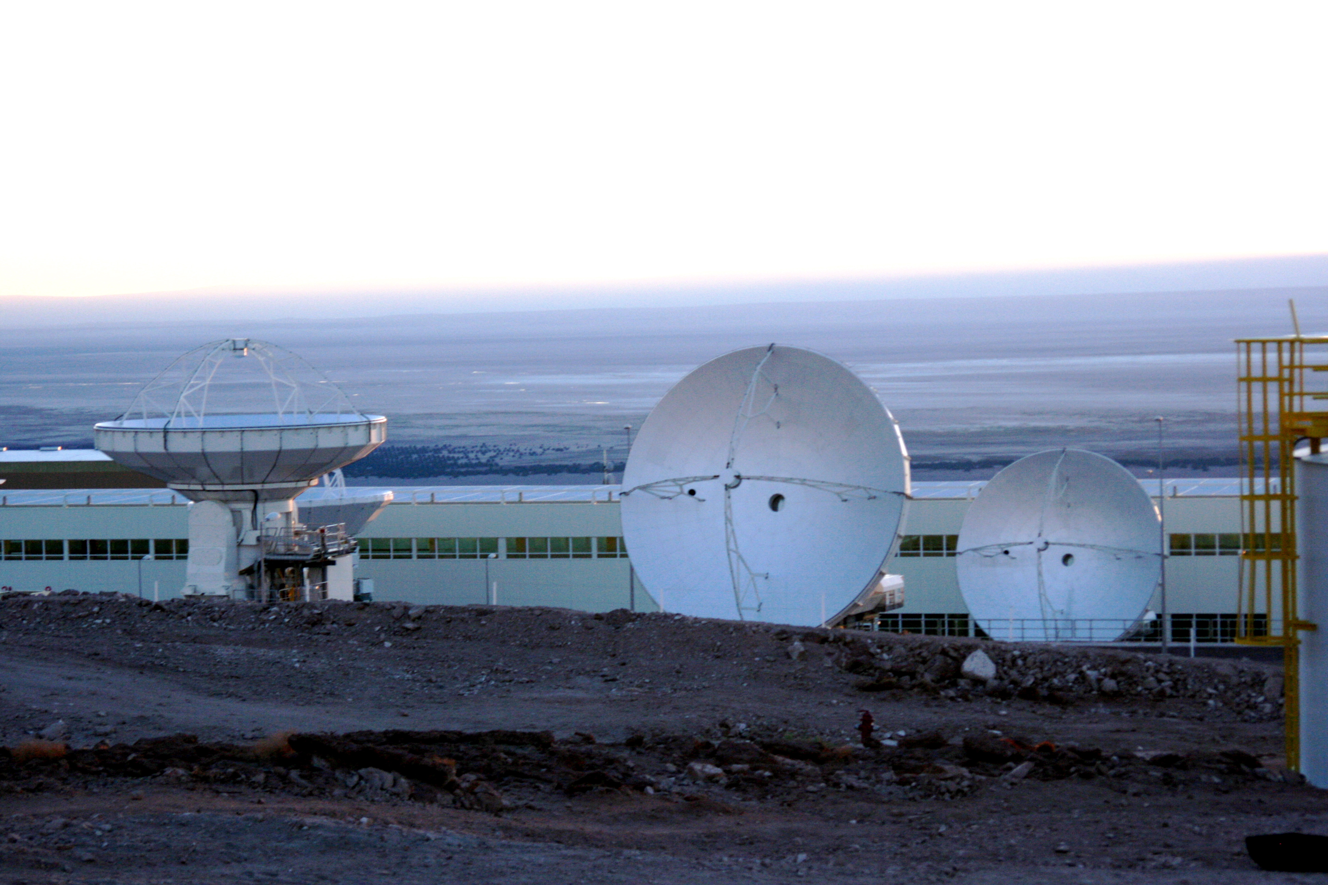
The push to Early Science…
ALMA is pushing to issue a Call for Early Science Proposals around the end of this year
This target is a key driver for the entire project at the moment
To achieve this requires all of the necessary infrastructure and equipment to be in place and tested
This activity is being masterminded by the ALMA CSV team, led by Richard Hills and Alison Peck
The path to the Early Science phase began with the beginning of Commissioning on 2010 January 22.

Slide 3
Early Science Requirements
16 Antennas
Front Ends
Stations for Configurations out to 250m
Synthesis Imaging of Single Fields
Basic Correlator Modes suggested by ASAC
Calibration to a level achieved by current millimeter arrays
  Amplitude calibration using multiple-temperature loads
  Phase calibration including water vapor radiometry
Software
  Observation preparation
  Observation execution
  Observation reduction
End to End Connectivity and stability

Slide 4
Early Science Requirements
16 Antennas
Synthesis Imaging of Single Fields
Stations for Configurations out to 250m
Basic Correlator Modes suggested by ASAC
Calibration to a level achieved by current millimeter arrays
  Amplitude calibration using multiple-temperature loads
  Phase calibration including water vapor radiometry
Software
  Observation preparation
  Observation execution
  Observation reduction
End to End Connectivity and stability

Slide 5
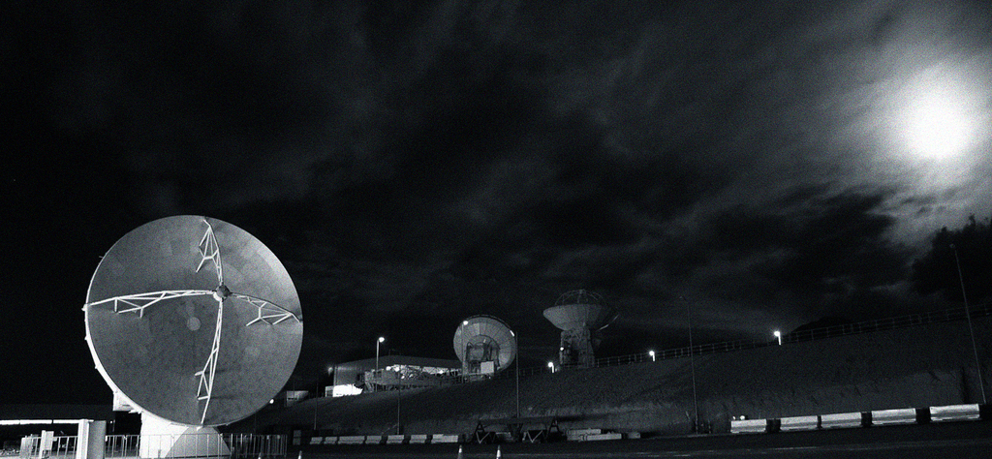
Antennas
ALMA has accepted nine antennas conditionally
  3-4 at AOS in CSV
  6-5 at OSF in AIV
  Twenty in various stages in contractor’s camps

Slide 6
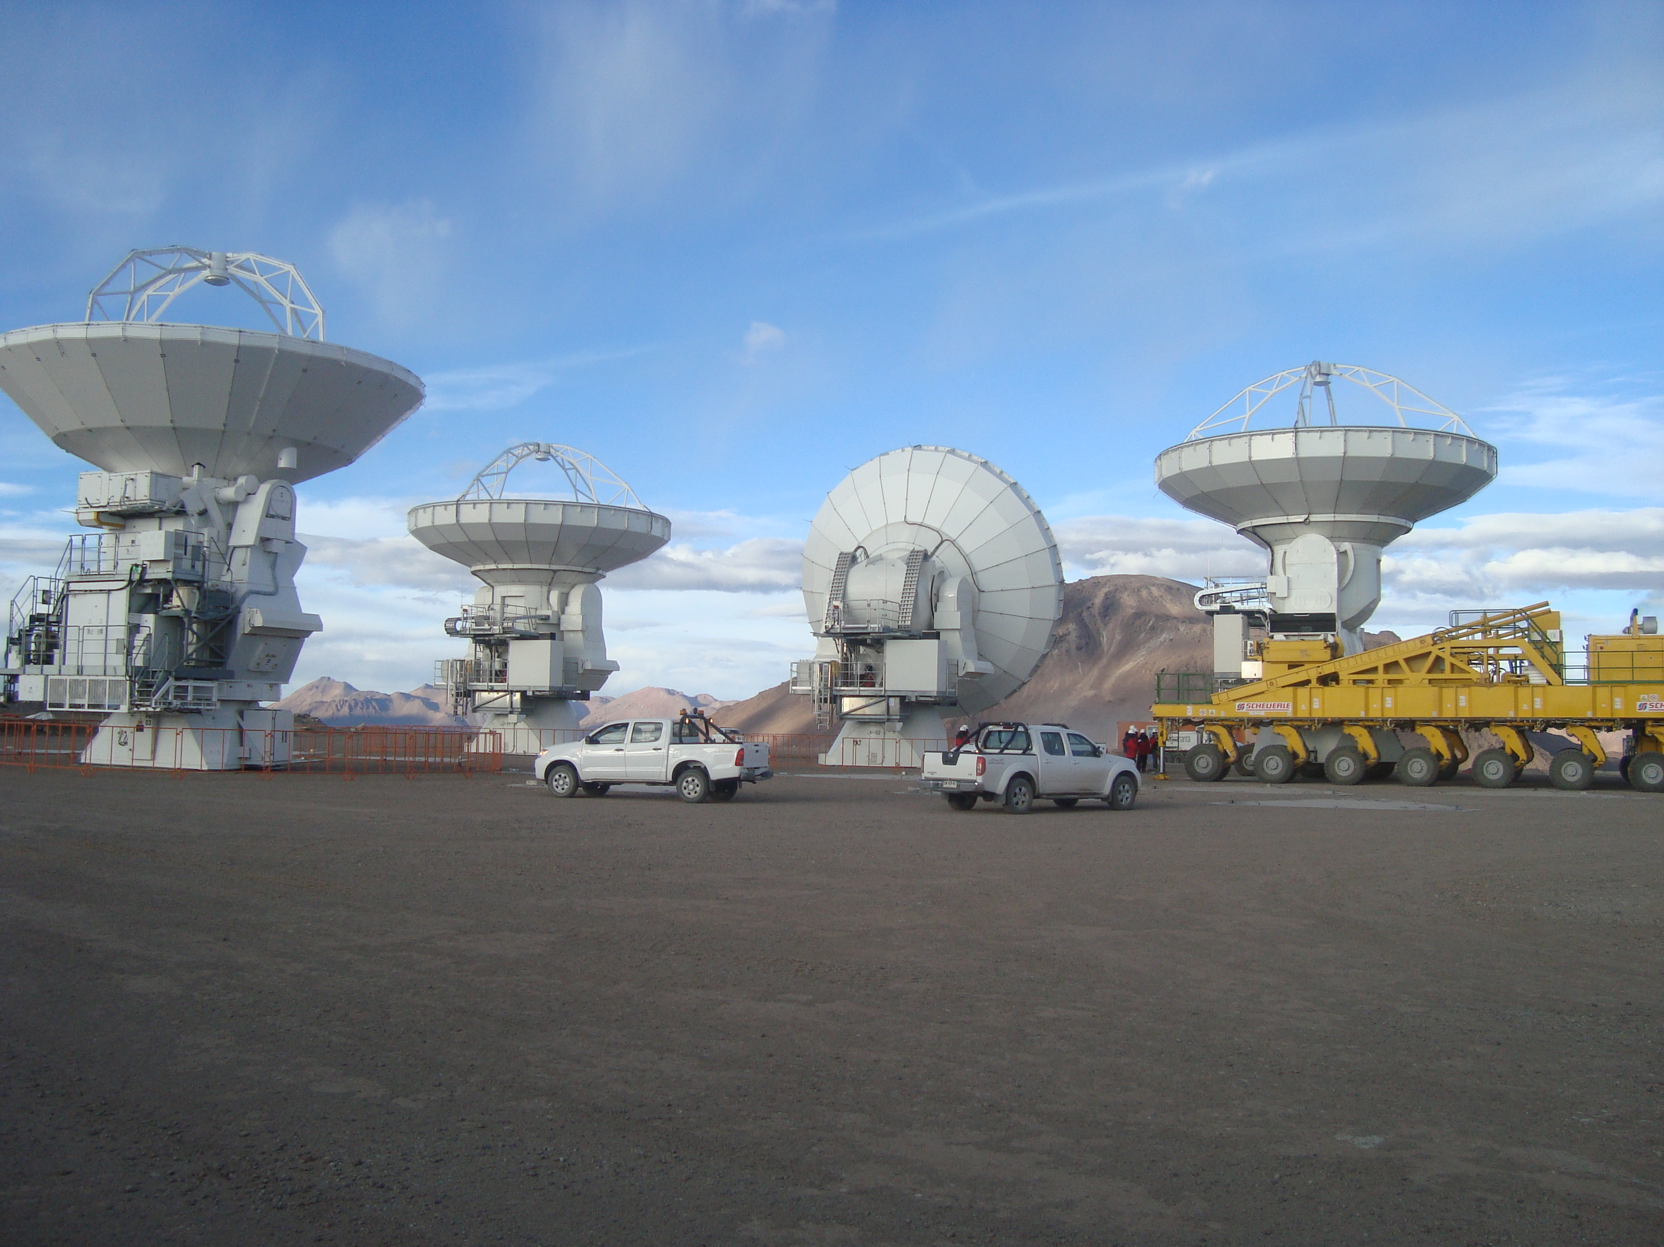
Four Antennas in Array

Slide 7
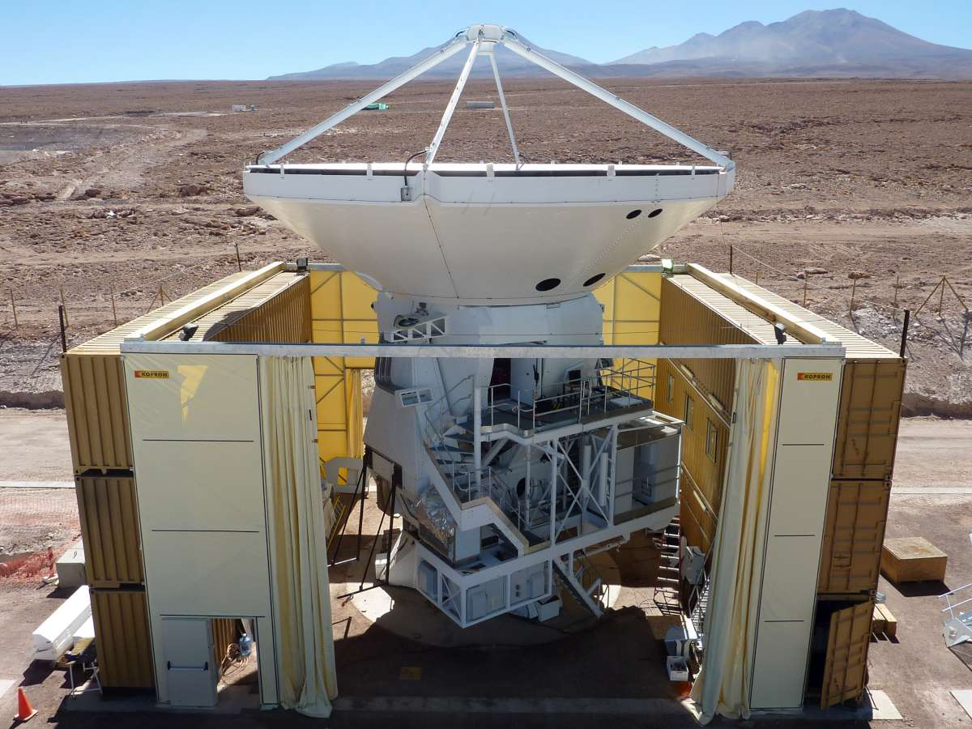
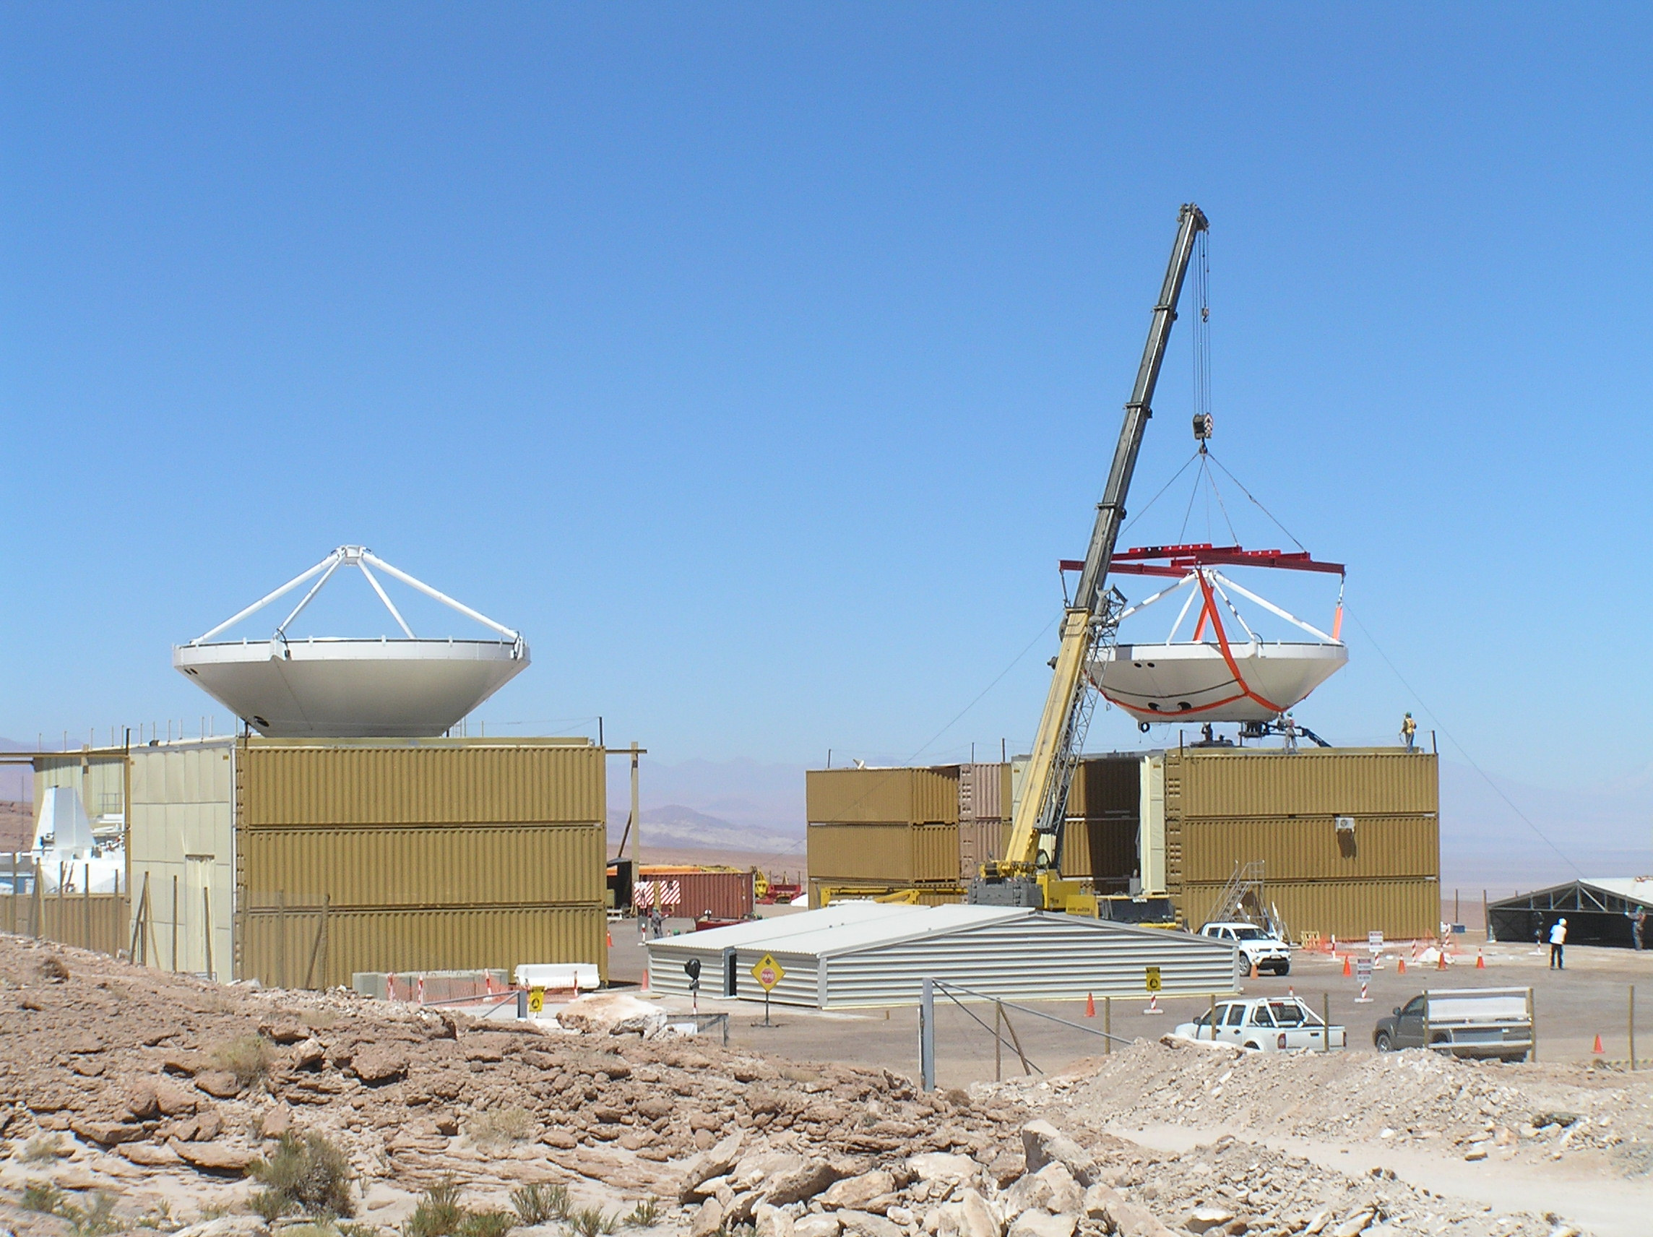
AEM Antennas

Slide 8
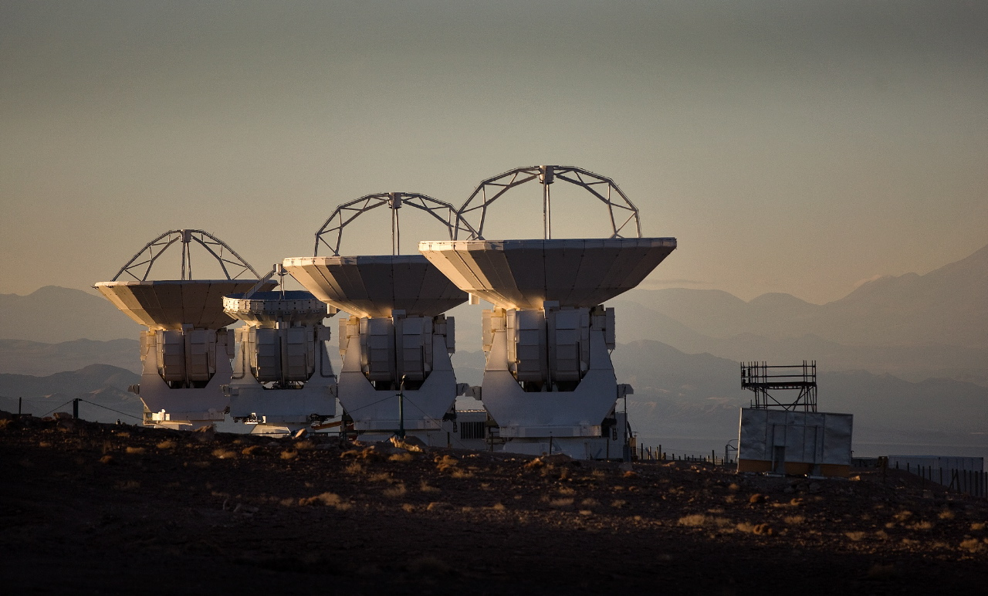
Antennas
Pointing
  Some anomalies observed, understood
    Setting antenna on foundation can introduce an error (DV01)
    Some iterating on metrology settings (PM03)
  Tracking and switching motion tests begun on short baselines
Surface accuracy
  Tower holography occurred at one elevation
  Short baselines enable astronomical holography; elevation dependence
  Extreme environmental conditions occur at AOS, not OSF
  Far sidelobes probe finescale structure in panel setting (observe Sun, Moon)

Slide 9
Antennas Summary
Two types of antennas tested extensively
  Surface appears good, with differences among types
  Pointing appears good
    Transporter setting down procedure needs work
    Metrology can pose problems
  Further tests under different conditions of weather, illumination
  More tracking tests under way
Three antenna types remain untested
  Refurbished Mitsubishi prototype
  AEM
  Mitsubishi 7m

Slide 10
Early Science Requirements
16 Antennas
Front Ends
Stations for Configurations out to 250m
Synthesis Imaging of Single Fields
Basic Correlator Modes suggested by ASAC
Calibration to a level achieved by current millimeter arrays
  Amplitude calibration using multiple-temperature loads
  Phase calibration including water vapor radiometry
Software
  Observation preparation
  Observation execution
  Observation reduction
End to End Connectivity and stability

Slide 11
‘Tunability’
Tunability - can we tune randomly using CCL and SBs: CSV-113
  Peck, Simms, Wootten, Dent, Wiklind, Zwaan, Barkats, Bhatia
Some hiccups but in general good performance
  Honing of lookup table parameters
  Some correlator problems
    ‘platforming’
    Output limitations

Slide 12
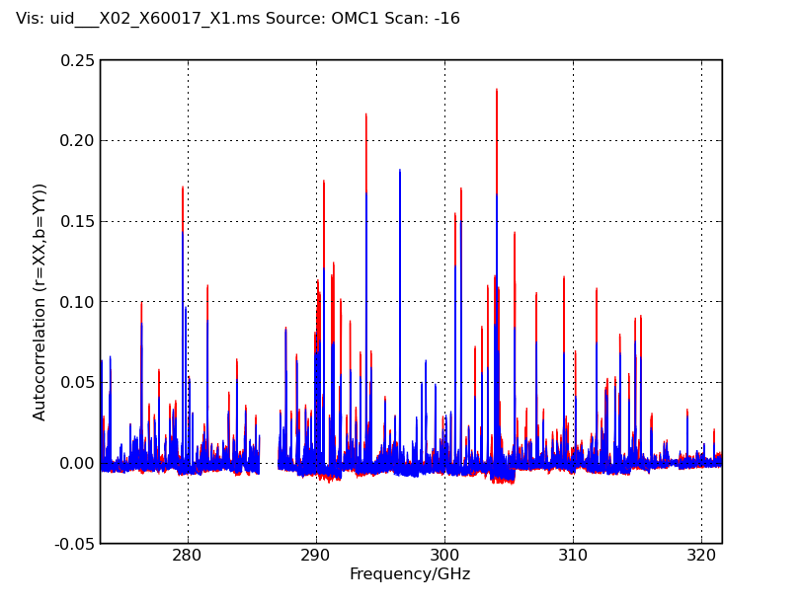
Band 7 (275-373 GHz/1.1-.8mm)

Slide 13
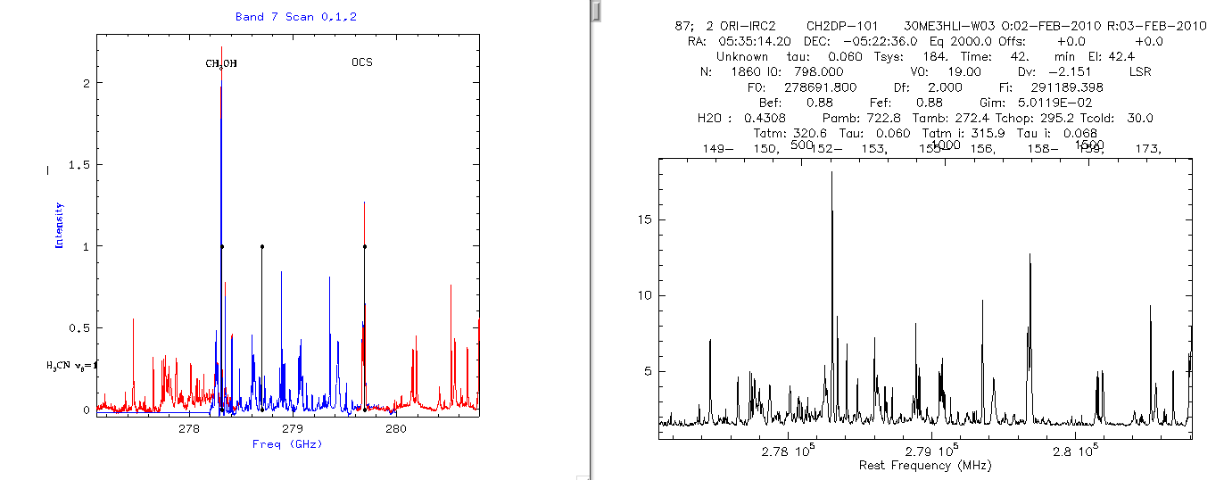
Comparison with IRAM 30m

Slide 14
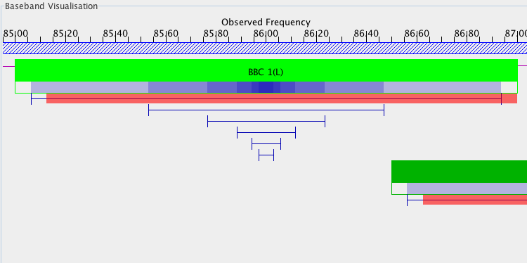
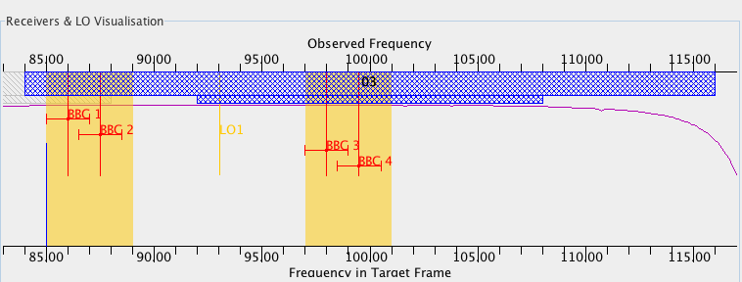
Example Correlator Setups
Four 2 GHz windows, B3. Then zoom in on BBC1.

Slide 15
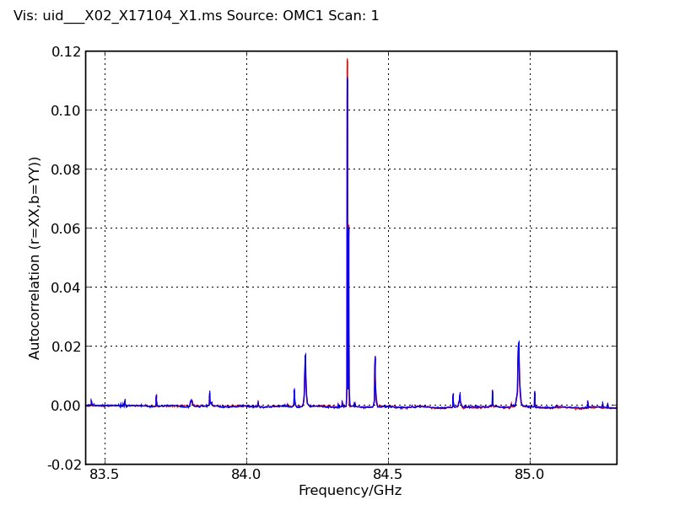
Correlator Modes
Mode 7
  3840 chs
  .488 MHz
  1.875GHz BW

Slide 16
Early Science Requirements
16 Antennas
Front Ends
Stations for Configurations out to 250m
Synthesis Imaging of Single Fields
Basic Correlator Modes suggested by ASAC
Calibration to a level achieved by current millimeter arrays
  Amplitude calibration using multiple-temperature loads
  Phase calibration including water vapor radiometry
Software
  Observation preparation
  Observation execution
  Observation reduction
End to End Connectivity and stability

Slide 17
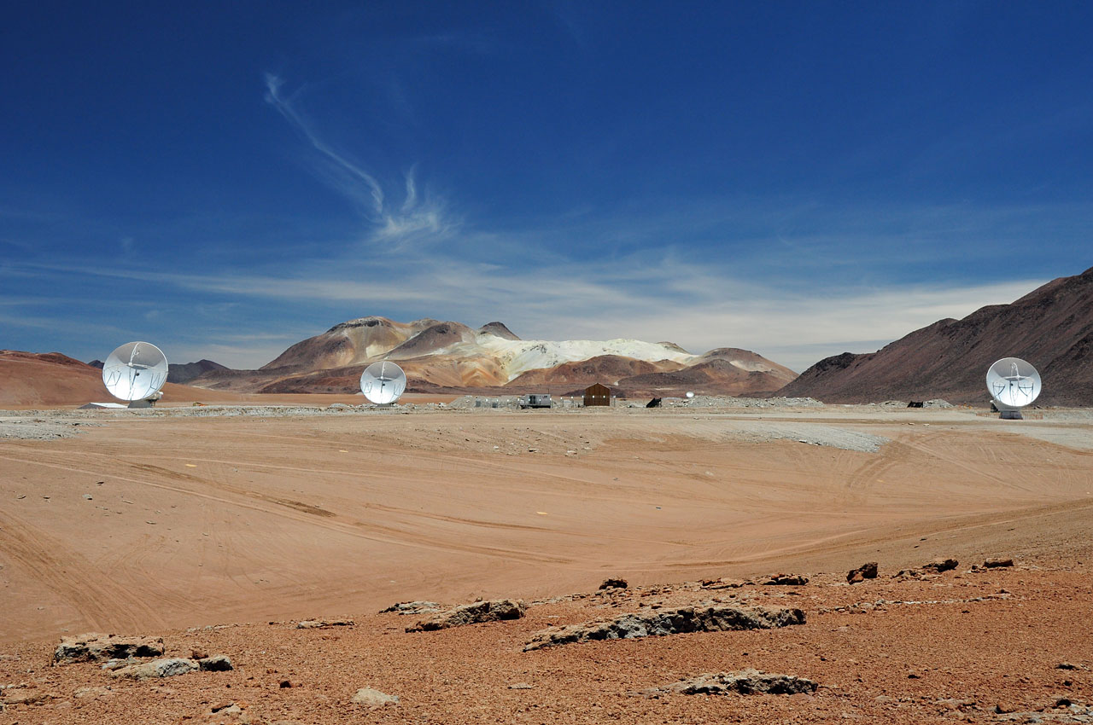
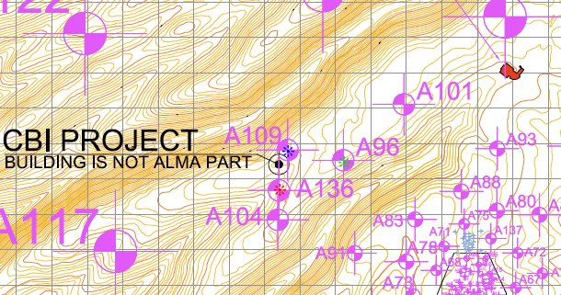
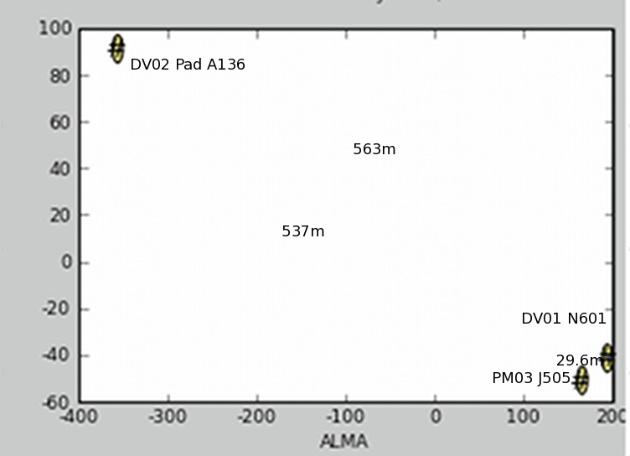
Antennas at AOS
PM02, DV01 and DV02
Three configurations
  1st: ~150m baselines
  2nd: ~30m, one 550m
  3rd: ~30m
Next antenna Week after next
Configuration 2
Configuration 1

Slide 18
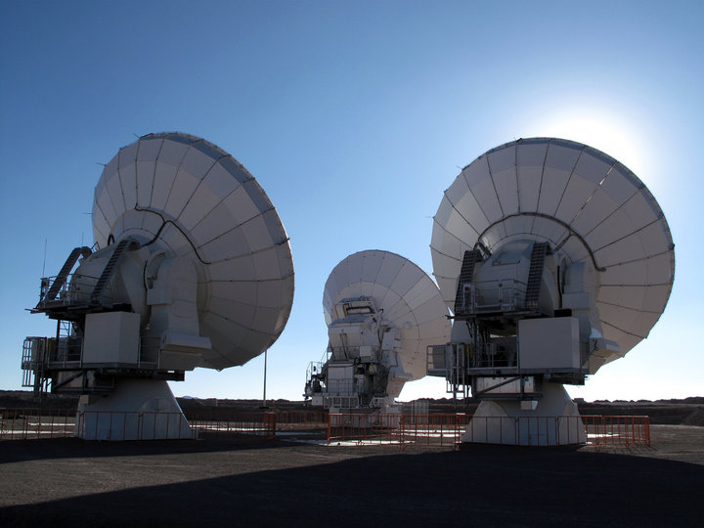
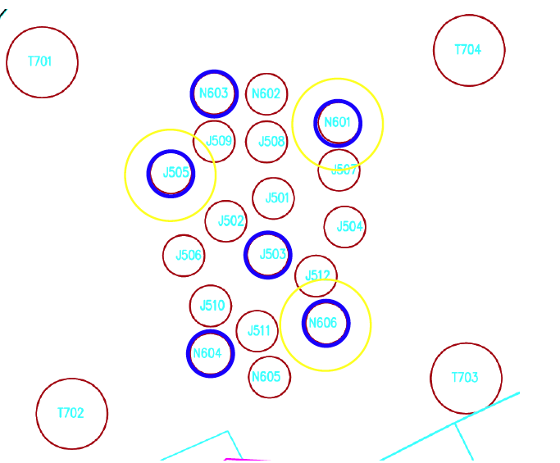
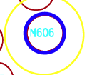
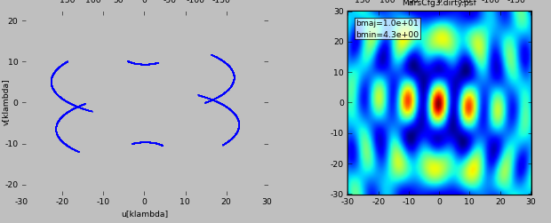
Current Configuration
Three 12m antennas on future ACA 7m foundations

Slide 19
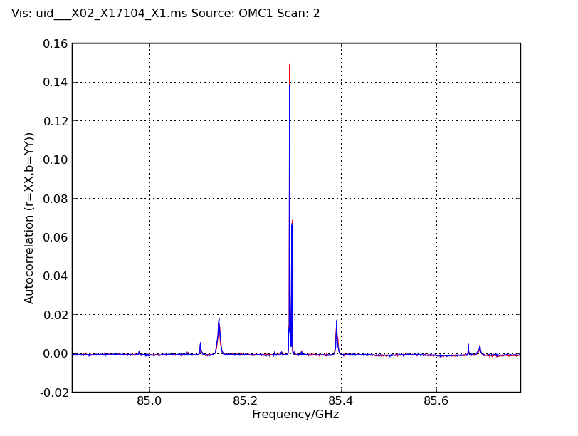
Correlator Modes
Mode 8
  3840 chs
  .244 MHz res
  0.9375GHz BW

Slide 20
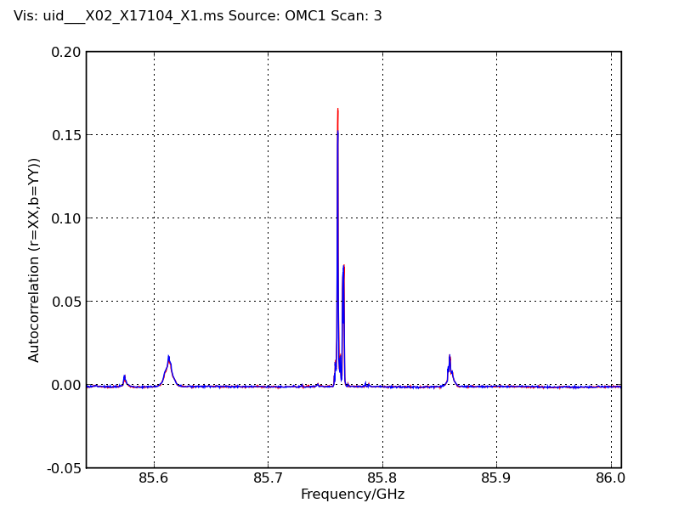
Correlator Modes
Mode 9
  3840 chs
  .122 MHz res
  0.4688GHz BW

Slide 21
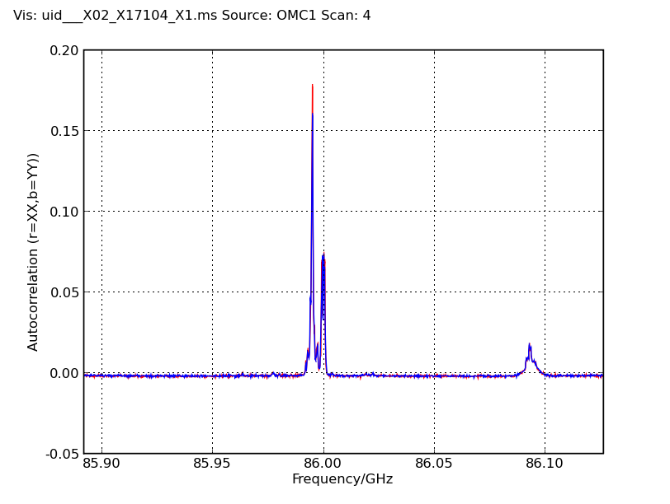
Correlator Modes
Mode 10
  3840 chs
  .061 MHz res
  0.2344GHz BW

Slide 22
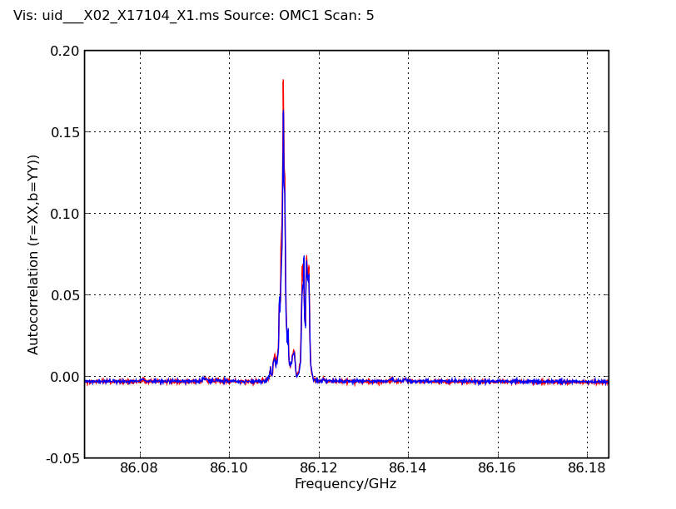
Correlator Modes
Mode 11
  3840 chs
  .0305 MHz res
  0.117GHz BW

Slide 23
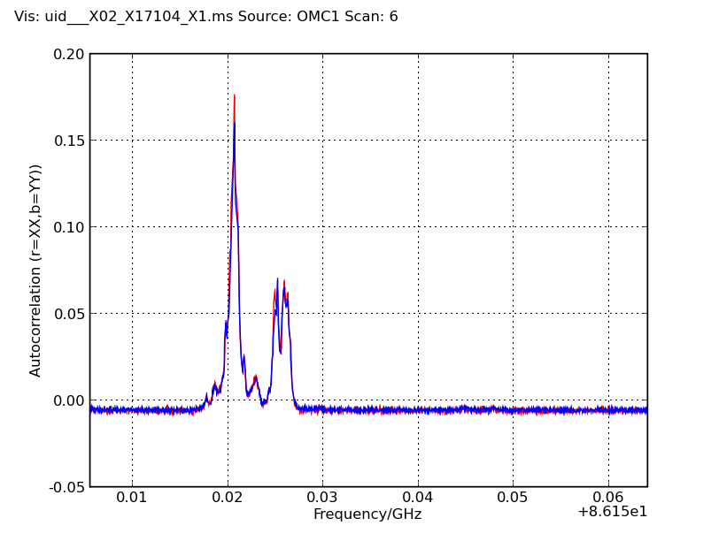
Correlator Modes
Mode 12
  3840 chs
  .0153 MHz res
  0.0586GHz BW

Slide 24
Early Science Requirements
16 Antennas
Front Ends
Stations for Configurations out to 250m
Basic Correlator Modes suggested by ASAC
Synthesis Imaging of Single Fields
Calibration to a level achieved by current millimeter arrays
  Amplitude calibration using multiple-temperature loads
  Phase calibration including water vapor radiometry
Software
  Observation preparation
  Observation execution
  Observation reduction
End to End Connectivity and stability

Slide 25
Early Science Requirements
16 Antennas
Front Ends
Stations for Configurations out to 250m
Basic Correlator Modes suggested by ASAC
Synthesis Imaging of Single Fields
Software
  Observation preparation
  Observation execution
  Observation reduction
Calibration to a level achieved by current millimeter arrays
  Amplitude calibration using multiple-temperature loads
  Phase calibration including water vapor radiometry
End to End Connectivity and stability

Slide 26
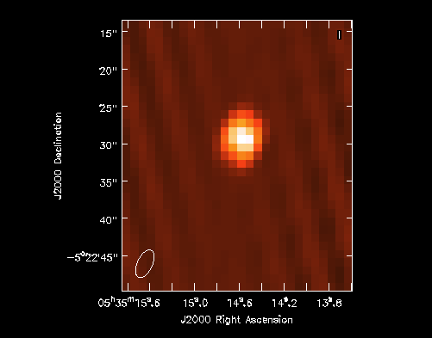
‘Imaging’
Three antennas limit the quality of ‘imaging’ particularly since most early configurations have been limited by pad availability.
Nonetheless, ‘images’ of the Orion SiO maser and other lines have been obtained from short tracks.
Here is shown ~30 minutes
Several realistic observing sessions have been carried out
  Use of Observing Tool to create ‘Schedule Blocks’
  Execution of the Schedule Blocks on the array
  Export of the ASDM files to Measurement Sets
  Calibration and imaging of data in CASA; development of scripts and techniques which may be used for the general dataset.

Slide 27
Early Science Requirements
16 Antennas
Front Ends
Stations for Configurations out to 250m
Basic Correlator Modes suggested by ASAC
Synthesis Imaging of Single Fields
Software
  Observation preparation
  Observation execution
  Observation reduction
Calibration to a level achieved by current millimeter arrays
  Amplitude calibration using multiple-temperature loads
  Phase calibration including water vapor radiometry
End to End Connectivity and stability

Slide 28
Calibration
Amplitude Calibration Device can be inserted and removed from beam
Water Vapor Radiometer
  Provides multichannel data in all crosscorrelation datasets
  Nikolic program wvrgcal provides phase correction through a gain table which may be applied in CASA
  Under many circumstances, correction is near spec
  Only simple atmospheric modeling so far
    Some thoughts on corrections for liquid
    No amplitude correction currently

Slide 29
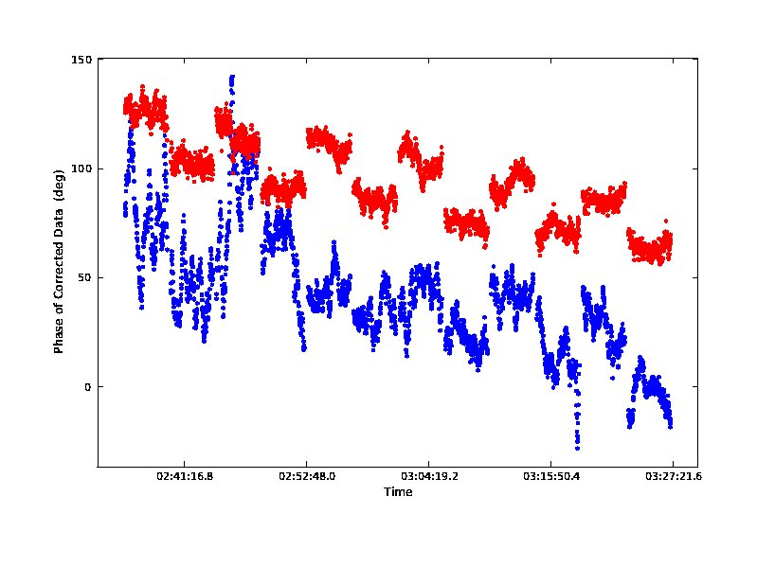
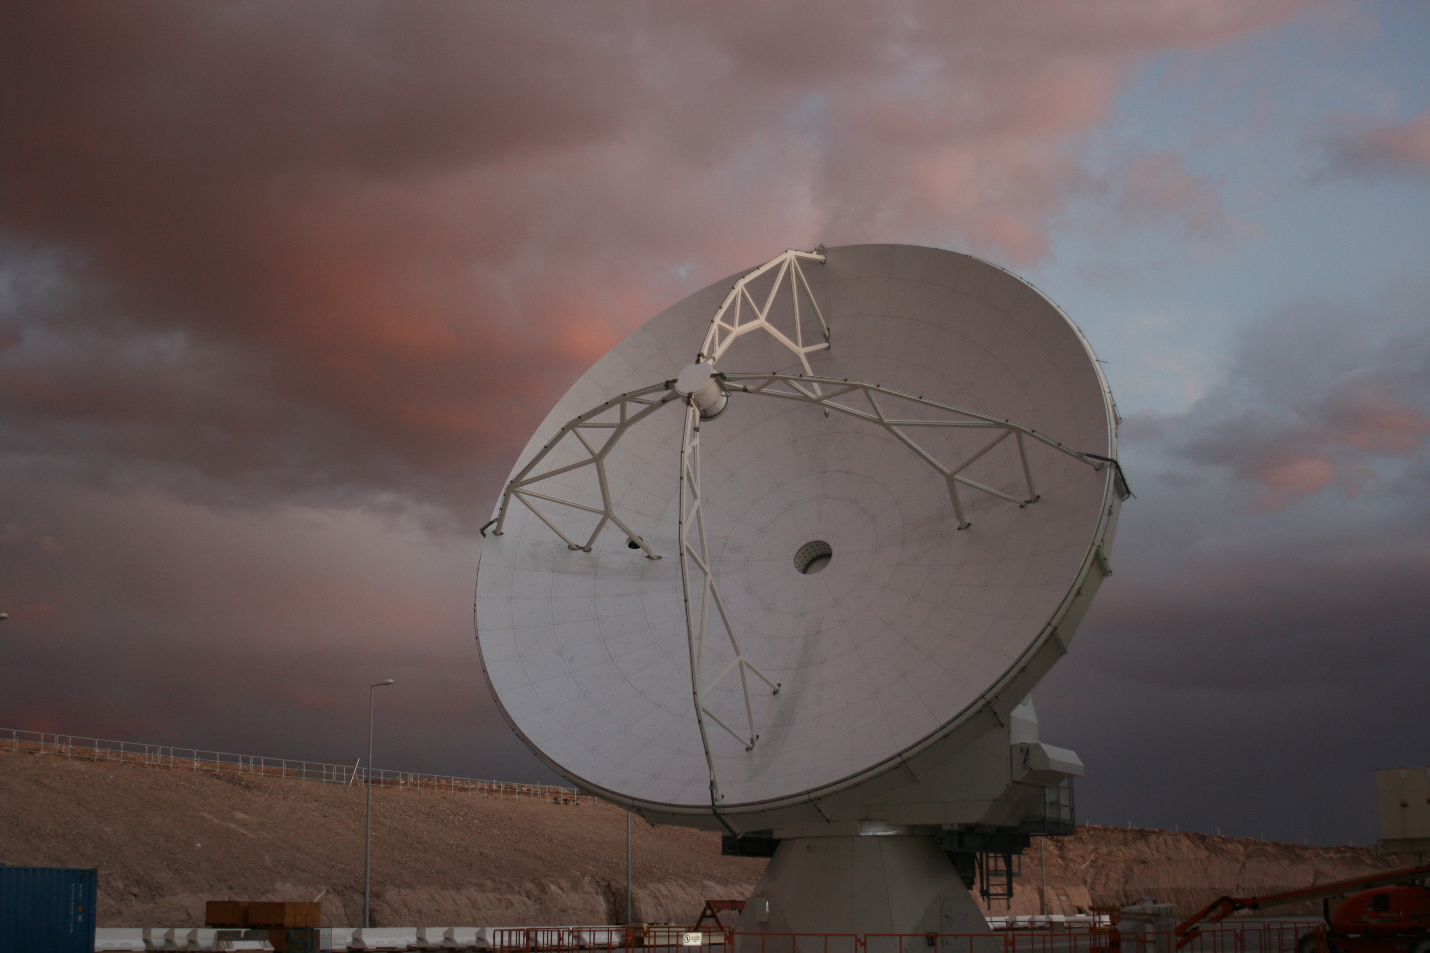
Example WVR Data
One baseline, two calibrators alternating, ~150m baseline
  Blue: no correction—can barely see the two calibrators
  Red: corrected data—clearly two calibrators are present
Taken during improving conditions—lightning thunder and rainbows initiated the session
Data were taken on 550m baseline—more challenging in some conditions (esp. day)

Slide 30
Early Science Requirements
16 Antennas
Front Ends
Stations for Configurations out to 250m
Basic Correlator Modes suggested by ASAC
Synthesis Imaging of Single Fields
Software
  Observation preparation
  Observation execution
  Observation reduction
Calibration to a level achieved by current millimeter arrays
  Amplitude calibration using multiple-temperature loads
  Phase calibration including water vapor radiometry
End to End Connectivity and stability

Slide 31
Comet Observation Example

Slide 32
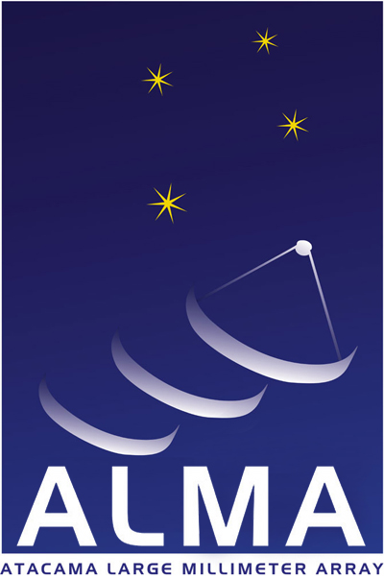
www.alma.info
The Atacama Large Millimeter/submillimeter Array (ALMA), an international astronomy facility, is a partnership among Europe, Japan and North America, in cooperation with the Republic of Chile. ALMA is funded in Europe by the European Organization for Astronomical Research in the Southern Hemisphere, in Japan by the National Institutes of Natural Sciences (NINS) in cooperation with the Academia Sinica in Taiwan and in North America by the U.S. National Science Foundation (NSF) in cooperation with the National Research Council of Canada (NRC). ALMA construction and operations are led on behalf of Europe by ESO, on behalf of Japan by the National Astronomical Observatory of Japan (NAOJ) and on behalf of North America by the National Radio Astronomy Observatory (NRAO), which is managed by Associated Universities, Inc. (AUI).

