Slide 1
The March to Early Science and Beyond
Al Wootten
North America ALMA Project Scientist

Slide 2
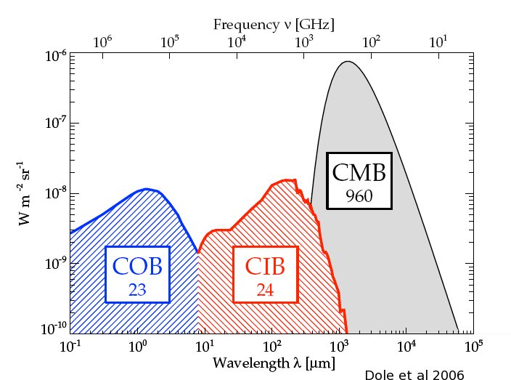
The mm/Submm Spectrum:
Focus of ALMA
Millimeter/submillimeter photons are the most abundant photons in the cosmic background, and in the spectrum of the Milky Way and most spiral galaxies.
ALMA range--wavelengths from 1cm to ~0.3 mm, covers both components to the extent the atmosphere of the Earth allows.
Notes:
Most important component is the 3K Cosmic Microwave Background (CMB)
After the CMB, the strongest component is the CIB/THz component, which carries most of the remaining radiative energy in the Universe, and 40% of that in for instance the Milky Way Galaxy.

Slide 3
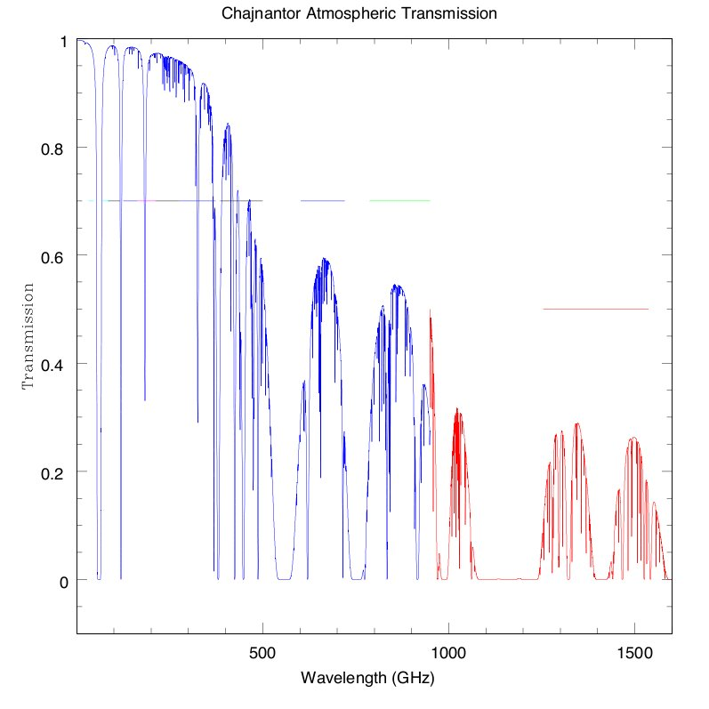
ALMA Bands and Transparency
B3
B6
B7
B9
Early Science
B4
B8
Goal
B5
B10
Construction
Future
B1
B2
???
‘B11’

Slide 4
Transformational Performance
ALMA improves
  Sensitivity: 100x
  Spatial Resolution: up to 100x
  Wavelength Coverage: ~2x
  Bandwidth: ~2x
    Scientific discovery parameter space is greatly expanded!
ALMA Early Science begins the transformation
  Sensitivity: ~10% full ALMA
  Resolution: up to ~0.4” (0.1” goal)
  Wavelength Coverage: 3-4 of final 8 bands (7 goal)
  Bandwidth: ~2x improvement
  Beginning the Discovery Space Expansion
Notes:
Best accessible site on Earth
Highest performance receivers available
Enormous collecting area (1.6 acres, or >6600 m²) Not only is the site high and dry but it is big! 18km baselines or longer may be accommodated.
Take advantage of the site by covering all atmospheric windows with >50% transmission above 30 GHz
Correlator processes 16 GHz or 8 GHz times two polarizations

Slide 5
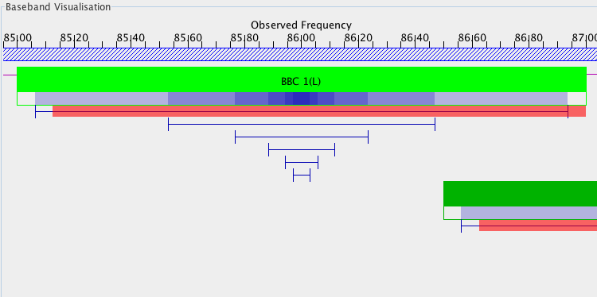
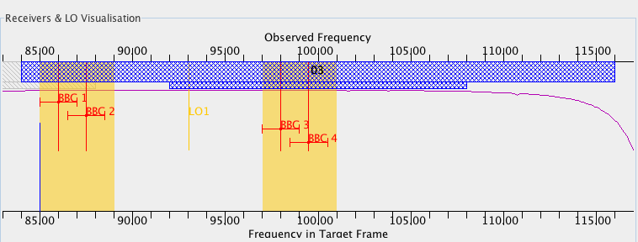
Example Correlator Window Setups
Four 2 GHz windows, B3. Then zoom in on BBC1.

Slide 6
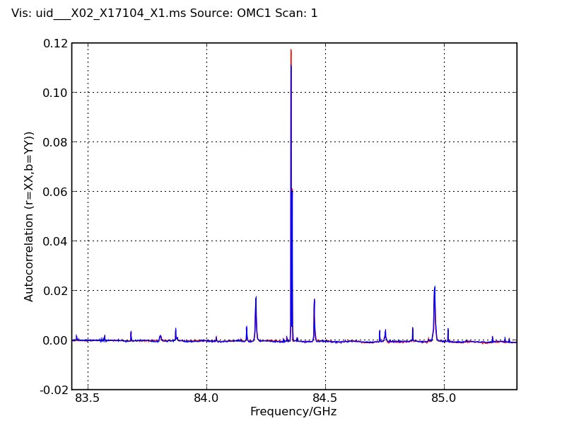
Correlator Modes
Mode 7
  3840 chs
  .488 MHz
  1.875GHz BW
  ES Mode

Slide 7
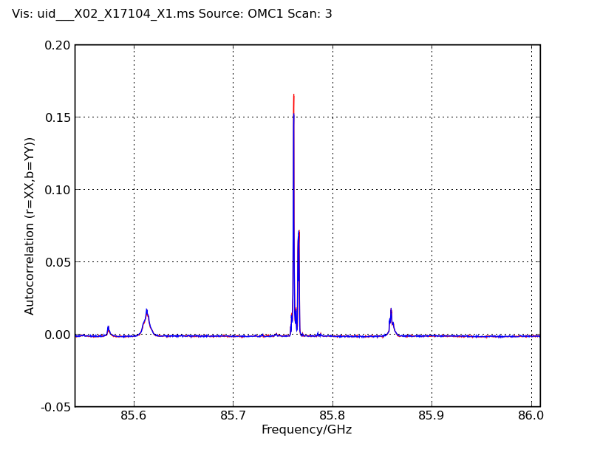
Correlator Modes
Mode 9
  3840 chs
  .122 MHz res
  0.4688GHz BW
  ES Mode

Slide 8
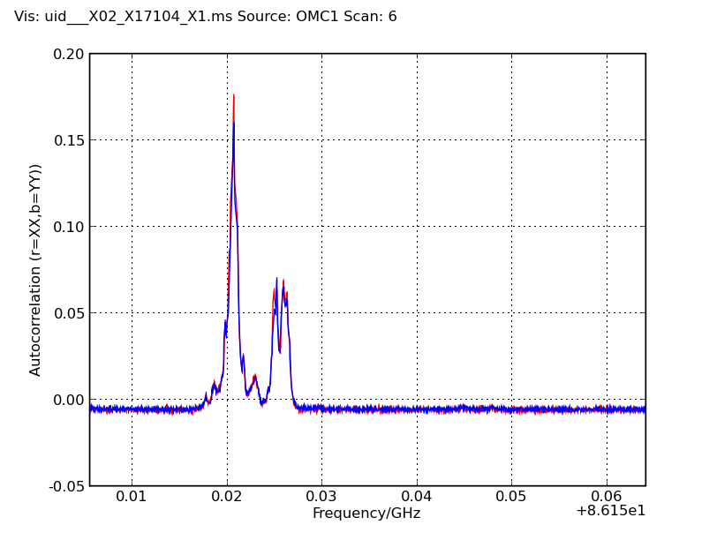
Correlator Modes
Mode 12
  3840 chs
  .0153 MHz res
  0.0586GHz BW
  ES Mode

Slide 9
DRSP Examples: Early Science
Design Reference Science Plan
Among the examples:
  A Deep Field Object
  Protoplanetary disks
Consider possibilities for Early Science
  Excellent sensitivity—better than any current array—witness the 3-element spectra shown here
  Excellent imaging—imaging quality goes as N^{^2} for a given antenna size; for the ES array we have 120 baselines; 1225 up to 2016 for full science, plus total power.

Slide 10
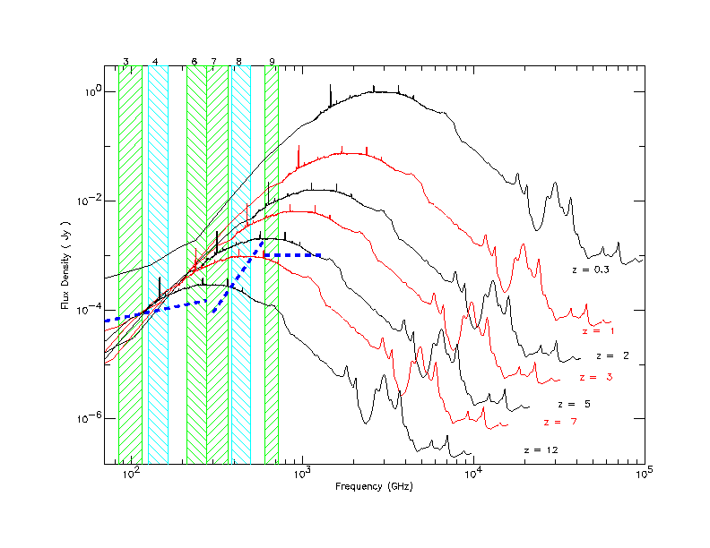
Inverse K-correction, or magic of the submillimeter
Super M82 from ISO, Beelen and Cox
As galaxies get redshifted into the ALMA bands, dimming due to distance is offset by the brighter part of the spectrum being redshifted in. Hence, galaxies remain at relatively similar brightness out to high distances.
10
11

Slide 11
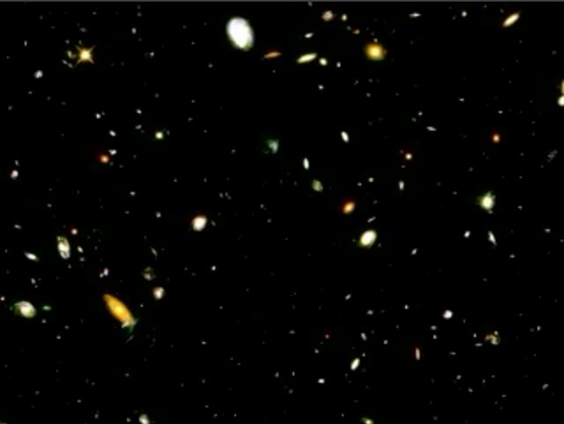
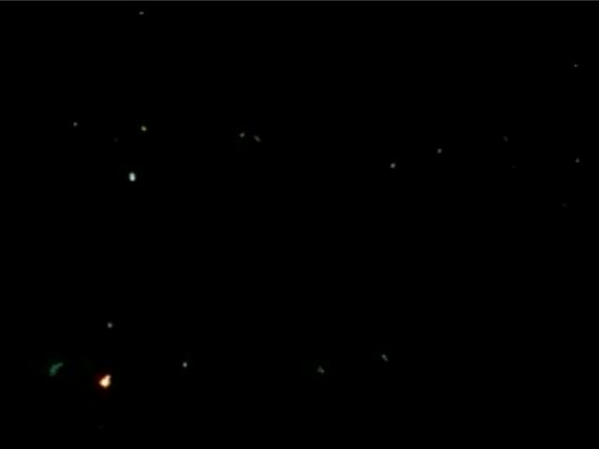
Hubble Deep Field
Rich in Nearby Galaxies, Poor in Distant Galaxies
Source: K. Lanzetta, SUNY-SB
Nearby galaxies in HDF
Distant galaxies in HDF
Notes:
On the left is a field from the Lanzetta et al. movie showing a zoom through time from nearer to more distant galaxies in the HDF, based on measurement of photometric redshifts of 1067 galaxies. Only 25% of these lie at z>2, with only 7% at z>3. Only photometric redshifts can be determined from these galaxies from the optical data.
The area if these two views is about a third or so of the HDF. From statistics, I’d estimate that the slide at the right, with ~20 galaxies, shows those for z>3. That is ~7% of the total number of galaxies.

Slide 12
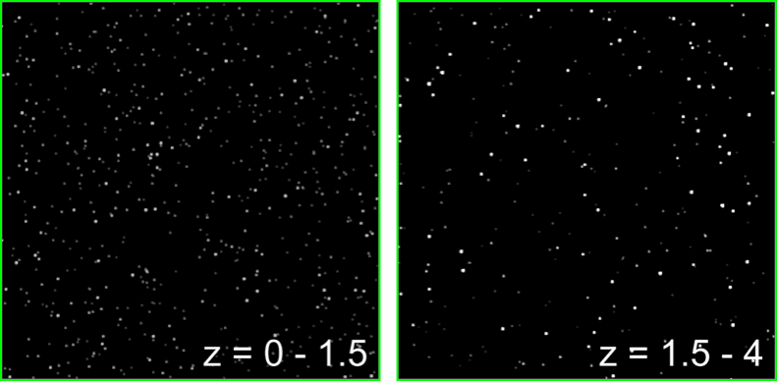
Submm Sources at High and Low z
Wang 2008
Simulation based on:
(1) blank-field bright-end number counts (Wang, Cowie, Barger 2004)
(2) lensing cluster faint-end number counts (Cowie, Barger, Kneib 2002)
(3) redshift distribution of the submm EBL (Wang, Cowie, Barger 2004)

Slide 13
Distant Galaxies with ALMA Early Science
Continuum Sensitivity: Better than 1 mJy 1 minute most bands; ~3mJy .4 mm
  Weakest sources ever seen in submm emit ~few mJy
  With many more antennas, deep surveys will be more effective with full ALMA
Spectral line sensitivity: ~3 Jy km s⁻¹ in 1 minute at .4mm
  ~30x better than current ~10m submm telescopes in one hour
  Whole-band search, requiring ~15 tunings, feasible to good sensitivity
Imaging performance, but ~10x better with full ALMA
Conclusion: Excellent sensitivity
  Spatial surveys should await full ALMA
  Line surveys practical with ALMA Early Science array on targeted objects

Slide 14
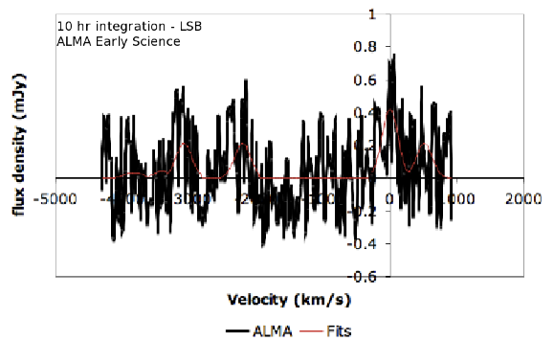
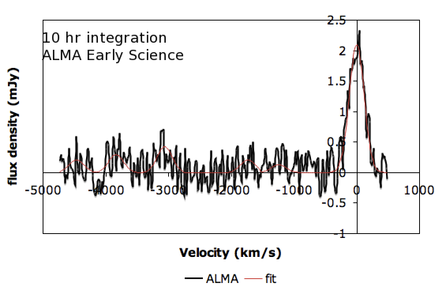
J1148+5251: an EoR paradigm with ALMA
Secure redshifts
Molecular astrophysics
z=6.4 CO J=6-5
Top: USB, 3mm or 94.8 GHz
CO 6-5
HCN 8-7
HCO+ 8-7
H2CO lines
Lower: LSB, 86.8 GHz
HNC 7-6
H2CO lines
C18O 6-5
H2O 658GHz maser?
~10 hr ALMA Early Science
Notes:
If one placed CO 6-5 in the LSB, one would get the 211-202 line of H2O and the 7-6 line of 13CO, in addition to several H2CO lines, in the USB.

Slide 15
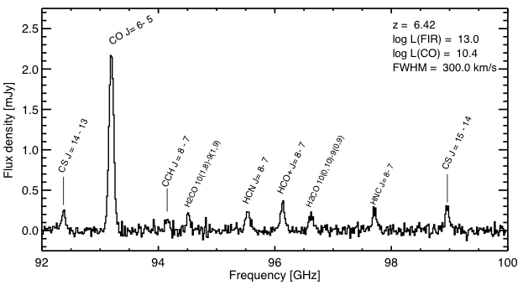
Full ALMA ~24 hr
Bandwidth compressed by (1+z) => many lines
50 GHz rest frame

Slide 16
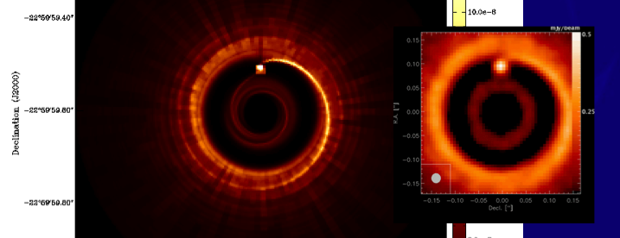
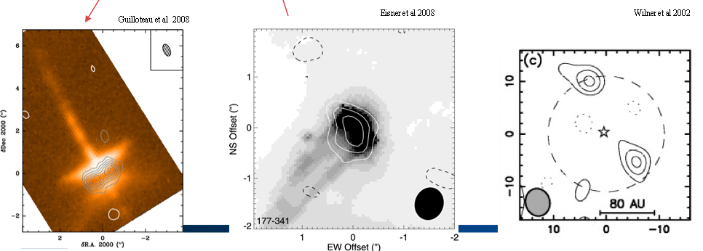
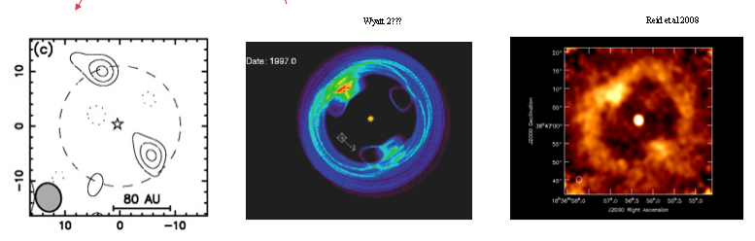
Protoplanetary Disks with ALMA Early Science
Continuum Sensitivity excellent: targeted continuum observations will work well
Spectral Sensitivity excellent—multi line surveys an excellent science target
Good imaging performance, but high resolution high fidelity science best with full ALMA
Conclusion:
  Discovery and characterization of lower mass disks nearby improved
  Excellent progress expected on understanding the detailed composition and processes in disks
  Edges of explorable space reach to the nearby spiral arms

Slide 17
ALMA Early Science:
Beginning the Discovery Space Expansion
ALMA Early Science initiates the transformation
  Sensitivity: ~10% full ALMA
  Resolution: up to ~0.4” (0.1” goal)
  Wavelength Coverage: 3-4 of final 8 bands (7 goal)
  Bandwidth: ~2x improvement
Begins next year

Slide 18
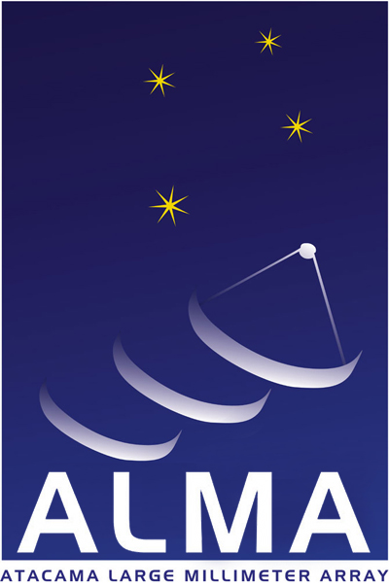
www.alma.info
The Atacama Large Millimeter/submillimeter Array (ALMA), an international astronomy facility, is a partnership among Europe, Japan and North America, in cooperation with the Republic of Chile. ALMA is funded in Europe by the European Organization for Astronomical Research in the Southern Hemisphere, in Japan by the National Institutes of Natural Sciences (NINS) in cooperation with the Academia Sinica in Taiwan and in North America by the U.S. National Science Foundation (NSF) in cooperation with the National Research Council of Canada (NRC). ALMA construction and operations are led on behalf of Europe by ESO, on behalf of Japan by the National Astronomical Observatory of Japan (NAOJ) and on behalf of North America by the National Radio Astronomy Observatory (NRAO), which is managed by Associated Universities, Inc. (AUI).

