Slide 1
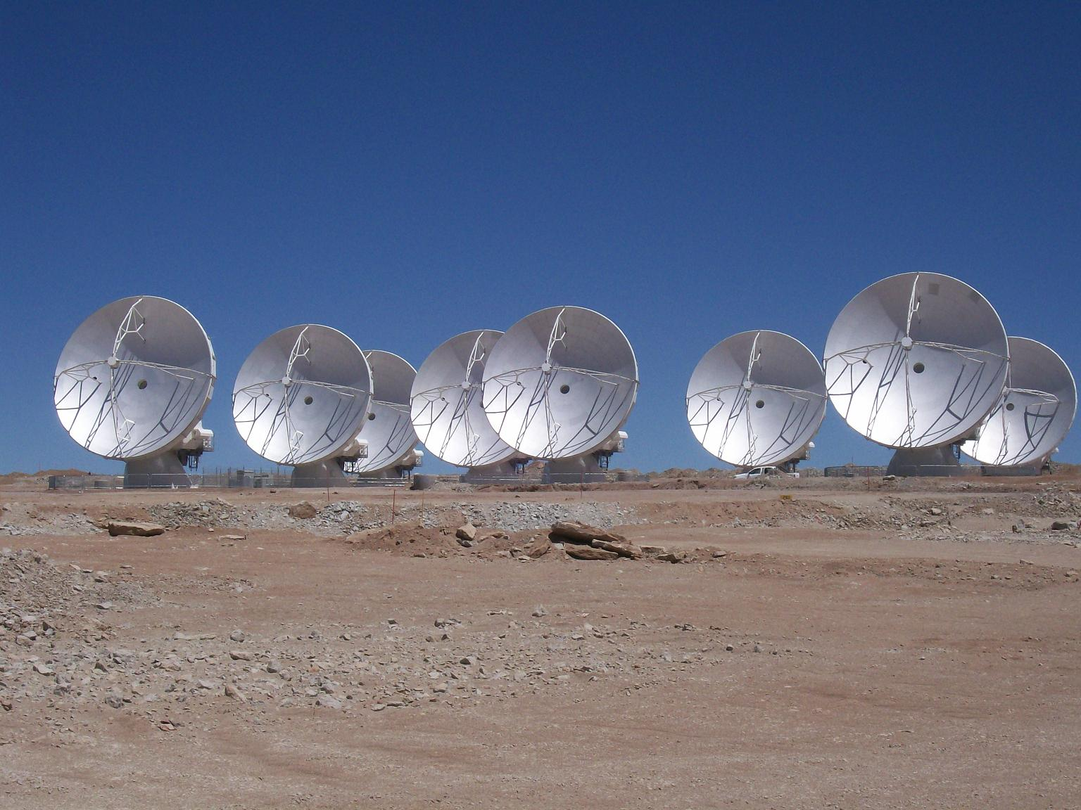
The Atacama Large Millimeter/Submm Array: A Telescope for the Next Decade and Beyond
Al Wootten
North America ALMA Project Scientist
Natl Radio Astronomy Observatory
U. Va. Dept of Astronomy
www.nrao.edu

Slide 2
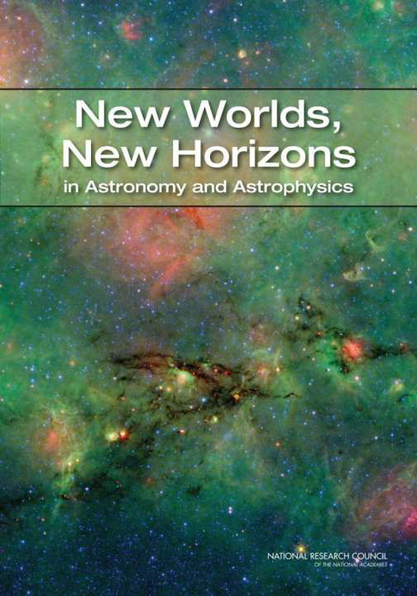
Outline
History of the ALMA project
What is ALMA?
Where is ALMA?
When is ALMA complete?
How does ALMA work?
What are the scientific questions ALMA will help to answer?

Slide 3
Short History
Idea dates to ca 1983
Endorsed by 1991 ‘Decadal Survey of Astronomy’ by US Natl Research Council (and by reference, the two succeeding surveys).
Similar concepts also endorsed by reports from Canada, France, UK, Italy, Netherlands, Japan
Developmental funding began in the late 90’s; site selection in Chile
1998: Agreement to work towards an international partnership
2003: Bilateral Agreement between European Southern Observatory and US National Science Foundation (with NRC of Canada) initiates project; agreements with Chile; construction initiated.
2006: East Asia (Japan, Taiwan) joins.
2011: First science planned toward end of year
2013: End construction

Slide 4
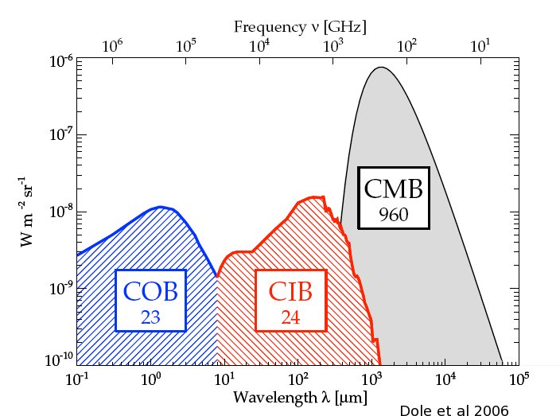
The mm/submm Spectrum: Focus of ALMA
Millimeter/submillimeter photons are the most abundant photons in the cosmic background, and in the spectrum of the Milky Way and most spiral galaxies.
ALMA range--wavelengths from 1cm to ~0.3 mm (frequencies 30-1000GHz), covers both components to the extent the atmosphere of the Earth allows.
Notes:
Most important component is the 3K Cosmic Microwave Background (CMB)
After the CMB, the strongest component is the CIB/THz component, which carries most of the remaining radiative energy in the Universe, and 40% of that in for instance the Milky Way Galaxy.

Slide 5
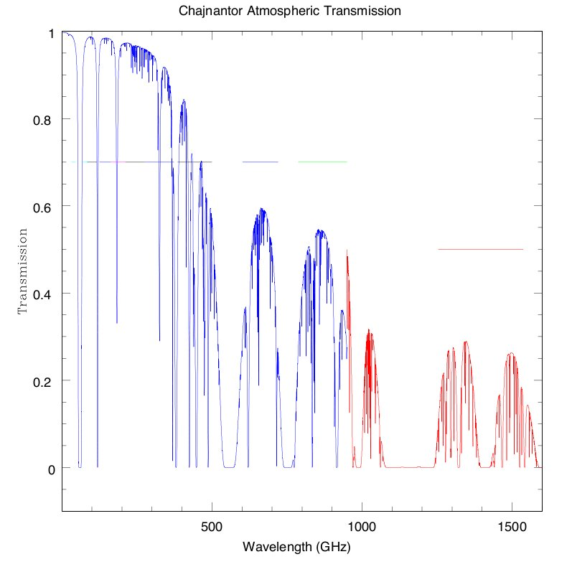
ALMA Bands and Transparency
Note axis reversal from previous slide!
B3
B6
B7
B9
Early Science
B4
B8
Goal
B5
B10
Construction
Future
B1
B2
???
‘B11’
Notes:
Note the sense is reversed from the previous slide!

Slide 6
What Astronomy Can be Addressed?
Discovery areas:
Identification and characterization of nearby habitable exoplanets
Gravitational wave astronomy
Time-domain astronomy
Astrometry
The epoch of reionization
Questions:
How did the universe begin?
What were the first objects to light up the universe and when did they do it?
How do cosmic structures form and evolve?
What are the connections between dark and luminous matter?
What is the fossil record of galaxy assembly and evolution from the first stars to the present?
How do stars and black holes form?
How do circumstellar disks evolve and form planetary systems?
How do baryons cycle in and out of galaxies and what do they do while they are there?
What are the flows of matter and energy in the circumgalactic medium?
What controls the mass-energy-chemical cycles within galaxies?
How do black holes work and influence their surroundings?
How do rotation and magnetic fields affect stars?
How do massive stars end their lives?
What are the progenitors of Type Ia supernovae and how do they explode?
How diverse are planetary systems and can we identify the telltale signs of life on an exoplanet?
Why is the universe accelerating?
What is dark matter?
What are the properties of the neutrinos?
What controls the masses, spins and radii of compact stellar remnants?
Notes:
Areas highlighted in red may be addressed by studies involving ALMA.

Slide 7
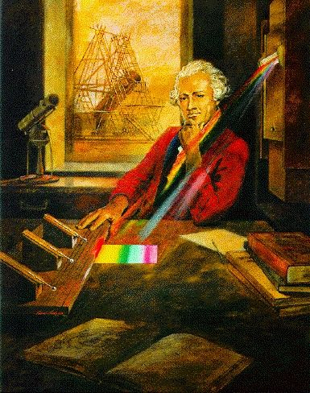
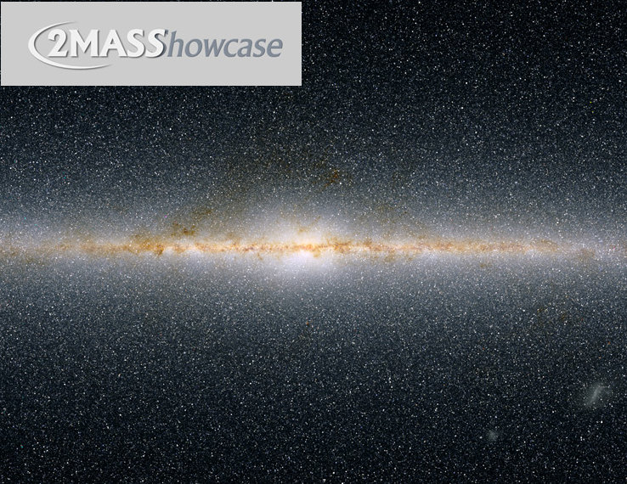
Historical Context: Infrared Emission
Near-Infrared: room to solar temperature
William Herschel discovered near-infrared radiation
Near-IR Surveys: IRC catalog to 2MASS
Far Infrared: cool, forming stars, planets

Slide 8
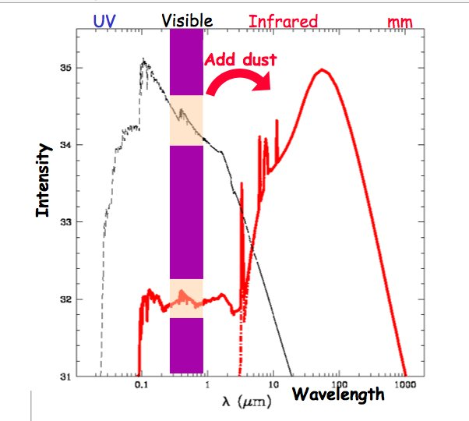
Infrared Emission: An Example
Cool dusty objects
Emit directly in IR
Can reprocess shorter wavelength radiation

Slide 9
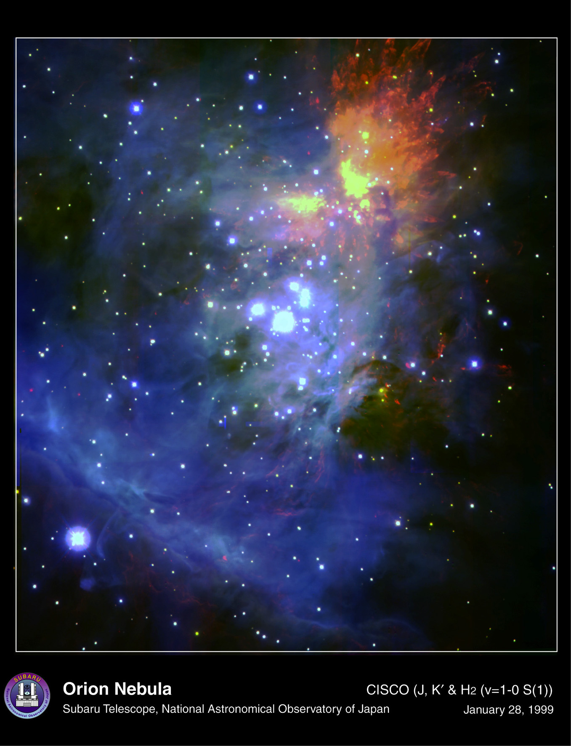
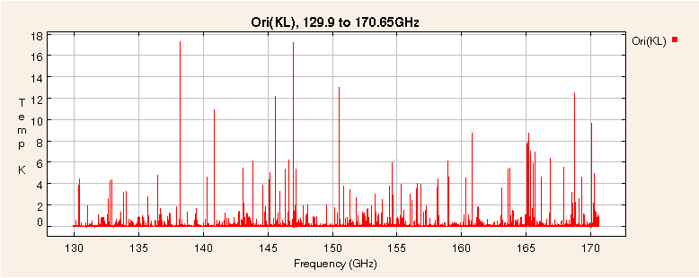
Contributors to the Millimeter Spectrum
Spectrum courtesy B. Turner (NRAO)
Spectral lines contribute significant flux to the overall spectrum.
In dense regions, lines may contribute a large fraction of the total emission
Here thousands of lines are seen in a portion of the Orion core spectrum at 2mm.
Earth’s atmospheric lines block access to some spectral regions except at Earth’s highest dryest site.
ALMA’s 16500’ altitude site affords excellent spectral access.
ALMA’s spectral reach enables study of the Universe in all mm/submm windows for which transmission is better than 50%.
Notes:
Earth’s atmosphere transmission
Molecule list
iras, ISO, SWAS, ODIN apertures thru CSO/HHT/JCMT and resolution.

Slide 10
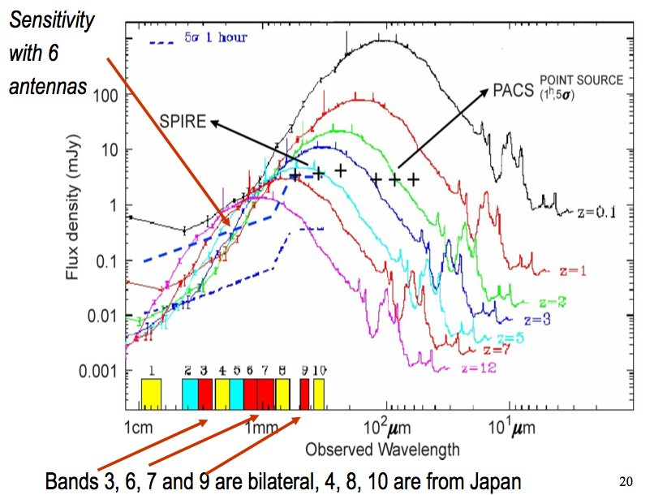
Infrared Emission: Second Example
Normal spectra may be redshifted into the infrared

Slide 11
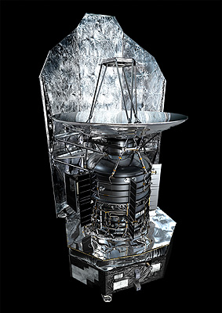
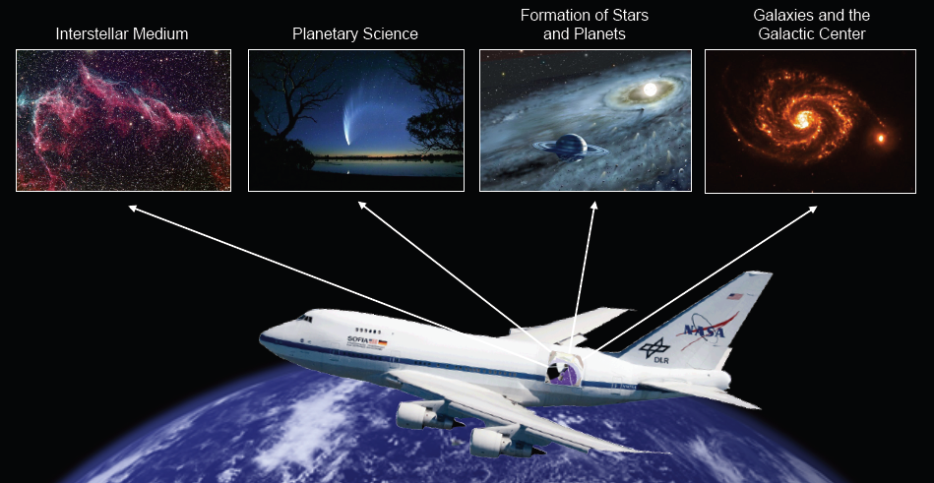
The Final Frontier
ALMA
SOFIA
Herschel
PLANCK Image Galactic dust: 100, 350 and 550 microns wavelength

Slide 12
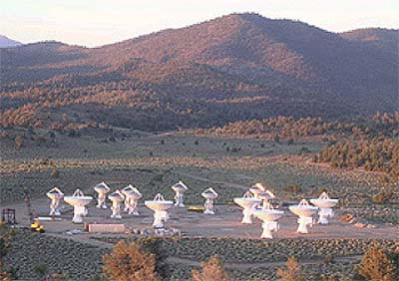
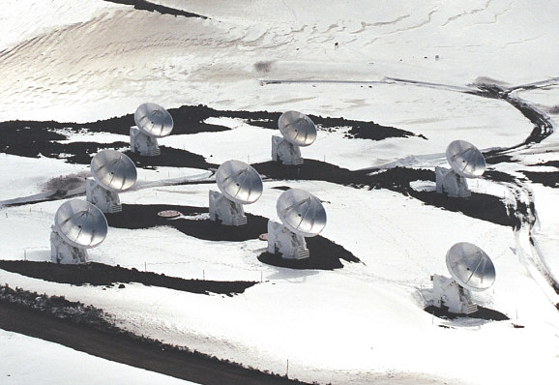
Millimeter/Submillimeter Spectrum
Radio: Sub-LN₂
Interferometers: VLA, OVRO, BIMA, SMA, IRAM
The next step: CARMA, ALMA on Earth
SOFIA, Herschel in space
CARMA
SMA

Slide 13
ALMA Science Requirements
Project ensures ALMA meets three “level I” science goals:
Spectral line CO/C+ in z=3 MWG < 24hrs
resolve ProtoPlanetaryDisks at 150 pc – gas/dust/fields
Precise 0.1” imaging above 0.1% peak
These require the instrument to have certain characteristics:
High Fidelity Imaging.
Routine sub-mJy Continuum / mK Spectral Sensitivity.
Wideband Frequency Coverage.
Wide Field Imaging Mosaicing.
Submillimeter Receiver System (..& site..).
Full Polarization Capability.
System Flexibility (hardware/software).
Notes:
What is z~3 in years since big bang? 2.19 Gyr

Slide 14
Technical Specifications
54 12-m antennas, 12 7-m antennas, at 5000 m altitude site.
Surface accuracy ±25 μm, 0.6” reference pointing in 9m/s wind, 2” absolute pointing all-sky.
Array configurations between 150m to ~15 -18km.
10 bands in 31-950 GHz + 183 GHz WVR. Initially:
86-119 GHz “3”
211-275 GHz “6”
275-370 GHz “7”
602-720 GHz “9”
8 GHz BW, dual polarization.
Flux sensitivity 0.2 mJy in 1 min at 345 GHz (median cond.).
Interferometry, mosaicing & total-power observing.
Correlator: 4096 channels/IF (multi-IF), full Stokes.
Data rate: 6MB/s average; peak 60-150 MB/s.
All data archived (raw + images), pipeline processing.

Slide 15
Specifications Demand Transformational Performance
With these specifications, ALMA improves
Existing sensitivity, by about two orders of magnitude
Best accessible site on Earth
Highest performance receivers available
Enormous collecting area (1.6 acres, or >6600 m²)
Resolution, by nearly two orders of magnitude
Not only is the site high and dry but it is big! 18km baselines or longer may be accommodated.
Wavelength Coverage, by a factor of two or more
Take advantage of the site by covering all atmospheric windows with >50% transmission above 30 GHz
Bandwidth, by a factor of a few
Correlator processes 16 GHz or 8 GHz times two polarizations
Scientific discovery parameter space is greatly expanded!

Slide 16
Transformational Performance
ALMA improves
Sensitivity: 100x
Spatial Resolution: up to 100x
Wavelength Coverage: ~2x
Bandwidth: ~2x
Scientific discovery parameter space is greatly expanded!
ALMA Early Science begins the transformation
Sensitivity: ~10% full ALMA
Resolution: up to ~0.4” (0.1” goal)
Wavelength Coverage: 3-4 of final 8 bands (7 goal)
Bandwidth: ~2x improvement
Beginning the Discovery Space Expansion
Notes:
Best accessible site on Earth
Highest performance receivers available
Enormous collecting area (1.6 acres, or >6600 m²) Not only is the site high and dry but it is big! 18km baselines or longer may be accommodated.
Take advantage of the site by covering all atmospheric windows with >50% transmission above 30 GHz
Correlator processes 16 GHz or 8 GHz times two polarizations

Slide 17
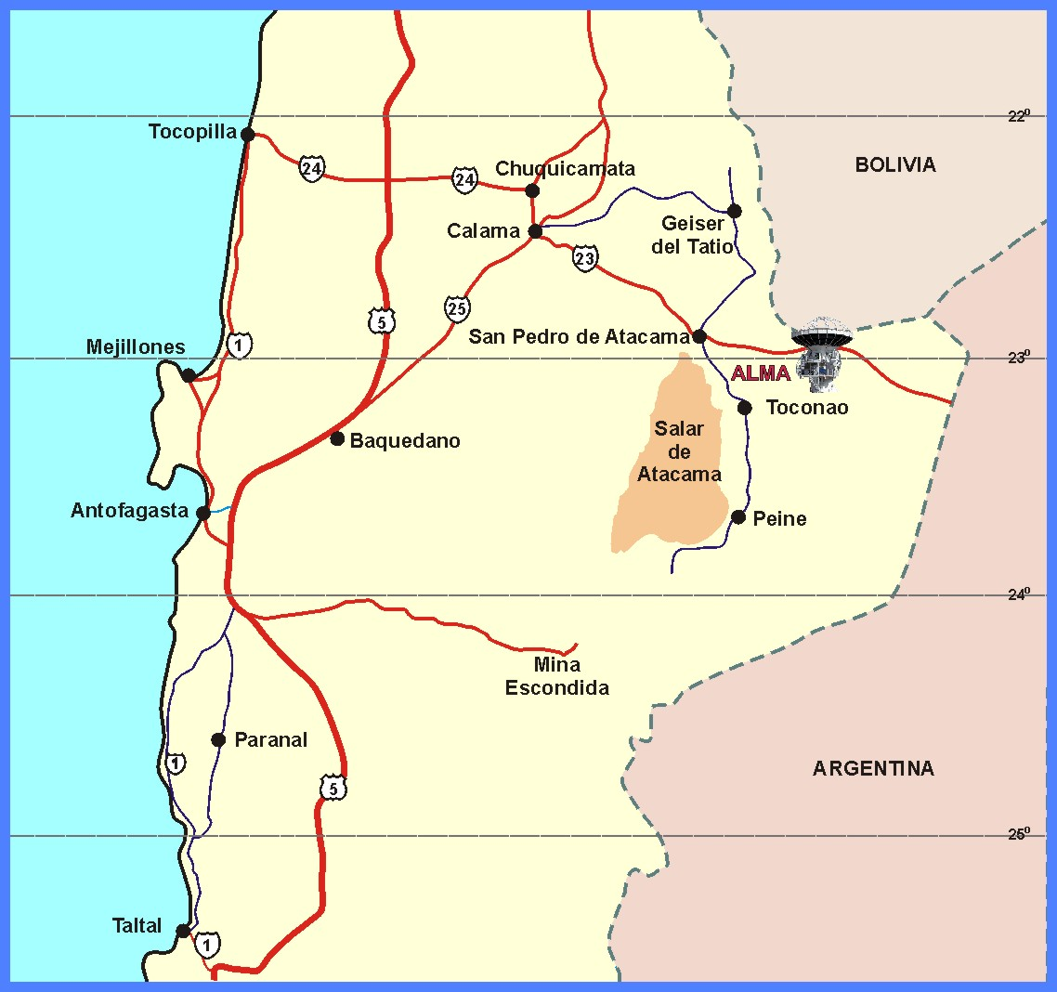
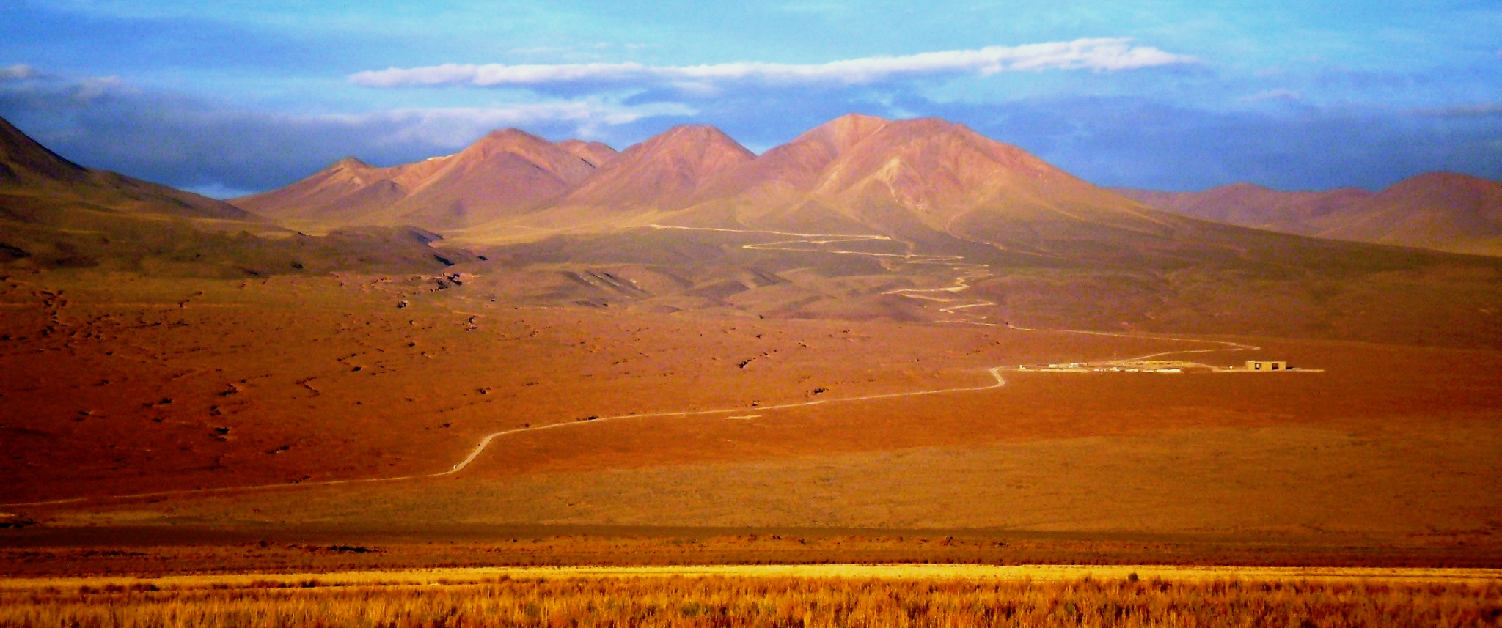
How can I find the ALMA Site?
Paranal
La Serena
Santiago

Slide 18
Visit to the AOS

Slide 19
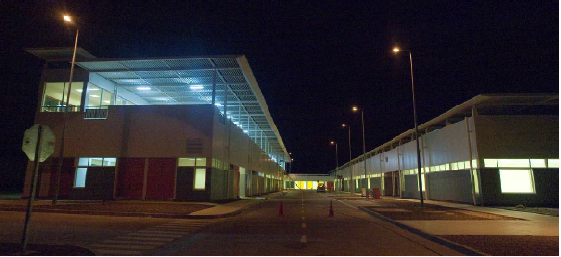
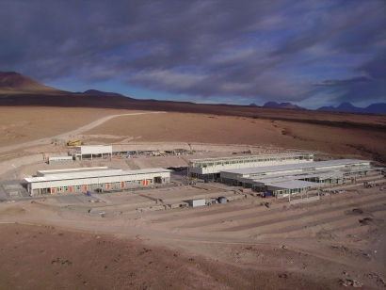
Operations Support Facility: 9500 ft altitude 15 km from gate on CH23
Technical Building
Completed
Warehouse
Shops, offices, antenna area
Camps: House, feed and amuse >500 people
ALMA
Contractors
Antenna erection areas
VertexRSI (NA)
Mitsubishi (JP)
Alcatel (EU)
Temporary Offices
OSF TB

Slide 20
Continue on to the AOS

Slide 21
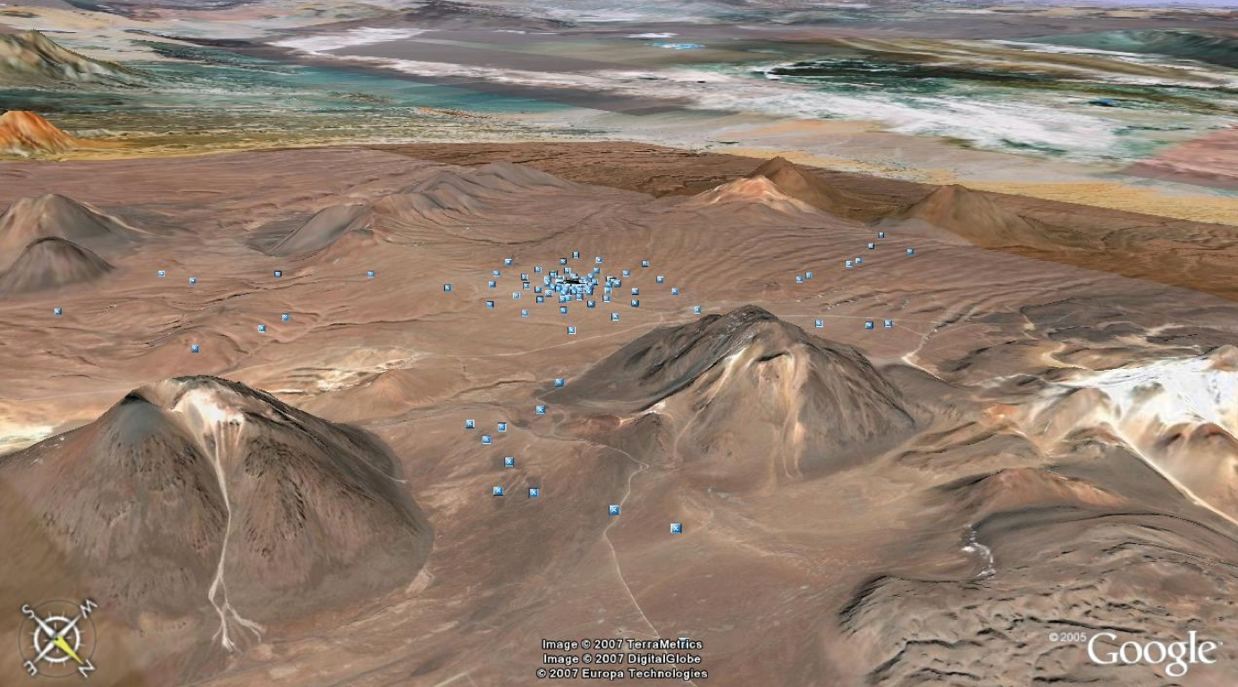
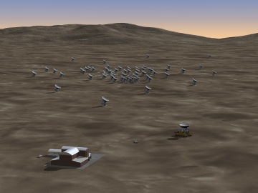
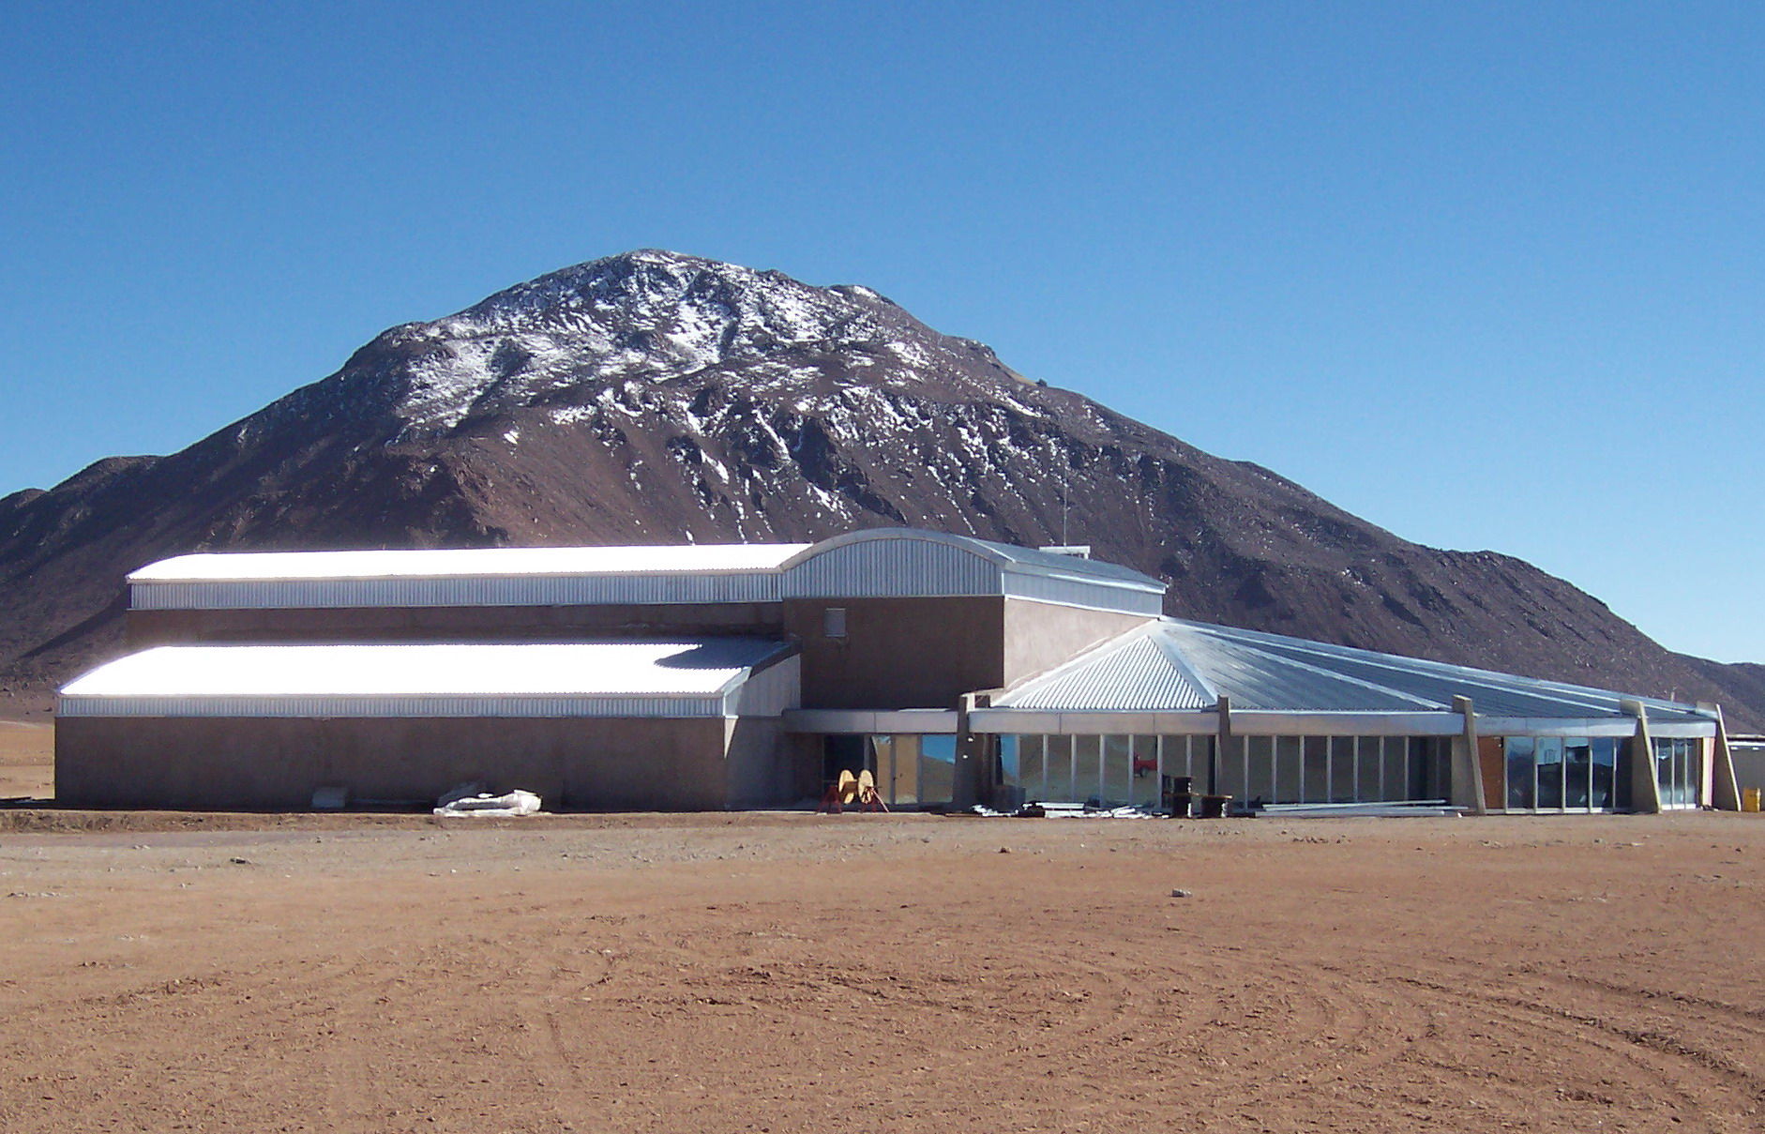
Array Operations Site: 16400 feet 43 km from gate on CH23 on 51ft wide new road
Array reconfigurable 150m-14km
Digitized signals from antenna to TB
TB houses Correlator
Local oscillator signals
Antenna transporter shelter
Refuge
No one overnight, few during day
Array Operations Site Technical Building

Slide 22
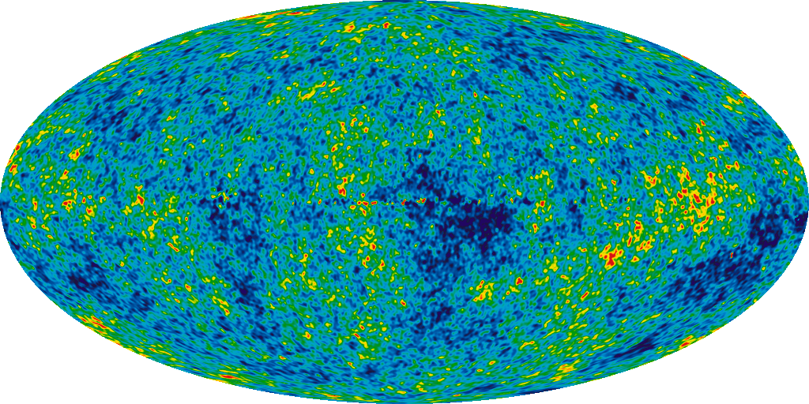
ALMA Science Targets
Design Reference Science Plan contains a suite of potential science experiments
Cosmic Dawn
First Stars and Galaxies
First Star Deaths: Gamma Ray Bursters
Nearby Universe
Galaxy Clusters
Galaxies
Star Formation
Massive Stars
Normal Stars and Planets
Stellar Systems
Sun
Planets and Small Bodies
Notes:
Seven Year Microwave Sky
The detailed, all-sky picture of the infant universe created from seven years of WMAP data. The image reveals 13.7 billion year old temperature fluctuations (shown as color differences) that correspond to the seeds that grew to become the galaxies. The signal from the our Galaxy was subtracted using the multi-frequency data. This image shows a temperature range of ± 200 microKelvin.
Credit: NASA / WMAP Science Team

Slide 23
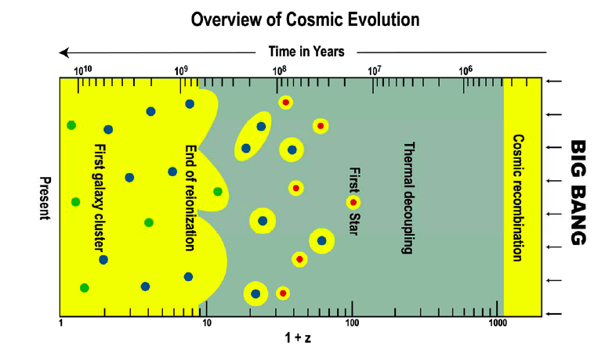
Opening Up the Dark Side of Reionization
After R. Barkana
Notes:
Evolution proceeds from right to left. Following recombination, the Dark Ages stretch
from z ~1,000 to ~100. The first Population III stars are currently believed to have formed
around redshift z ~ 20, or even earlier. Yellow is the region where most of the hydrogen is
ionized. Dark matter concentrations shown in red, blue and green, respectively, denote
concentrations with sizes 0.1, 1, and 200 kpc. FIR/SMM observations will contribute to our
understanding of most of these evolutionary phases. (After R. Barkana.(6))

Slide 24
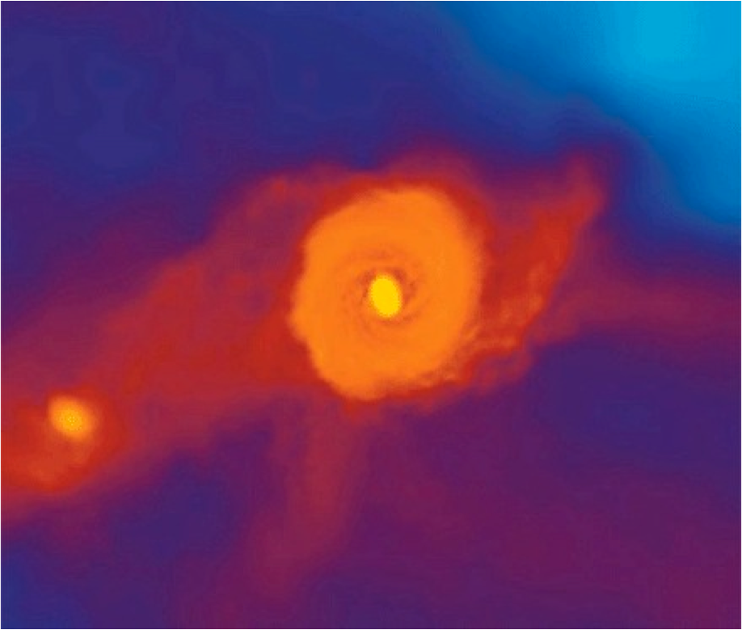
First Light
Dark Matter structures concentrate matter shortly after t=0
Molecular hydrogen (H₂, HD) forms from associative detachment
Cooling of gas allows first stars, expected to be massive, to form
This cooling via rotational lines of H₂ produces emission which shifts into ALMA bands at z~10, potentially observable from the first waves of star formation in massive proto-galaxies.
Massive stars evolve, producing heavier elements, which are distributed throughout the protogalaxies via supernovae, which may appear as Gamma Ray Bursts (GRBs)
Cooling then proceeds via the atomic fine-structure lines, which are redshifted into the ALMA bands
ALMA should be able to observe
Rotational lines of H₂ from large mass accumulations forming the first stars
Emission from GRBs, probing the demise of those first stars
Emission from fine-structure lines as the first galaxies evolve
Notes:
Primordial galaxy. A supercomputer frame showing how the pristine hydrogen and helium gas has assembled in the center of one of the first galaxies, 500 million years after the Big Bang. The prominent disk is a few thousand light years across, with a massive gas cloud in the very center. This cloud is expected to fragment and give rise to a massive cluster of stars, possibly bright enough to be observable with the JWST. Future simulations will include the new Kreckel et al. results.
CREDIT: A. PAWLIK, M. MILOSAVLJEVIC, V. BROMM/TEXAS ADVANCED COMPUTING CENTER

Slide 25
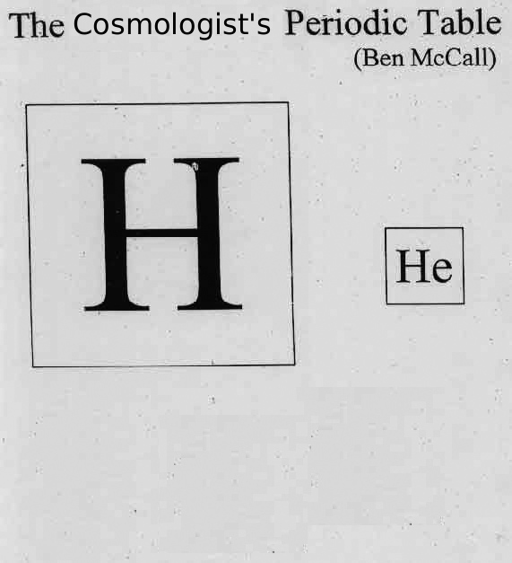
The Birth of Chemical Complexity
When chemistry got interesting
(H₃⁺, H₂D⁺, H₂, HD notwithstanding)
ALMA should be able to monitor the creation of
O ([O I], [O III], OH, H₂O)
C ([C I], [C II], CO, CH, CH⁺,¹³C)
N ([N II], NH, N₂H⁺)

Slide 26
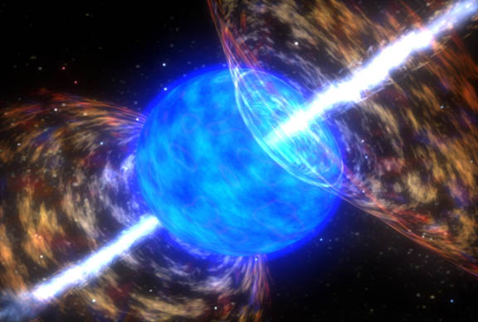
Gamma Ray Bursts and First Stars
Long duration GRBs are though to be related to the death of massive stars which give rise to bright, long-lived afterglow emission that allow them to be observed to great distances.
They probe the epoch from the formation of the first stars (z~30) through to that of reionization (z~11)
Form a distant background against which to view nearer stuff
GRB 090423 (z~8.3) measured at PdBI at ~0.2mJy at 3mm, detectable with ALMA to 5σ in 2 minutes
Excellent time resolution (emission thought caused by a reverse shock propagating inward; a short-lived phenomenon and probe of structure)
Seeded the embryonic Universe with ‘metals’
Notes:
TITLE: GCN CIRCULAR
NUMBER: 9273
SUBJECT: GRB 090423: millimeter detection
DATE: 09/04/28 00:29:21 GMT
FROM: Alberto Castro-Tirado at Inst.de Astro. de Andalucia <ajct@iaa.es>
A. J. Castro-Tirado (IAA-CSIC Granada), M. Bremer and J.-M. Winters
(IRAM Grenoble), J. Gorosabel, S. Guziy, M. Jelínek (IAA-CSIC), P.
Kubánek (GACE, Univ. de Valencia), A. de Ugarte Postigo (ESO Santiago)
and D. Pérez-Ramírez (Univ. de Jaén), report:
"Following the detection by Swift of GRB 090423 (Krimn et al. GCNC
9198), millimeter observations were conducted on Apr 23 & 24 at the
Plateau de Bure Interferometer. Consistent with the nIR afterglow
(Tanvir et al. GCNC 9202) we clearly detect a source at 3-mm with a flux
density of ~0.2 mJy (preliminary) on the combined dataset. Pending of
confirming its variability we propose this as the likely millimeter
afterglow to GRB 090423. Considering the reported redshift values
around z ~ 8, this is the most distant radio source detected to date.
Further observations are scheduled. We acknowledge the Bure staff for
its excellent support."
(remember after z>5 the optical is gone. By z=10 the NIR
is restframe UV and also absorbed. ALMA and a sensitive X-ray
telescope will be all there is to detect the AG.)

Slide 27
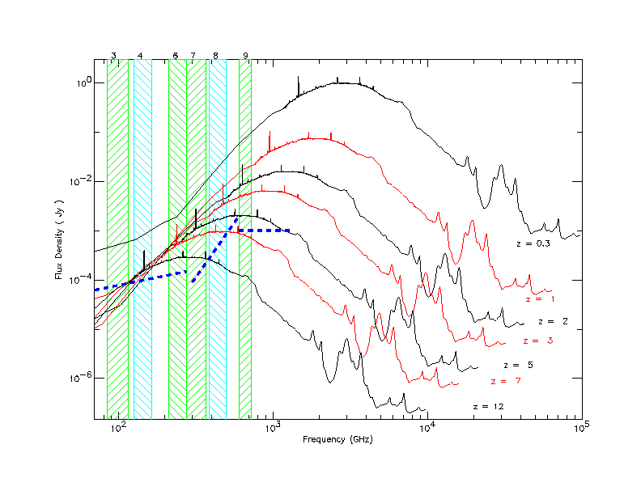
Distant Galaxies and the Inverse K-correction--advantage: submm
As galaxies get redshifted into the ALMA bands, dimming due to distance is offset by the brighter part of the spectrum being redshifted in. Hence, galaxies remain at relatively similar brightness out to high distances.
ALMA Bands
Atomic Fine Structure Lines
Notes:
Few minute sensitivities

Slide 28
Hubble Deep Field (HDF) Rich in Nearby Galaxies, Poor in Distant Galaxies
Source: K. Lanzetta, SUNY-SB
Nearby galaxies in HDF
Distant galaxies in HDF
Notes:
On the left is a field from the Lanzetta et al. movie showing a zoom through time from nearer to more distant galaxies in the HDF, based on measurement of photometric redshifts of 1067 galaxies. Only 25% of these lie at z>2, with only 7% at z>3. Only photometric redshifts can be determined from these galaxies from the optical data.
The area if these two views is about a third or so of the HDF. From statistics, I’d estimate that the slide at the right, with ~20 galaxies, shows those for z>3. That is ~7% of the total number of galaxies.

Slide 29
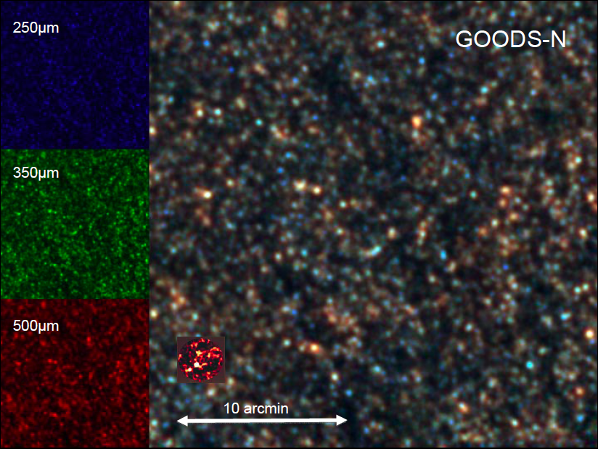
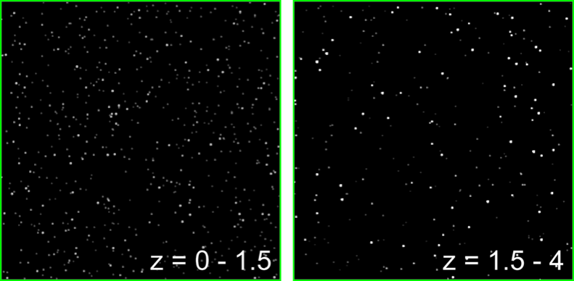
Submm Sources High and Low z
Wang 2008
ALMA knows no confusion limit
Simulation based on:
(1) blank-field bright-end number counts (Wang, Cowie, Barger 2004)
(2) lensing cluster faint-end number counts (Cowie, Barger, Kneib 2002)
(3) redshift distribution of the submm EBL (Wang, Cowie, Barger 2004)

Slide 30
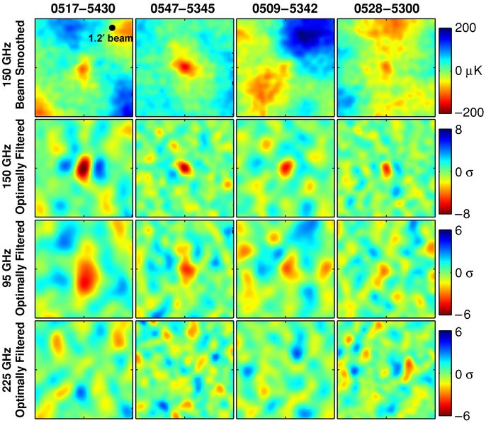
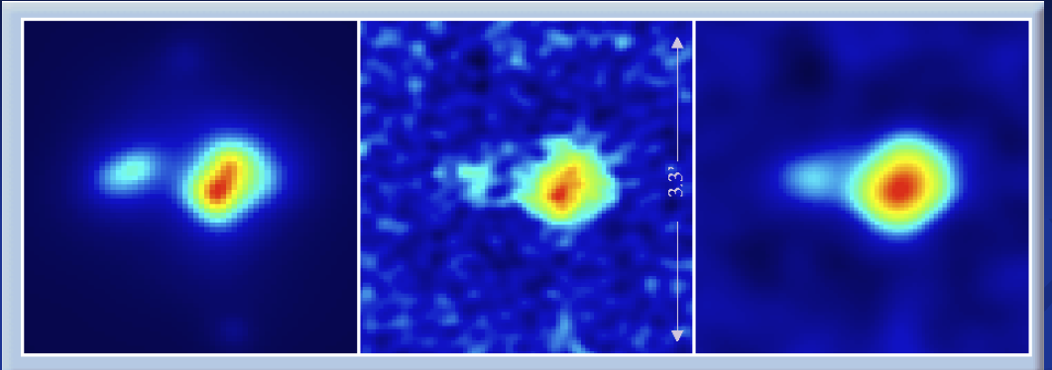
Galaxy Clusters: Sunyaev-Zel’dovich Effect
‘Hole’ in CMB where background photons scatter off hot plasma in galaxy clusters to higher energy (at ~3-7mm).
7mm capability a development item, future implementation,
Combined with a luminosity indicator, such as cluster Xray brightness, a distance may be determined.
Substructures at shock fronts, other interaction regions.
Model
ALMA Simulation
Tapered
Simulation: 34 GHz, by J. Carlstrom
Notes:
Left—simulated cluster at z~1, mass 2.5E14. Center—ALMA in compact configuration, 34 GHz. Right—4klambda taper applied.

Slide 31
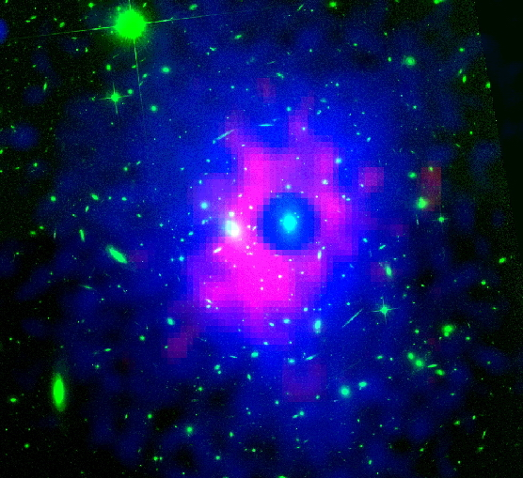
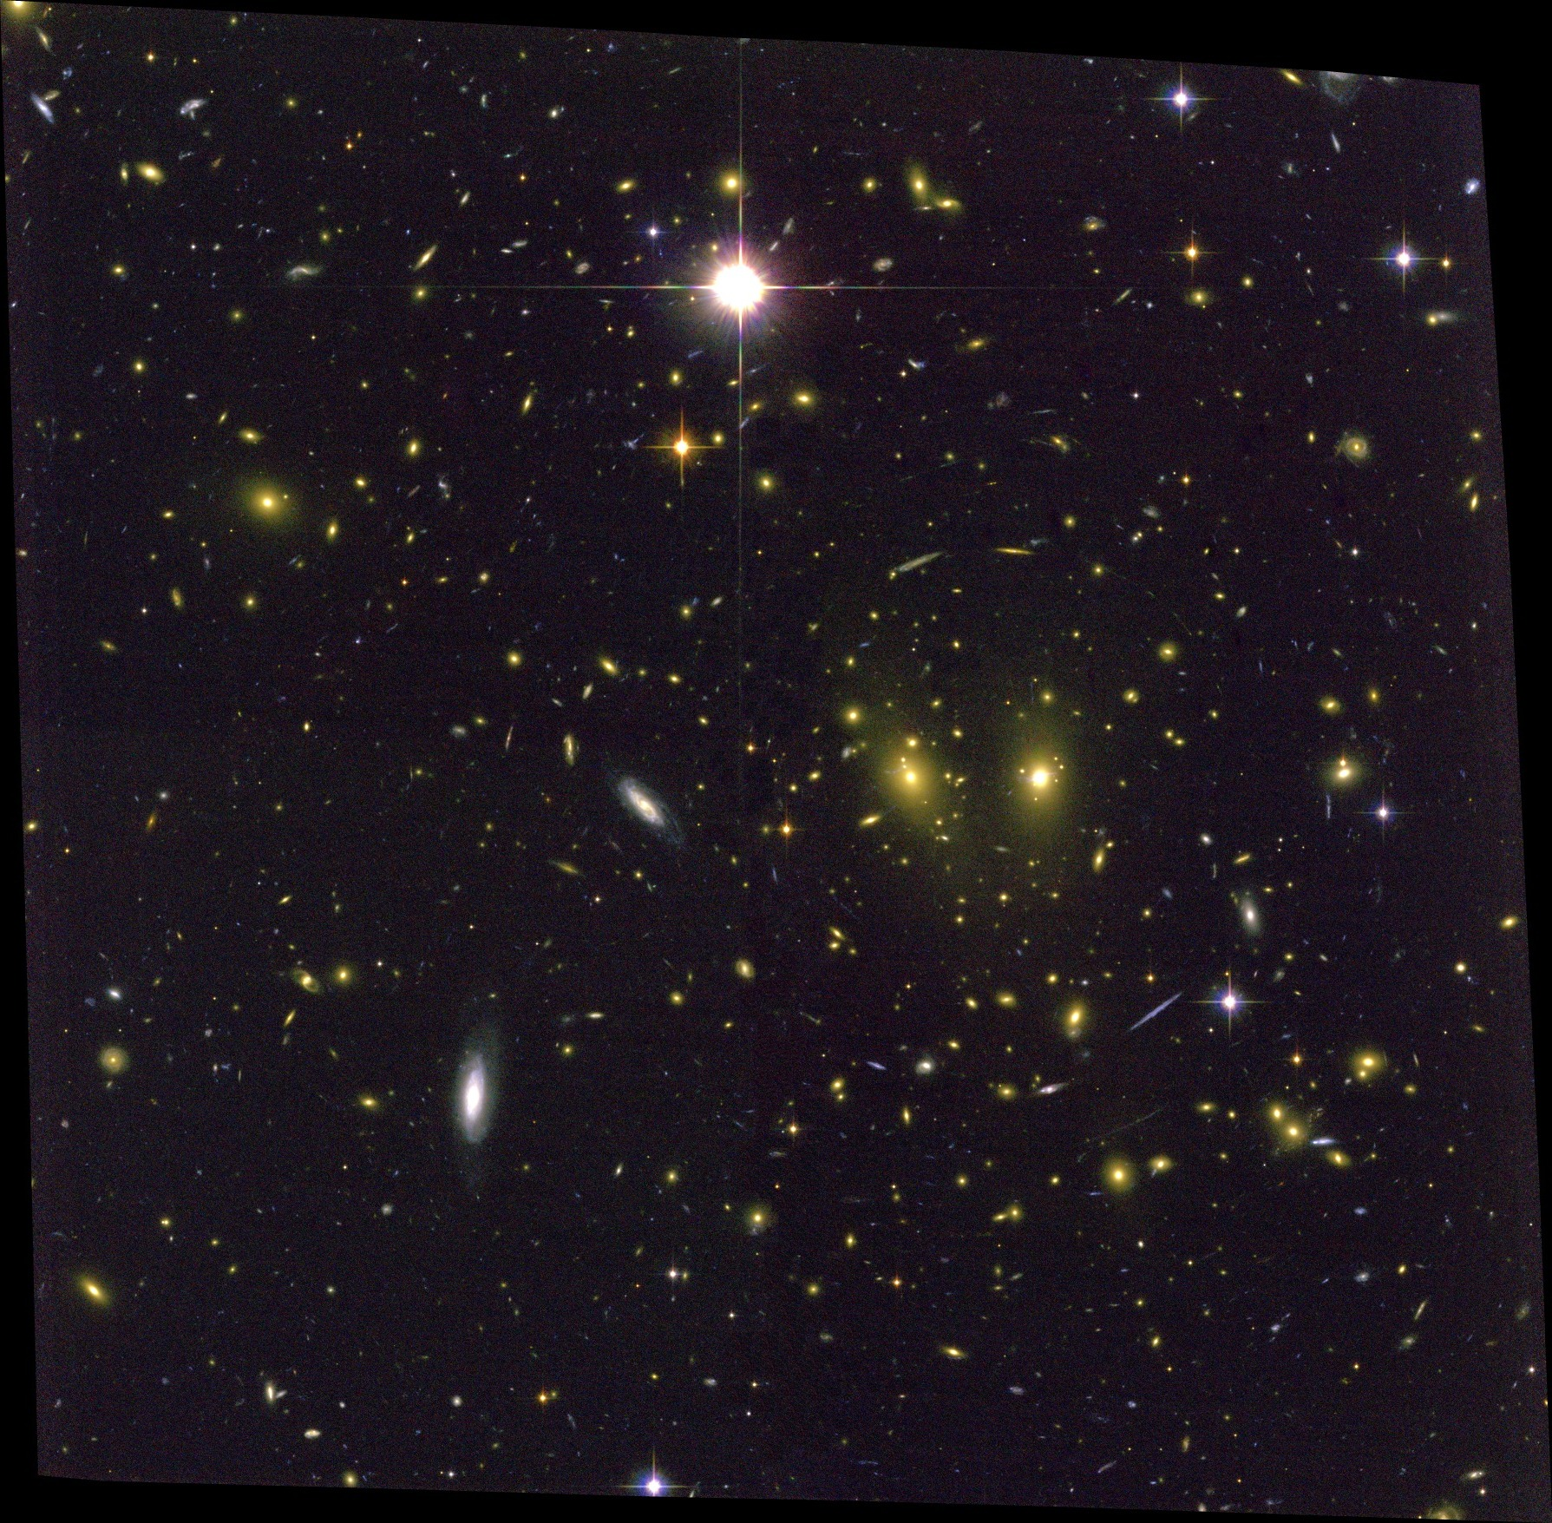
RXJ1347-1145 (z=0.45)
Shock-heated gas revealed in GBT image at 3mm
Suggests merger of two massive clusters
Possible illustration of how clusters get their hots
Fine scale structure an important guide to the interpretation of SZ observations
Highest current resolution (8”)
Notes:
Recent Mustang image of the Sunyaev Zeld'ovich effect in Galaxy Cluster RXJ1347-1145 (Red)
superimposed on Chandra X-ray (blue) and HST optical (green). At 9", this is the highest resolution image of
the SZ effect made to date.
Left: false-color composite image of RXJ1347–1145. Red/blue: Mustang SZ. Green: archival HST/ACS image taken through the F814W filter; and white contours: surface mass density κ from the weak + strong lensing analysis of Bradač et al. (2008). Contours are linearly spaced in intervals of Δκ = 0.1 beginning at κ = 1.0. Several features are labeled: "A" indicates the central BCG, which is a radio source; "B" indicates the BCG of the secondary cluster; and "3" (also labeled in the right-hand panel) indicates the location of the discrepancy between NOBA and MUSTANG, discussed in the text and Figure 5. The diamond, cross, and box mark the locations of the peaks in X-ray surface brightness, surface mass density, and SZE decrement, respectively. Right: contours of the MUSTANG decrement SNR (1σ-5σ in 1σ increments) superposed on the Chandra count-rate image smoothed to 10'' resolution.

Slide 32
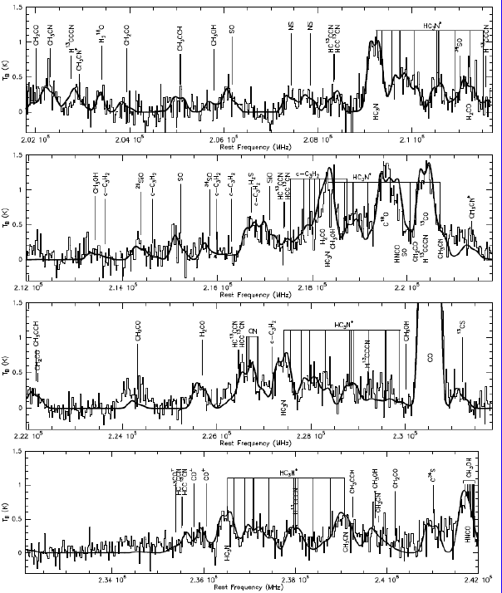
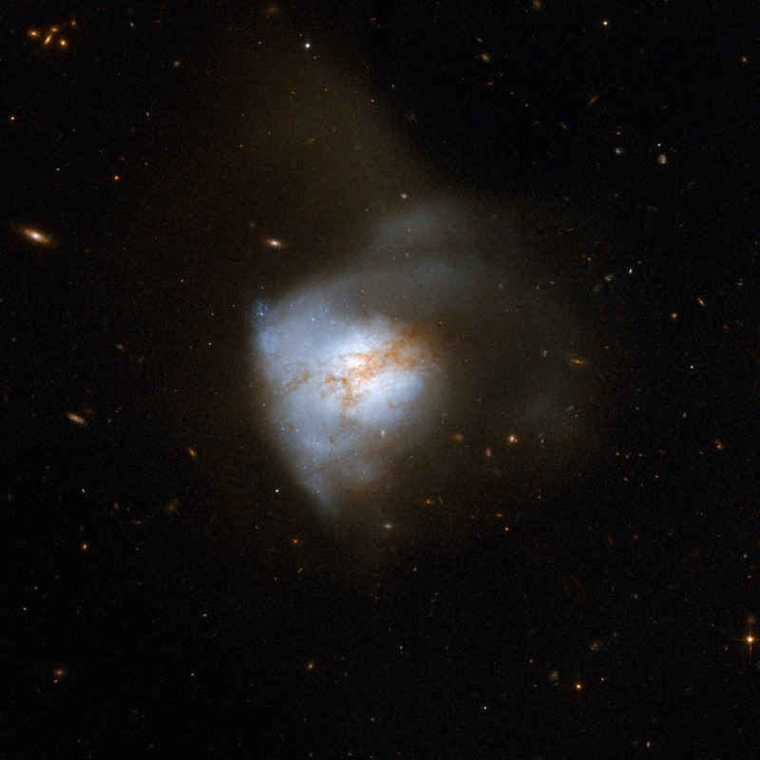
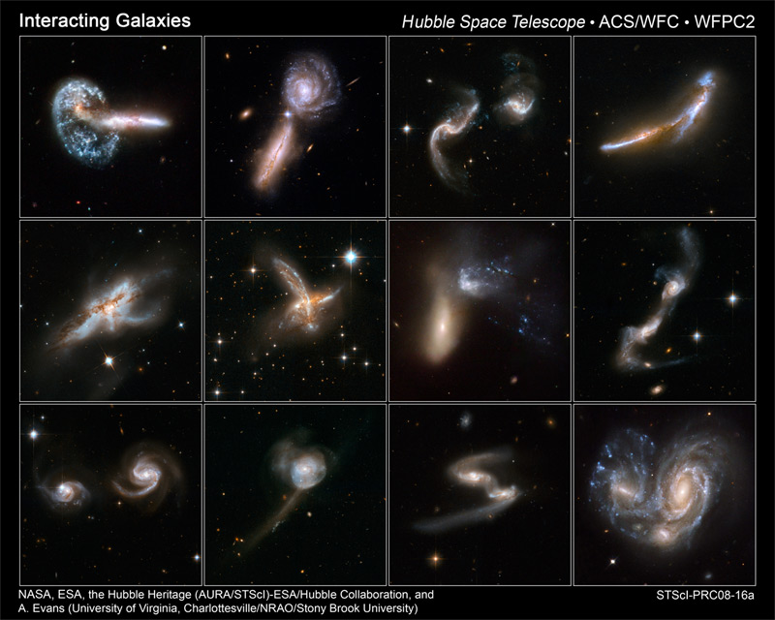
Galaxy Assembly Continues
Galaxies collide; stars passing through while gas clouds collide and shock, forming new stars from the joint molecular reservoirs.
A relatively nearby example is Arp220, 76 Mpc (250Mlyrs) distant. Current instruments reveal a chemically complex spectrum but cannot image the spatial components.
Arp 220
Martin, in prep.
Notes:
The collision, which began about 700 million years ago, has sparked a cracking burst of star formation, resulting in about 200 huge star clusters in a packed, dusty region about 5,000 light-years across (about 5 percent of the Milky Way's diameter). The amount of gas in this tiny region equals the amount of gas in the entire Milky Way Galaxy. The star clusters are the bluish-white bright knots visible in the Hubble image. Arp 220 glows brightest in infrared light and is an ultra-luminous infrared galaxy. Previous Hubble observations, taken in the infrared at a wavelength that looks through the dust, have uncovered the cores of the parent galaxies 1,200 light-years apart. 76 Mpc or 250Mlyr

Slide 33
Complexity of Molecule Distributions
Different molecules trace different environments in nearby galaxies, lending insight into their physics and providing a basis for interpretation of unresolved line emission from more distant galaxies.
Excellent tracers of gas mass: CO, C¹⁸O, N₂H⁺, HNC
Luminosity/nuclear mass tracers: HCN, HNC, continuum
Spiral arm tracers: CH₃OH, HNCO (shocked gas)
Photodissociation region tracers: C₂H, C³⁴S, CN
ALMA will enable
Higher resolution on nearby galaxies
More sensitivity, allowing imaging of additional species
Therefore providing a basis for interpretation of spectra of more distant objects, at a time when star formation in the Universe was more rampant and galaxies were obtaining their presently-observed characters.

Slide 34
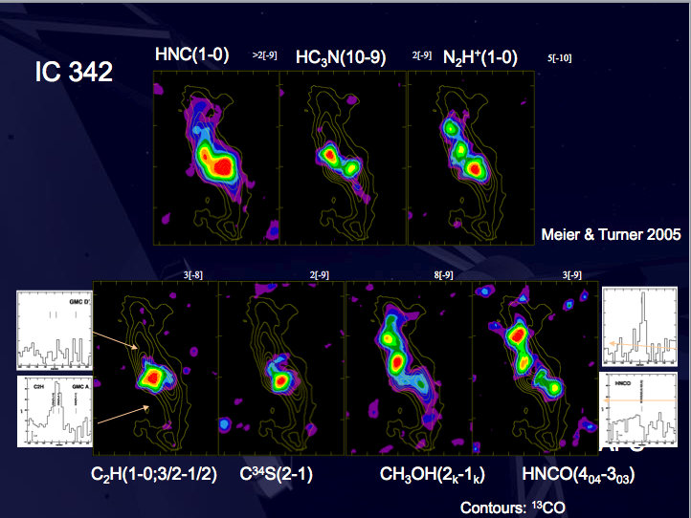
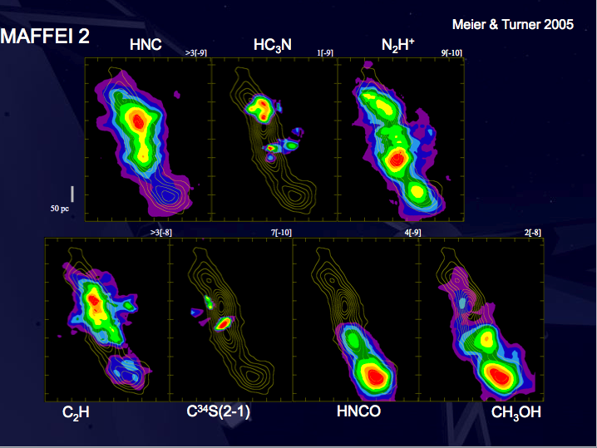
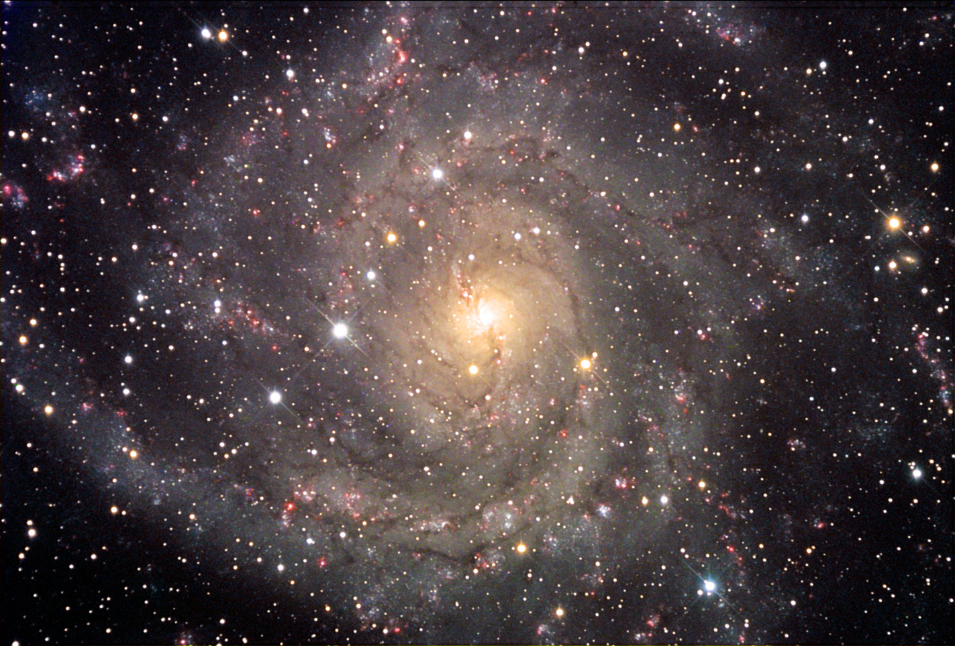
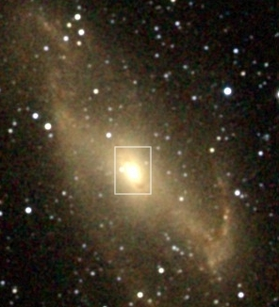
MAFFEI 2
NOAO -- Siarkiewicz
IC 342
R. Hurt - 2MASS

Slide 35
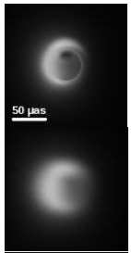
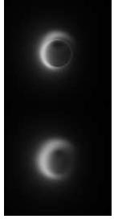
Imaging the Violent Hearts of Galaxies
230GHz
345 GHz
Very Long Baseline Interferometry
Not in the construction plan
ALMA Development upgrade
Enable imaging of Sgr A* Black Hole
Model at right at 345 GHz
ALMA as an element of a worldwide array
M87 BH also usefully imaged

Slide 36
Birth of Stars and Planets
The fundamental objects in the Universe
The nearest Star Formation regions: ~100 pc from the Sun
ALMA Beam at 300 GHz (100 pc): 1.5 AU
L1457 was once reported to lie at ~80 pc but now seems to be beyond 300 pc.
B68 lies at 95 pc (Langer et al.)
Rho Oph has parts as close as 120 pc out to 160 pc
Taurus has parts as close as 125 pc out to 140 pc
Coal Sack and Chameleon and Lupus are about the same.
The nearest protoplanetary regions lie at ~20 pc from the Sun
ALMA Beam at 300 GHz (20 pc): 0.3 AU
TW Hya at 56 pc, TW Hya assn is 10 Myr old, not likely to be forming many planets.
AU Microscopium, about 14 Myr old, lies only 10 pc from the Sun.
Beta Pictoris, 20 Myr old, lies at 17 pc
The nearest debris disks are even closer—around ~10% of nearby stars.
ALMA Beam at 300 GHz (3 pc): 0.05 AU
Epsilon Eridani lies a little over 3 pc from the Sun
Fomalhaut: 7.7 pc

Slide 37
Star Formation Stages
Stars are the result of an evolving balance between gravity and energy

Slide 38
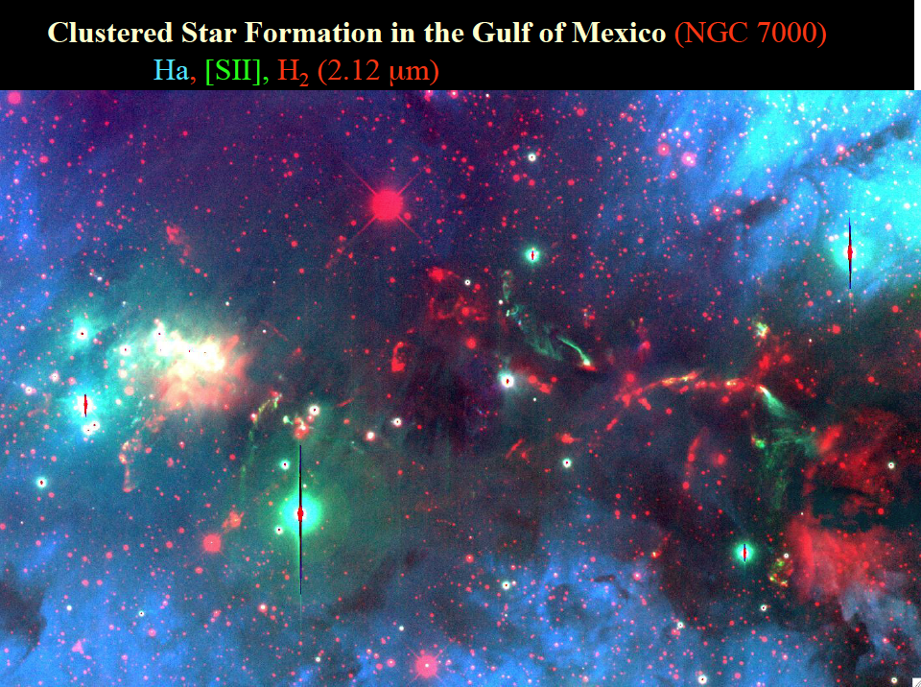
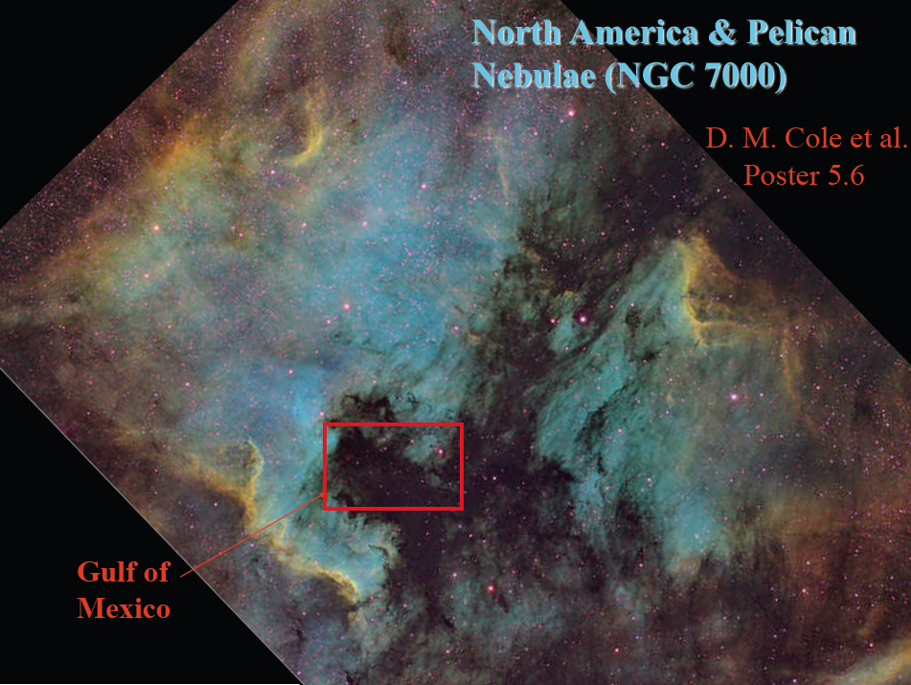
Star Spill in the Gulf
J. Bally
ALMA: Sensitive high resolution unobscured imaging of confused fields over modestly large areas.

Slide 39
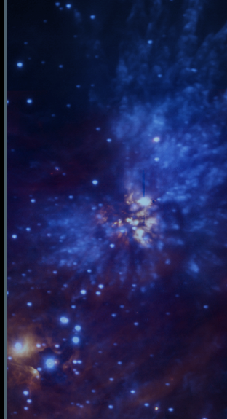
Massive Stars
J. Bally
Multiplicity high
Tend to favor massive clusters
Accretion goes quickly in massive cloud cores
Favor central regions of giant molecular clouds
Form via isolated collapse? Competitive accretion?
ALMA brings resolution and sensitivity
Disentangle complex morphology
Probe rarer high mass star forming regions at greater distances
Southern hemisphere location
OMC1 in H₂: Smith et al 2005; Cunningham 2008

Slide 40
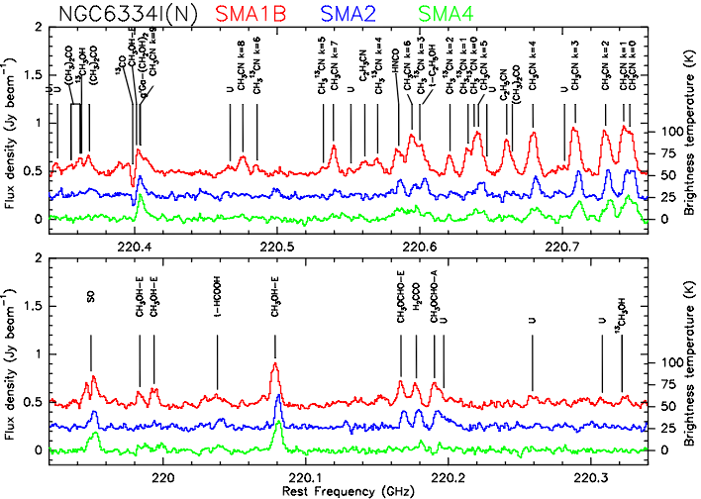
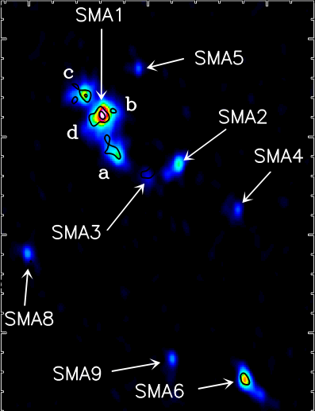
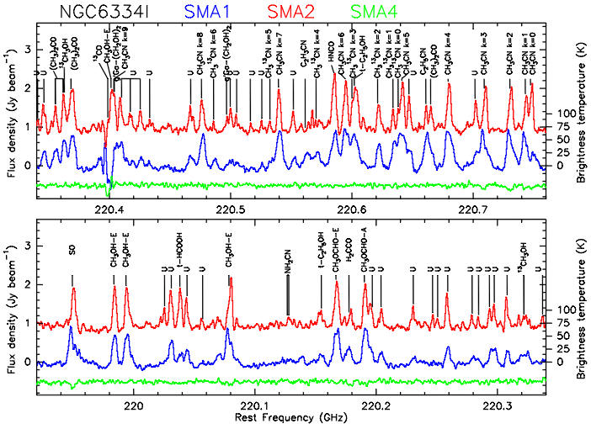
Chemical Complexity of Molecular Clouds
I(N)
A total of 6 line sources in I(N) and 3 in source I
Remarkable chemical variation between sources as little as 4000 AU apart
The 1-d radial velocity dispersion is ~2 km s⁻¹ for both protoclusters
I
Brogan
Notes:
Brogan’s slide!!

Slide 41
Orion Cloud Methyl Formate
Many clumps were detected in multiple transitions in this much more sensitive study of the nearer Orion Molecular Cloud. Excellent correlation of the spatial distribution with that of vibrationally excited H₂ suggests a shock origin for these clumps. This is consistent with a picture in which methyl formate is released from the icy mantles of the grains, where presumably it formed. In that sense, the clumps show some similarities to comets in our own Solar System.
ALMA will bring much improved sensitivity and resolution to the study of many more regions.

Slide 42
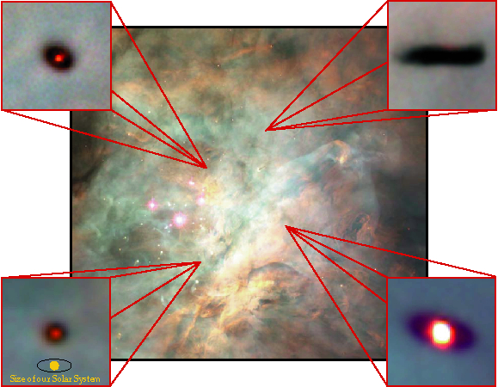
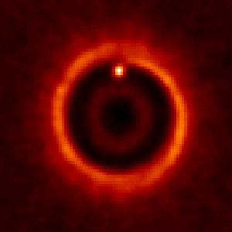
Formation of Planetary Systems
Wolf and D’Angelo 2005
HST view (left) sees opaque dust projected upon a bright background (if persent). In the ALMA view (above, the dust and the protoplanetary region appear bright.

Slide 43
Birth of Stars and Planets
Evolutionary Sequence Observations—
Molecular Cloud Core to Protostar (10⁴ yrs) to
Protoplanetary Disk (to ~10⁶ yrs) to
Debris Disk (to 10⁹ yrs)
Guilloteau et al 2008
Eisner et al 2008
Wilner et al 2002
Vega Dust Disk
Notes:
Guilloteau et al 2008 : A&A 478, L31-L34 (2008) HH30 disk.
\bibitem[Eisner et al.(2008)]{2008ApJ...683..304E} Eisner, J.~A., Plambeck,
R.~L., Carpenter, J.~M., Corder, S.~A., Qi, C.,
\& Wilner, D.\ 2008, \apj, 683, 304
Vega: Wilner, D.~J., Holman, M.~J., Kuchner, M.~J., \& Ho, P.~T.~P.\ 2002, \apjl, 569, L115

Slide 44
Birth of Stars and Planets
Evolutionary Sequence—
Molecular Cloud Core to Protostar (10⁴ yrs) to
Protoplanetary Disk (to ~10⁶ yrs) to
Debris Disk (to 10⁹ yrs)
Lodato and Rice 2005
Wolf and D’Angelo 2005
M. Wyatt; R. Reid
25AU
5AU
160 AU
Vega Dust Disk
Notes:
Lodato and Rice 2005: April volume of MNRAS, 358, 1489: A massive star forming disk.
Wolf and D’Angelo 2005: \apj, 619, 1114
Vega: Wilner, D.~J., Holman, M.~J., Kuchner, M.~J., \& Ho, P.~T.~P.\ 2002, \apjl, 569, L115 Image Wyatt’s model simulated observation by ALMA

Slide 45
www.almaobservatory.org
The Atacama Large Millimeter/submillimeter Array (ALMA), an international astronomy facility, is a partnership among Europe, Japan and North America, in cooperation with the Republic of Chile. ALMA is funded in Europe by the European Organization for Astronomical Research in the Southern Hemisphere (ESO), in Japan by the National Institutes of Natural Sciences (NINS) in cooperation with the Academia Sinica in Taiwan and in North America by the U.S. National Science Foundation (NSF) in cooperation with the National Research Council of Canada (NRC). ALMA construction and operations are led on behalf of Europe by ESO, on behalf of Japan by the National Astronomical Observatory of Japan (NAOJ) and on behalf of North America by the National Radio Astronomy Observatory (NRAO), which is managed by Associated Universities, Inc. (AUI).

Slide 46
San Pedro de Atacama, Chile
Inhabited for thousands of years—one can visit houses from 2000 years ago which were buried under sand then recently uncovered!
Atacameno peoples, related to Aymara
Tiahuanacan culture penetrated the area ca 1000 AD; fortress at Quitor dates from this period
After the fall of Tiahuanacans to the Incas, a period of Atacameno renassaince
Inca expansion into the area around 1460; tax collection post at Catarque
Pedro de Validivia arrives 1540—house he stayed in still stands on plaza
Church ca 1550
Population stable at ~1100-1500 but tourist development began late 90s
Tourists now outnumber townfolk
Geysers, lagunas, flamingoes, Vally of the Moon, Volcanoes, wildlife

Slide 47
El Tatio Geysers (altitude ca 14000 ft)

Slide 48
Quitor fortress

Slide 49
San Pedro Town

Slide 50
Town

Slide 51
Church

Slide 52
Licancabur from Town

Slide 53
Lagunas and Flamingoes

Slide 54
Lascar Volcano
Notes:
18 April 2006 eruption

Slide 55
www.almaobservatory.org
The Atacama Large Millimeter/submillimeter Array (ALMA), an international astronomy facility, is a partnership among Europe, Japan and North America, in cooperation with the Republic of Chile. ALMA is funded in Europe by the European Organization for Astronomical Research in the Southern Hemisphere, in Japan by the National Institutes of Natural Sciences (NINS) in cooperation with the Academia Sinica in Taiwan and in North America by the U.S. National Science Foundation (NSF) in cooperation with the National Research Council of Canada (NRC). ALMA construction and operations are led on behalf of Europe by ESO, on behalf of Japan by the National Astronomical Observatory of Japan (NAOJ) and on behalf of North America by the National Radio Astronomy Observatory (NRAO), which is managed by Associated Universities, Inc. (AUI).

Slide 56
Technical Specifications
54 12-m antennas, 12 7-m antennas, at 5000 m altitude site.
Surface accuracy ±25 μm, 0.6” reference pointing in 9m/s wind, 2” absolute pointing all-sky.
Array configurations between 150m to ~15 -18km.
10 bands in 31-950 GHz + 183 GHz WVR. Initially:
86-119 GHz “3”
211-275 GHz “6”
275-370 GHz “7”
602-720 GHz “9”
8 GHz BW, dual polarization.
Flux sensitivity 0.2 mJy in 1 min at 345 GHz (median cond.).
Interferometry, mosaicing & total-power observing.
Correlator: 4096 channels/IF (multi-IF), full Stokes.
Data rate: 6MB/s average; peak 60-150 MB/s.
All data archived (raw + images), pipeline processing.

Slide 57
The Far-Infrared
Far-IR: Liquid nitrogen to Antarctic temperatures
IR:
Kuiper Airborne Observatory, IRAS, ISO and Spitzer discover an unknown Universe
Short Radio wavelengths:
NRAO 12m, JCMT, CSO, IRAM 30m
IRAS
ISO
Spitzer

