Slide 1
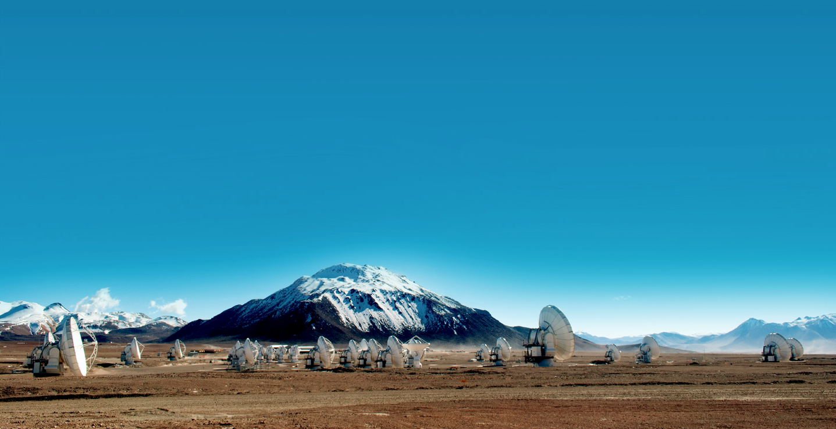
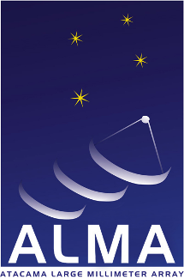





Millimeter/submillimeter Astronomy at High Sensitivity and High Resolution
Al Wootten, Stuartt Corder, Daisuke Iono, Leonardo Testi
IAU Div B
August 10th, 2015
Notes:
Thanks to organizers@

Slide 2
Presentation Outline
Introduction
A Brief History
Key Design Elements
Operations
Science Goals
Science
Development Program
Summary

Slide 3
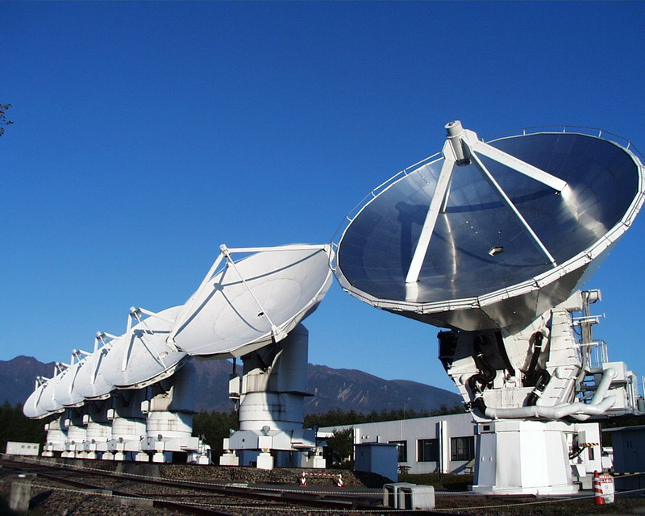
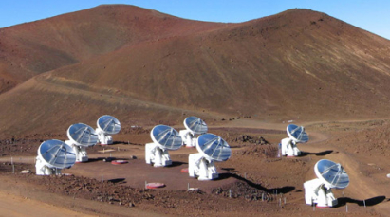
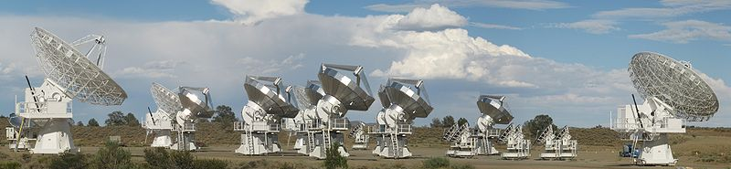
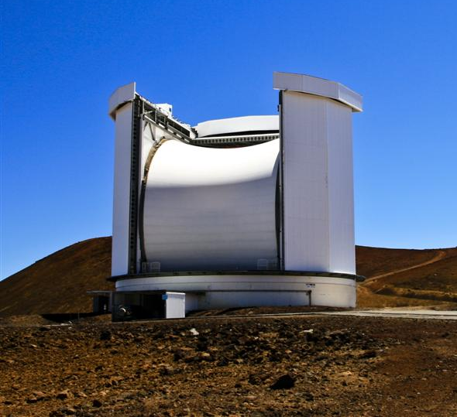
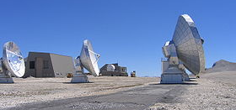
Introduction
ALMA is a revolutionary imaging & spectroscopic telescope system for mm & submm astronomy
Builds on pioneering technical development & scientific research conducted at
  Submillimeter Array (SMA)
  Institut de Radioastronomie Millimétrique Plateau de Bure Interferometer (IRAM PdB)
  Nobeyama Millimeter Array (NMA)
  Combined Array for Research in Millimeter Astronomy (CARMA)
  James Clerk Maxwell Telescope (JCMT)
NMA
SMA
CARMA
JCMT
IRAM PdB
Notes:
----- Meeting Notes (8/5/15 18:09) -----
NMA

Slide 4
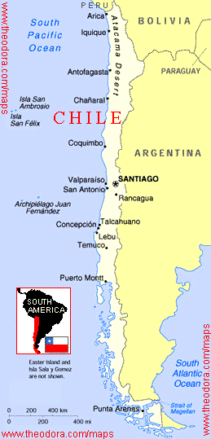
Introduction
Global partnership (shared cost ~1.3 billion 2006$):
  North America (US, Canada, Taiwan)
  Europe (ESO)
  East Asia (Japan,Taiwan, Korea)
  In collaboration with Chile
Unique high, dry site:
  5000m (16,500 ft) in Chilean Atacama desert
66 submillimeter/millimeter telescopes:
12-m Array – 50 x 12-m
Atacama Compact Array (ACA) - 12x7-m, 4x12-m
Completed 2014

Slide 5
Introduction
Array configurations between 150 meters and 15 kilometers: 192 possible antenna locations for 66 12m antennas; 22 for 16 ACA antennas on shorter baselines
Angular resolution to 0.005 arcsec (900 GHz)
Ten frequency bands: 35 – 950 GHz
All science data archived, with reference images
Pipeline processing
The ALMA telescope is an effort of many nations for all astronomers
Notes:
ALMA could fit on the White House Ellipse or span the DC Beltway
----- Meeting Notes (8/2/15 18:56) -----
Compare to Hawaiian Islands
----- Meeting Notes (8/5/15 16:25) -----
ACA pads also

Slide 6

Introduction
A partnership of North America (37.5%), Europe (37.5%), and East Asia (25%), in cooperation with the Republic of Chile
Funding
North America: National Science Foundation (US), in cooperation with National Research Council (Canada) and National Science Council (Taiwan)
Europe: European Organisation for Astronomical Research in the Southern Hemisphere (ESO)
East Asia: National Institute of Natural Sciences (Japan) in cooperation with Academia Sinica (Taiwan) and KASI (Republic of Korea)

Slide 7
A Brief History of ALMA: I
A fusion of ideas under development since the 1980s
  Millimeter Array (MMA) United States
  Large Southern Array (LSA) Europe
  Large Millimeter Array Japan
NRAO & ESO agreed in 1997 to merge MMA and LSA → Atacama Large Millimeter Array
ALMA Agreement signed 25 Feb 03 by North America & Europe
Japan joined partnership Sep 2004, providing additional capabilities
  Atacama Compact Array & very high frequency bands
ALMA → Atacama Large Millimeter/submillimeter Array

Slide 8
A Brief History of ALMA: II
Nov 2003 Groundbreaking in northern Chile
Apr 2007 First ALMA Antennas arrive in Chile
Oct 2011 Cycle 0 Early Science begins with 16 antennas
May 2012 Cycle 1 Early Science Call for Proposals
Oct 2013 Cycle 2 Call for Proposals
Jun 2014 Cycle 2 Early Science begins
Sep 2014 ALMA construction completed
Mar 2015 Cycle 3 Call for Proposals
Oct 2015 Cycle 3 Early Science Begins
Notes:
----- Meeting Notes (1/7/15 14:19) -----
Check dates
----- Meeting Notes (8/5/15 16:25) -----
Cycke 1 began?

Slide 9
Key Design Elements
  ALMA improves available mm/submm sensitivity by ~ two orders of magnitude
      Best accessible site on Earth
      Highest performance antennas & receivers available
      Enormous collecting area (1.6 acres or 6600+ m²), huge number of baselines provides image fidelity
    Covers ten atmospheric windows with 50% or more transmission above 35 GHz: Large bandwidths
  Resolution improvement of nearly 100x
  Wavelength coverage improved by 2x
  ALMA Development: Update & Extend Capabilities
Notes:
Large bandwidth provides continuum sensitivity and spectral grasp.
Examples of science with these? Resolution: HL Tau, SDP.81
Wavelength coverage: [C II] from z~1 to z~10 and beyond.
Bandwidth: show high z spectral survey.
Note Development cost is of similar order to what a homeowner invests to maintain a home over a lifetime.

Slide 10
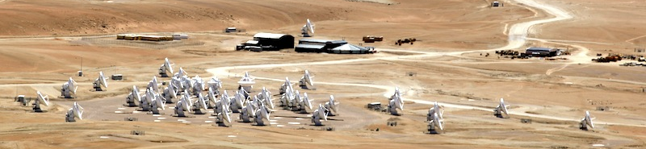
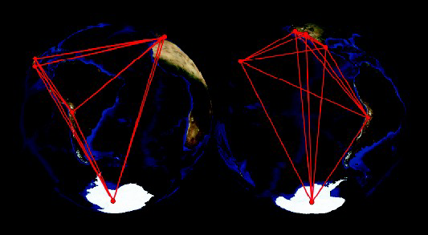
Key Design Element: Antennas
66 high precision antennas operated as an imaging interferometer
  12m Array: Fifty 12m diameter antennas
  Atacama Compact Array (ACA)
    Twelve 7m diameter antennas ‘Morita Array’
    Four 12m antennas = “Total Power Array”
192 +22 antenna stations
ALMA as an element of a global network now being enabled through the ALMA Development Program: Cycle 4 goal.
Notes:
, 25 μm surfaces
Cover an area the size of the DC beltway (compare to something Hawaiian?).
APP funded primarily by NSF.
----- Meeting Notes (8/5/15 16:25) -----
plus ACA stasions

Slide 11
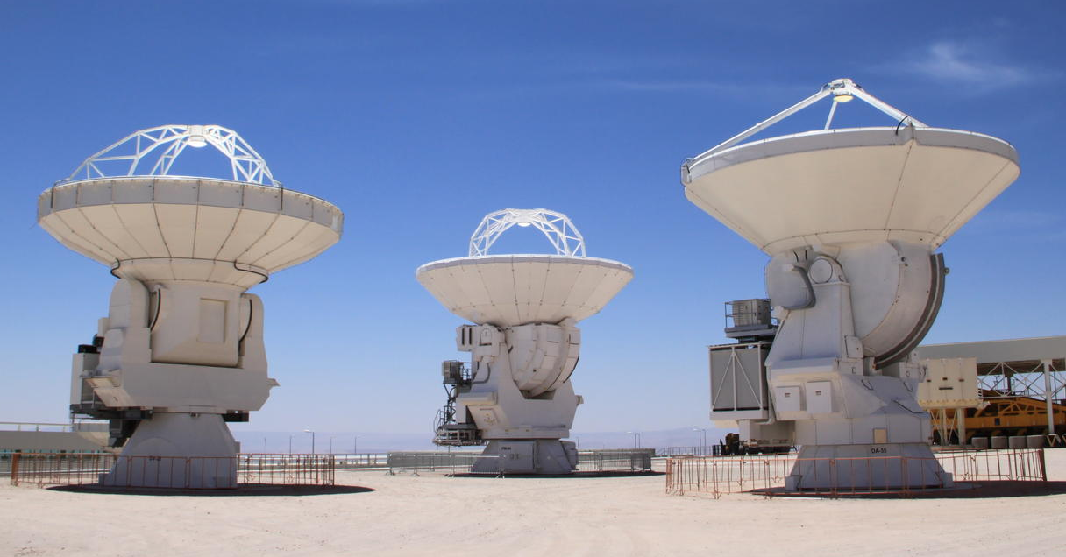
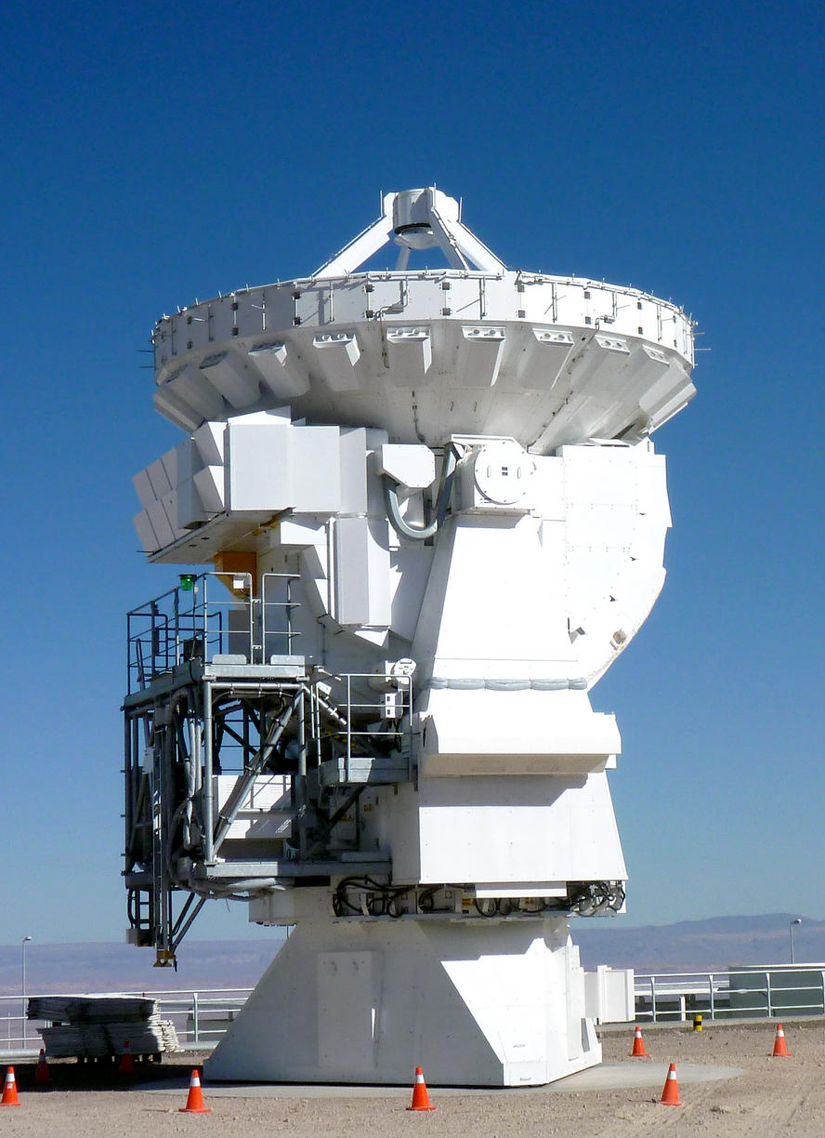
Key Design Element: Antennas
General Dynamics SATCOM Technologies
North America
Alcatel Consortium
Europe
Mitsubishi Electric Corp
Japan
Notes:
Three different designs for 100 ton antennas performing to the same specifications.
----- Meeting Notes (8/2/15 17:17) -----
Note that work to understand antenna performance in the harsh high altitude environment continues

Slide 12
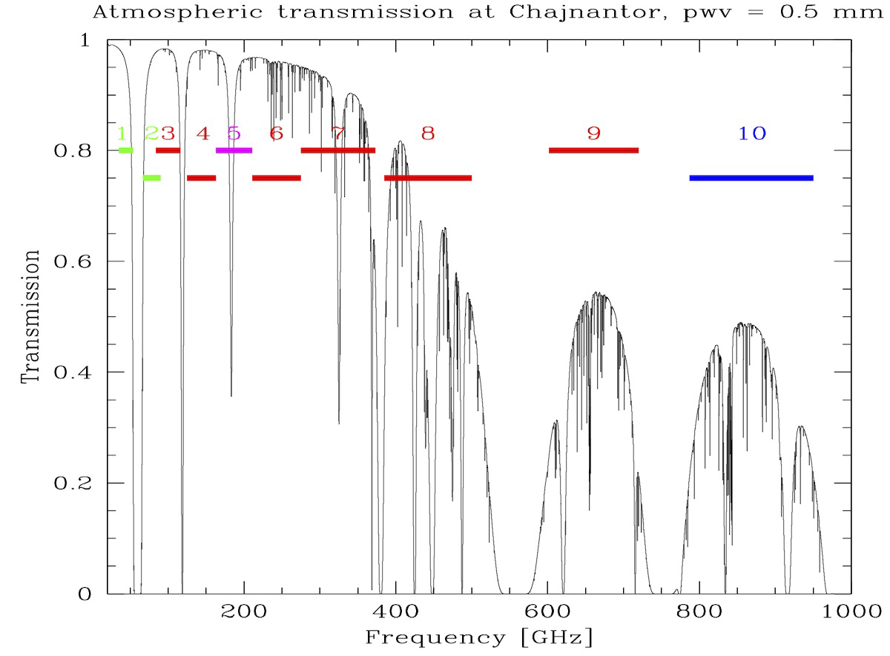
Key Design Element: ALMA Receiver Bands
Notes:
Seque to Development?
----- Meeting Notes (8/2/15 17:21) -----
Commissioning Band 10 for Cycle 3 deployment, beginning installation of Band 5, prototypes being constructed under the Develoment Program for Bands 1 and 2 (7mm, 4mm).

Slide 13
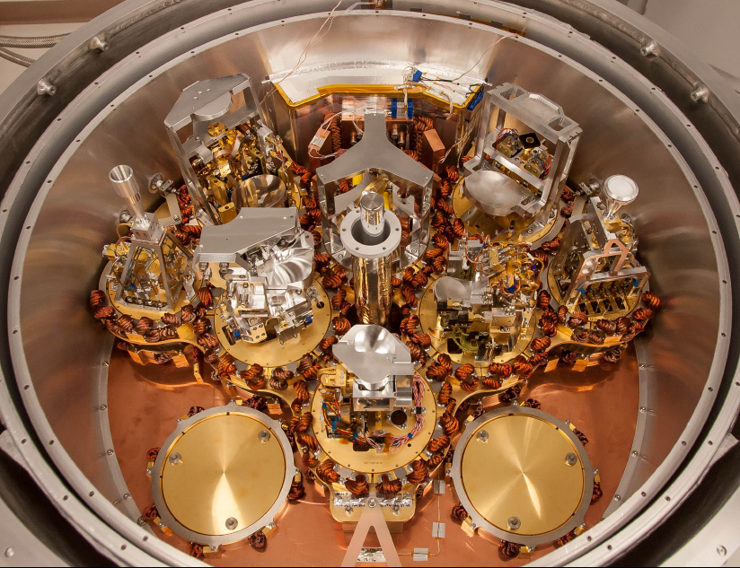
Key Design Element: Receivers
No moving parts: all electronically tunable
State-of-the-art receiver performance: 35-950 GHz
Dual linear polarization, 8 GHz per pol, 2 GHz basebands
Line Replaceable Units → Ease of Maintenance and Upgrades through ALMA Development Program
Digitization: 4 Gbit/s, 3 bits, 8-level (96 Gbit/s per antenna)
Signals cross-correlated for a large number of delays and all possible antenna pairs
Notes:
Just last month the first in a series of receivers covering a a new Band—1.6mm—was installed, to be complete by 2017.
----- Meeting Notes (8/2/15 17:21) -----
Note that some bands can actually provide more than 16 GHz of processable signal, suggesting an upgrade for the development program to increase ALMA's sensitivity still further.

Slide 14
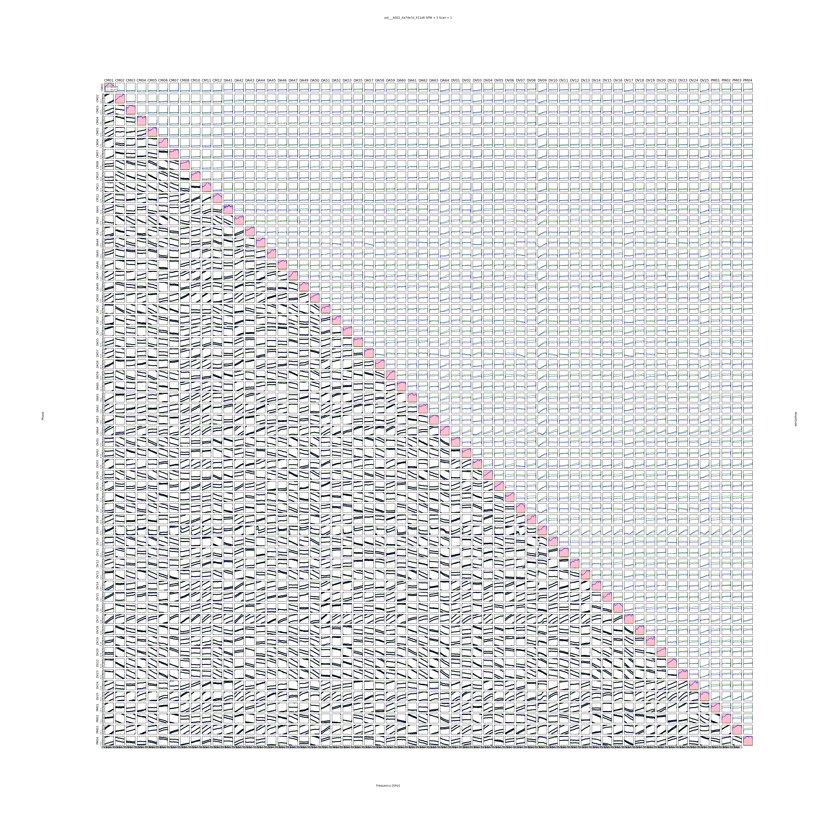
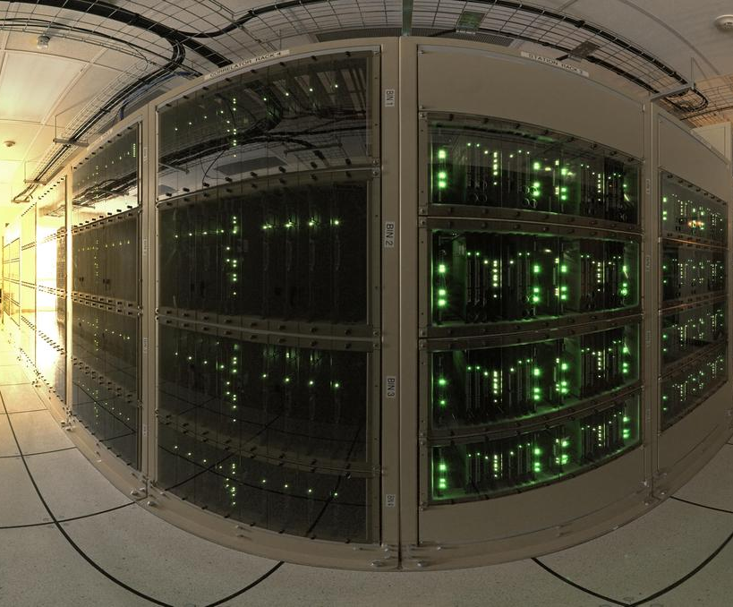
Key Design Element: Correlators
1770 Baselines, 403.5 GHz 3C454.3
ALMA correlators: special purpose supercomputer that combines the digital signals from each antenna
BL Correlator (64 input)
  Custom CMOS chips
  4096 processors
  32,768 chips on 512 boards
  17 Tera-operations/second
ACA Correlator (16 input)
  Independent processing
BL Correlator
Upgrades forseen through ALMA Development Program
Kameno et al 2015
Notes:
----- Meeting Notes (8/2/15 17:27) -----
May be divided into independent subarrays for special purposes, such as measuring baselines to newly moved antennas.
the new record of the number of antennas. I'd like to share the 1770-baseline cross power spectra. The upper triangular plots show amplitudes of cross power spectra, while lower triangular plots do phases. The diagonal plots stand for autocorrelations. The quasar 3C 454.3 was observed at Band 3. 3C 454.3 at 403.5 GHz, 1.54-sec integ.
----- Meeting Notes (8/17/15 10:12) -----
Kameno, Phillips, Hirota, Gaillardo

Slide 15
Operations
ALMA Operations led on behalf of:
  North America by NRAO
  Europe by ESO
  East Asia by National Astronomical Observatory of Japan (NAOJ)
Joint ALMA Observatory (JAO) is responsible for ALMA operations in Chile
  Operations Support Facility
  Array Operations Site
  Santiago Central Office
Communications occur through almascience.org
Communications
Notes:
----- Meeting Notes (8/2/15 19:14) -----
Visite at OSF

Slide 16
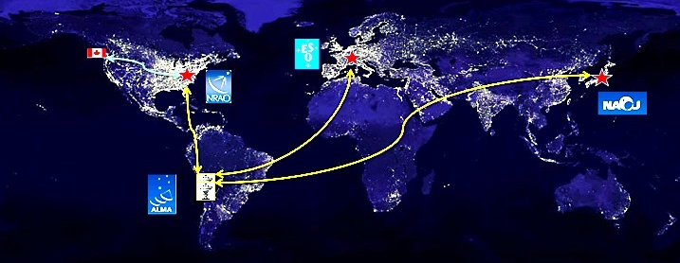
Operations: Science Archive
Science Archive available from each of Santiago, NRAO-CV, ESO, and NAOJ
Notes:
----- Meeting Notes (8/2/15 19:14) -----
Mention new data highway through ALMA Development Program

Slide 17
Science Goals
ALMA design driven by three Key Science Goals
Detect spectral line emission from CO or [CII] in a normal galaxy like the Milky Way at z=3 in less than 24 hours
Image the gas kinematics in protostars and protoplanetary disks around young Sun-like stars in the nearest molecular clouds (150 pc)
Provide precise high dynamic range images at an angular resolution of 0.1 arcsec

Slide 18
Science
Cycle 0 Early Science
  919 proposals received, began Oct 2011
  Observations acquired for 113 projects
  All data delivered, available in archive, 178 papers
Cycle 1 Early Science
  1173 proposals received, began Jan 2013
  Observations being acquired for 198 projects
  Data becoming available in archive, 25 papers
Notes:
Cycle 0 919 proposals, 113 projects in highest priority. All delivered.
Cycle 1 1173 proposals, 198 in highest priority,
Cycle 2 1381 proposals, 354 in highest priority,
Cycle 3 1578 proposals, 501 in highest priority.
----- Meeting Notes (8/17/15 10:12) -----
Cyc 3 stats

Slide 19
Science
Cycle 2 Early Science
  1381 proposals received, began 1 June 2014
  Observations being acquired for 354 projects
  5 refereed papers.
Cycle 3 Early Science
  1582 proposals received, to begin 1 Oct 2015
  Observations to be acquired for 401 projects
Notes:
----- Meeting Notes (8/2/15 19:14) -----
Cycle 2 data still mostly in proprietary period.
----- Meeting Notes (8/9/15 22:01) -----
401

Slide 20
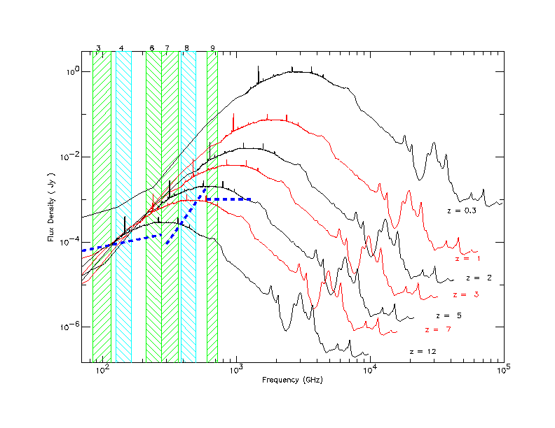
Distant Galaxies: Inverse K-correction
As galaxies get redshifted into the ALMA bands, dimming due to distance is offset by the brighter part of the spectrum being redshifted in. Hence, galaxies remain at relatively similar brightness out to high distances. This spectrum assumes solar metallicity of course; lower metallicity galaxies may be suppressed at higher z.
Atomic Fine Structure Lines
[C II], [O I], [N II]
ALMA Bands
10
Notes:
Few minute sensitivities
favors the mm/submm windows for detection of distant objects with cool galaxy SEDs

Slide 21
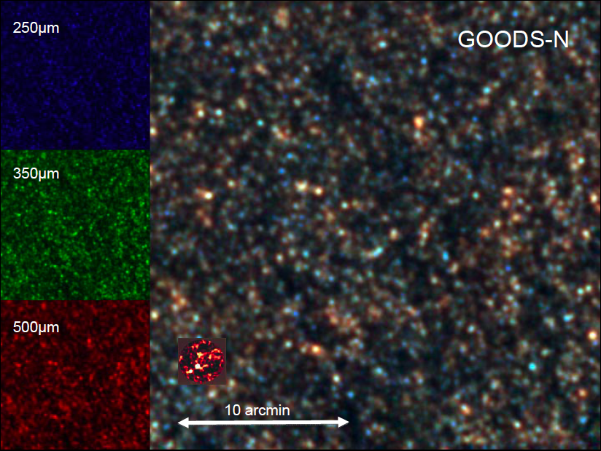
At Deep Sensitivities, Galaxies Crowd
ALMA knows no confusion limit
Notes:
But at deep sensitivities the mm sky is crowded, demanding a fine beam to separate emitters and penetrate the confusion limit/
~3× deeper and with a beam area ~200× smaller than the original LESS observations, doubling the current number of interferometrically-observed submillimeter sources. The high resolution of these maps allows us to resolve sources that were previously blended and accurately identify the origin of the submillimeter emission. We discuss the creation of the ALESS submillimeter galaxy (SMG) catalog, including the main sample of 99 SMGs and a supplementary sample of 32 SMGs. We find that at least 35% (possibly up to 50%) of the detected LABOCA sources have been resolved into multiple SMGs, and that the average number of SMGs per LESS source increases with LESS flux density.

Slide 22
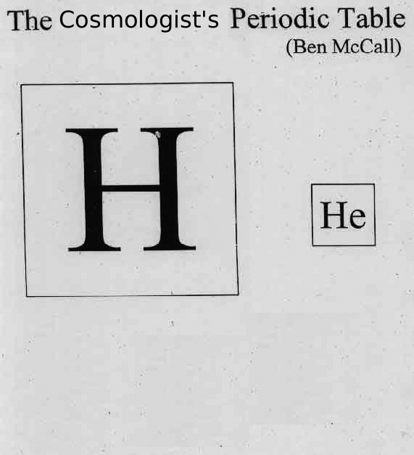

The Birth of Chemical Complexity
When chemistry got interesting
(H₃⁺, H₂D⁺, H₂, HD notwithstanding)
ALMA should be able to monitor the creation of
O ([O I], [O III], OH, H₂O)
C ([C I], [C II], CO, CH, CH⁺,¹³C)
N ([N II], NH, N₂H⁺)
Notes:
discussion of the N/C ratio at z=4.76 in arXiv:1205.4834 from ALMA [N II] observations. N is a secondary nucleosynthetic product but appears as abundant as locally even at an age since the big one of 1.27 Gyr. Since the [N II] line is only 5% of [C II] this is pretty much an ALMA-only sort of project.
----- Meeting Notes (1/7/15 14:27) -----
black

Slide 23
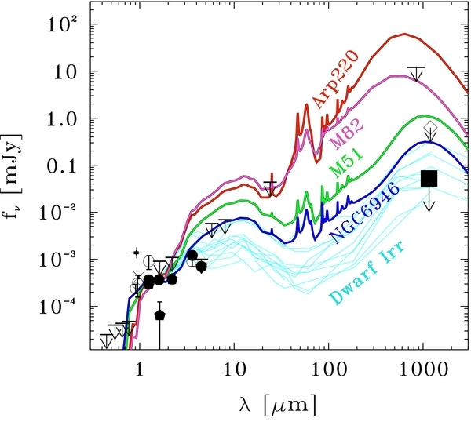
Submillimeter Continuum
Figure 5 from An Intensely Star-forming Galaxy at z ~ 7 with Low Dust and Metal Content Revealed by Deep ALMA and HST Observations Masami Ouchi et al. 2013 ApJ 778 102 doi:10.1088/0004-637X/778/2/102
Notes:
The optical to far-infrared SED of Himiko in the observed frame. The filled square shows the upper limit from our deep ALMA Band 6 observations and filled circles represent photometry from HST/WFC3J125 and H160 photometry and Spitzer SEDS 3.6 and 4.5μm. Filled pentagons indicate the UKIDSS-UDS DR8 J , H , and K photometry. Cross and plus symbols denote HST/WFC3 F098M and Suprime-Cam NB921 photometry that includes Lyα emission and Gunn-Peterson trough in their bandpasses. Open circles and arrows are data points and the upper limits taken from
Ouchi et al. (2009). The open diamond with an arrow shows the upper limit from the IRAM observations (Walter et al. 2012). Red, magenta, green, and blue lines represent the SEDs of local galaxies, Arp220, M82, M51, and NGC6946 (Silva et al. 1998), respectively, redshifted to z= 6.595. SEDs of local dwarf irregular galaxies similarly redshifted are presented with cyan lines (Dale et al. 2007). All local galaxy SEDs are normalized in the rest-frame UV, where Himiko’s SED is determined reliably
Note
Requires continuum sources—does dust exist at z~7?
UV slope is redder for metal poor hi z galaxies Dunlop 2013.
bright end of luminosity function appears to steepen from z~7 to z~5. Suggests dust.

Slide 24
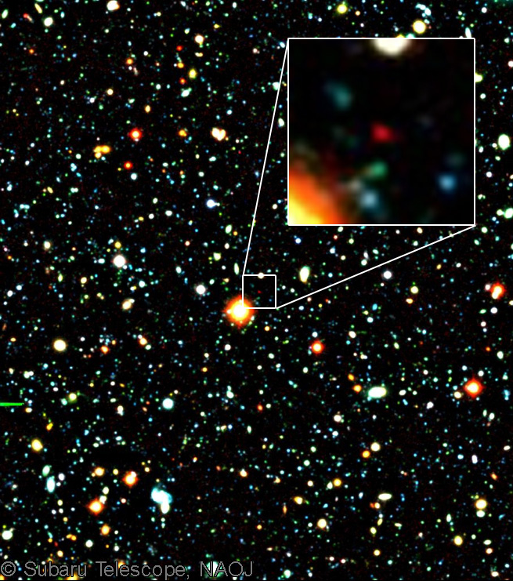
Formation of the 1st Galaxies
ALMA observation of distant Lyα entities:
  Deep non-detections in 250GHz continuum and [CII] (z~7)
  Very low dust content and atomic carbon (e.g. metal poor system) – [CII] may not be the best tracer for 1st galaxies
Possibly witnessing an assembly of ‘first galaxy’
  In BDF2399, [C II] detected 4kpc away (Maiolino et al. 2015)
But [C II] strong in several z~6 QSOs
[CII]
[CII]
Top: Himiko Ouchi et al. (2013), Bottom: BDF2399 [C II]: Maiolino et al 2015.
Notes:
“Himiko” at z = 6.6:1.5–3 × 10¹⁰ M☉ star forming (100 Msun/yr) galaxy with spatially extended Ly alpha emission
“IOK-1” at z=6.96 FIR luminosity L_{FIR}<3.7x10¹⁰L⊙ (42.5–122.5 μ m), total IR luminosity L_{IR} < 5. 7 x10¹⁰L⊙ (8–1000 μ m) and dust-obscured star formation rate (SFR) < 10 M⊙ yr⁻¹.
Suggests gas may be dispersed or destroyed by star formation at LyA core.
We summarize our conclusions as follows.
1. The 1.2 mm dust continuum flux from this star-forming galaxy is very weak, <52 μJy, and comparable with or weaker than that observed for local dwarf irregulars with much lower SFRs.2. We find a surprisingly stringent upper limit to the flux of the [C ii] 158 μm line, , placing it a factor 30 below expectations based on the scaling relation established between and SFR for lower redshift galaxies. This indicates a very metal poor system and may imply that the [C ii] line will be a poor diagnostic of early z >7 galaxies.3. Our deeper HST+Spitzer photometry allows us to considerably refine the stellar population properties of Himiko. Using models with and without nebular lines, we infer a stellar mass of 1.5–3 × 10¹⁰ M☉ and a SFR of 100 ± 2 M☉ yr⁻¹, comparable with the properties of luminous LBGs at z ~ 3.4. Our HST image has revealed three L* galaxy clumps which, together with our earlier kinematic constraints, suggest a rare triple merger. One clump reveals intense Lyα emission and an extremely blue color continuum of β = −2.84 ± 0.32, which is suggestive of metal-poor star-formation and an age of less than 200 Myr.5. From these properties, we conclude that we are witnessing intense star formation induced by this triple merger and that the associated photoionizing radiation is sufficient to power the extensive Lyα nebula.
Ota et al 2014 present ALMA observations of the [CII] line and far-infrared (FIR) continuum of a normallyvstar-forming galaxy in the reionization epoch, the z = 6. 96 Ly emitter (LAE) IOK-1. Probing to sensitivities of line = 240 μ Jy beam−1 (40 km s−1 channel) and cont = 21 μ Jy beam−1 , we found the galaxy undetected in both [CII] and continuum. Comparison of UV–FIR spectral energy distribution (SED) of IOK-1, including our ALMA limit, with those of several types of local galaxies
(including the effects of the cosmic microwave background, CMB, on the FIR continuum) suggests
that IOK-1 is similar to local dwarf/irregular galaxies in SED shape rather than highly dusty/obscured
galaxies. Moreover, our 3 FIR continuum limit, corrected for CMB effects, implies intrinsic dust mass
Mdust < 6. 4 Å~ 107M⊙ , FIR luminosity LFIR < 3. 7 Å~ 1010L⊙ (42.5–122.5 μ m), total IR luminosity
LIR < 5. 7 Å~ 1010L⊙ (8–1000 μ m) and dust-obscured star formation rate (SFR) < 10 M⊙ yr−1 , if we
assume that IOK-1 has a dust temperature and emissivity index typical of local dwarf galaxies. This
SFR is 2.4 times lower than one estimated from the UV continuum, suggesting that < 29% of the
star formation is obscured by dust. Meanwhile, our 3 [CII] flux limit translates into [CII] luminosity,
L[CII] < 3. 4 Å~ 107L⊙ . Locations of IOK-1 and previously observed LAEs on the L[CII] vs. SFR and
L[CII]/LFIR vs. LFIR diagrams imply that LAEs in the reionization epoch have significantly lower gas
and dust enrichment than AGN-powered systems and starbursts at similar/lower redshifts, as well as
local star-forming galaxies.
----- Meeting Notes (8/2/15 19:26) -----
Unclear that a Ly alpha emitter is the best place to look for young dust-forming galaxies.
----- Meeting Notes (8/9/15 17:26) -----
update

Slide 25
The ability to detect spectral line emission from CO or C II in a normal galaxy like the Milky Way at a redshift of z=3, in less than 24 hours of observation.
Example: The ISM in Galaxies at a Billion Years after the Big Bang
Are evolved galaxies present among the fainter star-forming population at z > 3?
With ALMA, Capak et al. observed nine dusty, normal (L~1-4 L*) galaxies at z=5~6
Detected [C II] with ALMA (20 min observations) in all nine at ~290 GHz S_{ν} = 0.61± 0.12 mJy but only 4 in continuum
Gas distributed over scales 1-8 kpc, with diverse dynamics
Highly evolved galaxies: large stellar mass (~fewx10¹⁰ M_{O}) SFR <3to100 M_{O} yr⁻¹ (Present day MW rate is ~1M_{O} yr⁻¹ )
Thermal emission depressed by 12x relative to galaxies at z~2 suggests strong evolution in ISM properties; these galaxies resemble low metallicity systems
Hence, evolved galaxies not unlike the MW are present at z>5!
This goal may have been met…
Capak et al. Nature (2015 Nature)
Notes:
Ref on MW SFR Robitaille and Whitney 2010 ApJ 701, L11.
Continuum images figure caption:
The [CII] line detections (red contours) and weak ~158μm FIR continuum detections (blue contours) are shown with the rest frame UV images as the background. The images are 5"x5" and the contours are 2, 6 and 10 σ with [CII] line profiles for each source shown in Figure 3. The background images are from HST-ACS in the F814W16 band where the morphologies will be affected by Ly-α, except for HZ10, which is Subaru z' band. All objects are detected in [CII] showing that a large amount of gas is present in these systems, but only 4 are detected in continuum
[C II] line figure caption:
The line velocity profiles of our [CII] measurements are shown our 10 sources and two blind detections HZ5a and HZ8W. All sources but HZ5, a quasar, are clearly detected. For objects HZ8 and HZ8W a dotted line showing that the integrated flux over both sources is also plotted showing they are at similar redshifts.
----- Meeting Notes (8/2/15 17:38) -----
evolved galaxies not unlike the MW

Slide 26
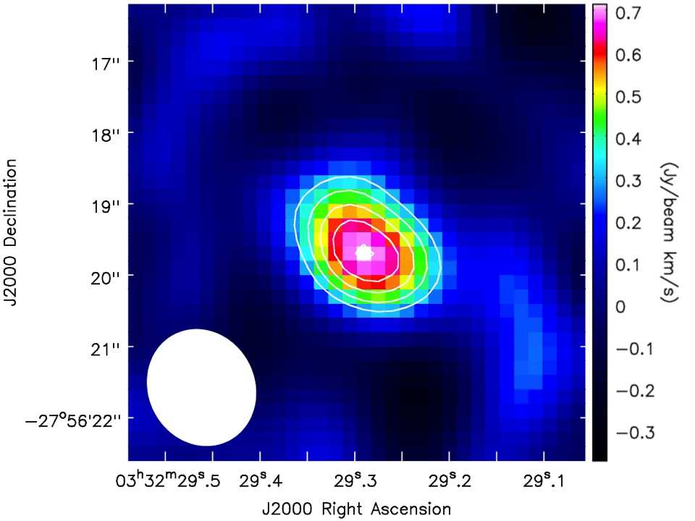
ALMA: Nitrogen in the Early Universe
Nitrogen is a secondary element, produced within low mass stars, hence its abundance rise in the Universe may be expected to lag that of O and C
Spectrally, it is traced by the [N II] lines at 122 and 205 microns, which emit at about 5%of the [C II] intensity in the local Universe
Nagao et al. (2012) report ALMA observations of [N II] in J033229.4-275619, a starburst submillimeter galaxy at an age since the Big Bang of 1.27 Gyr (z=4.75). [N II]/[C II]~0.043 in this galaxy, suggesting a solar nitrogen abundance (the ratio is 0.05 in M82). (see new [C II]/ALMA data from de Breuck et al 2014)
Coppin et al. 2009
Visible, NIR/radio, FIR images
Coppin et al. 2009
J03329.4 Spectral energy distribution
Nagao et al. 2012
De Breuck et al 2014
ALMA Image, Spectrum
Notes:
discussion of the N/C ratio at z=4.76 in arXiv:1205.4834 from ALMA [N II] observations fairly interesting, as N is a secondary nucleosynthetic product but appears as abundant as locally even at an age since the big one of 1.27 Gyr. Since the [N II] line is only 5% of [C II] this is pretty much an ALMA-only sort of project.
LESS J033229.4-275619
http://astronomy-br.blogspot.com/2012/06/galaxia-super-distante-less-j0332-124.html
See newer ALMA [C II] spectrum from de Breuck et al 2014 A&A 565, A59.

Slide 27
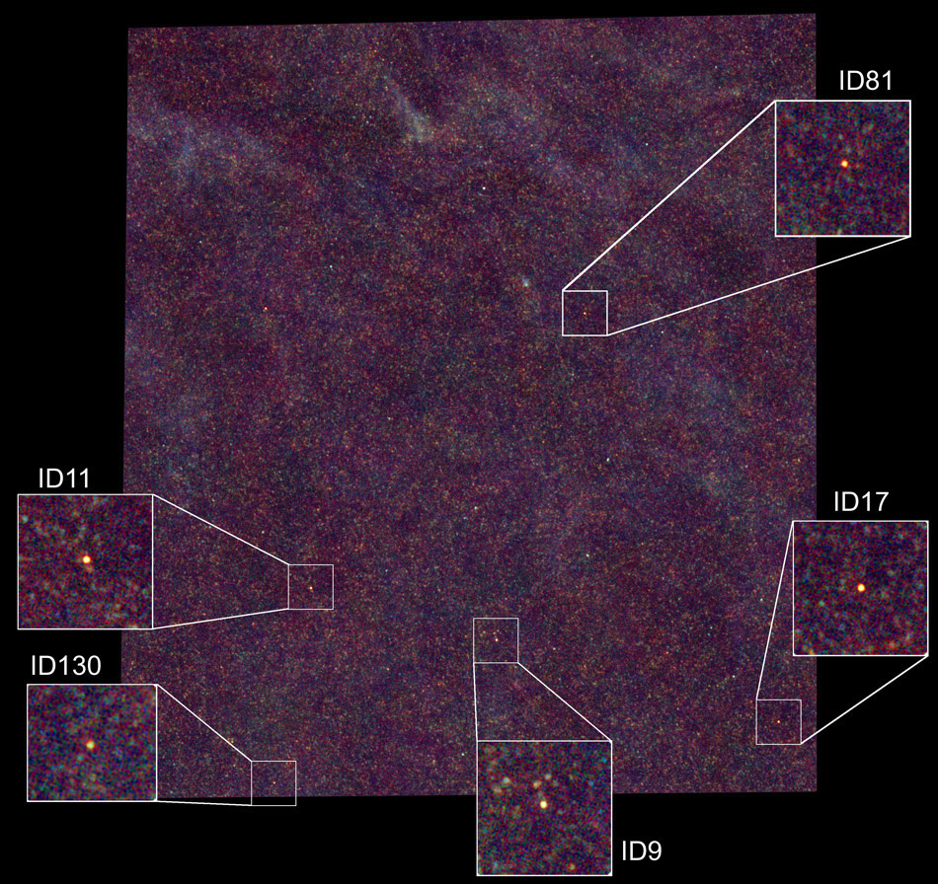
The Early Universe:
High Sensitivity and Resolution in SDP.81 z=3
Notes:
----- Meeting Notes (8/2/15 17:52) -----
Get some science in. magnification

Slide 28
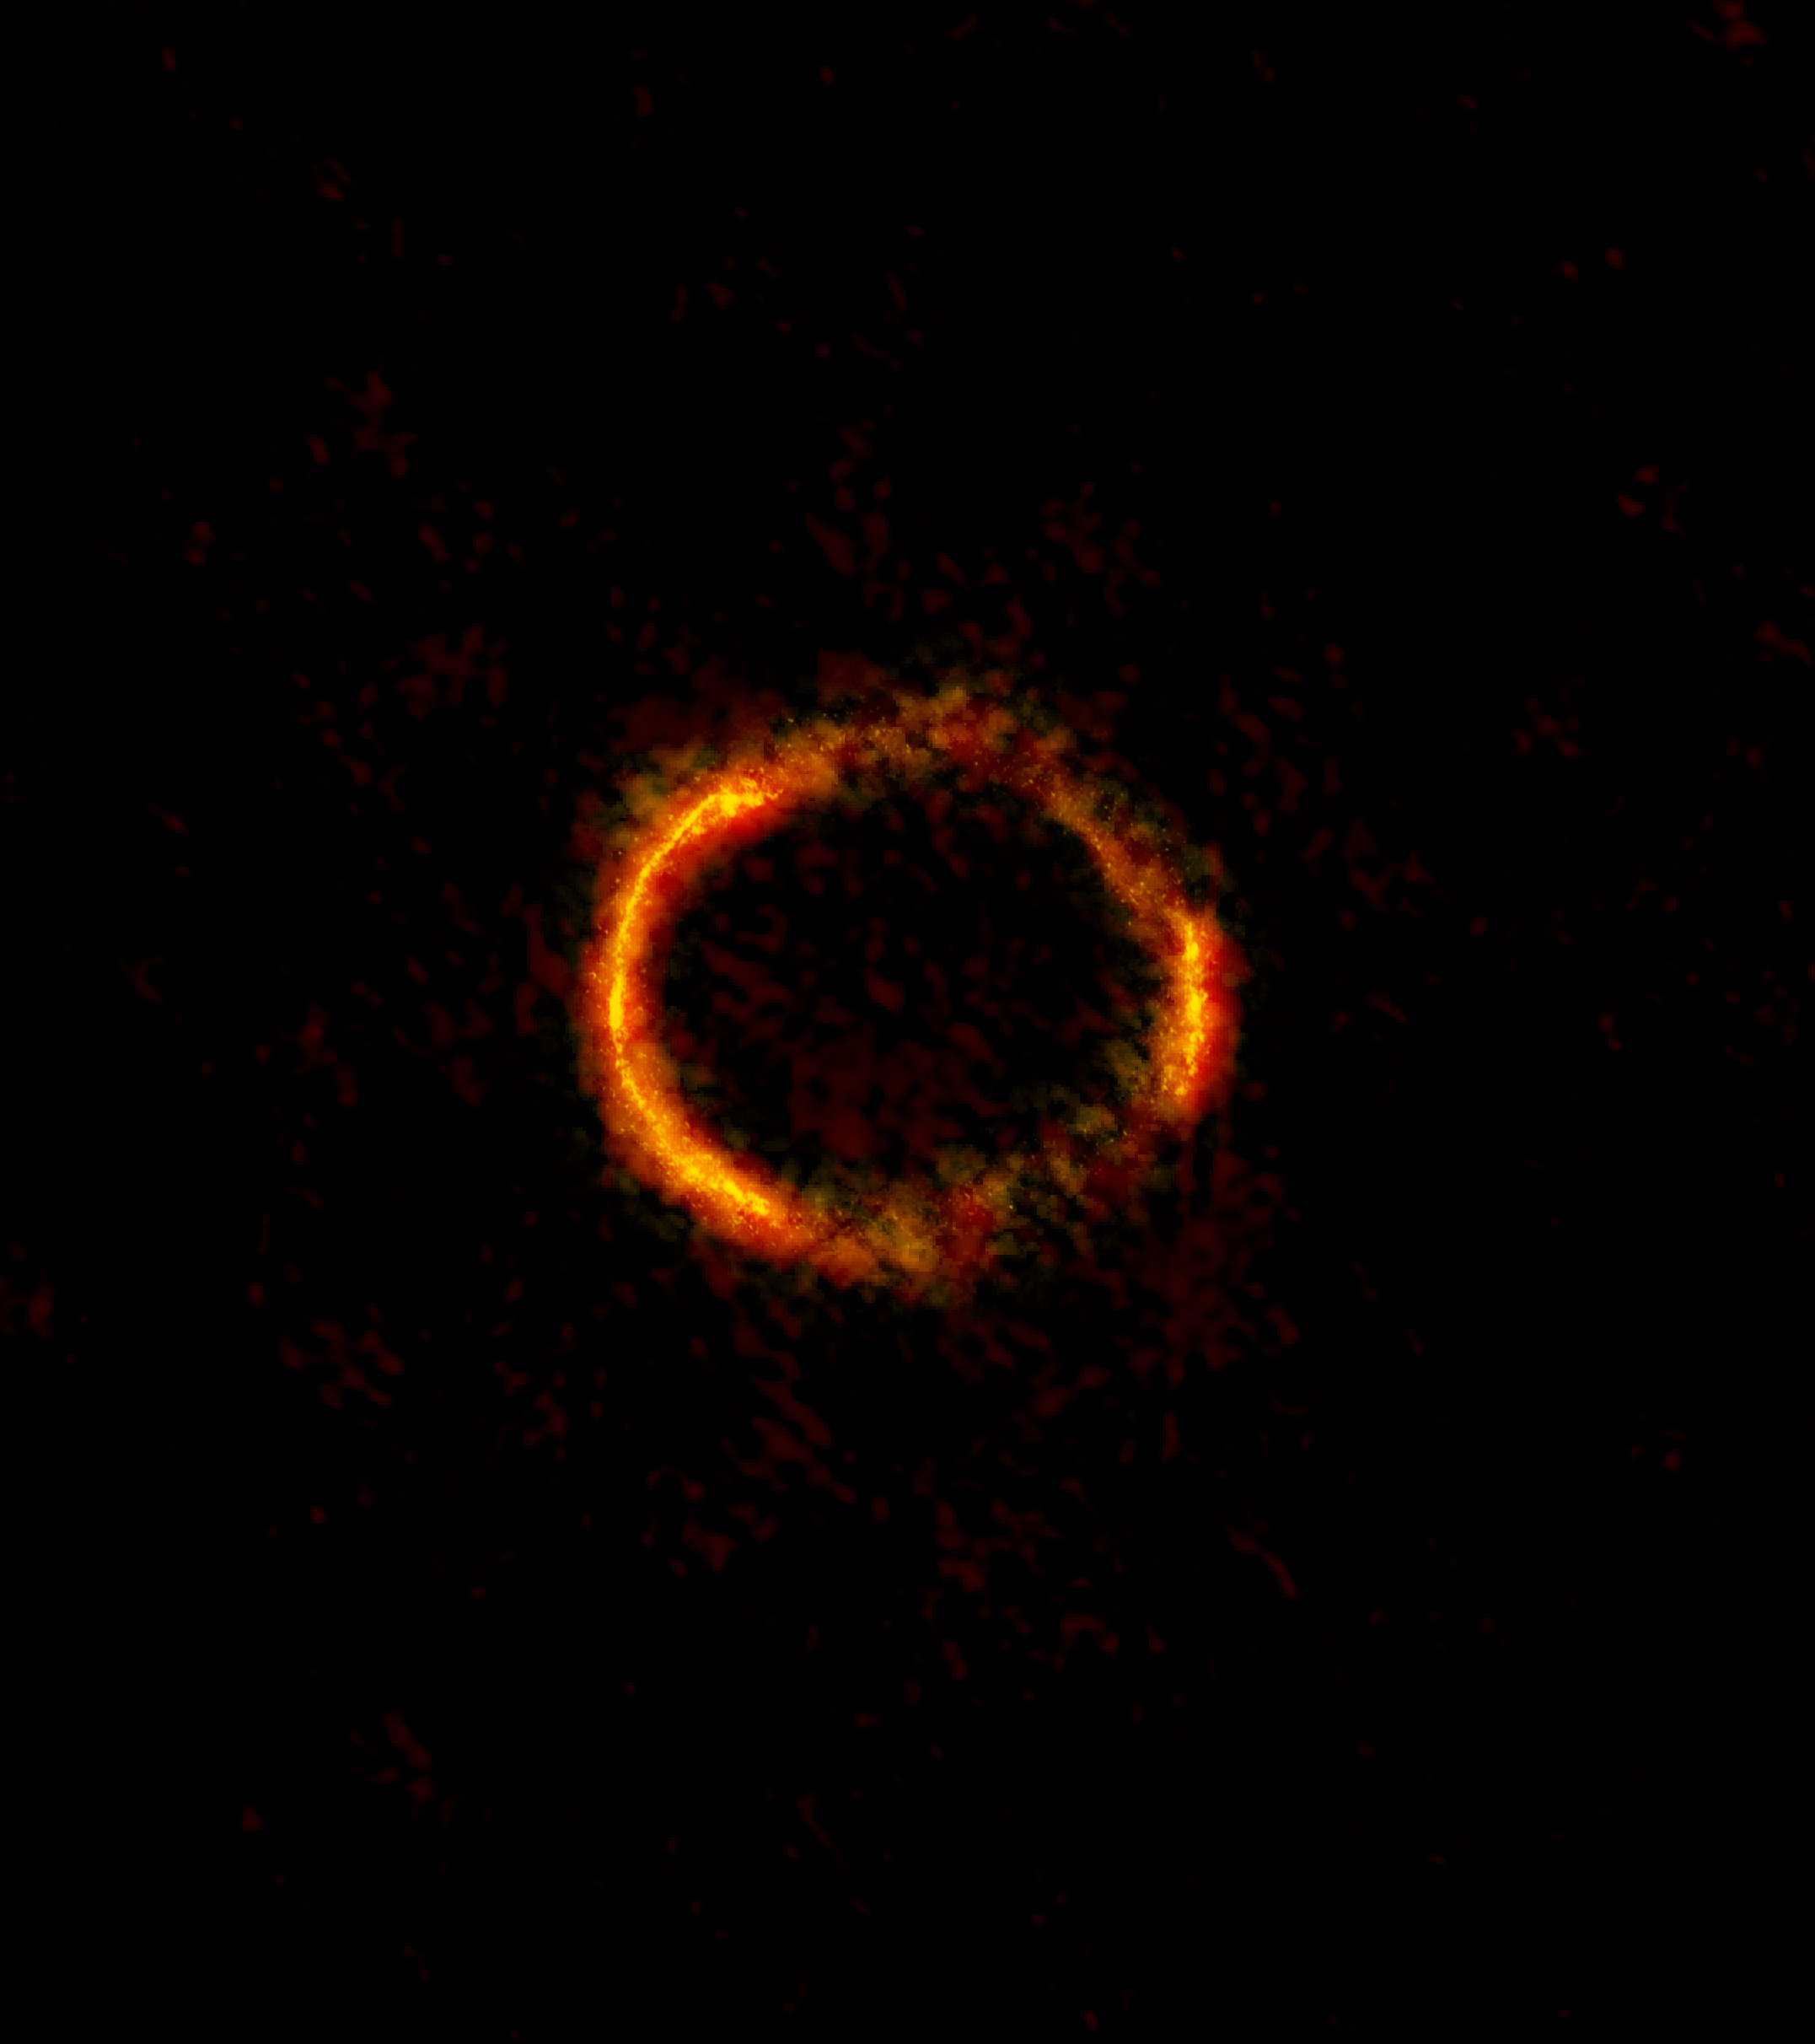
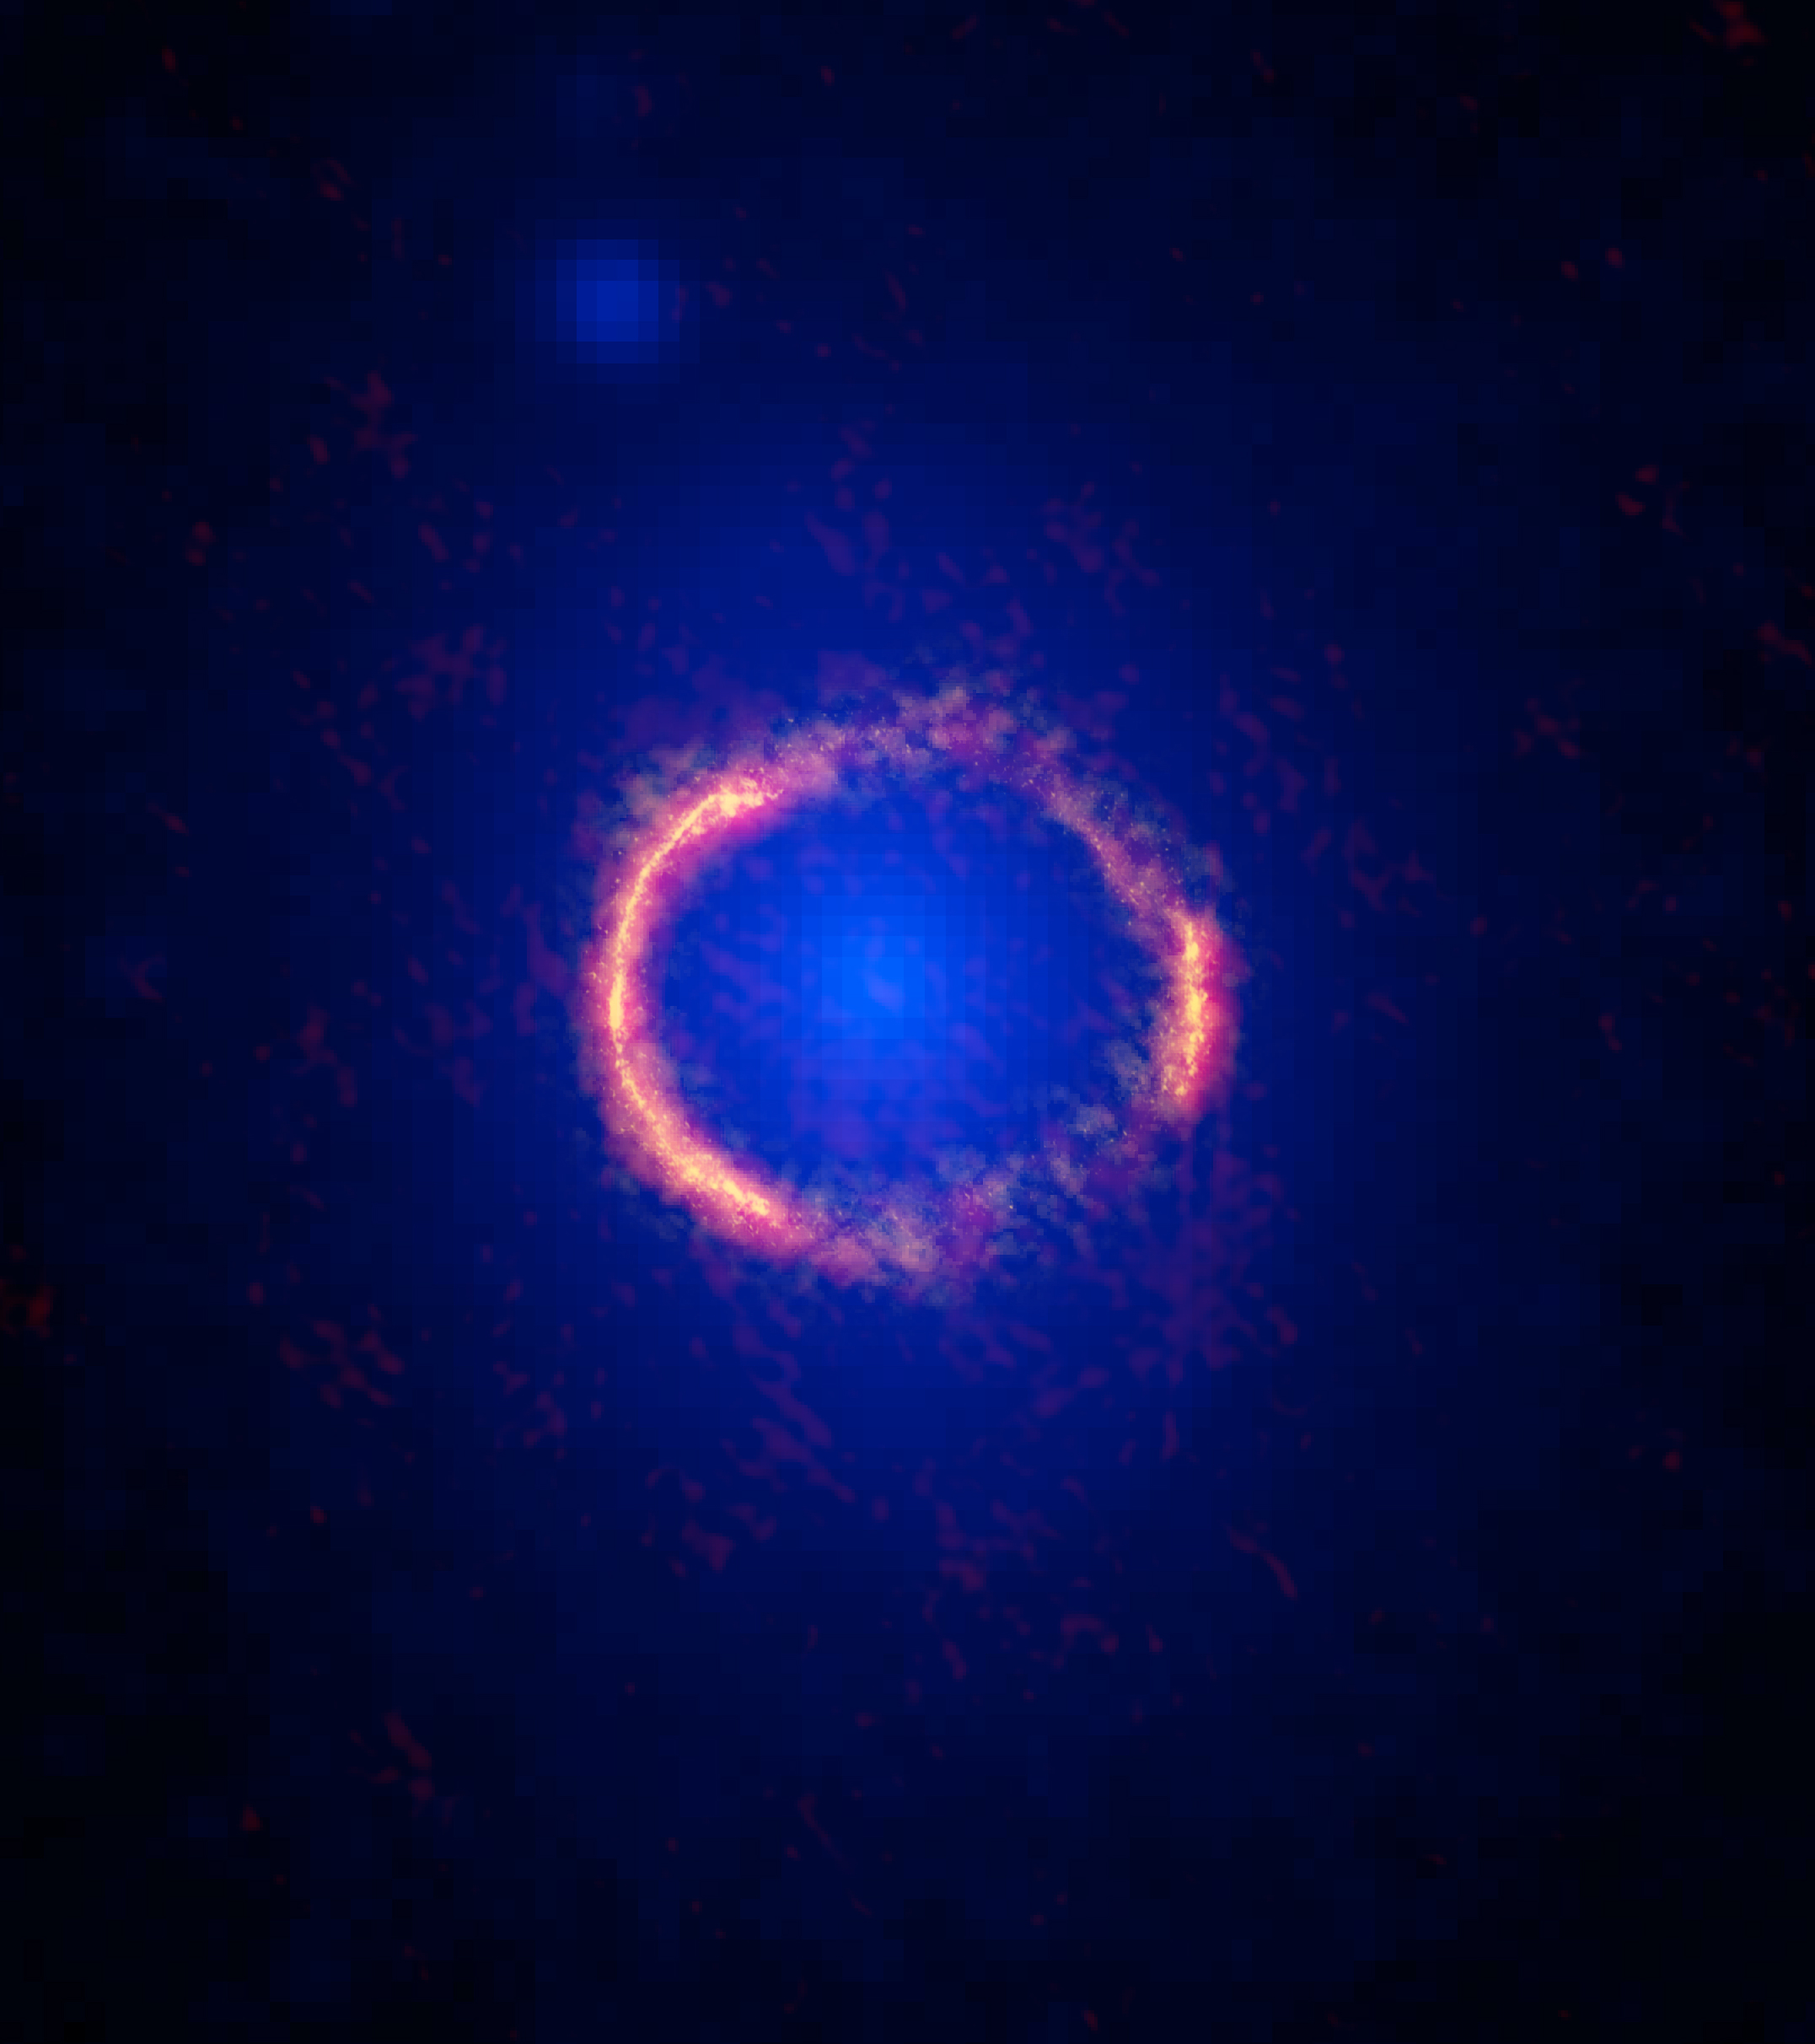
ALMA Partnership, Vlahakis et al. 2015
Notes:
Note that the number of antennas was not high—the campaign began not long after construction ended, one of the final deliverables being the distant antenna stations. Soon, for Cycle 3, ALMA will be moving to fully populated 10km configurations.

Slide 29
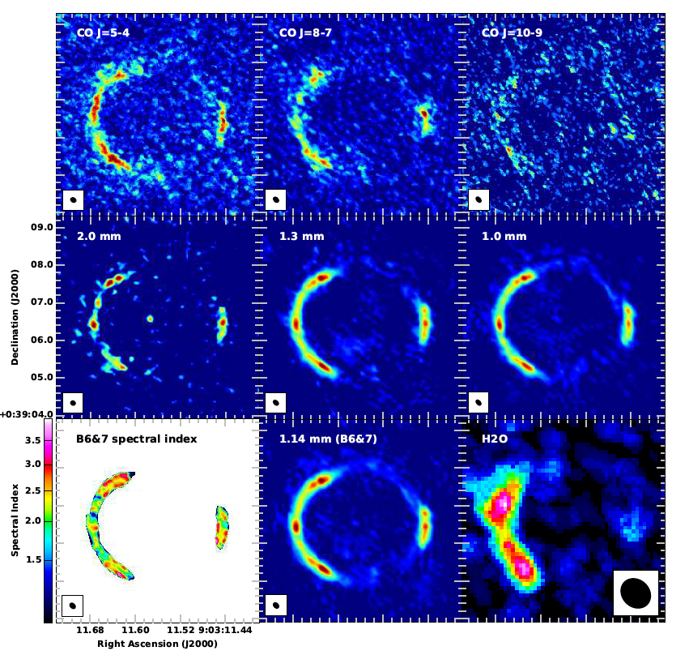
Spectrally Resolved Images…
ALMA’s unparalleled line sensitivity provides detailed kinematic information
0.01”= 400 pc at z=3
ALMA Partnership,
Vlahakis et al. 2015
Notes:
----- Meeting Notes (8/2/15 18:12) -----
Figure out the effective magnification!! Resolution is 0.023”.

Slide 30
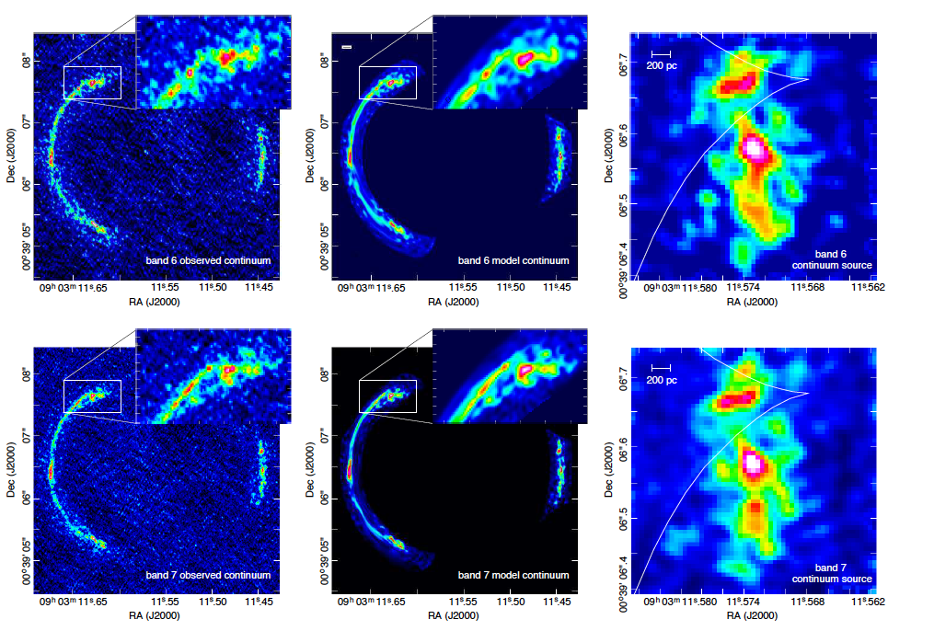
Reveal the Complex Nature of SDP.81
Dye et al. 2015 (see also Rybak et al. 2015, Hatsukade et al 2015,Wong et al. 2015, Swinbank et al. 2015, Tamura et al. 2015)
Notes:
Add the other references…This is continuum—any spectral line inversions?

Slide 31
An Unstable Gas-rich Disk
Reconstructed image shows a number of exceptional star-forming regions
Swinbank et al (2015): A rotationally-supported disk (V_{rot}~320 lm/s, M~4 x 10¹⁰ M_{o})
Extreme molecular cloud conditions similar to those in the Galactic Center
Notes:
Swinbank: The kinematics of the CO gas within this system are well described by a rotationally-supported disk with an inclination-corrected rotation speed, v=320+/-20km/s and a dynamical mass of M=(3.5+/-1.0)x10^10Mo within a radius of 1.5 kpc. The disk is gas rich and unstable, with a Toomre parameter, Q=0.30+/-0.10 and so should collapse in to star-forming regions with Jeans length L_J~130pc. We identify five star-forming regions within the ISM on these scales and show that their scaling relations between luminosity, line-widths and sizes are significantly offset from those typical of molecular clouds in local Galaxies (Larson's relations). These offsets are likely to be caused by the high external hydrostatic pressure for the interstellar medium (ISM), P/kB=(40+/-20)x10^7K/cm3, which is ~10,000x higher than the typical ISM pressure in the Milky Way. The physical conditions of the star-forming ISM and giant molecular clouds appears to be similar to the those found in the densest environments in the local Universe, such as those in the Galactic center.
2 Star Forming Regions in SDP 81 at
z
=3.04 from ALMA
Fig. 1.—
Source plane images of SDP81.
Top Row: Left:
Source-plane 1.0mm (rest-frame 250
μ
m image) continuum image of SDP81.
The star-forming clumps, A–E, are identified by the solid con
tours. The black dashed line defines the major morphological
axis and the
white contours indicate the amplification map. The luminosi
ty weighted amplification at 1.0mm is 16.0
±
0.7. The white ellispes show the
source-plane PSF at the location of the clumps (offset to the r
ight hand size of the image for clarity).
Center Left:
Source-plane 2.1mm
image with the clumps identified at 1.0mm also highlighted. T
he solid line denotes the caustic curve from the best-fit lens
model.
Center
Right:
12
CO(5–4) velocity field. The gas disk has an observed peak-to-
peak velocity gradient of 210
±
10kms
−
1
. The solid white line
shows the major kinematic axis and the dotted line denotes th
e major 1.0mm morphological axis.
Top Right:
Beam-corrected
12
CO(5–4)
line-of-sight velocity dispersion

Slide 32
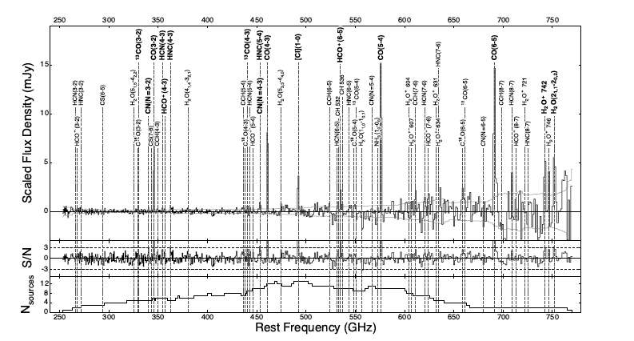
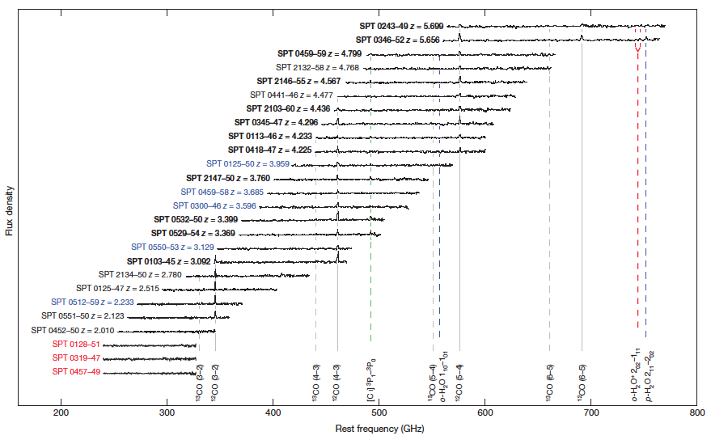
The Rest-Frame Submillimeter Spectrum of High-z, Dusty Star-Forming Galaxies
Vieira et al. 2013 / Spilker et al. 2014
Notes:
Superposition of spectra of lensed galaxies from the SPT survey

Slide 33
Nearby Galaxies
ALMA’s excellent line sensitivity and resolution provides a new window into central regions of galaxies
Central chemistry: HNCO in well shielded disk gas, HC₃N traces X-ray exposed gas, SiO may trace innermost dense gas (also in NGC 1068 Takano et al ‘14)
Constrain mass of central black holes (NGC1097)
Fathi et al. (2013), Martin et al (2014)
Notes:
BH mass measurement in N1097 using HCN probe.

Slide 34
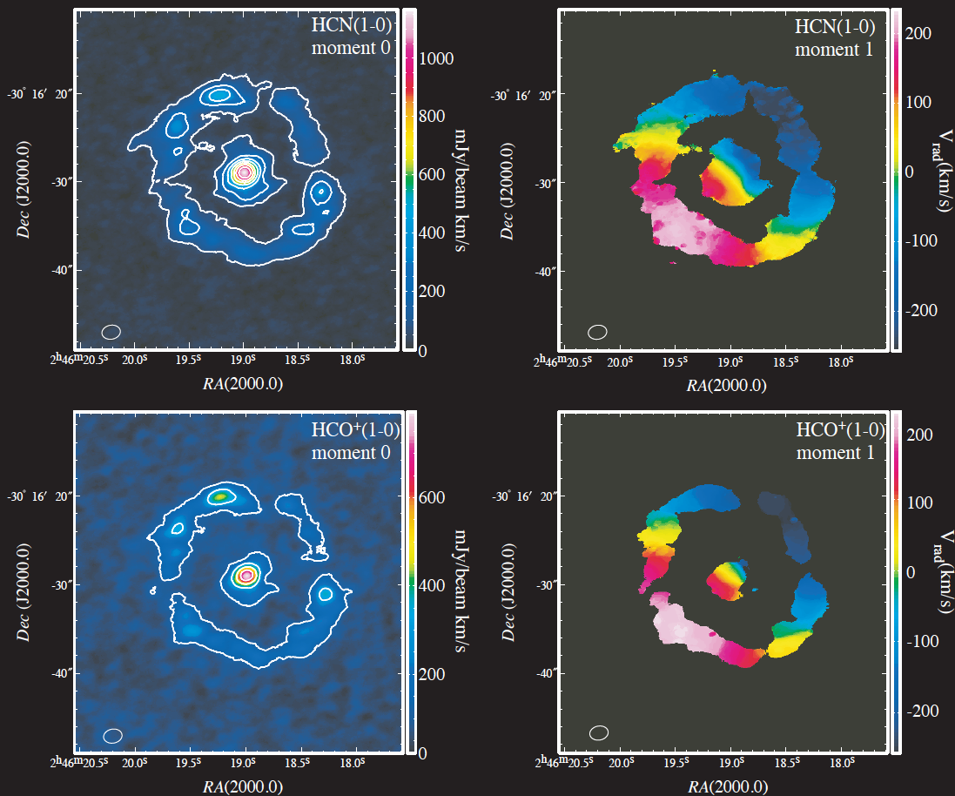
MEASUREMENT OF THE BLACK-HOLE MASS IN NGC 1097
ALMA provides excellent line sensitivity and resolution (~2” here)
HCN and HCO+ J=1-0 measure dense near-nuclear mass
SMBH mass:
M_{BH}= 1.40×10⁸M⊙
Onishi, Iguchi, Sheth and Kohno 2015
Notes:
ynthesized beam size (1′′.60×2′′.20 at P A
Velocity res 3 km/s

Slide 35
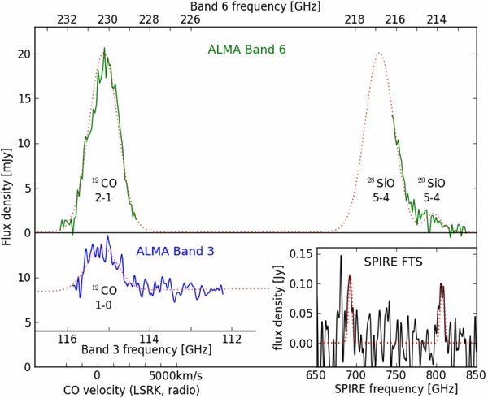
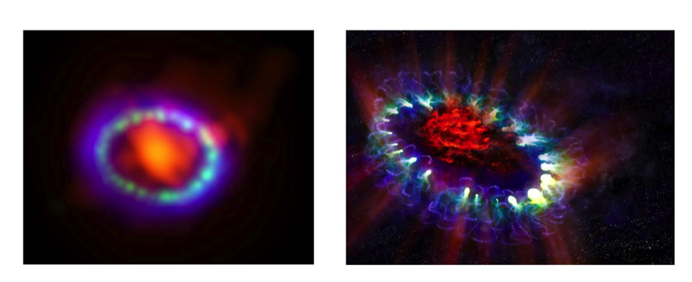
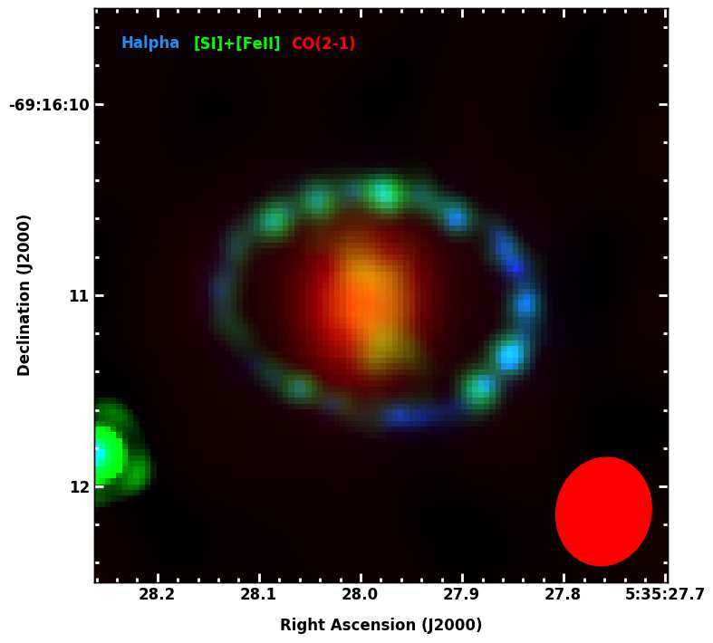
SN87A Molecule and Dust Production, Particle Acceleration
Kamenetzky, McCray, Indebetouw et al ApJ 2013 Indebetouw et al. 2014
Notes:
ALMA has produced resolved images at 0.45mm to 3 mm, of the nearest and most recent supernova since the invention of the telescope (Indebetouw et al. 2014)
Emission from the largest mass of dust measured in a supernova remnant (>0.2 M_{sun}) dominates at shorter wavelengths (to 0.45mm) while synchrotron radiation from shock-accelerated particles dominates emission at longer wavelengths (3mm)
ALMA images show the dust has formed in the inner ejecta (the cold remnants of the exploded star's core). The extent corresponds well to CO and SiO emission imaged previously by ALMA expanding at 1250 km/s (Kamenetzky et al 2013). ALMA's high resolution demonstrates that the dust emission is concentrated to the center of the remnant, a region not yet affected by the shocks.
If SN 1987A is typical, supernovae are important cosmological dust producers.
The C/O clumps in SN1987A contain at least 0.01 M⊙ of ¹²CO, an order of magnitude greater than measured in the first few years after the explosion: ¹²CO has continued to form over the past 25 years. SiO, other molecules are also seen.
Left: ALMA data in Red shows newly formed dust. Hubble data (green) and Chandra data (blue) show the expanding supernova shock wave. (R. Indebetouw et. al, ) Right: Artists illustration shows the cold inner region of the supernova’s remnants. The outer regions are where the ejected gas are colliding with the gas ejected from the star before its supernova detonation.
ALMA’s unprecedented sensitivity and resolution identify CO in the SN87A inner ejecta. SiO is also seen.
The C/O clumps in SN1987A contain at least 0.01 M⊙ of ¹²CO, an order of magnitude greater than measured in the first few years after the explosion: ¹²CO has continued to form over the past 25 years.
ALMA views the full velocity range of emission, unobscured by dust. Doppler tomography will be possible in CO and other molecules (SiO) to probe the spatial, chemical and kinetic environment within the inner ejecta.

Slide 36
ALMA observations of disks in young stars
Sensitivity provides gas images—chemistry, dynamics
ALMA extends knowledge of low mass disks to lower masses, finer scales, chemistry
  Subsolar mass stars
  Brown dwarfs
Brown Dwarf 2M0444
*L1527 (Sakai et al ’14), HH212 (Codella et al ‘14), VLA1623A (Murillo et al ‘13), RCrA IRS7b(Lindberg et al ’14) ★ ρ Oph 102 Ricci et al ‘12, M0444, CIDA 1, and CFHT Tau4 (Ricci et al ‘14)
Ricci et al 2014
Notes:
Young subsolar mass stars*
Host rotationally supported disks
R_{disk}~50AU, M*~0.2 M_{solar}
M_{disk} ≤0.05 M_{solar}
Unexpected chemistry (abundance variations in e.g. SO (Sakai et al ‘14)
Brown dwarf stars★
Host disks of gas and dust similar to stellar disks
R_{disk}≤50AU, M*≤0.1 M_{solar}
M_{disk} ~.3-1% M_{BD}~M_{jupiter}
Disk dust appears ‘normal’
could support terrestrial-type planets
could form by core accretion

Slide 37
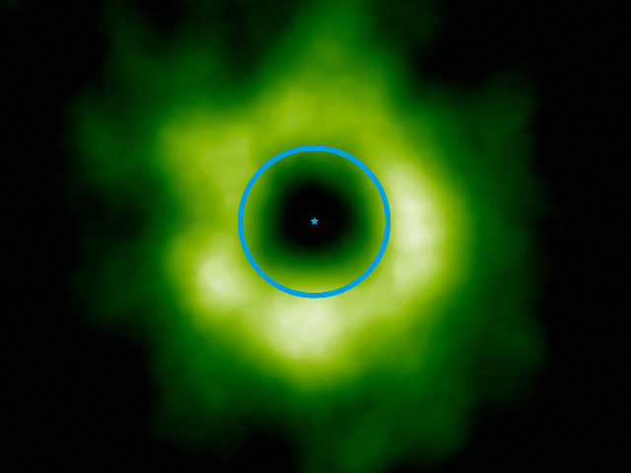
Protoplanetary Disk Midplane Snow Lines
Disk midplanes are
  The sites of planet formation, the main reservoirs of mass and probable sources of complex organics
  Cold—ices form; ices are sticky; good larger body seeds
  Characterized by a range of low-energy lines of ions, deuterated molecules, isotopologues and organics
Observational feature: ‘Snow Line’ which occurs where the temperature drops to where frost forms—in this case CO frost
TWHya CO Snow Line Qi et al.
HD163296 Mathews et al.
Notes:
Disk midplanes are
The sites of planet formation, the main reservoirs of mass and probable sources of complex organics
Cold—ices form; ices are sticky; good larger body seeds
Characterized by a range of low-energy lines of ions, deuterated molecules, isotopologues and organics
Observational feature: ‘Snow Line’ which occurs where the temperature drops to where frost forms—in this case CO frost
N₂H⁺ is strong where CO is depleted by frosting out
ALMA showed in the TW Hya disk a division between a region with no N₂H⁺ closer than about 28 to 31 AU (Neptune’s orbital radius, blue circle), and plentiful emission farther from the star (Qi et al 2013)
ALMA showed in the HD163296 disk a similar ring of emission in DCO⁺ again probably locating the CO snow line (Mathews et al 2013)
http://ay201b.wordpress.com/the-snow-line-in-protoplanetary-disks/ The “snow line” (also called frost line, ice line, snow boundary, etc.) is the distance from a central protostar at which ice grains can form– this occurs at temperatures of about 150-170 K. At the snow line, the density of solid particles in the disk increases rather abruptly. This increase in solid-particle surface density changes the time- and mass-scales of planets that form beyond this distance. Specifically, the isolation mass of planetesimals is amplified by a factor of ~8, and these cores also form faster. These factors, taken together, mean that gas giants form much more easily beyond the snow line, since cores that form beyond the snow line are more massive and have a longer time to accrete gas from the disk before it dissipates.

Slide 38
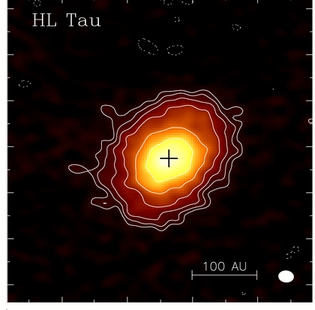
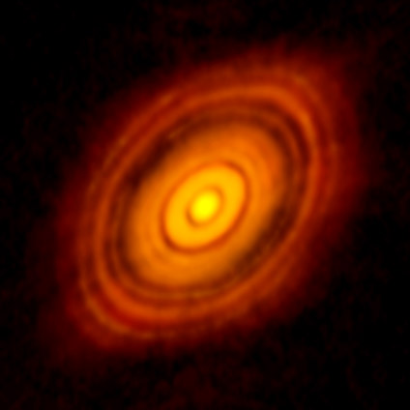
Power of Many Long Baselines: HL Tau

Slide 39
Long Baseline Campaign: HL Tau
ALMA Partnership, Brogan et al. 2015
ALMA HL Tau SV data at 3 and 1mm (combined B6&B7), and Spectral Index image. The images were made from 14 executions x 4 GHz bandwidth (BW), 9 executions x 8 GHz BW, and 10 executions x 8 GHz BW and Bands 3, 6, and 7, respectively. Beam sizes are 83x60, 42x30 and 31x19 mas at Bands 3, 6, and 7, respectively.
Notes:
From left to right the three panels show ALMA HL Tau SV data at 3, 1.3, and 0.87 mm. The images were made from 14 executions x 4 GHz bandwidth (BW), 9 executions x 8 GHz BW, and 10 executions x 8 GHz BW and Bands 3, 6, and 7,
respectively.
The images in all three panels were created using clean mode=‘mfs’ with nterms=1 and multiscale=[0,5,15]. The fractional bandwidth of the Band 3 data is only 4%, obviating the need for nterms=2.
The data from all three bands were self-calibrated, with improvements to the S/N of order 30% but with some loss of the longest baselines, and hence angular resolution.
Beam sizes are 83x60, 42x30 and 31x19 mas at Bands 3, 6, and 7, respectively.

Slide 40
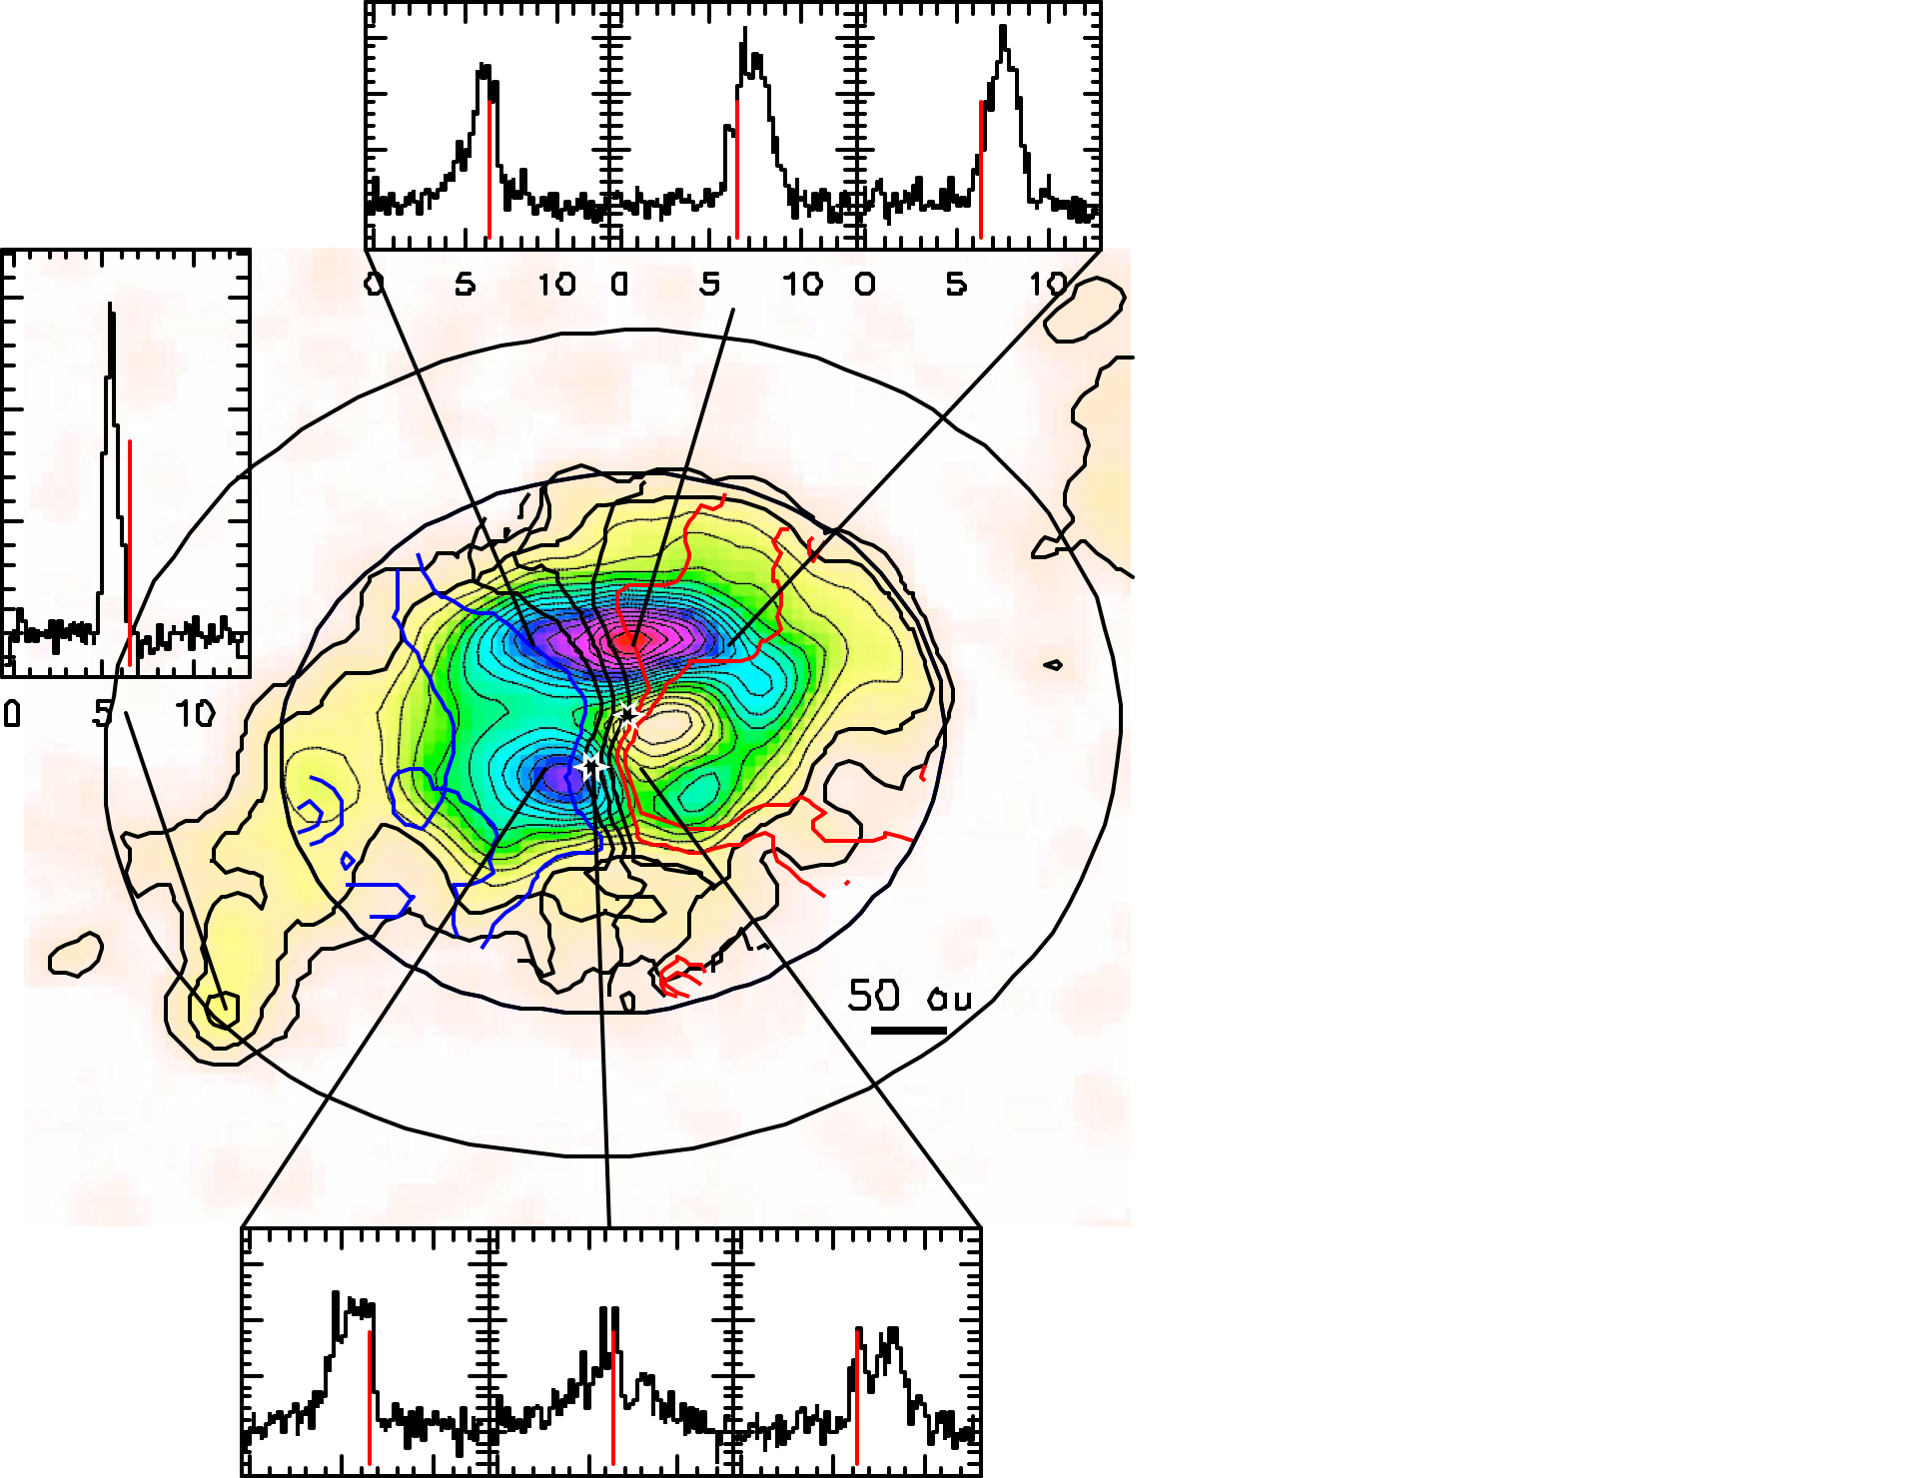
Interconnecting Streamer in Binary GG Tau
Can nature form planets in multiple star systems?
ALMA revealed a streamer channeling gas from a massive outer disk to the inner disk in this hierarchical triple system
  Flow appears capable of sustaining the 1 M_{jupiter} inner disk beyond the accretion lifetime, leaving time for planet formation to occur there.
  Planets may form here!
A Dutrey et al. Nature 514, 600-602 (2014)
CO J=6-5 data. Black: integrated area, blue: approaching gas, red: receding gas, Stars: Aa (south) and Ab (north). Ellipses: ring edge. Spectra illustrate velocities.
Notes:
29 Oct press release ‘Planet-forming Lifeline Discovered in a Binary Star System: ALMA Examines Ezekiel-like ‘Wheel in a Wheel’ of Dust and Gas’
Extended Data Figure 3 | Montage of the CO J 5 6–5 data. False colours and black contours show the integrated area. The velocity gradient is given in thick contours: blue (gas approaching), black (systemic velocity) and red (gas receding). Stars show the location of Aa (south) and Ab (north). The two large ellipses show the ring edges. The three spectra sets (y axis, intensity in units of Jy per beam; x axis, velocity in units of km s21) show the velocity gradient along the northern/southern CO J 5 6–5 clump, respectively (dominated by rotation). On spectra, the red line is the systemic velocity (6.4 km s21). From east to west, the black contours correspond to velocity contours of 6.0, 6.4 and 6.8 km s21. The systemic velocity contour passes between the two stars (barycentre). The single spectrum corresponds to the location of the hotspot.
This kind of feature was previously observed in single stars HD142527 (Casassus et al 2013) and

Slide 41
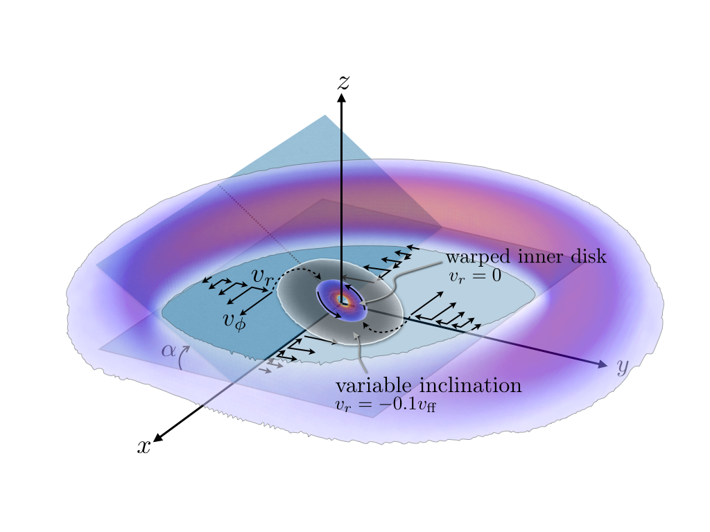
‘Dust Traps’ in Transition Disks
An annular gap is created in the gas disk (perhaps owing to a planet)
A high-pressure vortex forms at the gap edge, collecting and trapping millimeter-sized dust particles that would otherwise spiral rapidly inward through the disk.
HD142527
Casassus et al 2015
Perez et al 2014
Notes:
IRS 48 dust and gas observations.The inclined disk around IRS 48 as observed with ALMA Band 9 observations, centered on the star (white star symbol). The ALMA beam during the observations is 0.32′′ × 0.21′′ and is indicated with a white ellipse in the lower left corner. (A) The 0.44-mm (685 GHz) continuum emission expressed both in flux density and relative to the root mean square (rms) level (σ = 0.82 mJy per beam). The 63 AU radius is indicated by a dashed ellipse. (B) The integrated CO 6-5 emission over the highest velocities in contours (6,12,...,60σ_{CO} levels, σ_{CO} = 0.34 Jy km s⁻¹): integrated over –3 to 0.8 km s⁻¹ (blue) and 8.3 to 12 km s⁻¹ (red), showing a symmetric gas disk with Keplerian rotation at an inclination i = 50°. The green background shows the 0.44-mm continuum. The position angle is indicated in the upper right corner. (C) The Very Large Telescope Imager and Spectrometer for the mid-infrared (VISIR) 18.7-μm emission in orange contours (36 to 120σ_{VISIR} levels in steps of 12σ_{VISIR}, σ_{VISIR} = 0.2 Jy arc sec⁻²) and orange colors, overlayed on the 0.44-mm continuum in green colors and the 5σ contour line in green. The VISIR beam size is 0.48′′ in diameter and is indicated with an orange circle in the bottom right corner.
We report the detection of the H2CO 9(1,8)–8(1,7) line at 674 GHz, which is spatially resolved as a semi-ring at ∼ 60 AU
radius centered south from the star. The inferred H2CO abundance is ∼ 10−8 , derived by combining a physical disk model of the
source with a non-LTE excitation calculation. Upper limits for CH3OH lines in the same disk give an abundance ratio H2CO/CH3OH
>0.3, which indicates that both ice formation and gas-phase routes play a role in the H2CO production. Upper limits on the abundances
of H13CO+, CN and several other molecules in the disk were also derived and found to be consistent with full chemical models.
Conclusions. The detection of the H2CO line demonstrates the start of complex organic molecules in a planet-forming disk. Future
ALMA observations are expected to reduce the abundance detection limits of other molecules by 1–2 orders of magnitude and test
chemical models of organic molecules in (transitional) disks.

Slide 42
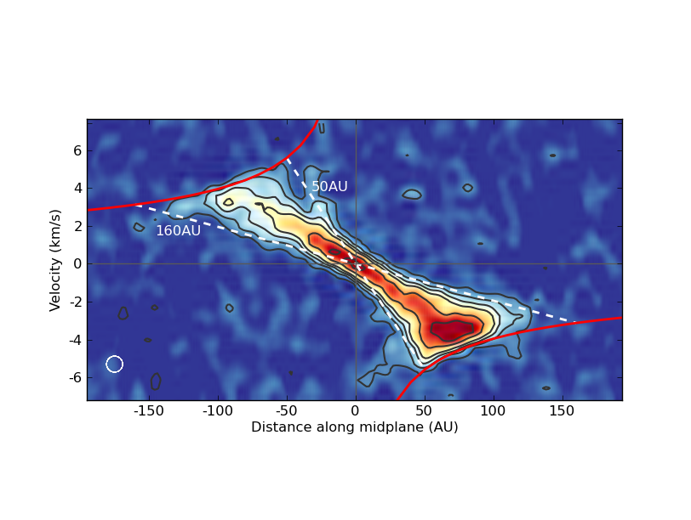
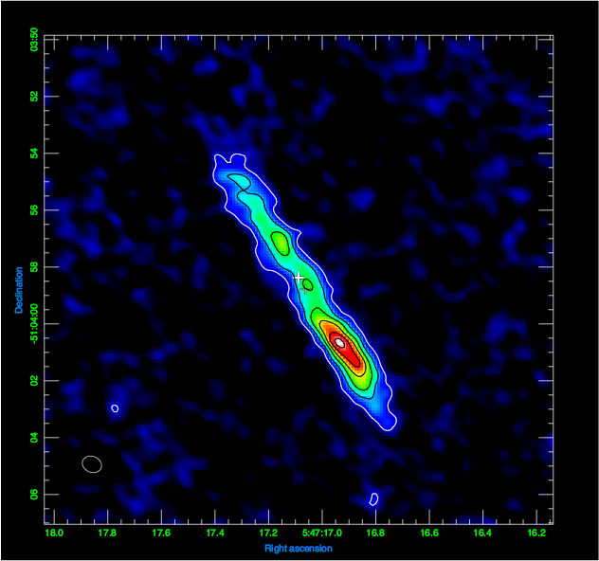
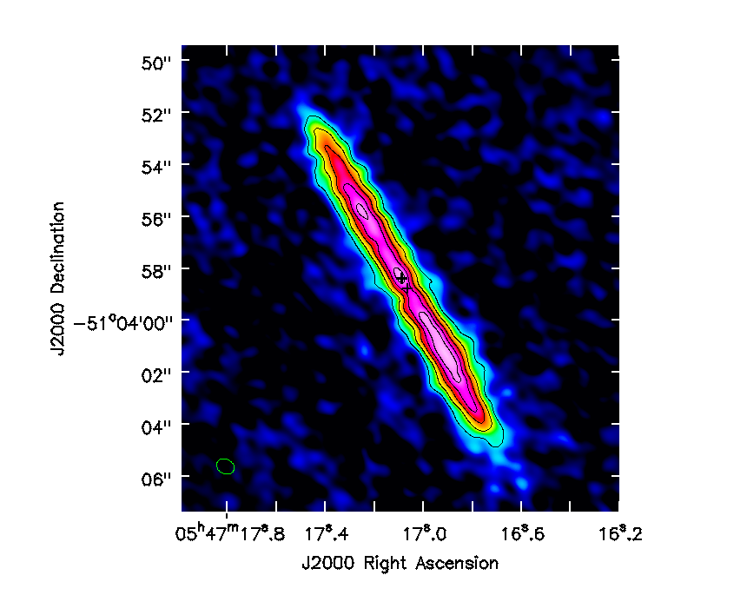
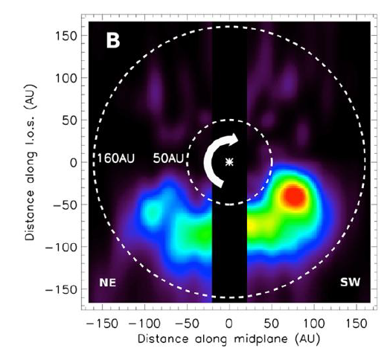
Beta Pictoris Debris Disk
CO (3-2) velocity field
Dust, then CO
Dent et al. (2014) Science
Polar view
Notes:
First detection of CO emission in this object
The CO velocity field shows Keplerian rotation
The CO emission distribution is more asymmetrical than that of the dust (see deprojected distribution lower left)
The CO lifetime is estimated to about 100 years, implying that the CO gas was released recently in collisions

Slide 43
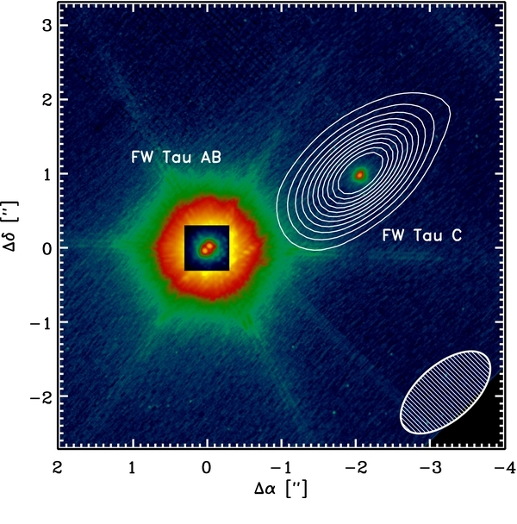
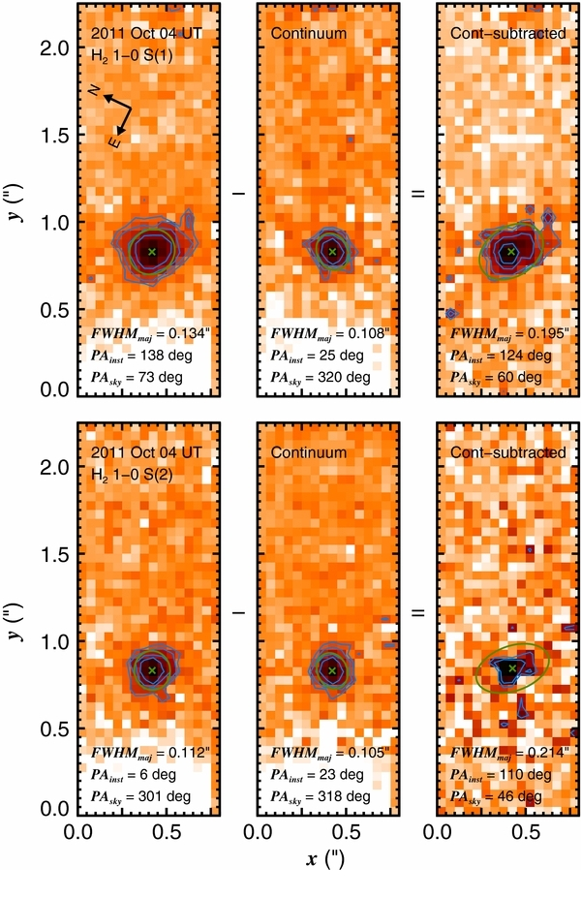
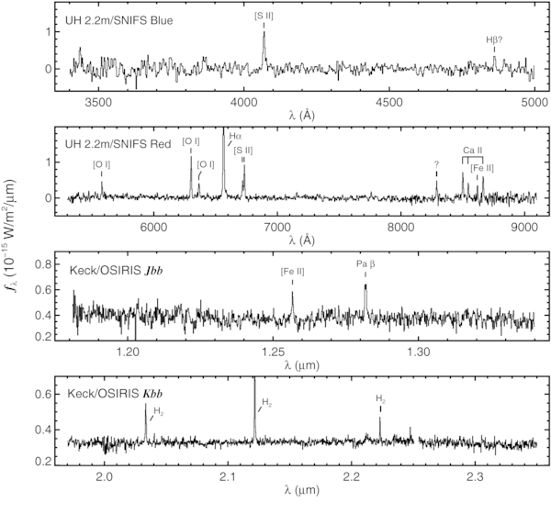
Candidate Protoplanetary Companion to FW Tau
Kraus et al 2015
ALMA data: new regime of sensitivity enabling characterization of fundamental circum (sub)stellar and circumplanetary disk properties.
All of the ~1–3 M⊕ disk material in the system associates solely with the faint companion, FW Tau C
  Disk is accreting (Paβ and strong Hα emission)
  H₂ extended suggesting outflow
M~mass of compact systems of sub-Earth planets seen around field ultracool dwarfs e.g. Kepler-42 bcd
Reservoir ~10x mass of Galilean satellites
Notes:
2015ApJ...798L..23K

Slide 44
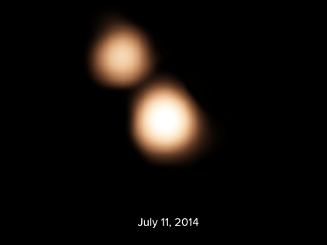
Pluton & Charon Observations
Astrometry using a reference network of neaby QSOs achieved Astrometric accuracy of 4 mas
ALMA data improved targeting of New Horizons spacecraft
Fomalont et al, in prep
Notes:
Emission Peak 13 mJy
Noise is 0.0002 Jy
Resolution of 0.25 arcsec
Astrometry using a reference network of neaby QSOs
Astrometric position is
4 mas
ALMA data improved targeting of New Horizons spacecraft
Many people are responsible for the ALMA ephemeris accuracy. The ephemeris tracking: Ralph
Marsen, Rachel Rosen, Rafael Hirart. Ephemeris testing and scheduling: Bill Dent, Diego Garcia,
Antonio Hales. The ALMA commissioning team: Stuartt Corder, Tony Remijan, Catherine Vlahakis
and others.
----- Meeting Notes (8/5/15 16:27) -----
Add CO ref

Slide 45
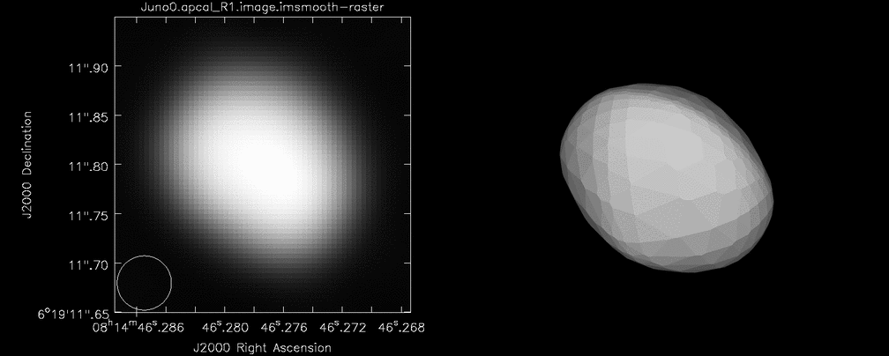
Juno at High Resolution
ALMA Parntership, Hunter et al (2015)
1.3 mm (Band 6) ALMA SV continuum images of Juno—3x15 minute snapshots (l) compared to model (r) from online software DAMIT (Durech et al 2013)
Notes:
1.3 mm (Band 6) ALMA SV continuum images of Juno. These 15-minute “snapshots” are from the 0, ¼, and ½
phase points of the 7.2 hour rotation period. Next to the ALMA images are Juno model images obtained from the online tool:
Database of Asteroid Models from Inversion Techniques (DAMIT) which is described in Durech et al. 2010 (A&A 513, 46) and
are available from http://astro.troja.mff.cuni.cz/projects/asteroids3D/web.php. These models are produced by inverting timeresolved
optical photometry (and in this case two occultations) into a polyhedral shape, rotation period and spin axis direction.
Moving image by T. Hunter.

Slide 46
Development Program
Development of post-construction receivers, phasing hardware, and new data analysis tools underway
  Development Studies program calls issued
  After external review, proposals funded
  Studies may form the basis for new equipment, software or techniques to be deployed on the array
New NA Call for 2016 Development Studies April/May 2015, ESO Call expected Spring 2016, NAOJ Development Workshop (Just concluded)
New Call for Development Projects and Studies will occur from each partner in due course.

Slide 47
Summary
After three decades of planning/construction, ALMA is approaching full science operations
An internationally built and governed of the facility
Early Science has been hugely successful
  Regular observing cycles underway
Further technical/scientific development via community involvement: in progress
On behalf of our international partners – we encourage everyone to consider using ALMA for your cutting-edge research.

Slide 48
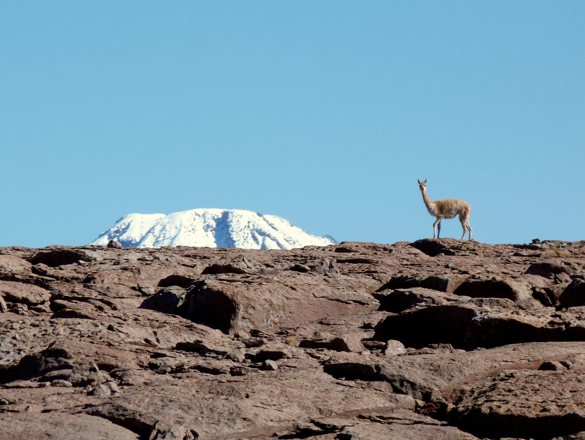
The Atacama Large Millimeter/submillimeter Array (ALMA), an international astronomy facility, is a partnership of ESO (representing its members states), NSF (USA) and NINS (Japan), together with NRC (Canada), NSC and ASIAA (Taiwan), and KASI (Republic of Korea), in cooperation with the Republic of Chile. The Joint ALMA Observatory is operated by ESO, AUI/NRAO and NAOJ. The National Radio Astronomy Observatory is a facility of the National Science Foundation operated under the cooperative agreement by Associated Universities Inc. We thank all those who have contributed to making the ALMA project possible.
Notes:
Use LBC collage here rather than lost vicuna…

