Slide 1
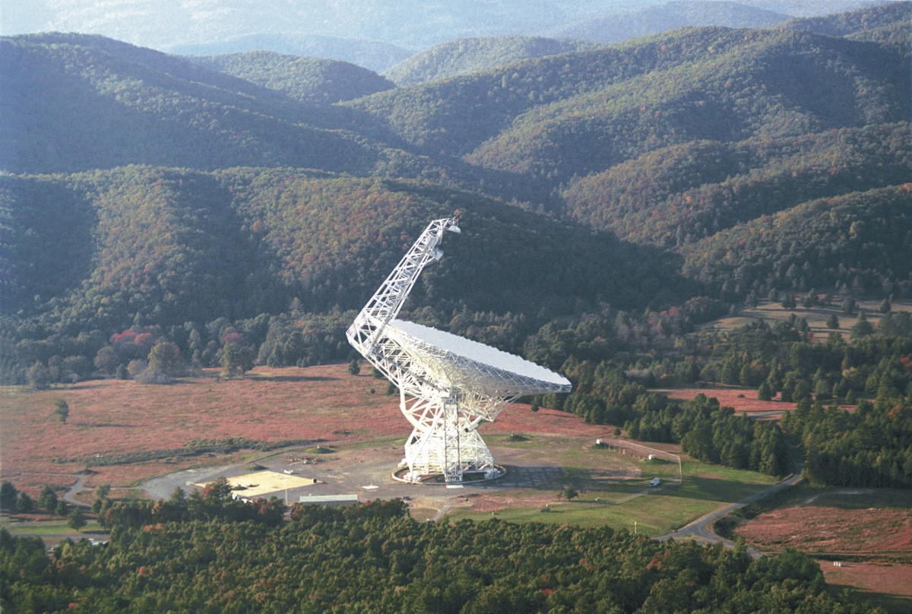
The Effects of the Atmosphere on Radio Astronomy Observations Dana S. Balser
Notes:
Part I: the effects of the atmosphere on the radio signal
Part II: the effects of the atmosphere on the telescope
Here “atmosphere” includes solar heating!
Talk will focus on GBT.

Slide 2
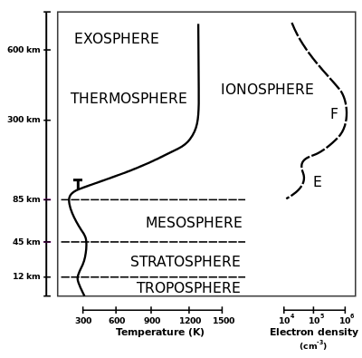
The Effects of the Atmosphere on the Radio Signal
Notes:
Plasma Frequency: f_p ~ 10-20 MHz
Phase path irregularities: 1-100 km in size and important for interferometers

Slide 3
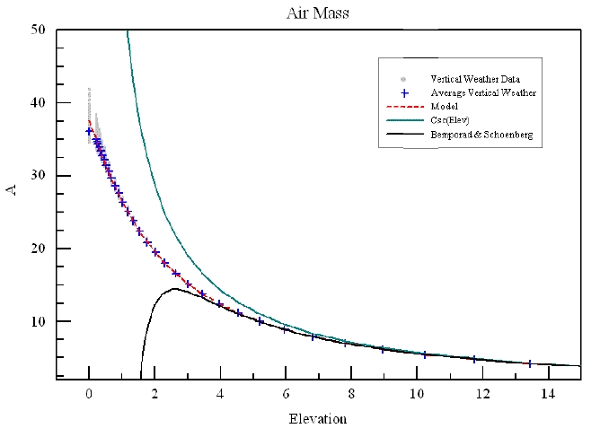
Atmospheric Refraction
R = $E_{o }−E_{t}$
Plane Parallel
$$n_{o}Cos\left(E_{o}\right)=Cos(E_{t})$$
$$R \sim {(n}_{o} −1) Cot(E_{o})$$
Maddalena & Johnson (2006)
Spherical
$$R= r_{o}n_{o}Sin(z_{o})\int_{1}^{n_{o}}{\frac{dn}{n{(r^{2}n^{2} − {r_{o}}^{2}{n_{o}}^{2}{Sin}^{2}(z_{o}^{}))}^{1/2}}}$$
Green (1985)
Notes:
Plane Parallel use Snell’s law
Most telescopes use an approximation; this will depend on weather.
Index of refraction: n = c/v (v phase velocity)

Slide 4
Anomalous Refraction (Seeing)
$$m_{50}= \frac{f}{100 GHz}{\left(\frac{D}{50 m}\right)}^{5/6}$$
= 0.4 at 10 GHz for Arecibo
= 1.8 at 100 GHz for the GBT
= 3.0 at 300 GHz for the LMT
$$Important when m_{50}>1$$
Olmi (2002)
Notes:
The wave front encounters a refractive wedge of water vapor. The wave front is tilted from its original
Direction because of the phase difference between the opposite ends of the aperture. This results in a
pointing error (the beam shape is okay).
m50 is a dimensionless parameter related to the standard deviation of the angle of the arrival fluctuations
which is related to the Structure function.

Slide 5
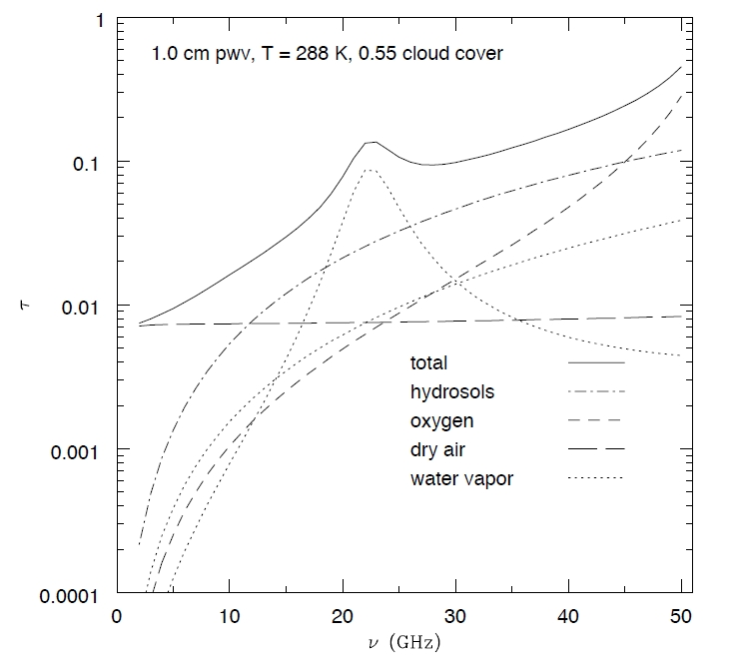
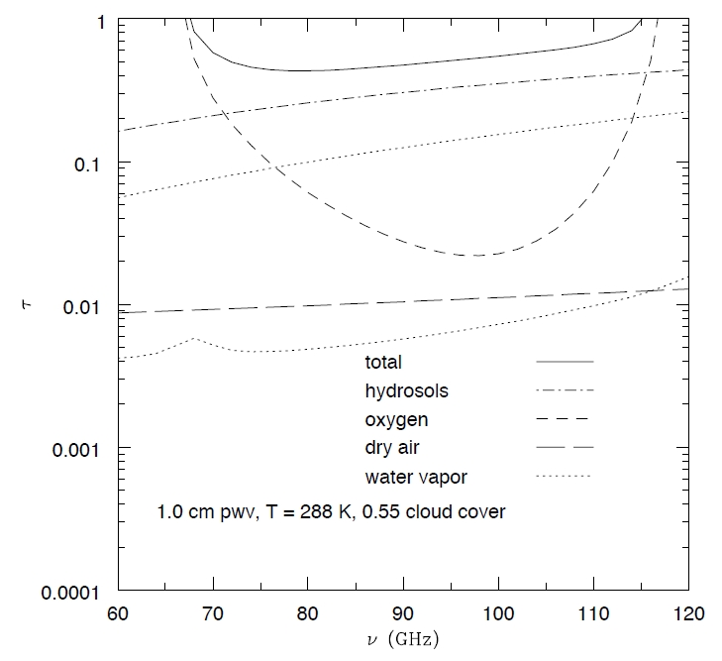
Atmospheric Absortion
$$T_{A} ∝ e^{−τ}$$
Condon (2007)
Notes:
Hydrosols are liquid droplets (clouds)
H2O lines
O2 lines
Dry air continuum
→ Hydrosols and H2O are weather related

Slide 6
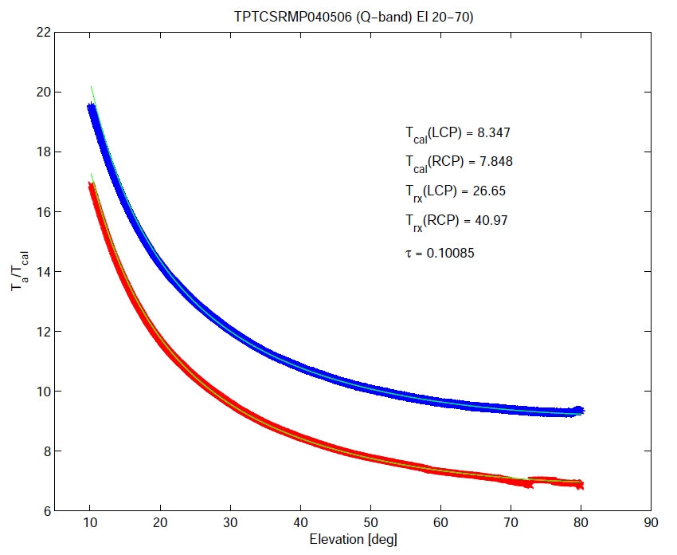
Atmospheric Emission (Noise)
$$T_{sys}= T_{o}+ T_{b}$$
System Temperature
$$T_{o} \sim T_{rcvr}+T_{src}+ T_{grd}+ T_{cmb}$$
$$\sim { T}_{rcvr}+6K$$
${ T}_{b}= T_{k}(1 − e^{−τ})$
Elevation
Condon (2007)
Balser (2004)
Notes:
To – nearly fixed component
Tb – atmospheric (variable) component
Tk >> To so atmospheric emission is more important than atmospheric absorption in reducing observing efficiency

Slide 7
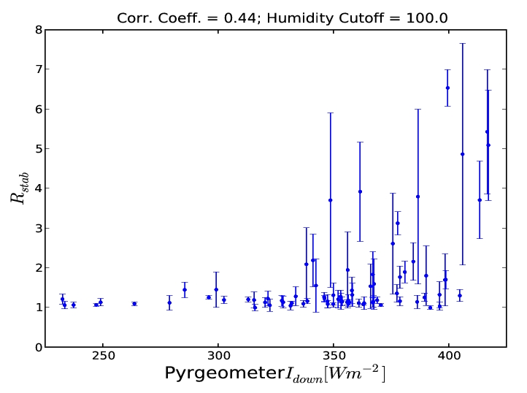
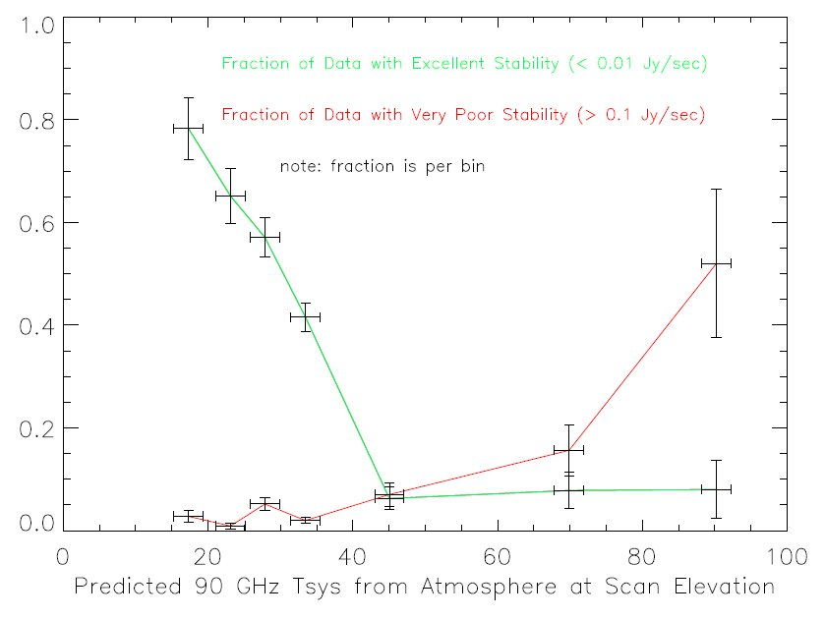
Atmospheric Stability
9 GHz
90 GHz
Stability
Fraction
poor
good
IR Irradiance
Tsys (90GHz)
Balser (2011)
Mason & Perera (2011)
Notes:
Pyrgeometer: 4.5-40 microns over 150 deg.

Slide 8
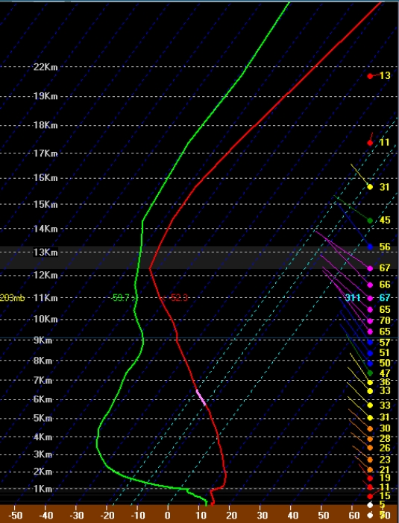
Weather Forecasts
Vertical Profiles from
GOES and Balloon
Soundings (NOAA)
$$→T_{sys}\left(f\right), τ(f)$$
Maddalena: www.gb.nrao.edu/
~rmaddale/Weather

Slide 9
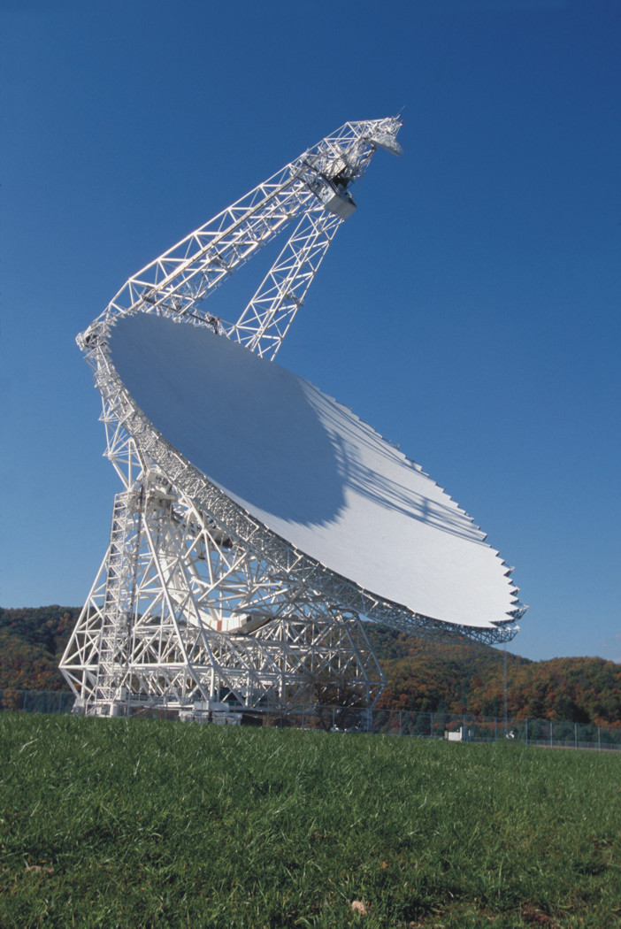
The Effects of the Atmosphere on the Telescope
Repeatable Errors:
Gravity
→ Static Corrections
Non-repeatable Errors:
Thermal (slow)
Wind (fast)
→ Dynamic Corrections

Slide 10
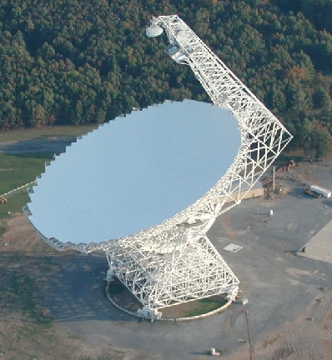
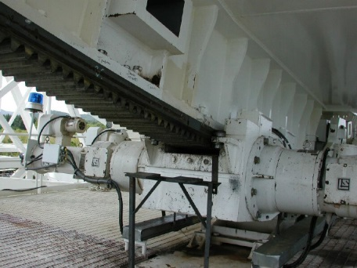
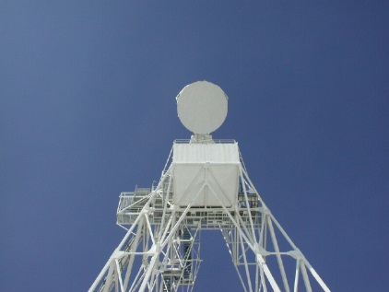
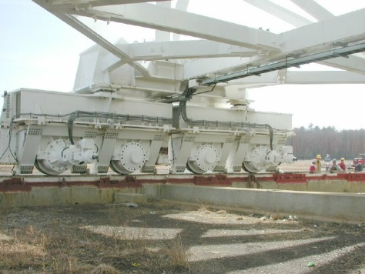
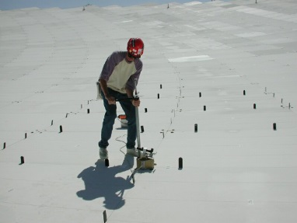
Telescope Adjustments
Focus
Pointing
Surface

Slide 11
Telescope Performance

Slide 12
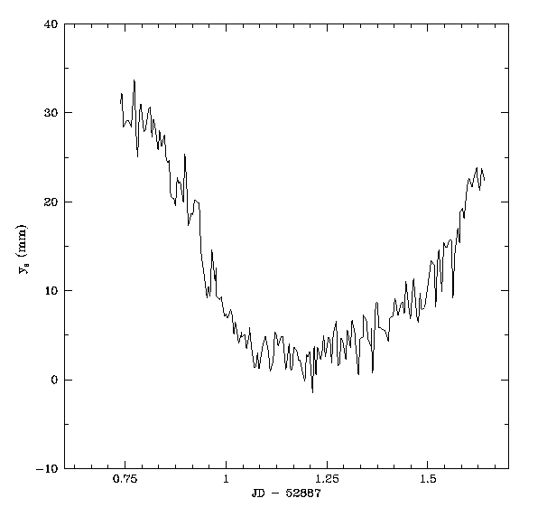
Thermal Effects: pointing, focus, surface shape
Axial Focus
Time

Slide 13
Telescope Pointing and Focus: thermal model
Constantikes (2007)
Notes:
→ Azimuth Corrections
Alidade: left and right tilts produce an elevation dependent azimuth error
Horizontal feedarm: left-to-right bending
BUS: translation in the x-direction around the y-direction
Vertical feedarm: left-to-right differences
Elevation Corrections
BUS: translation in the y-direction around the x-direction (elevation axle)
Horizontal feedarm: bending around the x-direction
Vertical feedarm: differences in the y-direction (front-to-back)
Alidade: temperature differences in the legs

Slide 14
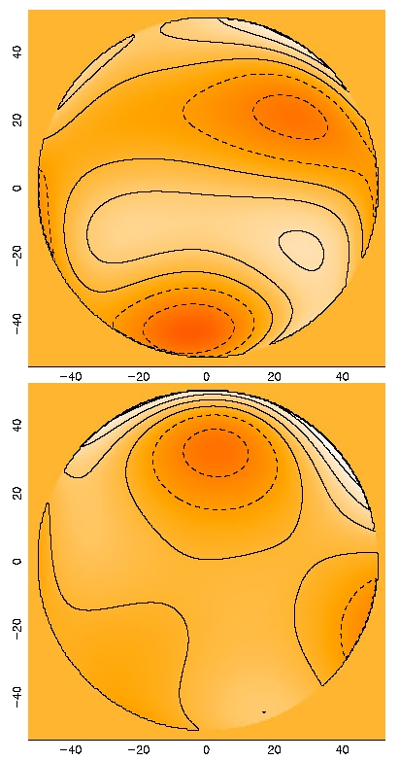
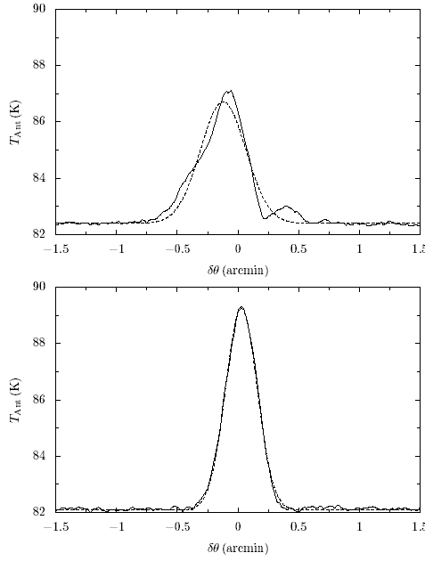
Telescope Surface: OOF Holography
$$rms=330μm$$
$$rms=220μm$$
Nikolic et al. (2007)
Notes:
Conventional “with phase” Holography: use a phase reference antenna to measure the amplitude and phase of the far-field beam pattern. The Fourier transform yields the aperture function and thus the deformations. Measuring just the power pattern of the in-focus beam underdetermines the aperture function. For example, you cannot distinguish a sign change in a surface error.
OOF “phase retrieval” Holography: introduce a known phase change across the aperture by defocusing the telescope. Due to the non-linearity of the measurement process, a straight forward inversion from the observed beam power pattern to the aperture plane is not possible. The aperture plane is parameterized by a set of basis functions (Zernike Polynomials) and determined by numerical fits. Zernike polynomials are a good choice since they are orthogonal.
Images: wavefront errors with contours at half radian intervals at +/- 2pi

Slide 15
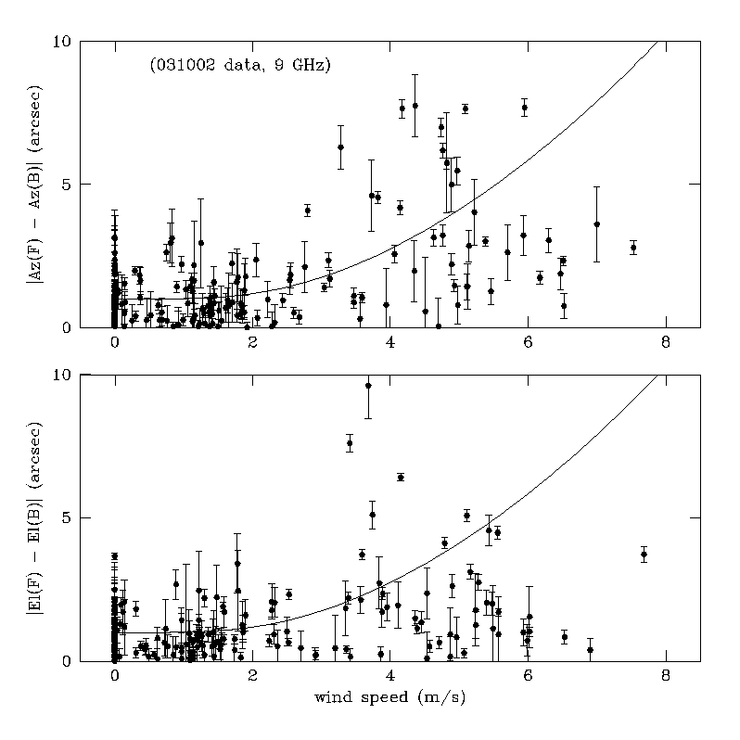
Wind Effects: pointing
Condon (2003)
Notes:
Forward and Backward scan differences.
Hooke’s Law: pointing offset is proportional to pressure which goes as the velocity squared.

Slide 16
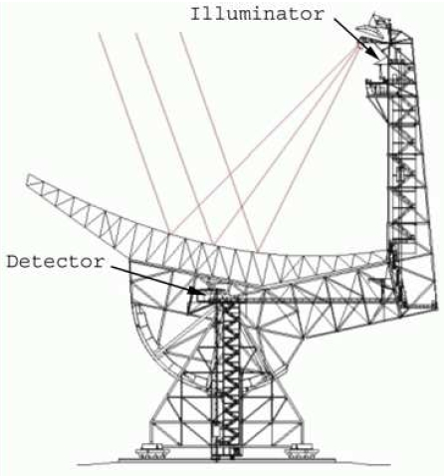
Quadrant Detector
→ Flag bad data
Correct maps from arrays
Real-time corrections

Slide 17
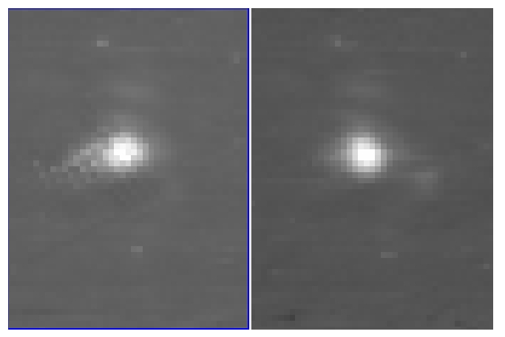
Map Corrections
Before
After
Ries et al. (2009)
Notes:
Mustang data

Slide 18
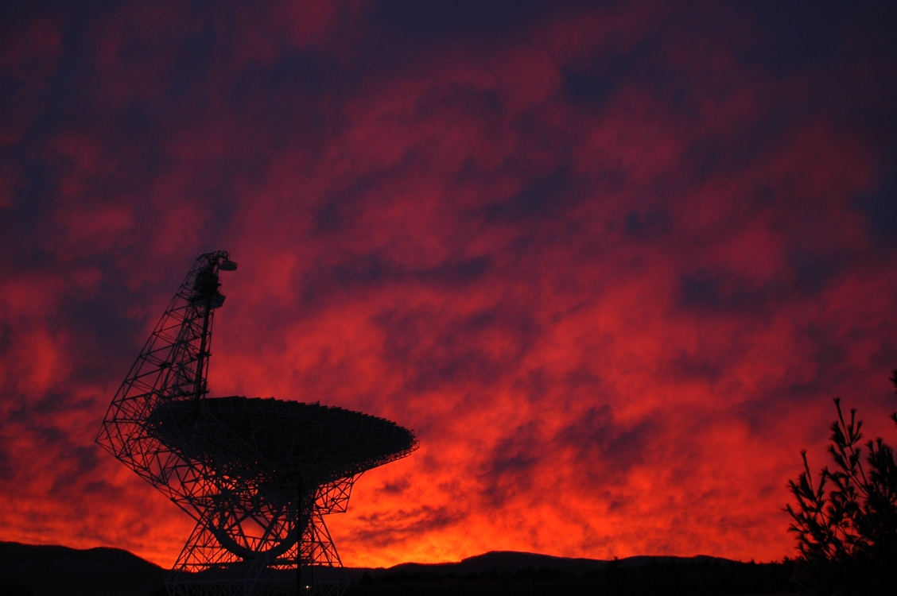
Fini

