Slide 1
GBT Dynamic Scheduling System (DSS)
Dana Balser, Jim Braatz, Mark Clark, Jim Condon, Ray Creager, Mike McCarty, Ron Maddalena, Paul Marganian, Karen O’Neil, Eric Sessoms, Amy Shelton

Slide 2
Nomenclature
GBT
Open Sessions
Windowed Sessions
Fixed Sessions
Butler

Slide 3
How does it work?
Data Collection
Advance of Semester
Scheduling Probabilities
Sensitivity
calculator
Time
availability
prediction
Historical
probabilities
Weather
forecasts
Proposal
Submission
Tool
Science
grades
Phase II
data
collection
Scheduling Algorithm
24-48 Hours in Advance
Provided by the DSS
Provided outside the DSS
Autoscheduler
Run
Scheduler modifies
and approves
Notification
sent
Requirements
Scheduling observers, not scripts
•Observers retain control
•Minimum of 24 hours advance notice for observers
Wide array of hardware
•Cannot increase workload of staff or observers
Observing
Post-Observation
Reports
Monitor
schedule
Observing
scripts
Backup
Project run
Reports of schedule,
logs, time lost, etc
Notes:
Algorithm, simulations: Haskell
Databases: PostGres
Scheduler Tool/Sensitivity Calculator: Django Server and Google Web Toolkit GWT/GXT Client
Observer pages: Django

Slide 4
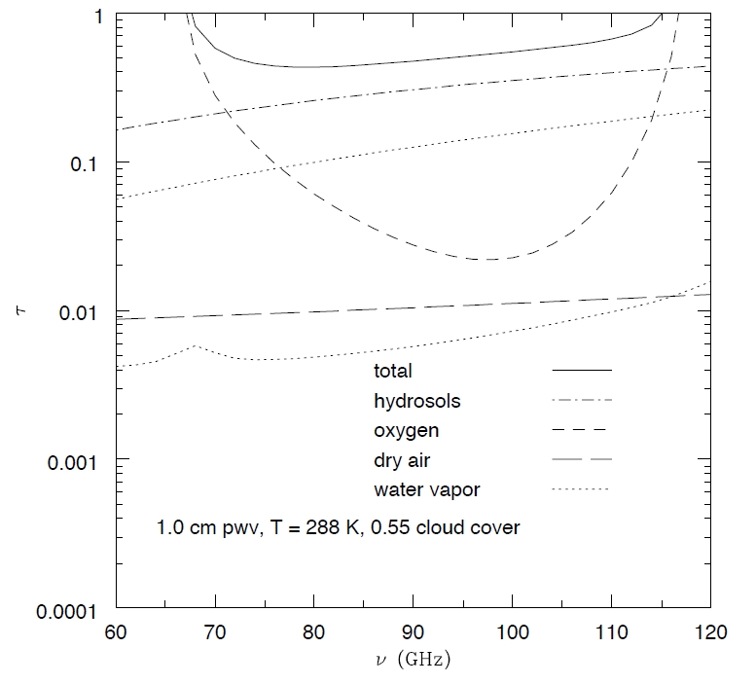
Atmospheric Effects
Condon & Balser (2011)
Notes:
Two effects: attenuates signal and adds noise
Independent of weather: Dry air (continuum) and Oxygen (pressure-broadened lines)
Dependent of weather: water vapor (pressure broadened line and continuum) and hydrosol (continuum)
Ratio of water vapor line and water vapor continuum is nearly constant since they are both proportional to the column of precipitable water vapor (PWV). When the relative humidity is high enough, clouds and hydrosols (water droplets) form and can dominate the total zenith opacity at high frequencies.

Slide 5
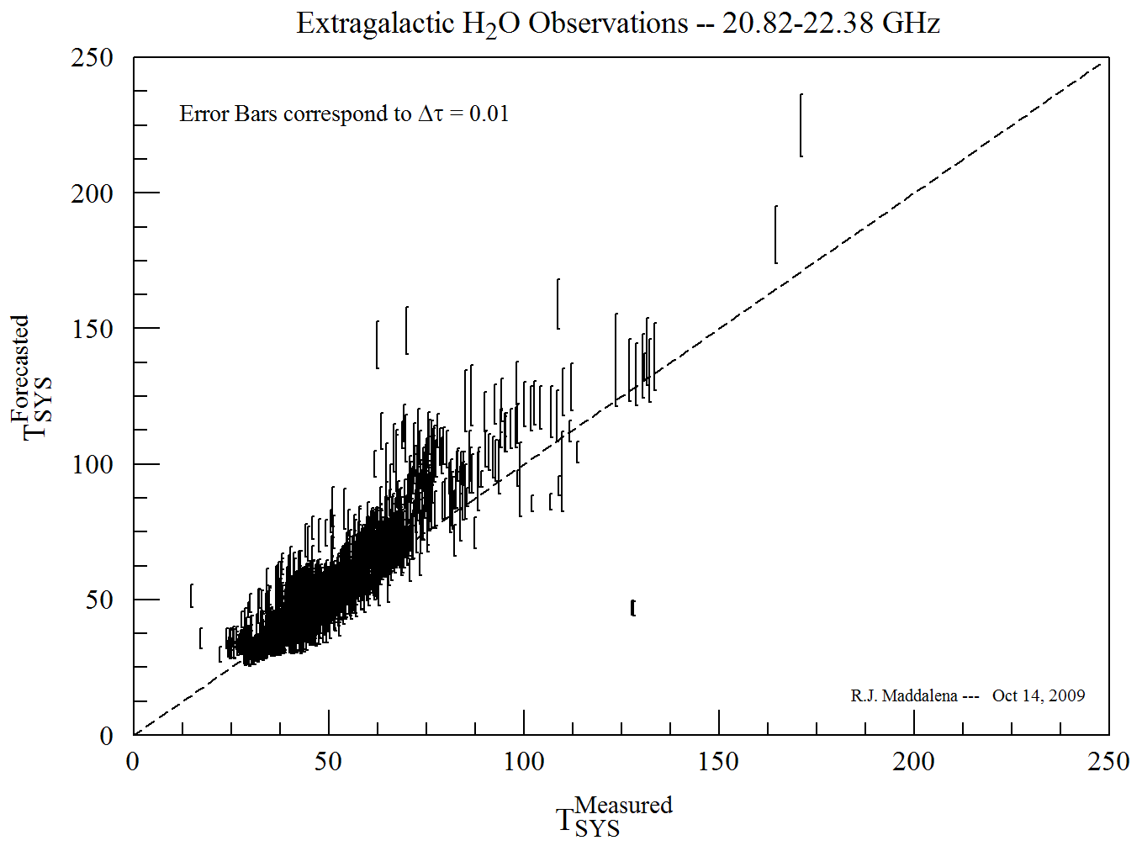
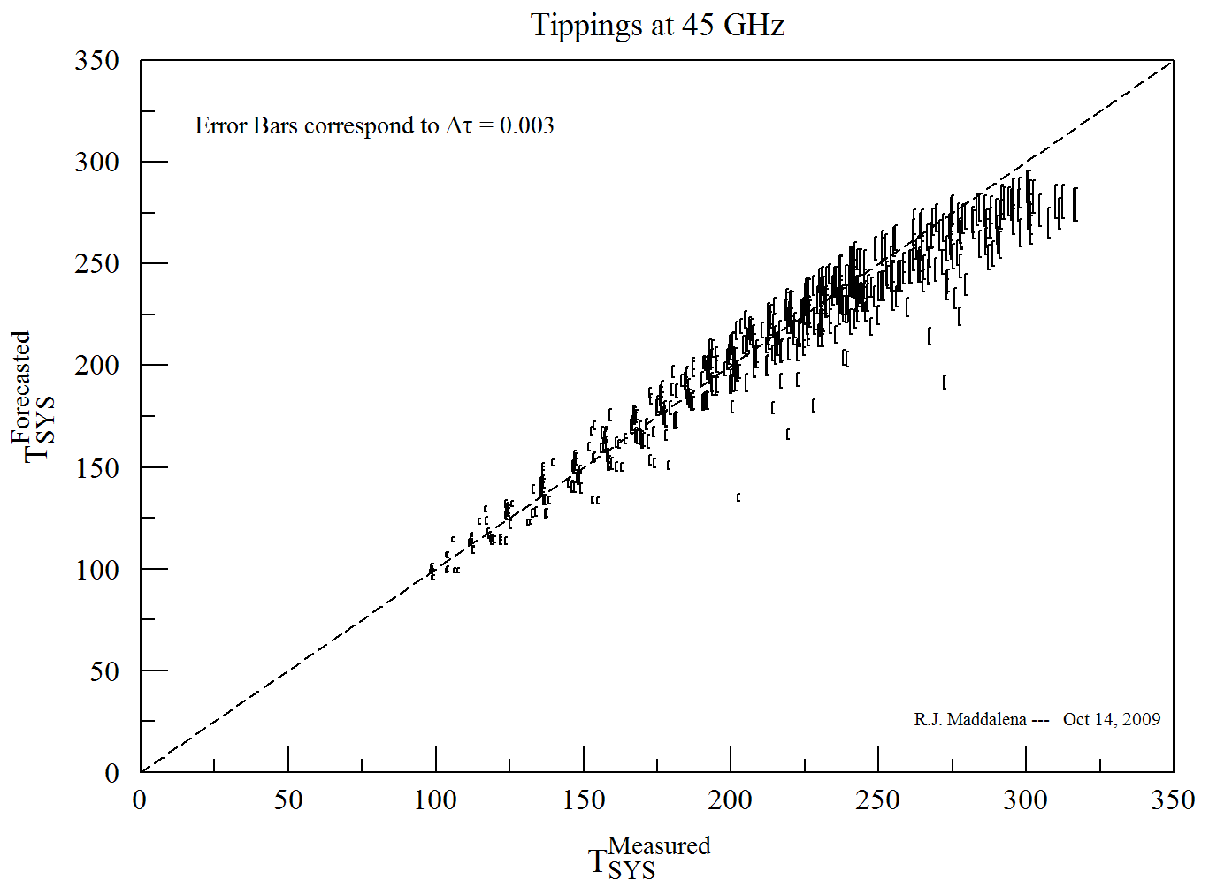
Weather Forecasts
Maddalena
Notes:
Weather data are derived from the national weather services that provide vertical weather conditions. They are based on computer models that use balloon soundings and GOES satellite soundings as input. We average info from Lewisburg, Elkins, and Hot Springs. We are using the North American Mesoscale (NAM, formally known as ETA) model.

Slide 6
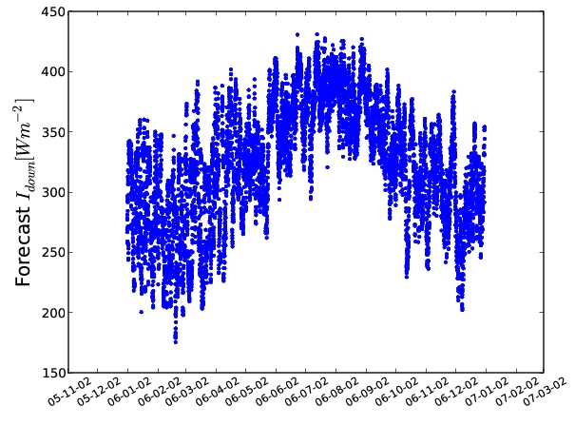
Atmospheric Stability
Pyrgeometer: non-imaging device sensitive to
4.5-40 micron over 150 deg fov.
Maddalena; Balser (2011)
Notes:
Clouds become opaque at frequencies above 5 GHz. They are also a measure of stability as well as temperature.

Slide 7
Wind Effects
Condon (2003)
Notes:
We assume the GBT obeys Hooke’s law so the pointing shift is proportional to the wind pressure, and we make the approximation that the wind pressure is proportional to the square of the wind speed.

Slide 8
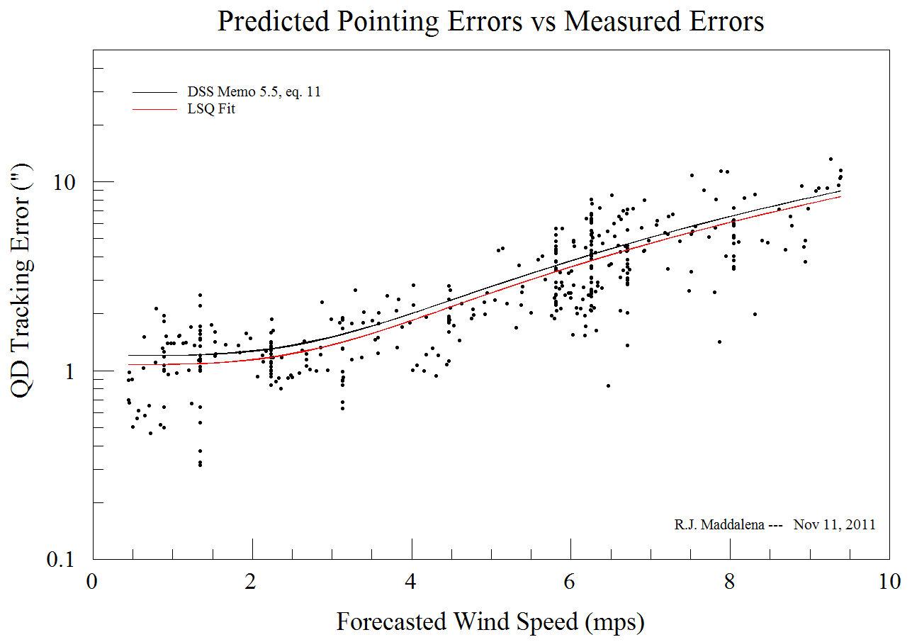
Weather Forecasts: wind
Day
Obs Wind Speed (m/s)
Night
Balser (2010); Maddalena
Forecast Wind Speed (m/s)
Notes:
Blue crosses: wind speed value for each hour.
Red crosses: 80th percentile wind speed binned in 0.25 m/s intervals.

Slide 9
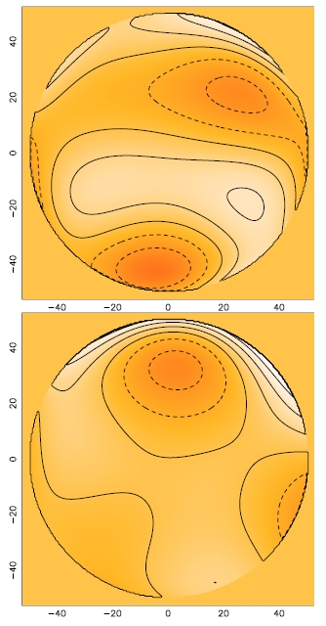
Solar Heating
Primary Surface
Day: 300 micron
Night: 250 micron
Offset Pointing
Day: 3.3 arcsec
Night: 2.7 arcsec
rms
330 micron
Surface
Wave front errors from OOF maps.
Grayscale: +/- 2 rad
Contour: ½ rad intervals
rms
220 micron
Nikolic et al. (2007)

Slide 10
Scoring Equation
Other Factors:
Observers on Site
Completion of Projects
Science Grades
Thesis Projects
Weather:
Observing Efficiency
Stringency
R = (ηS P_{α}^{β} P_{ν}^{γ}) (l_{eff} l_{HA} l_{z} l_{tr} l_{st}) (f_{oos} f_{com} f_{sg} f_{tp})(t_{t}t_{n}t_{le}t_{tb})
Performance Limits:
Observing Efficiency
Hour Angle
Zenith Angle
Tracking Error
Atmospheric Stability
Temporal Constraints:
Transit
Nighttime
LST Exclusion
Time Between
Pressure Factors:
Right Ascension Frequency

Slide 11
Scoring Equation
Weather:
Observing Efficiency
Stringency
R = (ηS P_{α}^{β} P_{ν}^{γ}) (l_{eff} l_{HA} l_{z} l_{tr} l_{st}) (f_{oos} f_{com} f_{sg} f_{tp})(t_{t}t_{n}t_{le}t_{tb})

Slide 12
Observing Efficiency
Notes:
The ratio of the integration time needed to make a transit observation in the best weather to the time needed to reach the same sensitivity given the actual weather conditions and hour angle. Efficiency normalized this way always ranges from zero to unity.
Atmosphere: use radiometer equation and corrections to opacity
Surface: use Ruze’s equation and how the rms relates to aperture efficiency
Tracking: assume Gaussian beam and that the tracking errors are approximately Gaussian; plus Hooke’s law.

Slide 13
Observing Efficiency

Slide 14
Stringency
Notes:
The reciprocal of the fraction of time that the following limits for a transit observation are all satisfied: observing efficiency, tracking error, and atmospheric stability. It is a function of receiver, frequency, elevation, and observing type.

Slide 15
Scoring Equation
R = (ηS P_{α}^{β} P_{ν}^{γ}) (l_{eff} l_{HA} l_{z} l_{tr} l_{st}) (f_{oos} f_{com} f_{sg} f_{tp})(t_{t}t_{n}t_{le}t_{tb})
Pressure Factors:
Right Ascension Frequency

Slide 16
Pressure Factor
Notes:
The schedule pressure P is a measure of unsatisfied demand. Feedback can be used to equalize pressure across right ascension and frequency by favoring sessions having higher pressure values. Feedback is blind and competes with observing efficiency, so it reduces efficiency and should be used only as a last resort.

Slide 17
Scoring Equation
R = (ηS P_{α}^{β} P_{ν}^{γ}) (l_{eff} l_{HA} l_{z} l_{tr} l_{st}) (f_{oos} f_{com} f_{sg} f_{tp})(t_{t}t_{n}t_{le}t_{tb})
Performance Limits:
Observing Efficiency
Hour Angle
Zenith Angle
Tracking Error
Atmospheric Stability

Slide 18
Observing Efficiency Limit
Notes:
We began our simulations by requiring eta_min = 0.5 at all frequencies on the grounds that observing time is proportional to 1/eta and diverges rapidly when eta_min < 0.5. However, the observing efficiency attainable in practice is actually as strong function of frequency and almost never falls to 0.5 for low frequencies, so we allowed eta_min to vary with frequency in a way that prohibits needlessly inefficient observations at any frequency.

Slide 19
Hour Angle Limit
Condon & Balser (2011)
Notes:
The HA limit is the HA at which eta_atm = sqrt(0.5*eta_min).

Slide 20
Tracking Error Limit

Slide 21
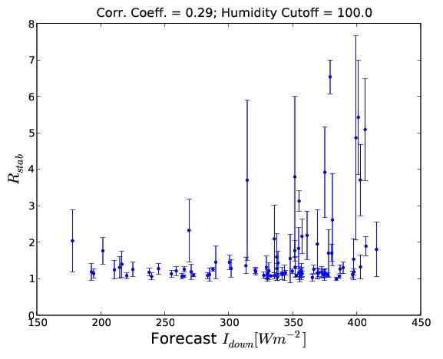
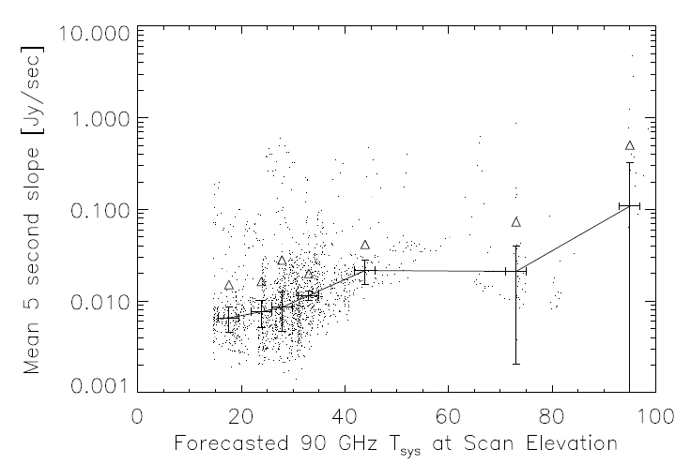
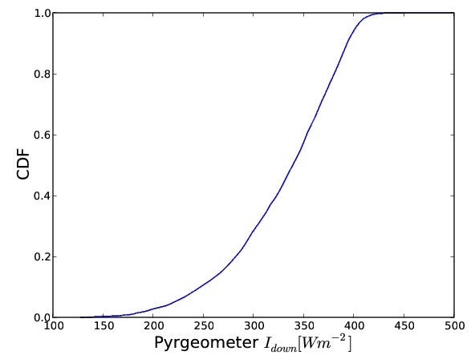
Atmospheric Stability Limit
Balser (2011); Mason & Perera (2010)
Notes:
Most Bands: R_stab = sigma_large/sigma_small for pointing scans at X-band.
MUSTANG: Tsys at scan elevation = 35K, 50K.

Slide 22
Packing (Open Sessions)
Problem: a thief with a bag of capacity N, faced with a number (M) of possible goodies each having a different weight (cost) and value, how do you pack your bag to maximize your take?
Brute Force: order (M!)
Knapsack Algorithm: order (M*N)
N = number of quarter hours to schedule
M = number of potential sessions
Overhead = 15 min.
Sessoms
Notes:
The knapsack algorithm solves this problem iteratively. First, find the maximum value with cost 1. Then find the maximum value with cost 2, etc. This may involve adding a new item of cost 1 to the existing item, or it may involve forgetting the existing item of cost 1 and replacing it with a new, more valuable, item of cost 2. Importantly for this algorithm, remember both solutions. Then, to find the maximum value of cost 3, the solution may involve adding an item of cost 1 to the solution of cost 2, it may involve adding an item of cost 2 to the solution of cost 1, or it may involve a new item of cost 3.

Slide 23
Scheduler Page

Slide 24
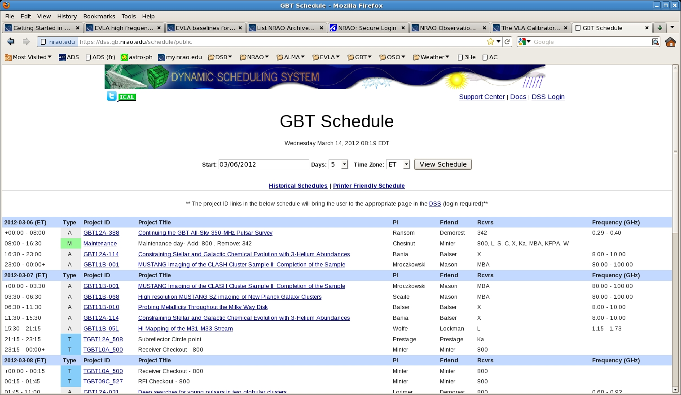
Schedule

Slide 25
User Home Page

Slide 26
User Project Page

Slide 27
Fini

