Slide 1
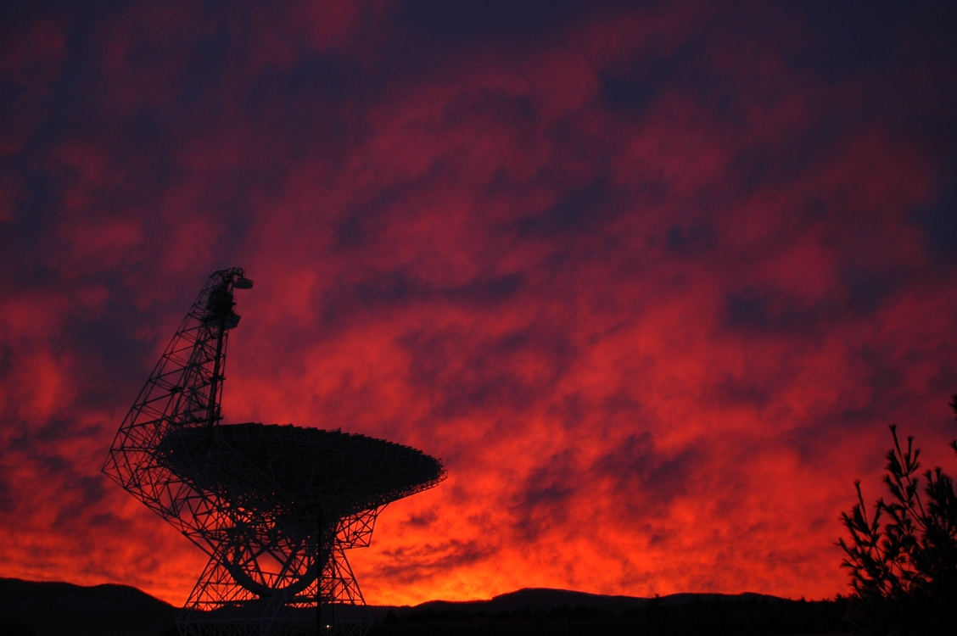
GBT Galactic HII Region Discovery Survey Dana S. Balser

Slide 2
Collaborators
Tom Bania
(Boston University)
Loren Anderson
(Laboratoire d’Astrophysique
de Marseille)
Bob Rood
(University of Virginia)

Slide 3
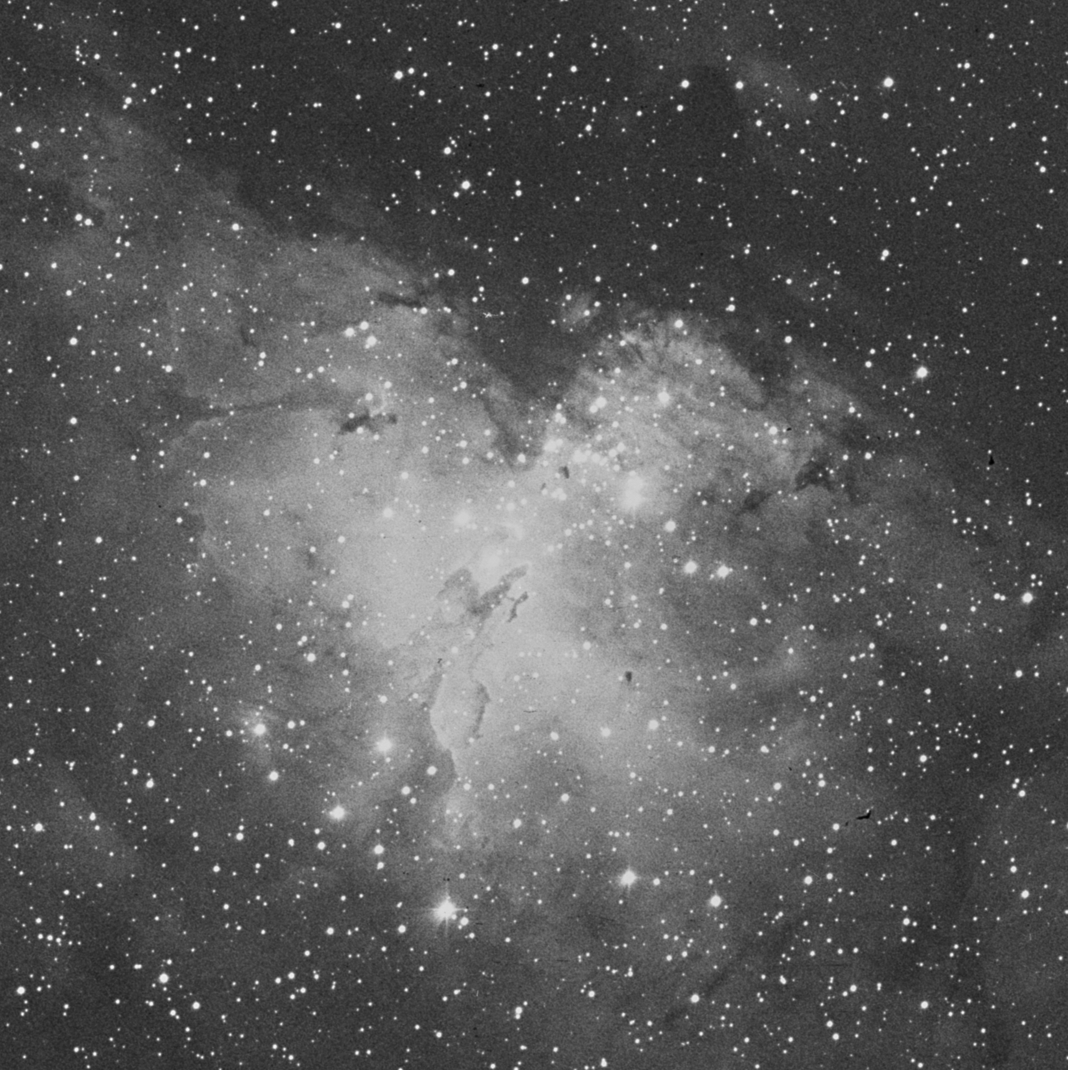
HII Region Surveys
Eagle Nebula
NGC 6611
M16
POSS
Notes:
First “modern” HII region surveys:
North: Sharpless (1953, ApJ, 118, 362); Sharpless (1959, ApJS, 4, 257) [313 objects]
Using Palomar Observatory Sky Survey (POSS)
South: Gum (1955, MRAS, 67, 155) [85 objects]
Rodgers, Campbell, & Whiteoak (1960, MNRAS, 121, 103) [182 objects]

Slide 4
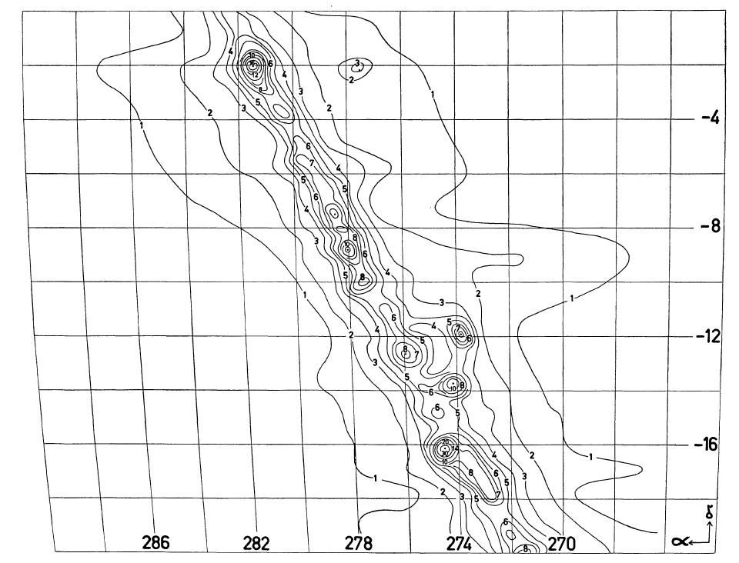
Radio Continuum Surveys
Westerhout (1958)
Notes:
25m radio telescope in Dwingeloo at 1390 MHz

Slide 5
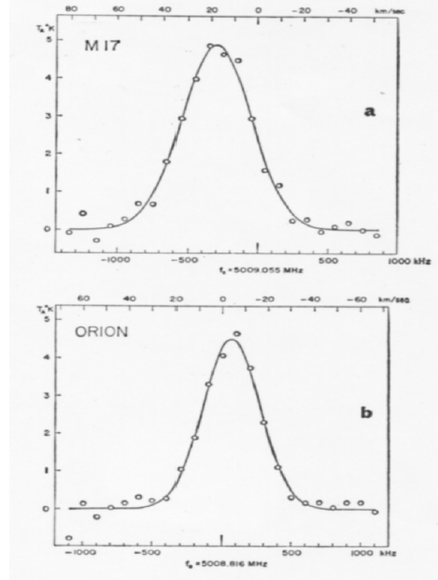
Radio Recombination Lines (RRLs)
Antenna Temperature
Frequency
Hoglund & Mezger (1965)
Notes:
Hoglund & Mezger (1965, Science, 150, 339) – first detection of RRLs on the 140 Foot
Lilley, Palmer, Penfield, & Zuckerman (1966, Nature, 211, 174) – First detection of He RRLs on Harvard 60 Foot
Palmer, Zuckerman, Penfield, & Lilley (1967, Nature, 215, 40) – First detection of C RRLs on 140 Foot
Palmer & Zuckerman (1966, Nature, 209, 1118) – Use current nomenclature

Slide 6
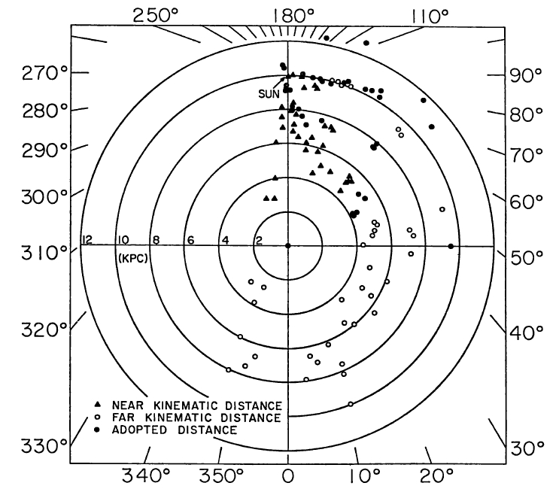
Radio Recombination Line Surveys
Reifenstein et al. (1970)
Notes:
Reifenstein et al. (1970, A&A, 4, 357) – North (140 Foot)
Wilson et al. (1970, A&A, 6, 364) – South (210 Foot)
McGee & Gardner (1968, AuJPh, 21, 149) – South (210 Foot)
Downes et al. (1980, A&AS, 40, 397)
Shaver et al. (1983, MNRAS, 204, 53)
Caswell & Haynes (1987, A&A, 171, 261)
Lockman (1989, ApJS, 71, 469)
Wood & Churchwell (1989, ApJS, 69, 831) – UCHII using radio continuum and FIR emission to select sources.
Paladini et al. (2003, A&A, 397, 213) – Compilation of 1442 objects

Slide 7
HII Region Emission
Simulated 30 GHz HII Region Emission (mK)
Master Catalog of 1442 Objects
Paladini et al. (2003)
CO Integrated Emission (K km/s)
Dame et al. (2001)
Notes:
HII Region: 0-100mK at 30 GHz. Convolve symmetric Gaussain brightness distribution of HII region catalog with symmetric HPBW of 33.6 arcsec (Planck). CMB experimetns: Free-free emission dominates between 30-100 GHz in the plane. It contributes to stray radiation. The HII regions can be used as calibrators as they have a flat spectrum.
CO Integrated Intensity: 0-250 K km/s
N.B., Anderson et al. (2009) found CO/HII region morphological association in position and velocity for 80% of the objects in the GRS.
Motivation: Why another survey?
Clearly sensitivity limited at larger distances (few HII regions beyond Solar orbit in Galactic quadrants I and IV but not II and III)
Not many HII Regions within 4 kpc. Sensitivity?
Not many HII Regions associated with the 3 kpc Arm. Sensitivity?

Slide 8
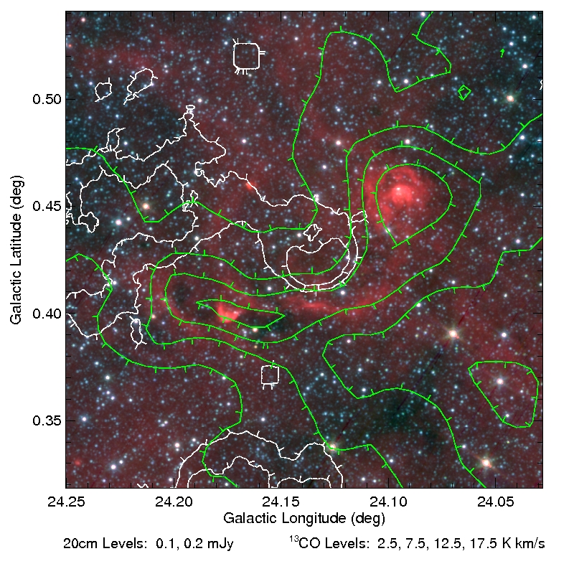
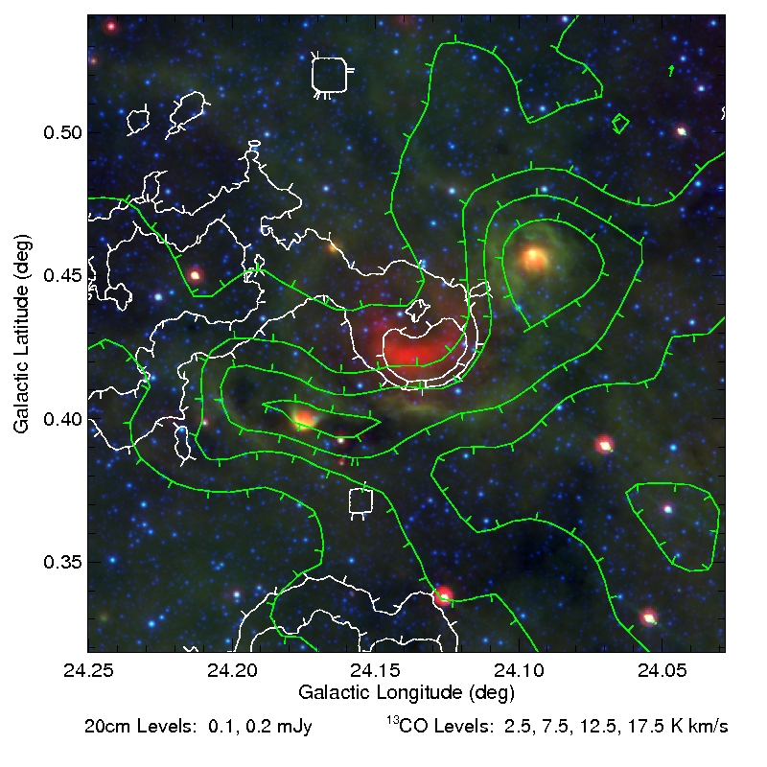
HII Region Targets
RGB → 8, 4.5, 3.6 microns
RGB → 24, 8, 3.6 microns
Spitzer IR MAGPIS 20cm (white contour) GRS 13CO (green contour)
Notes:
Note: this is not entirely a new technique as Wood & Churchwell used radio continuum images and FIR data to target potential UCHII targets.

Slide 9
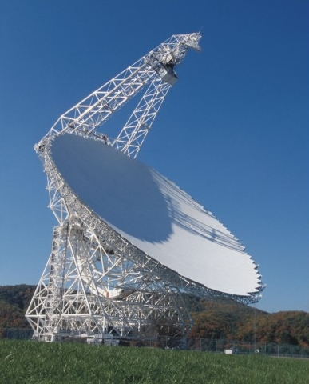
GBT HII Region Survey
All HII regions ionized by a single O-type star within the Solar orbit
Notes:
Rubin (1968) assumes ionization bounded HII regions.

Slide 10
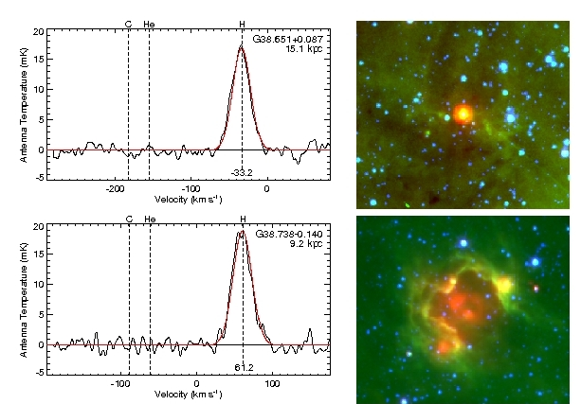
GBT Spectra
Notes:
Images: Spitzer IR with RGB → 24, 8, 4.5 microns
Spectra: H87a-H93a re-gridded and then averaged; smoothed to 4.5 km/s
Many of the target objects are unresolved in our 80 arcsec HPBW. Also, we are finding that most of the HII regions are at the far kinematic distance.

Slide 11
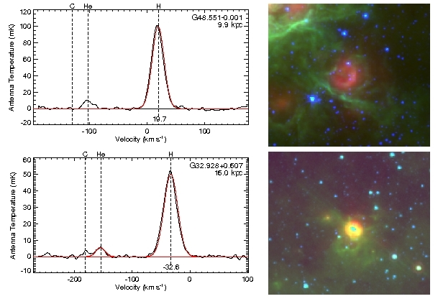
GBT Spectra
Notes:
Images: Spitzer IR with RGB → 24, 8, 4.5 microns
Spectra: H87a-H93a re-gridded and then averaged; smoothed to 4.5 km/s

Slide 12
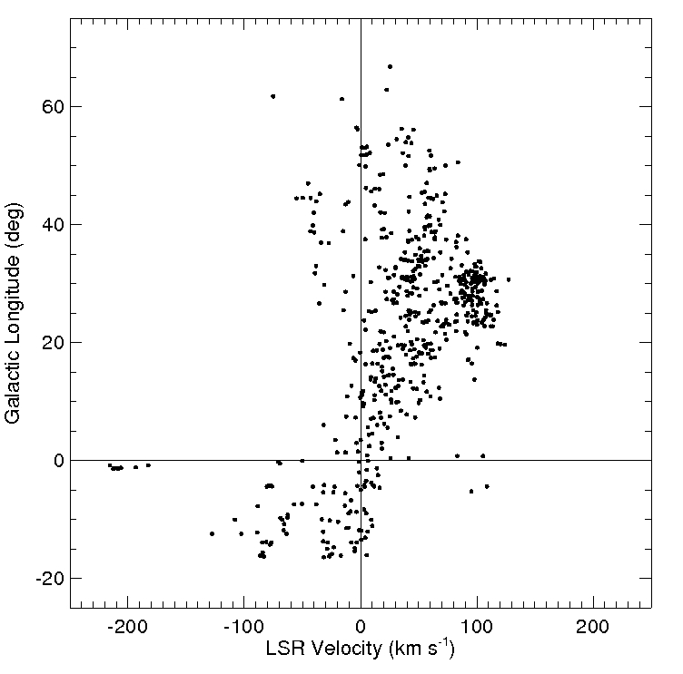
Longitude-Velocity Diagram
602 Detections
448 Directions
95%
Beyond Solar
Orbit
Spiral Arms
Nuclear Disk
Notes:
Paladini: 1442 total HII regions (674 in this longitude range)
HRDS: 602 detections (448 lines-of-sight; 129 multiple)

Slide 13
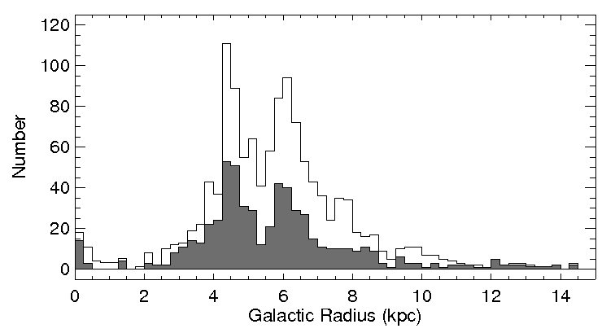
HII Region Radial Distribution
Notes:
Open histogram: 1276 combined HRDS + Paladini
Filled histogram: 602 HRDS sources
Rgal was determined using the longitude and LSR velocity and the Brand (1986) rotation curve.

Slide 14
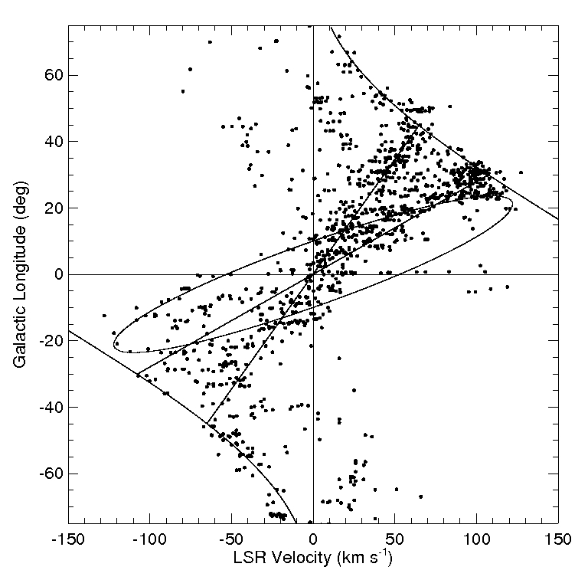
Galactic Structure
Notes:
HRDS + Paladini et al. (2003) survey (1276)
Note the limited velocity range (no Nuclear Disk)
L-V loci:
Circular rotation solid body for the peaks in the HII region Galactocentric radial distribution.
3 kpc-arm ring model (Cohen & Davies 1976).
Circular rotation terminal velocity from Brand (1986) rotation curve.

Slide 15
Summary
Detected 602 RRLs (448 directions)
95% of sample targets detected
Doubled number of know HII regions in this part of the Milky Way
25 HII regions detected beyond the Solar orbit in the first Galactic quadrant

Slide 16
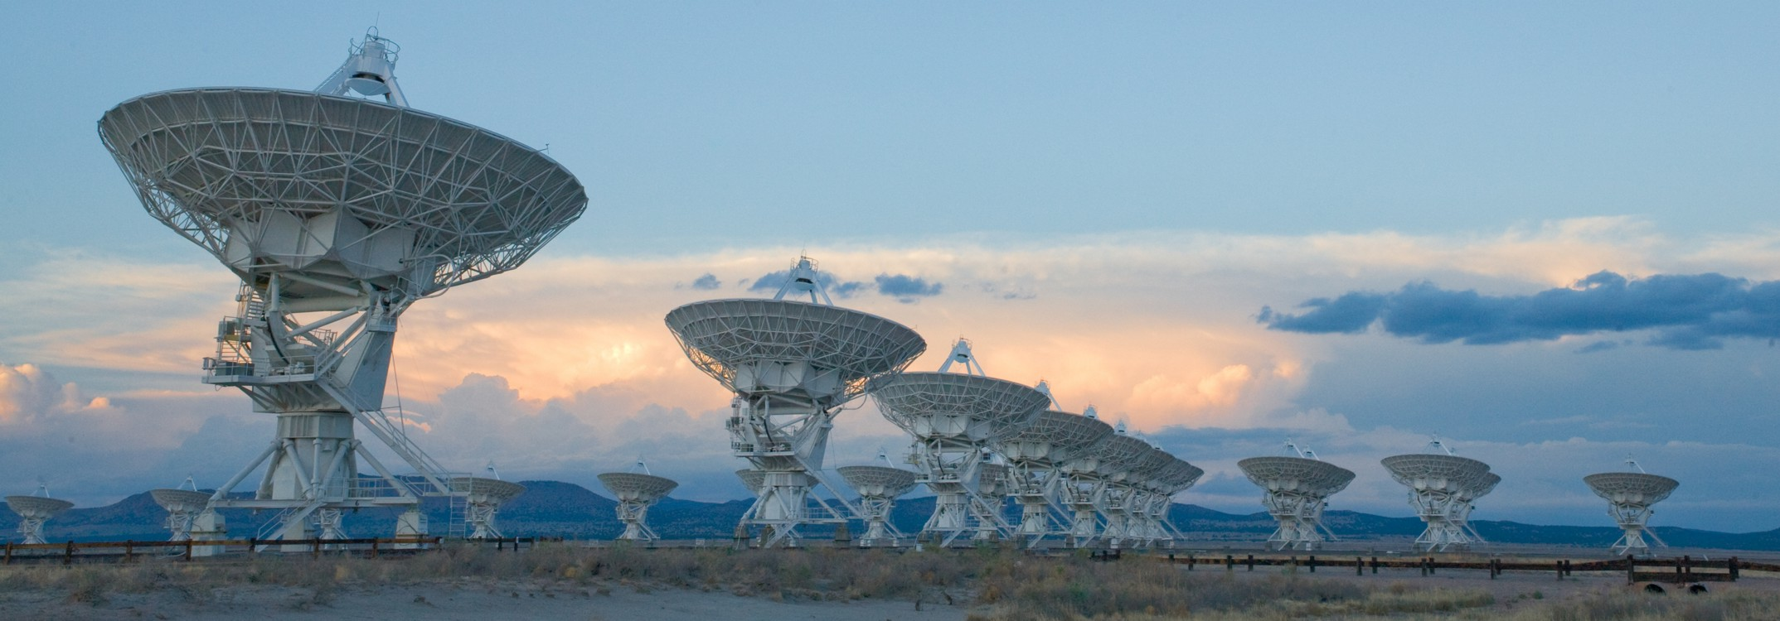
Future
Determine distances (HI E/A experiments)
Galactic structure
Galactic chemical evolution

Slide 17
Additional Slides

Slide 18
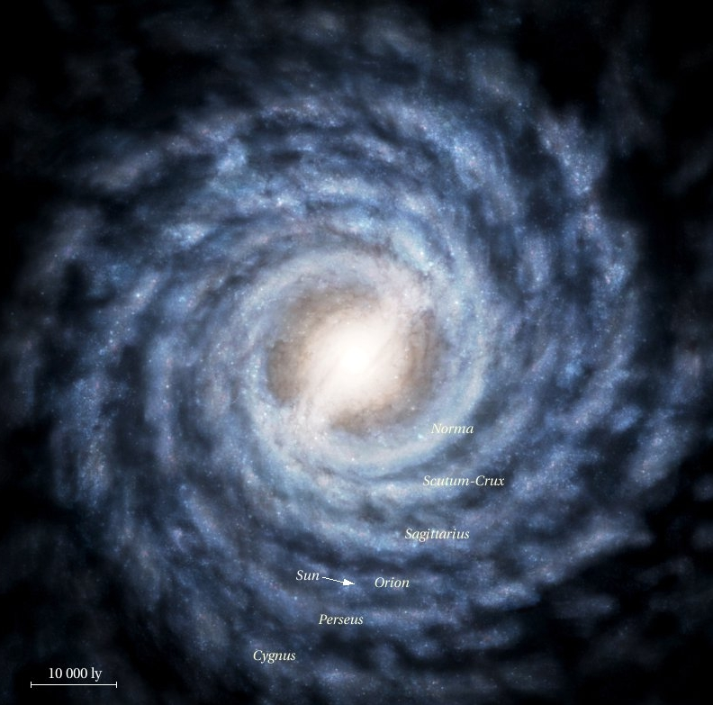
Spiral Arms
Notes:
Cygnus arm (outer arm)
Orion arm (local arm)
Sagittarius arm (Sagittarius-Carina arm)
Scutum-Crux arm (Centaurus arm)
Norma arm (3 kpc arm)

Slide 19
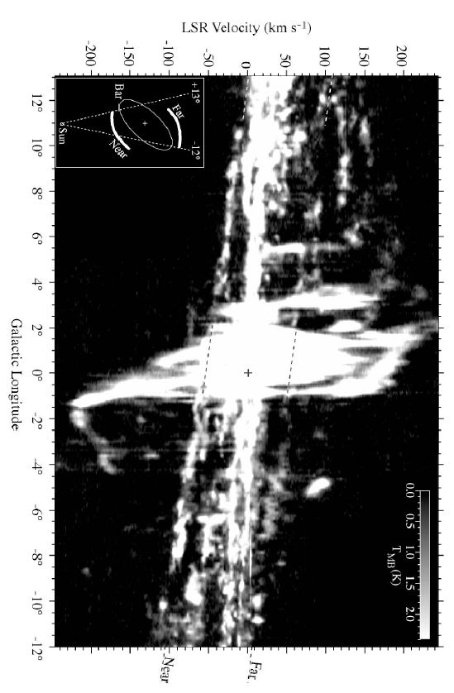
3 kpc Arm (Carbon Monoxide)
Dame & Thaddeus (2008)

Slide 20
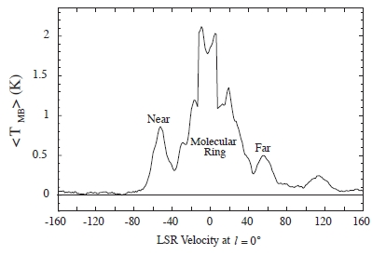
3 kpc Arm (Carbon Monoxide)
Dame & Thaddeus (2008)
Notes:
They average the emission in narrow strips running parallel to the lines in the previous figure.

Slide 21
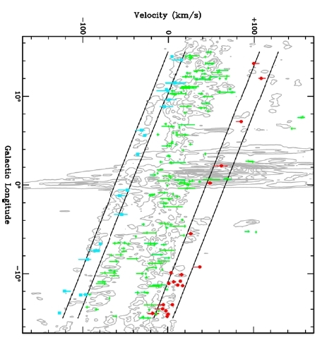
3 kpc Arm (Methanol Masers)
Green et al. (2009)
Notes:
CO(1-0) emission (contours) from 1.2 m (Dame & Thaddeus 2008, ApJ, 683, L143)
6.7 methanol maser emission (points) from Parkes multibeam (Green et al. 2009, ApJ, 696, L156)
Blue – near arm Red – far arm

Slide 22
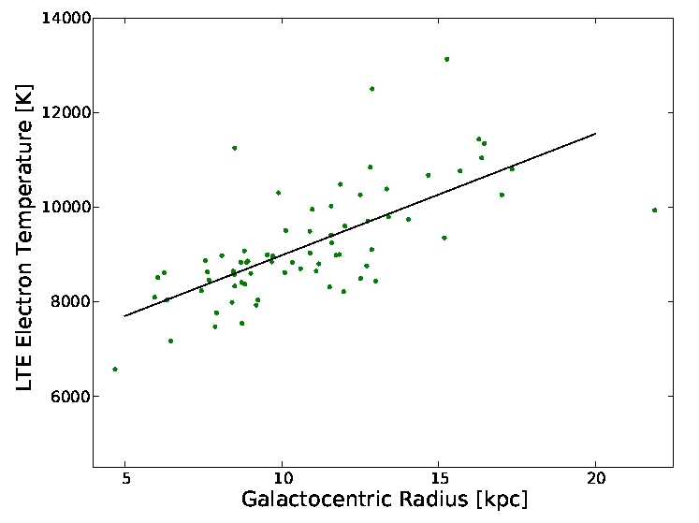
HII Region Electron Temperature Gradient
GBT 9 GHz RRL and Continuum

Slide 23
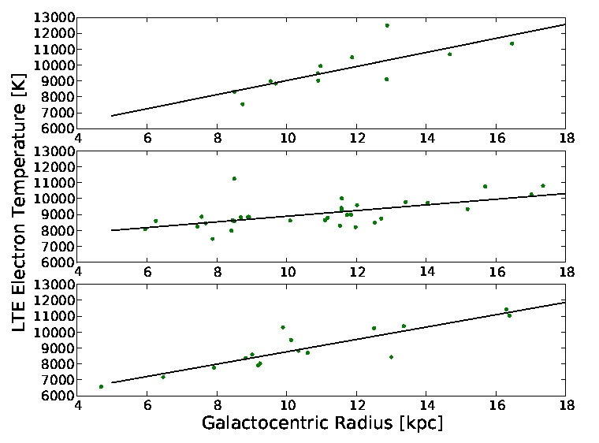
HII Region Electron Temperature Gradient
GBT 9 GHz RRL and Continuum

