Slide 1
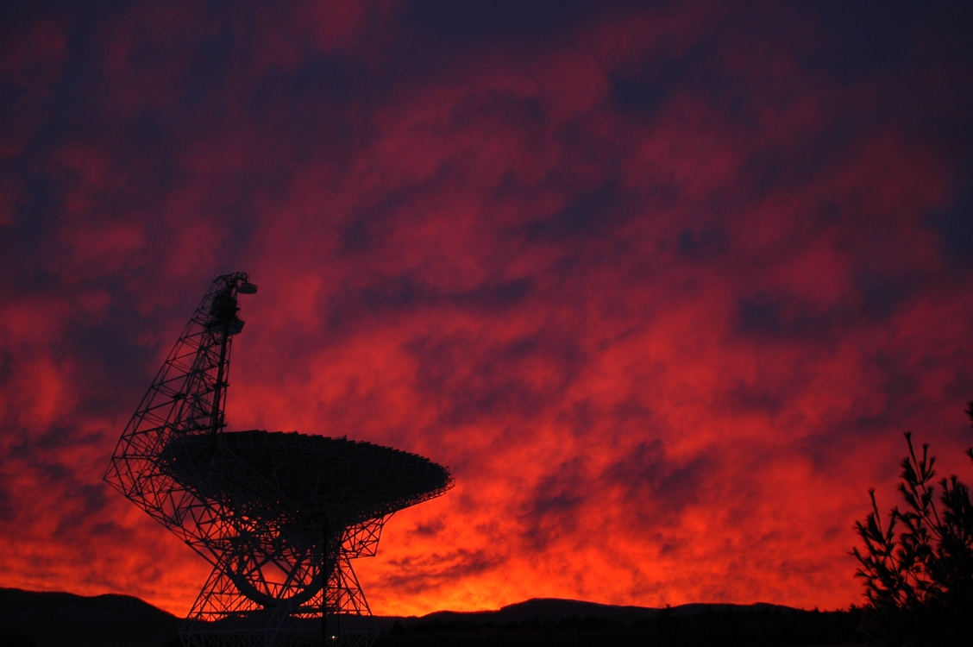
Metallicity Distribution in the Milky Way Disk Dana S. Balser, R.T. Rood, T.M. Bania, L.D. Anderson
Photo: Harry Morton
Notes:
There are several tracers of metallicity in the Milky Way disk: open clusters, Cepheids, OB-type stars, planetary nebulae, and HII regions.
HII regions abundances indicate the current state of the ISM and reveal the chemical enrichment caused by the nuclear processing of many stellar generations.

Slide 2
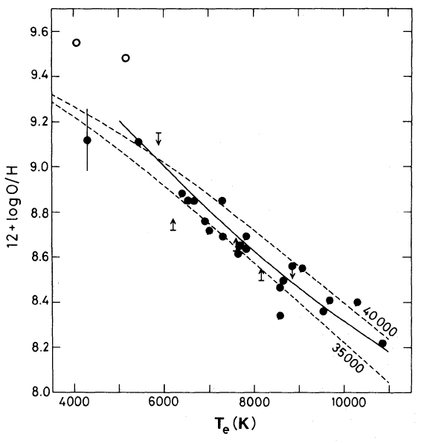
HII Region Electron Temperature and Metallicity
RRL and free-free
continuum emission
in LTE at 3 cm.
Shaver et al. (1983)
Notes:
The RRL and free-free continuum emission have the same dependence on ne, but a different dependence on Te, for an optically thin gas in LTE. Therefore the line-to-continuum ratio can be used to derive Te. Metals within HII regions will cool the gas primarily through CELs. Thus the electron temperature can be used as a proxy for metallicity.
Solid Line: Empirical relationship from Pagel et al. (1979) based on Extragalactic HII regions
Dashed Lines: Model calculations from Stasinska (1980) with Teff=35000K/40000K and ne = 100 cm-3
Open Circles: S38 and S48

Slide 3
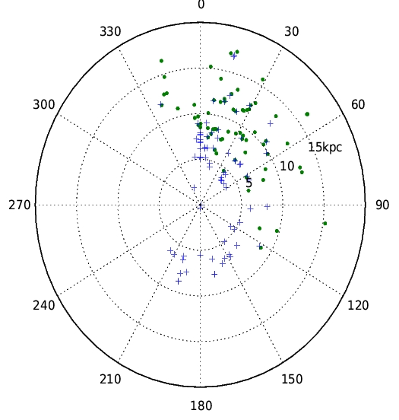
HII Region Sample
Sun
GC
GBT
+ 140 Foot
Quireza et al. (2006)
Notes:
140 Foot: from Quireza et al. (2006); N=78 objects with QF=C or better.
GBT: new observations; N=72 objects with QF=C or better.
Total: N=150 objects (133 excluding 140 Foot duplicate sources).
GBT Sample:
Selected HII regions at large Rgal to probe radial gradient discontinuities
Selected HII regions to uniformly sample Az = 330 → 60 deg. Azimuthal structure?
Selected HII regions that had single components with good signal-to-noise ratios
Only two objects are from GBT HRDS since this work was done in parallel.

Slide 4
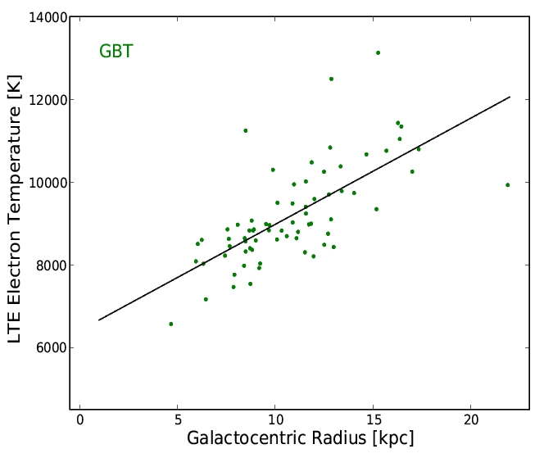
Electron Temperature Radial Gradient
Notes:
Only GBT data with N=72 objects with QF=C or better.

Slide 5
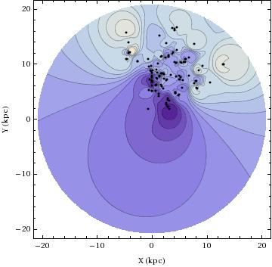
Electron Temperature Azimuthal Structure
Notes:
The image was generated using Shepard’s method, an inverse distance method, with an exponent of 5. This is a way to generate an image from a discrete distribution. The points correspond to HII regions from the GBT + 140 Foot between Az = 330→ 60 deg.

Slide 6
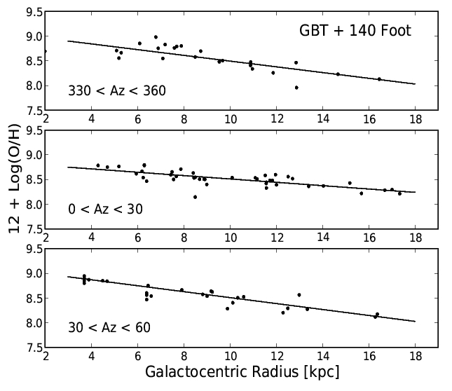
O/H Radial Gradient
Slope (dex/kpc)
Notes:
Solar Abundance: 8.69 +/- 0.05 (Asplund et al. 2009)
Meterorite Abundance: 8.40 +/- 0.04 (Lodders et al. 2009)

Slide 7
Summary
O/H radial gradients: -0.03 to -0.06 dex/kpc
No radial discontinuities
Azimuthal structure

Slide 8
Extra Slides

Slide 9
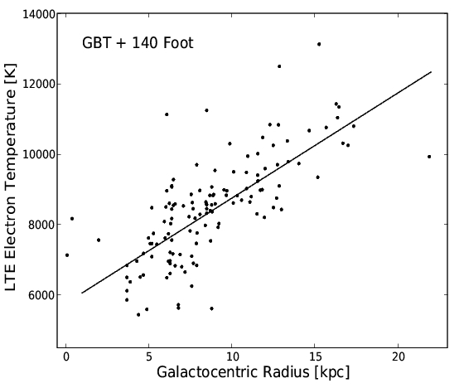
Electron Temperature Radial Gradient

Slide 10
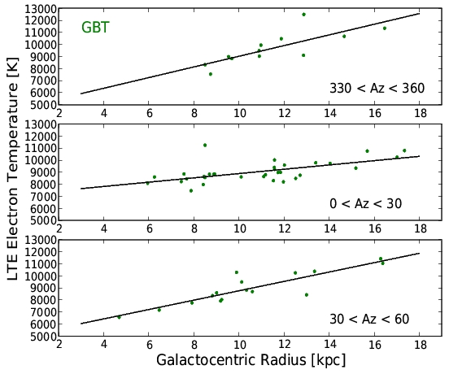
Electron Temperature Radial Gradient (Composite)

Slide 11
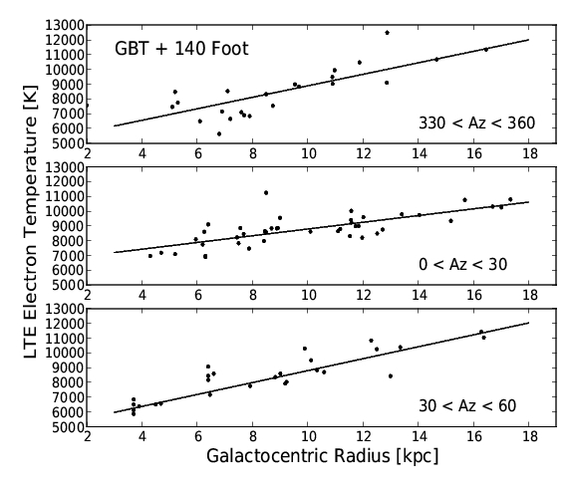
Electron Temperature Radial Gradient (Composite)

Slide 12
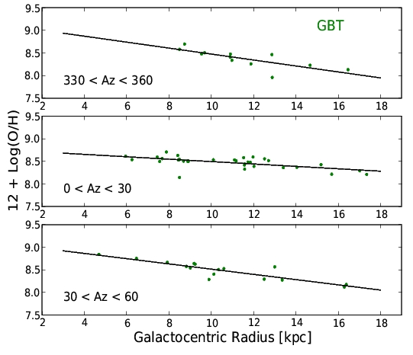
O/H Radial Gradient

Slide 13
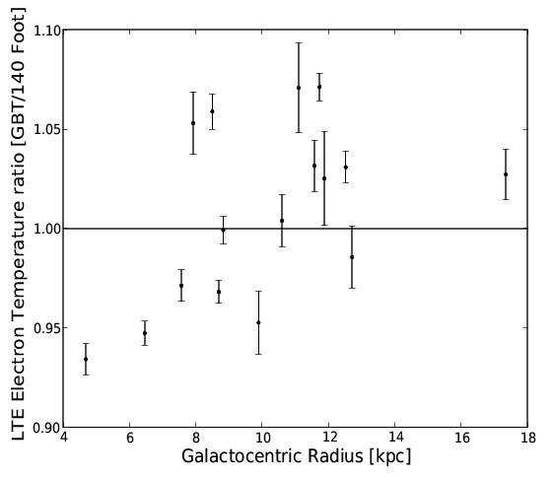
GBT/140 Foot Cross Calibration

Slide 14
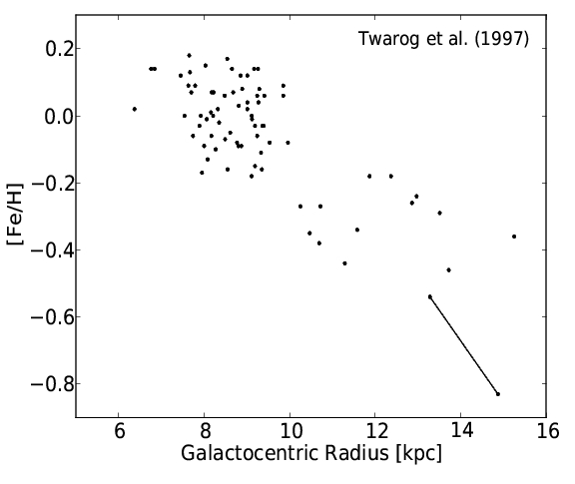
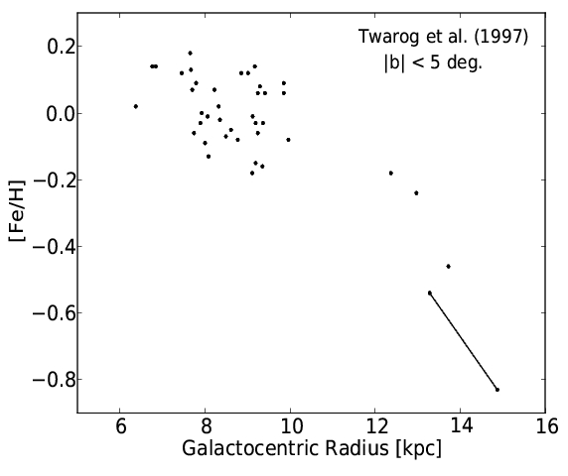
Open Clusters

