Slide 1
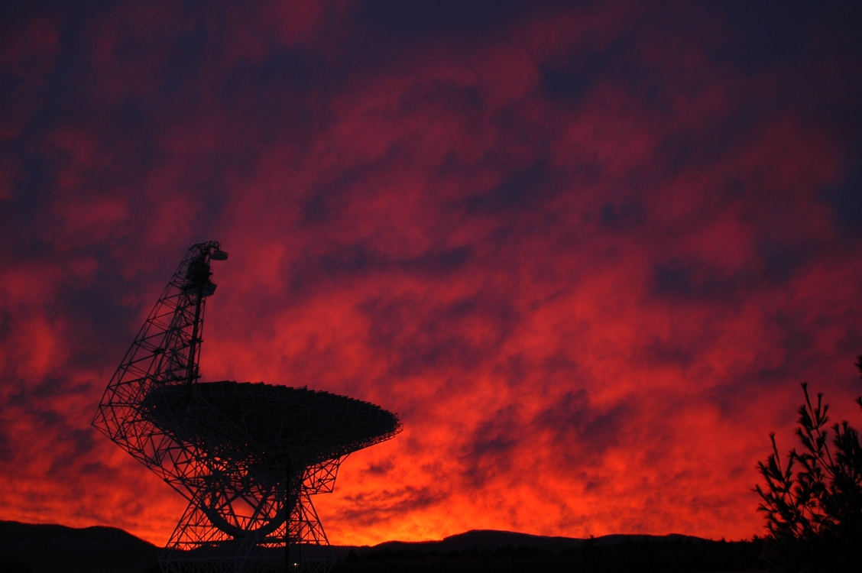
Probing Metallicity across the Galactic Disk with the GBT Dana S. Balser (NRAO) L.D. Anderson (WVU), T.M. Bania (BU), & T.V. Wenger (BU)
Photo: Harry Morton
Notes:
There are several tracers of metallicity in the Milky Way disk: open clusters, Cepheids, OB-type stars, planetary nebulae, and HII regions.
HII regions abundances indicate the current state of the ISM and reveal the chemical enrichment caused by the nuclear processing of many stellar generations.

Slide 2
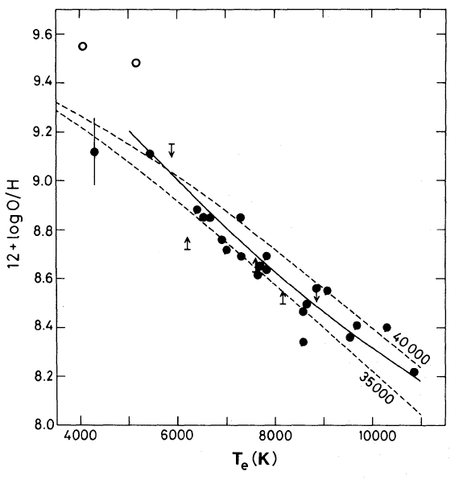
HII Region Electron Temperature and Metallicity
RRL and free-free
continuum emission
in LTE at 3 cm.
Shaver+ (1983)
Notes:
The RRL and free-free continuum emission have the same dependence on ne, but a different dependence on Te, for an optically thin gas in LTE. Therefore the line-to-continuum ratio can be used to derive Te. Metals within HII regions will cool the gas primarily through CELs. Thus the electron temperature can be used as a proxy for metallicity.
Solid Line: Empirical relationship from Pagel et al. (1979) based on Extragalactic HII regions
Dashed Lines: Model calculations from Stasinska (1980) with Teff=35000K/40000K and ne = 100 cm-3
Open Circles: S38 and S48

Slide 3
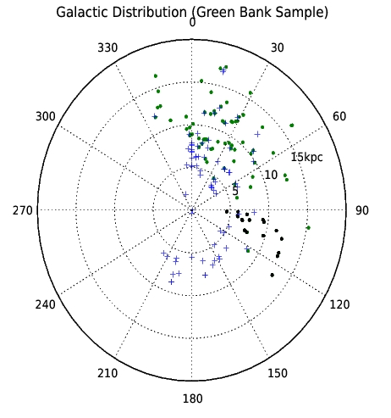
HII Region Sample
Sun
18 HRDS
GC
GBT
+ 140 Foot
Quireza+ (2006); Balser+ (2011)
Notes:
140 Foot: from Quireza+ (2006); N=78 objects with QF=C or better.
GBT: from Balser+ (2011) plus 18 HRDS; N=89 objects with QF=C or better
Total: N=150 objects (excluding duplicate sources).

Slide 4
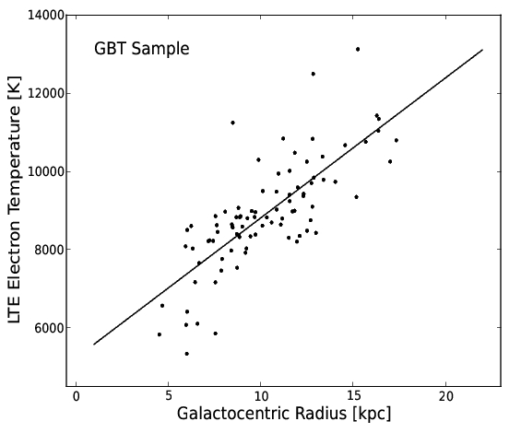
Electron Temperature Radial Gradient
Notes:
GBT Sample: N=89; r=0.77; Rgal=4.53-17.34 kpc
rms = 889 K; <Te> 8900 K; rms/<Te> = 0.1

Slide 5
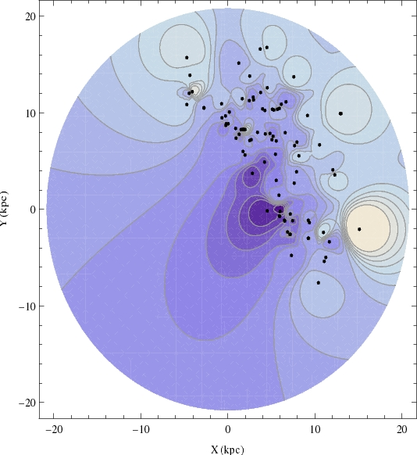
Electron Temperature Azimuthal Structure
GBT Sample
Notes:
The image was generated using Shepard’s method, an inverse distance method, with an exponent of 5. This is a way to generate an image from a discrete distribution. The points correspond to HII regions from the GBT Sample.

Slide 6
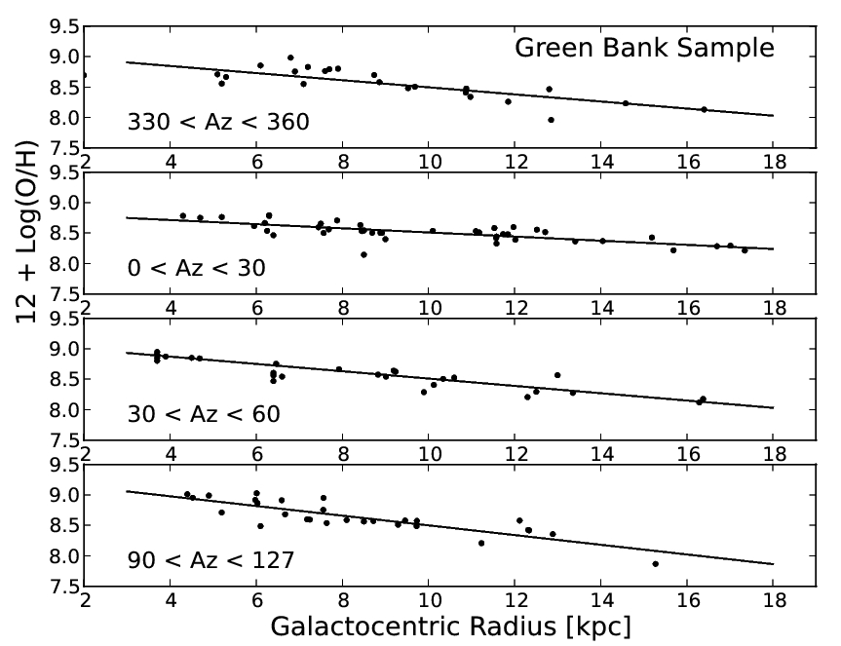
O/H Radial Gradient
Slope (dex/kpc)
Notes:
Solar Abundance: 8.69 +/- 0.05 (Asplund et al. 2009)
Meterorite Abundance: 8.40 +/- 0.04 (Lodders et al. 2009)
Az Range rms [K]
------------ ----------
0-360 0.175
--------------------
330-360 0.15
0-30 0.10
30-60 0.19
90-127 0.14

Slide 7
Summary
HRDS Probes Metallicity Across the Galaxy
Azimuthal Structure
O/H radial gradients: -0.03 to -0.08 dex/kpc

Slide 8
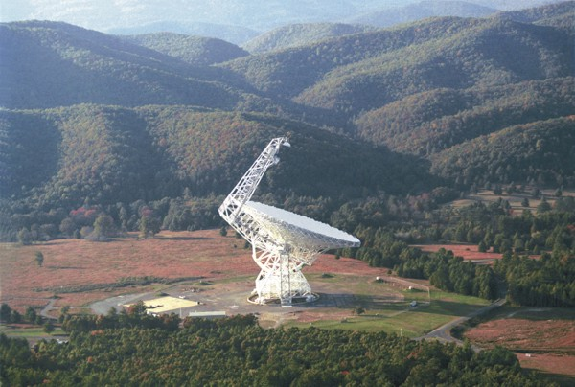
Questions

Slide 9
Extra Slides

Slide 10
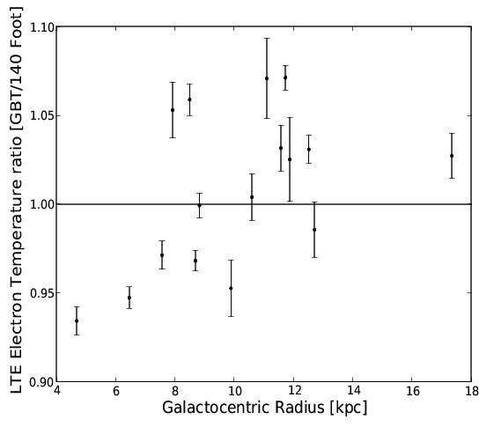
GBT/140 Foot Cross Calibration
Balser+ (2011)

Slide 11
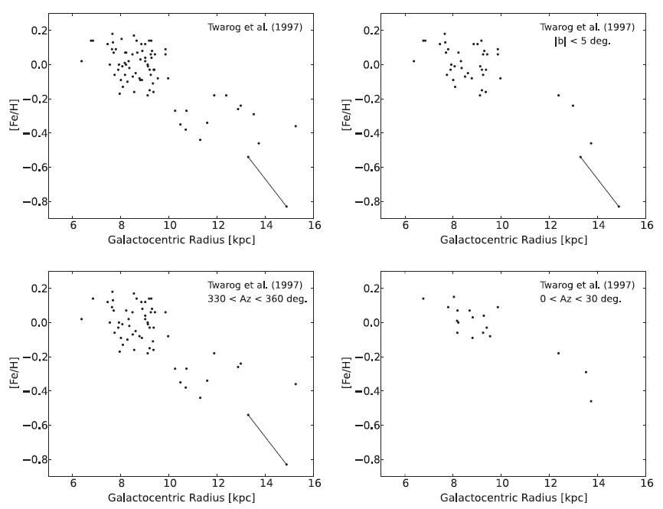
Open Cluster Data
Balser+ (2011)

Slide 12
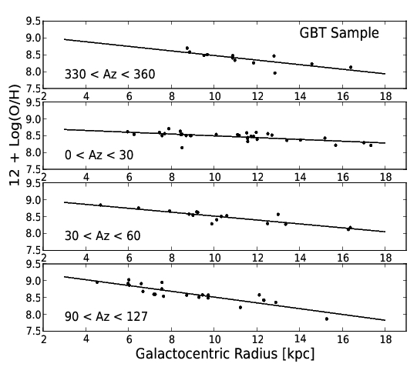
O/H Radial Gradient - GBT

