Slide 1
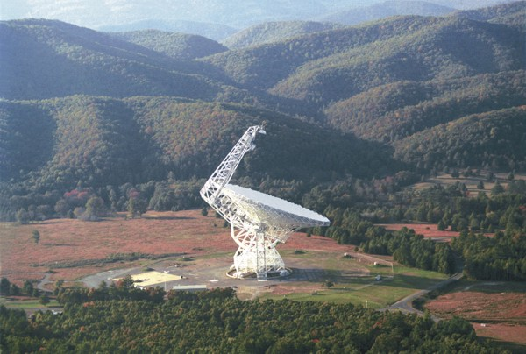
Probing Metallicity across the Galactic Disk with the Green Bank Telescope Dana S. Balser (National Radio Astronomy Observatory) L.D. Anderson (West Virginia Univ.), T.M. Bania & T.V. Wenger (Boston Univ.)
dbalser@nrao.edu
434-466-8999

Slide 2
Main Result
Metallicity variations in the Galaxy indicate
that it is not as well mixed as expected.
Astronomer’s Periodic Table:
Hydrogen, Helium, and Metals

Slide 3
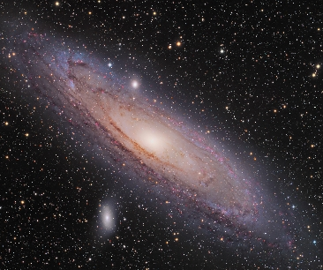
Galaxy Formation and Evolution
Andromeda
(M31)
Martin Pugh

Slide 4
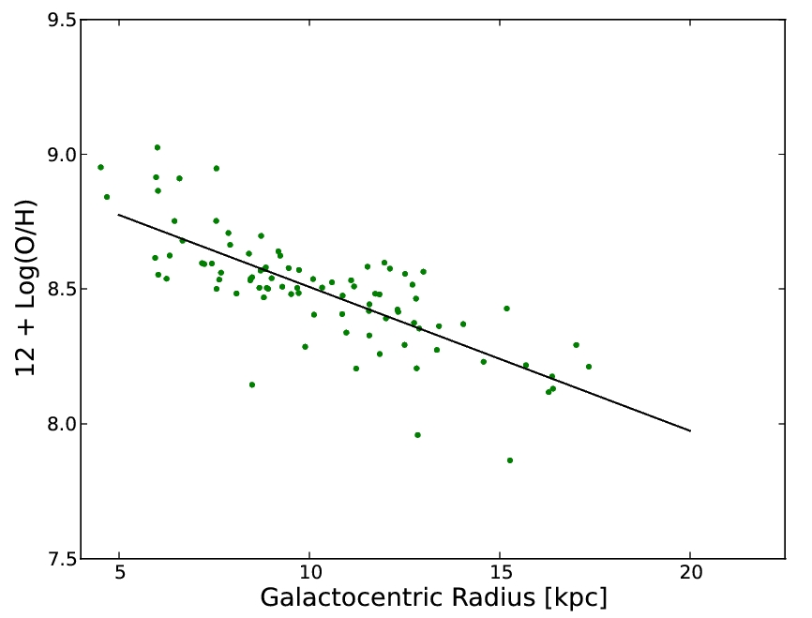
Metallicity Radial Gradient

Slide 5
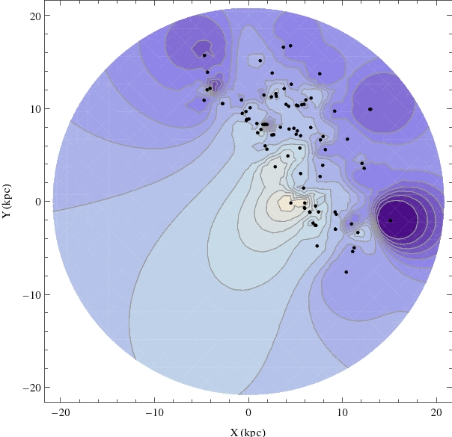
Metallicity Azimuthal Structure
Notes:
Contours: 12 + Log(O/H) 7.92 to 8.928 by 0.072

Slide 6
Summary
Green Bank Telescope probes metallicity across the Galactic disk.
Metallicity variations in the Galaxy indicate that It is not as well mixed as expected.
dbalser@nrao.edu
434-466-8999

