Slide 1
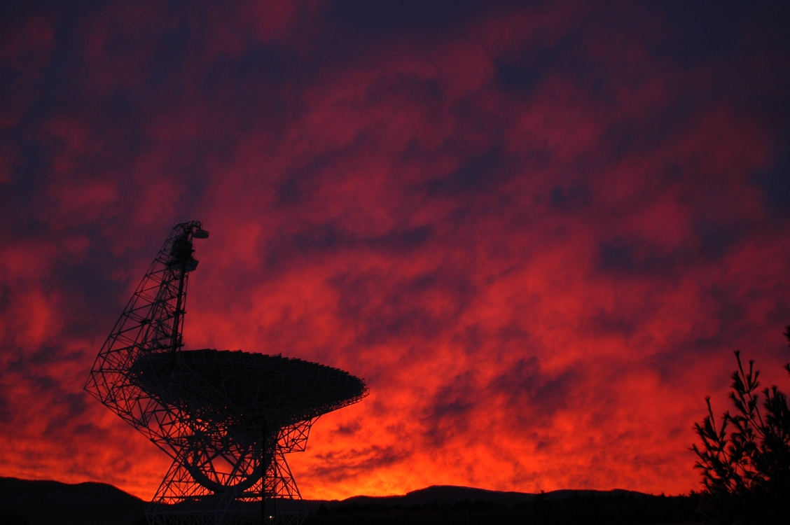
HII Region Metallicity Distribution in the Milky Way Disk Dana Balser (NRAO) Loren Anderson (WVU), Tom Bania (BU), & Trey Wenger (UVa)
Photo: Harry Morton

Slide 2
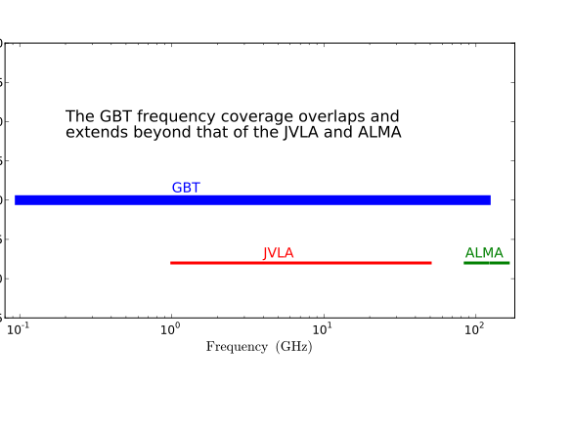
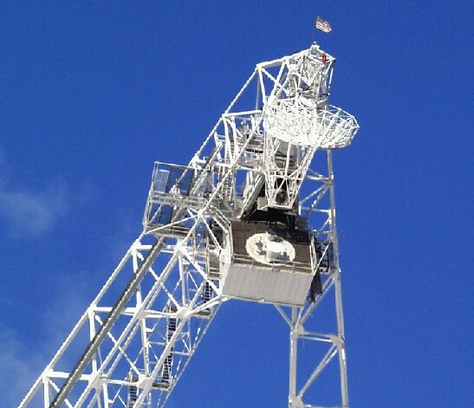
Key Capabilities of the GBT
Receivers cover 0.1 to 100 GHz
Excellent point-source sensitivity
Excellent sensitivity for low surface-brightness mapping
>85% of total sky covered δ≥-46°
Location in the National Radio Quiet Zone

Slide 3
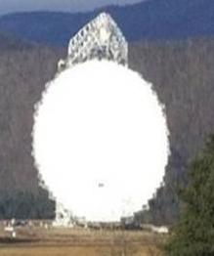
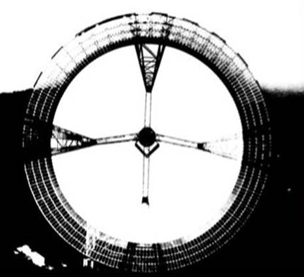
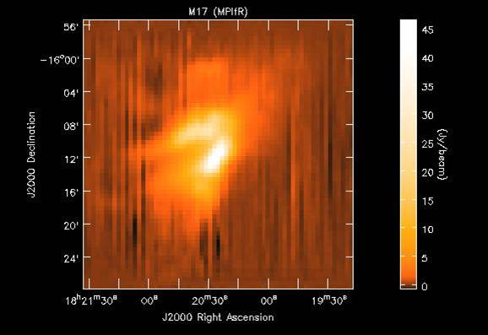
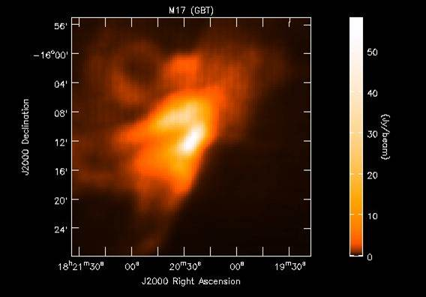
Unblocked Optics for High Dynamic Range

Slide 4
science.nrao.edu/facilities/gbt

Slide 5
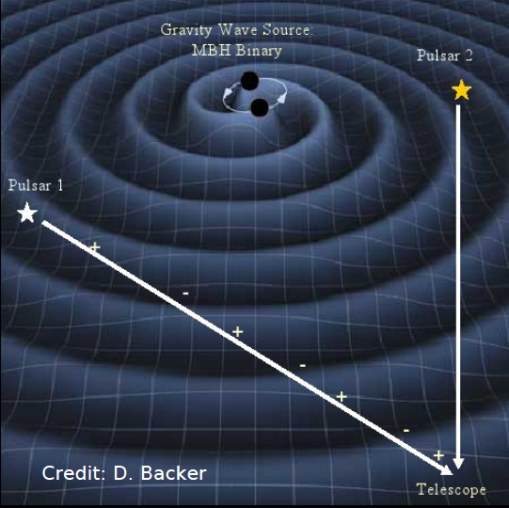
Using Pulsars to Detect Gravitational Radiation

Slide 6
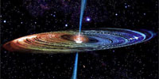
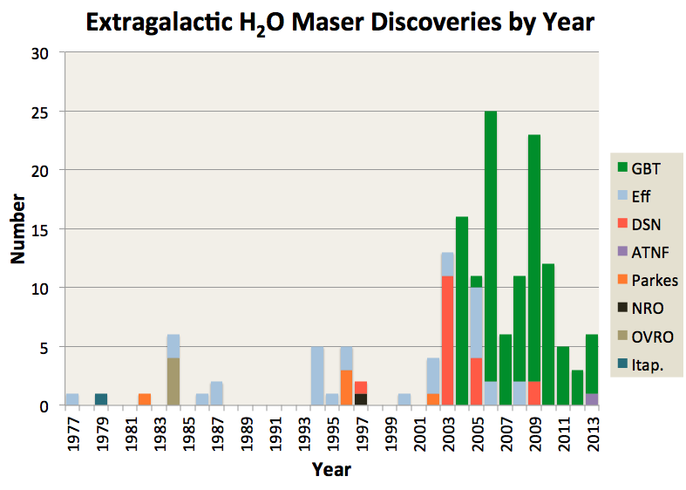
Water Masers in AGN
Mass of the Black Hole
Hubble Constant (Ho)
H2O Masers in
Nuclear Accretion Disks
Discovered by the GBT
Monitored by the GBT
Imaged by the VLBA+GBT

Slide 7
HII Region Metallicity Distribution in the Milky Way Disk Dana Balser (NRAO) Loren Anderson (WVU), Tom Bania (BU), & Trey Wenger (UVa)
Photo: Harry Morton
Notes:
There are several tracers of metallicity in the Milky Way disk: open clusters, Cepheids, OB-type stars, planetary nebulae, and HII regions.
HII regions abundances indicate the current state of the ISM and reveal the chemical enrichment caused by the nuclear processing of many stellar generations.

Slide 8
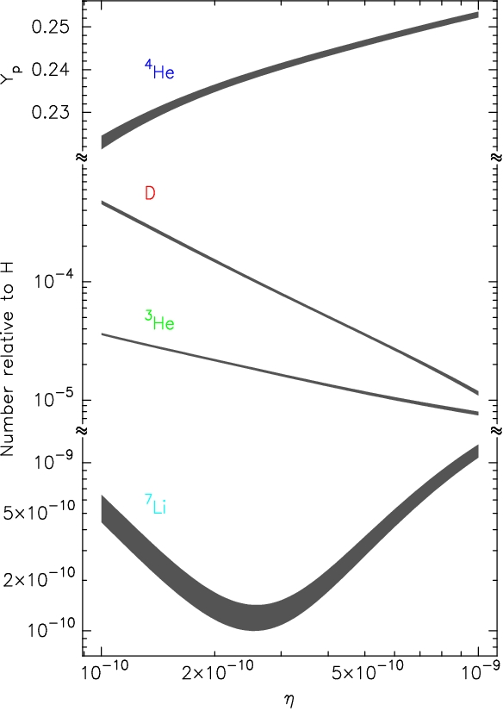
Primordial Nucleosynthesis
Burles+ (2001)
Notes:
Nucleosynthesis 100 sec
As the universe cools the quarks condense into neutrons and protons. There are fewer neutrons since they are heavier. The details of the nuclear composition depend on the baryon-to-photon ratio (eta).
Plot:
D and 3He are burned into 4He. So the larger eta the more processing and so D and 3He decrease with increasing eta. D gets processed faster than 3He since it is less strongly bound and has a smaller Coulomb barrier.
7Li is double valued since there are two competing reactions that produce 7Li.
Most of the neutrons end up in 4He since there is no stable nucleii at mass 5 and the 4He is very stable. Also, the Coulomb barriers are too large given that the Universe is expanding.
N.B. the baryon-to-photon ratio is unchanged in the standard model. That is, the number of baryons and CMB photons in a co-moving volume are unchanged. The value of the baryon-to-photon ratio at present, at recombination, and at BBN are the same.

Slide 9
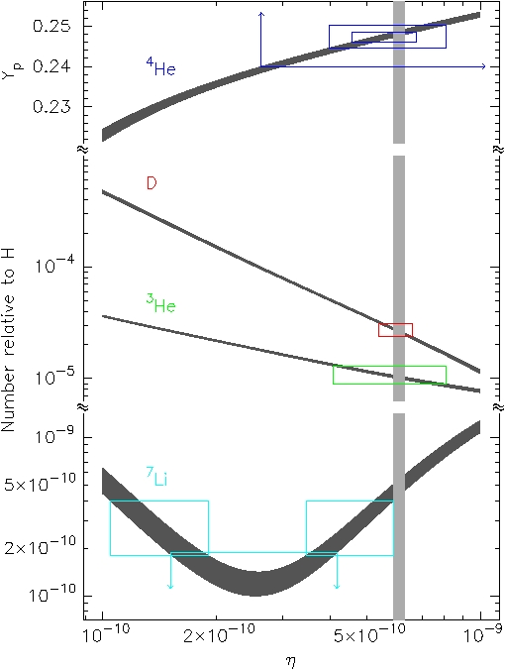
Primordial Abundances
Izotov+ (2007)
Peimbert+ (2007)
Olive & Skillman (2004)
Kirkman+ (2003)
Bania, Rood & Balser (2002)
Ryan+ (2000)
Boesgaard+. (2005)
Burles+ (2001)
Spergel+ (2006)
Notes:
4He: optical recombination lines in metal poor blue compact galaxies. Need better than 5% measurement. Differences depend on He I emissivities, ionization corrections, corrections for temperature fluctuations, etc.
D: Lyman series in the Lyman forest. Based on 5 best sources. Need to be careful of HI interlopers.
3He: hyperfine line in HII regions. Based on outer Galaxy HII region S209.
7Li: resonance line in metal poor halo stars. Based on many low metallicity stars.

Slide 10
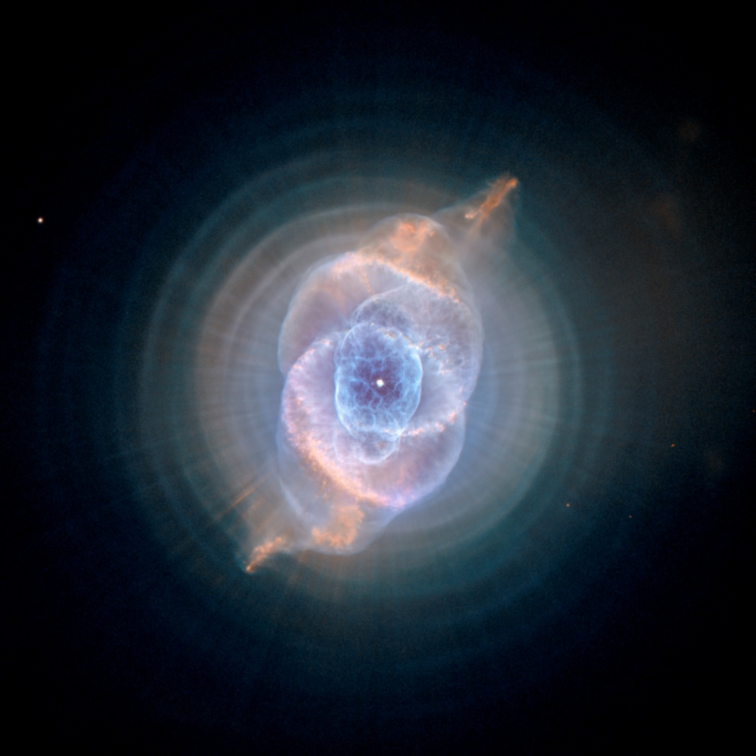
Stellar Nucleosynthesis
Cat’s Eye
(NGC 6543)
Corradi &
Tsvetanov
Notes:
NGC6543 (Cat’s Eye): Hubble Space Telescope Advanced Camera for Surveys (HST ACS)
Thermal pulses every 1500 years in AGB phase
Q: Why is the evolution of the elements important?
A: We are made up of elements. Carbon based. All carbon processed in stars.
Interesting fact: Helium was discovered in the Sun. Helios is Greek for Sun.
Important Areas:
Big Bang
Stellar Evolution
Galaxy Formation and Evolution
Focus on Light Elements

Slide 11
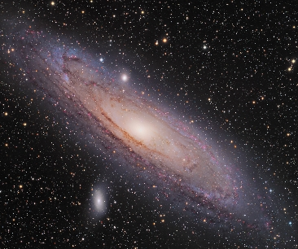
Galaxy Formation and Evolution
Andromeda
(M31)
Martin Pugh

Slide 12
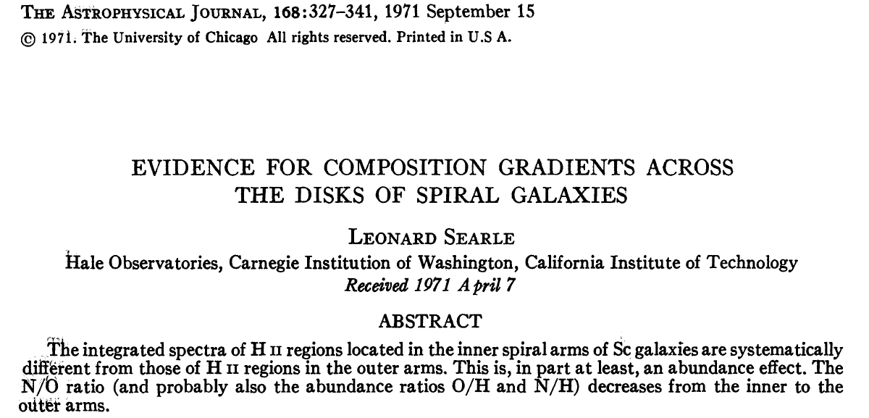
Radial Abundance Gradients

Slide 13
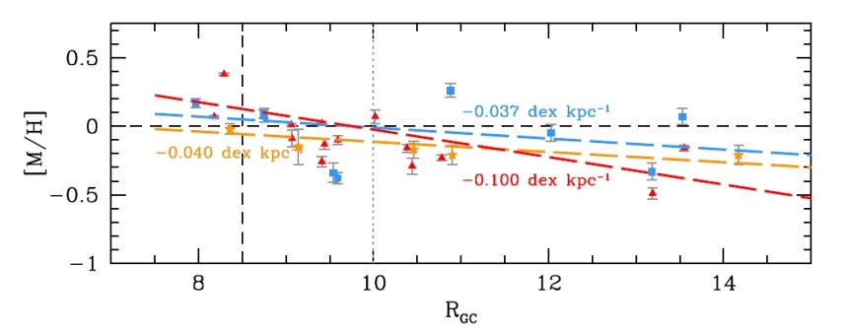
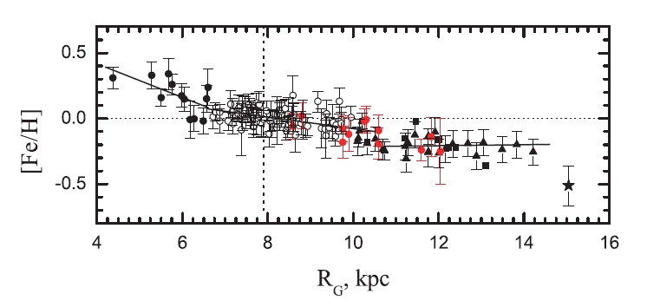
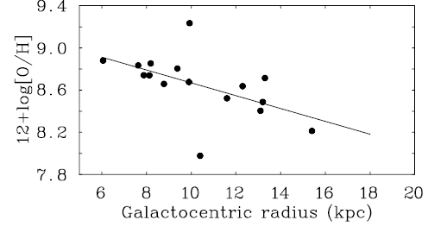
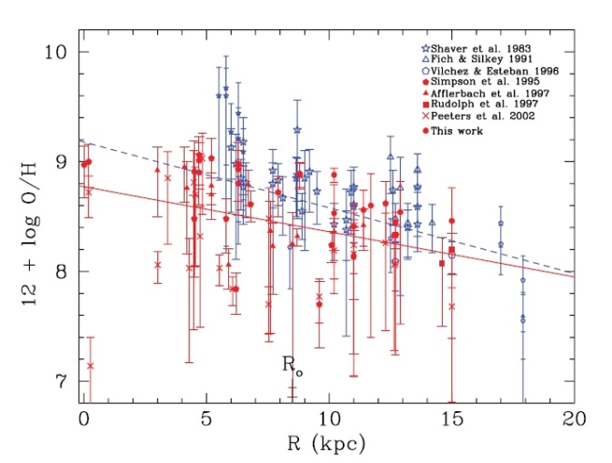
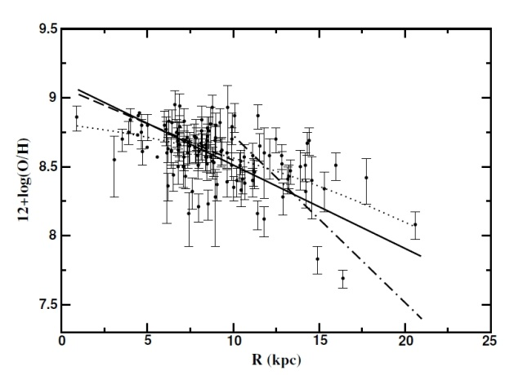
Abundance Tracers
Open Clusters (Frinchaboy+ 2013)
Cepheids (Andrievsky+ 2004)
OB Stars (Rolleston+ 2000)
HII Regions (Rudolph+ 2006)
PNe (Henry+ 2010)
Notes:
Open Clusters (30 Myr – 11 Gyr): cover wide range of metallicity and age.
Cepheids (< 200 Myr): bright with accurate distances.
OB Stars (< 10 Myr): young; need to worry about mixing in outer layers.
Pne (1-8 Gyr): probe metallicity with time; hard to get age and distances.
HII Regions (< 10 Myr): young and bright.
230 Myr to complete one orbit.

Slide 14
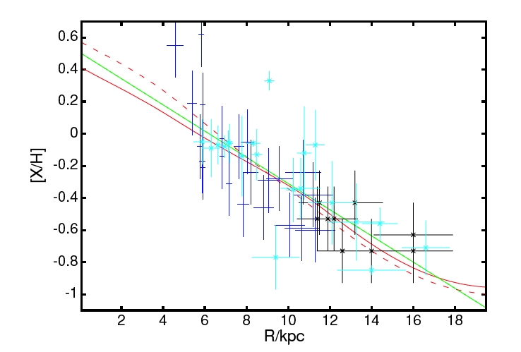
Chemodynamical Models
Schonrich & Binney (2009)
Notes:
Models:
Z/H – red dashed curve
O/H – red solid curve
Data
Shaver+ (1983) – dark blue
Vilchez & Esteban (1996) – black
Rolleston+ (2000) – light blue

Slide 15
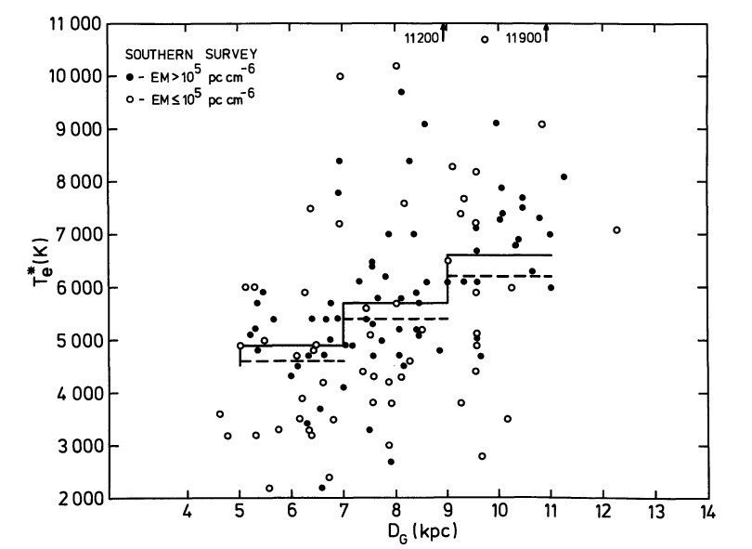
HII Region Electron Temperature Radial Gradient
Churchwell & Walmsley (1975)
Notes:
Te depends on:
Stellar Effective Temperature (hardness of field): B0 to O5 is 1300K
Electron Density (cooling): 100 to 10^5 is 2900K
Dust (photoelectric heating/cooling with collisions with dust): 500 K
Metallicity (cooling): factor of 10 is 7000K

Slide 16
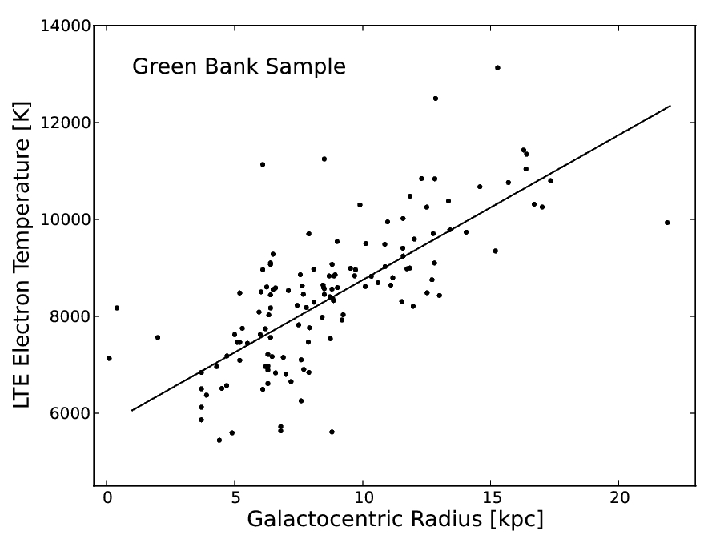
Electron Temperature Radial Gradient
Balser+ (2011)

Slide 17
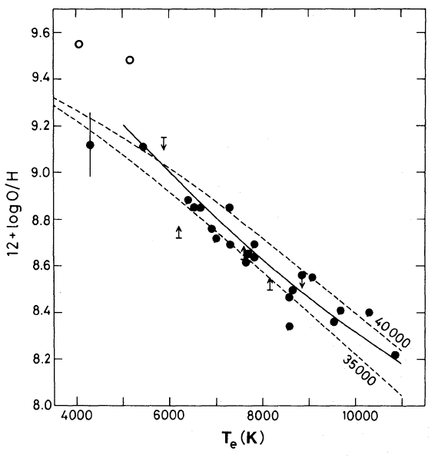
HII Region Electron Temperature and Metallicity
RRL and free-free
continuum emission
in LTE at 3 cm.
Shaver+ (1983)
Notes:
The RRL and free-free continuum emission have the same dependence on ne, but a different dependence on Te, for an optically thin gas in LTE. Therefore the line-to-continuum ratio can be used to derive Te. Metals within HII regions will cool the gas primarily through CELs. Thus the electron temperature can be used as a proxy for metallicity.
Solid Line: Empirical relationship from Pagel et al. (1979) based on Extragalactic HII regions
Dashed Lines: Model calculations from Stasinska (1980) with Teff=35000K/40000K and ne = 100 cm-3
Open Circles: S38 and S48

Slide 18
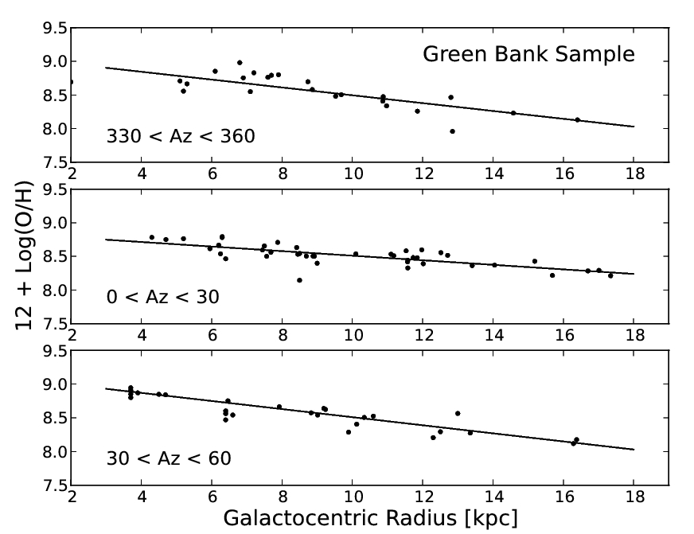
O/H Radial Gradient
Slope (dex/kpc)
Balser+ (2011)
Notes:
Solar Abundance: 8.69 +/- 0.05 (Asplund et al. 2009)
Meterorite Abundance: 8.40 +/- 0.04 (Lodders et al. 2009)
Az Range rms [K]
------------ ----------
0-360 0.175
--------------------
330-360 0.15
0-30 0.10
30-60 0.19

Slide 19
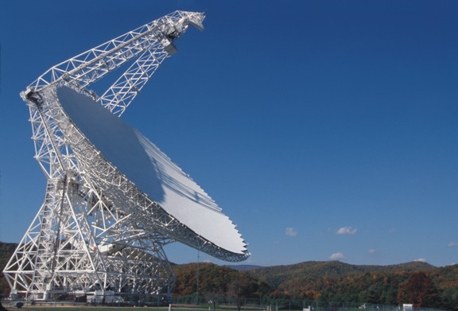
HII Region Discovery Survey (HRDS)
GBT 100 m

Slide 20
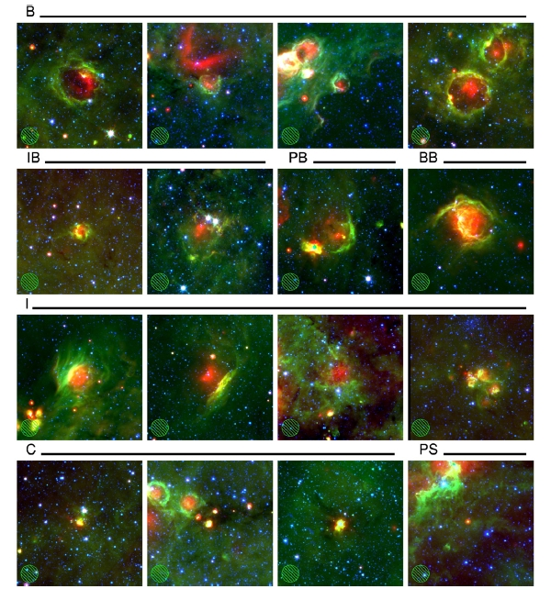
Spitzer IR HII Region Candidates
MIPSGAL 24 micron (red)
GLIMPSE 8 micron (green)
GLIMPSE 3.6 micron (blue)
Anderson+ (2011)

Slide 21
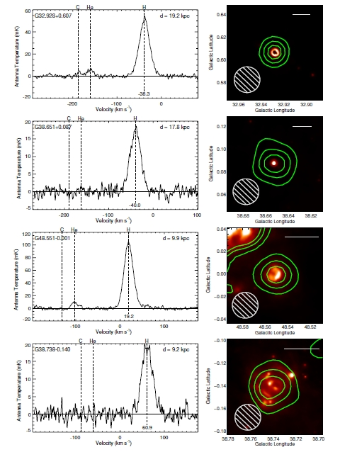
HRDS RRL Detections
Bania+ (2010)

Slide 22
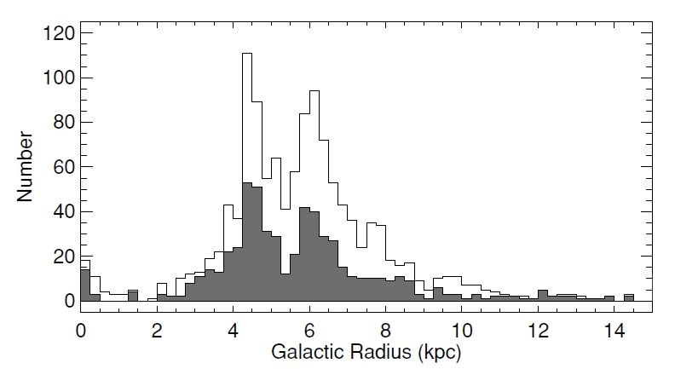
Galactocentric Radius Distribution
Known+HRDS: 1276
HRDS: 603
Bania+ (2010)
Notes:
HRDS have similar properties as Known sample but are weaker, narrower line widths and are more distant.
Completeness limit: all O-type stars to a distance of 12 kpc.

Slide 23
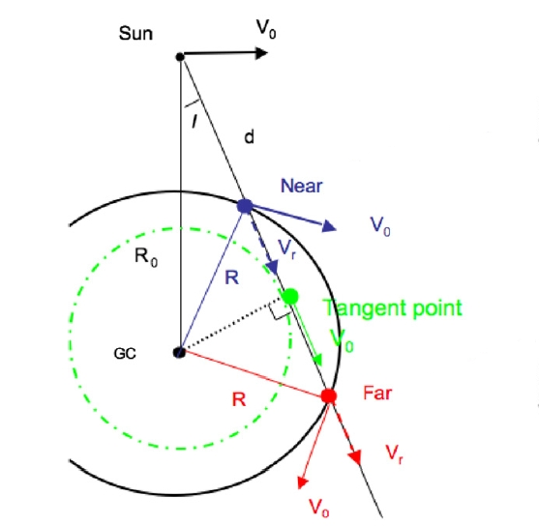
Kinematic Distance Ambiguity
Roman-Duval+ (2009)

Slide 24
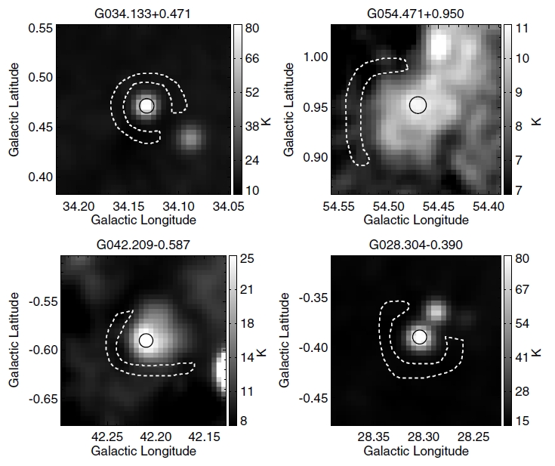
HRDS: Distances
Anderson+ (2012)
Notes:
On-source aperture (solid)
Off-source aperture (dashed)
VGPS 21cm continuum (image)

Slide 25
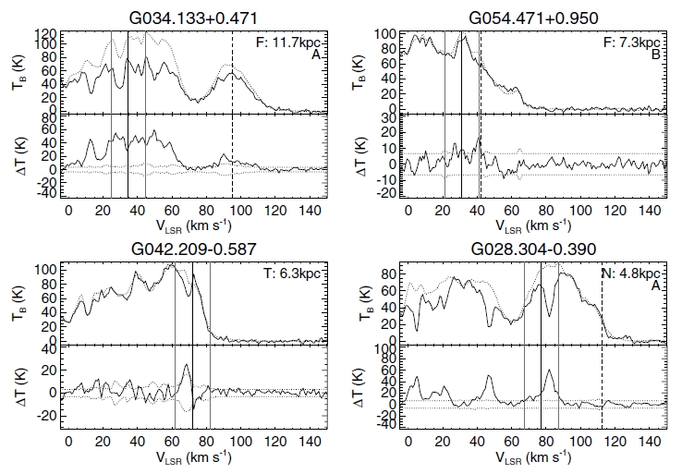
HRDS Distances
Anderson+ (2012)
Notes:
Top: On-source (solid); Off-source (dotted)
Bottom: On-Off (solid); error (dotted)
RRL velocity +/- 10 km/s (three vertical lines)
Tangent Point velocity (dashed)

Slide 26
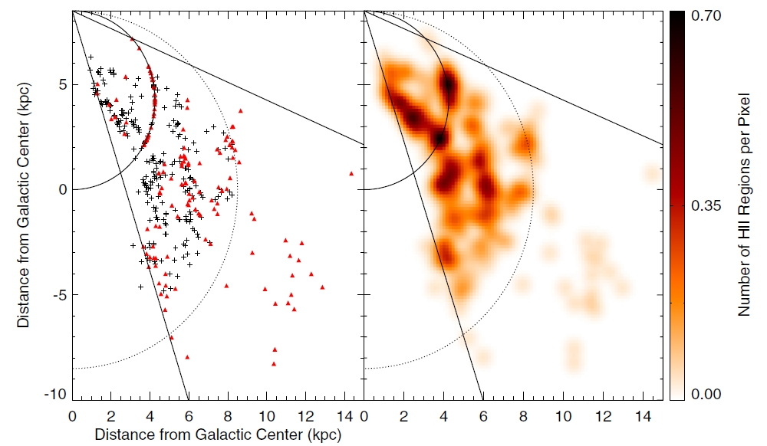
HRDS: Face-On Map
Anderson+ (2012)
Notes:
Black: Known; Red: HRDS
Solid lines: long of 17.9 and 67 deg.
Solid half circle: tangent point distance.
Dotted half circle: Solar Circle.
82% of distances were resolved (61% far; 31% tangent; 7% near)
Uncertainty: rotation curve model; non-circular motions; solar circular motion parameters
~10% uncertainty

Slide 27
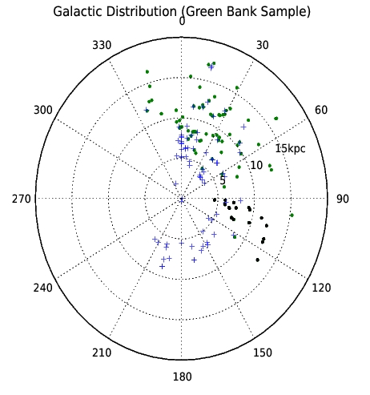
HII Region Sample
Sun
18 HRDS
GC
GBT
+ 140 Foot
Quireza+ (2006); Balser+ (2011)
Notes:
140 Foot: from Quireza+ (2006); N=78 objects with QF=C or better.
GBT: from Balser+ (2011) plus 18 HRDS; N=89 objects with QF=C or better
Total: N=150 objects (excluding duplicate sources).

Slide 28
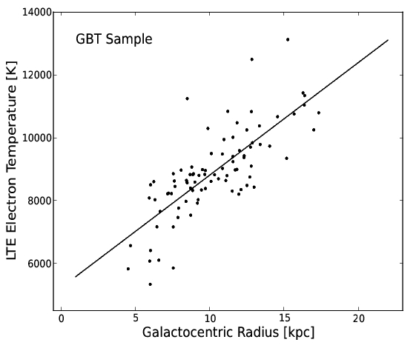
Electron Temperature Radial Gradient
Notes:
GBT Sample: N=89; r=0.77; Rgal=4.53-17.34 kpc
rms = 889 K; <Te> 8900 K; rms/<Te> = 0.1

Slide 29
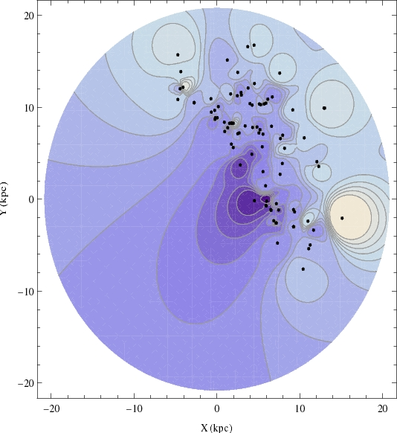
Electron Temperature Azimuthal Structure
GBT Sample
Notes:
The image was generated using Shepard’s method, an inverse distance method, with an exponent of 5. This is a way to generate an image from a discrete distribution. The points correspond to HII regions from the GBT Sample.

Slide 30
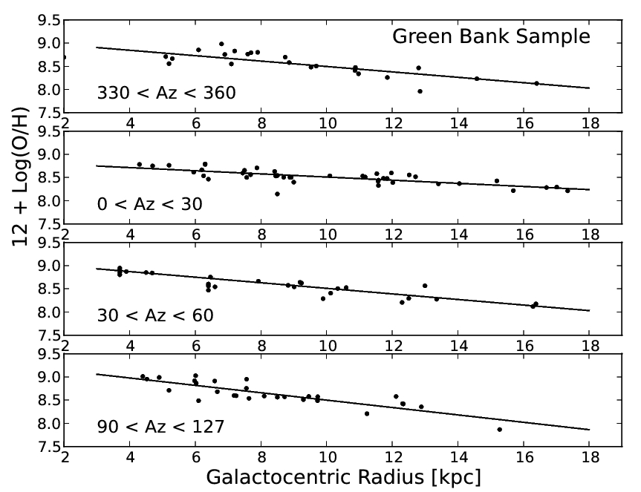
O/H Radial Gradient
Slope (dex/kpc)
Notes:
Solar Abundance: 8.69 +/- 0.05 (Asplund et al. 2009)
Meterorite Abundance: 8.40 +/- 0.04 (Lodders et al. 2009)
Az Range rms [K]
------------ ----------
0-360 0.175
--------------------
330-360 0.15
0-30 0.10
30-60 0.19
90-127 0.14

Slide 31
Summary
HRDS Probes Metallicity Across the Galaxy
Azimuthal Structure
O/H radial gradients: -0.03 to -0.08 dex/kpc

Slide 32
Future
Expand HRDS (WISE)
Expand Te Measurements (GBT/VLA)
Explore O/H – Te Relationship
Modern Optical/Radio
IR data (Herschel/SOFIA)
Models (Cloudy)

Slide 33
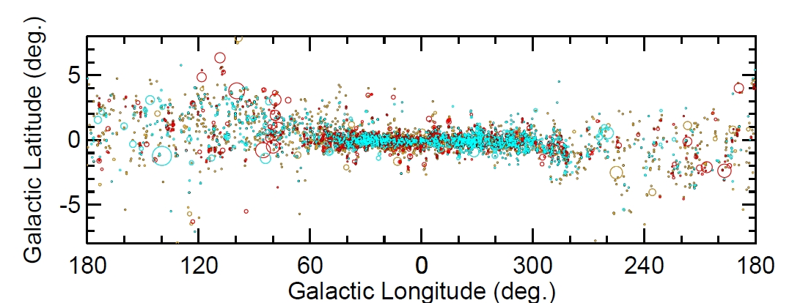
WISE HII Region Catalog Distribution
Notes:
Known/Grouped – red (1518 known)
Candidate – cyan (1986)
Radio Quiet – yellow (4120)

Slide 34
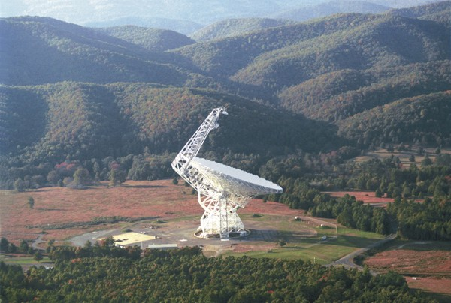
Questions

Slide 35
Extra Slides

Slide 36
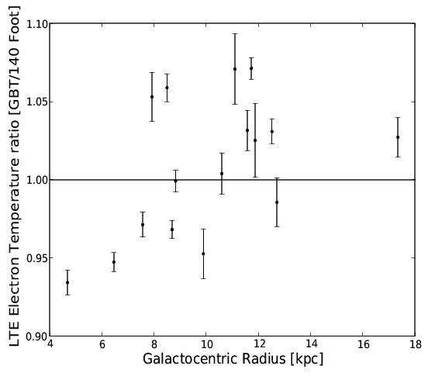
GBT/140 Foot Cross Calibration
Balser+ (2011)

Slide 37
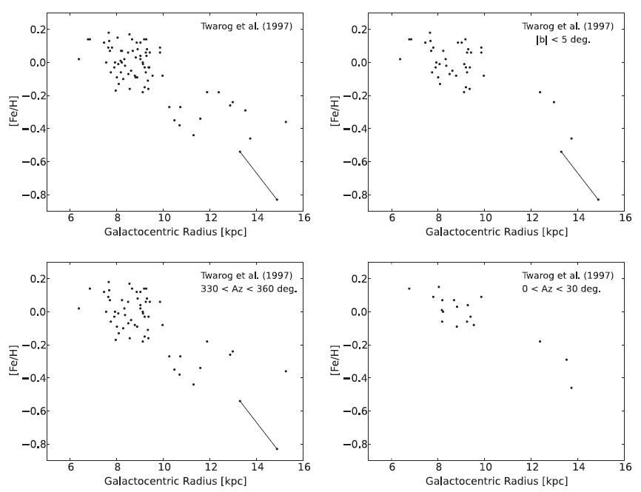
Open Cluster Data
Balser+ (2011)

Slide 38
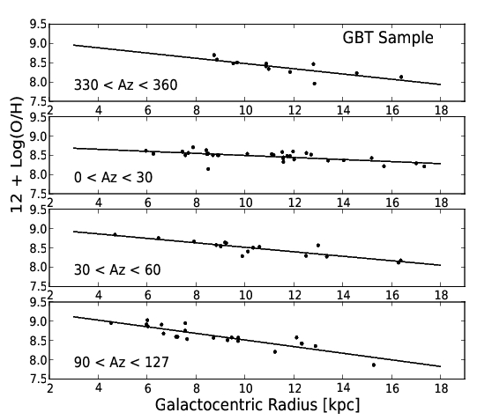
O/H Radial Gradient - GBT
Balser+ (2011)

Slide 39
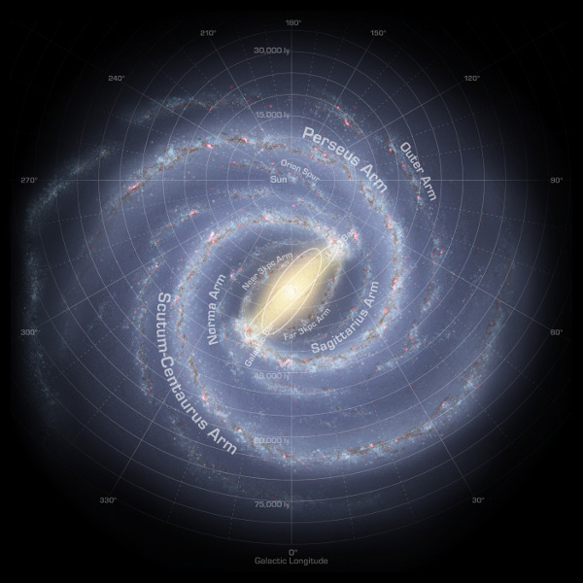
Milky Way Spiral Arms
Robert Hurt
Notes:
Based on Spitzer data (Benjamin et al.). Rotated by galaxymap.org.

