Slide 1
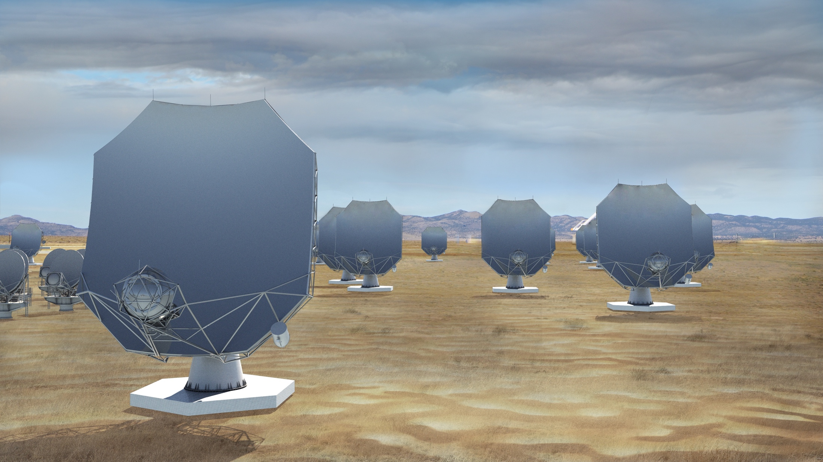


Maser Science with the next-generation Very Large Array (ngVLA)
Todd Hunter
NRAO – Charlottesville
Member of Science Working Group 1: Stars, Planetary Systems and their Origins
ngVLA.nrao.edu IAU 380 - March 24, 2023 ngvla.nao.ac.jp
Notes:
Will be the next U.S. Flagship Radio Observatory.

Slide 2

US Decadal Survey of National Academies (Astro2020 Report)
Identified ngVLA as a high-priority large, ground-based facility whose construction should start this decade.
ngVLA Key Science Goals
Unveiling the Formation of Solar System Analogues on Terrestrial Scales
Probing the Initial Conditions for Planetary Systems and Life with Astrochemistry
Charting the Assembly, Structure, and Evolution of Galaxies Over Cosmic Time
Using Pulsars in the Galactic Center as Fundamental Tests of Gravity
Understanding the Formation and Evolution of Stellar and Supermassive BH’s in the Era of Multi-Messenger Astronomy
Notes:
ngVLA essentially checked off every box of Astro2020 scientific priorities.

Slide 3













































Strong Community Participation
Academic, industrial, and international groups that have engaged with the project either by sitting on various committees (SAC/TAC), participating in the community studies program, or providing some other type or effort.

Slide 4
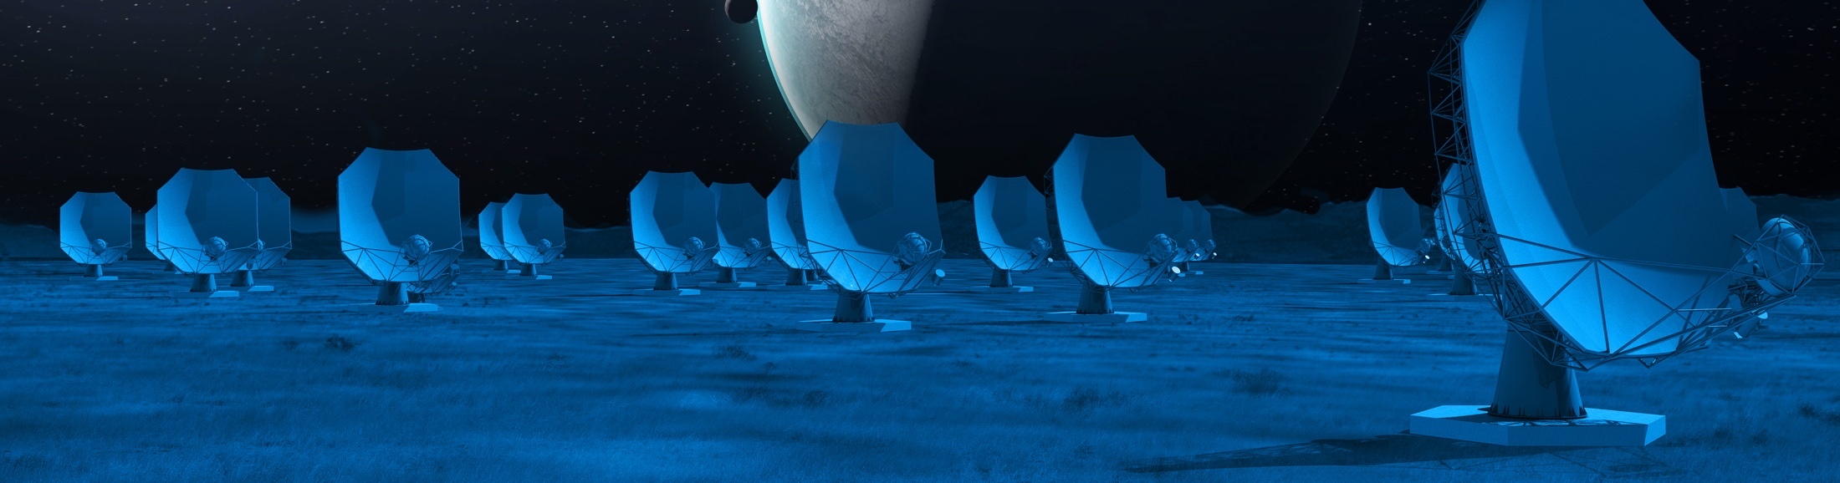

ngVLA Technical Baseline
ngVLA Reference Design
Key design choice: Antennas in fixed locations
  Year-round access to all angular resolutions
  PI-driven facility providing “science sub-arrays”
3)
Frequency Range: 1.2 - 116 GHz
Main Array: 244 x 18m offset Gregorian Antennas
  Core: 114 antennas; B_{max} = 4.3 km
  Spiral: 54 antennas; B_{max} = 39 km
  Mid: 46 antennas in NM, AZ, TX, MX; B_{max}=1070 km
  Long: 30 antennas across continent; B_{max}= 8860 km
Short Baseline Array: 19 x 6m offset Greg. Antennas
  Use 4 x 18m in Total Power mode to fill (u,v) hole
Band # | freq. range (GHz)
1 | 1.2 - 3.5
2 | 3.5 - 12.3
3 | 12.3 - 20.5
4 | 20.5 - 34
5 | 30.5 - 50.5
6 | 70 - 116
Correlator / Beamformer | Requirement (design)
digital efficiency | >95%
narrowest channel | <1 kHz
total # channels | >240,000
sub-band width | <250MHz (218.75)
total bandwidth | >14GHz/pol (20)
# formed beams | 10
Notes:
Our technical concept to achieve this science.
MAIN GOAL OF ARRAY
To be flexible enough to support the breadth of scientific investigations that will be proposed by its creative scientist-users over the decades-long lifetime of the instrument.
Much different style of instrument than SKA and LSST, which is really focused on surveys.
Front-end 6-bands in two dewars
Up to 20 GHz instantaneous processed bandwidth
Continuum Sensitivity: ~0.1 uJy/bm @ 1cm, 10mas, 10hr => T_{B} ~ 1.8 K
Line sensitivity: ~20 uJy/bm @ 1cm, 10 km/s, 1”, 10hr => T_{B} ~ 25 mK

Slide 5
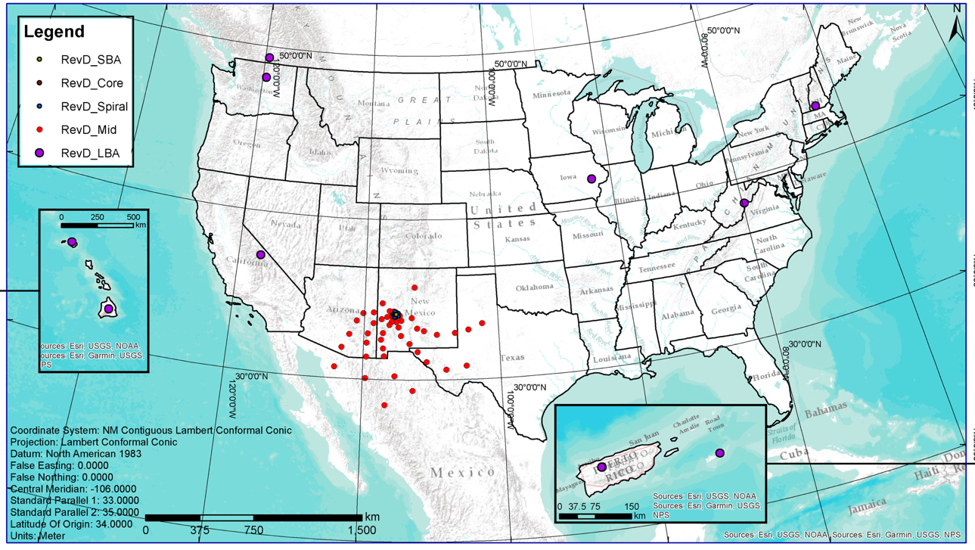
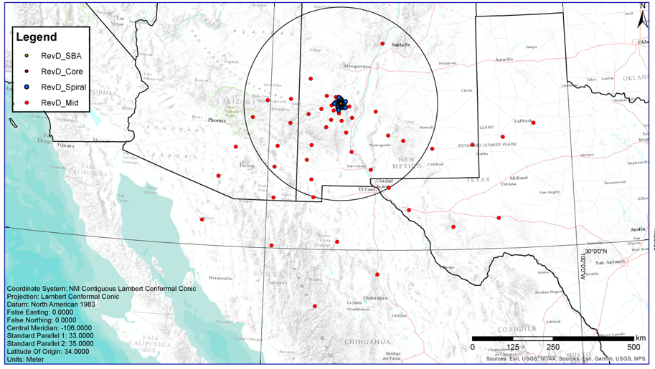
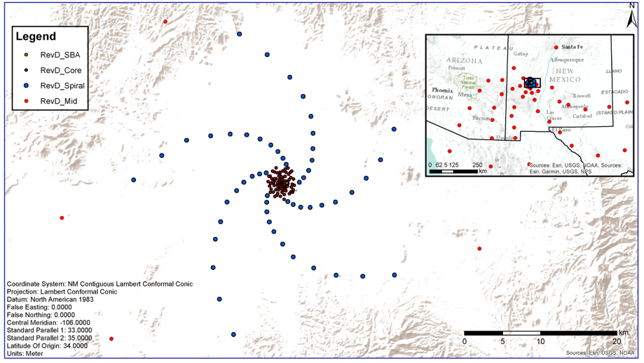
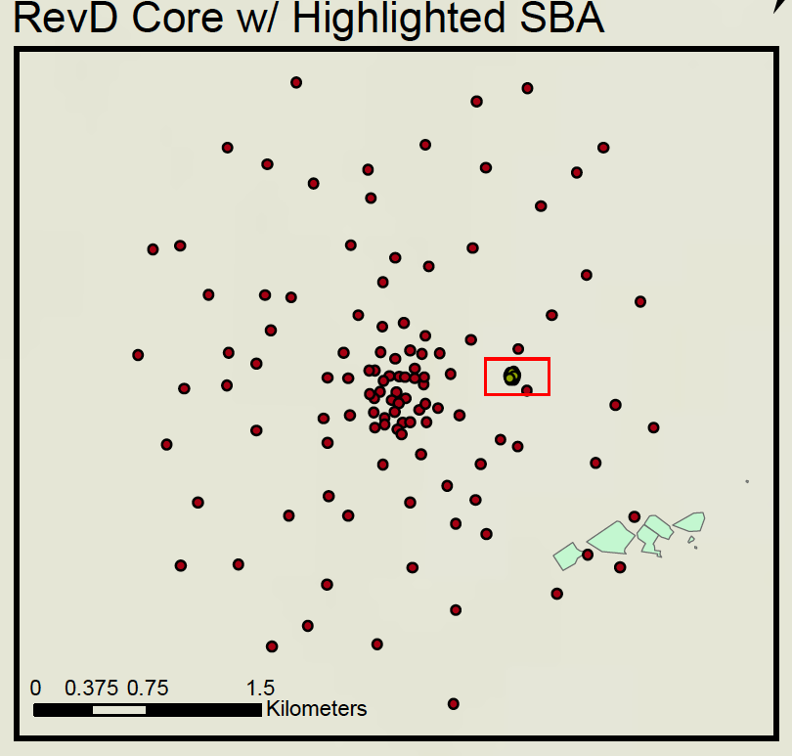
Distribution of Antennas
“Mid”
500 km
1500 km
Core
Long Baseline Antenna Locations
Qty | Location | Notes
3 | Puerto Rico | Arecibo Site
3 | St. Croix | VLBA Site
3 | Kauai, HI | Kokee Park Obs.
3 | Hawaii, HI | not Mauna Kea Site
3 | Hancock, NH | VLBA Site
Qty | Location | Notes
3 | Green Bank, WV | GBO
3 | Brewster, WA | VLBA Site
3 | Penticton, BC | DRAO
3 | North Liberty, IA | VLBA site
3 | Owens Valley, CA | VLBA site
350 miles
1.5 km
Spiral
Antenna data rate: up to 732 Gbps
(8 bit * 2pol * 20 GHz * 16/7)
20 km

Slide 6
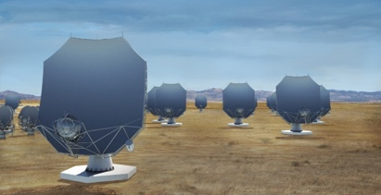



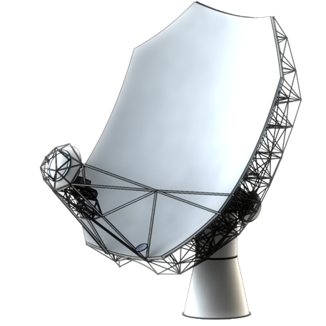

Project Milestones
Milestone | Date
Astro 2020 recommendation | Nov 2021
Conceptual Design Review (technical) | July 2022
Conceptual Design Review (programmatic) | Sept 2023
Prototype antenna delivery | Early 2024
Preliminary Design Review | June 2024
Final Design Review | July 2027
Construction | 2027-2036
Currently funded by NSF for the design stage, including the antenna prototype. Securing construction funding is a long process, but the initial step is expected soon.

Slide 7
Main Antenna Development
Key Specifications
18m Aperture | Offset Gregorian
Shaped Optics | 4° Slew & Settle in 10 sec
Surface: 160 µm rms | Reference pointing: 3” rms
Precision conditions: | Total efficiency >80% (X..Q)
Feed Low: Maintenance requirements favor a receiver feed arm on the low side of the reflector.
Mount and Drive concept: Chosen for life-cycle cost.
Materials: Cast and post-machined Al panels with steel BUS, composite sub-reflector and mostly carbon fiber feed arm.
Status
Prototype under construction in Germany
Delivery to VLA site expected in early 2024
Testing at 3 cm and 7 mm, including correlation with VLA antennas
mtex antenna technology gmbh

Slide 8
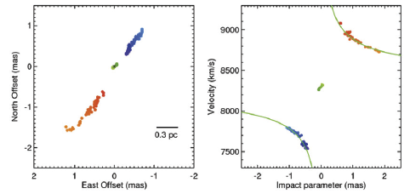
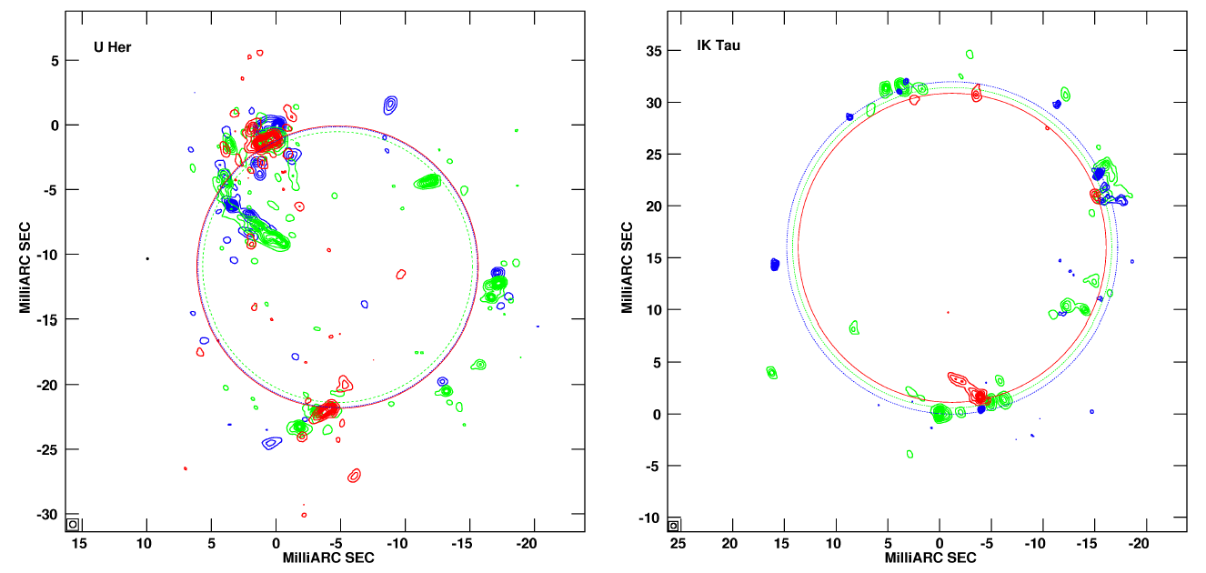
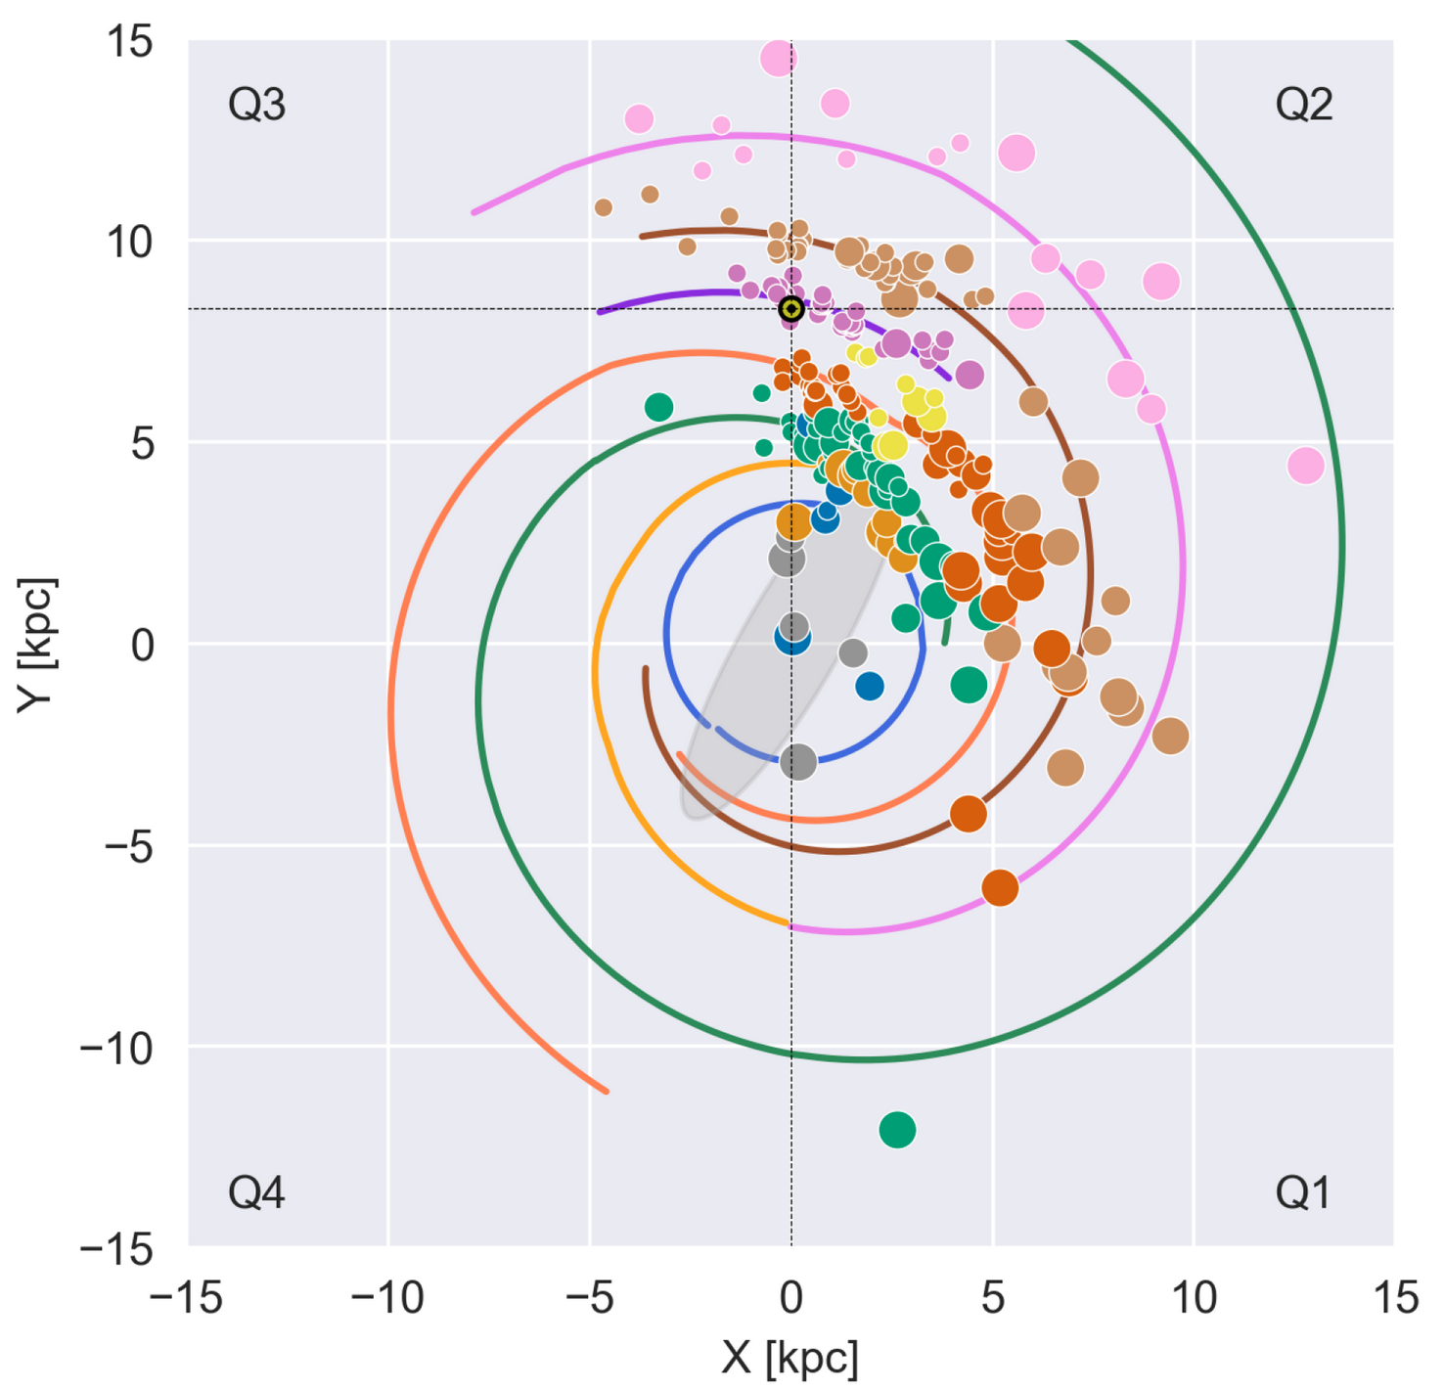
Examples of maser science impacted by ngVLA
from 85 in the 2018 ngVLA Science book (ASPC 517)
H₂O Megamaser Cosmology with the ngVLA (Braatz et al.)
Measure H₀ to 1% to test ΛCDM model (need ~50 galaxies at 7%)
Distant galaxies may resolve tension between Early Universe value of 67 (Planck) vs. Local Universe value of 74 (standard candle) - MCP2 (C.-Y. Kuo+)
SENSITIVITY
Gao et al. 2016
Evolved Stars (Matthews & Claussen)
Simultaneous imaging of masers and stellar photosphere to more accurately study layering of gas properties
Measure maser motion over a pulsation period to constrain the pumping mechanism
Multi-band spectra SiO 1-0, 2-1 (BAaDE: Sjouwerman, Lewis)
SENSITIVITY
uv COVERAGE
Desmurs et al. 2014
Six-Dimensional Tomographic View of Galactic Star-Formation (Loinard & Reid)
Trace spiral arms on far side of galaxy with massive star-forming regions
Trace spiral arms with magnetically active young stars (beyond current <500pc)
SENSITIVITY
CLOSER CALIBRATORS
Immer & Rygl 2022

Slide 9
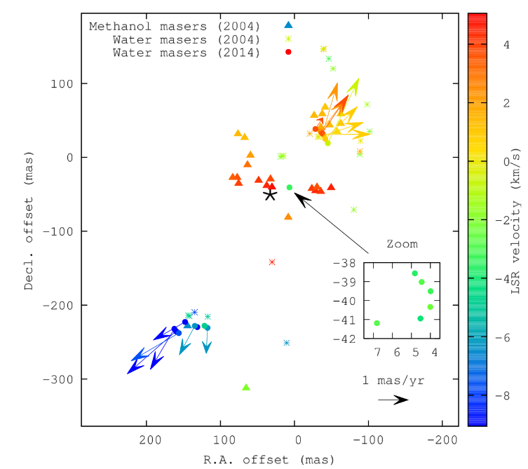
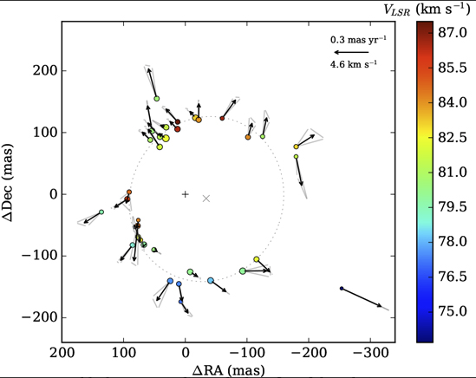
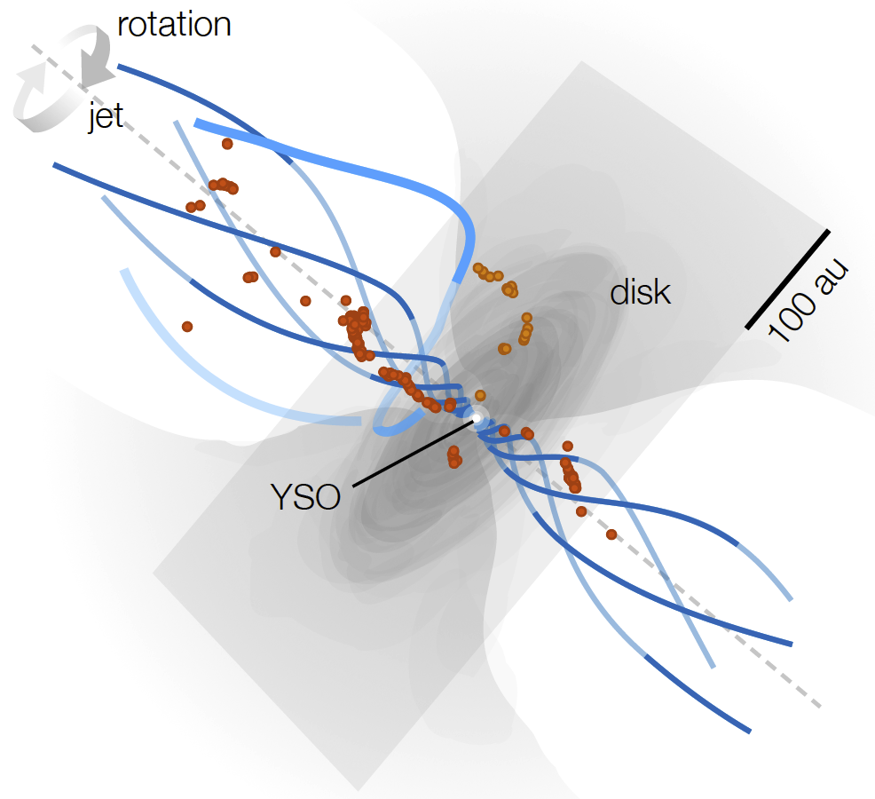
Understanding massive star formation through maser imaging
cm masers unimpeded by high dust optical depths that affect mm thermal lines
Trace outflow and infall/accretion motions at 1-10 au in massive protostars
Complication: require pumping and velocity coherence (geometry matters)
Recent progress is promising, but fainter components may be the key (Sanna+)
SENSITIVITY
RESOLUTION
(Hunter et al.)
uv COVERAGE
Disk / jet system AFGL5142
(Burns et al. 2017,, VERA, VLBA, EVN)
CH₃OH maser expanding ring
(G23.657-0.127, Bartkiewicz et al. 2020)
H₂O maser disk wind / outflow
(I21078+5211, Moscadelli, Sanna+ 2022, gVLBI)

Slide 10
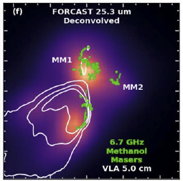
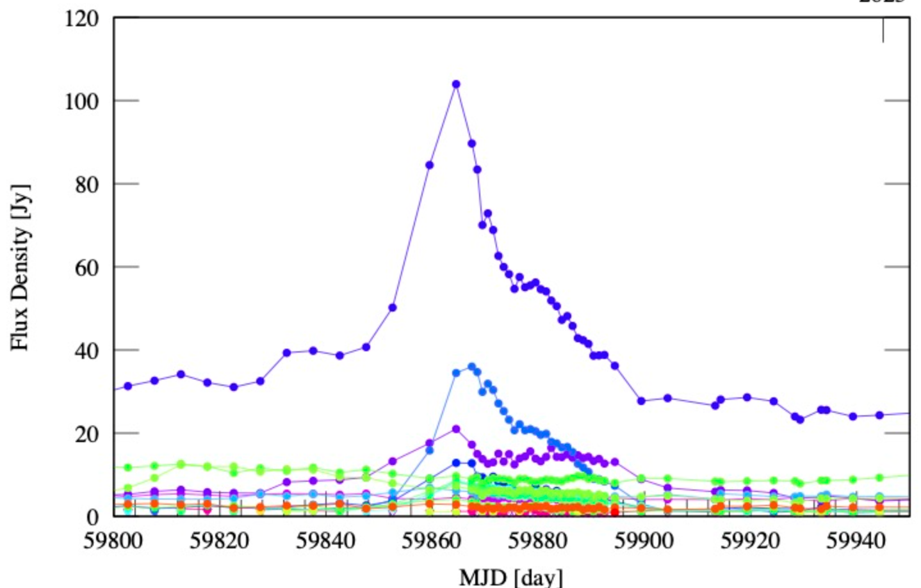
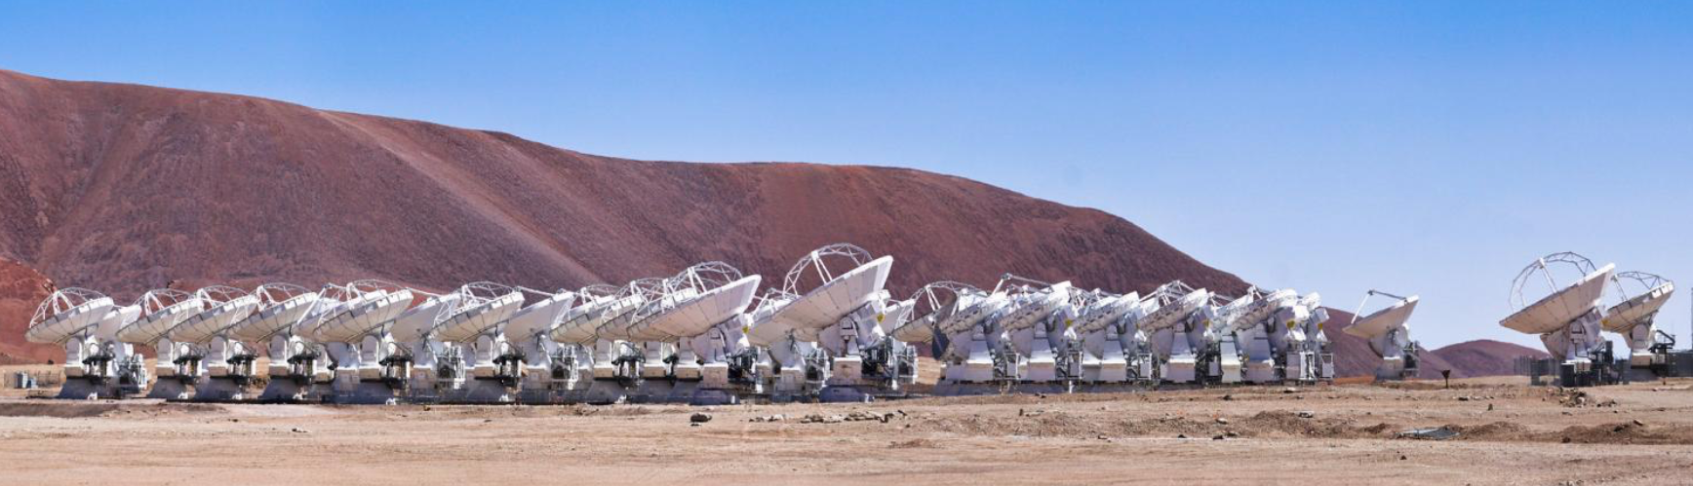

Masers as probes of accretion outbursts
Class II CH₃OH masers (including 6.7 GHz), are intimately tied to accretion outbursts
Flares trace the rapid increase in mid-IR/far-IR radiation from the active massive protostar
NGC6334I-MM1, S255IR-NIRS3, G358.93-0.03
SENSITIVITY
FLEXIBILITY
uv COVERAGE
Current challenges:
  Rise/fall time can be rapid (days to weeks)
  Follow-up is constrained by interferometer configurations
      Example: for G358.93 (Jan2019) & G36.11+0.55 (Oct2022), SMA was in a larger configuration than ALMA. Both times!
G36.11+0.55 6.7 GHz light curve
(Y. Yonekura,
priv. comm.)
NGC6334I-MM1, Hunter et al. 2021
The fixed layout of ngVLA means that rapid follow-up at each necessary angular scale will always be possible!

Slide 11
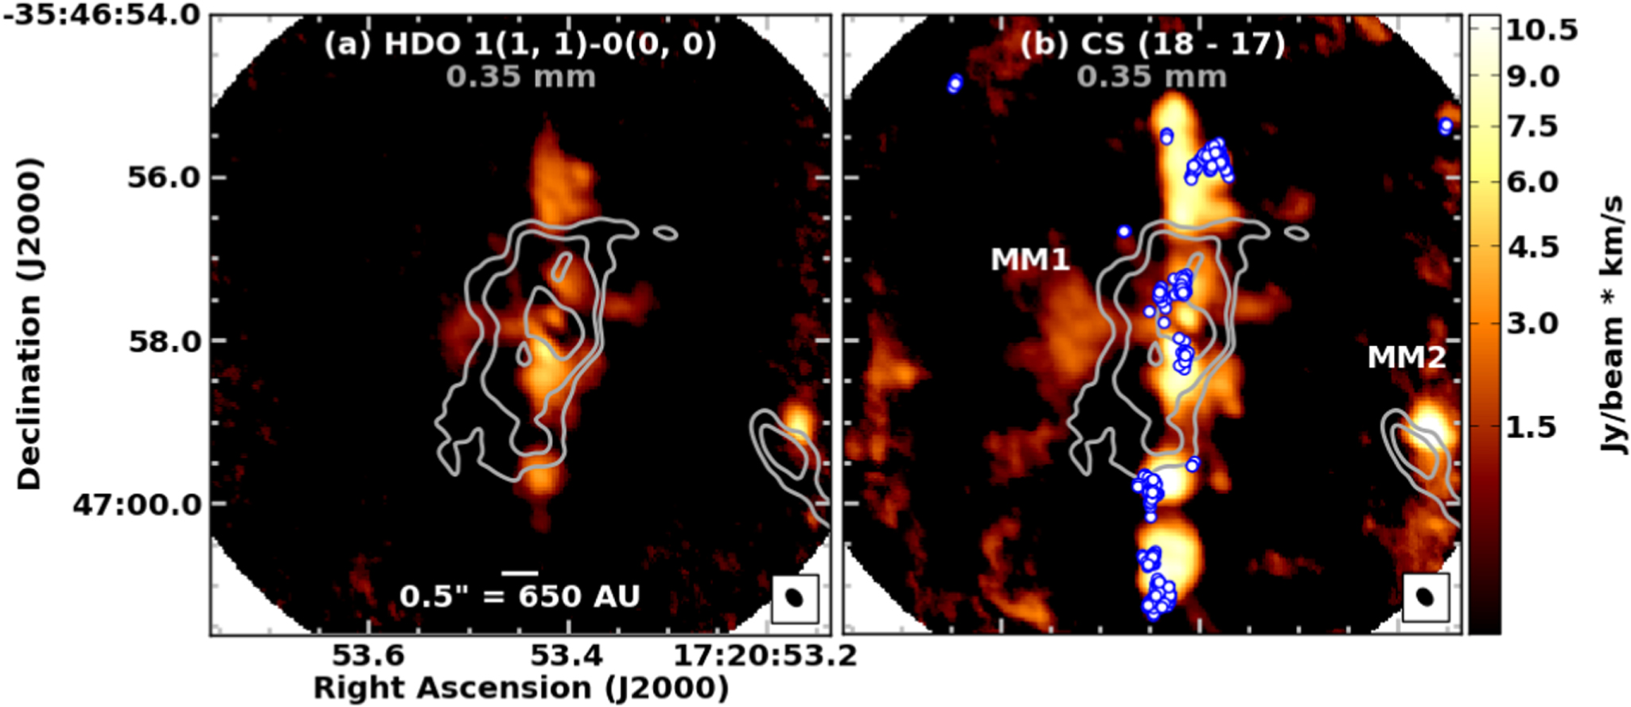
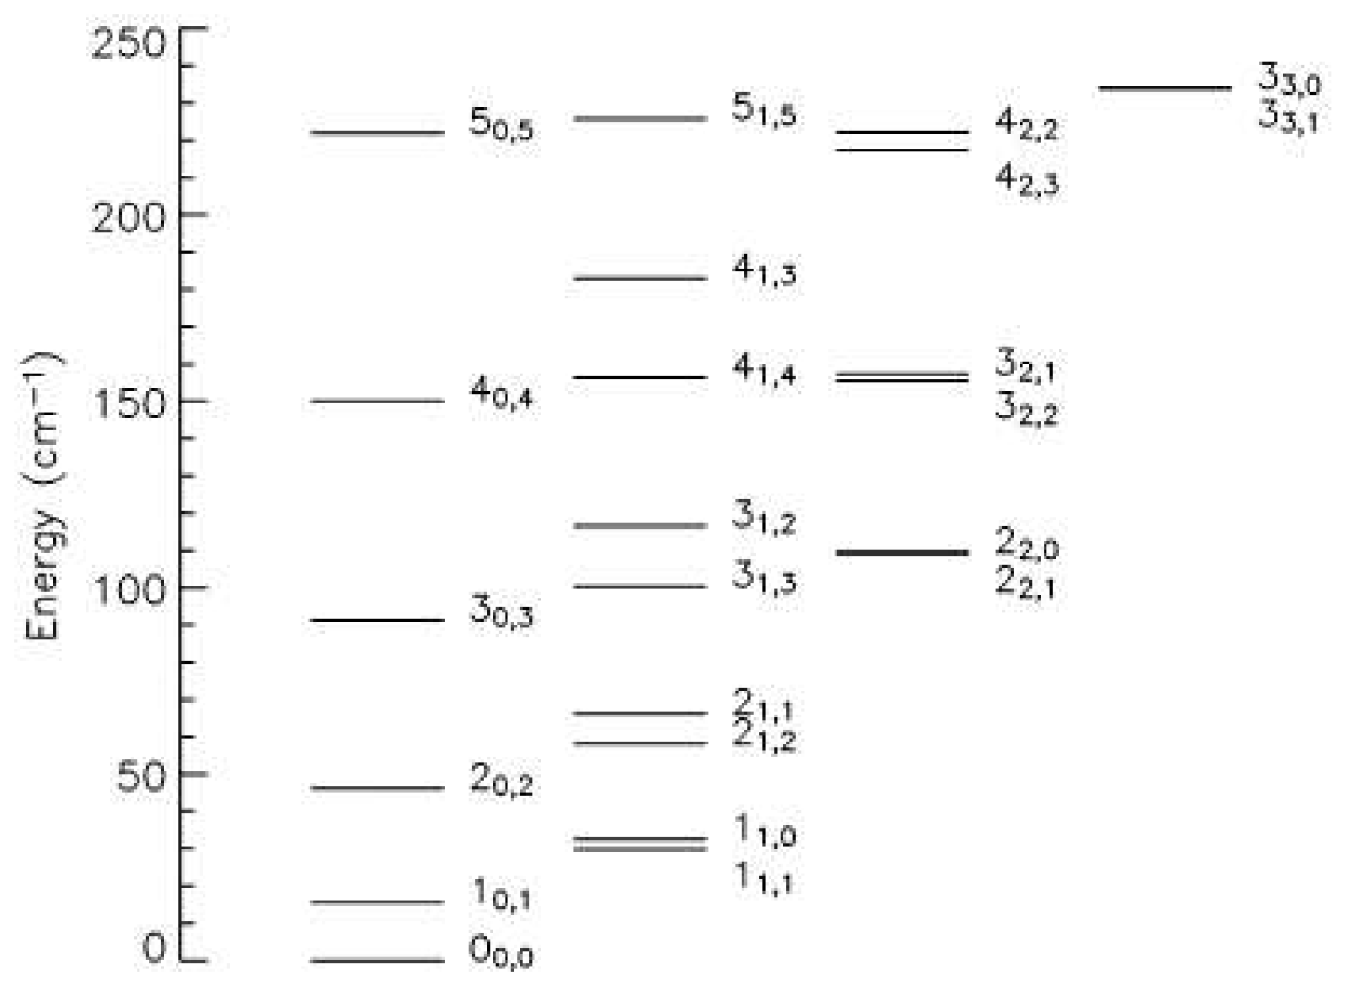
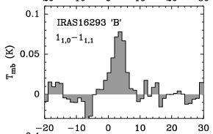
Connecting with thermal lines in 3mm Band
893.636 GHz
Masers provide only a partial view
Thermal lines can provide T and n_{H} but difficult for current VLA at >=B-config
HDO is a powerful tracer of the thermal water reservoir
HDO Energy Level
Diagram
(Kulczak-Jastrzȩbska 2016)
VLA 22 GHz H₂O masers
Band 10 ALMA detection of the North/South outflow from NGC6334I–MM1 (McGuire et al. 2018)
ngVLA will access the
HDO 1(1,0) – 1(1,1)
transition at 80.578 GHz
E_{upper} = 47 K
(in ALMA Band 2)
IRAM 30m
Parise et al. 2005
plus CS, HCN, HCO+, SiO, CH₃CN, and many more…

Slide 12
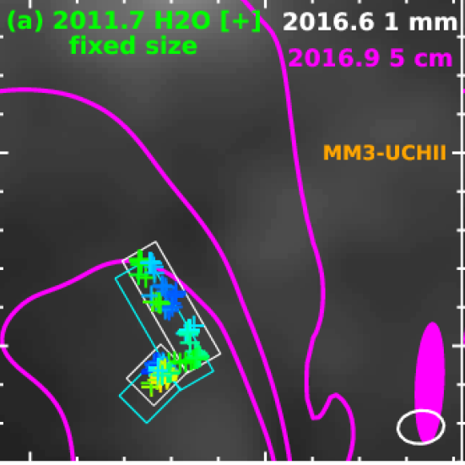
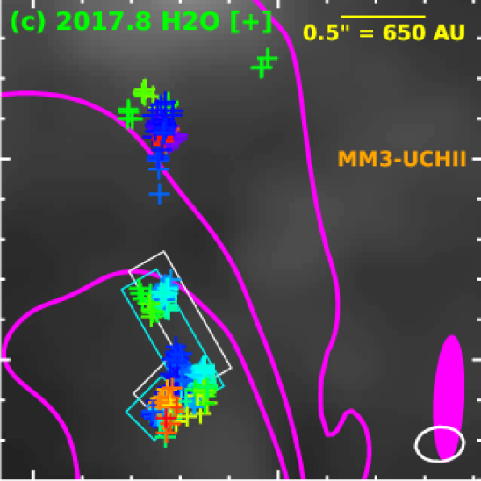
Example observing program #1:
“Multi-epoch triggered study of outburst objects”
  Watch masers and SED evolve; search for new jet emission (S255)
  100-antenna imaging subarray will be 3-4x more sensitive than VLA (3x for lines, up to 4x for continuum in higher bands)
  1 hour/band/epoch * 10 epochs: total = 20 hours over 1 year
VLA 6-year proper motion in NGC6334I-MM1 outflow 120 km/s at 1.3 kpc
Brogan et al. 2018
Freq. range (GHz) | Baseline for 0.02” (100au@5kpc) | Maser lines | Relative positions: 𝚫𝜽/𝚫SNR | Continuum sensitivity per epoch:
3.5 – 12.3 | 500 km (Spiral + Mid antennas) | CH₃OH Class II: 6.67, 12.2 GHz CH₃OH torsional: 6.181, 12.23 CH₃OH Class I: 9.9 GHz ortho-H₂CO: 4.83 GHz exc. OH: 4.66, 4.75, 6.03,6.035 | 40 times better than VLA: at 5kpc, >80 km/s jet proper motion | 50 K rms per 2 GHz chunk
20.5 – 34 | 125 km (Spiral + Inner Mid + 20 core) | H₂O, ortho-NH₃ (3,3) & (6,6) CH₃OH J₂-J₁ 25 GHz ladder CH₃OH torsional: 20.97, 26.12 | 10 times better than VLA | 30 K rms per 2 GHz chunk

Slide 13
Example observing program #2:
“Matched resolution (500 au) survey of 40 massive protoclusters”
  Each ~100-antenna imaging subarray will be 10-16x faster than VLA (line, continuum)
  8 hour/src/band on VLA will become 0.8 hr/src/band → total time ~ 100 hrs
Band | Tuned frequency range (GHz) | Baseline for 0.1” (500au@5kpc) | Maser lines | Thermal lines | Continuum traces
2 | 3.5 – 12.3 (10’ FOV at 6.7 GHz: 15 pc at 5 kpc) | 125 km (Spiral + 25 Inner Mid + 15 Core) | CH₃OH Class II: 6.67, 12.2 GHz CH₃OH torsional: 6.181, 12.23 CH₃OH Class I: 9.9 GHz ortho-H₂CO: 4.83 GHz exc. OH: 4.66,4.75, 6.03, 6.035 | recombination | UCHII regions, Jets, Active PMS low- and intermediate mass stars
4 | 20.5 – 34 (3’ FOV at 22 GHz: 4 pc at 5 kpc) | 32 km (Spiral + 10 Inner Mid + 30 Core) | H₂O, ortho-NH₃ (3,3) & (6,6) CH₃OH J₂-J₁ 25 GHz ladder CH₃OH torsional: 20.97, 26.12 | NH₃ (1,1) thru (13,13), CCS, HC₃N 3-2 | Jets, UCHII and HCHII regions
6 | 70 – 116: any 20GHz bandwidth (45’’ FOV at 86 GHz: 1 pc at 5kpc) | 8 km (80 Core + 20 Inner spiral) | CH₃OH Class II: 7 lines CH₃OH Class I: 3 lines SiO 2-1 v=1,2,3,… | HDO, CS, HCO⁺, CO, CH₃CN, N₂H⁺ SiO 2-1 v=0, HCN HNC, HC₃N, etc. | Dust, HCHII regions
(based on Hunter et al. 2018, ASPC Series 517)

Slide 14


Joint 2023 Science Meeting
Vancouver, CANADA, May 1-5, 2023
https://go.nrao.edu/ngVLASKA
April 7: Deadline for in-person registration,
poster abstract submission
Virtual attendance option: $100

Slide 15
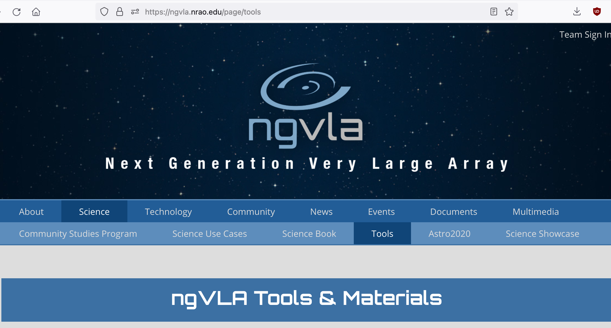
Summary
Named as a high priority by US Astro2020, the ngVLA project is currently well positioned to complete its design and start construction later this decade. Antenna prototype to begin on-sky testing in 2024.
The flexible capabilities promise year-round access to high angular resolution imaging of masers, free-free emission, thermal lines, and dust continuum.
    Revolution in massive protostellar accretion outbursts
    Comprehensive view of protoclusters, especially when combined with ALMA’s Wideband Sensitivity Upgrade
Join a ngVLA Science Working Group to help identify science and operations requirements: https://ngvla.nrao.edu/page/workinggroups
https://ngvla.nao.ac.jp/researcher/resources/working_group.html
Project Scientist = Eric Murphy (emurphy@nrao.edu)

Slide 16
Max data rate 132 GB/sec:
185 antennas, 240000 channels, 1 second integration, 2 polarizations
130 antennas -> 64 GB/sec

Slide 17
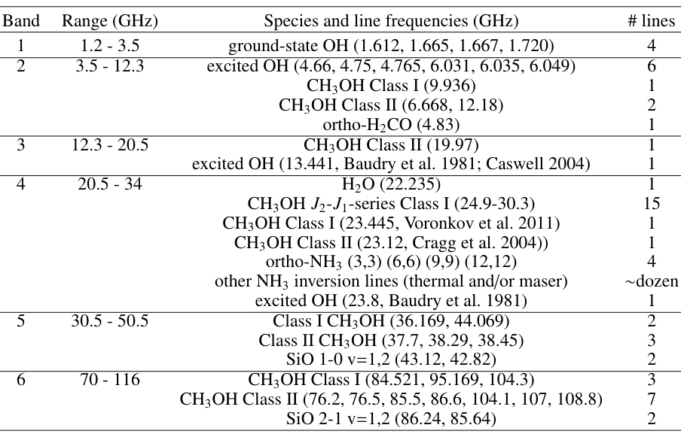
Known maser lines in ngVLA Bands (pre-G358!)
10 lines
CH₂NH (5.3GHz)
Gorski+2021
C.Xue talk SgrB2
SiS 18.155GHz
3 dozen lines
Detected molecular maser lines in each ngVLA band (see also Menten 2007)
CS 1-0 (49GHz)
CS 2-1 (98GHz) Ginsburg & Goddi 2019
,

Slide 18
Average data rate specification = 8 GB / sec
Would support: 100,000 channels * 4 pol * 4 bytes/vis * 1 sec/integration
* 4950 baselines (100 antennas)
92 subbands with 1024 channels each, plus 6000x3.3MHz channels for continuum
With no zoom, 218.75 MHz / 1024 channels = 0.80 km/s at 80 GHz
or 11 lines at 0.1 km/s resolution, etc.
Max data rate spec. = 132 GB / sec
Would support: 240,000 channels * 4 pol * 4 bytes/vis * 1 sec/integration
* 34453 baselines (263 antennas)

