Slide 1
Observing Modes Framework
Based on ngVLA document 020.10.05.05.00-0005-PLA-A
“Observing Modes Framework”,
T. Hunter, C. Hales, R. Hiriart, J. Hibbard, J. Kern, E. Murphy, V. Rosero, R. Selina, J. Wrobel, 2020-03-09

Slide 2
Background
Commissioning and Science Validation (CSV) Concept document completed last year
Highlights:
The inputs to CSV from AIV will be verified capabilities (incl. software) rather than individual components. → CSV will be able to focus on measuring system performance and commissioning observing modes, rather than debugging basic operations.
The outputs of CSV are validated science observing modes, which includes the processes of observing and data reduction, along with the associated technical documentation and procedures essential for operation of ngVLA as a user facility.
*Need to define observing modes! → Observing Modes Workgroup (August 2019)

Slide 3
Functional Operating Modes
The overarching functional configurations of the ngVLA system are described as Functional Operating Modes* [in Prelim. System Reqts.].
These are:
  Interferometric Mode
  Phased Array Mode
  Pulsar Timing Mode
  Pulsar and Transient Search Mode
  VLBI Mode
  Total Power Mode
  On-the-Fly Mapping Mode
  Solar Mode
  Concurrent Interferometric and Phased Array Mode
*Each FOM will have at least one (and often many) associated Observing Modes.

Slide 4
Definition of an “Observing Mode”
User perspective: terse phrase: “Stokes I Continuum w/Single Pointings or Pointed Mosaics”
Provides a unique science capability
Requires a scheduling block of a specific format
Produces a specific set of data products
Observatory perspective: we need a definition that includes numerous details:
to determine which hardware and control software resources are required
to define a prescribed sequence of observations of calibrators and science targets
to specify heuristics and methods to process the data in the pipeline
to define a set of data products that can be numerically validated in pipeline releases.
An observing mode = a list of rules that every subsystem must follow
This yields successful data products; avoids costly problems at the validation stage (when different subsystems make different assumptions about each observing mode)
Notes:
Previously, “Status Level” was called: lifecyle stages; then observing categories

Slide 5
12 categories of information to consider when defining observing modes
What information must be captured from PI?
What subarray(s) of antennas are needed?
What antenna motion is needed?
What receiver band(s) and tunings are needed?
How will science targets and tunings be split into SBs?
What will calibrator observing sequence and calibrator database entries will be used?
How will we map calibrator data to targets? (so that pipeline does not have to guess)
What correlator setup(s) are needed?
What dump time and archive storage rate is needed?
What calibration heuristics & QA are needed in pipeline?
What imaging heuristics & QA are needed in pipeline?
What analysis tools beyond the pipeline do we need to point users to?

Slide 6
Concept of Modes and Attributes
ObsMode working group analyzed 2 dozen science cases drawn from Reference Observing Program and elsewhere, noting requirements in all 12 categories
Requirements that involve major distinctions in hardware or software capabilities were then labeled as “modes”, while the other items were labeled as “attributes”.
The term “attributes” = properties of an observing mode that represent a limited perturbation on the required capabilities and/or data products compared to more standard uses of that mode
Major attributes vs. Minor attributes
  Major: requires validation in multiple configs or correlator modes (more work)
  Minor: independent of other modes (example: channel averaging)

Slide 7
Example 1 of Modes vs. Attributes: Correlator Setup
Modes:
Uniform mode (spectral windows all same width & resolution and are contiguous)
Mixed mode (windows are fully tunable w/Doppler setting, can have different widths)
Advanced mode (any aspect that requires additional commissioning, such as WIDAR’s recirculation to get ultimate resolution, or storing only subsets of spws)
Phased array (1-beam, N-beams)
Attributes:
Online channel averaging or decimation
Advanced window functions (i.e., beyond Hanning)
Doppler setting in frames other than LSRK or ephemeris body
Multiple phase centers for LBA (dividing correlator resources), of order 4 allowed
Capture normal visibilities at same time as phase array output

Slide 8
Example 2 of Modes vs. Attributes: Antenna Motion
Modes:
Pointed mode (i.e., single field or pointed mosaic)
OTFI (on-the-fly interferometry)
Lissajous or daisy pattern (i.e., single-dish scanning)
Attributes:
Reference pointing measured and applied online
Application of encoder corrections from pointing table in offline imaging
Ephemeris position tracking
Non-zero proper motion (i.e. specifying a rate rather than a table, e.g., nearby stars or fast pulsars)
Two-Line Element (TLE) position tracking (Earth satellites)

Slide 9
Example 3 of Modes vs. Attributes: Imaging products / heuristics
Modes:
Continuum images (IQUV) & spectral cubes (Stokes I)
Spectral polarization cubes
OTFI imaging
Attributes:
pointed mosaic
mtmfs continuum imaging
self-calibration of science targets
W projection (gridder='widefield')
AW projection (gridder='awproject')
Exceeds standard image area or cube volume
Ephemeris velocity tracking
Joint deconvolution of 6m-6m and 18m-18m visibilities (i.e., not 6m-18m)
Any non-standard imaging algorithm (including 6m-18m baselines)
Notes:
add peak and total flux density in PI info requirement
add wideband self-cal
add Taylor terms to spectral index bullet point
note: paired antenna calibration not mentioned (nor in Calibration doc, yet)

Slide 10
Synthesizing the results
Continuum images (IQUV) & spectral cubes (Stokes I)
Spectral polarization cubes
Pulsar timing mode data
Pulsar search mode data
Phased visibilities (VLBI)
Single-dish autocorrelation imaging
Single-dish combined imaging with interferometry
Five categories
Data products
Antenna subarray
Correlator mode
Major Attributes
Minor Attributes
Core
Plains
Mid-baselines
LBA
SBA
Attributes:
spectral index images
per-execution or per-epoch images
calibrated visibility spectra
time-critical processing
higher-order data products (e.g., source finder)
rotation measure cubes (Faraday dispersion cube)
processing of multiple phase centers
Using Data products as the primary axis, we constructed a 2D matrix to visualize the combination of items into observing modes

Slide 11
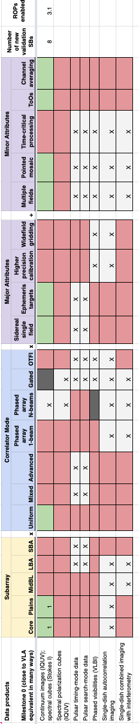
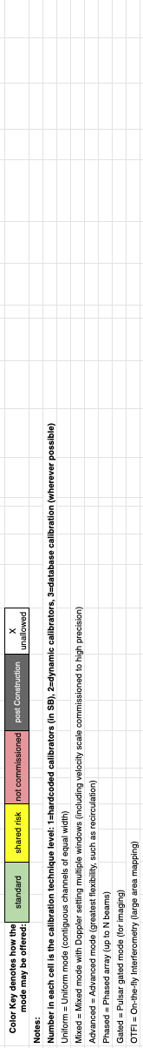
Observing mode matrix (overview)
Data products Subarray Correlator Mode Major Attributes Minor Attributes….

Slide 12
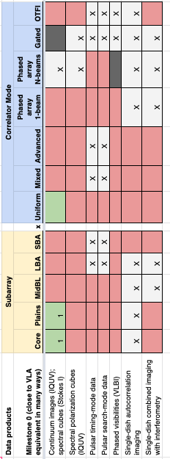
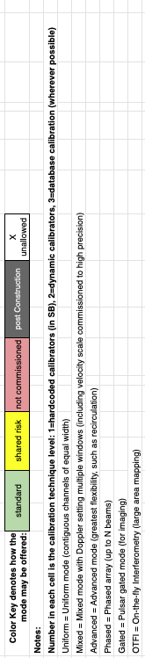
Observing mode matrix (zoom left)
Example of
minimum capabilities “Cycle 0”
(with some yellow boxes likely added)

Slide 13
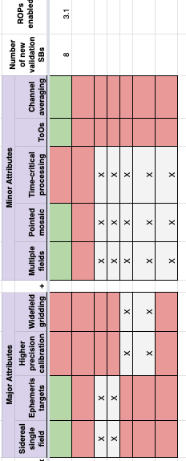
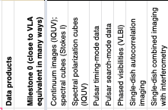
Observing mode matrix (zoom right)

Slide 14
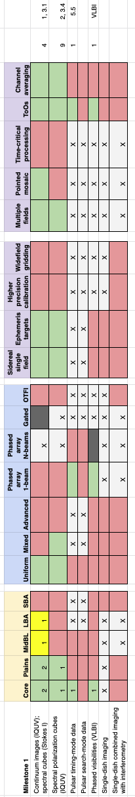
Path forward
Major and minor attributes can be refined as ngVLA design progresses
Matrix can be used to:
  Plan and track CSV activities (map to CSV milestones)
  Determine number of validation SBs needed (w/consolidation)
  Visualize the roll out of capabilities

Slide 15
Assigning “Status Level” to Observing Modes – J. Hibbard (last week’s talk)
  New Mode Test Observations (NMTO)
  Shared Risk Observations (SRO)
  Non-standard Data Reduction (NSDR)
  Standard Mode Data Reduction (SMDR): All stages from generating SBs to producing quality-assured SRDPs is automated, and has been tested and validated for use by PIs.
  Principle Investigator Data Reduction (PIDR)
Assignment will be done by Sci. Operations, but considering readiness (online software, pipelines & QA) & available CSV effort
Goal is for most Observing Modes to be SMDR, but timescale depends on available effort

Slide 17
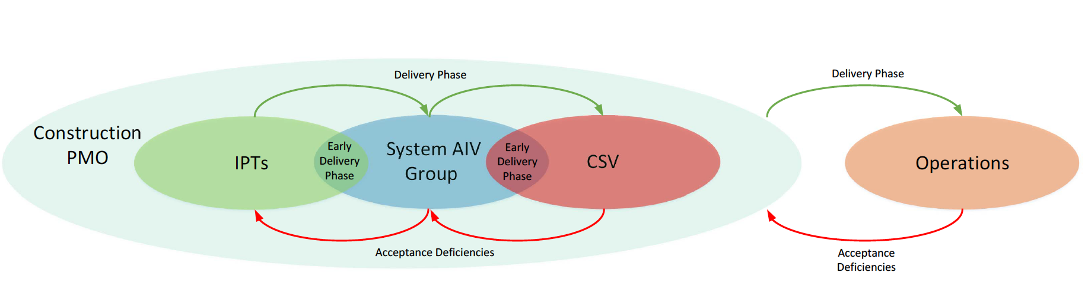
AIV Interaction diagram

Slide 18
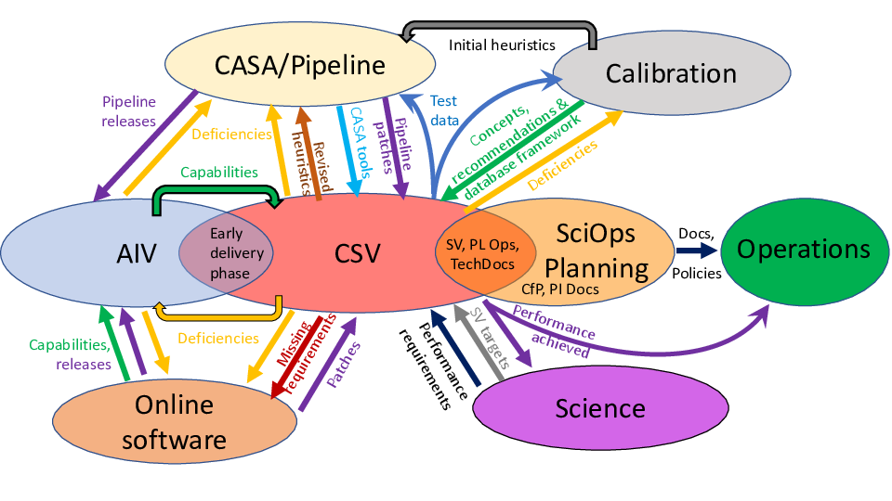
CSV Interaction diagram

