Slide 1


Portrait of a Forming Massive Protocluster: NGC6334 I(N)
Todd Hunter
(NRAO/North American ALMA Science Center)
Collaborators:
Crystal Brogan (NRAO)
Ken (Taco) Young (CfA)
Great Barriers in High Mass Star Formation
Townsville, Australia, Sept. 2010

Slide 2
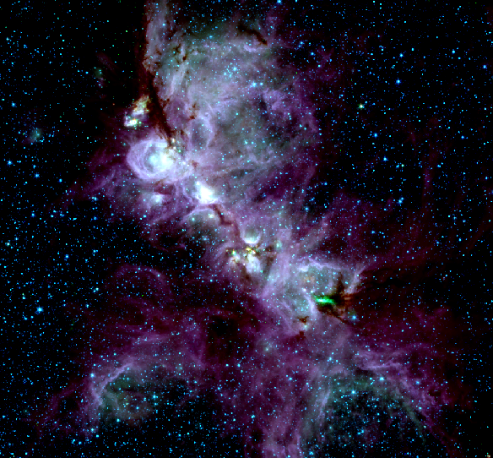
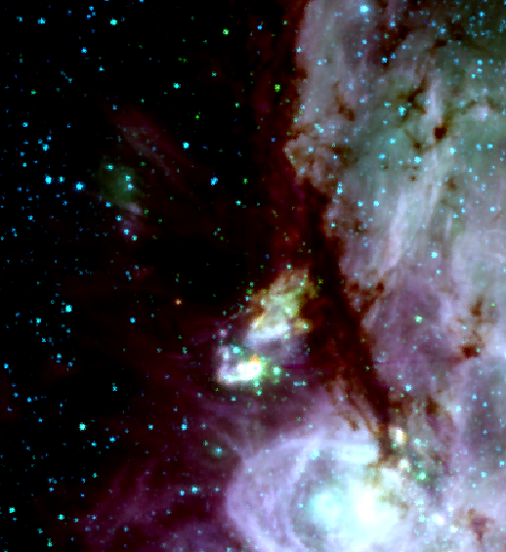
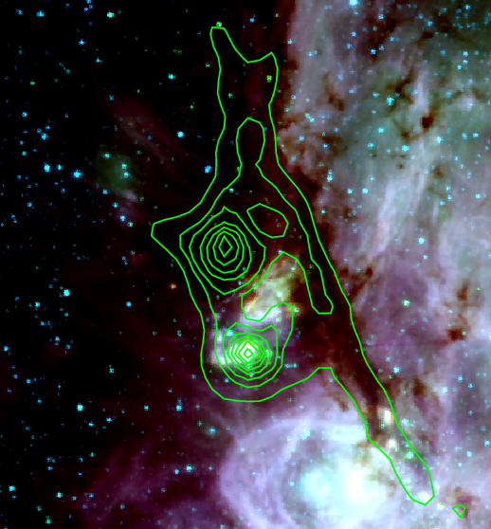
The NGC6334 Star Forming Complex
25 ’ = 15 pc
SCUBA 850 μm dust continuum
Distance ~ 1.7 kpc
Nomenclature:
  FIR sources I..VI
  radio source A..F
I(N)
(2800 M)
1 pc
I
(2000 M)
GLIMPSE 3.6 μm 4.5 μm 8.0 μm
Source I NIR cluster with density of ~1200 pc⁻³ (Tapia et al. 1996)
NGC 6334 I luminosity 3x10⁵ L, I(N) two orders of magnitude less
Based on infrared, I(N) speculated to be less evolved than I

Slide 3
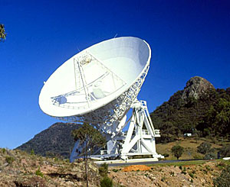
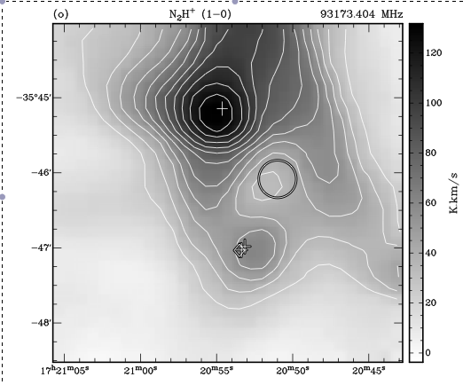
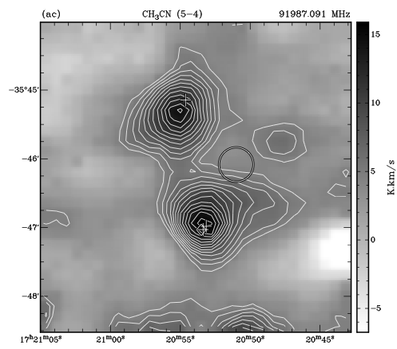
Single dish view of molecular lines
Examples from Mopra mapping survey (Walsh et al. 2010)
N₂H+ (1-0) CH₃CN (5-4)

Slide 4
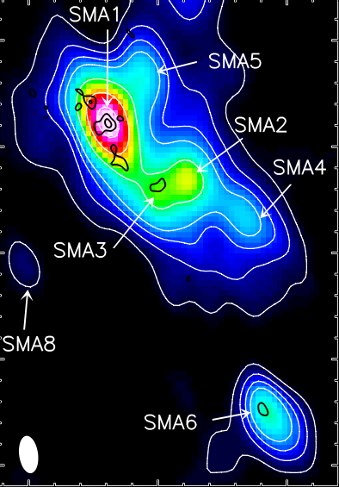
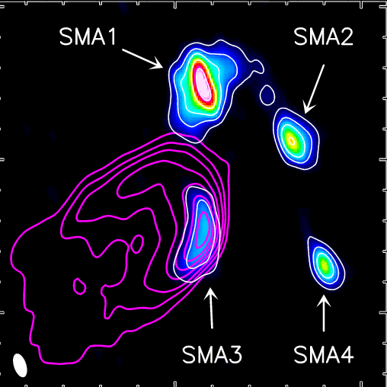
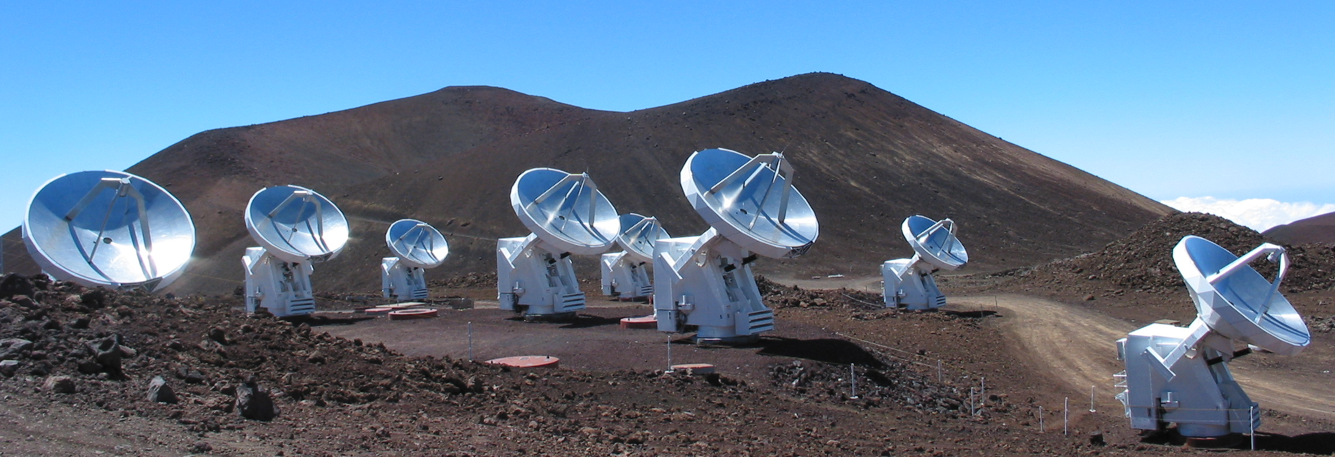
High Resolution Continuum
SCUBA 850 μm continuum
1.3 mm
6”= 10,000 AU

Slide 5
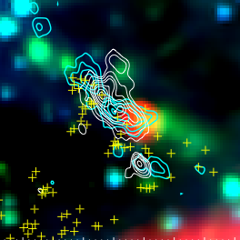
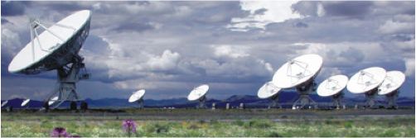
SMA, VLA, Spitzer observations
SiO(5-4) outflow
1.3 mm Continuum
3.6 μm 4.5 μm 24 μm
6”= 10,000 AU
1.3 mm 7 mm
~1.7”
+ 44 GHz methanol masers
Brogan, Hunter et al. (2009)

Slide 6
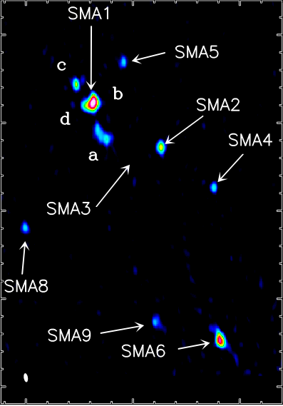
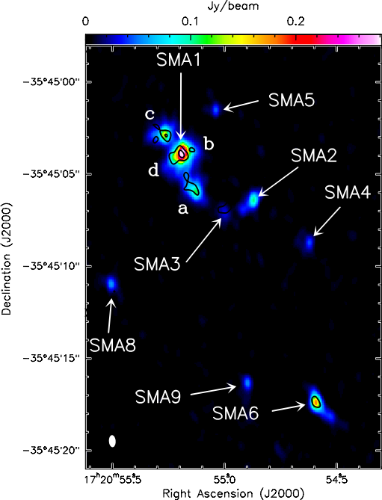
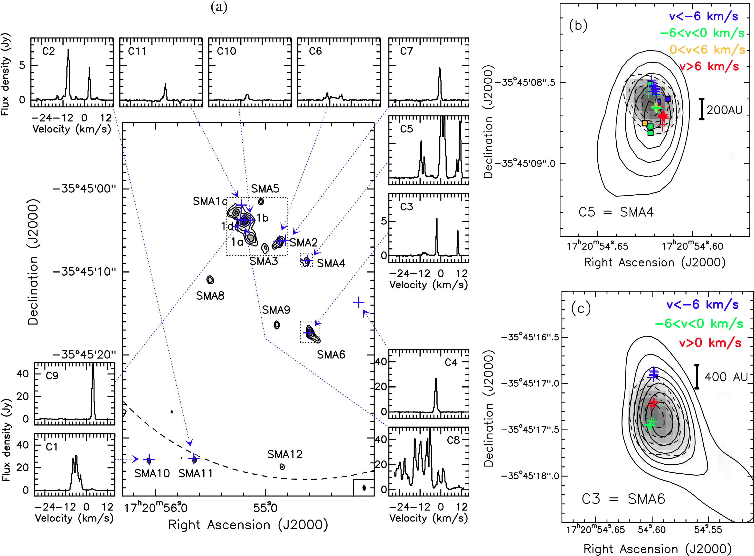
Zooming in on NGC6334 I(N)
6”= 10,000 AU
~0.4”
~1.7”
~0.5”
0.87 mm
1.3 mm 7 mm
Brogan, Hunter et al. (2009)
1.3 mm 7 mm

Slide 7
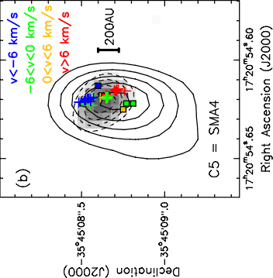
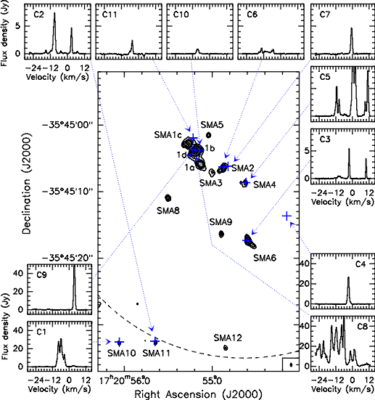
VLA
Water
Maser
spectra
H₂O masers show linear vel. gradient
6.7 GHz maser
MIPS 24 um
protostellar density is ~500 pc⁻²

Slide 8
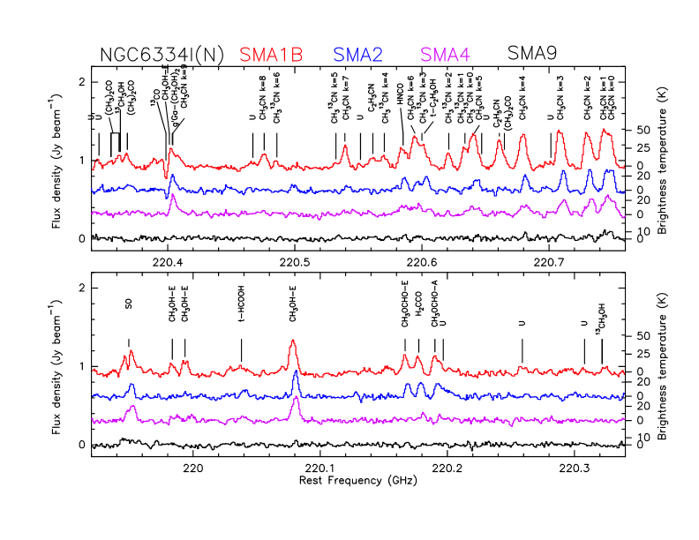
Multiple hot cores (and more)
SMA 9: Curious line-free source
➔ Large and cool? (Hosokawa et al. 2010)

Slide 9
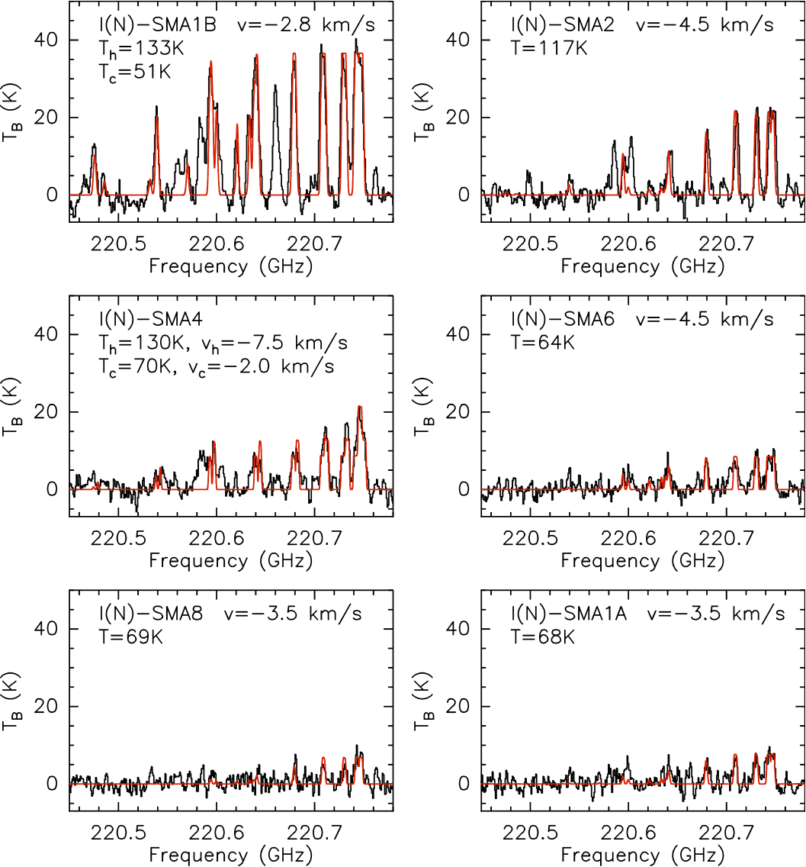
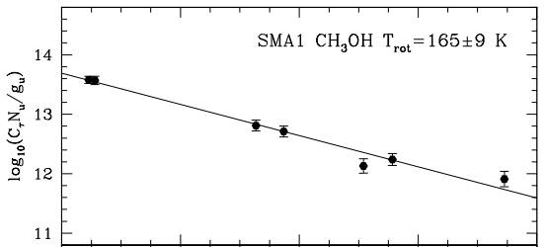
I(N) CH₃CN Temperatures
Some require two velocity and temperature components.
T_{hot}=130 K, T_{B}=40 K
Size ~ 0.3” = 500 AU
Cluster dynamics: Δv=5km/s, rms=1.6

Slide 10
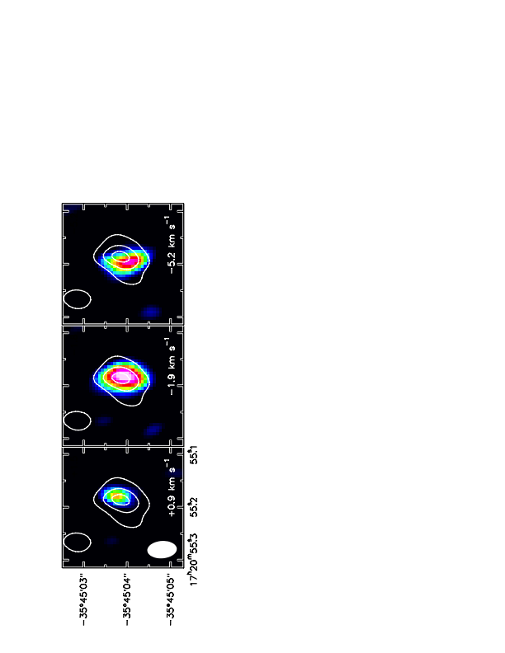
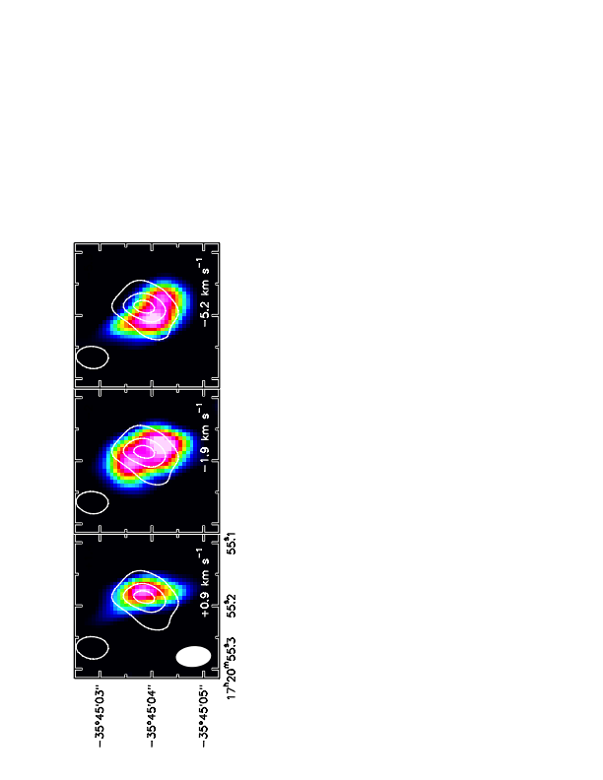
CH₃CN J=12-11 Kinematics
K=2
E_{lower}=87 K
K=7
E_{lower}=400 K
➔ K=2 is optically thick and avoids continuum peak

Slide 11
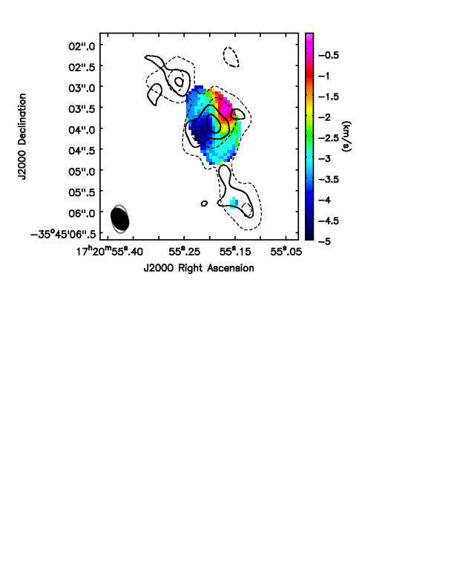
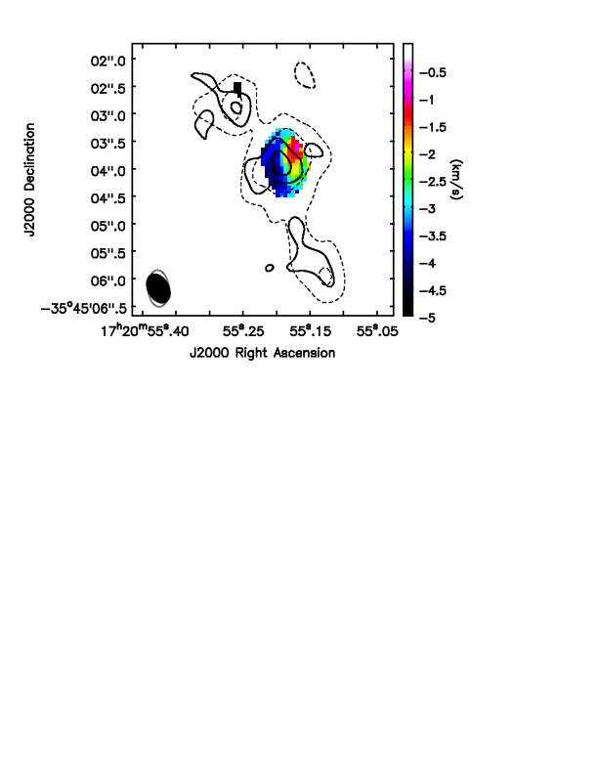
CH₃CN J=12-11 Kinematics at SMA1
K=4 (E_{lower}= 168 K)
K=7 (E_{lower}= 400 K)
If SMA 1b/1d is indeed a binary, SMA 1b is clearly dominant

Slide 12
Dust emission at 800 AU resolution
Source | Integrated Flux density (mJy) | Brightness T (K) | Gas T (K) | Warm Gas Mass (M₈)
1b/d | 844 | 50 | 51, 133 | 8-60
1a | 315 | 19 | 68 | 5
2 | 190 | 26 | 60, 117 | 2-4
4 | 92 | 6 | 70, 130 | 1.5
5 | 58 | 6 | 30? | 2
6 | 304 | 46 | 64 | 4
8 | 87 | 17 | 69 | 1.5
9 | 66 | 10 | 30? | 3
10 | 40 | 3 | 30? | 1
11 | 37 | 3 | 30? | 1
IRAS16293@1.7kpc | 9 |  | 40 | 0.2
106 K/Jy at 222GHz; 89 K/Jy at 342 GHz

Slide 13
Summary
~800 AU imaging of NGC6334I(N) protocluster reveals:
  12 compact sources: protostellar density ~ 500 pc⁻²
    SMA1b = main hot core, CH₃CN velocity gradient suggests rotation
    Velocity dispersion of 1.6 km s⁻¹ ; t_{cross}~8x10⁴ years
  T_{gas} ~ 60 to 150 K, masses at this resolution are a few to few 10s of solar.
  A range of evolutionary states present
Two “greatest barriers” to understanding massive star formation:
Angular resolution limit of 0.3”
Sensitivity limit of ~1 mJy continuum
ALMA will break both barriers by a significant factor
Early science call in the next few months

