Slide 1
ALMA Offline Software Considerations for Improved Bandwidth and Resolution
Todd Hunter
(NRAO-CV / NAASC)
Photo credit: Pablo Carillo (ALMA)
full 20 minute version

Slide 2
Focus on: QA0, QA2 (Pipeline), and JAO ADC / Archive
Impact on QA0: Minor increase in processing time
Impact on Pipeline:
Higher Spectral Resolution likely = many more channels
Increase in processing time (more channels to calibrate and image)
Bandpass SNR may become more of a concern
Cube sizes become more challenging
Benefit: findContinuum results for low-resolution spws will improve
Wider Bandwidth
Effects of spectral index and varying atmospheric transmission become more important (need to invoke spectral weights)
Further increase in processing time and size of each measurement set
Benefit: Greater opportunity for continuum self-calibration
Impact on JAO ADC / Archive
Hardware upgrades required to handle increase in data rate and volume

Slide 3
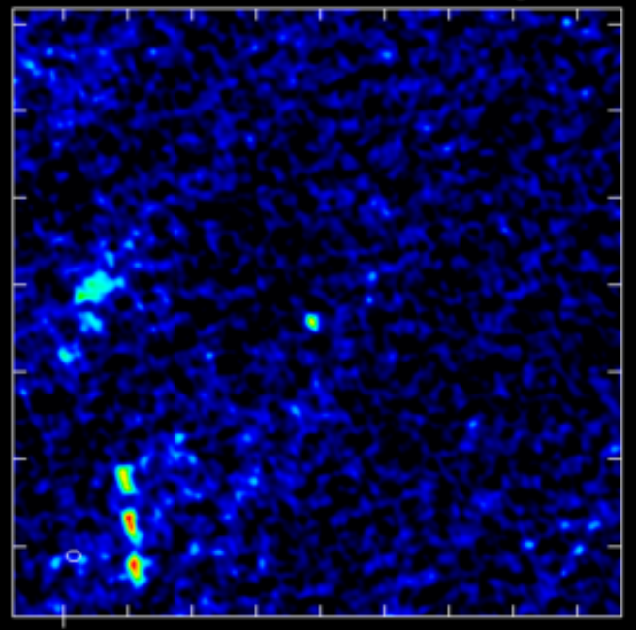
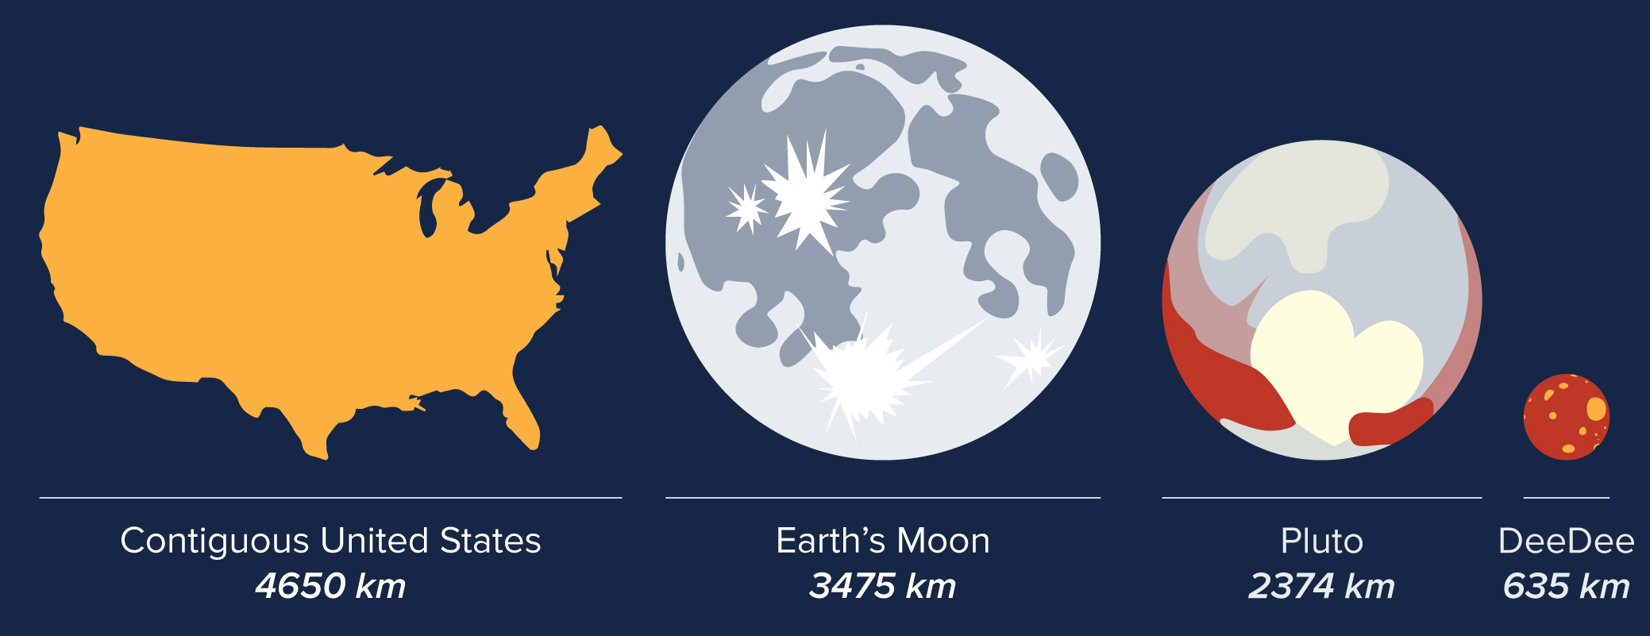
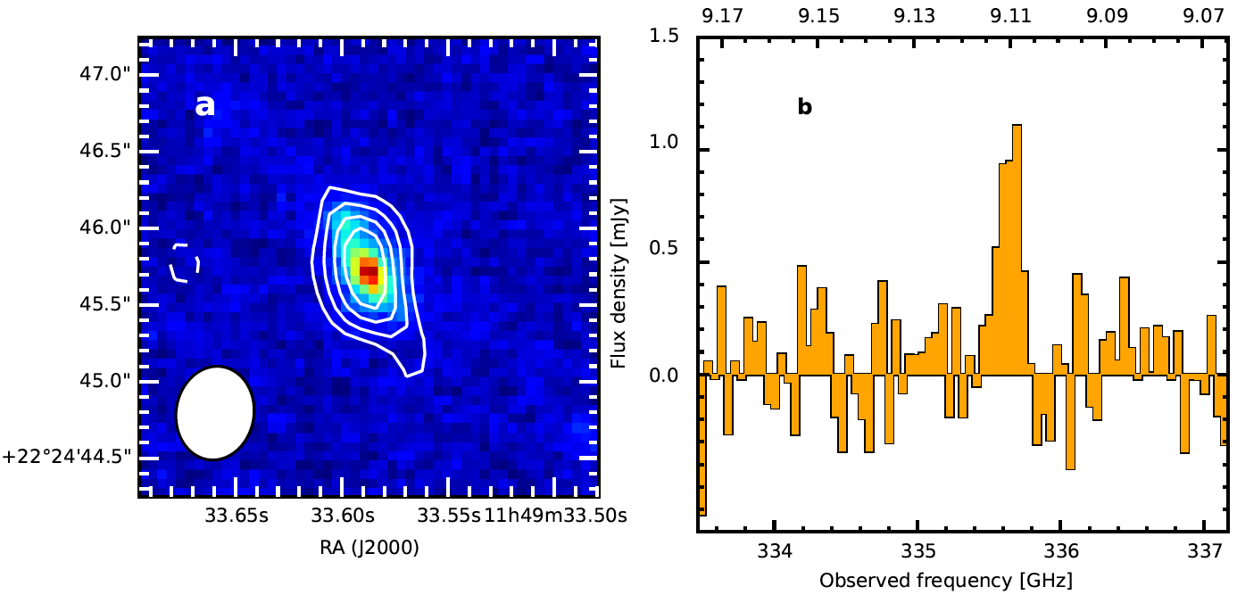
Context: Motivations for wider bandwidth
Trans-Neptunian Object “DeeDee” at 92 au (2nd most distant) detected in continuum at
7 sigma with 3 hours on source
Band 6, 1.4km configuration
Yields size=635km (Gerdes+ 2017)
A submm galaxy is flying past over the course of 2 nights!
Earliest star formation: 88 um OIII (z=9.1) detection of MACS1149-JD1 at 5 sigma with 2 hrs (4.5 hrs counting all tunings) in Band 7, in 500m config (Hashimoto+ 2018, Nature)

Slide 4
Impact on QA0: (processing time of highlighted items will increase)
Categories currently assessed
Are all critical calibration intents present?
Antennas/Weather: >50% antennas not flagged, including relative Tsys, delay, amplitude gain, and phase noise (<1 radian)
SNR on gain calibrator (>10 per antenna per scan after spws combined)
Time on science target (at least 20% of expected time per-EB)
Bandpass SNR (>30 across >=4 bins) and shape of solution (platforming)
Impact on QA0+
Presently a scaled down (imprecise) version of calibration, images only the channel averaged data
Unclear what future plans for QA0+ will entail
Any processing times that involve channelized data will increase

Slide 5
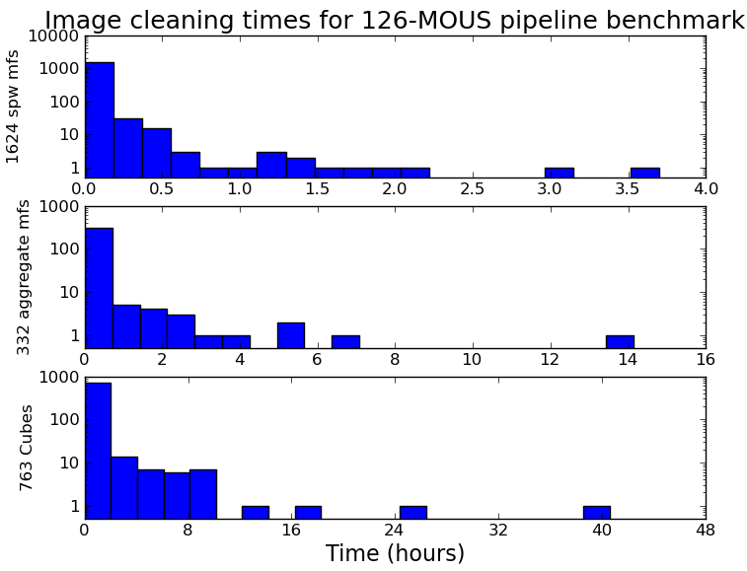
Impact on QA2 (Pipeline): Concerns with Higher Spectral Resolution
Increase in processing time due to potentially huge data rate increases.
See C. Brogan talk: spectral scan with 0.17 km/s spectral resolution, will have data rates of of 10-20x present
affects both calibration and imaging stages
further parallelization will be needed in CASA/pipeline (currently only available in imaging and some plotting)
~0.5 hour: per-spw continuum
~2 hours: aggregate continuum
~8 hours: cubes (some take days)
Cycle 7 pipeline

Slide 6
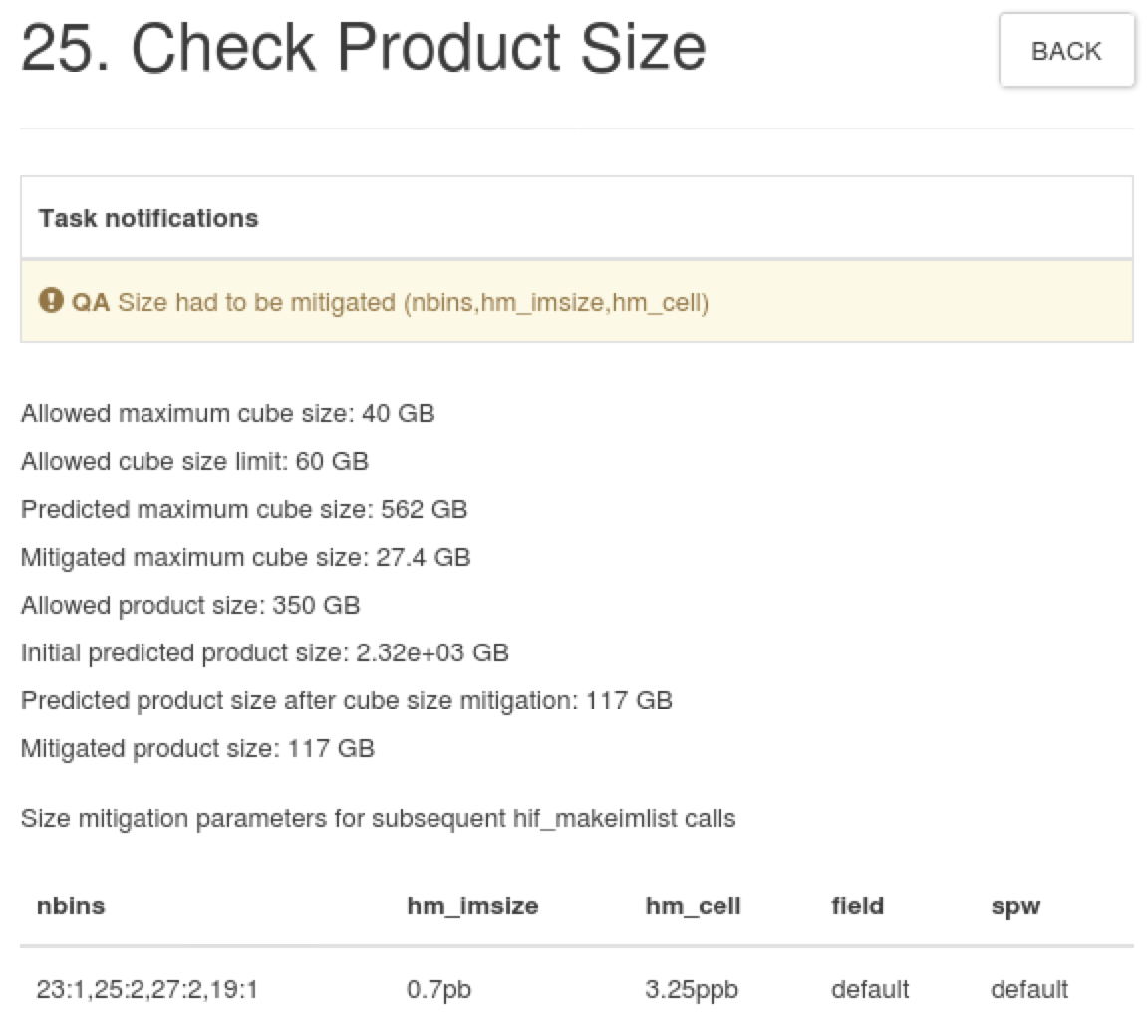
Impact on QA2 (Pipeline): Concerns with Higher Spectral Resolution
2. Cube sizes become much more challenging. We currently limit:
Cube sizes to 60 GB (any larger is difficult to dowload/view)
Total product size to 350 GB
Mitigation is a cascade of spectral binning, imsize, cellsize, # fields, # spws.
We will likely need to continue this policy with the new correlator, and possibly introduce more options (e.g. sub-cubes)
~8 hrs: cubes

Slide 7
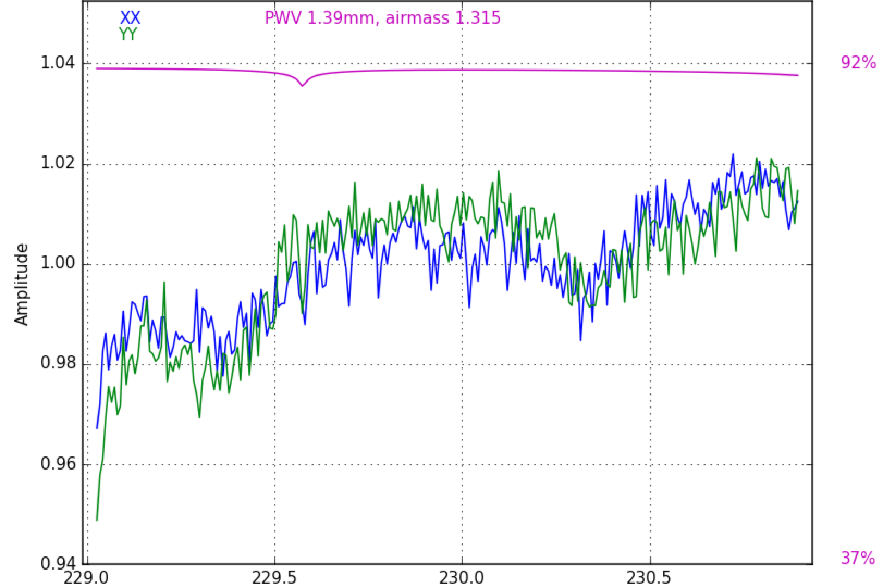
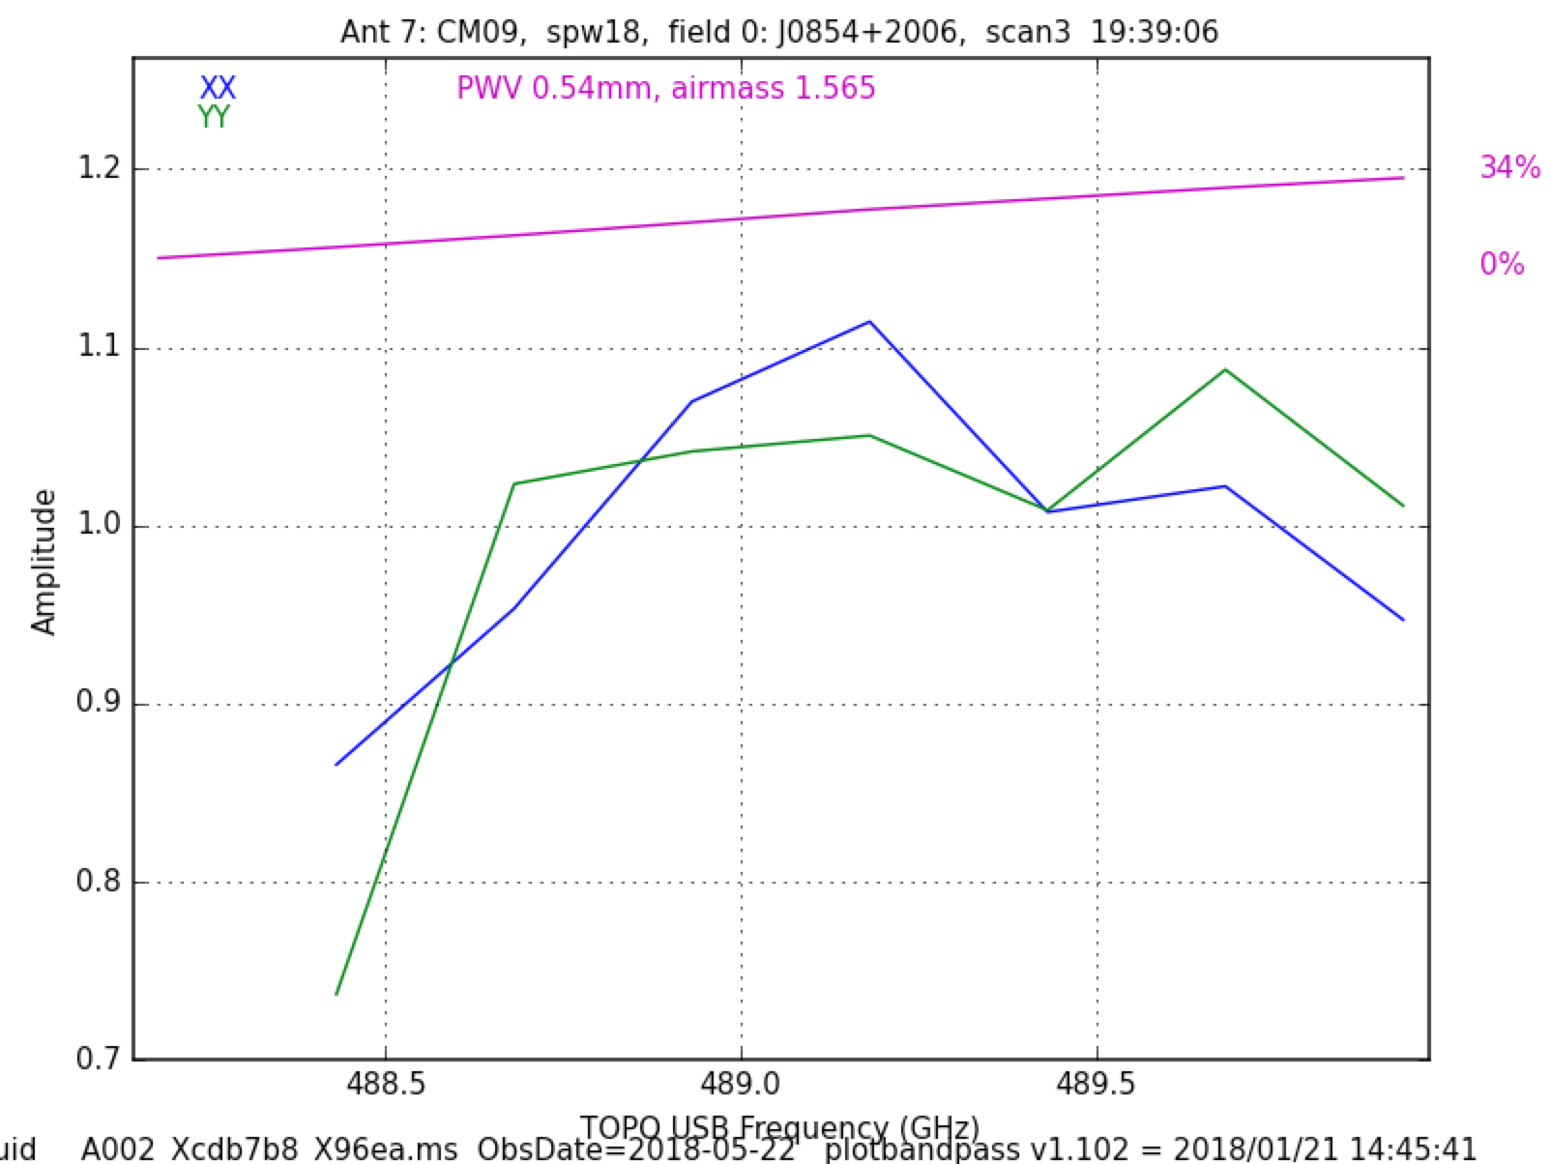
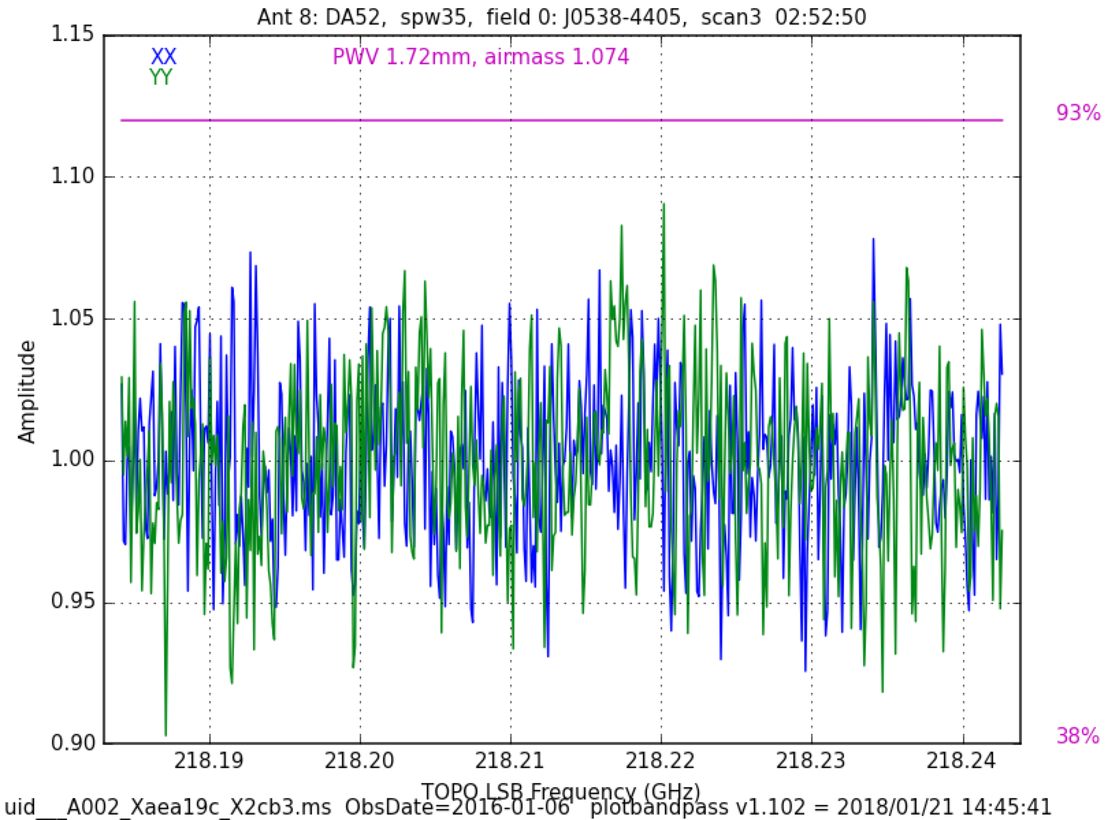
Impact on QA2: Summary of Concerns with Higher Spectral Resolution
Increase in processing time
further parallelization needed
Cube sizes become more challenging. We currently limit:
Cube sizes to 60 GB (any larger is difficult to view)
Total product size to 350 GB
Mitigation is a cascade of spectral binning, imsize, cellsize, # fields, and # spws.
Getting sufficient SNR on bandpass scan may be difficult
Current minimum requirement of 8 channels already troublesome in some cases, even for wide spws
Bandpass ripple in new hardware may be stronger or have finer frequency structure
High SNR 2 GHz wide spw (Band 6)
Low SNR 2 GHz wide spw (Band 8)
few % ripple of width ~500 MHz
~10 % variation: Shows that even wide spws are sometimes challenging
Typical 62 MHz wide spw (Band 6)
few % ripple of width ~20 MHz

Slide 8
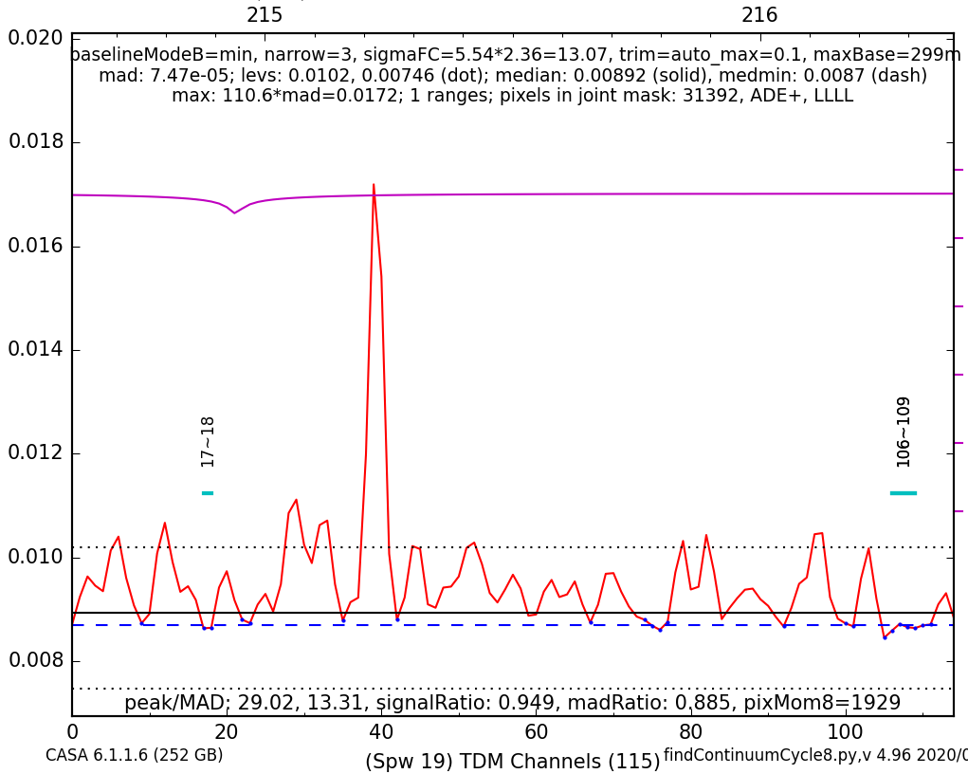
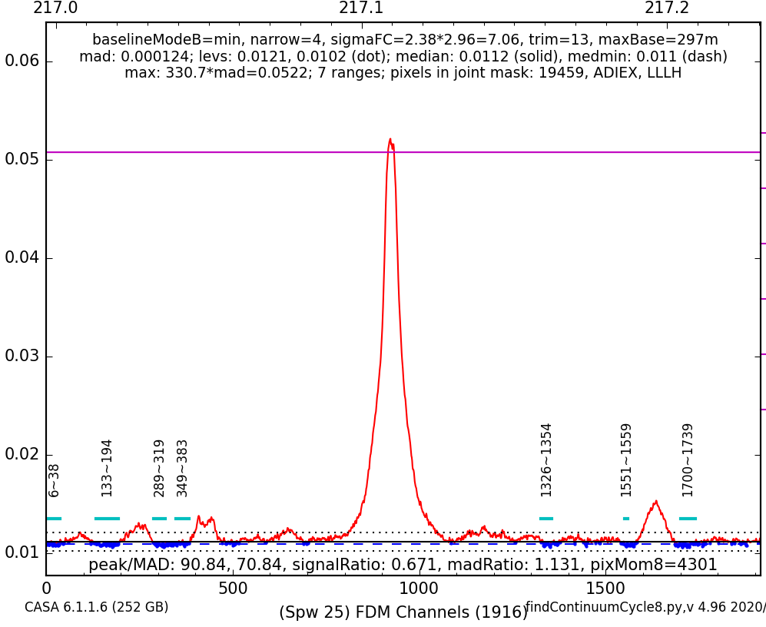
Impact on QA2 (Pipeline): One Benefit of Higher Spectral Resolution
findContinuum results for coarsest spectral windows will improve
Current TDM resolution of 31 MHz (40 km/s in Band 6) dilutes & blends narrow lines
Proposed correlator specification of 7.6 MHz (would improve to 10 km/s in Band 6)
Example: Same modest hot core observed in TDM vs. FDM: Number of continuum channels recovered: 5% vs. 12%
TDM at 216 GHz
FDM at 217 GHz
It is difficult to tell which features are real lines. So, sometimes they contaminate the chosen continuum ranges.
TDM resolution

Slide 9
Impact on QA2 (Pipeline): Concerns with Wider Bandwidth
1. Effect of spectral index becomes more important
Fractional bandwidth at Bands 1 & 3: (f_{max}-f_{min})/f_{mean} is currently 18% & 15%
Doubling IF bandwidth will make it 37% & 25%
Any errors in flux calibrator spectral index propagate to science target
Precision of spectral index from calibrator database needs improvement
If spws become wider, will need 2 or more Taylor terms for continuum subtraction & imaging
Spectral index vs. time of J1924-2914, according to ALMA calibrator database
Mitigation -- reduce extrapolation errors:
Monitor absolute flux calibrators more often to better constrain temporal variations of spectral index
Monitor at wider range of frequencies to better constrain spectral index as a function of potentially changing emission mechanisms

Slide 10
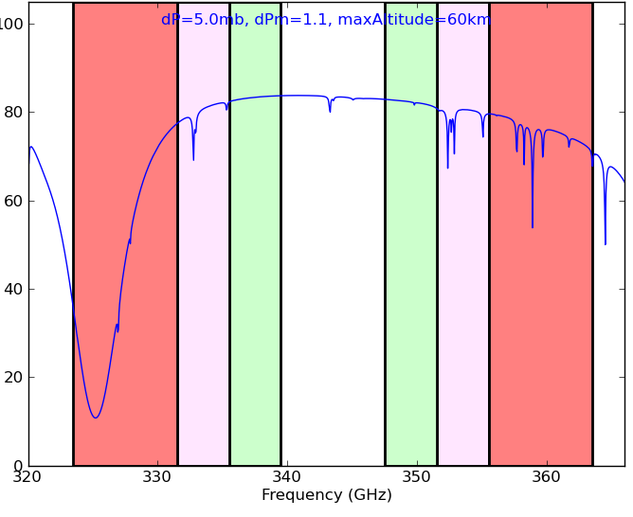
Impact on QA2 (Pipeline): Concerns with Wider Bandwidth
2. Greater variation in atmospheric transmission across each tuning, hence variable Tsys and sensitivity both within and between spws:
Use of per-channel weights will be more important to achieve optimal sensitivity for new bandwidths
Not yet commissioned, it will increase size of measurement set by 50%, and it will increase the processing time (first MOUS tested took 30% longer: CAS-8868)
Band 7 Default Continuum Tuning
Transmission (%)
today
today
2x BW
2x BW
4x BW
4x BW
Frequency (GHz)

Slide 11
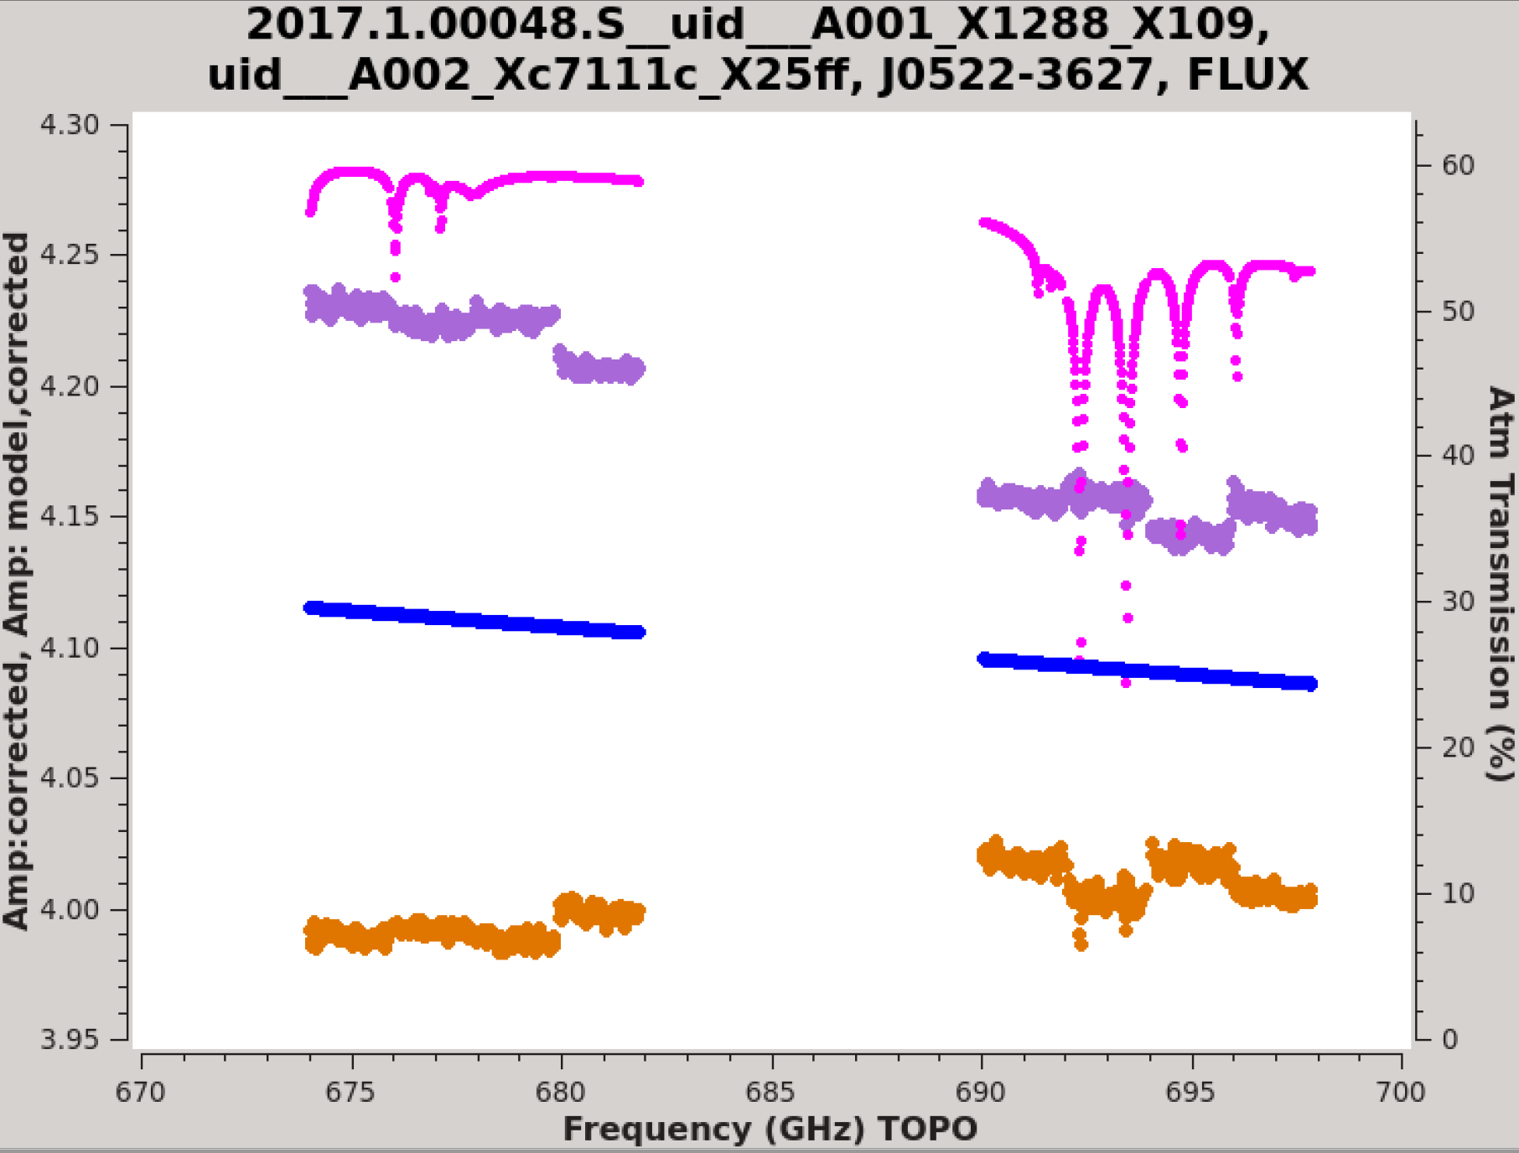
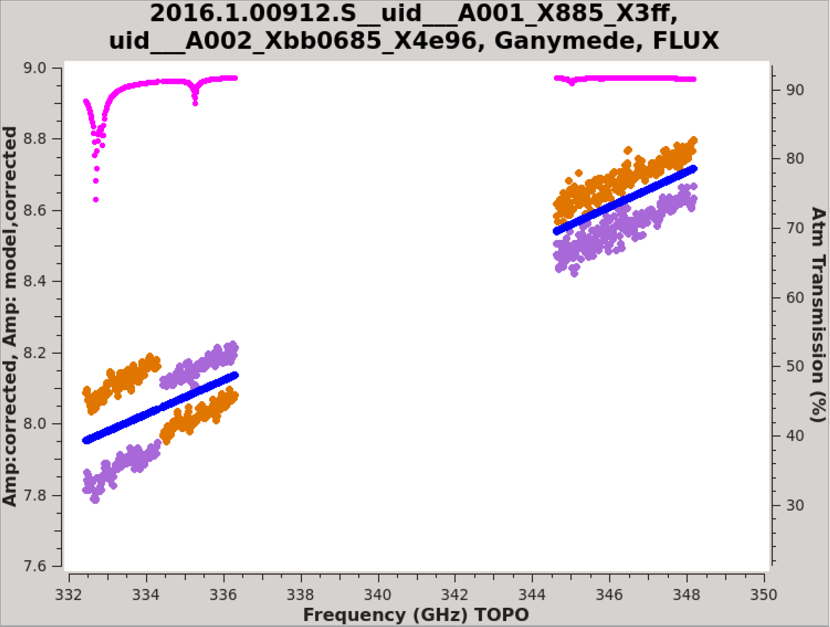
Impact on QA2 (Pipeline): Concerns with Wider Bandwidth (Summary)
3. Need to solve remaining issues with spw-to-spw discontinuities in calibrated visibilities
Transmission curve
YY
Stokes I model
non-physical flip of polarizations?
XX

Slide 12
Impact on QA2 (Pipeline):
Potential Benefits with Wider Bandwidth
Might be able to fit for spectral index (in low bands)
Could be more accurate than uncertainty inherent in inter-band monitoring
Greater opportunity for self-calibration
Self-calibration is not yet in Pipeline, but under consideration for Cycle ~9, dependent on observatory priorities
Even a single solution per EB will remove the bulk of residual antenna position errors
Especially important at long baselines where surface brightness sensitivity is low and antenna positions are uncertain and problematic (CSV-3579)

Slide 13
Impact on JAO ADC / Archive: Summary of: “Impact on JAO-ADC Infrastructure of the Correlator Upgrade Project (CUP)”
PRELIMINARY ASSESSMENT, ALMA-70.05.00.00-0077-A-REP, March 2018
Based on “Data Rate Impact of the ALMA Correlator Upgrade Project (Phase-1)” by Brogan & Hunter (Jan. 2017) → Factor of 5.6 times more channels and 2.8 times volume than Cycle 5 (which still stored dual-stream ASDMs with online WVR)
OSF Data Center:
Rack space is limited, but not thought to be a critical situation
Electrical power and cooling: not a problem; but need more power outlets (completed in 2019?)
SCO Data Center (similar issues to OSF)
Data Handling
CDP network cards and switches at AOS and OSF: 1Gb -> 10Gb (underway: ICT-13957, ICT-16513)
Improve firewall bandwidth capacity (AOS/OSF and SCO)
AOS to SCO fiber link “should be able to handle the additional data“
Data Processing:
Memory upgrade to gas06 to 256 GB (for TelCal)
Increase number of NGAS-FrontEnd servers
Increase storage size on gas03 (spool area), NGAS storage at SCO (1PB/year), JAOPOST cluster

