Slide 1
ALMA Offline Software Considerations for Improved Bandwidth and Resolution
Todd Hunter
(NRAO-CV / NAASC)
Photo credit: Pablo Carillo (ALMA)
5 minute summary version

Slide 2
Main Focus of this talk is QA2 (Pipeline)
Impact on Pipeline:
Higher Spectral Resolution
Increase in processing time (more channels to calibrate and image)
Bandpass SNR may become more of a concern
Cube sizes become more challenging
Benefit: findContinuum results for low-resolution spws will improve
Wider Bandwidth
Effects of spectral index and varying atmospheric transmission will increase
Need to use spectral weights and improve monitoring of flux/bandpass calibrators
Further increase in processing time and size of each measurement set
Benefit: Greater opportunity for continuum self-calibration
Impact on QA0:
Minor increase in processing time
Impact on JAO ADC (Archive)
Hardware upgrades are required to handle increase in data rate and volume

Slide 3
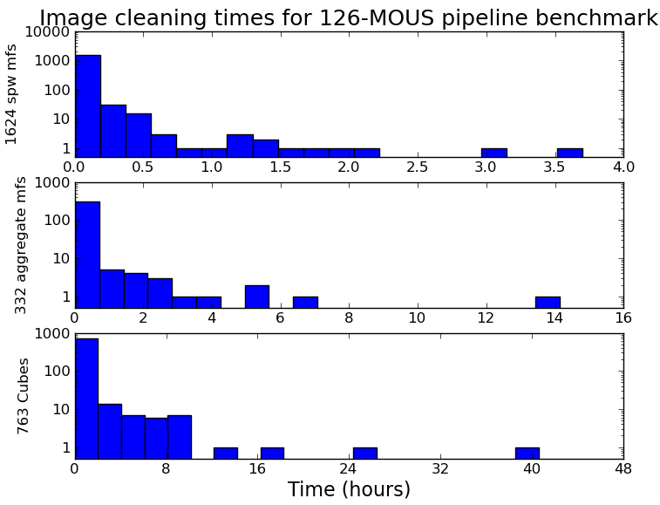
Impact on QA2 (Pipeline): Concerns with Higher Spectral Resolution
Increase in processing time due to data rate increase (up to 8-16x, see Brogan presentation) further parallelization needed
Cube sizes become more challenging. We currently limit:
Cube sizes to 60 GB (any larger is difficult to view)
Total product size to 350GB
Mitigation is a cascade of spectral binning, imsize, cellsize, # fields, # spws.
~0.5 hour: per-spw continuum
~2 hours: aggregate continuum
~8 hours: cubes (some take days)
We will likely need to continue this policy with the new correlator, and perhaps add more options (e.g. sub-cubes)
Cycle 7 pipeline

Slide 4
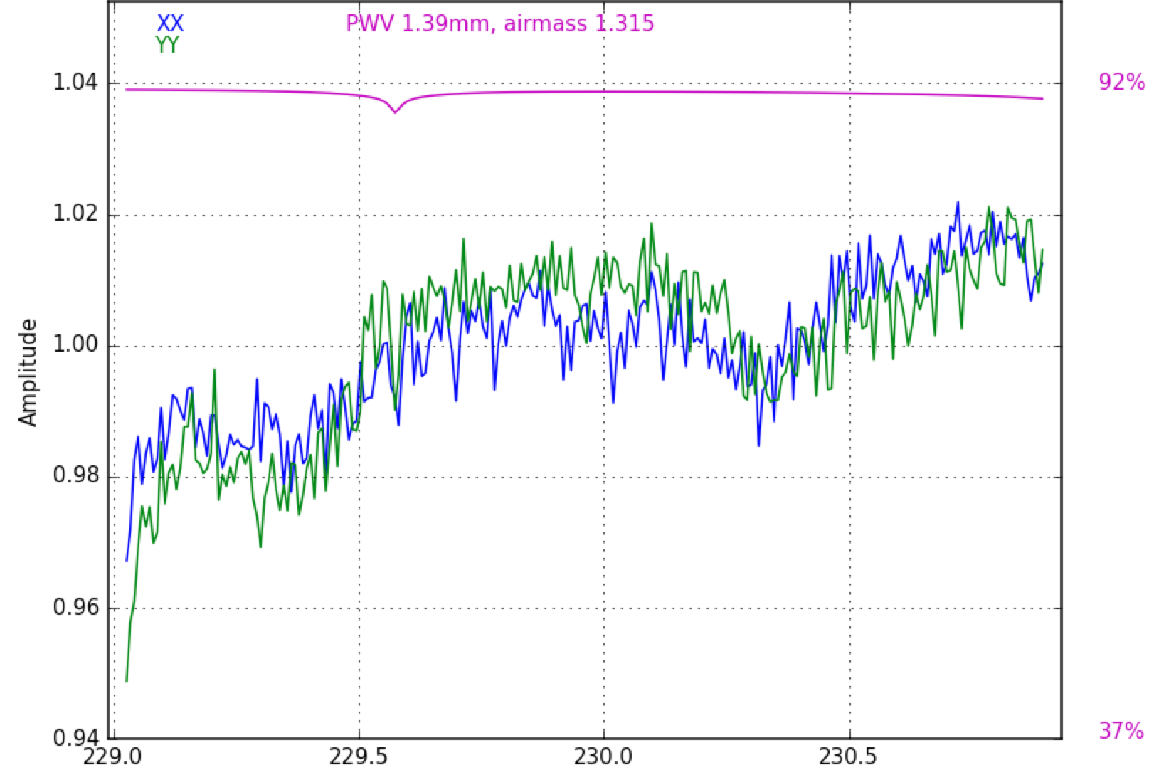
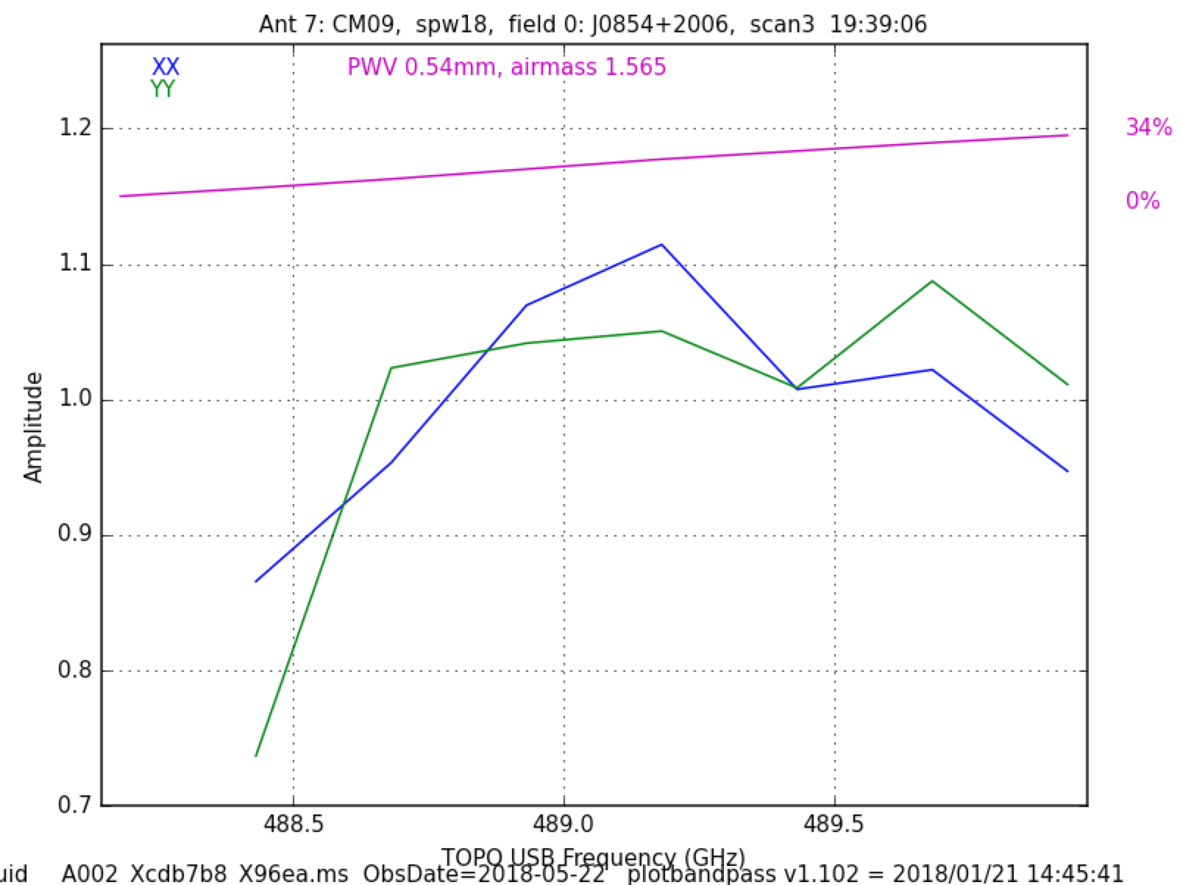
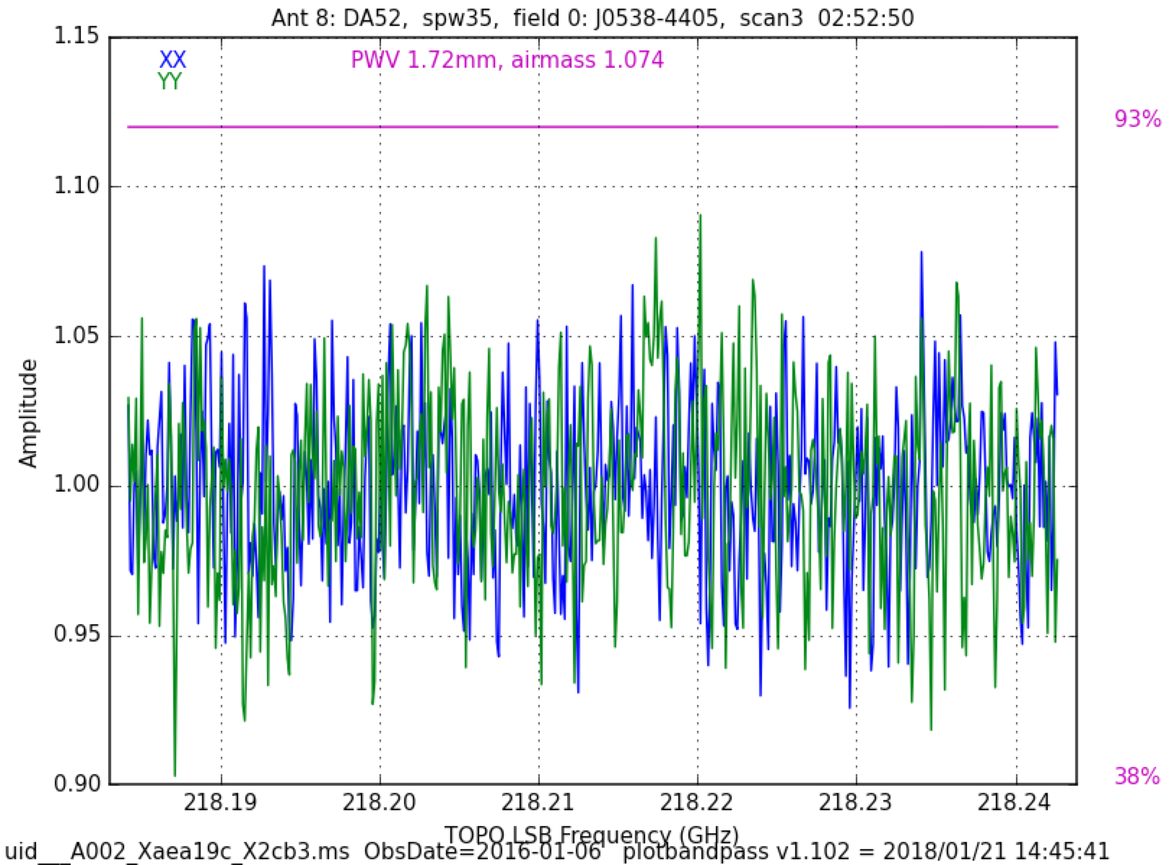
Impact on QA2 (Pipeline): Concerns with Higher Spectral Resolution
3. Getting sufficient SNR on bandpass scan may become more difficult
Pipeline currently requires minimum of 8 channels across all spws
Typical level of bandpass ripple in new hardware may be stronger or show finer frequency structure → more observing time
Some typical bandpass solutions in current ALMA data
High SNR 2 GHz spw (Band 6)
Low SNR 2 GHz spw (Band 8)
62 MHz spw (Band 6)
few % ripple of width~500 MHz
few % ripple of width ~20 MHz
~10 % variation: Shows that even wide spws are sometimes challenging today

Slide 5
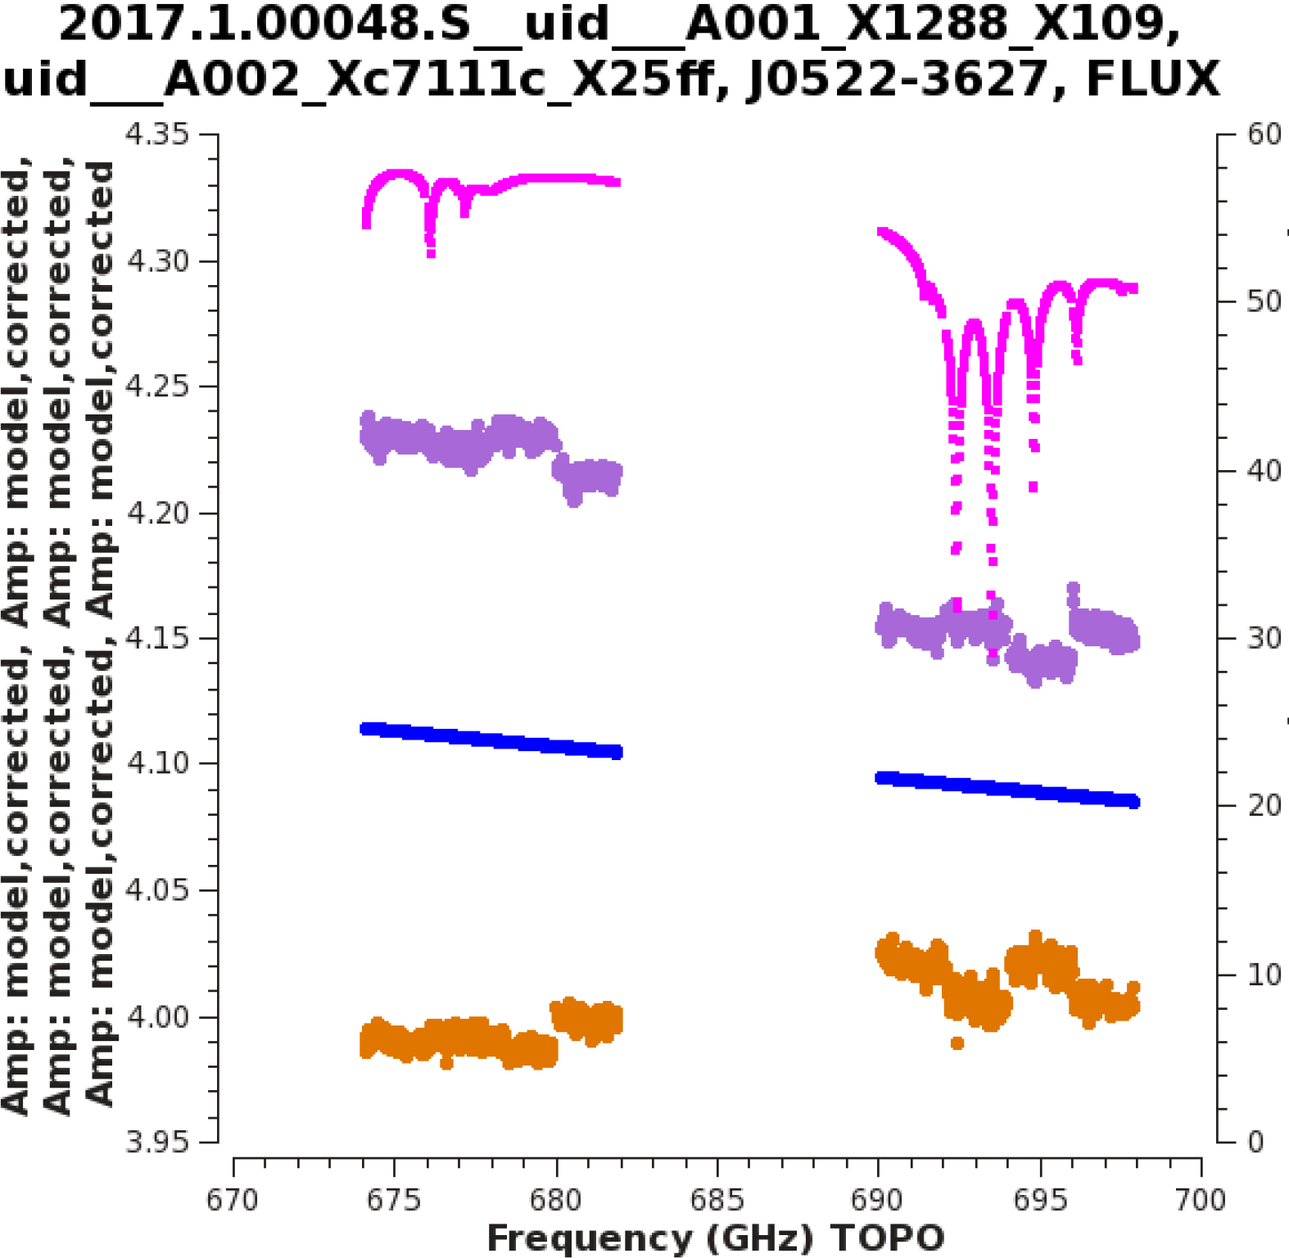
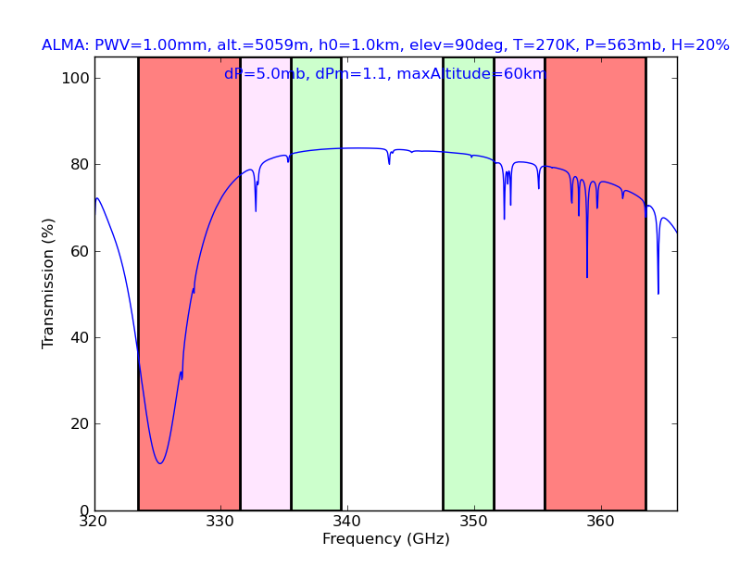
Impact on QA2 (Pipeline):
Concerns with Wider Bandwidth
1. Increase in processing time (calibration & imaging)
2. Effect of spectral index becomes more important!
Fractional bandwidth will increase (37%, 25% at Band 1, 3)
Errors in flux calibrator spectral index propagate to sci target
Monitoring needs to be more often and in more bands
Wider spws will need 2 Taylor terms for per-spw mfs imaging
Continuum subtraction stage may need higher fit order
3. Greater variation in atmospheric transmission across each tuning, hence more variable Tsys and sensitivity:
use of per-channel weights will be needed for optimal S/N
not yet commissioned for ALMA, will increase measurement set size by 50% and further increase processing time
Spectral index vs. time of J1924-2914
4. Need to solve the remaining issues with spw-to-spw offsets in calibrated visibilities (PIPE-613)
Transmission (%)
2x
2x
4x
today
today
4 x
Frequency (GHz)

Slide 6
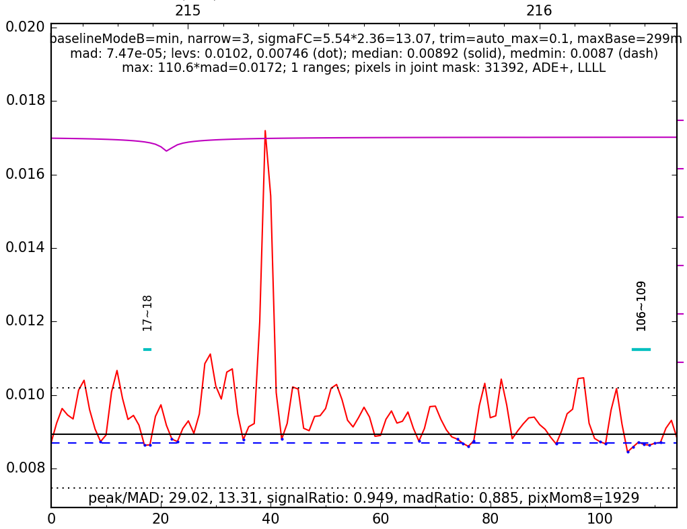
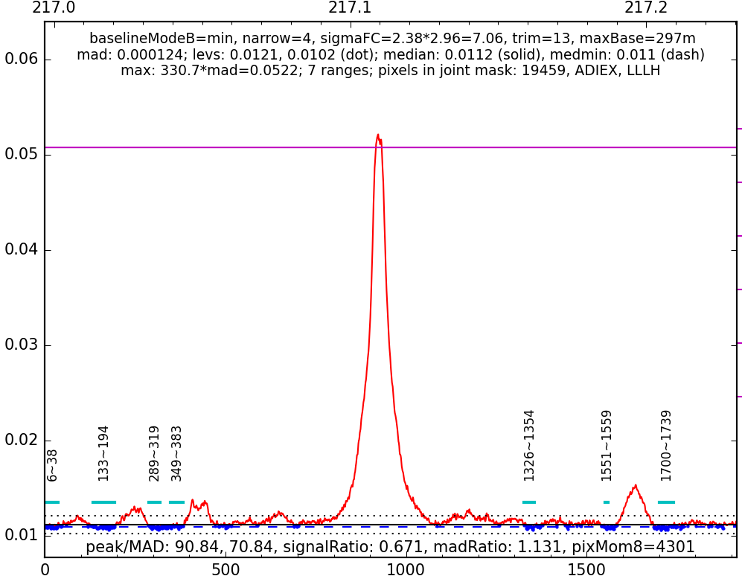
Impact on QA2 (Pipeline):
Potential Benefit of Higher Spectral Resolution
findContinuum results for the coarsest spectral windows will improve
Current TDM resolution of 31 MHz (40 km/s in Band 6) dilutes and blends narrow spectral lines
Proposed correlator specification of 7.6 MHz (stretch goal 3.8 MHz) would improve this to 5-10 km/s in Band 6
Potential Benefits with Wider Bandwidth
1. Could try to fit for calibrator spectral index in low bands
Might be more accurate than current inter-band monitoring
2. Greater opportunity for continuum self-calibration
Even a single solution per EB will remove the bulk of residual antenna position errors
Especially important at long baselines: low surface brightness sensitivity and uncertain antenna positions (CSV-3579)
TDM at 216 GHz
It is difficult to tell which features are real lines; sometimes they contaminate the chosen continuum ranges
FDM at 217 GHz
TDM resolution

Slide 7
Impact on QA0: Minor increase in processing time
Categories currently assessed
Are all critical calibration intents present?
Antennas/Weather: >50% antennas not flagged, including relative Tsys, delay, amplitude gain, and phase noise (<1 radian)
SNR on gain calibrator (>10 per antenna per scan after spws combined)
Time on science target (at least 20% of expected time per-EB)
Bandpass SNR (>30 across >=4 bins) and shape of solution (no platforming)
Impact on QA0+
Presently a scaled-down (imprecise) version of calibration, and it images only the channel averaged data of first science target
Unclear what future plans for QA0+ will entail
Any steps that involve channelized data will increase in processing time

Slide 8
Impact on JAO ADC / Archive: Summary of: “Impact on JAO-ADC Infrastructure of the Correlator Upgrade Project (CUP)”
PRELIMINARY ASSESSMENT, ALMA-70.05.00.00-0077-A-REP, March 2018
Based on “Data Rate Impact of the ALMA Correlator Upgrade Project (Phase-1)” by Brogan & Hunter (Jan. 2017) → Factor of 5.6 x more channels and 2.8 x volume than Cycle 5 (which still stored dual-stream ASDMs with online WVR).
OSF Data Center:
Rack space is limited, but not thought to be a critical situation
Electrical power and cooling: not a problem; but need more power outlets (completed in 2019?)
SCO Data Center (similar issues to OSF)
Data Handling
CDP network cards and switches at AOS and OSF: 1Gb -> 10Gb (underway: ICT-13957, ICT-16513)
Improve firewall bandwidth capacity (AOS/OSF and SCO)
AOS to SCO fiber link “should be able to handle the additional data“
Data Processing:
Memory upgrade to gas06 to 256 GB (for TelCal)
Increase number of NGAS-FrontEnd servers
Increase storage size on gas03 (spool area), NGAS storage at SCO (1PB/year), JAOPOST cluster

