Slide 1
Antennas and Receivers in Radio Astronomy
Todd Hunter (NRAO Charlottesville)

Slide 2
Outline: Following the Signal Path
Antennas:
Shapes, efficiencies, primary beam response, holography
Pointing, tracking, and servo systems
Polarization
Receivers:
Amplifiers & Mixers
Local oscillators
Phase lock loop
Modulation (Walsh functions and sideband separation)
Sensitivity
Receiver temperature
Derivation of radiometer equation

Slide 3
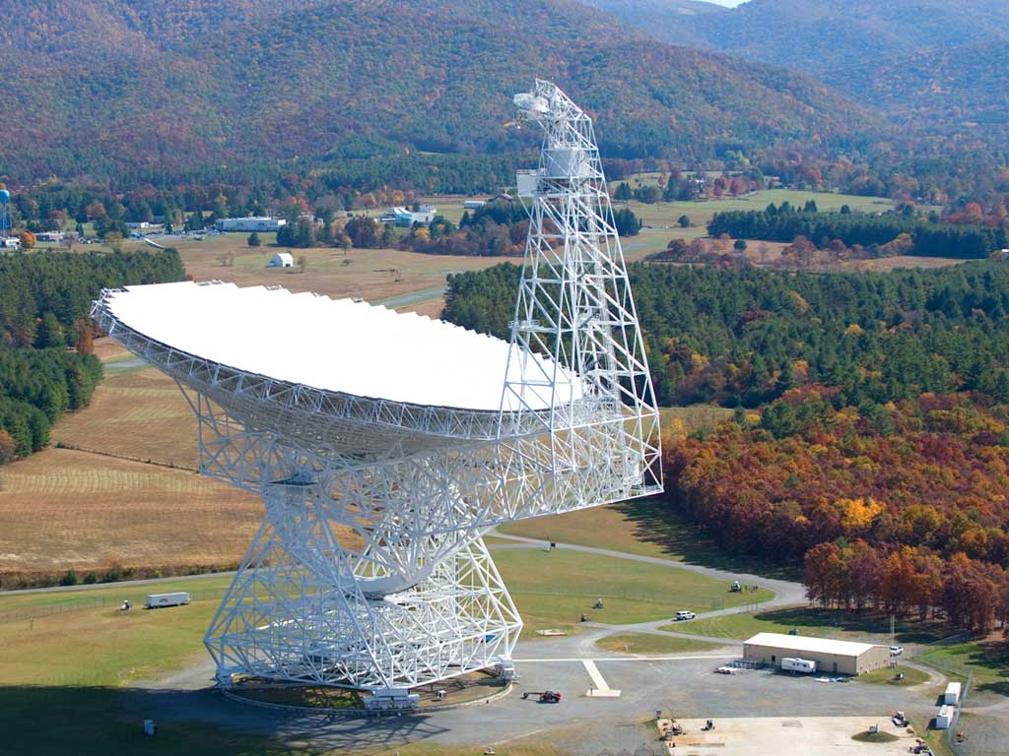
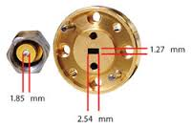
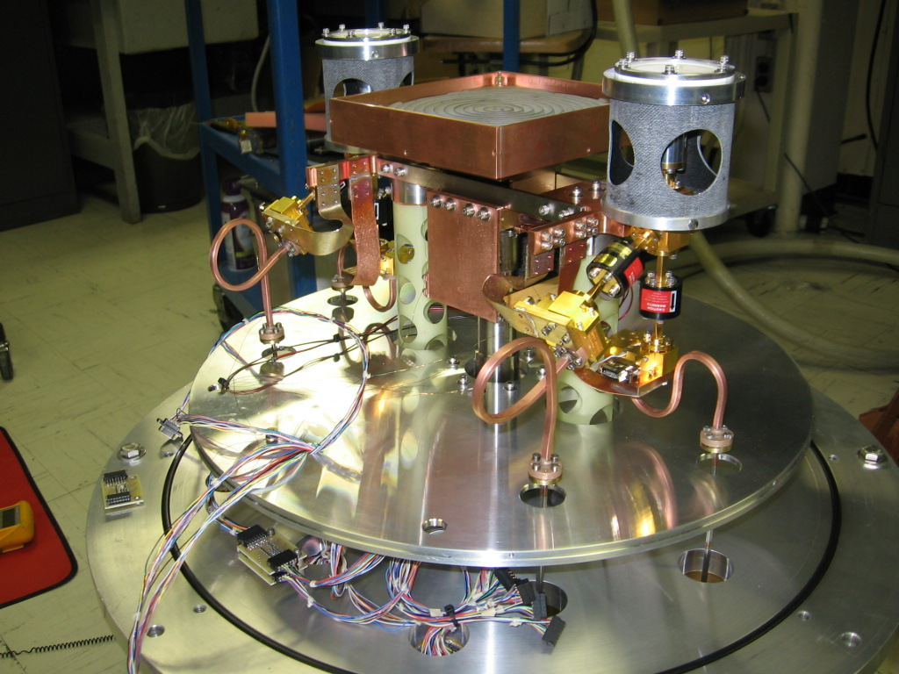
Role of an antenna
Track and capture radiation from an object over a broad collecting area and efficiently couple it into a receiver so that it can be detected, digitized, and analyzed.
Example:
100m GBT operating at 90GHz
WR-10 waveguide: 2.54 mm
Physical reduction: 40000x
An aside: What the heck is a dB (decibel)?
Expression of the relative strength of two signals
A change of 3dB = 2x (-3dB = 0.5x)
A change of 10dB = 10x (-10dB = 0.1x)
A change of 20dB = 100x (-20dB = 0.01x)

Slide 4
Importance of Antenna properties on your data
Antenna amplitude and phase patterns cause amplitude and phase to vary across the field of view.
Polarization properties of the antenna modify the apparent polarization of the source.
Antenna pointing errors cause time varying amplitude and phase errors.
Variation in noise pickup from the ground can cause time-variable amplitude errors.
Deformations of the antenna surface can cause amplitude and phase errors, especially at short wavelengths.

Slide 5
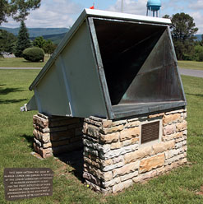
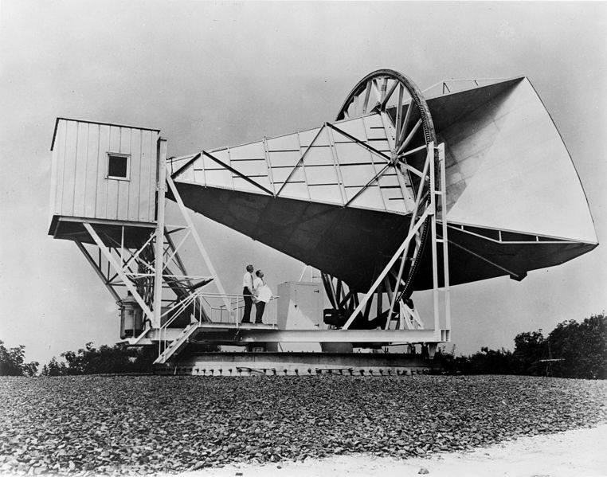
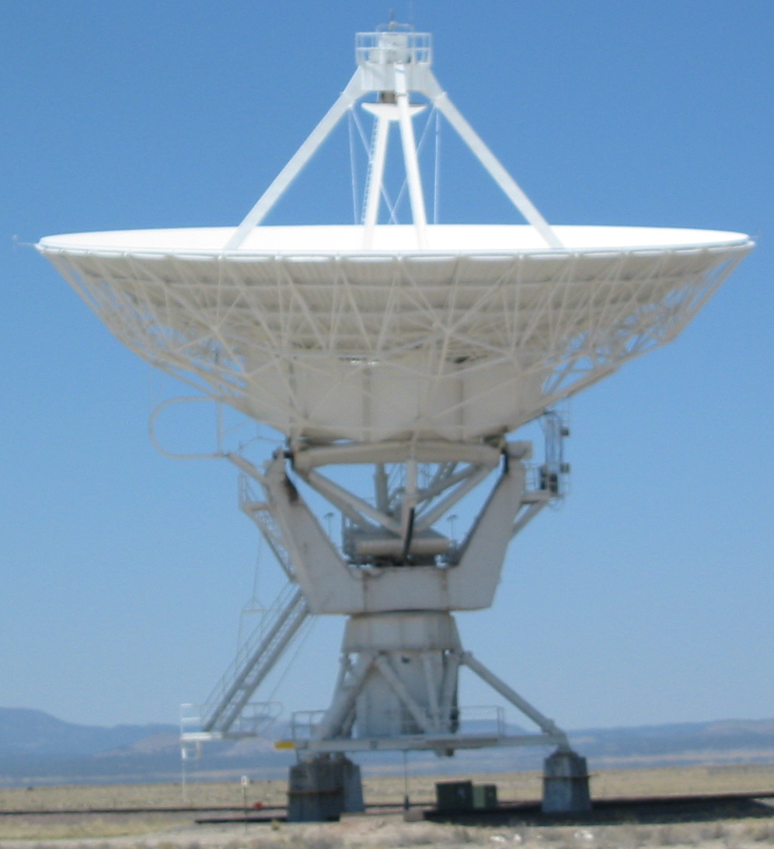
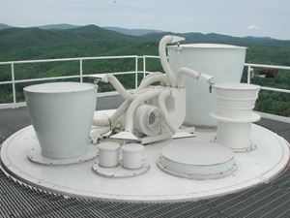
Antenna shapes
Crawford Hill horn
reflector: CMB (1965)
Horn antennas
Advantage: Broad bandwidth
Large apertures not practical,
(long, cannot be close-packed)
Reflector dish antennas
Advantage: large apertures, homology (von Hoerner 1967)
Disadvantage: Require many feeds,
each of limited bandwidth
Dipole (wire) antennas
Examples: LWA, LOFAR low-band
Advantage: wide field, beam-forming
Disadvantage: low gain, need 1000s
Purcell horn: HI (1951)
VLA
GBT feeds
LWA
antenna

Slide 6
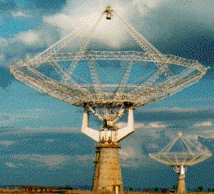
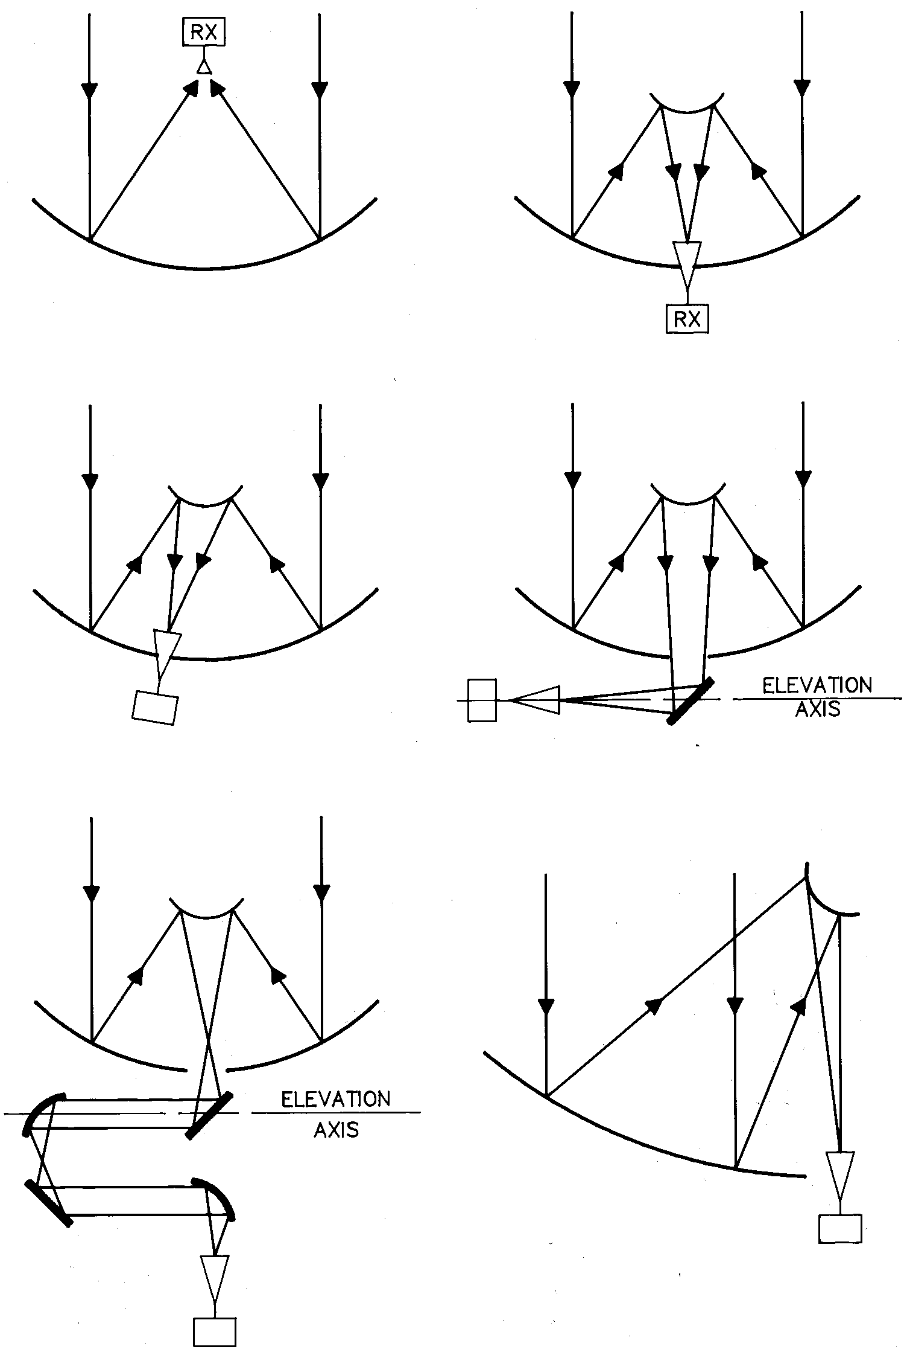
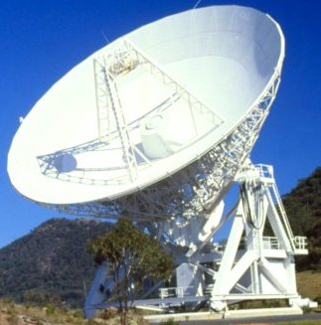
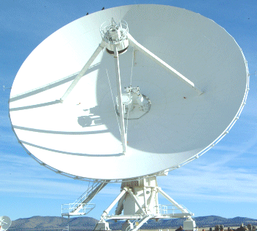
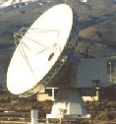
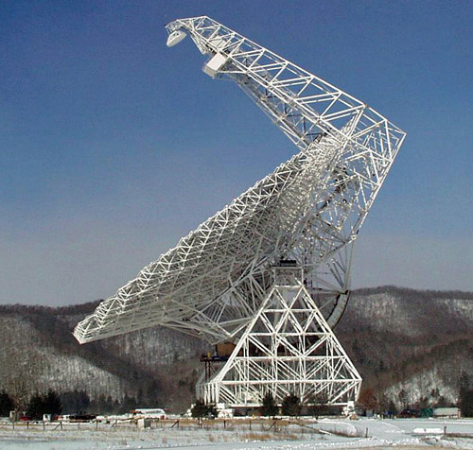
Reflector antennas
On-axis Cassegrain
(best for array receivers)
Prime Focus
GMRT
ATCA,
Mopra
Offset Cassegrain
Nasmyth
VLA,
ALMA
CARMA,
CSO
Bent Nasmyth
Dual offset Gregorian
SMA
GBT
Cleanest beam, minimizes standing waves, polarization asymmetry compensated -- Mizugutch et al. (1976)
Receivers do not tilt in elev.

Slide 7
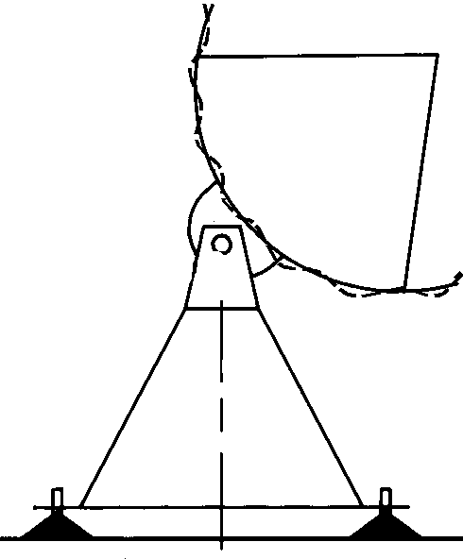
Reflector antenna efficiencies
Response pattern (primary beam): A(ν,θ,φ) = A(ν,θ,φ)/A₀
Effective area (on-axis): A₀=ηA=(aperture efficiency)(πR²)
where η = η_{surface}η_{blockage}η_{spillover}η_{taper}η_{radiation}η_{misc}
η_{surface} = exp(−(4πσ/λ)²) σ = rms surface error (Ruze 1966)
= 0.44 for σ = λ/14 (VLA at 43 GHz) σ_{VLA}∼500μm
= 0.79 for σ = λ/26 (VLA at 22 GHz) σ_{ALMA}∼25μm
η_{blockage} = blockage efficiency (feed legs and subreflector)
η_{spillover} = feed spillover efficiency
η_{taper} = feed taper efficiency
η_{radiation} = metal reflection efficiency (~0.99 per Al mirror)
η_{misc}= diffraction, phase, focus error, polarization efficiencies
σ
} η_{illumination}=0.8 for -10dB taper

Slide 8
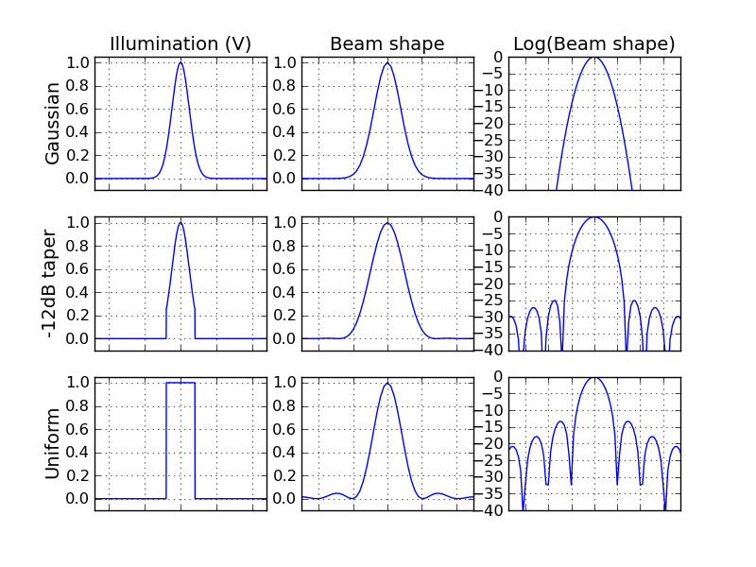
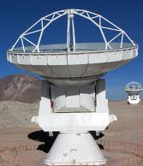
Comparison of primary beam response
Set by the illumination taper of the receiver feed,
i.e how much of the outer part of the dish are we using?
Fourier transform pairs
in radians,
λ and D in the same units

Slide 9
Uniform Antenna illumination: VLA
Shaped symmetric primary, shaped asymmetric secondary
Close to Airy disk (FWHM~1.028 λ/D) (radius of 1st null=1.22 λ/D)
Better illumination efficiency (90%) at expense of higher sidelobes (-16 dB)
CASA model: Airy truncated at 10%

Slide 10
Tapered Antenna illumination: ALMA
also SMA, CARMA, etc.
Paraboloidal primary
Hyperboloidal secondary
-10dB taper: good compromise between efficiency and sidelobes
Illumination efficiency ~ 80%
Low sidelobes (-23 dB)
Larger beam: θ_{FWHM} = 1.13 λ/D
Baars* (2007) and ALMA Memo 456 give numerical formulas relating FWHM to taper:
τ = 10^(taper/20)
θ_{FWHM}=(1.243 – 0.343τ + 0.12τ²) λ/D
*The Paraboloidal Reflector Antenna in Radio Astronomy and Communication

Slide 11
Holography is a vital tool
The technique of imaging the (complex) beam pattern of an antenna and Fourier transforming back to the antenna surface illumination (aperture plane) is known as “holography”. (Napier & Bates 1971, Bennett et al. 1976).
Interferometric holography is done with a beacon transmitter on a tower, or on a satellite, but can also be done on bright quasars, which is called “astroholography” or “celestial holography”.
Non-interferometric holography, also called “out-of-focus (OOF)” or “phase retrieval”, is useful for measuring large-scale surface error
Holography allows us to measure:
Antenna panel misalignment (e.g. ALMA: Baars et al. 2007, IEEE A&PM)
Systematic antenna panel mold error (GBT: Hunter et al. 2011, PASP)
Large-scale error due to thermal effects (GBT: Nikolic et al. 2007, A&A)
Illumination pattern alignment errors (see ALMA Memo 402)
Effect of feed legs on the beam

Slide 12
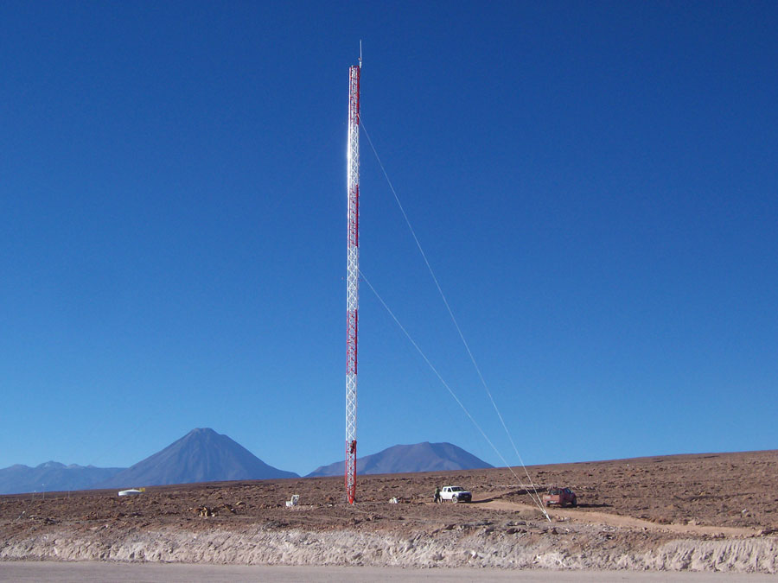
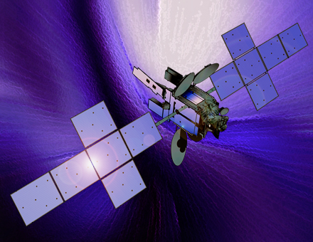
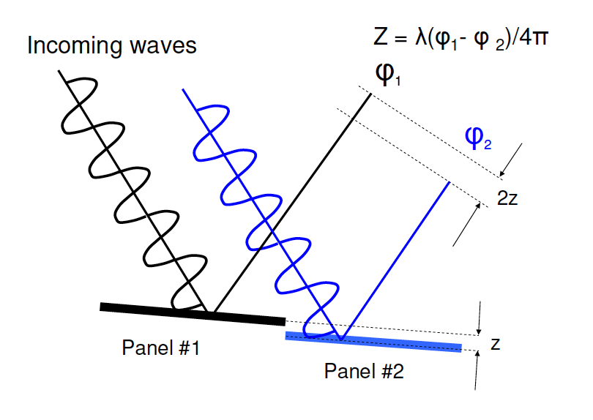
Holography principle
Record a 2D image of complex voltage pattern V(θ, θ’)
Antenna(s) under test
Reference antenna
θ
V(θ,θ’) = Σ exp[i(ψ_{x}(θ,θ’)-ψ_{y}(θ,θ’))]
x,y

Slide 13
What do holography data look like?
Beam map (angle units)
Example:
SMA at 232 GHz
Aperture map (distance units)
ELEVATION
Amplitude
Fourier transform
ELEVATION
Phase
AZIMUTH

Slide 14
Holography: ALMA surface panel adjustment
Phase map converted to path length error from ideal paraboloid
Before adjustment (43μm)
After adjustment (11μm)

Slide 15
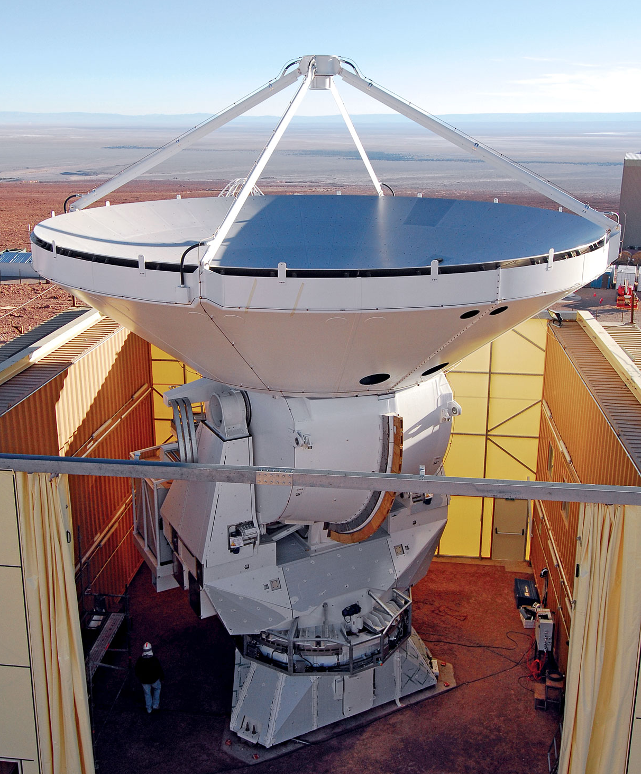
Holography: Effect of feed legs on beam
Feedlegs block and scatter radiation prior to reaching the primary
In some cases, they also block the path back up to the subreflector
Sidelobe pattern rotates w.r.t. celestial objects: parallactic angle coverage needed for proper polarization calibration
Focus errors cause beam asymmetry
AEC ALMA Antenna
in radians,
λ and D in the same units
Vertex NA ALMA Antenna

Slide 16
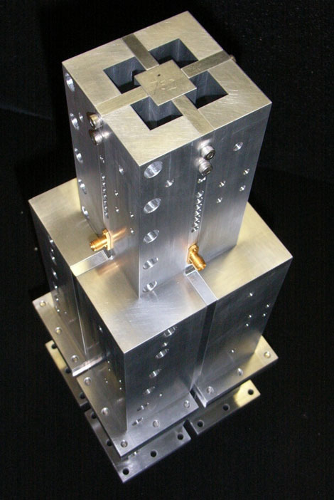
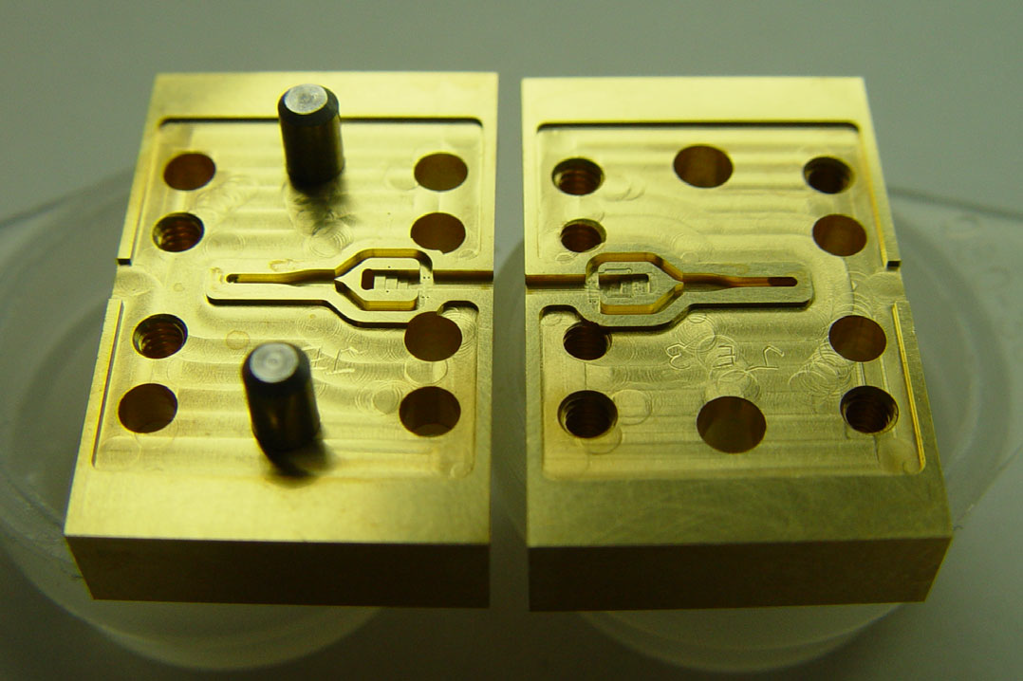
Front End polarization separation
For optimal sensitivity, we want dual-polarization receivers
Two types of devices can provide ~20dB purity with low loss:
1) Waveguide (i.e. after the feed): Ortho-Mode Transducers (OMTs)
Can be designed numerically (Maxwell’s eqs.)
Easy to machine when large (i.e. low frequency)
2) Quasioptical (i.e. in front of feed): Wire grid
Advantage: easier to construct for high freq.
Disadvantage: Alignment tricky (“squint” ~θ/10)
VLA S-band (2-4 GHz)
ALMA Band 3 OMT Band 6 OMT (opened)
Pol 0
in radians,
λ and D in the same units
Pol 1

Slide 17
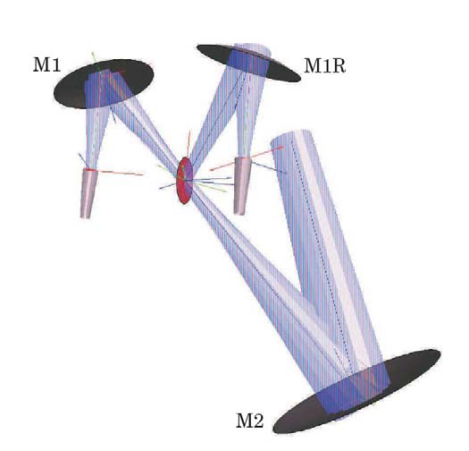
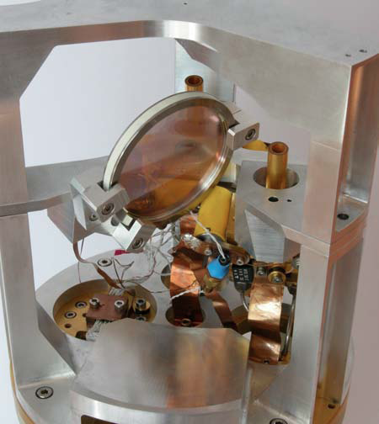
Polarization separation: ALMA Band 7 grid
High frequencies: wire grid
Reflects one linear polarization, passes the other
Wire diameters of ~ 10 microns, fairly easy to wind
Two feedhorns instead of one
in radians,
λ and D in the same units
IF
LO

Slide 18
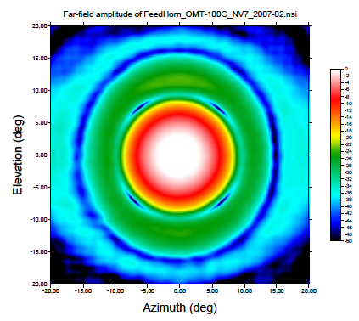
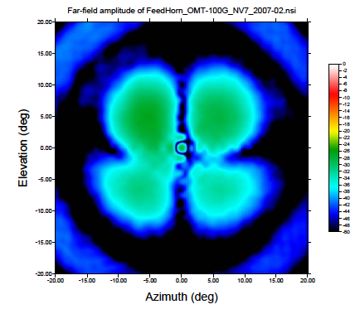
ALMA Cross-polarization patterns
Band 3 (100 GHz):
Co-polarization pattern
Off-axis cross-polarization pattern (“clover leaf”)

Slide 19
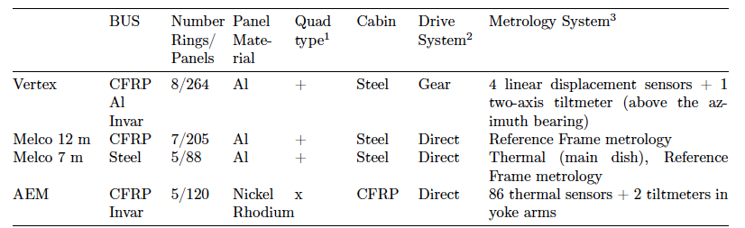
Antenna thermal effects and metrology
Thermal gradient in antenna structure affect the focus, pointing and surface accuracy of antennas ➔ point/focus more often during the day
Performance is generally best during second half of the night when temperature has stabilized and dish has “relaxed”
Some telescopes use “thermal terms” in their focus and/or pointing models using thermometers: e.g. IRAM 30m, GBT
Metrology devices: inclinometers to measure tilts (e.g. GBT, ALMA)
ALMA

Slide 20
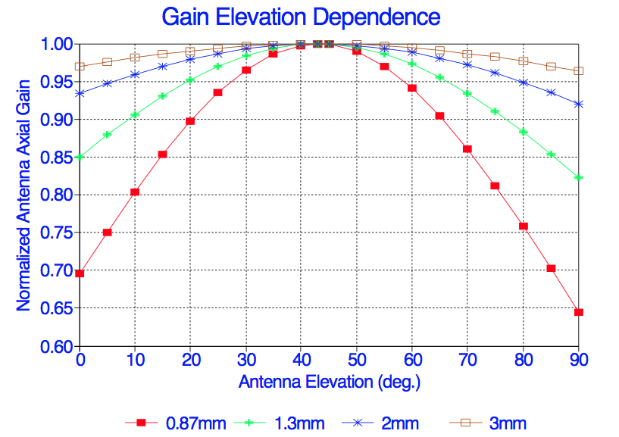
Antenna gain curve
Best efficiency is usually tuned to intermediate elevations
Gravity distortions increase away from this point
Similar curves for VLA are available in CASA
IRAM 30m (predicted, 1999)

Slide 21
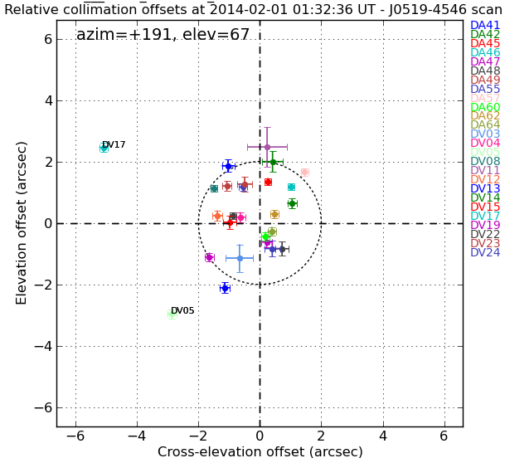
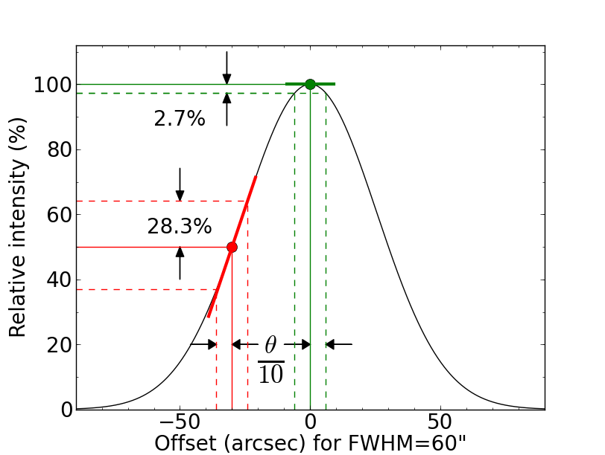
Antenna pointing and tracking
Static errors: Blind pointing vs. offset pointing
ALMA: blind=2”, offset=0.6” rms (θ_{FWHM}/10 at Band 10)
VLA: blind~15”, offset=3” rms (θ_{FWHM}/17 at 50 GHz)
Dynamic errors: wind etc.
VLA: tracking ~ 3” rms (no wind)
i.e. peak excursions +-6”
θ_{FWHM}/10 at 43 GHz
How good is θ_{FWHM} / 10 ?
not very good away from
the beam center!
in radians,
λ and D in the same units

Slide 22
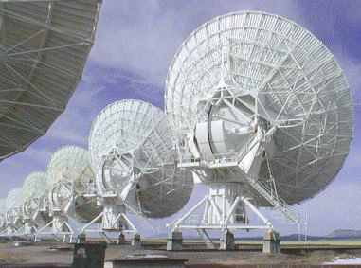
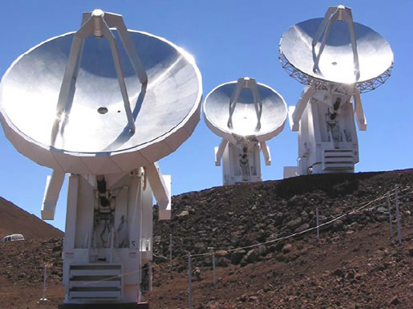
Antennas: How do they slew & track?
RA = 17:20:53.5
Dec = -35:47:00.0
LST = 15:43:12
Latitude = -23.0229
Longitude = -67.7549
Elevation = 5040m
Azimuth angle & velocity
Elevation angle & velocity
Servo system

Slide 23
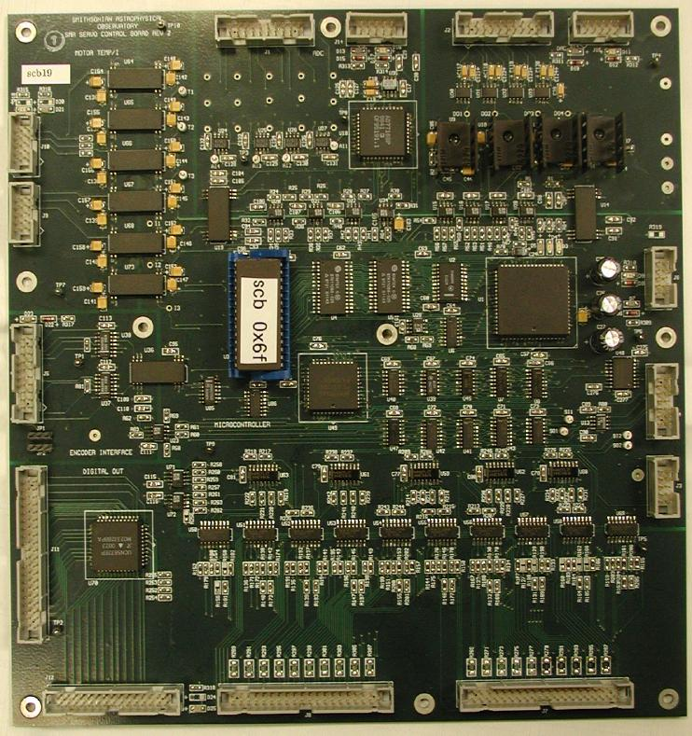
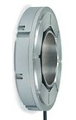
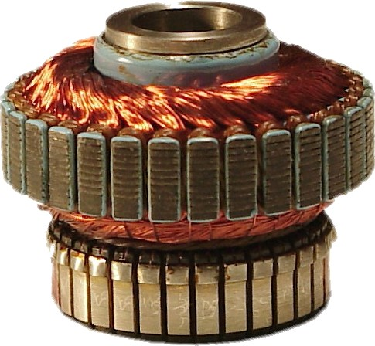
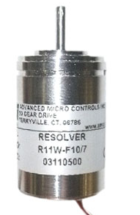
Antenna Az/El servo loop overview
Input parameters
Commanded position & tracking velocities (~5 Hz)
Pointing model: converts topocentric Az/El to actual Az/El
Multiple nested servo loops (software/firmware)
Position loop (~5 Hz): Encoder: converts angular position of antenna axis to integer
Velocity loop (~100 Hz) Tachometer: converts motor shaft angular velocity to voltage
Motor current (torque) loop (~ a few kHz) Resolver: converts motor shaft angle to voltage or integer
in radians,
λ and D in the same units
Position command
Motor Torque command
Velocity command

Slide 24
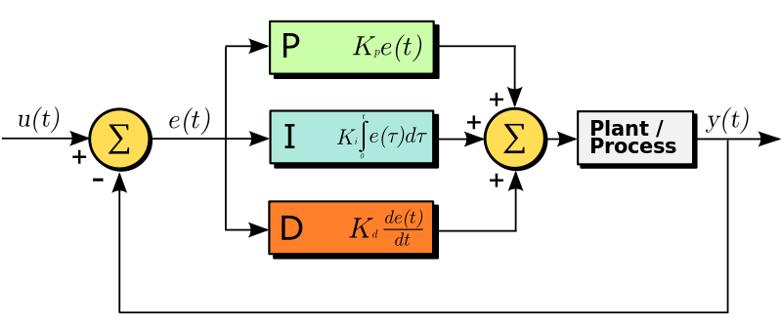
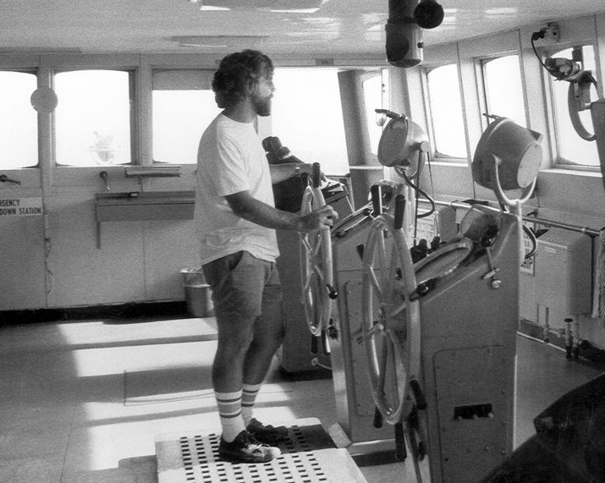
Detail of velocity servo loop: PID type proportional / integral / derivative
Commanded
velocity
Motor
Amplifier
Error
Velocity
Actual
velocity
The gains must be tuned for each loop: K_{pos}, K_{integ}, K_{deriv}

Slide 25
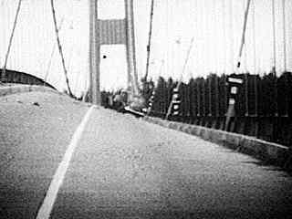
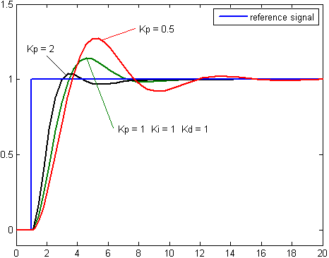
System response vs. gain
Trade-off between reducing overshoot and reducing oscillation frequency to below the antenna’s lowest resonant frequency
Servo systems use many hardware and software safety checks to avoid runaway conditions or damage.
VLA is currently revitalizing it servo system with modern components
Time (seconds)

Slide 26
Role of an receiver
Linearly amplify weak RF signals while adding minimal noise, and downconvert them to room-temperature output signals at a few GHz (called “IFs”) on coax cables suitable for digitization
Receivers are often called “Front Ends” or FE

Slide 27
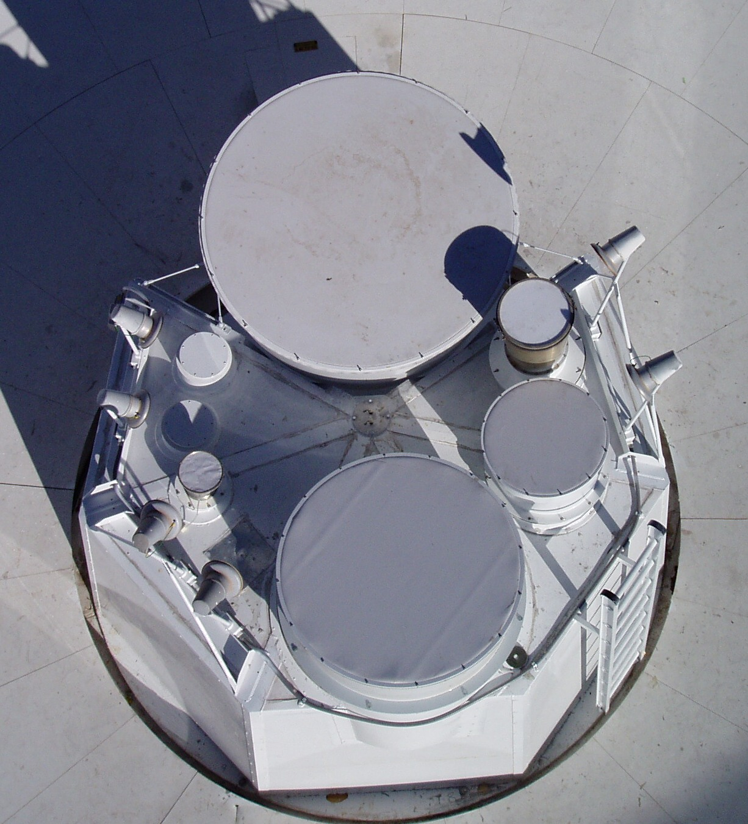
VLA receiver summary
Q
Letter designations have historical context and are second nature to microwave engineers.
Wavelength Band (letter code) | Nominal frequency range (GHz) | Polarization, operating temperature
4 m (4) | .058-.084 | Linear, 300K
90 cm (P) | 0.23-0.47 | Linear, 300K
20 cm (L) | 1.0-2.0 | Circular, 15K
13 cm (S) | 2.0-4.0 | Circular, 15K
6 cm (C) | 4.0-8.0 | Circular, 15K
3 cm (X) | 8.0-12.0 | Circular, 15K
2 cm (Ku) | 12.0-18.0 | Circular, 15K
1.3 cm (K) | 18.0-26.5 | Circular, 15K
1 cm (Ka) | 26.5-40.0 | Circular, 15K
0.7 cm (Q) | 40.0-50.0 | Circular, 15K
Ka
K
Offset Cassegrain Feed Circle
Ku
L
X
X
C
Ka
Q
C
S
K
Ku
S
L

Slide 28
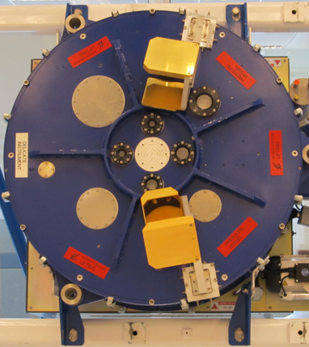
ALMA receiver summary (dual linear pol.)
Q
Letter designations have historical context and are second nature to microwave engineers.
Band (number code) | Frequency range (GHz) | Sidebands, Polarization splitter
7 mm (1) | 32-50* | SSB, OMT*
4 mm (2) | 67-90* | ?SB, OMT*
3 mm (3) | 84-116 | 2SB, OMT
2 mm (4) | 125-163 | 2SB, OMT
1.6 mm (5) | 163-211 | 2SB, OMT
1.3 mm (6) | 211-275 | 2SB, OMT
0.9 mm (7) | 275-373 | 2SB, Wire grid
0.7 mm (8) | 373-500 | 2SB, OMT
0.45 mm (9) | 600-720 | DSB, Wire grid
0.35mm (10) | 787-950 | DSB, Wire grid
Ka
K
4
Ku
6
Band 1
X
9
C
10
7
8
2
5
S
3
L
* under development

Slide 29
Overview of Receivers and IF systems
Three basic technological limitations dictate what we do:
We can build good amplifiers up to ~100 GHz
We can digitize signals of bandwidth up to ~2 GHz
➔ to observe at >100 GHz, the front-end must be a mixer
➔ to observe a bandwidth >2 GHz, you need a mixer in the IF chain
Mixers and amplifiers must be cold when used as the front-end
Cold amplifiers need ~15K (2-stage cryo)
SIS mixers need 4K (3-stage cryo)
So:
ALMA FE needs cold mixers & amplifiers
JVLA FE needs cold amplifiers
Both also require room temperature mixers
& amplifiers (prior to digitization)
Mixers are key devices!
Mixer
Amplifier
Mixer
Coldest Warmest

Slide 30
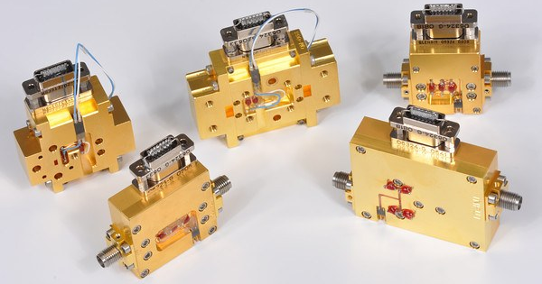
Amplifiers and mixers
Let’s compare an amplifier and a mixer:
Amplifiers are 2-port devices: one input and one output
IN
OUT (10-30dB stronger, same frequency)
Example: NRAO Cryogenic Low Noise Amplifiers (LNAs) using Heterostructure Field Effect Transistors (HFETs) used on the VLA, VLBA, GBT:
Operate at ~15 K
Tnoise ~ 5 hf/k
(i.e. 5 x quantum limit)
M. Pospieszalski (2012)
(MIKON conference)
in radians,
λ and D in the same units

Slide 31
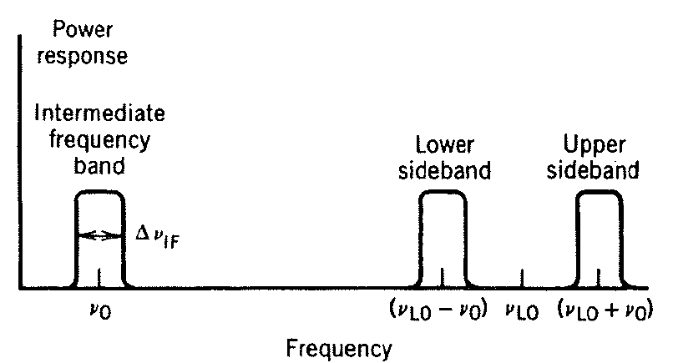
What is a mixer?
Mixers are 3-port devices: LO and RF inputs, and IF output.
Invented around WWI for radio direction finding (see IEEE Microwave Magazine Sept. 2013 special issue).
They multiply the LO & RF signals and transfer the phase from the RF to the IF by “heterodyning”. Typically the IF contains signals from two sidebands.
They are key components for interferometers!!
in radians,
λ and D in the same units
LO
Φ_{IF} = Φ_{RF}
RF input
= “Radio”
Frequency
IF output =
Intermediate Freq.
LO = Local Oscillator
υ_{IF}
υ_{USB}
υ_{LSB}

Slide 32
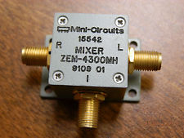
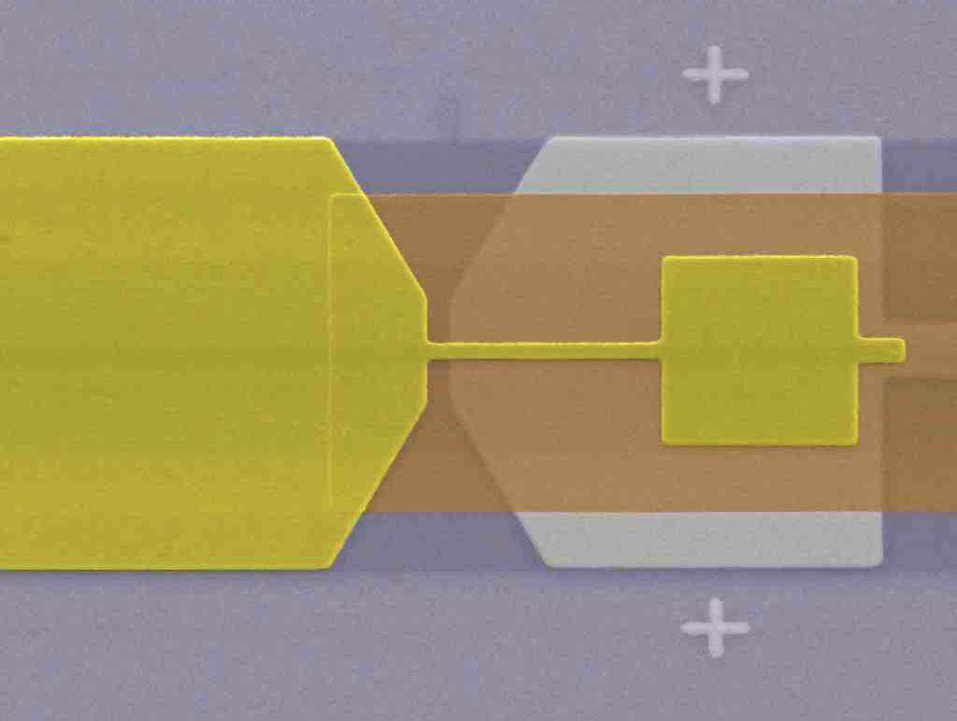
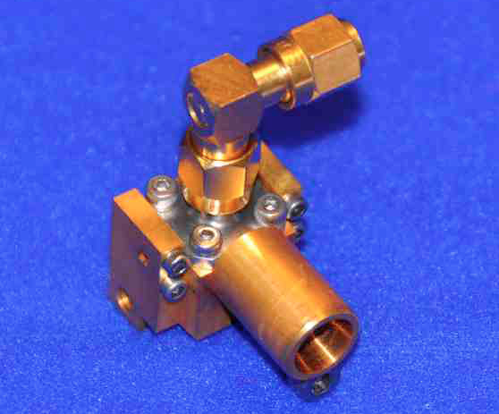
Different Kinds of Mixers
Inexpensive Off-the-Shelf room temperature mixers:
Used in IF circuitry after the received signal has been sufficiently amplified
Delicate, cryogenic SIS junctions mixers used as FE
SIS = Superconductor – Insulator – Superconductor
First astronomical use: Dolan, Phillips & Woody (1979)
Theory: Tucker (1979)
in radians,
λ and D in the same units
Image of SIS junction from
Electron Microscope (Hedden et al. 2010)
SMA 650 GHz mixer block (Nb/AlOx) with feedhorn (for LO and RF input)
S I S
80 micron
Area ~ 1 square micron

Slide 33
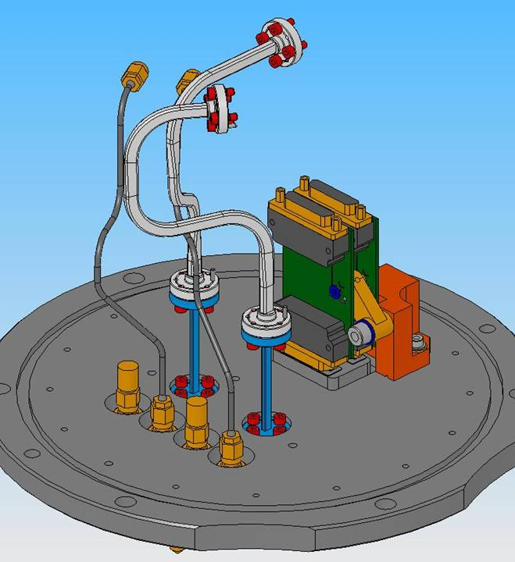
Sidebands
Receiver design options: SSB, 2SB, 1SB, DSB
SSB: the RF signal is filtered so that only one SB emerges from the mixer
Examples: VLA receivers
2SB: the mixer separates the two SBs with a 90° hybrid quadrature coupler. Rejects signal and atmospheric noise of the image SB by 10-20 dB
Examples: ALMA Bands 3 – 8,
1SB: a 2SB system where one SB output is simply terminated (i.e. unused)
Examples: ALMA Band 2 NA prototype
DSB: both sidebands are superposed on one another
Examples: ALMA Bands 9-10, SMA
Requires 90 deg Walsh modulation on the LO
to separate them (but only for inteferometry)

Slide 34
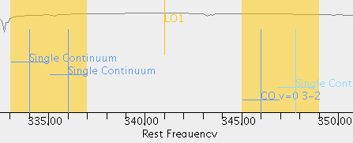
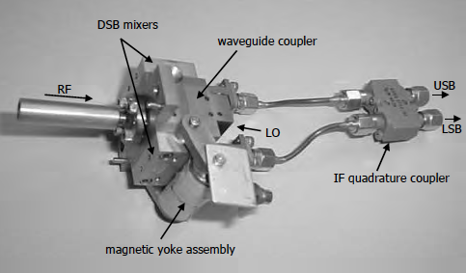
SSB: VLA receivers
Power
(dBm)
LO = 46 GHz
IF Out
8-18 GHz
Ka-Band Rx
26-40 GHz
28-38 GHz
Freq
(GHz)
0
4
8
12
16
20
24
28
32
36
40
44
48
52
56
60
LO = 341 GHz
2SB: ALMA Bands 3-8
LSB
2 pols
USB
2 pols
Band 7: Meier et al 2005

Slide 35
Local oscillators
Unlocked
Goal: Deliver stable, accurate phase reference to a remote mixer
Problem: Signals lose S/N upon transmission, and must be “cleaned up”
Intensity (dBm)
Phase lock loop (PLL) circuit is analogous to an antenna drive servo
Compares phase of two signals, correcting at BW ~ 1 MHz
Locked
Intensity (dBm)
Loop BW
ALMA YIG oscillator
Frequency

Slide 36
LO Modulation: Walsh switching
See Thompson, Moran &
Swenson (chapter 7);
ALMA Memo 586
Impose on LO
Remove in correlator
180 degree Walsh switching
Suppresses spurious signals (birdies) that arise between the frontend and the digitizer
90 degree Walsh switching
Allows you to separate sidebands in cross-correlation
Will double the bandwidth for DSB receivers (Bands 9-10)
LO Offsetting (see ALMA Memo 287)
Suppresses the opposite sideband (by moving its fringe to several kHz and letting it “wash” out)
Suppresses spurious signals, but does not reduce broadband noise
Phase
Time

Slide 37
Sensitivity: T_{rx} and the Temperature Scale
Good receiver systems have a linear response:
V_{out}
Unknown slope
Calibrated ‘load’
Receiver temperature
V_{rx} + V_{hot}
Power detector P ∝ V
Power(ν) ⇨
⇨ Voltage
V_{rx} +V_{cold}
To measure T_{rx}, you need measurements of two calibrated ‘loads’. In the lab, you use:
T_{cold} = 77 K liquid nitrogen load
T_{hot} = Room temperature load
−T_{rx}
T_{cold}
T_{hot}
T_{input}
Starting from
Define the
“Y” factor

Slide 38
ALMA Sensitivity: Band 6 (230 GHz)
T_{RX}: receiver sensitivity
Autocorrelation spectra from Tsys scan
Note 3dB IF power variation vs. freq
Shape is removed from cross-correlation
T_{SYS}: system sensitivity
O₃ line

Slide 39
T(Rx) vs. Frequency for JVLA Receiver Bands
Original EVLA Project Book - T_{Rx} Requirements (Band Center)
Band | L | S | C | X | Ku | K | Ka | Q
T_{Rx} | 14 | 15 | 16 | 20 | 25 | 34 | 40 | 48

Slide 40
Radiometer equation derivation & simulation
Consider a sample time series of an RF signal: x_{n} ~ N (mean=0, variance=σ²)
Normalize it by its standard deviation: Z_{n} = x_{n} / σ , x_{n} =σZ_{n}
Square this to get the power: Z_{n} ² =χ²(1) is the Chi square distribution with 1 d.o.f.
x_{n}² = σ² Z_{n} ² = Γ(1/2 , 2σ²) = the gamma distribution (c.f. constant * Chi square)
with expectation mean = μ_{gamma} = σ², and expectation variance =σ²_{gamma} = 2σ⁴

Slide 41
Radiometer equation derivation
5. The Nyquist sample rate is twice the bandwidth (2β) and the time interval of the data is τ, making the number of statistically independent samples N = 2βτ
The Standard Error of the Mean* states that the sample power as computed from (1/N) Σx_{n}² will have a distribution variance of σ²_{p} = 2σ⁴/N = 2σ⁴/ (2βτ) = σ⁴/ (βτ) and thus its standard deviation is σ_{p} = σ² / √(βτ)
Substitute μ_{gamma} (from Step 4) for σ² in the numerator: σ_{p} = μ_{gamma} / √(βτ)
NOTE: μ_{gamma} is the expectation mean of x_{n}² and is equivalent to the sample mean power P for large N. This gives: σ_{p} = P / √(βτ)
8. Radiometer output power in RJ limit is: P = k TβG (where G = gain)
Thus, σ_{p} /P = σ_{T} /T and σ_{T} = T / √(βτ) independent of Gain!
Recall the input power level was 4!
(*e.g. Casella & Berger 2002)

Slide 42
Conclusions and Further reading
Knowing a bit about the signal path can really help you understand your data, especially when there are problems or caveats (such as just how good is that primary beam correction?)
For more information on ALMA antennas, receivers, and correlators, see the ALMA Technical Handbook at http://almascience.org
Also, see my ADS Private Library on ALMA technology:
http://adsabs.harvard.edu/cgi-bin/nph-abs_connect?library&libname=ALMA+technology&libid=464295c89a
And my ADS Private Library on holography: libname=Holography&libid=464295c89a
For more info on EVLA receivers: http://www.aoc.nrao.edu/~pharden/fe/fe.htm

Slide 43
Extra Slides

Slide 44
Example: SMA antenna servo Three nested loops
Tachometer
Limit switches
Position and
Velocity request
Micro-
controller
board
Motor
DAC
ADC
3. Motor current loop ~ few kHz
2. Motor velocity loop ~ 100 Hz
1. Antenna position loop ~ 5 Hz

Slide 45
Safety is #1 priority
Hardware
Limit switches, 2 per direction per axis
Hardstops must decelerate antenna from Vmax without destroying antenna
Loss of power should cause brakes to engage (i.e. power holds them open)
Applying brakes at full speed should not destroy antenna
Manual E-stop switches prominent, with no Silicon in the circuit
Watchdog timer: if microcontroller fails to clear it every few ms, engage E-stop
Philosophy: if any wire breaks, system should stop as gracefully as possible
Software:
Software limit switches
Microcontroller must deactivate motors & apply brakes if:
encoder stops sending data, or antenna computer stops sending new values
tachometer reports overspeed, or differs from encoder derivative
Any large oscillation is detected

Slide 46
ALMA Receivers (dual linear polarization)
Lens, OMT
OMT
OMT
Wire grid
OMT
Wire grid
Band 3
84-116
Band 4
125-163
Band 6
211-275
Band 7
275-373
Band 8
385-500
Band 9
600-720 GHz

Slide 47
Rogues Gallery of (Naked) JVLA Receivers
L
S
C
1-2 GHz
2-4
4-8
World’s best LNA’s from CDL
X
Ku
K
26-40
A
Q
8-12
12-18
40-50
18-26
http://www.aoc.nrao.edu/~pharden/fe/fe.htm

Slide 48
Holography: effect of GBT panel mold error
Panel size ~2m, error beam ~50 θ_{FWHM}

Slide 49
Holography: measuring and correcting the daytime distortion of GBT

Slide 50
ALMA Block Diagram
4K SIS mixer
300K analog
mixer
Digital mixer

Slide 51
SIS mixer I/V curve
1. Resistor: Ohm’s law
2. Diode: Shockley’s law
“Non-linear” device
3. SIS tunneling junction:
I=0 below gap voltage
Photons can break Cooper pairs of electrons and create tunneling current
230 GHz = 0.8 meV
V_{gap}(Nb) ~2.9mV
Vbias ~ 2.5mV
f_{gap}(Nb)=(V_{gap})e/h=700 GHz
f>f_{gap} degrades T_{rx}
Requires T < 5 K
normal
in radians,
λ and D in the same units
V_{bias}
superconducting

Slide 52
Digitizers and Nyquist zones
Nyquist theory:
F_{sample} >= 2*Bandwidth
ALMA & VLA sample
in Nyquist Zone 2:
ALMA: 2-4 GHz (4.0 Gsample/sec) x 4 of them x 2 pols
JVLA: 1-2 GHz (2.048 Gsample/sec, 8-bit digitizers) x 2 of them x 2 pols
2-4 GHz (4.096 Gsample/sec, 3-bit digitizers) x 4 of them x 2 pols
in radians,
λ and D in the same units
Anti-aliasing bandpass filters are essential to prevent leakage from adjacent Nyquist zones.

Slide 53
Measurement of T_{sys} in the Sub(millimeter)
The “chopper wheel” method: putting an ambient temperature load (T_{load}) in front of the receiver and measuring the resulting power compared to power when observing sky T_{atm} (Penzias & Burrus 1973).
V_{in} = G T_{in} = G [T_{rx} + T_{load}]
V_{out} = G T_{out} = G [T_{rx} + T_{atm}(1-e^{−τ}) + T_{bg}e^{−τ} + T_{source}e^{−τ} ]
Load in
Load out
assume T_{atm} ≈ T_{load}
Comparing in and out
V_{in} – V_{out} T_{load}
V_{out} T_{sys}
=
T_{sys} = T_{load} * T_{out} / (T_{in} – T_{out})
Power is really observed but is ∝ T in the R-J limit
SMA calibration load swings in and out of beam
If T_{atm} ≈ T_{load}, and T_{sys} is measured often, changes in mean atmospheric absorption are corrected. ALMA has a two temperature load system which allows a measure of T_{rx}

Slide 54
ALMA

