Slide 1
The Extraordinary Outburst in NGC6334I-MM1:
Rise of Dust and Emergence of 6.7 GHz Masers
Todd Hunter (NRAO/NAASC)
Crystal Brogan (NRAO/NAASC)
Claire Chandler (NRAO)
James Chibueze (SKA South Africa, NorthWest Univ.)
Claudia Cyganowski (Univ. of St. Andrews)
Rachel Friesen (Univ. of Toronto)
Tomoya Hirota (NAOJ)
Remy Indebetouw (NRAO/ U. Virginia)
Gordon MacLeod (HartRAO, South Africa)
Cherise Thesner (NorthWest University)
Ken Young (Harvard-Smithsonian Ctr. for Astrophysics)
1 mm image of NGC6334I - 200 AU resolution

Slide 2
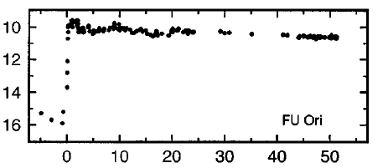
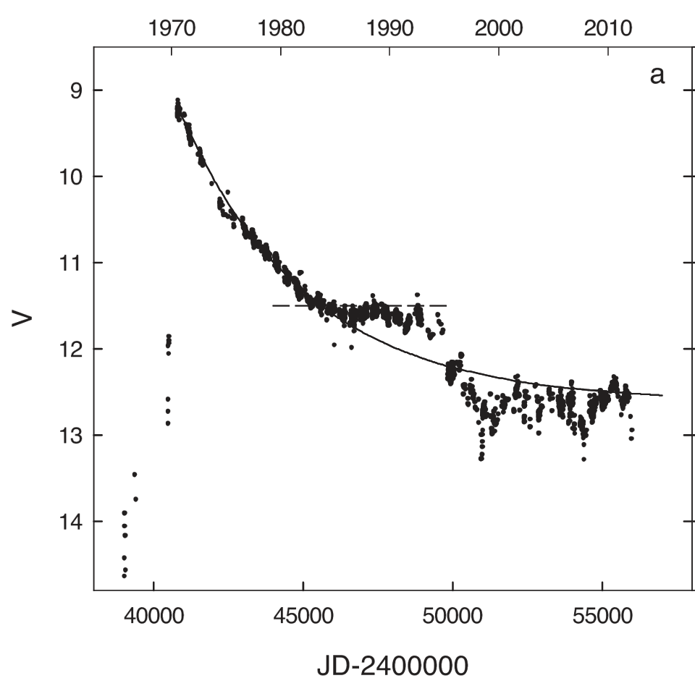
Introduction: Evidence for episodic accretion
Classical FU Ori stars: Kenyon & Hartmann (1996) >100x brightness boost lasting for decades
1970 1980 1990 2000 2010
V1057 Cyg
140 L ⦿
B (mag)
B (mag)
V (mag)
FU Ori
0.6 L ⦿
Time (years)
Kopatskaya+2013
Spitzer c2d Legacy results: most YSOs are underluminous relative to evolution models with a constant or decaying accretion rate (Evans+2009)
UKIDSS & VVV surveys finding hundreds of Near-IR variable YSOs (Lucas+2017)
Massive YSO: S255IR-NIRS3 (Caratti o Garatti+2016, Moscadelli+2017)
Flared by 30x at 60um between 2009-2015; accompanied by 6.7 GHz flare (Fujisawa+2015)
Luminosity rose 6x (up to >1e5 L⦿), now fading after a few years (Stecklum talk on Monday)

Slide 3
NGC 6334 I: Protocluster with a diversity of members
Nearby: 1.3 kpc [maser parallax of I(N), Chibueze+2014]
Heavily-obscured: only MM3 seen at 18um, DeBuizer+2002
ALMA 1.3 mm 2015.6
SED models: the MM sources other than MM1 and the UCHII region MM3 can be fit by dust emission alone
Dust sources MM1B and D also show free-free emission (VLA):
B: Model = Hypercompact HII region (n_{e}=3x10⁶ cm⁻³), high turnover freq; hottest dust (440 K)
D: 300 K dust plus jet (n_{e}=3x10⁵ cm⁻³)
Brogan, Hunter+ 2016, ApJ

Slide 4
However: Some MM1 components should have shown much brighter 7mm emission than observed. Mystery!
β=1.7
β=2.6
Brogan,
Hunter+ 2016
Epoch 2011.3
Epoch 2015.6
Possible explanations:
Time Variable?
or
Unusual dust properties?
7 mm
1.3 mm

Slide 5
An extraordinary brightening in Band 6 & 7 (2008-2015)
MM1 Band 6 flux density: 2008.6 SMA: 2.34 Jy versus 2015.6 ALMA: 10.8 Jy
Simulation: SMA could have recovered: 9.4 Jy
Increase = factor of 3.9! No change in other 3 sources.
MM1 Band 7 flux density: Increase = 21 Jy = factor of 4.2. No fading over a year.
Spectral index of excess is 2.6 – confirms it is dust
Hunter, Brogan+ 2017 ApJL

Slide 6
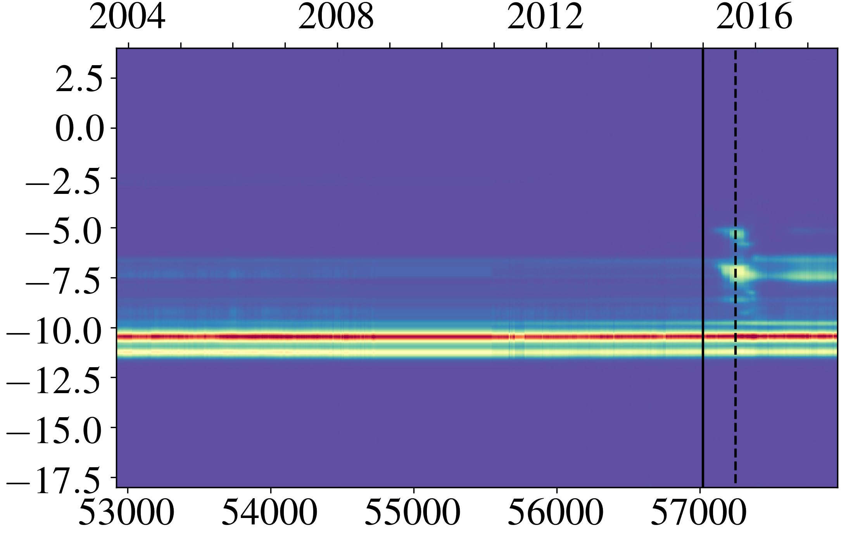
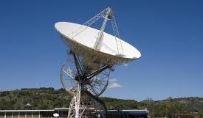
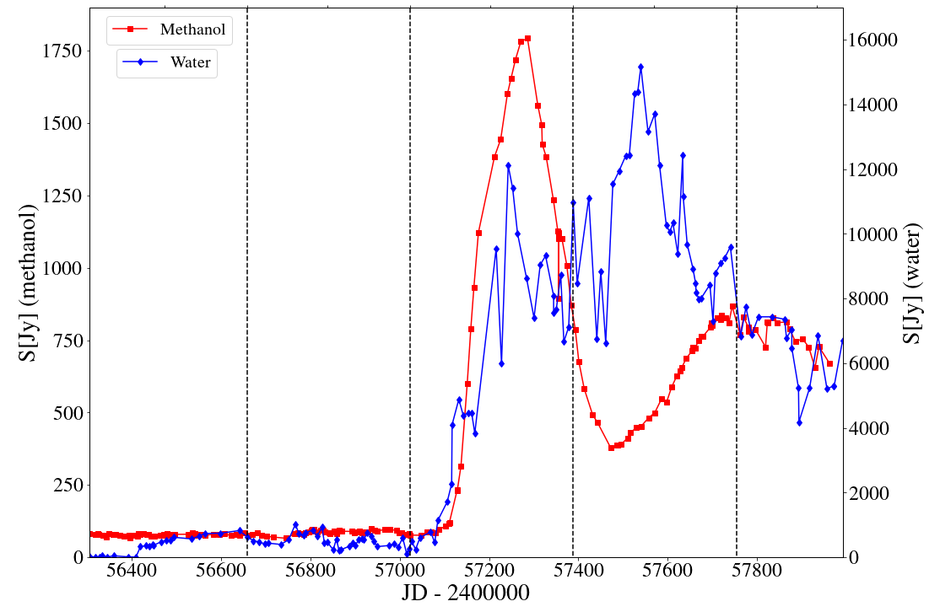
Maser outburst – single dish monitoring & VLA imaging
HartRAO 26m dish South Africa: 2 decades monitoring H2O, OH; CH3OH (Goedhart+2004)
Beginning in January 2015: a 40x increase in 22 GHz H2O and 6.7 GHz CH3OH masers!
-7.2 km/s Methanol & Water over time
2014 2015 2016 2017
V_{LSR} (km/s)
Date of ALMA Cycle 2 observation!
Macleod et al. 2017 in preparation. See Poster 21 for more details.

Slide 7
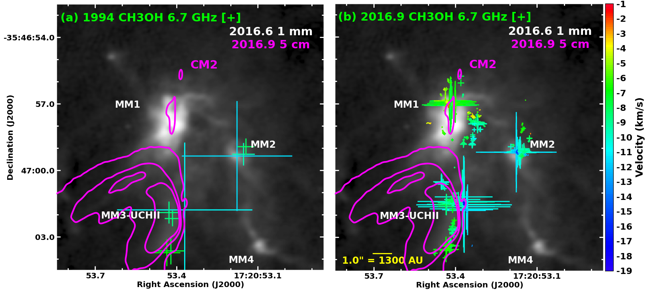
Traditional location of 6.7 GHz masers in older observations (e.g. Walsh+1998)
ATCA 1994.6
Spot size $∝\sqrt{flux}$

Slide 8
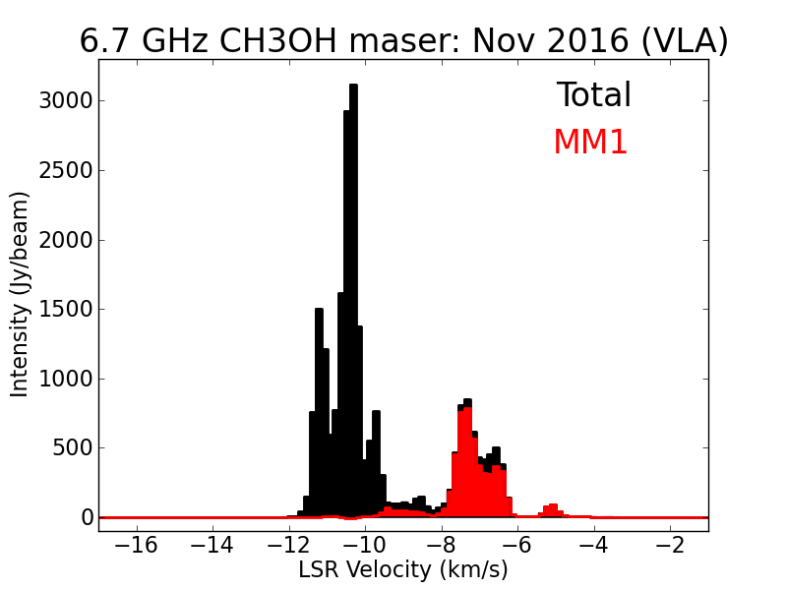
VLA-A follow-up: First detection of CH3OH maser toward MM1!
TOTAL
MM1
Not seen here in 1988, 1992, 1994, 2005, 2011 ...
ATCA 1994.6
Spot size $∝\sqrt{flux}$
VLA 2016.9

Slide 9
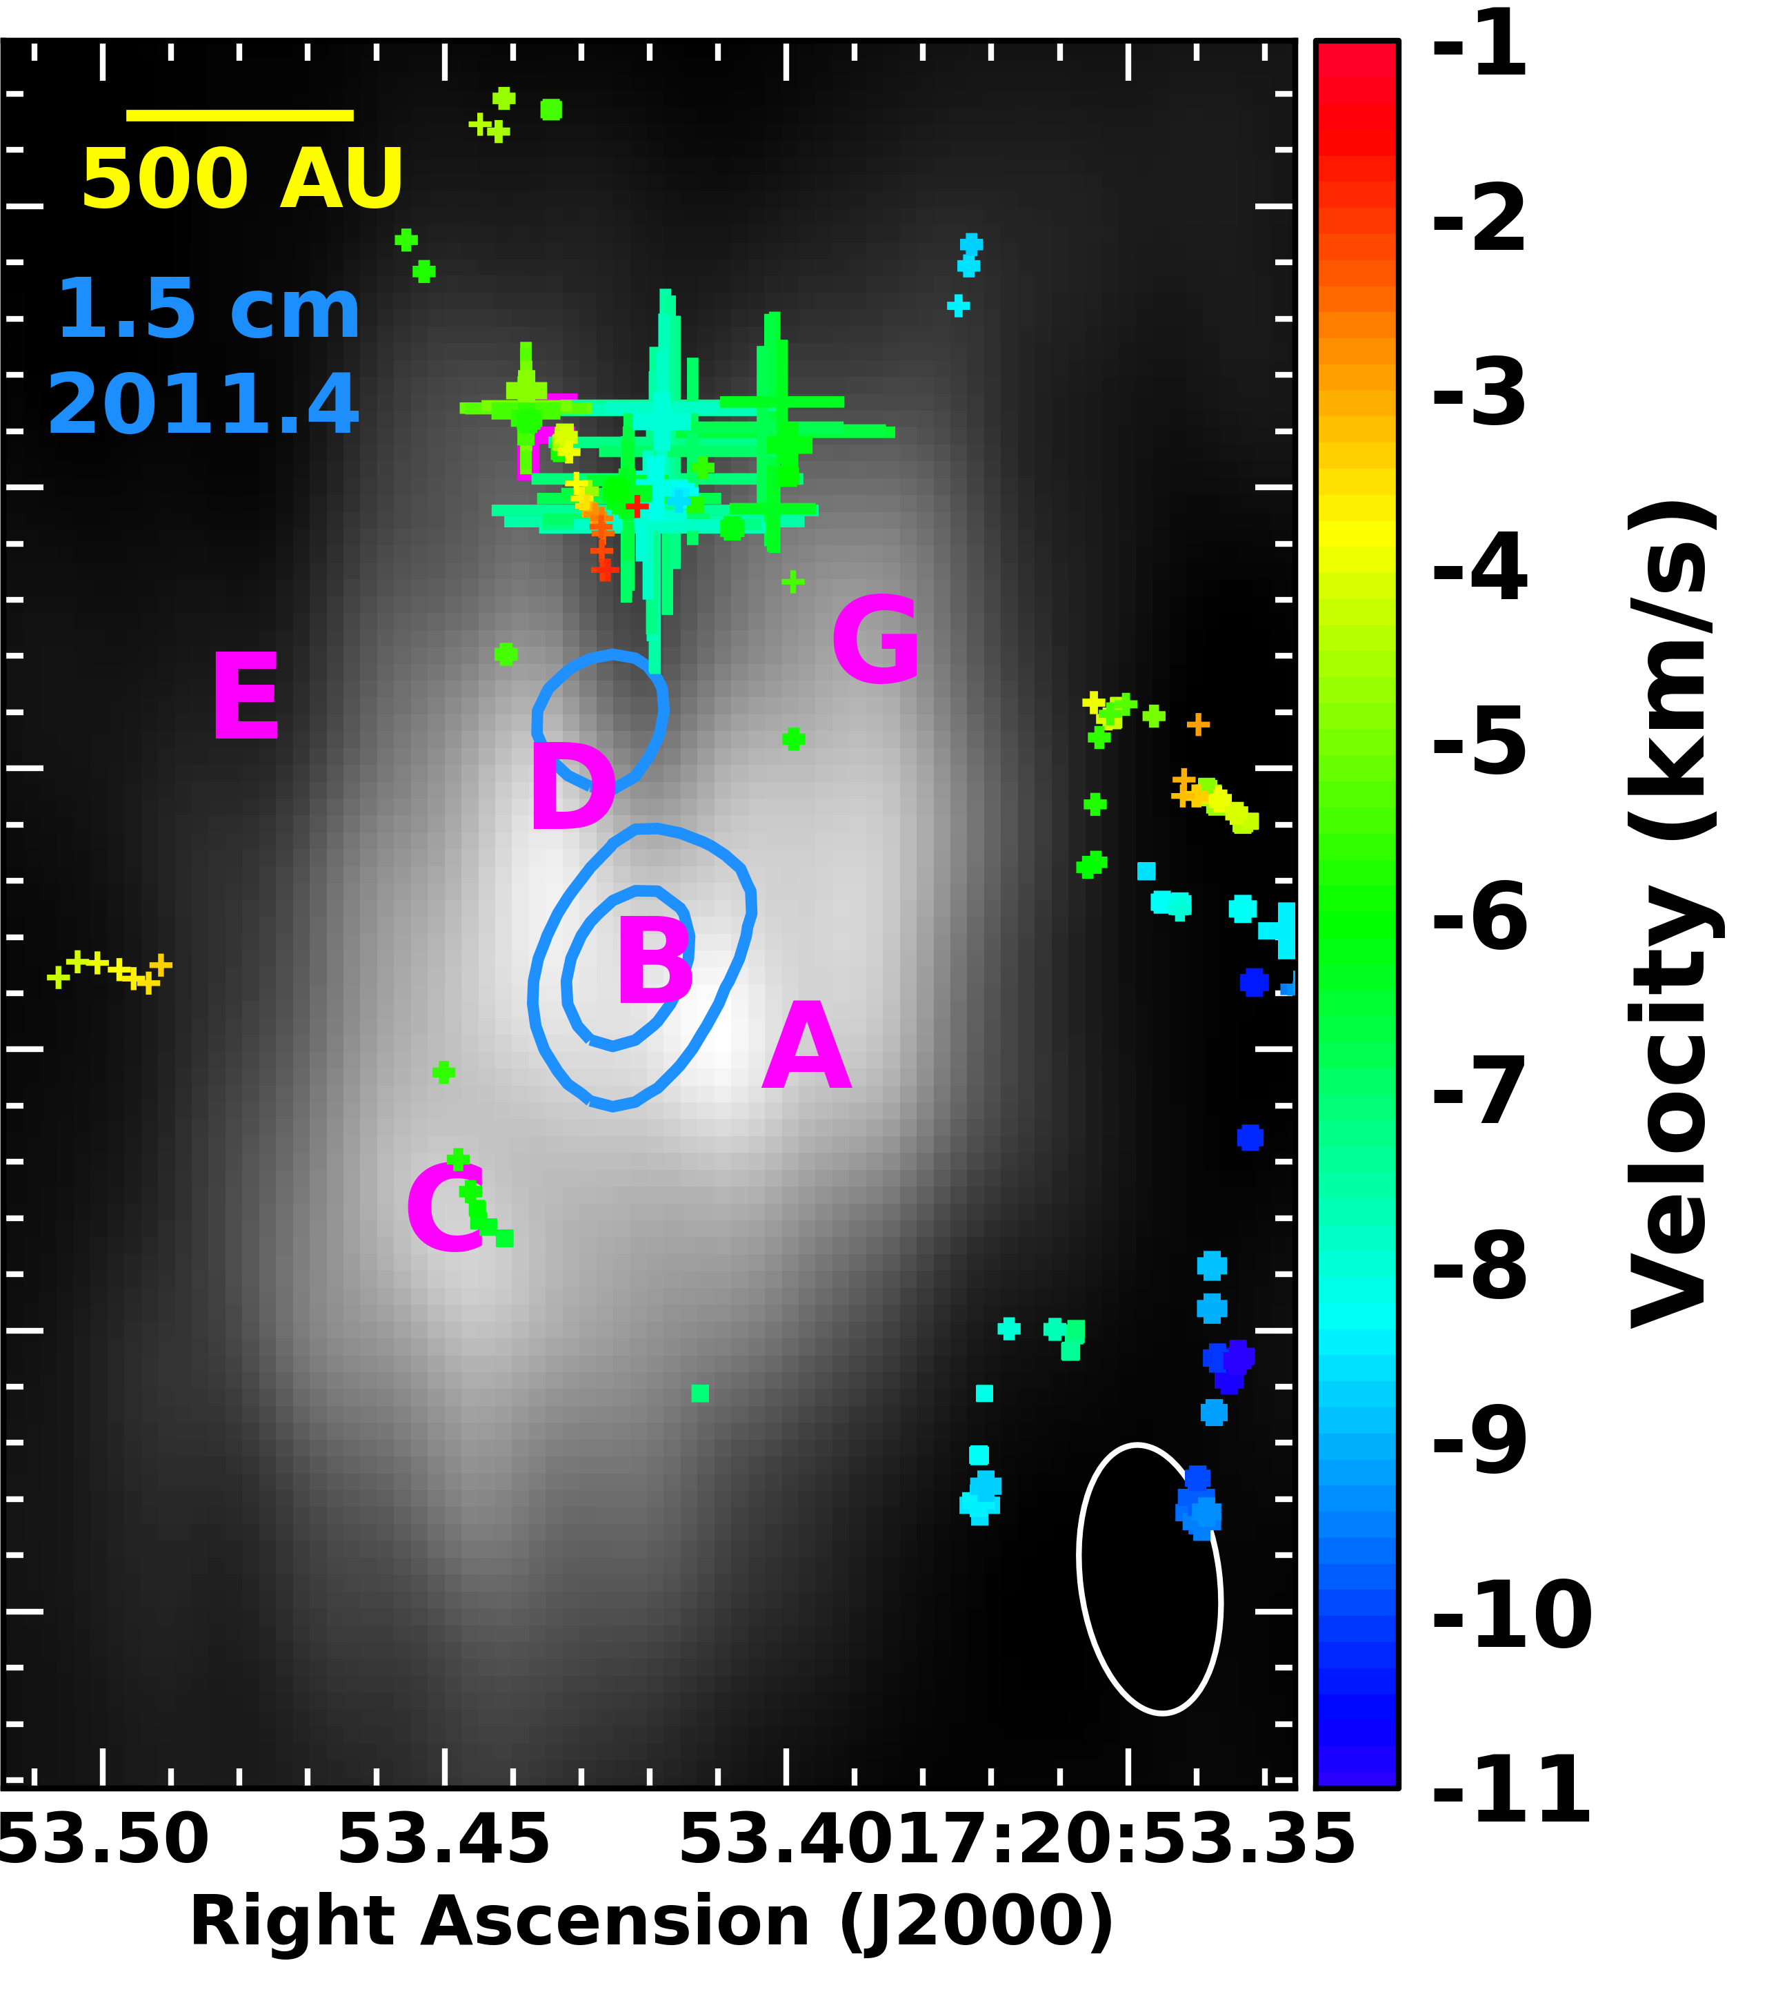
Difference image (2016-2008): Which source brightened?
Excess centered on HCHII region MM1B, but adjacent sources also increased….
Suggests dust was heated by a sudden increase in the accretion rate of MM1B
Outburst can heat dust cocoon rapidly (Johnstone+2013), 1200au/c = 1 week
0.87 mm difference Image
T_{brightness} increased from 33 to 96K (2.9x)
L_{bol} $∝$ T⁴ implies an increase in L_{bol} by 70x
1.3 mm T_{brightness} & angular size gives a lower limit to post-outburst L_{bol} > 42000 L☉
MM1B’s 1.5 cm flux in 2011.4 required: ionizing photon rate: log(N_{L})=43.9 →1300 L☉ On ZAMS, this is B2 star (Thompson 1984)
Conclusion: Progenitor a deeply-embedded 6M☉ ZAMS star!

Slide 10
What explains the location of the masers?
1. Strongest maser spots are located in the dust cavity between MM1F and G. Why?
Jet has previously excavated this cavity and its density is low enough to support maser.
IR pumping radiation coming from adjacent $≈$150K dust sources MM1F and MM1G.
2. No spots on central HCHII protostar MM1B, nor on MM1D. T_{dust}>250K, but the densities are likely too high
Consistent with pumping schemes requiring n < 10⁸ cm⁻³ and T > 100K (Cragg+ 2005)
But what about the other masers to the west and north ?

Slide 11
Other maser locations coincide with warm thermal CH3OH
Dust continuum peaks appear in absorption in lines with E_{Lower}< 300 K
279.35GHz
Maser spots west and north of MM1 reside in area of abundant thermal gas
Warm CH3OH also observed along MM3-UCHII ionization front, coincident with the masers

Slide 12
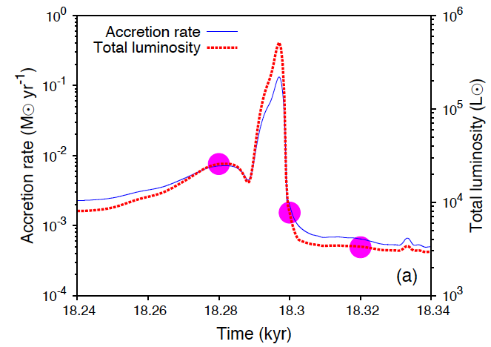
Large accretion events are expected
Large clump accreted.
Meyer et al. (2017):
numerical radiation hydrodynamic simulations, including gas self-gravity & radiative feedback (Kuiper & Klessen 2013).
Produces bursts in accretion rate of a factor of 100:
Yields 50x boost in luminosity for 10 yr
Large bursts separated by few 1000 yr
MM1 outburst of 70x is a rare event!
Smaller events are also expected. Is there evidence?
10 yr

Slide 13
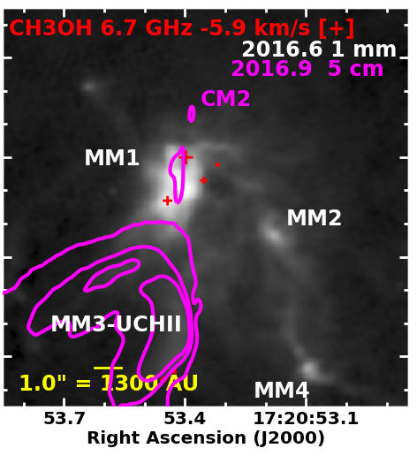
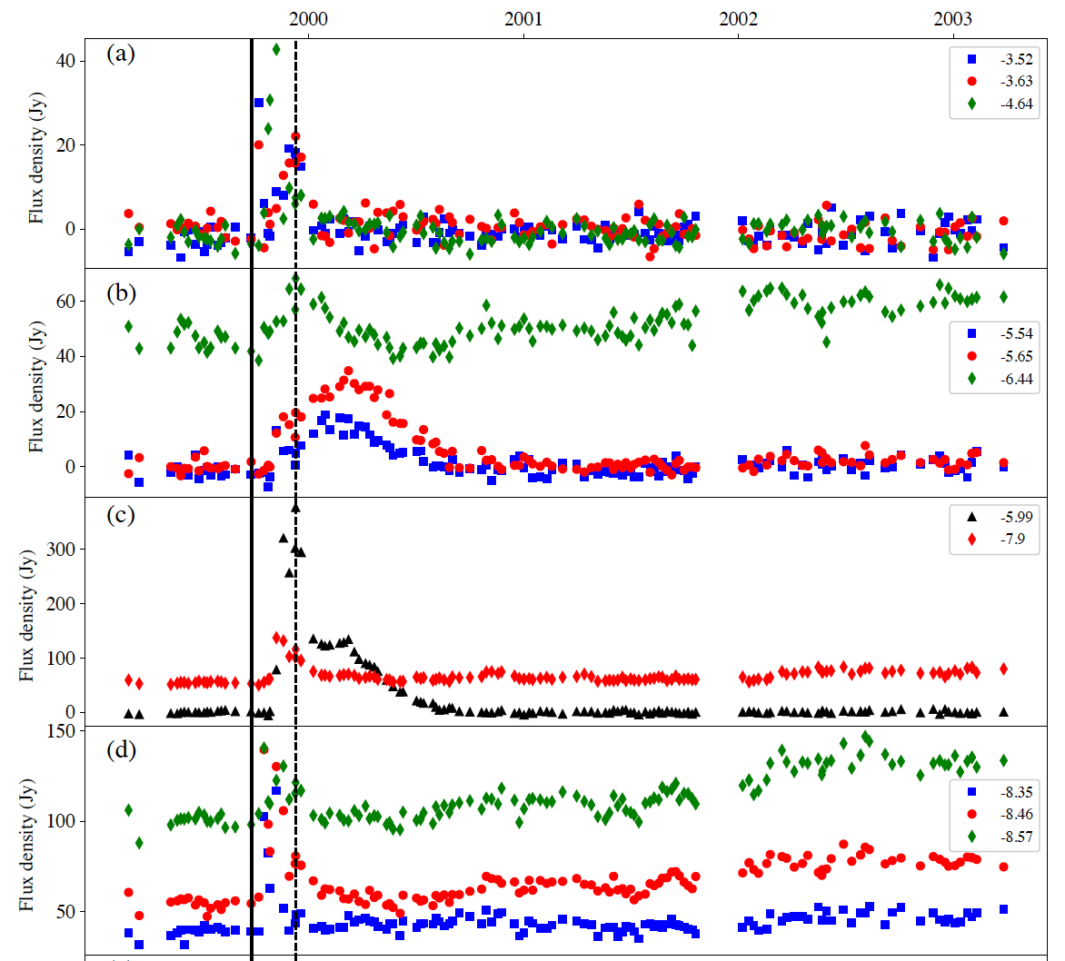
December 1999 “mini-burst” in single-dish spectra
-5.9 km/s went to >100 Jy for 6 months (Goedhart+2004, Macleod+2017 in preparation)
-5.9 km/s in 2016.9 cube is on MM1 (7.7 Jy)
Evidence for smaller outburst, recurring event!
2000 2001 2002 2003

Slide 14
Summary and Conclusions:
Pre-outburst
Post-outburst
Dust continuum outburst in NGC6334I - MM1
Lum. increase of 70 times ($≈$1300 to 90000 L☉)
Progenitor consistent with B2 ``ZAMS’’ star [See the following presentation by C. Brogan on how it has evolved since the outburst]
Appearance of Class II CH3OH masers
Strongest spots are along jet-carved cavity
No spots on the driving protostar/HCHII region
Evidence for “mini” precursor event in 1999
Monitoring of masers, mm dust, cm free-free emission continues; SOFIA 25/37um proposed
SMA
ALMA
ATCA
VLA
Lessons learned:
Single-dish maser monitoring is important to catch these events!
Follow-up with mm interferometry is essential! Outburst would not have been easily seen by single-dish: it’s only 30% of JCMT flux in 18” beam (Sandell 1994).

