Slide 1


Observational Challenges to Measuring Protocluster Multiplicity and Evolution
Todd R. Hunter (NRAO, Charlottesville)
Co-Investigators: Crystal Brogan (NRAO),
Claudia Cyganowski (University of St. Andrews),
Kenneth Young (Harvard-Smithsonian Center for Astrophysics)

Slide 2
Outline
Introduction: millimeter protoclusters with high multiplicity
Analysis of the structure and dynamics of a 400 M protocluster NGC6334 I(N) at 600 AU resolution
  Minimum spanning tree as a possible probe of evolution
  Hot core velocities as a probe of dynamical mass and crossing time
Future challenges:
  Finding evidence for past/future interactions via proper motion studies
  Obtaining a complete census of protocluster members
    Imaging from cm to submm at high resolution is essential
    Confusion from UCHIIs can limit dynamic range at < 100 GHz
  Probing innermost accretion structures (through dust opacity)
  Measuring individual cluster members (luminosity, mass, age)

Slide 3
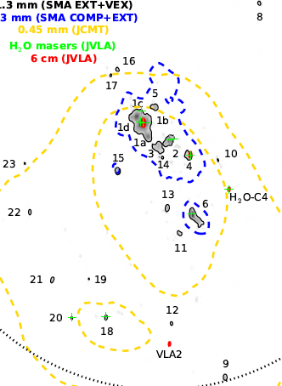
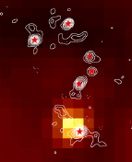
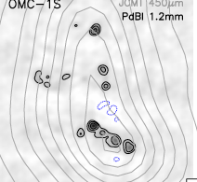
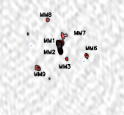
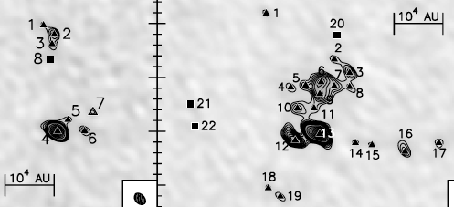
Example protoclusters with 7 or more members
0.1 pc = 20,000 AU
G11.11-P6 (3.6 kpc, SMA)
Wang+ 2014, 17 sources
AFGL 5142
(1.7 kpc, PdBI)
Palau+ 2013
NGC6334I(N) (1.3 kpc,SMA)
(Hunter+ 2014) 24 sources
OMC1-S
(0.4 kpc)
Palau+ 2014
IRAS 19410+2336
(2.2 kpc, PdBI) Rodon+ 2012
Notes:
Testbed for star formation theories

Slide 4
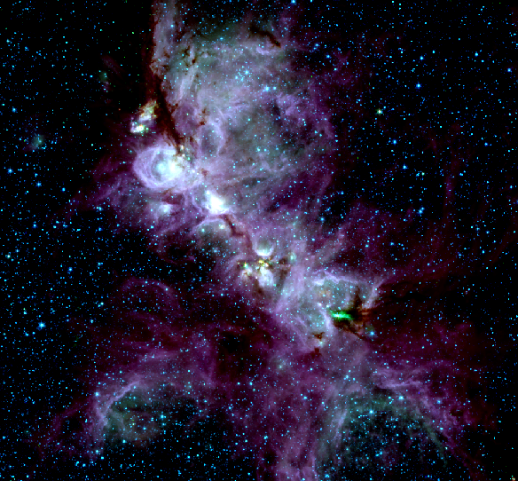
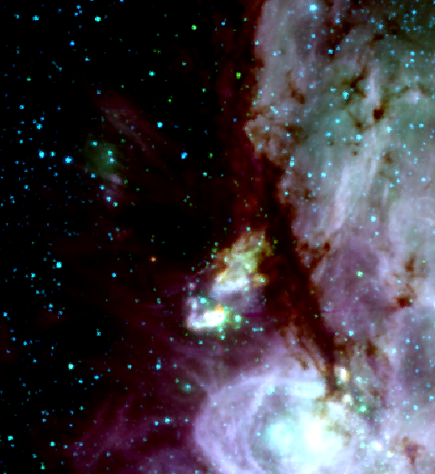
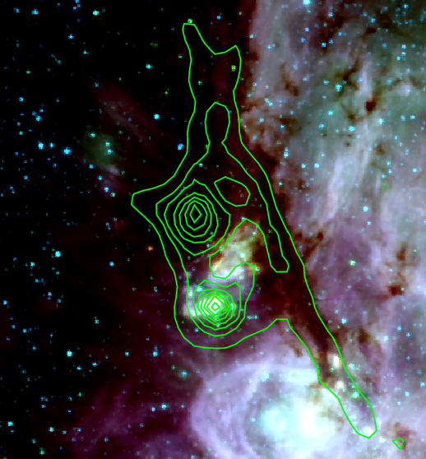
The NGC6334 Star Forming Complex
SCUBA
850 μm dust continuum
I(N)
L_{FIR}~10⁴ L
1 pc
25 ’ = 10 pc
I
3x10⁵ L
E
3.6 μm 4.5 μm 8.0 μm
Distance ~ 1.3 kpc (Reid et al. 2014 water maser parallax)
Gas Mass ~ 2 x 10⁵ Msun, >2200 YSOs, “mini-starburst” (Willis et al. 2013)

Slide 5
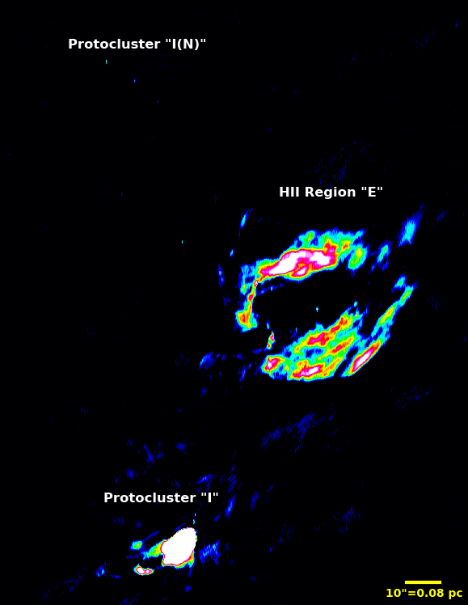
Ionized Gas
JVLA 6 cm continuum, 20 μJy rms
SCUBA
850 μm dust continuum
I(N)
10⁴ L
O8 star
(5x10⁴ L)
I
3x10⁵ L

Slide 6
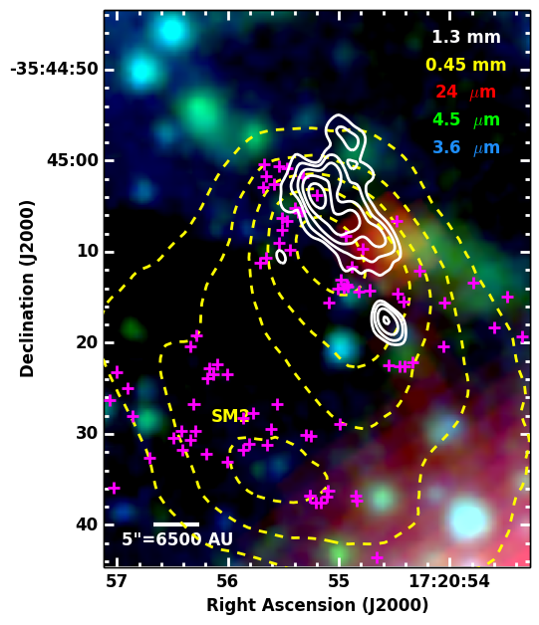
Overview of I(N)
Brightest source of NH₃ in sky (Forster+ 1987, Kuiper+ 1995)
2 clumps resolved (Sandell 2000)
  JCMT 450 micron, 9” beam
  Total mass ≈ 280 M
7 cores resolved (Hunter +2006)
  SMA 1.3mm, 1.5” beam
  No red NIR point sources
  Only 24um source looks like an outflow cavity
MM line emission resolved (Brogan+ 2009)
  Multiple outflows
  44 GHz Class I methanol masers

Slide 7
New SMA very-extended config. data (0.7”x0.4”)
➔significant reduction in confusion! arXiv:1405.0496
24 compact mm sources
  Weakest is 17 mJy, all are > 5.2 sigma
  3 coincident with H₂O masers
2 new sources at 6 cm
  one coincident with H₂O maser
# Density ~ 660 pc⁻³
None coincide with X-ray sources
Mass range ~ 0.4-10 Msun
Most unresolved, < 650 AU
  ➔Protostellar disks

Slide 8
Analysis of protocluster structure
Minimum spanning tree (MST)
NGC 6334 I(N)
Set of edges connecting a set of points that possess the smallest sum of edge lengths (and has no closed loops)
Q-parameter devised by Cartwright & Whitworth (2004)
R_{cluster} = 32”
*Correlation length = mean separation between all stars

Slide 9
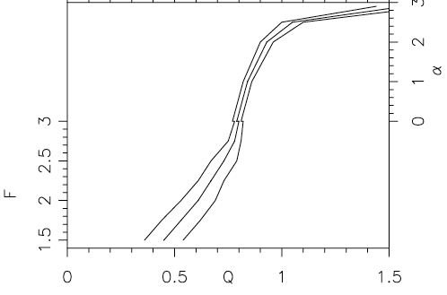
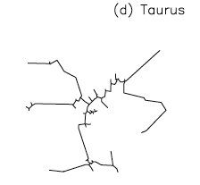
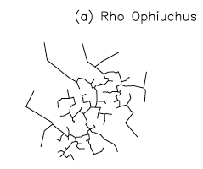
Q-parameter of the Minimum Spanning Tree
Q-parameter reflects the degree of central concentration, α
Taurus: Q = 0.47 ρ Ophiuchus: Q = 0.85

Slide 10
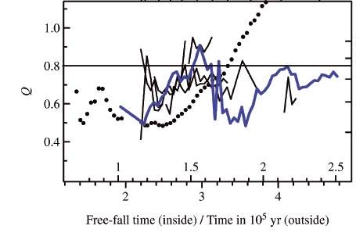
Q-parameter as evolutionary indicator?
Maschberger et al. (2010) analysis of the SPH simulation of a 1000 M spherical cloud by Bonnell et al. (2003)
Q-parameter evolves steadily from fractal regime (0.5) to concentrated (1.4), passing 0.8 at 1.8 free-fall times (3.5e5 yr)
Whole cluster
NGC 6334 I(N)
Largest
Subcluster

Slide 11
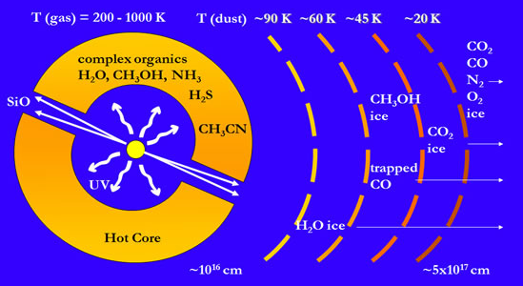
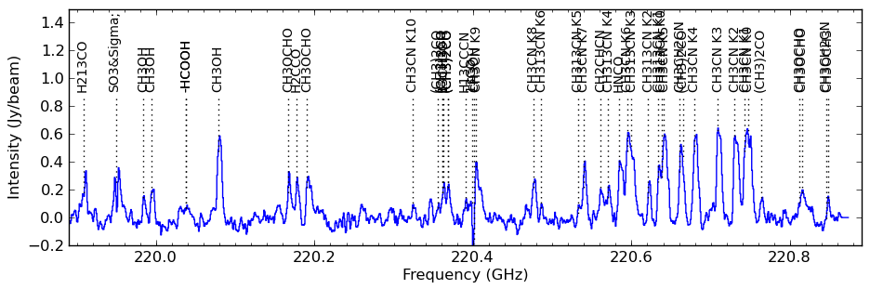
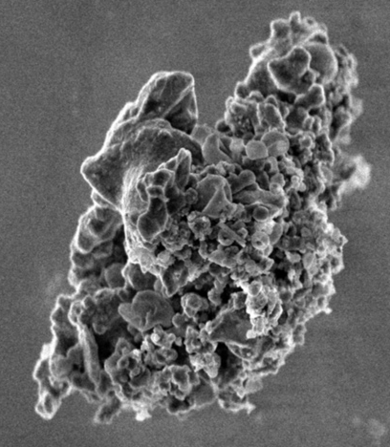
Protocluster dynamics: Hot cores
Young massive star heats surrounding dust, releasing molecules, driving gas-phase chemistry at ~200+ K
Millimeter spectra provide temperature and velocity information!
Interstellar dust grain
10¹⁶ cm = 700 AU ~ 1” at 1.3 kpc
Van Dishoeck & Blake (1998)

Slide 12
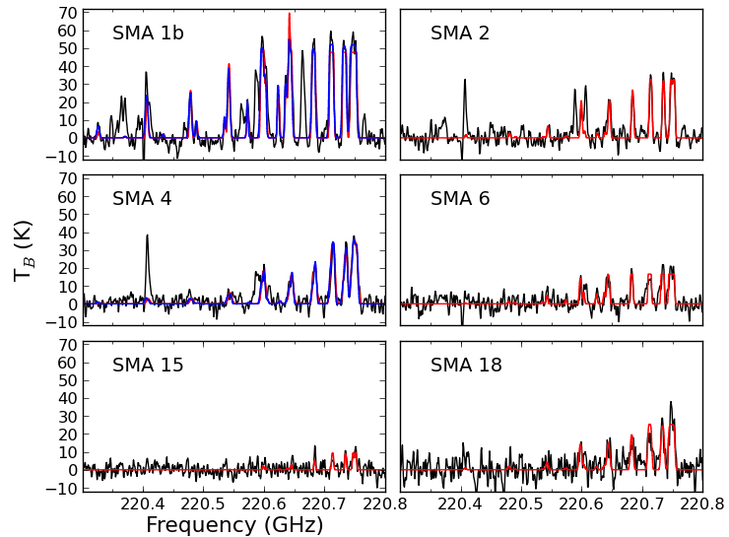
Six hot cores detected in CH₃CN
LTE models using CASSIS package: fit for: T, N, θ, v_{LSR}, Δv
Properties derived from LSR velocities:
140K
307K, 80K
Good match to Sco OB2:
1.0–1.5 km/s, de Bruijne (1999)
208K, 135K
95K
72K
139K
~ “Brick” active region
Preliminary! Sensitivity limited

Slide 13
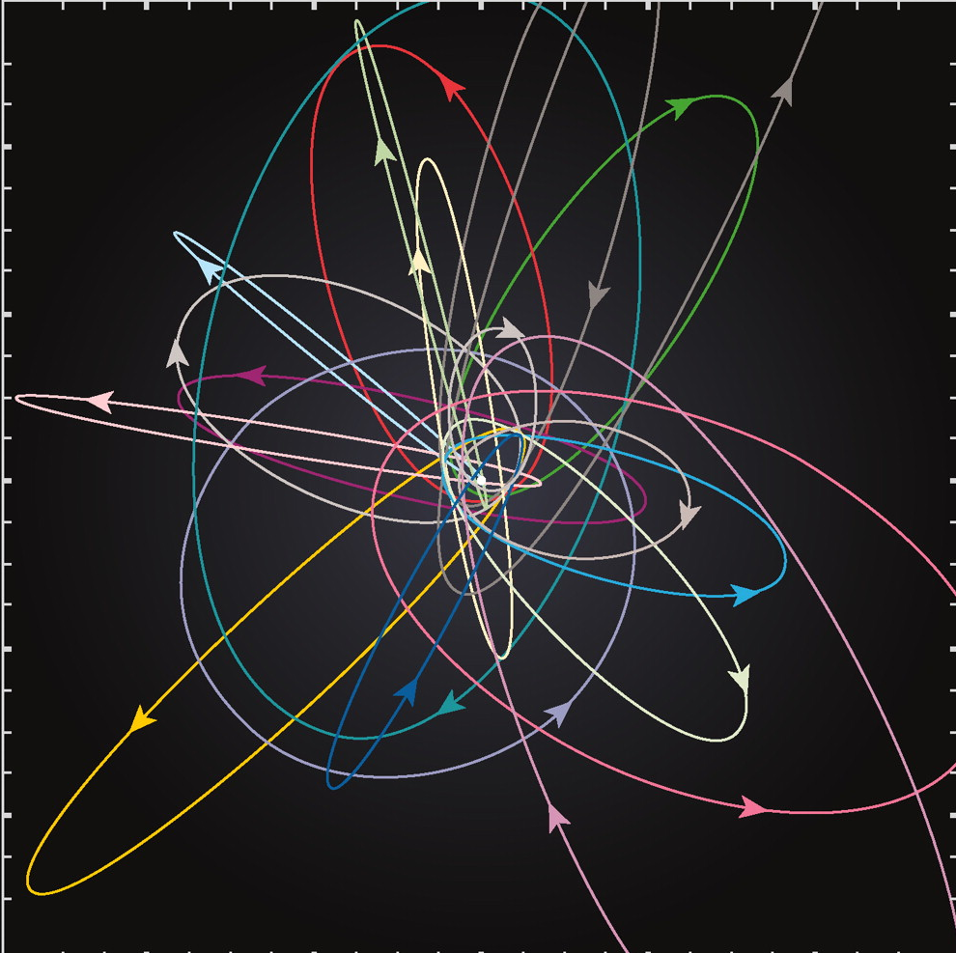
Future challenges – 1
Proper motion of protocluster members (a crazy idea?)
Feasibility
  ALMA astrometric accuracy expected ~ 0.5 milliarcsec with a 50 milliarcsec beam, (5km baseline at 300 GHz ➔100AU at 2kpc)
  0.5 mas * 1.3 kpc = 0.65 AU = 1e8 km
  Mean 2D velocity NGC6334I(N) = 2.0 km/s
  5 sigma detection requires 8 years
  Would deliver 3D velocity field
Survey could reveal prevalence of interactions
  Past events and future predictions
  Orion BN / Source I interaction at 50 AU resulted in motions of 12 and 26 km/s (e.g. Goddi+ 2011), i.e. much easier to detect!

Slide 14
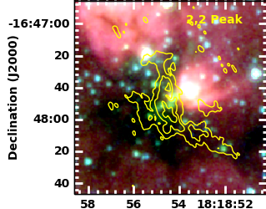
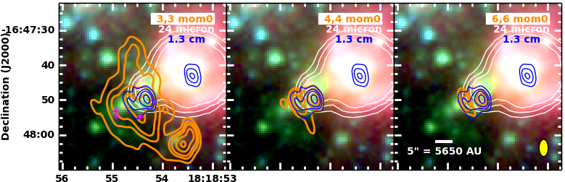
Future challenges – 2a
Obtaining a complete census of protocluster members
➔ Requires imaging from 6-600 GHz to probe cm multiplicity (HCHIIs, jets)
Example: G14.33-0.64
JVLA imaging survey of 20 EGOs in NH₃ (1,1)–(6,6) plus continuum (Brogan+ in prep.)
Extended HII region/24um source, plus 2 hot cores in NH₃ (4,4), with weak cm continuum (~0.6 and 1.5 mJy)
Weakest cm source is brightest mm source (Cyganowski+ in prep.)

Slide 15
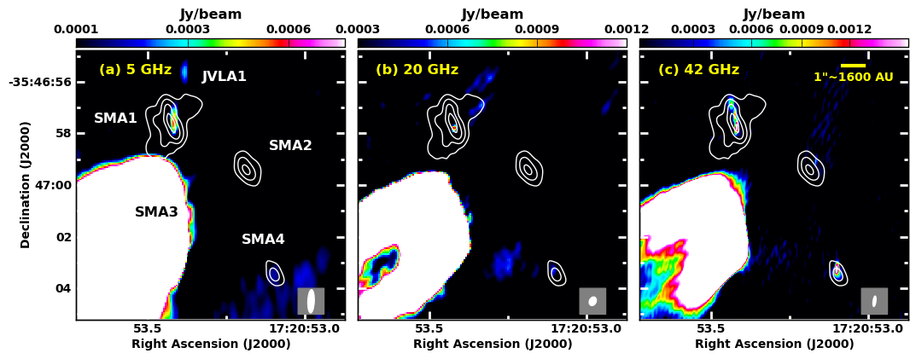
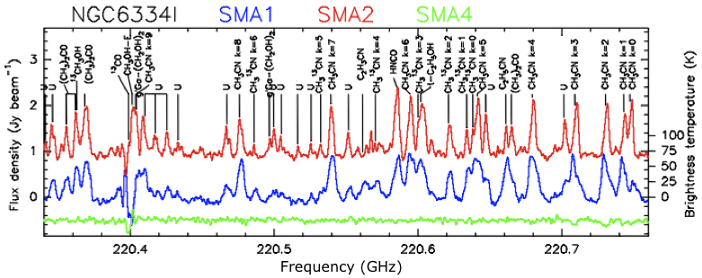
Future challenges – 2b
Obtaining a complete census of protocluster members
➔ Sub-arcsecond beams are essential to avoid confusion
Example: NGC 6334I at current best resolution with JVLA and SMA
  UC HII region limits JVLA sensitivity to nearby hot cores (which may ultimately be more luminous objects but simply more deeply embedded or younger)
SMA1 ~ resolved into 3 sources
SMA2 ~ 0.9 mJy at 42 GHz, offset (jet?)
SMA4 ~ 2.6 mJy at 42 GHz (ν³)

Slide 16
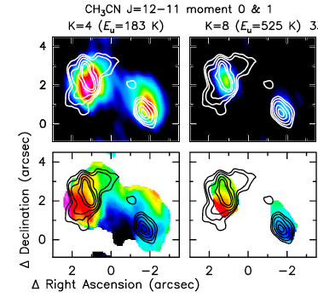
Future challenges – 3
Tracing innermost accretion structures
At higher submm frequencies, dust opacity may preclude tracing central regions with lines (even highly excited ones)
Inner regions of accretion with 200 g cm⁻² will have τ~1 at 220 GHz
Example: High temperature lines of CH₃CN 12-11 peak on the continuum in NGC6334I-SMA1 hot core, but not in SMA2 hot core

Slide 17
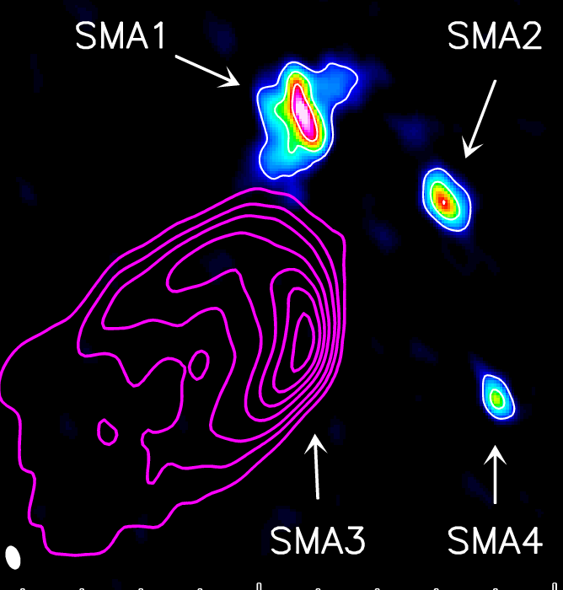
Future challenges – 4a
Measuring individual cluster members: Luminosity
Resolution in FIR is far too coarse to resolve protoclusters
Submm brightness temperature measured at high resolution is a powerful probe of minimum bolometric luminosity
T_{b}(K) T_{b,fit}(K) R_{fit}(AU) L_{b,fit}(L)
SMA 1 72 78 710 > 2400
SMA 2 44 77 380 > 700
SMA 4 23 83 240 > 360
But for SMA1 & SMA2, brightest lines have T_{b} ~ 125 K
⇨ Luminosities could be 6x larger
For T_{dust}=125 K, τ_{dust} ~ 1 at 340 GHz
17

Slide 18
Future challenges – 4b
Measuring individual cluster members: Mass
Detection of disks can allow us to model the mass of central protostar
Example: Consistent velocity structure in NGC 6334 I(N) SMA 1b, perpendicular to outflow
Modeled with a Keplerian, infalling disk:
M_{enc} ~ 10-30 M
(i>55°)
R_{o}~800 AU
R_{i}~200-400 AU
18

Slide 19
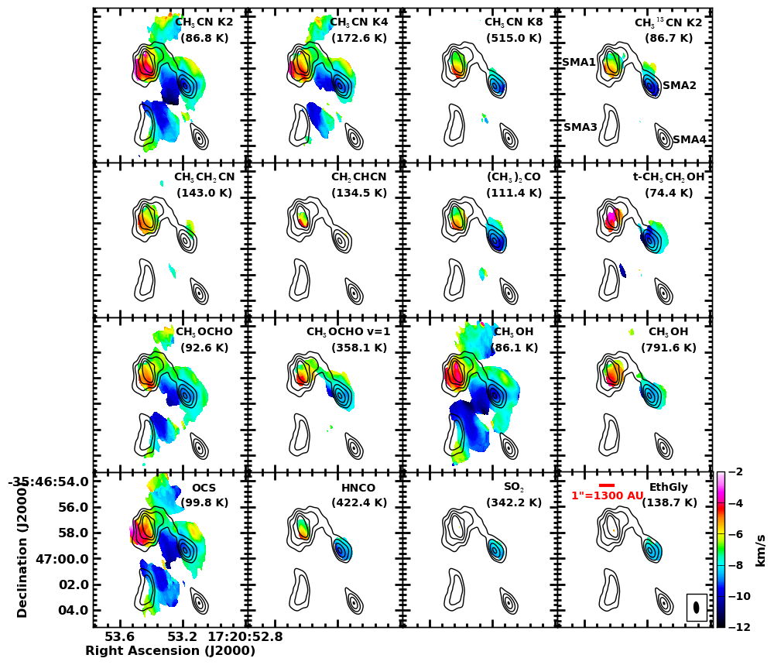
Back to NGC6334 I: Unfortunately kinematics are not usually so simple to interpret…
Future Challenges – 5
What is chemical diversity telling us?
Evolutionary state?

Slide 20
Future challenges – 6
Measuring individual cluster members: Age
?
20

Slide 21
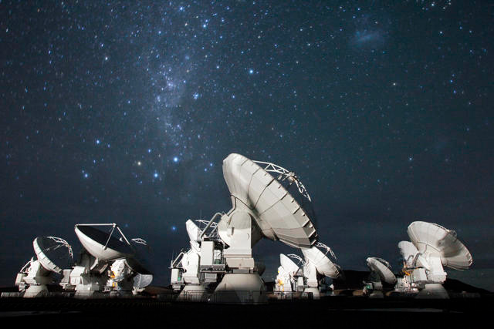
Summary
Sub-arcsecond SMA+VLA observations of NGC 6334 I(N)
  Analysis of 24 compact mm sources yield a MST Q-parameter of 0.82 suggesting a uniform density, not (yet) centrally-concentrated
  Dynamical mass measurement from 6 hot cores yields 410±260 M, slightly below the single-dish virial mass estimate
  Dust masses are consistent with disks around intermediate to high-mass protostars
Future challenges for 6-600 GHz observations at <100 AU resolution:
  Obtaining complete census of protocluster
  members, down to very low disk masses
  Finding evidence for past/future interactions
  between members via proper motion studies
  Measuring individual cluster members:
    Luminosity, mass, chemistry, age

Slide 22

The National Radio Astronomy Observatory is a facility of the National Science Foundation
operated under cooperative agreement by Associated Universities, Inc.
www.nrao.edu • science.nrao.edu

Slide 23
Uncertainty in variance
Statistical Inference, Casella & Berger 2002

Slide 24
Future challenges – 3
Measuring individual cluster members: Mass
Black line: Keplerian rotation
White line: Keplerian rotation plus free-fall (Cesaroni+ 2011)
M_{enclosed} ~ 10-30 M (i>55°)
R_{outer} ~ 800 AU
R_{inner} ~ 200-400 AU
Chemical differences (HNCO)
24

