Slide 1


Sub-arcsecond imaging of the NGC 6334 I(N) protocluster: two dozen compact sources and a massive disk candidate 2014ApJ...788..187H
Todd R. Hunter (NRAO, Charlottesville)
Co-Investigators: Crystal Brogan (NRAO),
Claudia Cyganowski (University of St. Andrews),
Kenneth Young (Harvard-Smithsonian Center for Astrophysics)

Slide 2
What do I mean by “protocluster” ?
This term is often used to describe groups of young galaxies in formation. Not the subject of this talk!
The first usage in reference to groups of young stars was in theoretical papers in 1970s:
  First appearance in a paper abstract: M. Disney (1975), “Boundary and Initial Conditions in Protostar Calculations”
  First appearance in a paper title: Ferraioli & Virgopia (1979), “On the Mass Distribution Law of Systems of Protocluster Fragments”
Observational papers begin to use the term in early 2000’s

Slide 3
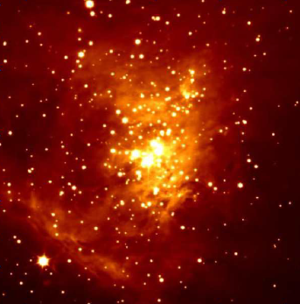
Some important features of star clusters
Common metallicity
Mass segregation
  Massive stars tend to be at center (Kirk & Myers 2011)
  Primordial or dynamical evolution? ~1 free-fall time
Correlation between mass of most massive star and number of cluster members (Testi+ 1999)
  Do low and high mass stars form at same time?
If we can examine clusters at an earlier stage of formation (“protoclusters”), we can perform stronger tests of theories of massive star formation.

Slide 4
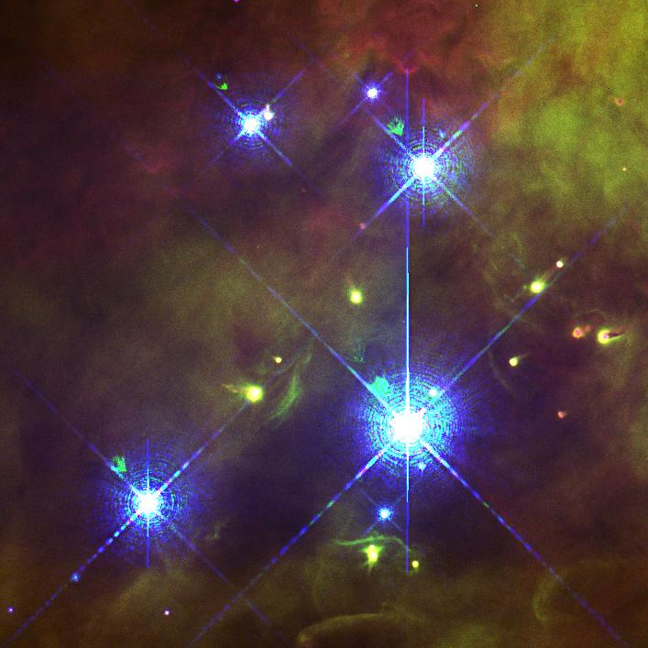
Evolution of massive protoclusters
R. Klein+ 2005 “MM Continuum Survey for Massive Protoclusters”
describes tentative stages of massive star formation:
STAGE PHENOMENA WAVELENGTH
0. Pre-protocluster massive cloud core without collapse mm
Early protocluster massive stars have begun to form mm
Protocluster HII region begins to evolve FIR, mm, cm
Evolved protoclusters cluster begins to emerge MIR - mm
Young cluster cluster has emerged from cloud NIR - mm
Cluster cluster has dispersed its parental cloud NIR - MIR
10,000 AU

Slide 5
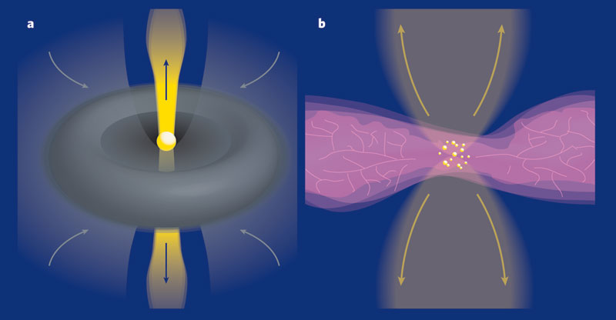
How Do Massive (M > 8 M) Stars Form?
Protocluster length scale: 0.05 pc ~10,000 AU
Key problems:
Tremendous radiation pressure (accretion luminosity and hydrogen burning) that turns on well before the star’s final mass is reached
Survival of protostars in the confused environment of cluster formation
Low Mass
High Mass
Observational Keys to Distinguishing
Properties of earliest phases
Multiplicity / protostellar density
Accretion mechanism(s)
Role of cluster feedback, outflows
Monolithic Collapse? (McKee,Tan, Krumholz, Klein et al.)
Radiative heating suppresses fragmentation
Majority of mass ➔ 1 object
Core mass maps directly to stellar mass (Core IMF=stellar IMF)
Competitive Accretion? (Bonnell, Bate, Zinnecker et al.)
Fragmentation ➔ produce many low-mass protostars
Competitive accretion ensues
Dynamics and interactions matter
Sum of above factors ➔ IMF

Slide 6
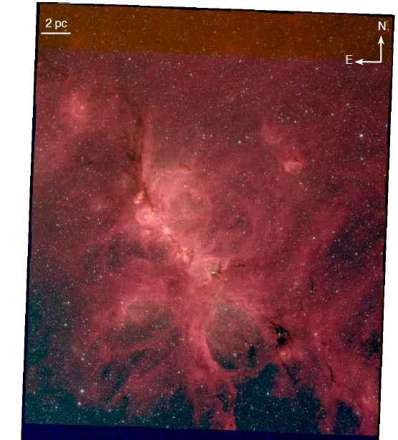
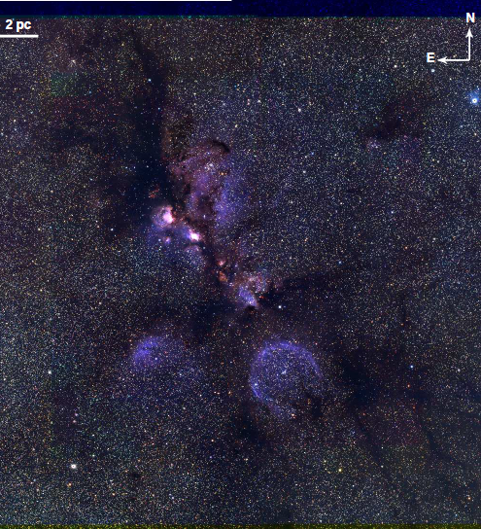
NGC 6334 Star Forming Complex (G351.4-0.6)
Distance ~ 1.3 kpc (Reid et al. 2014 water maser parallax), 0.5” = 650AU
Gas Mass ~ 2 x 10⁵ Msun, >2200 YSOs, “mini-starburst” (Willis et al. 2013)
3.6, 4.5, 8.0 μm (IRAC)
J, H, K (NEWFIRM)
Willis et al. (2013)

Slide 7
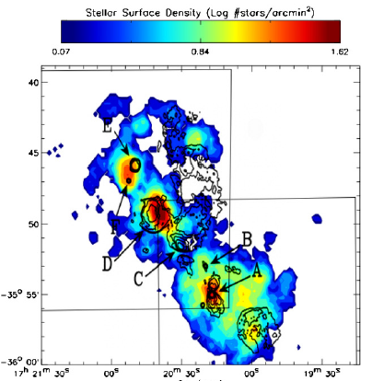
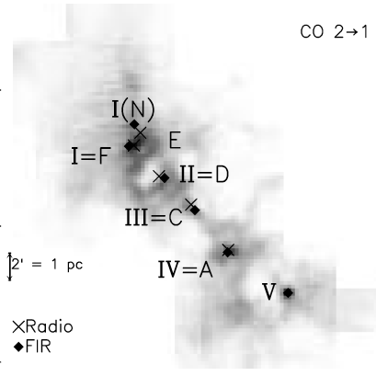
NGC 6334 Star Forming Complex (G351.4-0.6)
Chandra: 1600 faint sources, including dozens of OB stars (Feigelson+ 2009)
Extrapolates to ~25,000 PMS stars
3.6, 4.5, 8.0 μm (IRAC)
J, H, K (NEWFIRM)
color: hard X-rays,
contours: VLA 18 cm (Sarma 2000)

Slide 8
NGC 6334 Star Forming Complex (G351.4-0.6)
Confusing nomenclature: Radio sources A, C, D, E, F (Rodriguez+ 1982)
Far-infrared sources: I, II, III, IV (McBreen+ 1979, Gezari 1982)
3.6, 4.5, 8.0 μm (IRAC)
J, H, K (NEWFIRM)
CSO: Kraemer & Jackson (1999)

Slide 9
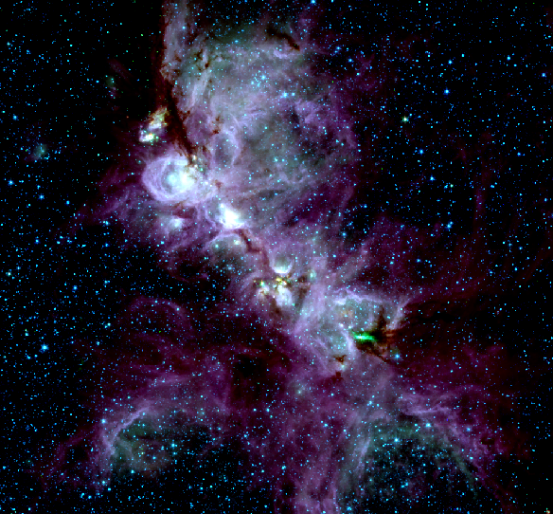
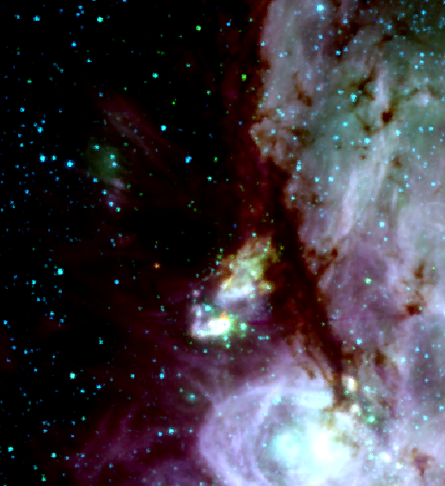
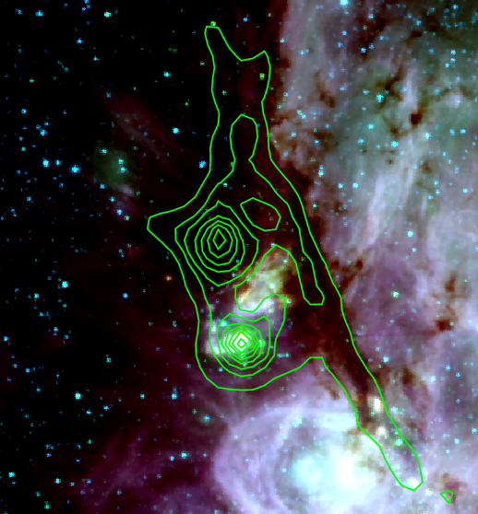
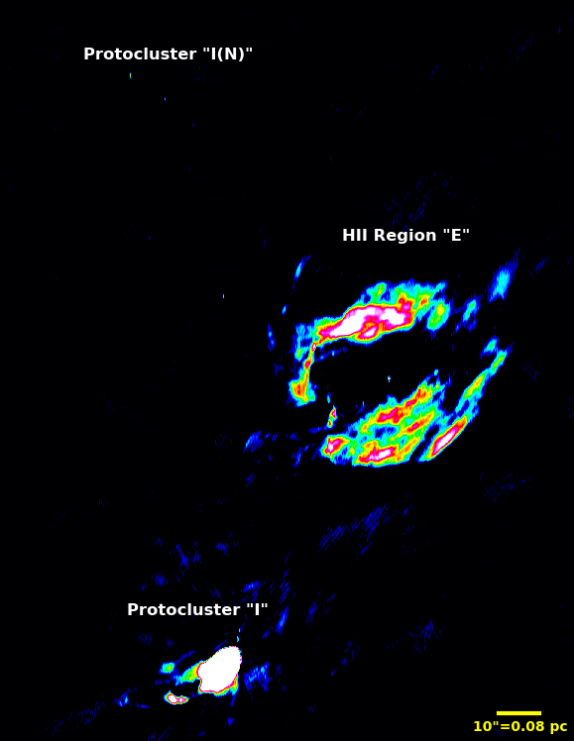
NGC 6334 Star Forming Complex
SCUBA
0.85 mm dust continuum
I(N)
10⁴ L
25 ’ = 15 pc
1 pc
I
10⁵ L
GLIMPSE 3.6 μm 4.5 μm 8.0 μm
Source I has NIR cluster of 93 stars, density of ~500 pc⁻³ (Tapia+ 1996)

Slide 10
NGC 6334 I, I(N) and E
SCUBA
0.85 mm dust continuum
Distance ~ 1.7 kpc
Nomenclature:
  FIR sources I..VI
  radio source A..F
VLA 6 cm continuum
I(N)
10⁴ L
1 pc
I
3x10⁵ L

Slide 11
Overview of I(N)
Discovered at 1.0 mm using bolometer on CTIO 4m (Cheung+ 1978)
Brightest source of NH₃ in the sky (Forster+ 1987)
2 clumps resolved (Sandell 2000)
  JCMT 450 micron, 9” beam
  Total mass ~ 275 M
7 cores resolved (Hunter +2006)
  SMA 1.3mm, 1.5” beam
  No NIR emission
MM line emission resolved (Brogan+ 2009)
  Multiple outflows

Slide 12
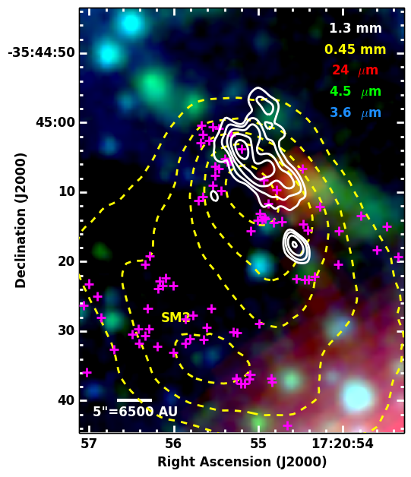
Overview of I(N)
Discovered at 1.0 mm using bolometer on CTIO 4m (Cheung+ 1978)
Brightest source of NH₃ in the sky (Forster+ 1987)
2 clumps resolved (Sandell 2000)
  JCMT 450 micron, 9” beam
  Total mass ~ 275 M
7 cores resolved (Hunter +2006)
  SMA 1.3mm, 1.5” beam
  No NIR emission
MM line emission resolved (Brogan+ 2009)
  Multiple outflows
  44 GHz methanol masers

Slide 13
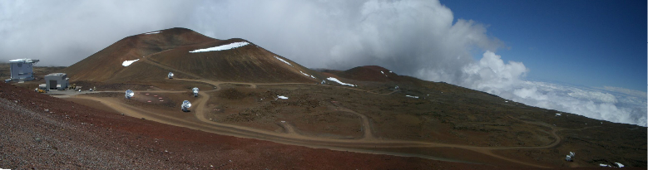
New SMA observations in very extended configuration (500m baselines)
230 GHz (1.3 mm) with 8 GHz bandwidth
  excellent weather, 0.7” x 0.4” beam
  nearly 4 times lower rms than our 2009 paper
340 GHz (0.87 mm) with 8 GHz bandwidth
  0.55” x 0.26” beam

Slide 14
24 compact sources at 1.3mm!
Weakest is 17 mJy, all are > 5.2 sigma
3 coincident with water masers
Odds of a dusty extragalactic interloper is 5e-6
In addition, one new source at 6 cm (6.3% chance of being extragalactic)
# Density ~ 660 pc⁻³
None coincide with X-ray sources

Slide 15
Protocluster structure: Minimum spanning tree (MST)
Set of edges connecting a set of points that possess the smallest sum of edge lengths (and has no closed loops)
Q-parameter devised by Cartwright & Whitworth (2004)
R_{cluster} = 32”
*Correlation length = mean separation between all stars

Slide 16
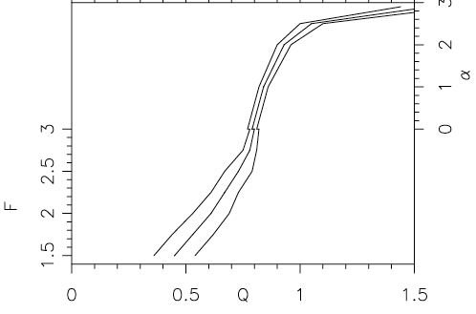
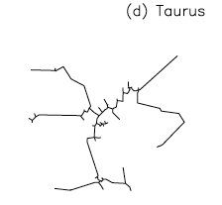
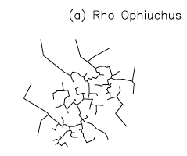
Protocluster structure: Q-parameter of the MST
Q-parameter reflects the degree of central concentration, α
Taurus: Q = 0.47
ρ Ophiuchus: Q = 0.85

Slide 17
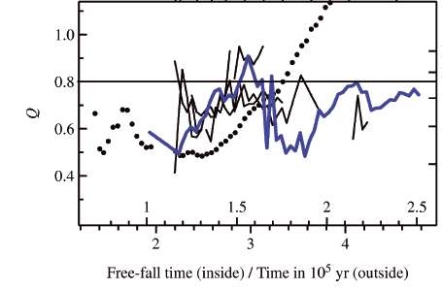
Q-parameter as evolutionary indicator?
Maschberger et al. (2010) analysis of the SPH simulation of a 1000 M spherical cloud by Bonnell et al. (2003)
Q-parameter evolves steadily from fractal regime (0.5) to concentrated (1.4), passing 0.8 at 1.8 free-fall times
Whole cluster
Largest
Subcluster

Slide 18
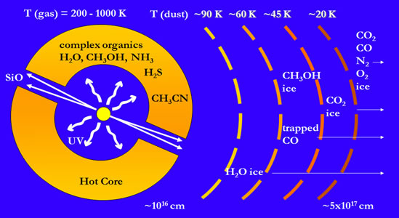
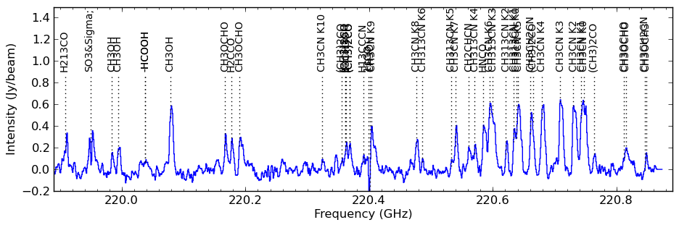
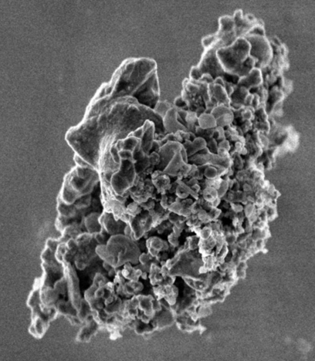
Protocluster dynamics: Hot cores
Young massive star heats surrounding dust, releasing molecules, driving gas-phase chemistry at ~200+ K
Millimeter spectra provide temperature and velocity information!
Interstellar dust grain
10¹⁶ cm = 700 AU ~ 1” at 1.3 kpc
Van Dishoeck & Blake (1998)

Slide 19
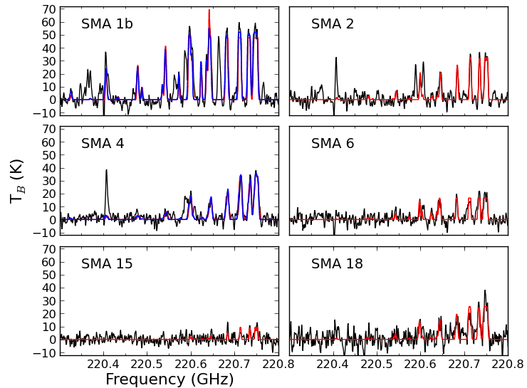
Six hot cores detected in CH3CN
LTE models using CASSIS package: fit for: T, N, θ, v_{LSR}, Δv
Properties derived from LSR velocities:
140K
307K, 80K
208K, 135K
95K
72K
139K
Preliminary!
Sensitivity limited

Slide 20
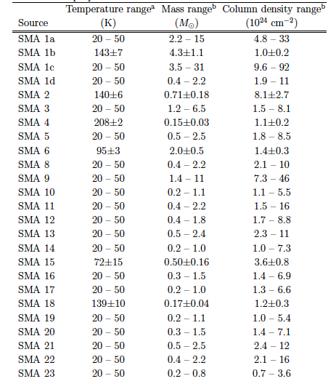
Mass estimates from dust emission
Temperature dependent, but mostly in range of 0.2-15 M
Consistent with disks around intermediate/high-mass YSOs
  AFGL 2591 VLA3 (0.8 M) van der Tak+ (2006)
  Mac CH12 (0.2 M) Mannings & Sargent (2000)

Slide 21
Dominant member of the protocluster:
SMA 1b: hot core / hypercompact HII region
Companion (SMA 1d) at 590 AU
Proto-binary?

Slide 22
Dominant source of protocluster:
SMA 1b: hot core / hypercompact HII region
Velocity gradient centered on SMA 1b
Companion (SMA 1d) shows no line emission
Earlier stage of evolution?

Slide 23
Dominant source of protocluster:
SMA 1b: hot core / hypercompact HII region
Companion (SMA 1d) shows no line emission
Small value of β (dust grain opacity index), suggesting large grains

Slide 24
First moment maps of 12 transitions
Consistent velocity gradient seen toward SMA 1b

Slide 25
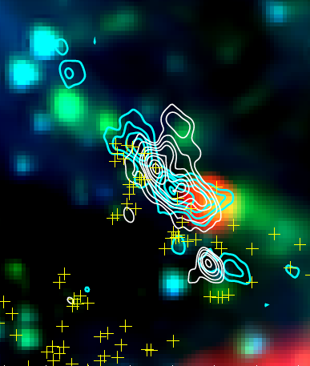
Disk / outflow system?
SiO 5-4 moment 0
Perpendicular to bipolar outflow axis (within 1°)

Slide 26
Position-velocity diagram along gradient
Black line: Keplerian rotation
White line: Keplerian rotation plus free-fall (Cesaroni+ 2011)
M_{enclosed} ~ 10-30 M (i>55°)
R_{outer} ~ 800 AU
R_{inner} ~ 200-400 AU
Chemical differences (HNCO)

Slide 27
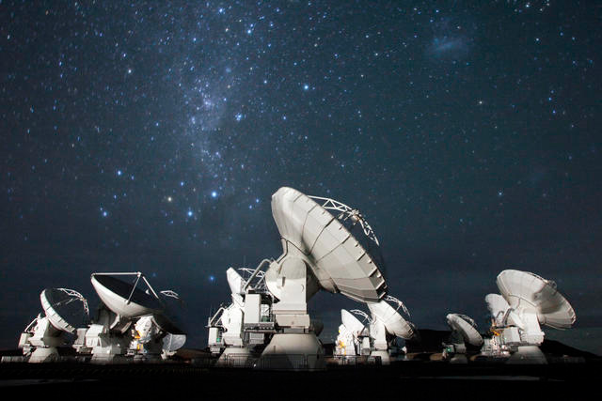
Summary
Sub-arcsecond SMA + VLA observations reveal a prolific protocluster with 25 members: NGC 6334 I(N)
We perform the first dynamical mass measurement using hot core line emission (410 ± 260 M), compatible with dust estimates
We analyze its structure using tools developed for infrared clusters (Q-parameter of MST)
Dust masses are consistent with disks around intermediate to high-mass protostars. The gas kinematics of the dominant member (SMA 1b) is consistent with a rotating, infalling disk of enclosed mass of 10-30 M.
Future ALMA imaging of protoclusters will allow:
  Complete census, down to very low
  disk/protostellar masses
  Imaging of massive accretion disks, allowing
  radiative transfer and chemical modeling
  Next ALMA deadline ~ April 2015!

Slide 28

The National Radio Astronomy Observatory is a facility of the National Science Foundation
operated under cooperative agreement by Associated Universities, Inc.
www.nrao.edu • science.nrao.edu

Slide 29
Other members of the inner protocluster
SMA 4 is a hypercompact HII region with water maser
SMA 2 and 6 are water masers

Slide 30
Millimeter methanol masers
229.7588 GHz (8₋₁-7₀)
first measurement with high T_{b} (3000K)
previous record was 4K (Cyganowski+ 2012)
218.4400 GHz (4₂-3₁)
new maser detection (T_{b} ~ 270 K)
appears to be Class I, but does not involve a K=0 or K=-1 state like most others
Analogous to the 25 GHz series but with ΔJ=-1 instead of 0:
2₂→2₁, 3₂→3₁, 4₂→4₁, 5₂→5₁, 6₂→6₁, and 9₂→9₁
(Menten+ 1986)
EVLA survey shows that 25 GHz series is common (Brogan+ 2012)
See Crystal’s talk later this month!

